Slide 1

A Comparison of Machine Learning Methods on a Medical Dataset: Predicting Diabetes
By Hamda, Simon, Rizwan and Priscila

Slide 2
Introduction
The objective is to make predictions based on diagnostic measurements whether a patient has diabetes or not.
All the patients in the dataset are females between the ages of 21-70 years old of Pima Indian Heritage (Native American).
The datasets consists of several medical predictor variables and one target variable, Outcome.
Predictor variables includes pregnancies, BP, BMI, insulin level, age, and so on.
Source: https://www.kaggle.com/datasets/mathchi/diabetes-data-set

Slide 3
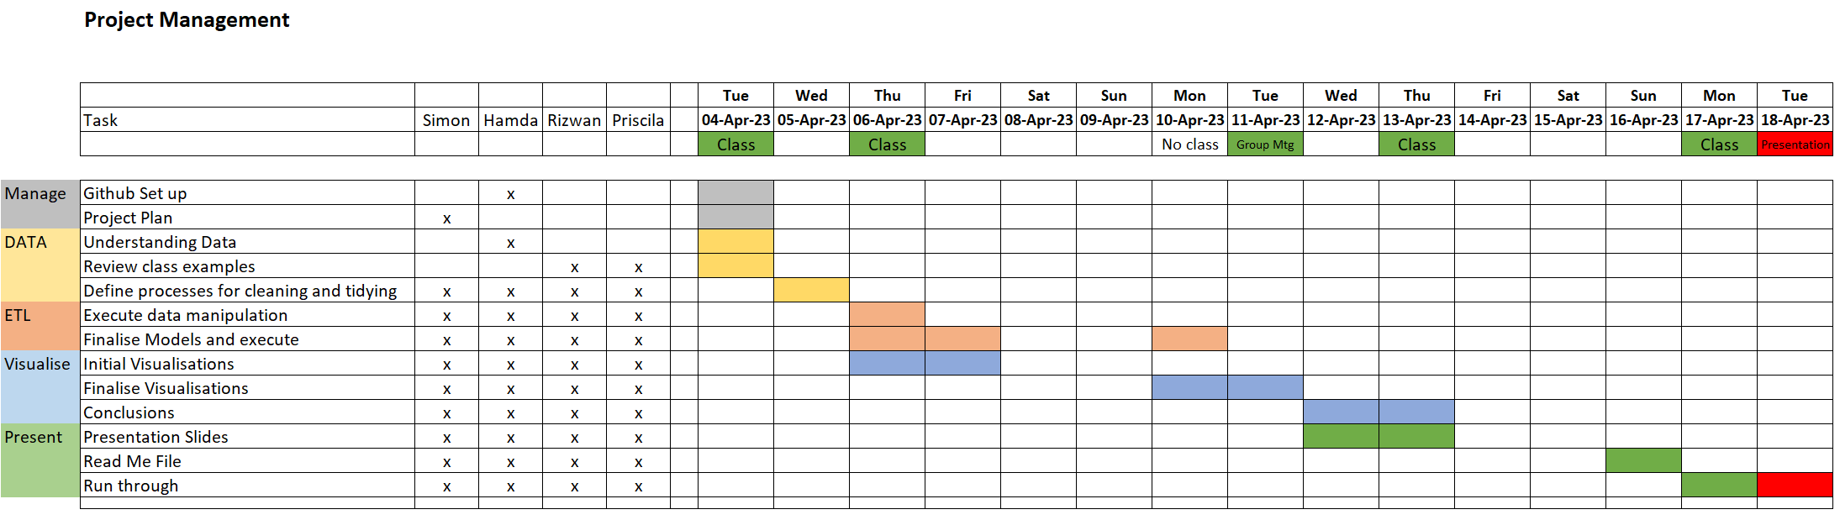
Project and Resource Management

Slide 4
Machine Learning
We defined our machine learning workflow in 5 stages:
Gathering our data
Data pre-processing
Identified which models were to be used
Training and testing the model
Evaluation

Slide 5
Algorithms
The Random Forest Classifier
Decision Tree
K nearest Neighbour
Logistic Regression
Support Vector Machine
Neural Networks
TPOT

Slide 6
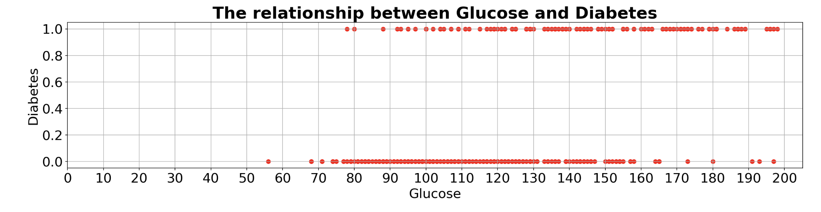
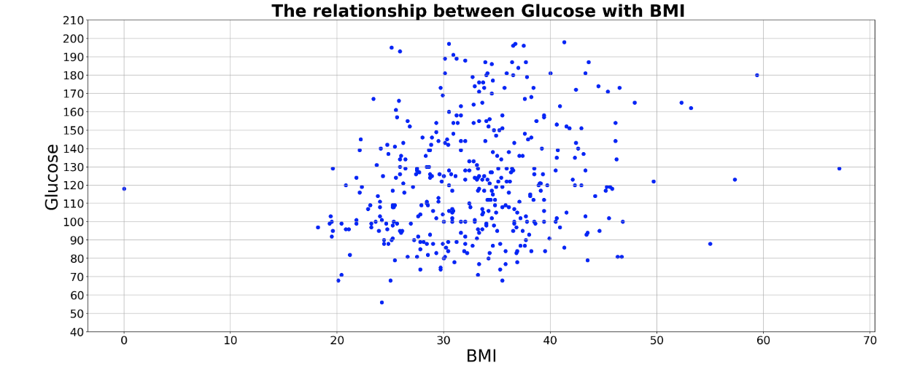
Glucose levels are concentrated in the range of 80 to 140, with the highest frequency occurring in the range of 100-120
As BMI increases, there may be a slight increase in glucose levels, but the association is not very strong.

Slide 7
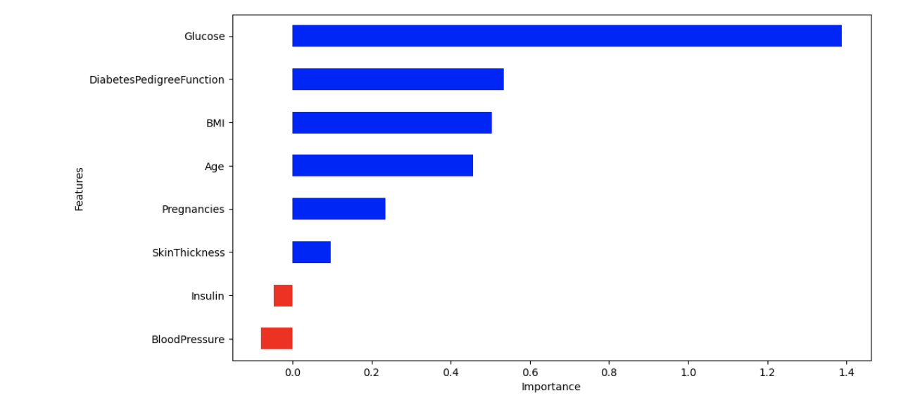
Visualization of the weights in the Logistic Regression model corresponding to each of the feature variables

Slide 8
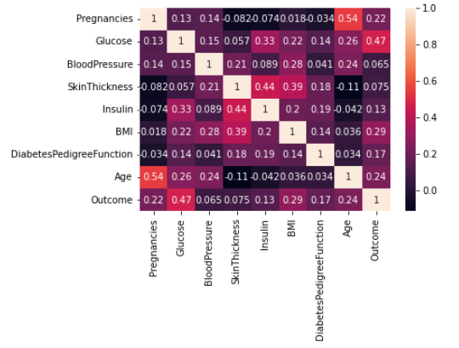
The brighter colours indicate more correlation. As we can see from the table and the heatmap, glucose levels, age, BMI and number of pregnancies all have significant correlation with the outcome variable. Also notice the correlation between pairs of features, like age and pregnancies, or insulin and skin thickness.

Slide 9
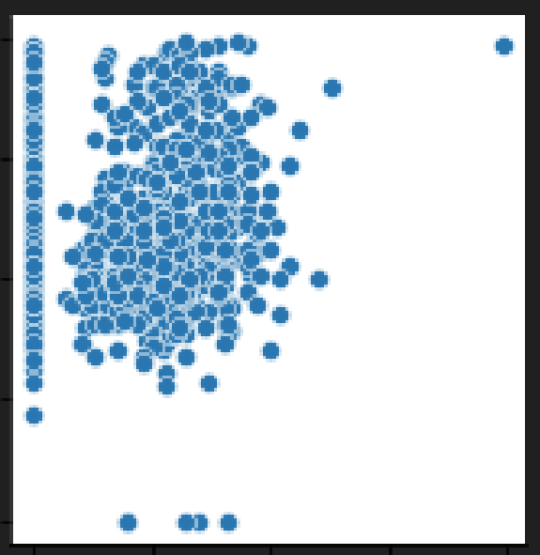
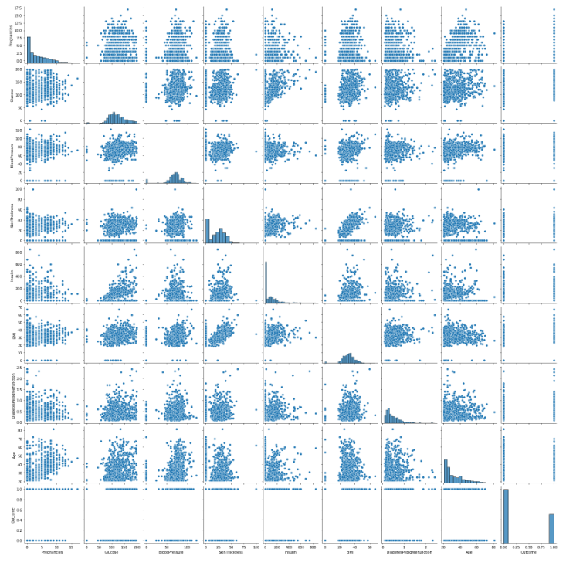
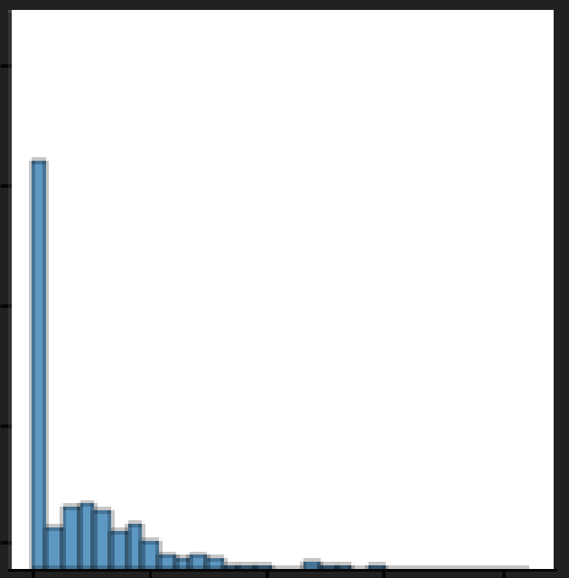
Pre modelling Data Analysis : peculiarities observed in some graphs in the “pairplot” visualisation - identification of possible “unreal” 0 values
Glucose
Skin Thickness
Count of Insulin levels

Slide 10
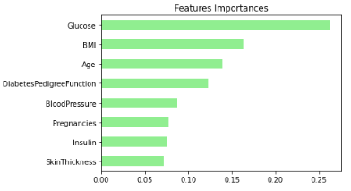
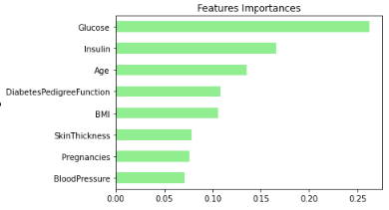
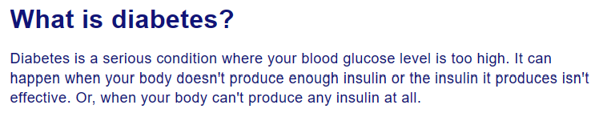
Provisional analysis using “Feature Importances” with and without zeros included
Data as received (with zero’s)
Processed Data (zero’s removed)

Slide 11
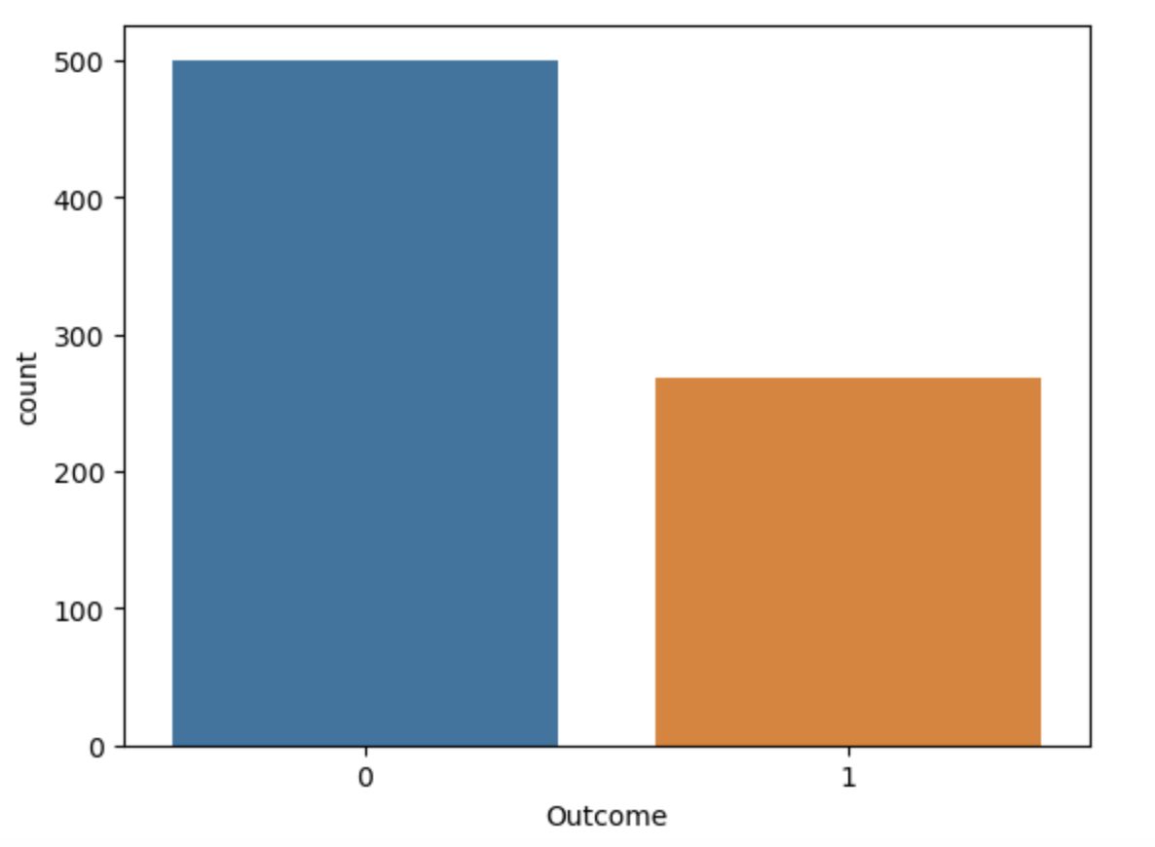
Outcomes
Non-diabetic
Diabetic

Slide 12
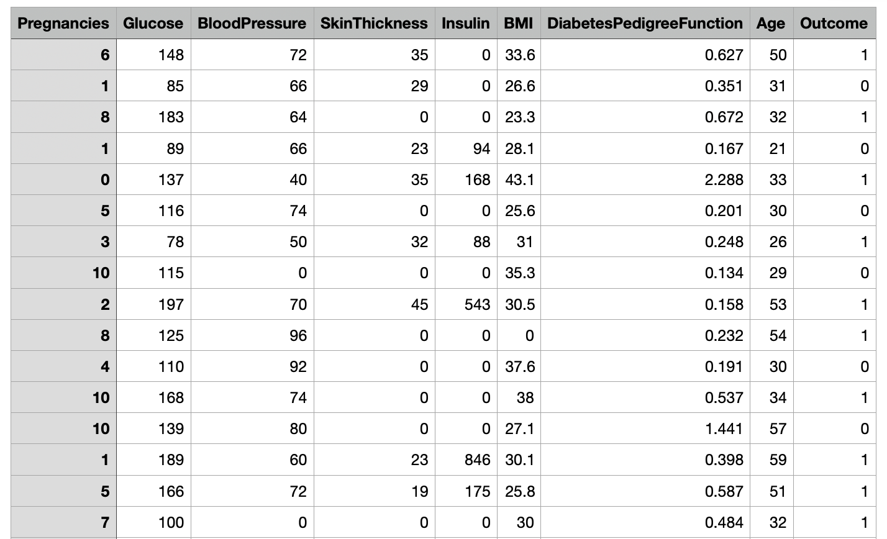
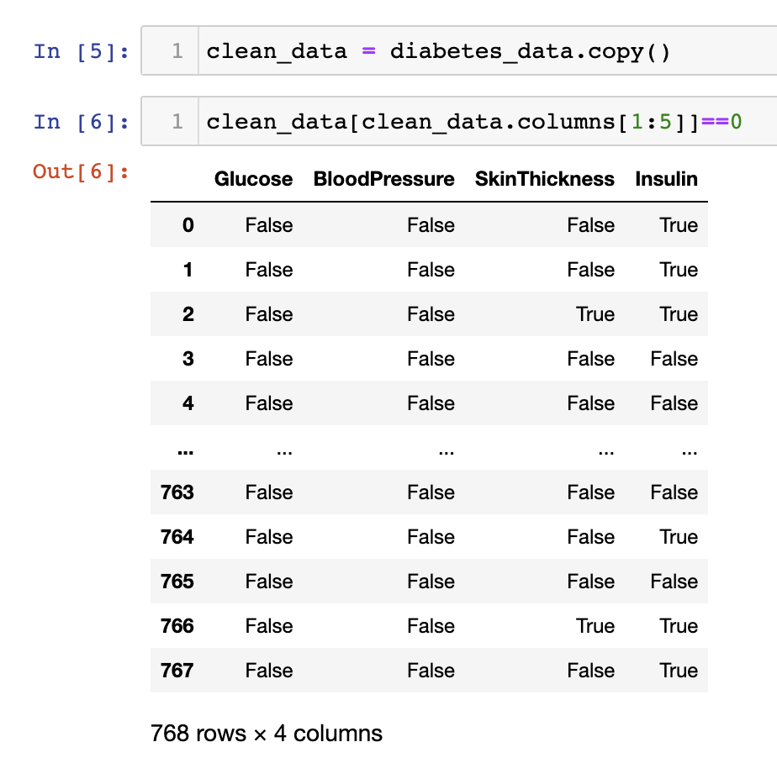
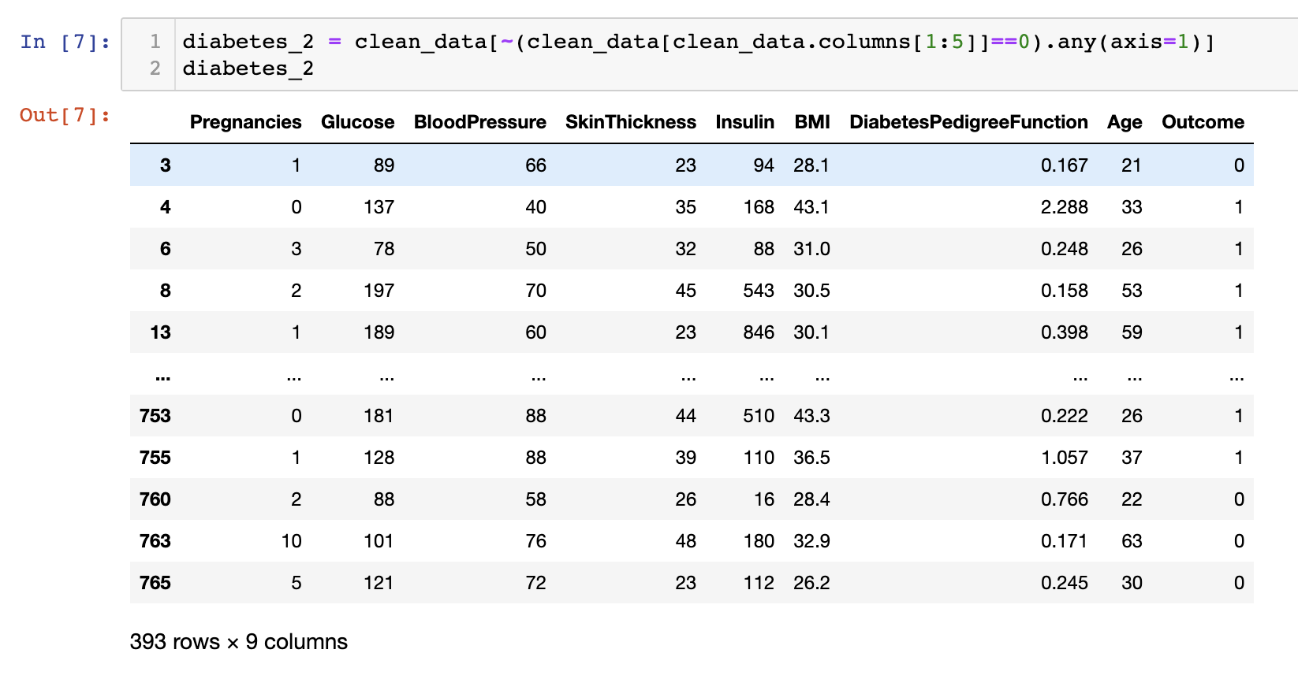
Cleaning the data

Slide 13
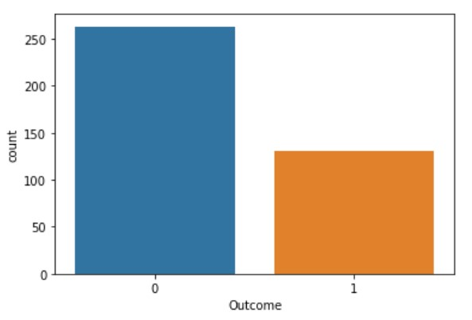
Cleaned Outcome
Number of outcomes has evidentially almost halved with the cleaned DF showing 250 people without and 125 with diabetes.

Slide 14
Results

Slide 15
Logistic Regression

Slide 16
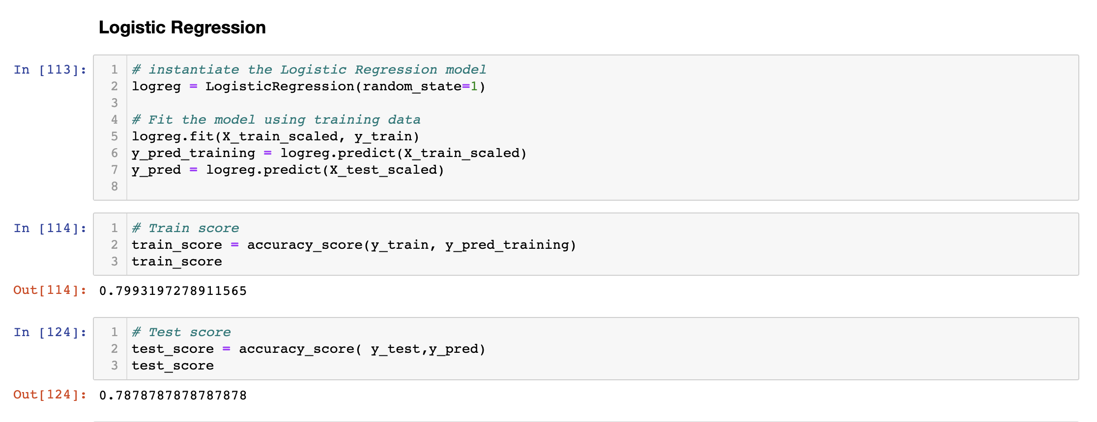
Code snippets of splitting X and y into training and test sets.

Slide 17
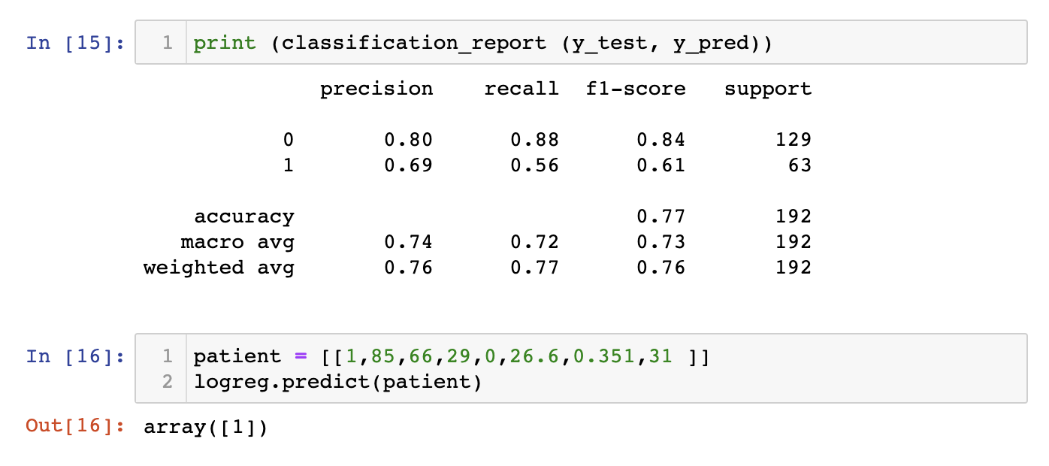
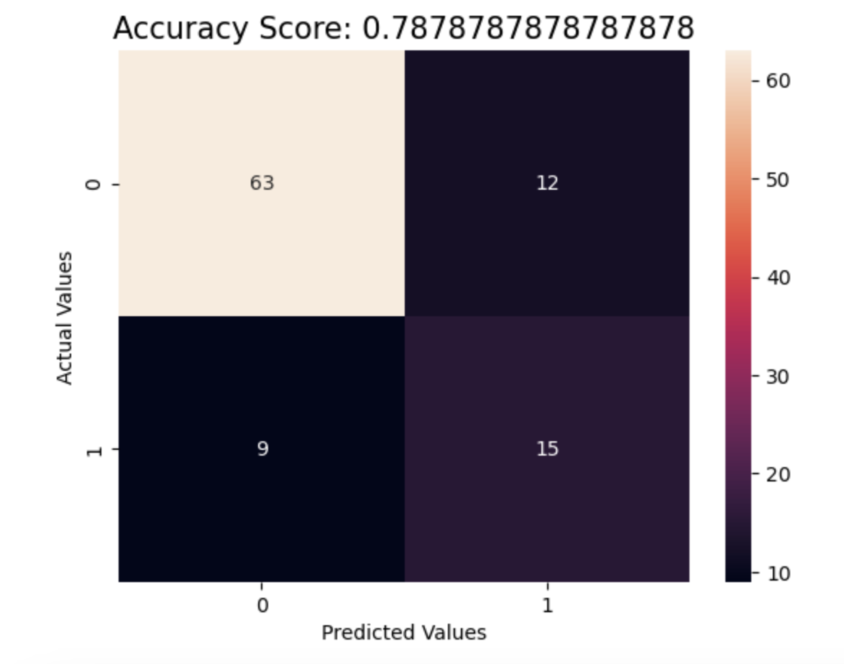
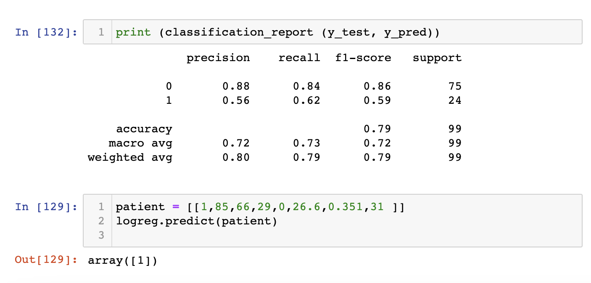
With the 0’s
Without the 0’s

Slide 18
Decision Tree

Slide 19
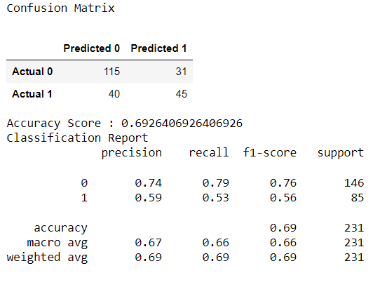
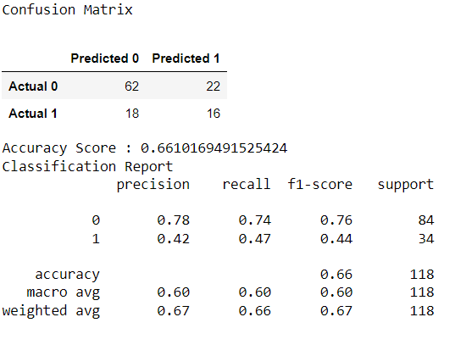
Classification Report
Produced accuracy unclean data of 0.69.
Rerunning the classification with cleaned data to compare decreased to 0.66.
Parameters used to set up and test the model.

Slide 20
K Nearest Neighbour

Slide 21
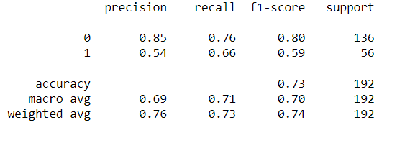
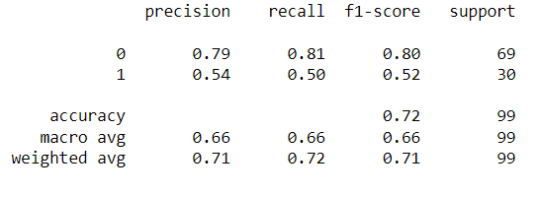
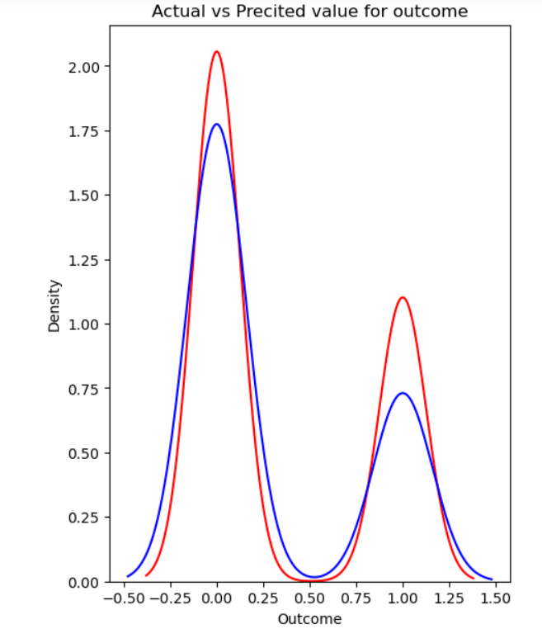
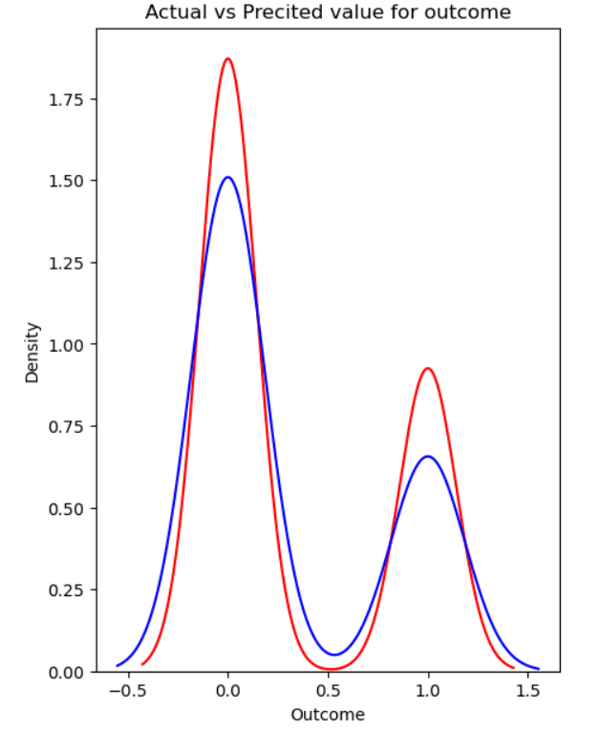
Classification Report
Produced accuracy reading of 0.73 with data as received.
Rerunning the classification with cleaned data to compare decreased accuracy to 0.72.

Slide 22
Random Forest

Slide 23
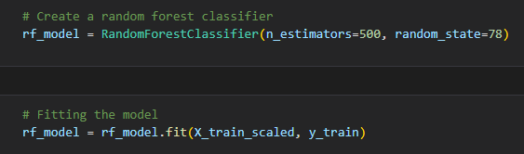
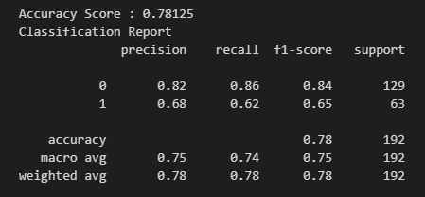
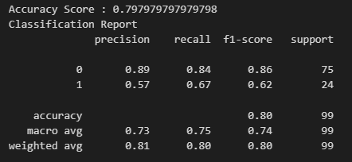
Data as received (with zero’s)
Processed Data (zero’s removed)

Slide 24
Support Vector Machine

Slide 25
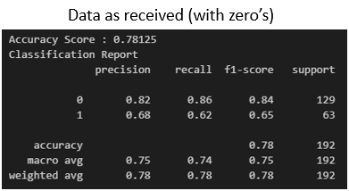
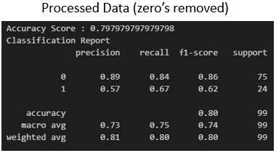
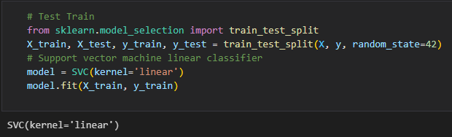
Classification Report
Produced accuracy reading of 0.78 with data as received.
Rerunning the classification with cleaned data to compare increased accuracy to 0.80
Parameters used to set up and test the model.

Slide 26
Neural Networks

Slide 27
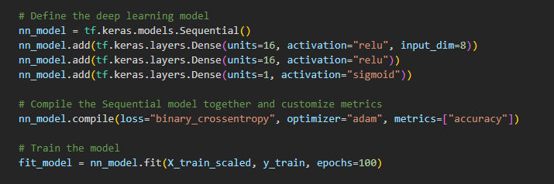
Neural Networks (Manual setting)
Data as received (with zero’s)
Processed Data (zero’s removed)

Slide 28

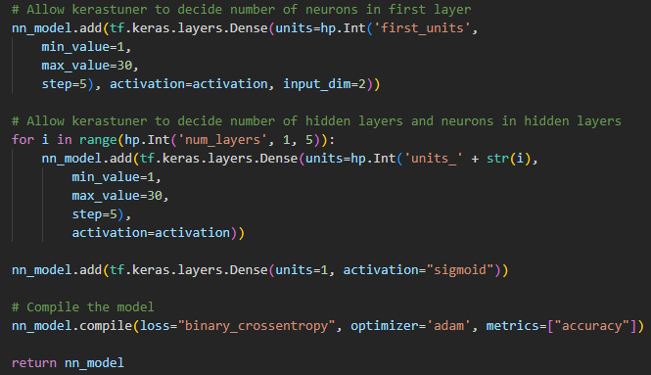
Data as received (with zero’s)
Processed Data (zero’s removed)

Slide 29
TPOT

Slide 30
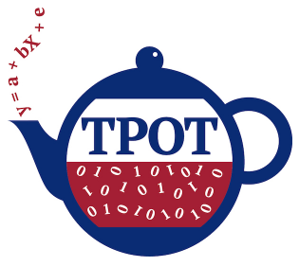
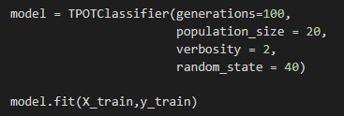


Data as received (with zero’s)
Processed Data (zero’s removed)

Slide 31
Conclusions
The examination of the two datasets (with and without zero’s) has shown that in nearly all cases removal of the zero’s gave a more accurate model, therefore indicating that it is likely they are rogue zeros.
The above highlights importance of interrogating and understanding the data before analysis.
The tuning techniques (Keras and TPOT) give improved accuracy over manually selected values.
The random forest gave the best model accuracy for the manually tested machine learning models on this dataset.
TPOT also found that the Random Forest gave the best performance on this dataset and improved the accuracy by optimising the factor settings.

Slide 32
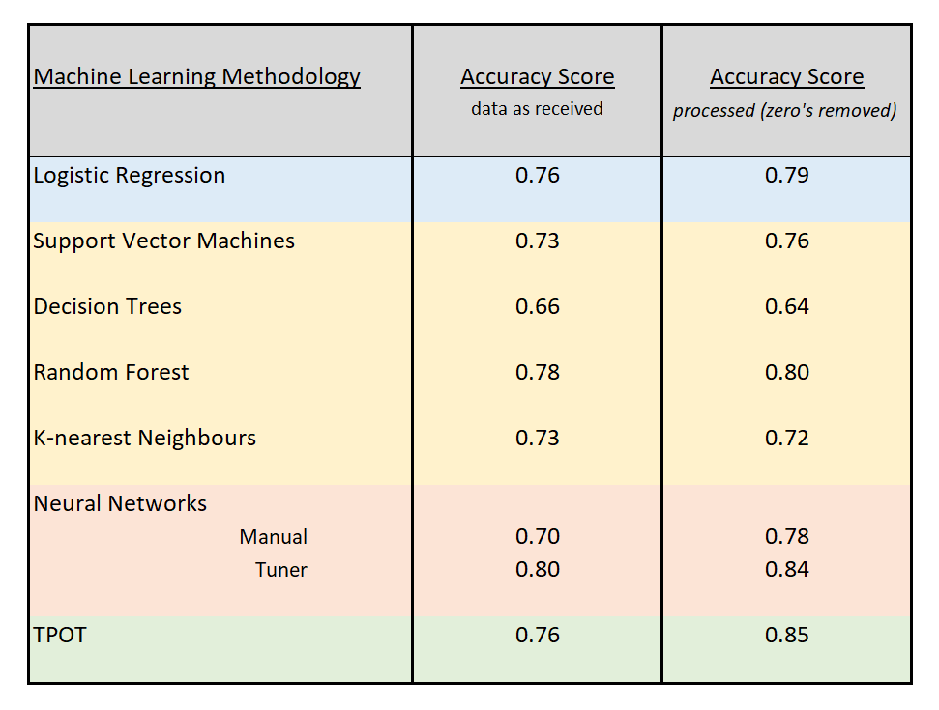
Summary Table

Slide 33
Thank you for listening
Any questions?

