Slide 1
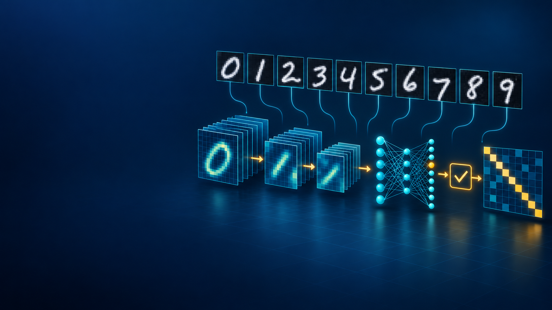
CME705
Machine Learning
Neural Networks, Deep Learning,
and Research Practice
WEEK 10
CNN implementation,
training, and inspection
Karabuk University Department of Computer Engineering
Notes:
Time: 2 minutes. State the guiding question: how do we turn an understood convolution into a reproducible PyTorch experiment whose claims stay within the evidence? The handwritten-digit illustration is an original generated course asset.

Slide 2
Today's evidence
A trained network is one part of the experimental record.
01
MNIST
source partitions and classroom subset
02
Preprocessing
training statistics reused everywhere
03
Device
automatic CUDA selection and hardware record
04
Model
tensor shapes and 105,866 parameters
05
Training
persistent Adam and correct update order
06
Selection
validation loss and restored checkpoint
07
Testing
digit recall and confusion directions
08
Inspection
errors, gradients, activations, translation
CME705
02
Notes:
Time: 4 minutes. Point students to the worksheet. Every item becomes evidence they can reproduce and challenge.

Slide 3
Week 9 computation inside PyTorch
PATCH
GATE
SUMMARY
SCORES
correlation
›
ReLU
›
pooling
›
ten logits
PyTorch adds parameters, gradients, device transfer, and checkpoint state.
The researcher remains responsible for the split and claim.
CME705
03
Notes:
Time: 8 minutes. Ask students to name the Week 9 operation behind each module. PyTorch executes the declared experiment; it cannot validate the research design.

Slide 4
MNIST and the classroom subset
Property | Week 10 value
input | one-channel 28 × 28 digit
classes | digits 0 through 9
TorchVision partitions | 60,000 train / 10,000 test
classroom train / validation | 20,000 / 5,000
locked official test | 10,000
majority test baseline | 0.113
Training and validation contain equal counts per digit.
CME705
04
Notes:
Time: 10 minutes. The lab selects 2,000 training and 500 validation images per digit from the official training partition. The official test partition stays intact. Source: https://docs.pytorch.org/vision/stable/generated/torchvision.datasets.MNIST.html

Slide 5
Split before preprocessing
OFFICIAL TRAIN
OFFICIAL TEST
20,000 train
60,000 images
›
10,000 locked
5,000 validation
X̃ = (X − μtrain) / σtrain
μ = 0.1318 σ = 0.3092
CME705
05
Notes:
Time: 10 minutes. Subset selection happens before preprocessing. Fit the mean and scale on selected training images and reuse those values for validation and test.

Slide 6
Automatic CUDA selection
CUDA
MPS
CPU
available
otherwise
otherwise
NVIDIA GPU
Apple GPU
portable fallback
Checked device: NVIDIA GeForce RTX 3060 Laptop GPU
Model, images, and labels must share the selected device.
CME705
06
Notes:
Time: 10 minutes. GPU hardware also needs a CUDA-enabled PyTorch build. Verify with torch.cuda.is_available(). Use the official selector: https://pytorch.org/get-started/locally/

Slide 7
Compact MNIST architecture
N × 1 × 28 × 28
input
N × 16 × 28 × 28
convolution and ReLU
N × 16 × 14 × 14
max pooling
N × 32 × 14 × 14
convolution and ReLU
N × 32 × 7 × 7
max pooling
N × 1,568
flatten
N × 64
hidden ReLU
N × 10
class logits
CME705
07
Notes:
Time: 12 minutes. The hidden layer preserves spatial arrangement after two pooling operations. The ten output logits correspond to digits 0 through 9.

Slide 8
Explicit tensor trace
Stage | Shape for batch 4
input | (4, 1, 28, 28)
conv1 / ReLU | (4, 16, 28, 28)
max pool 1 | (4, 16, 14, 14)
conv2 / ReLU | (4, 32, 14, 14)
max pool 2 | (4, 32, 7, 7)
flatten | (4, 1,568)
hidden / ReLU | (4, 64)
logits | (4, 10)
Shape tracing catches channel and classifier errors before training.
CME705
08
Notes:
Time: 10 minutes. Predict each output before running trace_shapes. Flatten combines channels and spatial positions within each example while retaining the batch axis.

Slide 9
Registered parameters
Component | Calculation | Parameters
conv1 | 16(1 × 3 × 3 + 1) | 160
conv2 | 32(16 × 3 × 3 + 1) | 4,640
hidden | 1,568 × 64 + 64 | 100,416
classifier | 64 × 10 + 10 | 650
total |  | 105,866
The hidden affine layer owns most parameters.
CME705
09
Notes:
Time: 10 minutes. Reconcile the arithmetic with model.parameters(). The parameter concentration motivates a later global-pooling or smaller-hidden-layer comparison.

Slide 10
CNN evolution on ImageNet-1K
Model | Architectural lesson | Top-1 | Top-5 | Params | GFLOPs
AlexNet V1 | ReLU + dropout + GPU | 56.52% | 79.07% | 61.1M | 0.71
VGG-16 BN V1 | stacked 3 × 3 blocks | 73.36% | 91.52% | 138.4M | 15.47
ResNet-50 V2 | residual shortcuts | 80.86% | 95.43% | 25.6M | 4.09
EfficientNet-B0 V1 | compound scaling | 77.69% | 93.53% | 5.3M | 0.39
ConvNeXt-Tiny V1 | modernized pure CNN | 82.52% | 96.15% | 28.6M | 4.46
TorchVision 0.21 reference weights · ImageNet-1K · single-crop accuracy
Read accuracy with parameters, compute, data, and training recipe.
CME705
10
Notes:
Time: 13 minutes. Define top-1 and top-5. Compare VGG-16 BN with ResNet-50, then identify EfficientNet-B0 under a 6M-parameter and 0.5-GFLOP budget. These are named TorchVision 0.21 weights evaluated with single crops on ImageNet-1K. A different weight or recipe can change accuracy. Research-frontier context: ConvNeXt V2 Huge reports 88.9% top-1 with 650M parameters and public training data under a different scale and pretraining protocol. Sources: https://docs.pytorch.org/vision/0.21/models.html ; https://www.image-net.org/download.php ; https://arxiv.org/abs/2301.00808

Slide 11
Cross-entropy receives logits
MODEL OUTPUT
TRAINING LOSS
ten scores z
cross_entropy(z, y)
pk = exp(zk) / Σj exp(zj)
Pass logits to the loss. Use softmax later for confidence.
CME705
11
Notes:
Time: 10 minutes. CrossEntropyLoss combines log-softmax and negative log-likelihood stably. Reference: https://docs.pytorch.org/docs/stable/generated/torch.nn.CrossEntropyLoss.html

Slide 12
Mini-batch update with device transfer
01
DEVICE
move images and labels
02
MODE
select training behavior
03
CLEAR
remove earlier gradients
04
FORWARD
produce ten logits
05
LOSS
compare logits with labels
06
BACKWARD
populate .grad
07
STEP
update parameters
CME705
12
Notes:
Time: 12 minutes. The model, images, and labels must share a device. Gradients accumulate unless cleared. Inspect them after backward and before the next clear.

Slide 13
Persistent Adam state
FIRST MOMENT
mt = β1 mt−1 + (1 − β1) gt
SECOND MOMENT
vt = β2 vt−1 + (1 − β2) gt²
Creating Adam inside the batch loop erases its history.
CME705
13
Notes:
Time: 10 minutes. Construct Adam once before the epoch loop. Its moving moments are part of the algorithm and experiment configuration.

Slide 14
Phase and gradient controls
Mechanism | Layer behavior | Autograd graph
model.train() | training | stored when enabled
model.eval() | inference | stored when enabled
torch.no_grad() | unchanged | not stored
Evaluation uses eval() together with no_grad().
CME705
14
Notes:
Time: 10 minutes. eval() does not disable gradients. no_grad() does not change phase-sensitive layers. Evaluation also runs in batches to limit GPU memory.

Slide 15
Deterministic GPU execution
01
VERSIONS
Python, PyTorch, TorchVision, CUDA
02
HARDWARE
selected device and GPU model
03
RANDOMNESS
seed and subset indices
04
CUBLAS
workspace configuration
05
ALGORITHMS
deterministic mode
06
PERFORMANCE
training time
Reproducibility settings may reduce peak speed.
CME705
15
Notes:
Time: 10 minutes. Deterministic CUDA matrix operations require CUBLAS_WORKSPACE_CONFIG before CUDA initialization. Record the settings with any runtime comparison. Reference: https://docs.pytorch.org/docs/stable/notes/randomness.html

Slide 16
Validation checkpoint selection
Evidence | Checked value
initial validation loss | 2.3064
initial validation accuracy | 0.053
best / stopped epoch | 5 / 6
restored validation loss | 0.0802
restored validation accuracy | 0.976
GPU training time | 2.61 seconds
Validation selected the checkpoint; test stayed locked.
CME705
16
Notes:
Time: 10 minutes. The untrained network need not predict digits uniformly. Copy the best state when validation loss improves, then restore it after the training loop.

Slide 17
Locked test evidence
Evidence | Result
majority baseline accuracy | 0.113
CNN test loss | 0.0682
CNN test accuracy | 0.977
correct predictions | 9,774
errors | 226
per-digit recall range | 0.954 to 0.995
Digit 7 had the lowest recall at 0.954.
CME705
17
Notes:
Time: 10 minutes. Overall accuracy hides class differences. The majority baseline uses digit 1 because the official test partition contains 1,135 ones.

Slide 18
Frequent confusion directions
True digit | Predicted digit | Count
7 | 2 | 21
7 | 9 | 17
4 | 9 | 16
3 | 9 | 11
8 | 9 | 11
Counts locate examples for review. They do not identify the cause.
CME705
18
Notes:
Time: 10 minutes. Read direction explicitly: 21 true sevens were predicted as twos. Inspect the handwriting before naming an error category.

Slide 19
Structured error records
KEEP CONTEXT
CHECKED ERROR
01
stable index
index 247
02
truth and prediction
true 4 predicted 2
03
confidence
04
allowed digit view
confidence 0.524
05
visible stroke pattern
06
hypothesized category
CME705
19
Notes:
Time: 12 minutes. Confidence is the maximum softmax value, not a calibration guarantee. Review at least ten errors and count categories before proposing a model change.

Slide 20
Gradient and activation inspection
Parameter group | Gradient norm
first convolution | 0.0575
second convolution | 0.1733
hidden layer | 0.5231
classifier | 0.6839
ACTIVATION
channel 1
mean |A| = 1.3437
These checks describe one batch or image. They do not explain causally.
CME705
20
Notes:
Time: 10 minutes. A finite nonzero norm confirms a gradient path for one batch. Feature activity ranks channels under one summary; it does not name a concept or prove a causal role.

Slide 21
Two-pixel translation check
Measure | Result | Question
prediction consistency | 0.944 | Did the predicted digit change?
shifted accuracy | 0.937 | Was the shifted prediction correct?
Scope: right shift, two pixels, zero fill, one MNIST test partition
Consistency and correctness answer different questions.
CME705
21
Notes:
Time: 10 minutes. A prediction can remain consistently wrong. The result covers one direction, displacement, fill rule, model, and dataset.

Slide 22
Results and error analysis milestone
01
Configuration
MNIST subset, model, seed, device
02
Selection
criterion, best epoch, restored state
03
Locked result
baseline, accuracy, digit recall
04
Errors
context, directions, category counts
05
Controlled check
one robustness or ablation factor
06
Claim
observation, interpretation, limitation
07
Next experiment
hypothesis and rejection condition
CME705
22
Notes:
Time: 10 minutes. Use the lab reporting structure, not its numbers, for the research project. Error evidence should motivate the next controlled experiment.

Slide 23
Exit ticket and Week 11
THREE EXPLANATIONS
01
Why does validation come from official training data?
02
Why does an NVIDIA GPU need a CUDA-enabled PyTorch build?
03
What do 0.944 consistency and 0.937 accuracy answer separately?
Week 11: ordered dependencies and learned state
CME705
23
Notes:
Time: 5 minutes. Collect three concise explanations. Preview sequence models while retaining the same data, device, selection, and evaluation discipline.

