Slide 1
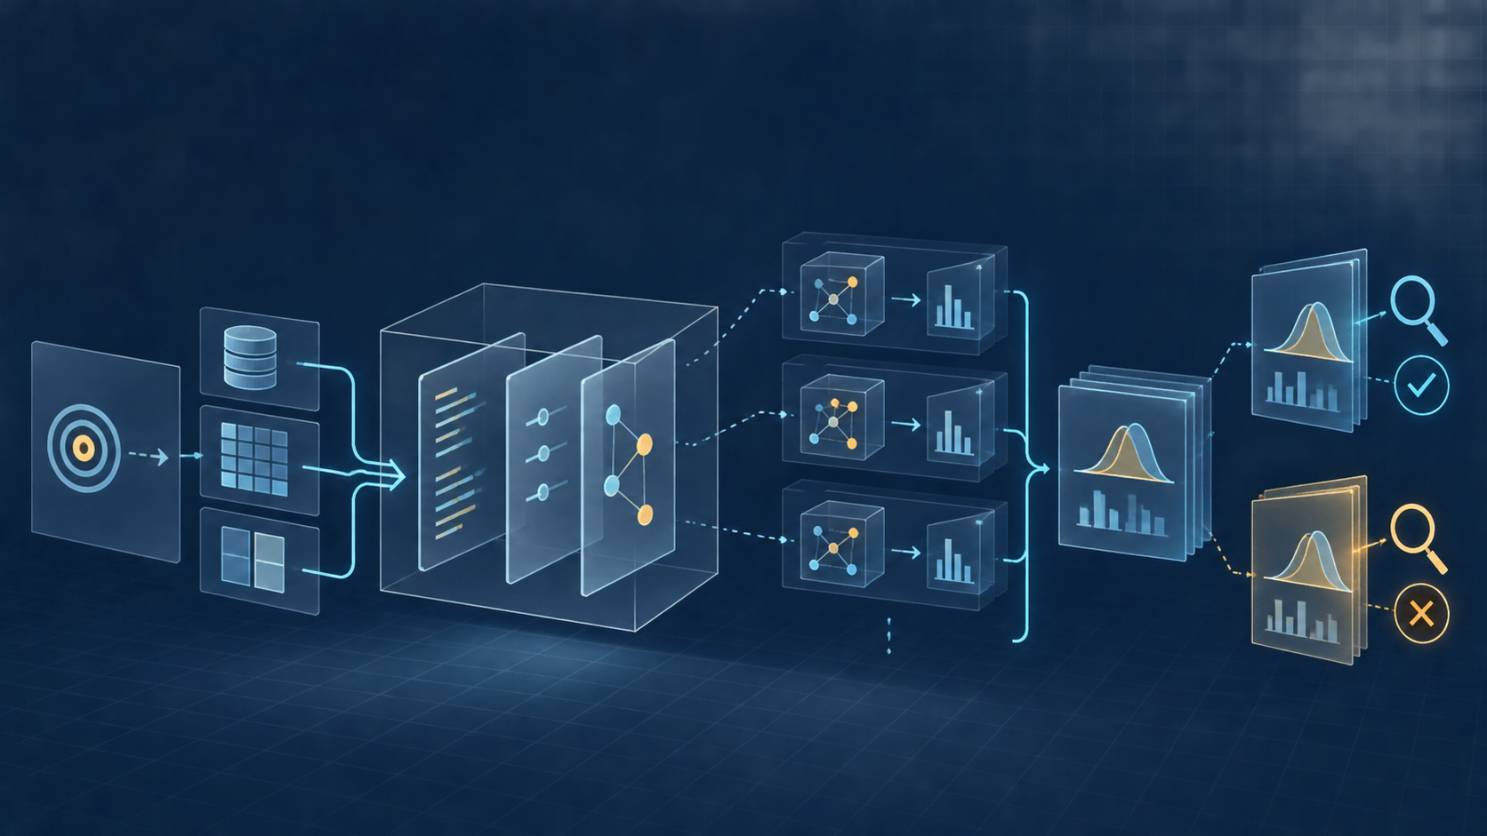
CME705
Machine Learning
Neural Networks, Deep Learning,
and Research Practice
WEEK 13
Reproducible research
and peer review
Karabuk University Department of Computer Engineering
Notes:
Time: 2 minutes. Ask what another researcher needs to regenerate one result without verbal help. The cover is an original generated course asset.

Slide 2
Session evidence
TRACE
PACKAGE
CALCULATE
One claim to its command and output
Hashed experiment bundle
Paired effect and confidence interval
REPRODUCE
CORRECT
REVISE
Independent peer attempt
Verified documentation fix
Report claim or limitation
CME705
02
Notes:
Time: 4 minutes. Students should finish with artifacts and recorded evidence. Assign author and reviewer roles before the peer workshop.

Slide 3
A number becomes evidence within a protocol
0.81
TASK
DATA
observation + target
version + split
MODEL
METRIC
test accuracy
baseline + selection
definition + averaging
RUNS
STATE
variation + seeds
code + config + env
CME705
03
Notes:
Time: 8 minutes. Ask students to interpret the number, then reveal each missing protocol element. A score alone cannot establish a comparison or population claim.

Slide 4
The claim-to-evidence chain
CLAIM
ANALYSIS
OUTPUT
CODE + CONFIG
DATA + ENV
bounded statement
declared calculation
recorded result
fixed experiment
identified inputs
CME705
04
Notes:
Time: 10 minutes. Trace one student table row backward. Missing split identity, configuration, or command breaks a specific link and limits the claim.

Slide 5
Four levels of statement
Level | Example | Required evidence
Observation | Accuracy 0.633 for seed 13 | One traceable run
Summary | Mean accuracy 0.634 | Run records + calculation
Comparison | Mean paired gain 0.113 | Controls + uncertainty
Scope claim | Feature helps similar tasks | Relevant external settings
Broader claims require broader evidence
CME705
05
Notes:
Time: 8 minutes. Ask students to classify a sentence from their abstract. A result can motivate a broad hypothesis without establishing it.

Slide 6
Research claim audit
CLASSIFY
LOCATE
IDENTIFY
COMPARE
REWRITE
statement level
result + command
config + data + env
claim and evidence scope
supported boundary
CME705
06
Notes:
Time: 10 minutes. Students complete Worksheet 1 using one central project sentence. Require a concrete file or mark the link missing.

Slide 7
Reproducibility terminology
Term | Team | Experimental setup
Repeatability | Same team | Same artifacts and setup
Reproducibility | Different team | Author artifacts and declared setup
Replicability | Different team | Independent artifacts or setup
Always describe team, artifacts, and setup because disciplines use different labels.
CME705
07
Notes:
Time: 10 minutes. This course follows ACM terminology. Accept another convention only when the student explicitly names team, artifacts, and setup. Source: ACM Artifact Review and Badging policy, https://www.acm.org/publications/policies/artifact-review-and-badging-current

Slide 8
What a successful rerun establishes
COMMAND
ARTIFACTS
RESULT
Executes in tested environment
Remain internally consistent
Agrees within declared criterion
PROVENANCE
VALIDITY
SCOPE
Points to expected output
Separate design check remains
Separate generalization check remains
CME705
08
Notes:
Time: 8 minutes. Computational agreement validates one path. Scientific validity and scope still require separate evidence. Source: Pineau et al., JMLR 2021, https://www.jmlr.org/papers/v22/20-303.html

Slide 9
Minimal artifact package
COMMAND
OUTPUT
COMMIT
DATA + SPLIT
RESULT
PACKAGE
ENVIRONMENT
CONFIG
TOLERANCE
LIMITS
CME705
09
Notes:
Time: 10 minutes. Availability alone does not make an artifact functional. Require a fixed state, construction recipe, data identity, command, output contract, and known limits.

Slide 10
Repository identity
repository: https://example.org/project
commit: 4b11d2...
command: python train.py
--config configs/final.json
output: outputs/final/metrics.json
BRANCH
moves
COMMIT
fixed state
STATUS
record before run
ARCHIVE
checksum if needed
CME705
10
Notes:
Time: 8 minutes. A tag may help readers, but it should resolve to a recorded commit. Uncommitted changes require a patch or archive checksum.

Slide 11
Environment identity
# Construction recipe
python -m venv .venv
python -m pip install -r requirements.txt
# Observed environment
python --version
python -m pip freeze
SYSTEM
operating system
COMPUTE
device + memory
NUMERICS
precision + backend
COST
elapsed time
CME705
11
Notes:
Time: 8 minutes. A dependency range supports installation while a lock records resolved software. Neither preserves data, hardware, external services, or licenses.

Slide 12
Data and split identity
SOURCE
POPULATION
LABELS
PREPROCESS
SPLITS
version + license
unit + exclusions
construction + quality
training fit
IDs + separation
CME705
12
Notes:
Time: 10 minutes. A dataset name rarely identifies exact bytes. Restricted data need permitted metadata, schema, split code, and access instructions.

Slide 13
Configuration identity
MODEL
TRAINING
SELECTION
Representation and architecture
Loss, optimizer, budget
Metric and checkpoint rule
RANDOMNESS
INFERENCE
EVALUATION
Seed set and augmentation
Threshold and decoding
Metric version and averaging
CME705
13
Notes:
Time: 8 minutes. Code shows possible settings. The output needs the settings after defaults and command-line overrides were resolved.

Slide 14
Randomness has several sources
INITIALIZATION
SAMPLE ORDER
AUGMENTATION
random generator state
random generator state
random generator state
STOCHASTIC LAYERS
PARALLEL REDUCTION
ACCELERATOR KERNELS
platform and algorithm path
platform and algorithm path
platform and algorithm path
A seed starts generators. It does not guarantee identical results on every platform.
CME705
14
Notes:
Time: 8 minutes. Ask which sources each project controls. Five training seeds estimate one kind of variation. Source: PyTorch reproducibility notes, https://docs.pytorch.org/docs/stable/notes/randomness.html

Slide 15
Repeated-run summaries
x̄ = (1/n) Σᵢ xᵢ s = √[Σᵢ(xᵢ − x̄)²/(n−1)]
Standard deviation describes run-to-run spread. Name what varies across runs.
CME705
15
Notes:
Time: 10 minutes. Standard deviation and standard error answer different questions. State the sampling unit and source of variation.

Slide 16
Paired comparisons
dᵢ = xᵢ⁽ᴮ⁾ − xᵢ⁽ᴬ⁾
Pair only when the shared seed, split, or observation has scientific meaning. Use the same seed set for both conditions.
CME705
16
Notes:
Time: 8 minutes. Paired differences remove variation shared by both conditions. Different seed sets can confound treatment with randomness.

Slide 17
Week 13 seed-level evidence
Seed | Baseline | Interaction | Paired difference
13 | 0.5222 | 0.6333 | 0.1111
29 | 0.5167 | 0.6389 | 0.1222
47 | 0.5167 | 0.6278 | 0.1111
71 | 0.5111 | 0.6444 | 0.1333
101 | 0.5389 | 0.6278 | 0.0889
Fixed data, split, optimizer, budget, selection rule, and metric
CME705
17
Notes:
Time: 8 minutes. Values come from labs/week13_reproducibility_audit.py with the default configuration. These are generated teaching data, not application evidence.

Slide 18
Paired interval calculation
d̄ ± t₀.₉₇₅,ₙ₋₁ s_d / √n
MEAN
STD DEV
STD ERROR
MARGIN
0.1133
0.01648
0.00737
0.02046
0.0929
0.1133
0.1338
CME705
18
Notes:
Time: 12 minutes. Work the interval from the five paired differences. It represents training-seed variation under one fixed generated-data procedure.

Slide 19
Agreement criteria
Target | Criterion | Example
Source + split | Exact bytes | SHA-256 matches
Deterministic metric | Numerical tolerance | Absolute difference ≤ 10⁻⁶
Stochastic training | Repeated-run agreement | Paired effect remains positive
Hardware timing | Behavioral agreement | Method B remains faster
Choose the criterion before the reproduction outcome is known.
CME705
19
Notes:
Time: 10 minutes. Tolerance follows numeric precision, expected variation, metric resolution, and the scientific decision. Record any later change explicitly.

Slide 20
Experiment manifest
{
"schema": "cme705-week13-v1",
"files": {
"config.json": "...sha256...",
"runs.csv": "...sha256...",
"summary.json": "...sha256..."
},
"numeric_tolerance": 1e-10
}
SCHEMA
interpretation
HASHES
byte changes
SOURCE
implementation
TOLERANCE
agreement rule
CME705
20
Notes:
Time: 8 minutes. The manifest must avoid secrets and personal data. Hash the actual configuration, environment record, raw runs, summary, and source.

Slide 21
Hashes and scientific validity
BYTE IDENTITY
LABELS
SPLIT
Matching SHA-256
Correct and appropriate?
Leakage-safe?
METRIC
CONTROL
SCOPE
Valid construct?
Fair comparison?
Where generalizes?
CME705
21
Notes:
Time: 8 minutes. Integrity answers whether bytes changed. Validity asks whether design and inference support the intended claim.

Slide 22
Lab 13 workflow
python labs/week13_reproducibility_audit.py
--audit-only
python labs/week13_reproducibility_audit.py
python labs/week13_reproducibility_audit.py
--verify outputs/week13/reference
CONFIG
config.json
ENVIRONMENT
environment.json
RUNS
runs.csv
SUMMARY
summary.json
CME705
22
Notes:
Time: 15 minutes. The default command produces the bundle and verifies it. Outputs stay beneath the ignored outputs directory.

Slide 23
Threats to validity
Threat | Main question | Project example
Construct | Does metric represent concept? | Accuracy hides rare-class failure
Internal | Could another factor explain it? | Preprocessing changed
Statistical | Does analysis support comparison? | One seed appears stable
External | Where should result generalize? | One site supports a broad claim
Name the affected claim, likely consequence, and next check.
CME705
23
Notes:
Time: 12 minutes. Students complete one threat in each category. Generic threat lists do not explain how a conclusion is affected.

Slide 24
A bounded limitation
BECAUSE
DOES NOT ESTABLISH
Evidence boundary
Affected claim
LIKELY CONSEQUENCE
TEST NEXT
Why the boundary matters
Specific experiment
CME705
24
Notes:
Time: 8 minutes. A limitation connects an evidence boundary to a claim and a useful experiment. Avoid generic phrases such as more data are needed.

Slide 25
Peer reproduction protocol
AUTHOR
PACKAGE
REVIEWER
Freeze commit and clean status
Command, target, tolerance, compute
Fresh environment and preserved output
DIAGNOSIS
CORRECTION
VERIFICATION
First material discrepancy
New author commit
Reviewer reruns affected step
CME705
25
Notes:
Time: 10 minutes. Authors intervene only for access, privacy, credential, or safety problems. The first attempt tests the written artifact.

Slide 26
Reproduction status record
Status | Meaning
Reproduced | Target agrees under the declared criterion
Partial | Some target outputs agree and scope is explicit
Inconclusive | Access or resources prevent the test
Different | Execution completes but exceeds tolerance
Blocked | Setup cannot reach the target output
Status describes evidence. It is not a grade by itself.
CME705
26
Notes:
Time: 8 minutes. A blocked result can expose a high-value documentation issue. Require evidence for the chosen status.

Slide 27
Focused review comment
LOCATION
OBSERVATION
CONSEQUENCE
REQUEST
VERIFY
exact file or result
commit + command + output
affected step or claim
smallest correction
rerun or comparison
CME705
27
Notes:
Time: 10 minutes. Review evidence rather than intent. A resolved comment identifies the corrected commit and verification result.

Slide 28
Draft report anatomy
QUESTION
bounded contribution
CONTEXT
related work + data
Every table
and figure
needs a source
or generating
command.
METHOD
baseline + protocol
EVIDENCE
results + uncertainty
LIMITS
threats + consequence
REPRODUCE
commit + command
NEXT
discriminating experiment
CME705
28
Notes:
Time: 10 minutes. Compare title, abstract, results, limitations, and conclusion. Claims should not expand in scope between sections.

Slide 29
From limitation to research direction
LIMITATION
MECHANISM
EXPERIMENT
DECISION
FEASIBILITY
observed boundary
candidate explanation
separates alternatives
changes conclusion
data + skills + approvals
CME705
29
Notes:
Time: 10 minutes. Ask for competing explanations and a decision threshold. Data access, skills, compute, collaborators, and ethical review determine feasibility.

Slide 30
Week 13 deliverable and exit ticket
RECORD
COMMENT
CORRECTION
Independent reproduction
Focused issue and evidence
New commit and verification
REPORT
DIRECTION
EXIT
Claims aligned with evidence
Experiment that can change conclusion
What was established and what remains?
CME705
30
Notes:
Time: 8 minutes. Collect reproduction status, one verified correction, and a bounded next experiment. A failed attempt can be strong evidence when documented carefully.

