Slide 1
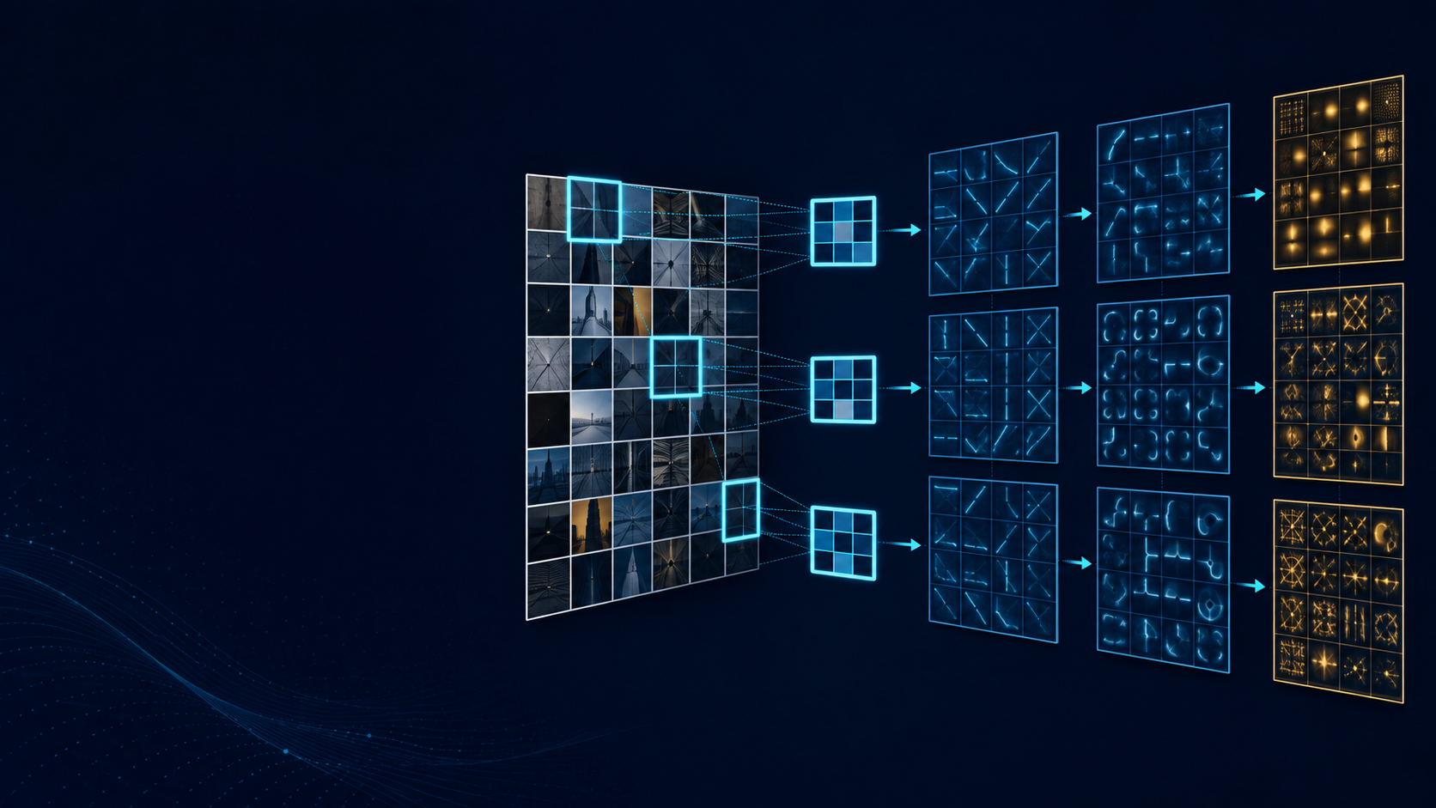
CME705
Machine Learning
Neural Networks, Deep Learning,
and Research Practice
WEEK 9
Convolutional networks
and spatial structure
Karabuk University Department of Computer Engineering
Notes:
Time: 2 minutes. State the guiding question: how do local connectivity and shared weights turn spatial structure into learnable evidence? The repeated filter windows represent weight sharing, and the stacked grids represent feature maps.

Slide 2
Today's evidence
Eight products make a convolutional method auditable.
01
Spatial assumption
locality and weight sharing
02
Patch response
multiply and sum
03
Operation name
correlation versus convolution
04
Tensor geometry
layouts and output sizes
05
Capacity
shared and unshared parameters
06
Spatial behavior
pooling and receptive fields
07
Checks
equivariance and kernel gradient
08
Method choice
data, baseline, compute, evaluation
CME705
02
Notes:
Time: 4 minutes. Point students to the worksheet. The lesson begins with the modeling assumption and ends with a project method-choice review.

Slide 3
Preserve spatial structure
IMAGE TENSOR
FLATTEN
values remain
explicit neighborhoods disappear
local neighborhood
convolution keeps a spatial output
CME705
03
Notes:
Time: 8 minutes. Flattening retains values but removes explicit neighborhood structure from the layer definition. Convolution processes local patches and preserves spatial organization.

Slide 4
Two inductive biases
Property | Dense | Locally connected | Convolutional
local patches | no | yes | yes
shared weights | no | no | yes
spatial output | usually no | yes | yes
locality limits initial access
sharing reuses one detector
CME705
04
Notes:
Time: 10 minutes. Keep locality and sharing separate. A locally connected layer uses patches without reuse; a convolutional layer applies one kernel at many positions.

Slide 5
One patch produces one response
PATCH
KERNEL
1
2
1
0
1(1) + 2(0)
+ 0(−1) + 1(2)
⊙
→
0
1
-1
2
= 3
Slide the same kernel to produce the other spatial responses.
One patch × one kernel → one output value
CME705
05
Notes:
Time: 12 minutes. Multiply corresponding patch and kernel values, sum, and add the bias if present. Then move the same kernel to the next valid position.

Slide 6
Cross-correlation is the library convention
CROSS-CORRELATION
MATHEMATICAL CONVOLUTION
3
7
1
7
0
0
0
-1
kernel used as stored
kernel flipped first
Learned kernels: same capacity, different stored orientation
CME705
06
Notes:
Time: 10 minutes. Deep-learning convolution layers usually implement cross-correlation. Learned kernels make the model classes equivalent, but the distinction matters for hand calculations and fixed filters.

Slide 7
State tensor layouts before tracing shapes
INPUT · NCHW
KERNEL · OIHW
OUTPUT · NCHW
N × Cin × H × W
Cout × Cin × Kh × Kw
N × Cout × Hout × Wout
One output kernel contains one slice for every input channel.
A stored image may be HWC; declare the conversion.
CME705
07
Notes:
Time: 10 minutes. Read every axis. Do not infer layout from four numbers alone. PyTorch uses NCHW inputs and OIHW kernels.

Slide 8
Output-size arithmetic
Lout = floor([Lin + 2P − D(K − 1) − 1] / S) + 1
LIN
K
S
P
D
8
3
2
1
1
Lout = floor((8 + 2 − 3) / 2) + 1 = 4
(2, 3, 8, 8) → (2, 4, 4, 4)
CME705
08
Notes:
Time: 12 minutes. Identify each symbol before substituting. The floor omits a final partial window. Apply the formula independently to height and width.

Slide 9
Stride, padding, and dilation change geometry
Choice | Changes | Main question
stride | sampling distance and output size | How densely are locations evaluated?
padding | boundary access and output size | What is assumed beyond the image?
dilation | spacing inside the kernel | How wide a context without more values?
A floor means the final partial window is omitted.
CME705
09
Notes:
Time: 10 minutes. Stride changes sampling, padding changes boundary access, and dilation changes effective kernel width. Ask what assumption each choice adds.

Slide 10
One output channel uses every input channel
RED SLICE
GREEN SLICE
BLUE SLICE
1
0
1
0
1
0
ONE
OUTPUT MAP
0
1
+
0
1
+
0
1
sum channel slices + one shared bias
number of feature maps = Cout
CME705
10
Notes:
Time: 10 minutes. One output kernel spans all input channels. It sums spatial products across every channel and adds one output-channel bias at all positions.

Slide 11
Weight sharing changes the parameter count
Mapping | Parameters | Relative to convolution
convolutional | 112 | 1×
locally connected | 1,792 | 16×
dense | 12,352 | 110.3×
Pconv = Cout(CinKhKw + 1) = 4(27 + 1) = 112
CME705
11
Notes:
Time: 10 minutes. The parameter count excludes output positions because the kernel is shared. Separate parameter count from the number of activation values and from runtime.

Slide 12
A feature map is a spatial response
INPUT STEP
KERNEL
RESPONSE
0
0
0
0
1
1
1
0
0
3
3
0
0
0
0
0
1
1
1
-1
0
1
0
0
3
3
0
0
0
0
0
1
1
1
-1
0
1
0
0
3
3
0
0
0
0
0
1
1
1
0
0
0
0
1
1
1
-1
0
1
0
0
3
3
0
0
0
0
0
1
1
1
0
0
3
3
0
0
0
0
0
1
1
1
maximum response = 3 along the transition
A learned map needs evidence before it receives a semantic name.
CME705
12
Notes:
Time: 10 minutes. The fixed kernel is known, so its vertical-edge interpretation is justified. A learned kernel should be interpreted from responses across inputs and controlled perturbations.

Slide 13
Convolution needs a nonlinearity
PATCHES
AFFINE LOCAL
NONLINEAR
FEATURES
X
Corr(X,K)+b
ReLU(Z)
H
linear spatial layer + linear spatial layer = linear transformation
ReLU changes which compositions the stack can represent.
CME705
13
Notes:
Time: 8 minutes. Convolution is affine in its inputs and weights. ReLU supplies the nonlinearity. Stacking only linear spatial operations remains linear, subject to boundary details.

Slide 14
Pooling summarizes each channel locally
FEATURE MAP
1
3
2
0
MAX
strongest response
6
4
6
5
1
0
2
8
7
AVERAGE
local mean
1
3
9
4
3.5
Pooling reduces resolution and discards information.
It may add local tolerance; it does not guarantee invariance.
CME705
14
Notes:
Time: 10 minutes. Compare the same two-by-two patch under max and average pooling. Ask which evidence each summary preserves and discards.

Slide 15
Pooling preserves different evidence
INPUT
MAX
AVERAGE
1
3
2
0
6
5
3.5
2
4
6
5
1
0
2
8
7
3
9
1.5
7
1
3
9
4
max: strongest local response
average: local mean response
CME705
15
Notes:
Time: 10 minutes. Calculate all four windows. Max and average pooling preserve different summaries; neither is universally best.

Slide 16
Receptive fields grow across layers
Layer | Kernel | Stride | Receptive field | Jump
input | — | — | 1 | 1
conv | 3 | 1 | 3 | 1
pool | 2 | 2 | 4 | 2
conv | 3 | 1 | 8 | 2
rℓ = rℓ₋₁ + (Kℓ − 1)jℓ₋₁ jℓ = jℓ₋₁Sℓ
CME705
16
Notes:
Time: 12 minutes. Track the input-coordinate jump as well as receptive field. After stride-two pooling, adjacent later activations correspond to input positions two pixels apart.

Slide 17
Equivariance and invariance differ
EQUIVARIANCE
INVARIANCE
f(TΔX) = TΔf(X)
f(TΔX) = f(X)
feature moves → map moves
feature moves → output stays
spatial map: often equivariant class score: may seek invariance
CME705
17
Notes:
Time: 10 minutes. Equivariance preserves transformation structure; invariance removes it from the output. A feature map and a class prediction may require different behavior.

Slide 18
Equivariance has boundary conditions
interior translation-equivariance error = 0.000e+00
SHIFT
OPERATION
WEIGHTS
one pixel right
stride-one valid
shared kernel
REGION
BORDERS
CLAIM
overlapping interior
new zeros excluded
one checked example
Padding, stride, pooling, cropping, and borders can change the result.
CME705
18
Notes:
Time: 10 minutes. The zero error has explicit conditions. Ask students to identify what changes near a padded boundary or under a one-pixel shift with stride two.

Slide 19
Shared uses create a shared gradient
patch contribution 1
Σ
patch contribution 2
∂J / ∂K
all batches
and positions
patch contribution 3
one shared update
patch contribution 4
maximum numerical-check error ≈ 4.5 × 10⁻¹¹
CME705
19
Notes:
Time: 10 minutes. Because one kernel parameter is reused in every patch, its gradient sums all contributions. The central-difference check supports the implementation at the checked values.

Slide 20
Architecture history records design ideas
Architecture | Design lesson
LeNet-5 | end-to-end learned document features
AlexNet | scale, ReLU, GPU training, augmentation, dropout
VGG | repeated small kernels
Inception | parallel spatial scales with projections
ResNet | skip connections for deeper optimization
Use the idea to reason; a name is not a method justification.
CME705
20
Notes:
Time: 8 minutes. Present architectures as responses to design problems. Do not assess memorized years or layer counts. Ask which idea could matter for the students' data.

Slide 21
Method-choice review
01
DATA
geometry, channels, resolution
02
ASSUMPTION
local patterns and valid transformations
03
BASELINE
simpler comparison
04
CAPACITY
shapes, parameters, activations
05
FEASIBILITY
batch, compute, memory, time
06
EVALUATION
split, metric, subgroups, test status
07
DECISION
one next experiment
The architecture follows the data and research question.
CME705
21
Notes:
Time: 8 minutes. The review may reject a CNN. Require an inductive-bias argument, a simpler baseline, a shape/capacity audit, feasibility evidence, and a validation-controlled next experiment.

Slide 22
Exit and next step
EXPLAIN
01
How does local connectivity differ from weight sharing?
02
Why does one output kernel span all input channels?
03
Why does output size use a floor?
04
Why are output positions absent from parameter count?
05
Why is equivariance different from invariance?
06
Why do shared parameters sum spatial gradients?
Next: implement, train, and inspect a compact CNN with PyTorch
CME705
22
Notes:
Time: 4 minutes. Collect six concise statements. Preview Week 10: mapping NCHW and OIHW shapes to Conv2d, automatic differentiation, training, error analysis, and cautious feature inspection.

