Slide 1
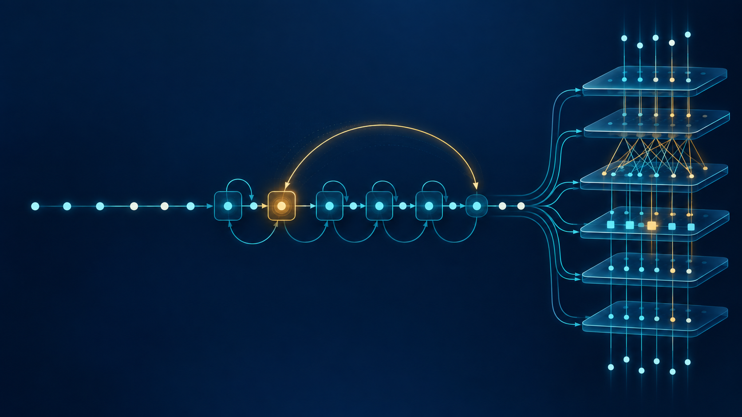
CME705
Machine Learning
Neural Networks, Deep Learning,
and Research Practice
WEEK 11
RNNs, LSTMs, attention,
and Transformers
Karabuk University Department of Computer Engineering
Notes:
Time: 2 minutes. Ask the guiding question: how should a model store, retrieve, and evaluate evidence when order and distance matter? The illustration is an original generated course asset.

Slide 2
Today’s evidence
01
Legal context
prediction time and allowed information
02
Recurrence
shared state, shapes, and parameters
03
Gradient path
a product across time
04
LSTM
all gates and the cell update
05
Experiment
matched validation plus locked length stress
06
Attention
weights, scaling, and masks
07
Transformer
block trace and position
08
Research
benchmark-qualified next experiment
CME705
02
Notes:
Time: 4 minutes. Each row becomes evidence students calculate, run, or qualify. Point to the worksheet before introducing architecture names.

Slide 3
Sequence tasks begin with prediction time
Mapping | Example | Legal context
sequence → one | document class | complete document
sequence → sequence | per-step label | task dependent
autoregressive | next token | past + current
forecasting | future demand | available by origin
A bidirectional model leaks when the application must predict online.
CME705
03
Notes:
Time: 8 minutes. Give one archived-document example and one streaming example. The legal context follows the deployment prediction time.

Slide 4
Split the process, not arbitrary rows
TRAIN
VALIDATE
LOCKED TEST
past / entities A
later / entities B
future / entities C
✓
entity disjoint
✓
no overlapping windows
✓
chronological when forecasting
✓
training-only preprocessing
CME705
04
Notes:
Time: 8 minutes. Ask what future information or shared raw observation could cross a partition in each student's problem.

Slide 5
Vanilla recurrent state
aₜ = Wₓₕxₜ + Wₕₕhₜ₋₁ + bₕ
sequence → one
z = WₕᵧhT + bᵧ
hₜ = tanh(aₜ)
One transition is shared across every time step.
CME705
05
Notes:
Time: 10 minutes. Trace D input features to H hidden features and C logits. Shared transition parameters allow variable sequence lengths.

Slide 6
Unroll the shared computation
x1
x2
x3
x4
x5
h1
h2
h3
h4
h5
same Wₓₕ and Wₕₕ at every step
An early cue reaches the loss through every intervening state.
CME705
06
Notes:
Time: 8 minutes. Follow the arrows from x1 to h5. The final state is a fixed-width summary in a many-to-one classifier.

Slide 7
Backpropagation through time
CHAIN RULE ACROSS STATES
∂L/∂hₜ = ∂L/∂hT · ∏ₖ₌ₜ₊₁ᵀ ∂hₖ/∂hₖ₋₁
FOR TANH RECURRENCE
∂hₖ/∂hₖ₋₁ = diag(1 − hₖ²) Wₕₕ
CME705
07
Notes:
Time: 12 minutes. The number of Jacobian factors grows with the distance between evidence and loss. Directions and activation derivatives matter, not only one scalar norm.

Slide 8
Repeated factors change gradient scale
SHRINKING PATH
GROWING PATH
0.8³⁰ ≈ 0.00124
1.2³⁰ ≈ 237.4
Gradient clipping limits explosion before the optimizer step.
It cannot reconstruct a signal that already vanished.
CME705
08
Notes:
Time: 10 minutes. Have students estimate 0.9 to the power 50 and 1.1 to the power 50 on the worksheet.

Slide 9
LSTM adds an explicit cell state
cell state c
FORGET
INPUT
CANDIDATE
OUTPUT
retain
write
propose
reveal
Hidden state h exposes the selected current output.
CME705
09
Notes:
Time: 8 minutes. Separate cell memory from exposed hidden output. Gates are learned vectors, not fixed switches.

Slide 10
LSTM gate equations
INPUT
FORGET
iₜ = σ(Wᵢxₜ + Uᵢhₜ₋₁ + bᵢ)
fₜ = σ(Wfxₜ + Ufhₜ₋₁ + bf)
CANDIDATE
OUTPUT
gₜ = tanh(Wgxₜ + Ughₜ₋₁ + bg)
oₜ = σ(Wₒxₜ + Uₒhₜ₋₁ + bₒ)
PyTorch stores the gates in the order input, forget, candidate, output.
CME705
10
Notes:
Time: 12 minutes. Calculate one scalar gate example before discussing vector operations. Sigmoid gates lie between zero and one.

Slide 11
Cell update and gradient path
cₜ = fₜ ⊙ cₜ₋₁ + iₜ ⊙ gₜ
hₜ = oₜ ⊙ tanh(cₜ)
local direct path: ∂cₜ/∂cₜ₋₁ = fₜ
A forget gate near one can preserve information. It does not guarantee useful memory.
CME705
11
Notes:
Time: 10 minutes. Use the worksheet values to compute c_t = 0.68 and h_t approximately 0.414.

Slide 12
PyTorch shapes and parameters
Object | RNN | LSTM
input | (N, T, D) | (N, T, D)
state | (L, N, H) | h and c: (L, N, H)
logits | (N, C) | (N, C)
parameters | 1,315 | 4,963
Equal hidden width is not an equal parameter budget.
CME705
12
Notes:
Time: 8 minutes. Counts use D=4, H=32, C=3, one layer, and two recurrent bias vectors. Ask for a parameter-matched extension.

Slide 13
Delayed-memory protocol
CUE
DELAY
SELECT
STRESS
class + flag
29 noisy steps
validation loss
60 steps locked
Split | Examples | Length
training | 1,200 | 30
validation | 400 | 30
locked stress | 600 | 60
CME705
13
Notes:
Time: 8 minutes. Both models receive the same data, width, optimizer, batch size, epochs, and checkpoint rule. The longer split is never used for selection.

Slide 14
Validation can hide a memory failure
Model | Validation loss | Validation accuracy
vanilla RNN | 0.0005 | 1.000
LSTM | 0.0005 | 1.000
Both models solve the matched length-30 problem.
The selected checkpoint has not yet answered the length question.
CME705
14
Notes:
Time: 7 minutes. Ask what evidence would reveal a failure that matched validation cannot show.

Slide 15
Locked longer-sequence evidence
Model | T=30 validation | T=60 locked stress
vanilla RNN | 1.000 | 0.000
LSTM | 1.000 | 1.000
majority baseline | 0.333 | 0.333
Supported claim
In this run, the LSTM retained the cue when the delay doubled.
One task, one seed, unequal parameter counts.
CME705
15
Notes:
Time: 10 minutes. Do not say LSTMs always win. Propose multiple seeds, parameter matching, several lengths, random cue locations, and stronger distractors.

Slide 16
Attention changes the access path
query
v1
v2
v3
v4
v5
A query directly weights stored values; distance alone does not set the path length.
CME705
16
Notes:
Time: 8 minutes. Contrast recurrent compression with direct content-addressed access. Attention still has finite context and computational cost.

Slide 17
Scaled dot-product attention
A = softmax(QKᵀ / √dₖ) O = AV
Query row | weight 1 | weight 2 | row sum
q₁ | 0.670 | 0.330 | 1.000
q₂ | 0.330 | 0.670 | 1.000
The scale controls dot-product magnitude as key width grows.
CME705
17
Notes:
Time: 12 minutes. Complete the two-token worksheet calculation. The course code returns weights so normalization can be tested.

Slide 18
Masks define legal access
query key | 1 | 2 | 3 | 4
1 | 1 | 0 | 0 | 0
2 | 1 | 1 | 0 | 0
3 | 1 | 1 | 1 | 0
4 | 1 | 1 | 1 | 1
PADDING MASK
blocks artificial pad tokens
CAUSAL MASK
blocks future positions
audit: row sums 1.000
blocked weights 0.000
CME705
18
Notes:
Time: 10 minutes. Read the lower-triangular allowed-access matrix. A bidirectional encoder can use both directions only when the complete input is legal.

Slide 19
Multi-head attention
head 1
Q1 K1 V1
head 2
Q2 K2 V2
CONCAT
OUTPUT
PROJECTION
head 3
Q3 K3 V3
head 4
Q4 K4 V4
A head is not automatically a human concept.
CME705
19
Notes:
Time: 8 minutes. Heads use different learned projections, then concatenate and project. Interpretability requires more than a heat map.

Slide 20
Transformer encoder block
INPUT + POSITION
LAYER NORM
MULTI-HEAD ATTENTION
RESIDUAL ADD
LAYER NORM
FEED-FORWARD
RESIDUAL ADD
X′ = X + MHA(LN(X))
Y = X′ + FFN(LN(X′))
CME705
20
Notes:
Time: 10 minutes. Trace the pre-normalization residual equations. Attention mixes positions and the feed-forward network transforms each position.

Slide 21
Position must enter the model
SINUSOIDAL
fixed basis
ABSOLUTE
learned index
RELATIVE
pairwise offset
ROTARY
rotate Q and K
STRUCTURE
local / recurrent
Configured context length ≠ effective context length
CME705
21
Notes:
Time: 8 minutes. Without position information, self-attention is permutation-equivariant. Training length and inference length are experimental variables.

Slide 22
Architecture tradeoffs
Family | Access | Time parallelism | Sequence cost
RNN | recurrent state | no | linear
LSTM / GRU | gated state | no | linear
full attention | all pairs | yes | quadratic attention
sparse attention | selected pairs | yes | pattern dependent
state space | state + scan | often | commonly near-linear
Asymptotics hide constants, precision, cache behavior, and hardware utilization.
CME705
22
Notes:
Time: 10 minutes. Require measured latency and peak memory on target hardware when efficiency is part of a claim.

Slide 23
Long Range Arena: one common benchmark
Model | Family | Average | Path-X
Transformer | full attention | 53.66 | failed
S4 | structured state | 86.09 | 96.35
S5 | multi-input state | 87.46 | 98.58
Mega | gated attention + EMA | 88.21 | 97.98
Historical paper-reported results under LRA protocols.
Check version, scale, compute, seeds, and whether baselines were reproduced.
CME705
23
Notes:
Time: 10 minutes. Sources: S4 Table 4, S5 Table 1, and Mega Table 2. This is a common-task comparison, not a universal model ranking.

Slide 24
Selected recent sequence architectures
Year | Model | Main idea
2023 | Mamba | input-dependent selective state spaces
2024 | xLSTM | exponential gates; scalar or matrix memory
2024 | ModernBERT | modern long-context bidirectional encoder
2025 | Titans | attention + learned long-term memory
2026 | LongBench Pro | realistic bilingual long-context evaluation
Dated research map checked 10 September 2026 — not one leaderboard
CME705
24
Notes:
Time: 10 minutes. Separate architecture ideas from benchmark scores. Discuss Mamba selection, xLSTM memory, ModernBERT encoders, Titans test-time memory, and LongBench Pro effective context.

Slide 25
Real application: ModernBERT on AG News
Component | Default
model | ModernBERT-base, 149M parameters
task | World / Sports / Business / Sci-Tech
split | 2,000 / 500 / 1,000 balanced
adaptation | train prediction head + classifier
tokens | maximum 128
runtime | automatic CUDA + mixed precision
selection | minimum validation loss, then locked test
Optional extension: unfreeze the last two encoder layers at batch size 4.
CME705
25
Notes:
Time: 12 minutes. The dataset card lists unknown license metadata and research use. Keep data, weights, and checkpoints outside Git. Record GPU, revision, errors, latency, and memory.

Slide 26
Research direction and exit ticket
01
Prediction
time and legal context
02
Comparison
baseline and candidate
03
Evidence
benchmark or task metric
04
Stress
length, latency, memory, or shift
05
Decision
result that rejects the direction
Explain the recurrent gradient path, LSTM memory path, attention access,
and one limitation of today’s evidence.
CME705
26
Notes:
Time: 8 minutes. Collect a falsifiable question and a rejection condition. The Week 12 ablation or robustness experiment should follow from this note.

