Slide 1
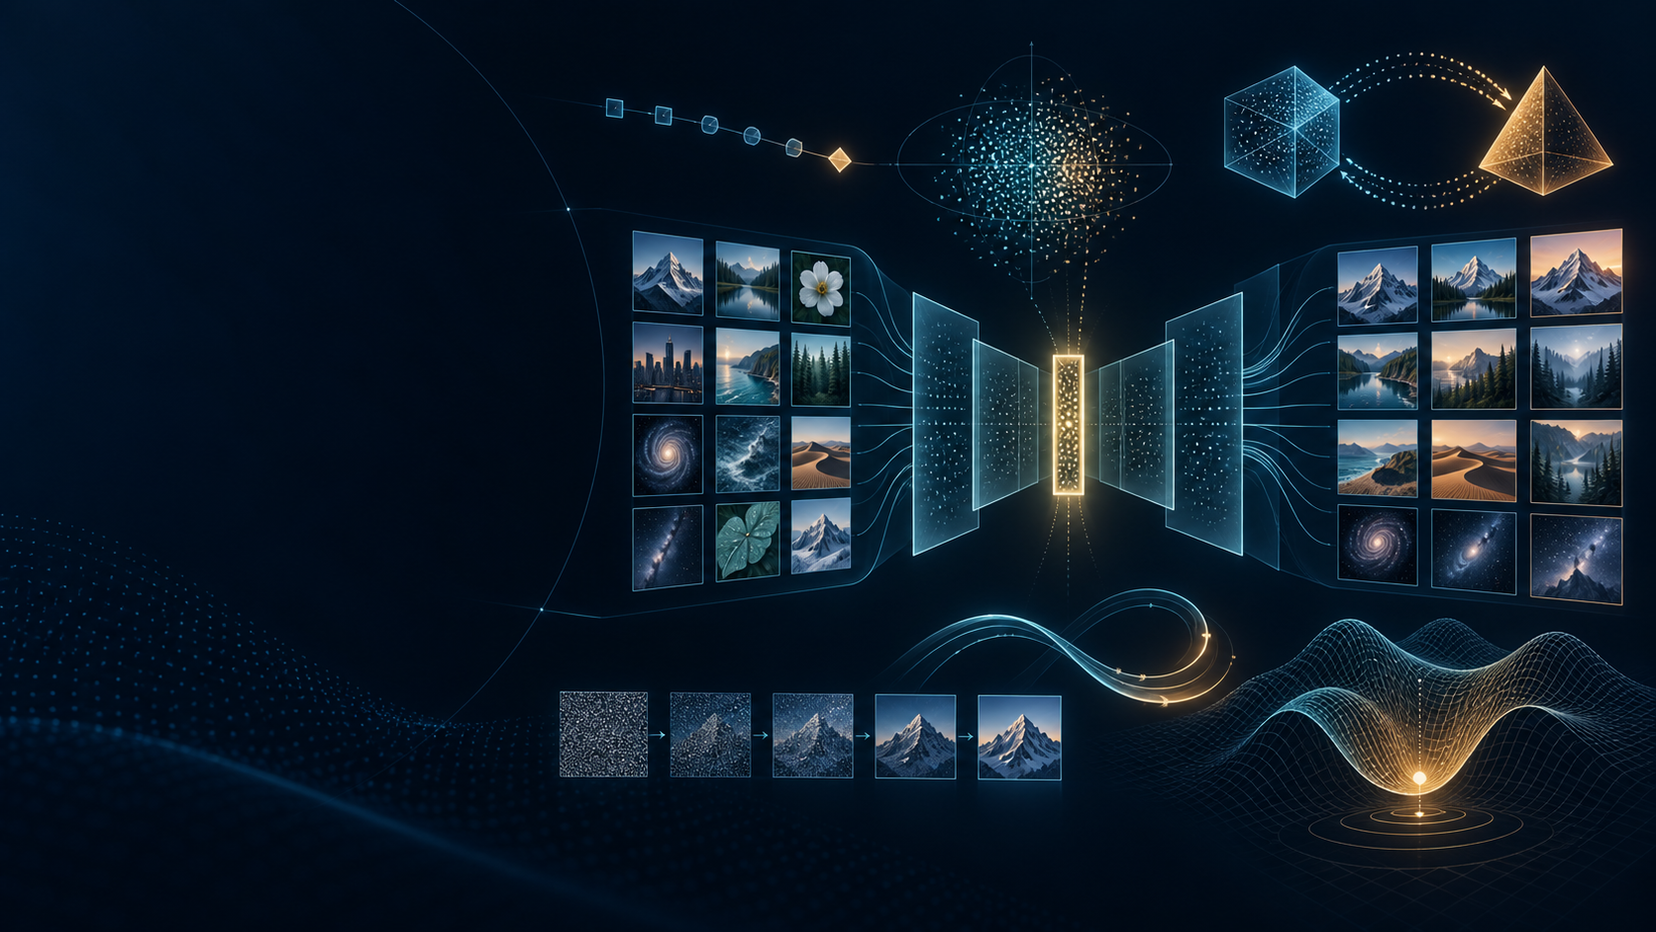
CME705
Machine Learning
Neural Networks, Deep Learning,
and Research Practice
WEEK 12
Autoencoders and
generative models
Karabuk University Department of Computer Engineering
Notes:
Time: 2 minutes. Ask: how can a model compress observations, assign probability, or generate new examples, and what evidence shows the learned distribution is useful? The illustration is an original generated course asset.

Slide 2
Today’s evidence
01
Autoencoder
shape trace and bottleneck claim
02
Autoregression
joint probability as legal factors
03
VAE
ELBO, KL, and reparameterization
04
GAN
two-player objective and failure evidence
05
Flow
invertible map and Jacobian
06
Diffusion
corruption, denoising, and sampler
07
Energy
positive and negative phases
08
Research
benchmark-qualified ablation
CME705
02
Notes:
Time: 4 minutes. Every row produces a calculation, protocol audit, or falsifiable claim. Point students to the worksheet before naming recent systems.

Slide 3
Start with the claim
Claim | Evidence needed
useful representation | downstream or robustness evidence
high likelihood | density + preprocessing protocol
realistic samples | fidelity and coverage
conditional control | alignment and quality
novelty | training-set similarity audit
A selected sample grid does not establish distribution coverage.
CME705
03
Notes:
Time: 8 minutes. Ask which claim each student's project makes. Sample realism, normalized probability, latent utility, and novelty require different evidence.

Slide 4
Five objects organize the field
DENSITY
LATENT JOINT
SAMPLER
SCORE
ENERGY
pθ(x)
pθ(x,z)
x = Gθ(z)
∇x log pt(x)
Eθ(x)
What is trained?
What is tractable?
How is sampling done?
What can the metric miss?
CME705
04
Notes:
Time: 8 minutes. The same architecture can participate in several probabilistic systems. Require the mathematical object, training objective, and sampling path.

Slide 5
Deterministic autoencoder
OBSERVATION
BOTTLENECK
RECONSTRUCTION
x
z = fφ(x)
x̂ = gθ(z)
LAE = ‖x − gθ(fφ(x))‖²
The bottleneck preserves information rewarded by the reconstruction loss.
CME705
05
Notes:
Time: 10 minutes. Keep representation and generation claims separate. A deterministic autoencoder needs a meaningful latent distribution before arbitrary latent sampling becomes useful.

Slide 6
A bottleneck is a hypothesis
Too small | Useful constraint | Too large
loses rare detail | preserves stable structure | may copy inputs
blurry reconstruction | supports transfer | may memorize
weak downstream utility | robust latent features | irregular latent space
Low reconstruction loss ≠ semantic factors ≠ novelty ≠ calibrated density
CME705
06
Notes:
Time: 8 minutes. Ask what prevents identity copying in the proposed design: dimensionality, noise, sparsity, architecture, or regularization. None automatically guarantees semantic factors.

Slide 7
Convolutional shape trace
Stage | Tensor shape
Fashion-MNIST image | (N, 1, 28, 28)
stride-2 conv | (N, 16, 14, 14)
stride-2 conv | (N, 32, 7, 7)
flatten | (N, 1568)
latent | (N, dz)
reconstruction | (N, 1, 28, 28)
Audit shapes before downloading data
CME705
07
Notes:
Time: 8 minutes. Ask students to calculate spatial dimensions and parameter locations. The offline audit verifies both deterministic and variational shapes.

Slide 8
Autoregressive chain rule
pθ(x) = ∏ᵢ pθ(xᵢ | x<ᵢ)
p(x₁)
p(x₂|x₁)
p(x₃|x<3)
p(x₄|x<4)
Exact normalized conditionals; ordering defines the prediction tasks.
CME705
08
Notes:
Time: 10 minutes. Multiply a four-factor example. Changing order changes conditional difficulty. Exact chain-rule likelihood does not make generation parallel.

Slide 9
Parallel training, serial generation
TRAIN
GENERATE
known previous tokens
feed each sampled token back
one masked forward pass
many sequential decisions
CME705
09
Notes:
Time: 8 minutes. Teacher forcing exposes true histories during training. Sampling temperature and truncation change the generated distribution and belong in the protocol.

Slide 10
VAE is a latent probability model
x
qφ(z|x)
z
pθ(x|z)
prior p(z) = N(0, I)
pθ(x) = ∫ pθ(x|z)p(z) dz
CME705
10
Notes:
Time: 8 minutes. Name prior, approximate posterior, and decoder. The marginal integral and true posterior motivate variational inference.

Slide 11
Evidence lower bound
log pθ(x) ≥ Eqφ [ log pθ(x|z) ] − DKL(qφ(z|x) ‖ p(z))
EXPLAIN THE DATA
MATCH THE PRIOR
expected decoder log likelihood
posterior-to-prior KL
CME705
11
Notes:
Time: 12 minutes. Derive the bound with Jensen's inequality. The reconstruction term is a conditional log likelihood; the KL term also makes prior sampling meaningful.

Slide 12
Reparameterization carries gradients
μ, log σ²
z = μ + exp(0.5 log σ²) ⊙ ε
ε ~ N(0, I)
Randomness stays in ε; μ and log σ² remain on a differentiable path.
CME705
12
Notes:
Time: 10 minutes. Use zero noise to show the sample equals the mean. Then calculate the one-dimensional KL example from the worksheet.

Slide 13
Beta controls a tradeoff
Lβ-VAE = −Eq log pθ(x|z) + β DKL(qφ(z|x) ‖ p(z))
LOW Β
BALANCED
HIGH Β
detail
usable latent
strong prior
weak prior match
declared tradeoff
detail loss
KL near zero may signal posterior collapse.
CME705
13
Notes:
Time: 10 minutes. Increasing beta strengthens prior matching but can lose detail. Monitor KL per dimension and active units rather than assuming a small KL is good.

Slide 14
Lab 12A: controlled AE / VAE
Component | Protocol
dataset | Fashion-MNIST official train / test
splits | 10,000 / 2,000 / 2,000 balanced
selection | minimum validation objective
AE evidence | BCE, MSE, interpolation
VAE evidence | BCE, KL, prior samples
runtime | automatic CUDA + mixed precision
ablation | latent dimension or beta
Locked test once — after the checkpoint and protocol are frozen.
CME705
14
Notes:
Time: 10 minutes. Run audit-only first. Compare AE and VAE reconstruction carefully because the VAE objective also contains KL and stochastic sampling.

Slide 15
GAN is a two-player game
NOISE
GENERATOR
DISCRIMINATOR
z ~ p(z)
x̃ = Gθ(z)
Dψ(x)
Generator follows discriminator gradients
minG maxD Ex log D(x) + Ez log(1 − D(G(z)))
CME705
15
Notes:
Time: 10 minutes. Assign students to generator and discriminator roles. Each player's improvement changes the other's objective, creating a non-stationary optimization problem.

Slide 16
Sharp samples can hide missing modes
Failure | Evidence to request
mode collapse | recall, diversity, rare cases
discriminator overfit | held-out discriminator evidence
oscillation | fixed-latent samples across training
gradient imbalance | both update and gradient records
memorization | training-neighbor and duplicate audit
One loss curve and one sample grid are insufficient.
CME705
16
Notes:
Time: 8 minutes. StyleGAN2-ADA addresses discriminator overfitting in limited-data settings. Coverage and memorization still need separate evidence.

Slide 17
Normalizing flow
x
f₁
f₂
z
↔
↔
↔
log pX(x) = log pZ(fθ(x)) + log |det Jfθ(x)|
Exact likelihood and inversion require tractable transforms.
CME705
17
Notes:
Time: 10 minutes. Trace density evaluation from x to z and sampling through the inverse. The Jacobian corrects probability mass under local expansion or contraction.

Slide 18
Change-of-variables calculation
z = 2x + 1 and z ~ N(0, 1)
JACOBIAN
DENSITY
SAMPLE
dz / dx = 2
log pX = log pZ(2x+1) + log 2
x = (z−1) / 2
Omitting log 2 assigns the wrong probability mass.
CME705
18
Notes:
Time: 8 minutes. The worksheet uses z equals 3x minus 2. Ask students to write both the log-density correction and inverse sampler.

Slide 19
Energy-based model
pθ(x) = exp[−Eθ(x)] / Zθ
low energy → high compatibility
POSITIVE PHASE
NEGATIVE PHASE
lower energy on data
raise energy on model samples
Partition function and MCMC mixing are the hard parts.
CME705
19
Notes:
Time: 10 minutes. The energy is unnormalized. The negative phase needs representative model samples; poor Markov-chain mixing biases learning.

Slide 20
DDPM forward corruption
x₀
x1
x2
x3
xT
xt = √ᾱt x₀ + √(1−ᾱt) ε
Sample any corruption level directly during training.
CME705
20
Notes:
Time: 10 minutes. The forward process is fixed. Alpha-bar decreases as noise accumulates. The network is trained to support reversal, not to learn how to add noise.

Slide 21
Work one noise step
x₀ = 0.8 ᾱt = 0.64 ε = −0.5
SIGNAL
NOISE
CORRUPTED
√0.64 × 0.8
√0.36 × (−0.5)
0.64 − 0.30
0.64
−0.30
0.34
If ε̂ = −0.3, squared error = (−0.5 + 0.3)² = 0.04
CME705
21
Notes:
Time: 8 minutes. Students calculate the signal and noise coefficients, corrupted value, and one-element noise-prediction error.

Slide 22
Noise-prediction objective
Lsimple = E x₀,t,ε ‖ ε − εθ(xt,t) ‖²
CLEAN
TIME
NOISE
CORRUPT
DENOISER
x₀
t
ε
xt
ε̂
The timestep embedding tells the network the corruption scale.
CME705
22
Notes:
Time: 8 minutes. Training chooses a clean example, random time, and random noise. The network predicts a reverse-relevant target; epsilon is one common parameterization.

Slide 23
Generation reverses corruption
xT
x3
x2
x1
x₀
DDPM
DDIM
stochastic reverse steps
fewer deterministic or stochastic steps
Report scheduler • steps • seed • precision • seconds / image
CME705
23
Notes:
Time: 10 minutes. The denoiser and scheduler are separate components. Changing steps at inference changes the sampling protocol without retraining the network.

Slide 24
Score is a noisy-density direction
sθ(xt,t) ≈ ∇xt log pt(xt)
high
density
∇xt log q(xt|x₀) = − ε / √(1−ᾱt)
CME705
24
Notes:
Time: 10 minutes. The score points toward increasing noisy-data density. For Gaussian corruption, predicted noise gives the conditional score up to a known scale.

Slide 25
Lab 12B: DDPM on CIFAR-10
Component | Default
checkpoint | google/ddpm-cifar10-32
backbone | 35.7M-parameter U-Net
sampler | DDIM, 50 network evaluations
evidence | 16 samples + five-stage trajectory
runtime | automatic CUDA; timed per image
optional metric | protocol-declared course FID
comparison | same seed; steps or scheduler only
Sixteen samples test the path — they do not reproduce a benchmark.
CME705
25
Notes:
Time: 10 minutes. Run audit-only before any download. The public checkpoint uses CIFAR-10; students record revision, device, scheduler, steps, timing, and sample-selection rule.

Slide 26
FID compares feature distributions
FID = ‖μr−μg‖² + Tr(Σr+Σg−2(ΣrΣg)¹ᐟ²)
SAMPLES
count + seed
FEATURES
extractor + version
REAL
reference statistics
PIXELS
resize + range
CONDITION
labels + guidance
MODEL
checkpoint + selection
FID does not test memorization, provenance, alignment, or downstream utility.
CME705
26
Notes:
Time: 10 minutes. FID is finite-sample and implementation sensitive. A metric card must accompany every number; use precision and recall or task-specific evidence for coverage.

Slide 27
CIFAR-10 research snapshot
Model | Family | FID ↓ | Sampling evidence
StyleGAN2-ADA | GAN | 2.42 | paper protocol
DDPM | diffusion | 3.17 | iterative sampler
NCSN++ / SDE | score | 2.20 | predictor-corrector
EDM | diffusion | 1.97 | 35 evaluations
Consistency | direct map | 3.55 | 1 evaluation
Paper-reported values — verify conditioning, data, samples, features, and compute.
CME705
27
Notes:
Time: 10 minutes. Sources: StyleGAN2-ADA, DDPM, score-SDE, EDM, and Consistency Models. Use the table to practice protocol questions, not to declare a universal winner.

Slide 28
Recent directions change the compute path
Direction | Representation / backbone | Main compute question
latent diffusion | autoencoder latent + denoiser | detail per spatial cost
Diffusion Transformer | latent patches + Transformer | quality per model FLOP
EDM | preconditioned denoiser | quality per evaluation
consistency | trajectory endpoint map | one vs few steps
flow matching | continuous velocity field | path + solver steps
Quality belongs beside training and sampling compute.
CME705
28
Notes:
Time: 10 minutes. Latent diffusion, DiT, EDM, consistency, and flow matching modify different components. Separate representation, backbone, training target, and sampler.

Slide 29
Autoregression and flows continue to evolve
System | Main idea | Question to test
LlamaGen | next-token visual codes | tokenizer ceiling vs generator
parallel visual AR | random-order parallel queries | speed vs coverage
continuous flow | velocity-field regression | path curvature vs solver cost
hybrid generator | AE + diffusion / AR / flow | which component limits quality?
REPRESENTATION
BACKBONE
OBJECTIVE
SAMPLER
CME705
29
Notes:
Time: 8 minutes. Modern systems combine components from several families. Ask students to identify the bottleneck and define a one-factor experiment.

Slide 30
Research direction and exit ticket
01
Mechanism
one factor with meaningful values
02
Controls
data, seeds, metric, and compute
03
Prediction
direction and practical threshold
04
Evidence
quality, coverage, and efficiency
05
Decision
result that rejects the claim
Distinguish reconstruction from density • explain VAE KL • compare sampling paths
• name one FID protocol detail
CME705
30
Notes:
Time: 8 minutes. Collect one predeclared ablation and rejection condition. Students should leave with a map of mathematical objects and evidence, not a ranking of model names.

