Slide 1
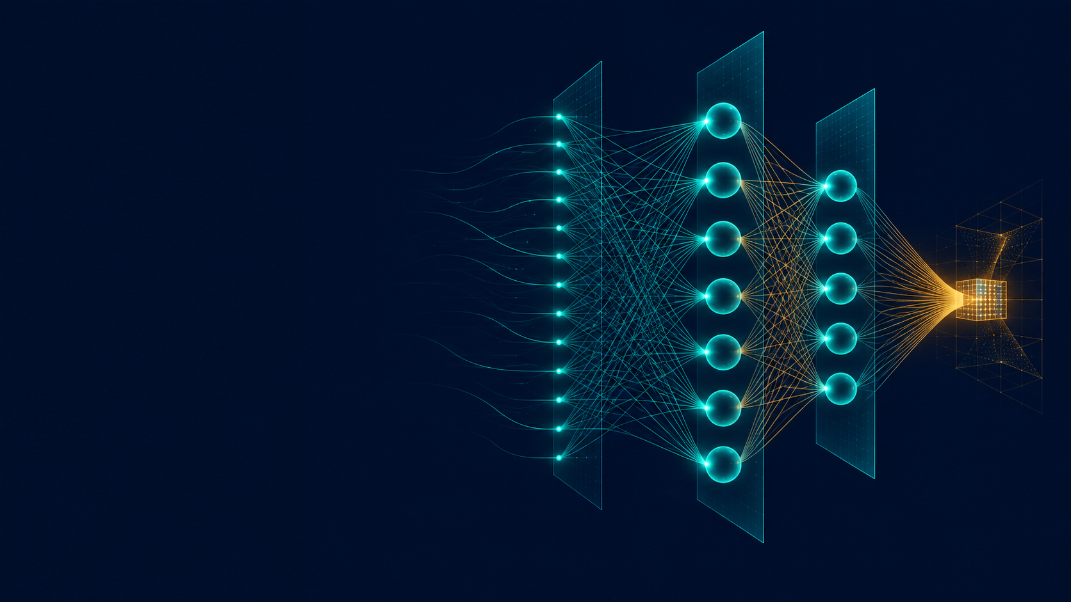
CME705
Machine Learning
Neural Networks, Deep Learning,
and Research Practice
WEEK 4
Neural-network
computation
Karabuk University Department of Computer Engineering
Notes:
Time: 2 minutes. State the guiding question: how do weighted transformations and nonlinear activations turn a batch of inputs into useful outputs? Explain that training begins in Week 5. The cover is an original generated illustration created for this course.

Slide 2
Today's evidence
Six visible products connect computation to research reading.
01
Neuron calculation
pre-activation and two activation outputs
02
Dimension trace
every tensor justified by an operation
03
Output decision
head matched to the target structure
04
Parameter count
weights and biases counted from shapes
05
Numerical identity
stacked affine layers compared with their collapse
06
Paper evidence
one architecture row tied to a source location
CME705
02
Notes:
Time: 4 minutes. Point students to the worksheet. These products let you inspect both procedural accuracy and the limits of each claim.

Slide 3
Opening calculation
x = [2, -1, 0.5]
z = xᵀw + b
w = [0.4, -0.8, 1.2]
= 0.8 + 0.8 + 0.6 - 0.3
b = -0.3
= 1.9
sigmoid(z) ≈ 0.870 ReLU(z) = 1.9
CME705
03
Notes:
Time: 8 minutes. Students calculate every contribution before the total. Expected contributions are 0.8, 0.8, and 0.6. Name z as the pre-activation before applying a function.

Slide 4
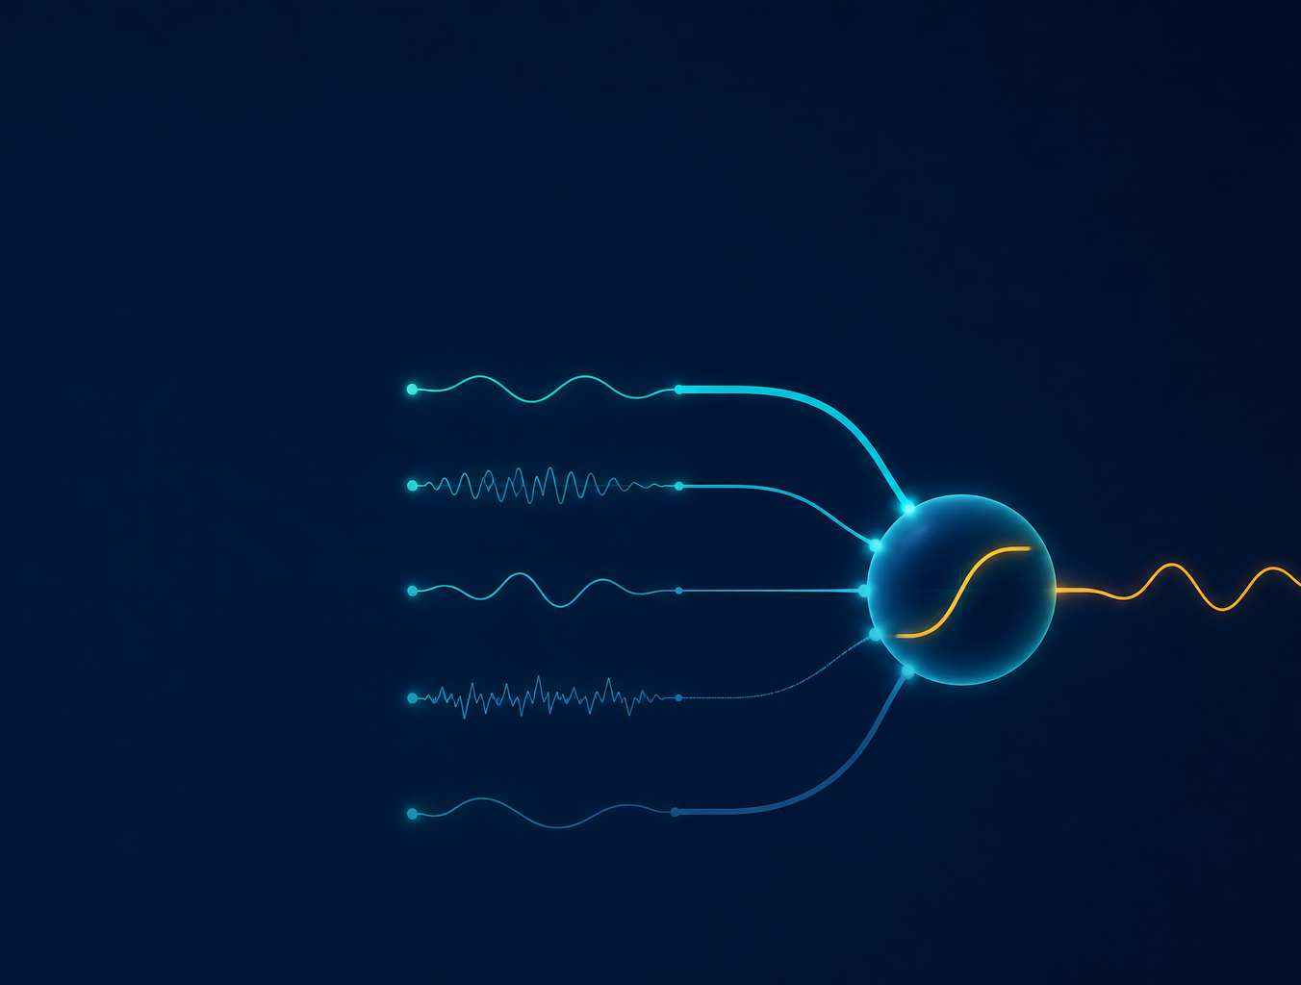
One neuron performs two operations
FIRST
Affine transformation
z = xᵀw + b
THEN
Activation
a = φ(z)
The forward pass computes. It does not update parameters.
CME705
04
Notes:
Time: 8 minutes. Use the image to trace inputs, weights, aggregation, bias, activation, and output. Keep computation separate from learning.

Slide 5
Weights orient; bias shifts
WEIGHTS
BIAS
wᵢ
Strength of one input contribution
b
Offset for one output unit
Sign sets direction of influence
Acts even when the inputs are zero
Zero removes that input from the unit
Shifts a boundary away from the origin
A dense layer gives every output unit its own weight vector and bias.
CME705
05
Notes:
Time: 10 minutes. Change one weight or the bias while holding the other quantities fixed. Ask what the unit produces at x equal to zero.

Slide 6
From one vector to a batch
Rows are observations. Columns are features or units.
X
W
Z
×
+ b
(n, d)
(d, h)
(n, h)
The shared dimension d is consumed. NumPy broadcasts b across n rows.
CME705
06
Notes:
Time: 10 minutes. Establish the course convention of observations in rows. Ask which dimension is shared and which dimensions remain after multiplication.

Slide 7
Dimension logic is part of the model
Quantity | Meaning | Shape
X | four observations, three features | (4, 3)
W₁ | three inputs to four hidden units | (3, 4)
b₁ | one offset per hidden unit | (4,)
Z₁ | four hidden values per observation | (4, 4)
(4, 3) × (3, 4) = (4, 4)
CME705
07
Notes:
Time: 10 minutes. Require students to justify each shape verbally. The inner dimensions match, and the remaining dimensions define the product.

Slide 8
Activation functions have different response shapes
Function | Range | Common role | Main caution
Identity | all real values | regression output | no added nonlinearity
Sigmoid | 0 to 1 | binary or multilabel output | saturates
Tanh | -1 to 1 | bounded hidden state | saturates
ReLU | 0 to infinity | hidden layer | inactive negative region
Layer role and controlled evidence guide the choice.
CME705
08
Notes:
Time: 10 minutes. Compare outputs at negative, zero, and positive pre-activations. No hidden activation should be presented as universally best.

Slide 9
Activation response shapes
Identity
preserves magnitude
ReLU
zero below 0
z
-3
3
Tanh
compresses to -1 and 1
Sigmoid
compresses to 0 and 1
The plot describes behavior. It does not rank functions for every task.
CME705
09
Notes:
Time: 10 minutes. Trace how each function responds from negative to positive z. Discuss saturation and the inactive negative region. The curves show behavior, not a universal performance ranking.

Slide 10
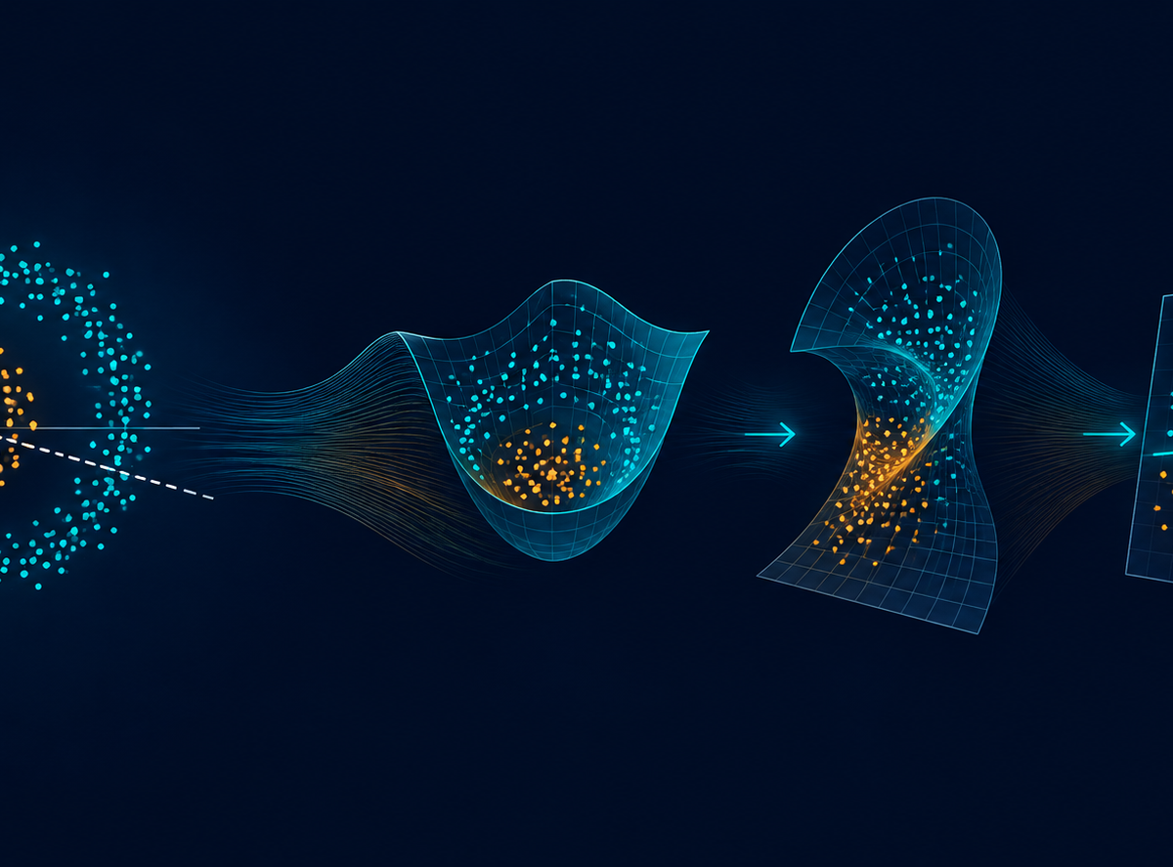
Nonlinearity changes representation
ORIGINAL SPACE
One flat boundary
cannot separate
every arrangement.
HIDDEN REPRESENTATION
A nonlinear transform
can make a later
boundary useful.
CME705
10
Notes:
Time: 10 minutes. Use the generated illustration to distinguish transformation from evaluation. A nonlinear representation can help, but useful generalization still requires unseen-data evidence.

Slide 11
Two affine layers collapse to one
START
Y = (XW₁ + b₁)W₂ + b₂
REGROUP
Y = X(W₁W₂) + (b₁W₂ + b₂)
W* = W₁W₂
b* = b₁W₂ + b₂
Without an intervening nonlinearity, added depth remains affine.
CME705
11
Notes:
Time: 15 minutes. Derive the identity line by line. Expected equivalents are W star equal to W1 W2 and b star equal to b1 W2 plus b2.

Slide 12
Two-layer forward pass
XW₁ + b₁
ReLU
A₁W₂ + b₂
softmax
X
Z₁
A₁
Z₂
P
(4, 3)
(4, 4)
(4, 4)
(4, 2)
(4, 2)
Every operation has a value rule and a shape rule.
CME705
12
Notes:
Time: 12 minutes. Trace values and shapes together. The forward pass ends with probabilities. No parameter has been updated.

Slide 13
Logit, probability, prediction
LOGIT
PROBABILITY
PREDICTION
raw model output
normalized interpretation
decision rule applied
z = [1.2, -0.4]
p = [0.832, 0.168]
class = 0
A threshold or argmax turns model output into a decision.
Select thresholds with validation evidence, not final test labels.
CME705
13
Notes:
Time: 8 minutes. Ask students to label each object precisely. A probability is not automatically calibrated, and a prediction depends on a decision rule.

Slide 14
Match the output head to the task
Task | Output units | Transformation | Meaning
Regression | one or more | identity | continuous value
Binary classification | one | sigmoid | positive-class probability
Single-label multiclass | number of classes | softmax | exclusive probabilities
Multilabel classification | number of labels | independent sigmoids | nonexclusive probabilities
The target structure, output head, and loss must agree.
CME705
14
Notes:
Time: 12 minutes. Students match temperature, binary fault detection, one-of-six fault type, and any-subset tags. Contrast softmax with independent sigmoids.

Slide 15
Stable softmax preserves probability ratios
pₖ =
exp(zₖ − max(z))
Σⱼ exp(zⱼ − max(z))
Subtract the largest logit before exponentiation.
finite values
nonnegative probabilities
each row sums to one
CME705
15
Notes:
Time: 8 minutes. Explain that subtracting the same constant from every logit leaves all ratios unchanged. Require checks for finiteness, nonnegativity, and row sums.

Slide 16
Dimension-tracing activity
Given
X (4,3) W₁ (3,4) b₁ (4,) W₂ (4,2) b₂ (2,)
Z₁
A₁
Z₂
P
XW₁ + b₁
ReLU(Z₁)
A₁W₂ + b₂
softmax(Z₂)
( , )
( , )
( , )
( , )
Write the reason beside every result.
CME705
16
Notes:
Time: 10 minutes. Pause for individual work before discussion. Expected shapes are four by four, four by four, four by two, and four by two.

Slide 17
Count parameters before adding capacity
d → h → k
TEACHING NETWORK
3 → 4 → 2
(dh + h) + (hk + k)
(12 + 4) + (8 + 2)
26
More parameters change capacity, compute, optimization, and evidence needs.
CME705
17
Notes:
Time: 10 minutes. Count weights and biases separately. The teaching network has 26 parameters. A ten-to-eight-to-three network has 115.

Slide 18
NumPy forward-pass lab
python labs/week04_forward_pass_numpy.py
SHAPES
(4,3) → (4,4) → (4,2)
SOFTMAX
each probability row sums to 1
CAPACITY
26 trainable scalar parameters
COLLAPSE
maximum difference near 2.22 × 10⁻¹⁶
Predict first. Run second. Interpret within the claim boundary.
CME705
18
Notes:
Time: 20 minutes. Hide results until predictions are recorded. Run the lab, compare shapes and softmax checks, then explain the affine-collapse difference as machine precision.

Slide 19
What the lab establishes
SUPPORTED
STILL UNTESTED
shape flow
successful learning
bias broadcasting
predictive accuracy
softmax normalization
probability calibration
parameter count
unseen-data generalization
affine-layer collapse
benefit from greater depth
A correct forward pass is necessary evidence, but it is not a performance result.
CME705
19
Notes:
Time: 8 minutes. Students classify observations as mathematical guarantees, fixed-value results, or future empirical claims.

Slide 20
Extract architecture evidence from a paper
Reported fact
Source location
Interpretation or missing detail
Input representation
Layer sequence and widths
Activation and output head
Objective and optimizer
Data, split, metric, baseline
Write “not reported” when the paper is silent.
CME705
20
Notes:
Time: 7 minutes. Model one row. Require a page, section, table, or figure location. Do not infer implementation details from an architecture name.

Slide 21
Literature comparison and exit
COMPARE AT LEAST FIVE CREDIBLE SOURCES
Classify direct, partial, and invalid score comparisons
Identify the simplest credible baseline
Name one unresolved question the available data can test
Exit ticket
one valid matrix expression • why nonlinearity matters • likely output head • one missing architecture fact
Next: gradient-based optimization
CME705
21
Notes:
Time: 5 minutes. Review the literature deliverables and 30-point rubric. Collect the exit ticket. Week 5 will introduce gradient descent and parameter updates.

