Slide 1

Electronic Commodities Monitoring System
(ECMS)
(Concept, Project scope, Implementation)

Slide 2
Key points of price monitoring system
Decision-maker.
All federal and local government agencies.
Non - governmental commercial sector.
Intelligent transformation.
Benefits from the Electronic Commodity Price Control System:

Slide 3
Key points of price monitoring system
Gathering and analyzing information and data from various local and international sources in order to derive indicators of the movement of prices, quantities and strategic stocks in the United Arab Emirates.
Provide policy makers and analysts with up-to-date information on all aspects of the shortage of supply and demand.
Rising prices on local food and global expectations.
Issuing regular publications on food production and markets at the global level, as well as reports on the nutritional status and prospects at the level of the UAE and other countries.
Predict the occurrence of undernourishment and warn of impending food crises using various tools, including specialized software and rapid assessment missions.
Features of the electronic commodity price movement control system:

Slide 4
Key points of price monitoring system
Implementation and milestones for the Electronic Commodities monitoring System:
Stage | Completion | Period
Visioning | Documentation (workflow, KPIs, Indicators, Reporting) | Week 04
Planning | Designing document, Solution architecture. | Week 08
Implementation | Internal portal. Early warning system. Outlets integration. | Week 22 Week 24
Delivery | Training. Supporting documents. | Week 33

Slide 5
Mechanism of the ECMS
The ability of the system to monitor many commodities.
Calculate the rate of change in the price of the commodities in the local market and the equilibrium price of the commodities
Calculate the percentage of change in the quantities offered and compare them with the available consumption.
Know the gap between supply and demand.
Calculation of available quantities of commodities.
Know the general trend of commodities prices.
Data flow and data analysis:

Slide 6
Mechanism of the ECMS
Commodities prices (domestic - international).
Quantities of commodities (import - export - re - export).
Census and distribution by age group.
According to each emirate.
Per capita consumption rates per commodity
Collecting and evaluating risk information systematically:

Slide 7
Mechanism of the ECMS
Linking the ECMS with the concerned authorities.
Issuance of notification reports to concerned parties in a timely manner
Send notifications.
Ability to track the effectiveness of actions taken.
Potential Risk and Early Warning System:

Slide 8
Mechanism of the ECMS
Supporting decision-makers concerned authorities.
Ability to identify recommendations and initiatives.
Cooperation on actions taken.
Ability to track the effectiveness of actions taken.
Analysis of the effectiveness of response plans.
Effective Response

Slide 9
Mechanism of the ECMS
Effective Response
Data collection
Data Analysis
Reporting
Decisions
Commodity activity in the market (import / export / re-export) Commodity prices (retail / wholesale) on the market (local / global) Facts and statistics of the | Supply and demand trends Monitoring safe borders Expect risks Analysis of market weaknesses Commodity Price Index (CPI) vs. Fair Price The index of the available quantity of commodities compared to the quantities available for consumption | Analysis of causes and results Economic Analysis | Definition of Recommendations Implementation of initiatives Corrective Preventive measures Track the initiatives Evaluate response effectiveness (receive feedback)

Slide 10




Mechanism of the ECMS
Federal Customs Authority: FCA
________________________
Commodities DB
Imported Commodities Report

Slide 11
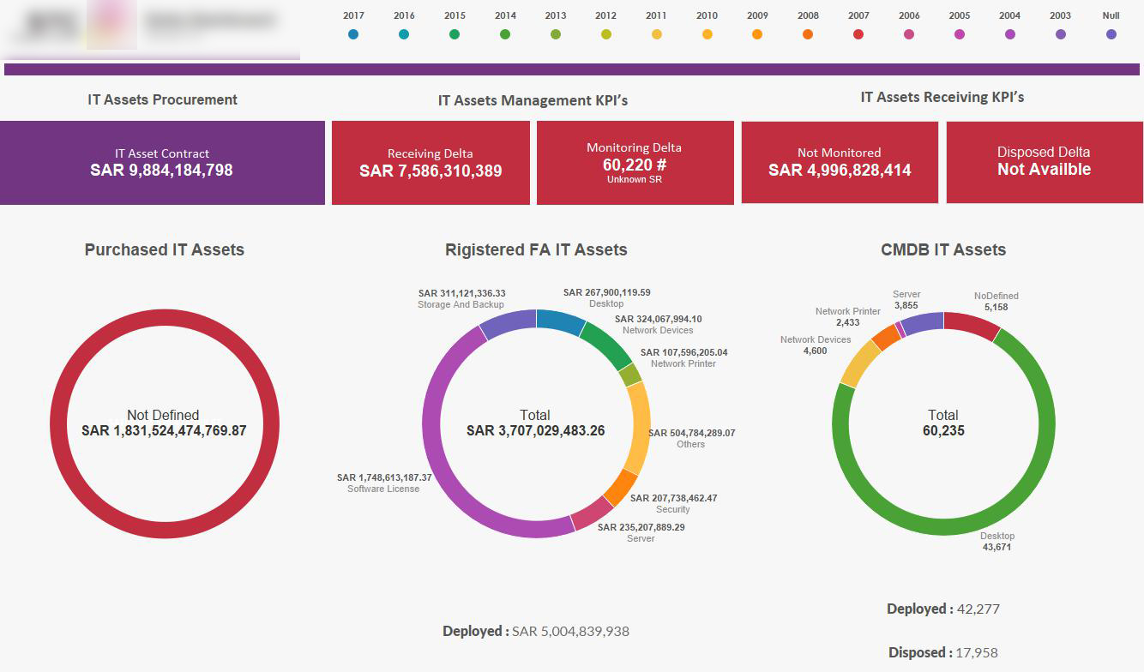
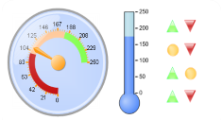
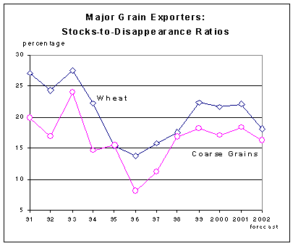
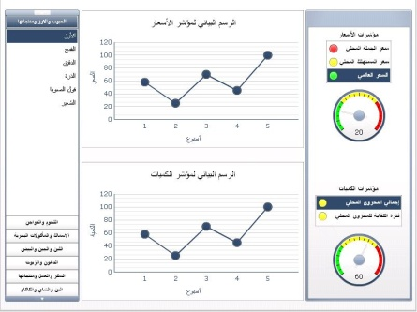
Mechanism of the ECMS
Commodities Price Index
Fair Price Index
Prices and Quantity Dashboards

Slide 12
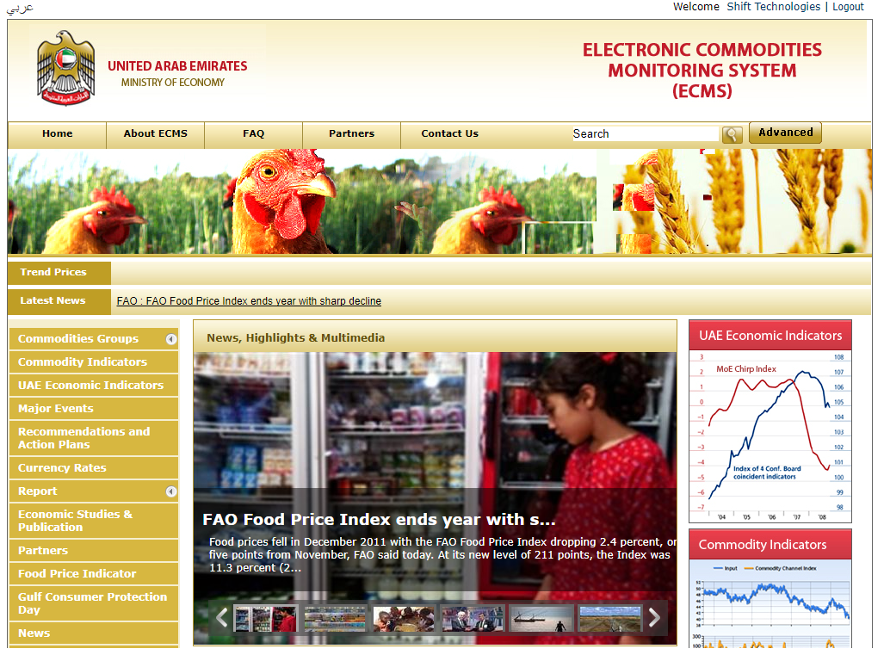
Mechanism of the ECMS

Slide 13
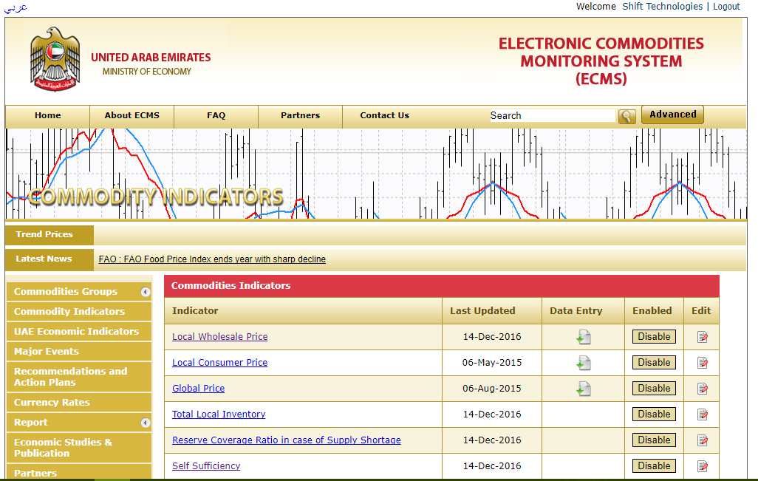
Mechanism of the ECMS

Slide 14
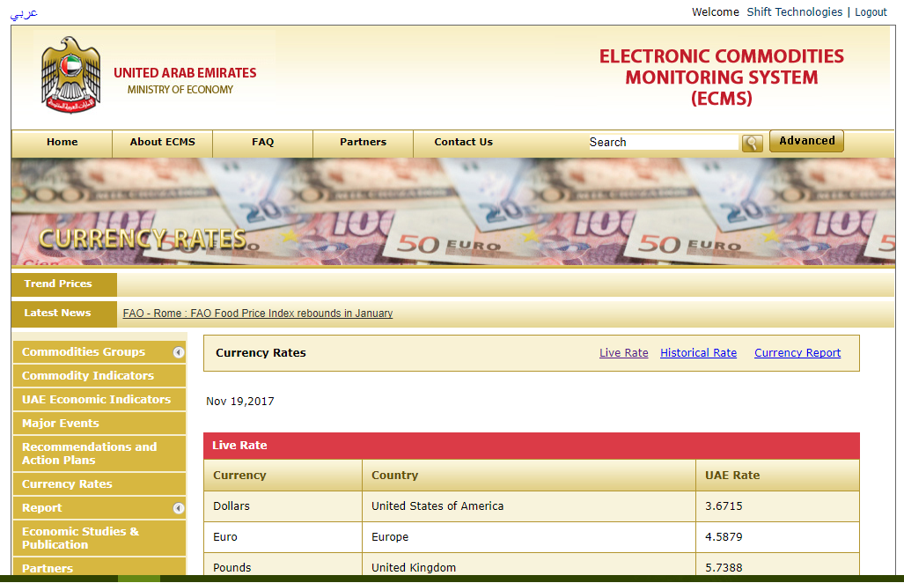
Mechanism of the ECMS

