Slide 1

Arrays
Presentation for use with the textbook Data Structures and Algorithms in Java, 6th edition, by M. T. Goodrich, R. Tamassia, and M. H. Goldwasser, Wiley, 2014

Slide 2
Array Definition
An array is a sequenced collection of variables all of the same type. Each variable, or cell, in an array has an index, which uniquely refers to the value stored in that cell. The cells of an array, A, are numbered 0, 1, 2, and so on.
Each value stored in an array is often called an element of that array.
A
0
1
2
i
n

Slide 3
Array Length and Capacity
Since the length of an array determines the maximum number of things that can be stored in the array, we will sometimes refer to the length of an array as its capacity.
In Java, the length of an array named a can be accessed using the syntax a.length. Thus, the cells of an array, a, are numbered 0, 1, 2, and so on, up through a.length−1, and the cell with index k can be accessed with syntax a[k].
a
0
1
2
k
n

Slide 4
Declaring Arrays (first way)
The first way to create an array is to use an assignment to a literal form when initially declaring the array, using a syntax as:
The elementType can be any Java base type or class name, and arrayName can be any valid Java identifier. The initial values must be of the same type as the array.

Slide 5
Declaring Arrays (second way)
The second way to create an array is to use the new operator.
  However, because an array is not an instance of a class, we do not use a typical constructor. Instead we use the syntax:
new elementType[length]
length is a positive integer denoting the length of the new array.
The new operator returns a reference to the new array, and typically this would be assigned to an array variable.

Slide 6
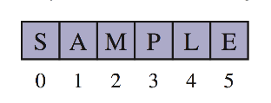
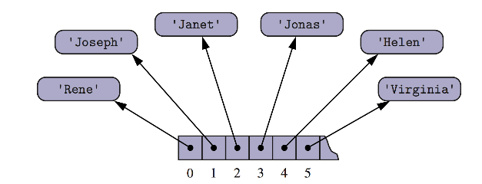
Arrays of Characters or Object References
An array can store primitive elements, such as characters.
An array can also store references to objects.

Slide 7
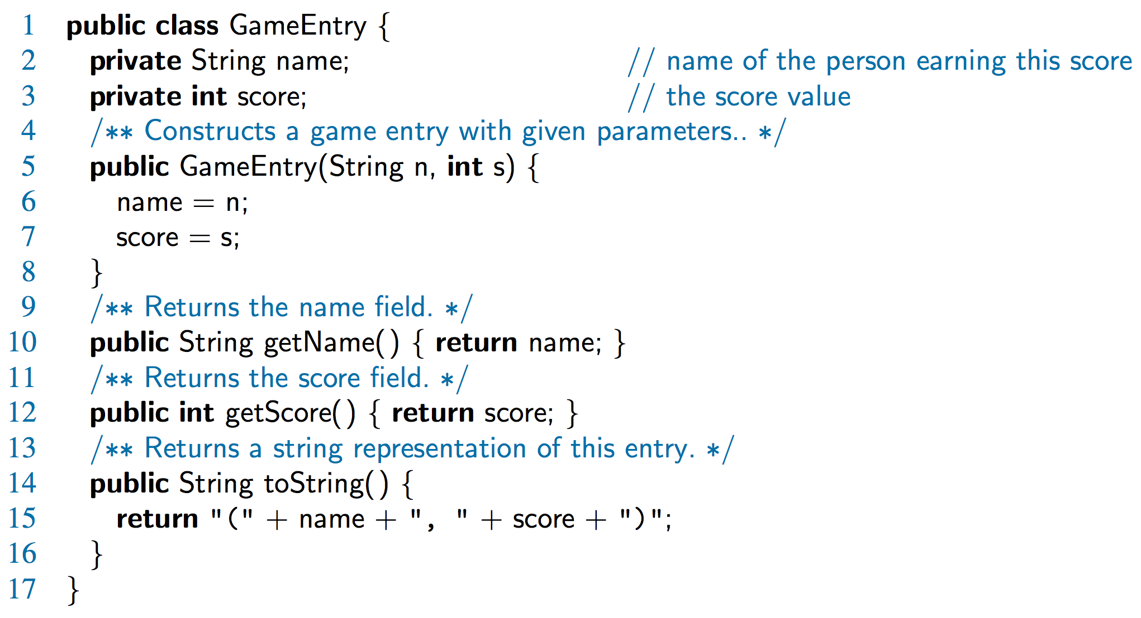
Java Example: Game Entries
A game entry stores the name of a player and her best score so far in a game

Slide 8
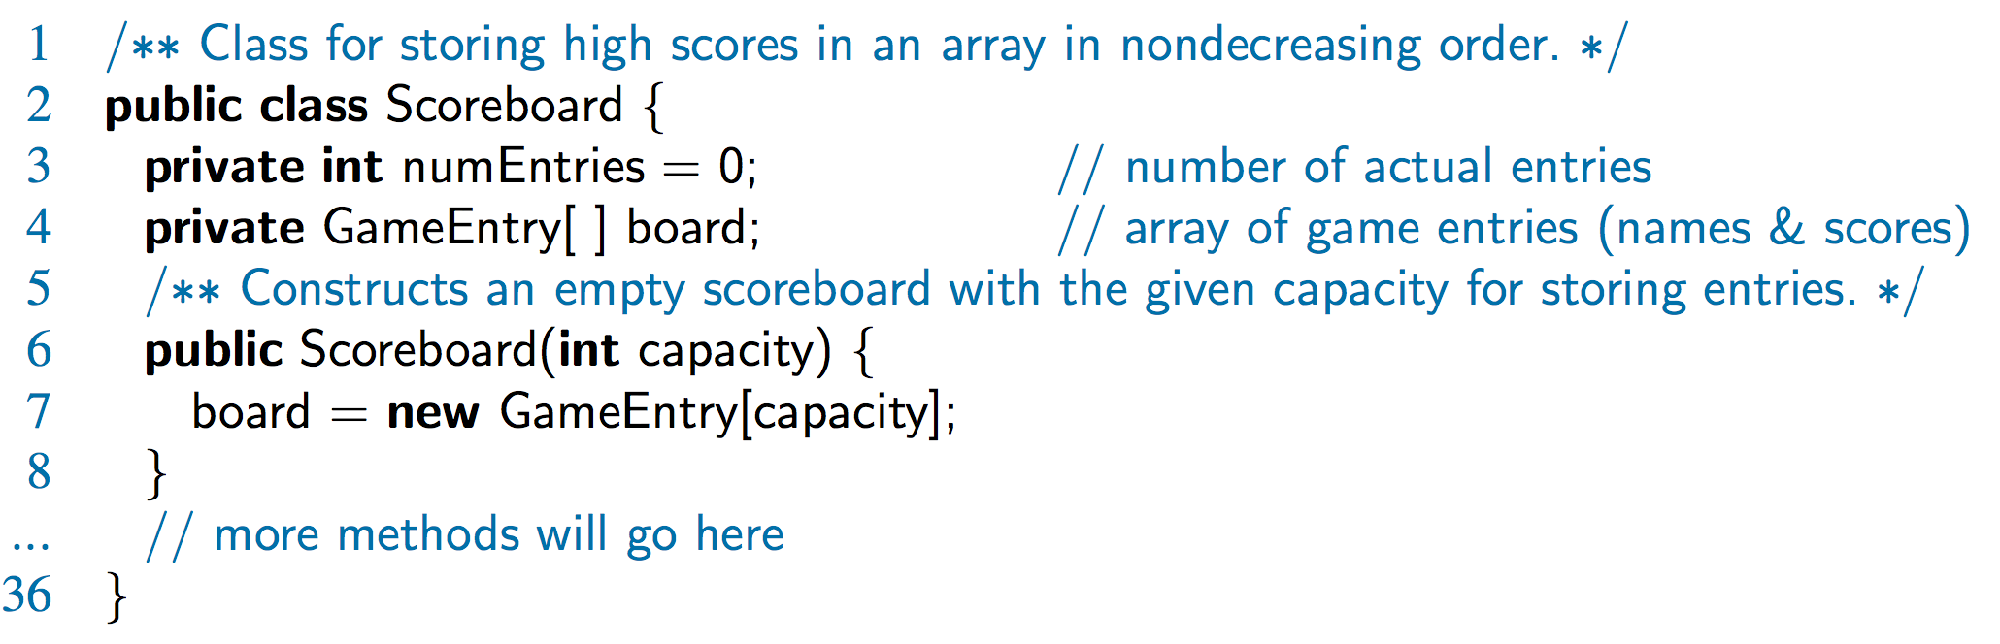
Java Example: Scoreboard
Keep track of players and their best scores in an array, board
  The elements of board are objects of class GameEntry
  Array board is sorted by score

Slide 9
Adding an Entry
To add an entry e into array board at index i, we need to make room for it by shifting forward the n − i entries board[i], …, board[n − 1]
board
0
1
2
i
n
board
0
1
2
i
n
board
e
0
1
2
i
n

Slide 10
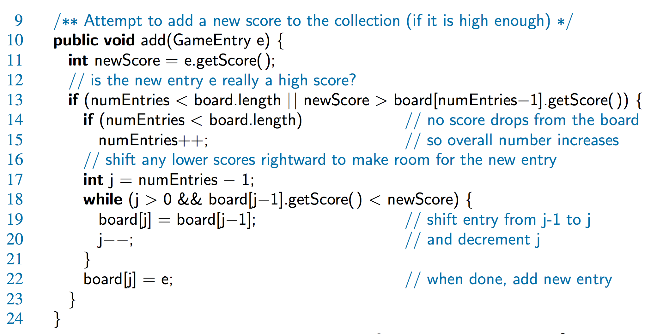
Java Example

Slide 11
Removing an Entry
To remove the entry e at index i, we need to fill the hole left by e by shifting backward the n − i − 1 elements board[i + 1], …, board[n – 1]
board
e
0
1
2
i
n
board
0
1
2
i
n
board
0
1
2
i
n

Slide 12
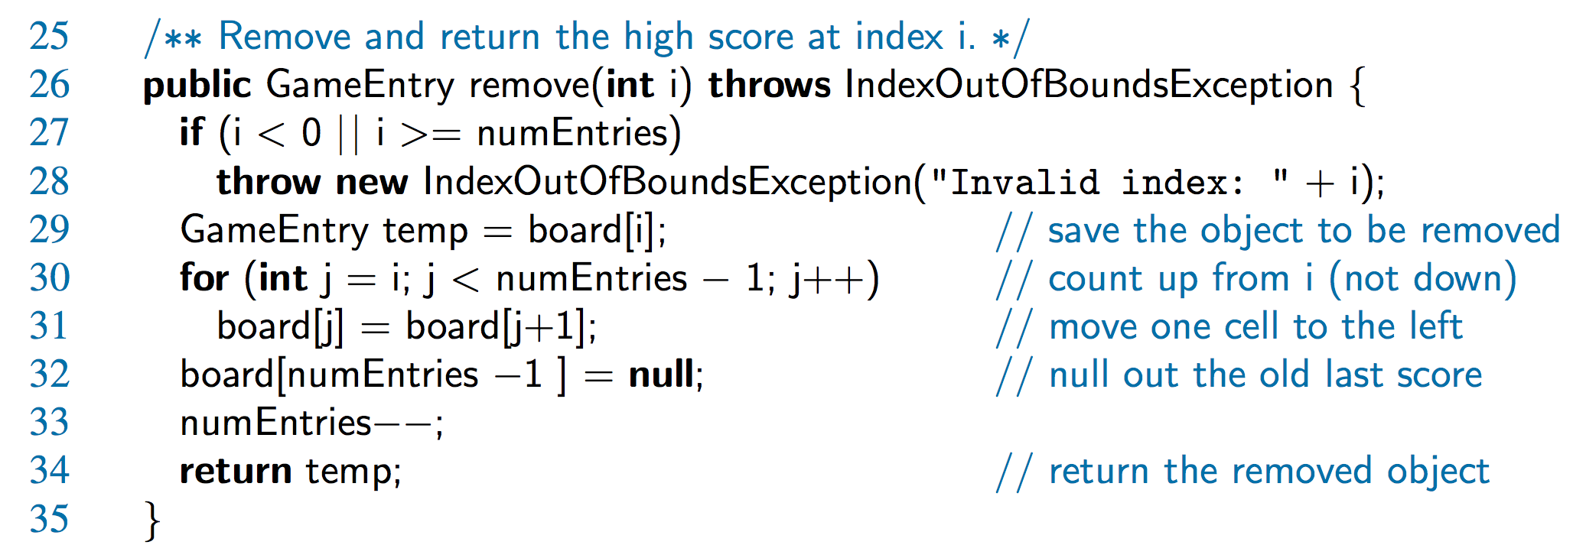
Java Example

Slide 13
Two-Dimensional Arrays
We can define a two-dimensional array to be an array with each of its cells being another array.
Such a two-dimensional array is sometimes also called a matrix.
  In Java, we may declare a two-dimensional array as follows:
  int[ ][ ] data = new int[8][10];
  int[ ][ ] b = {{1, 2}, {3, 4}};

Slide 14
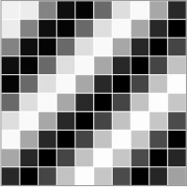
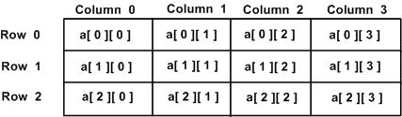
Two-Dimensional Arrays
A two-dimensional array can be used to store objects, which is especially convenient for programming sketches that involve some sort of “grid” or “board.”

Slide 15
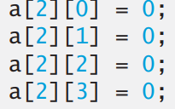
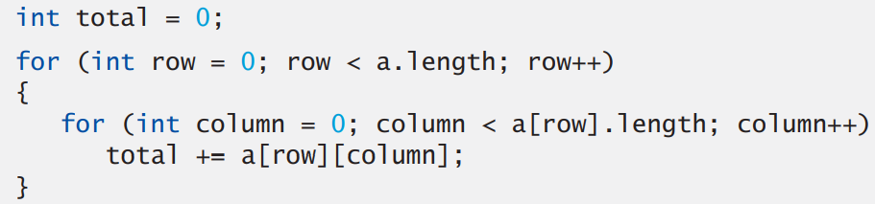
"For" Statements to manipulate Multidimensional-Array
The following nested for statement totals the values of all the elements in array a:

