Slide 1
Singly Linked Lists
Presentation for use with the textbook Data Structures and Algorithms in Java, 6th edition, by M. T. Goodrich, R. Tamassia, and M. H. Goldwasser, Wiley, 2014

Slide 2
Singly Linked List
A singly linked list is a concrete data structure consisting of a sequence of nodes, starting from a head pointer
Each node stores
  element
  link to the next node
next
element
node
head
∅
A
B
C
D

Slide 3
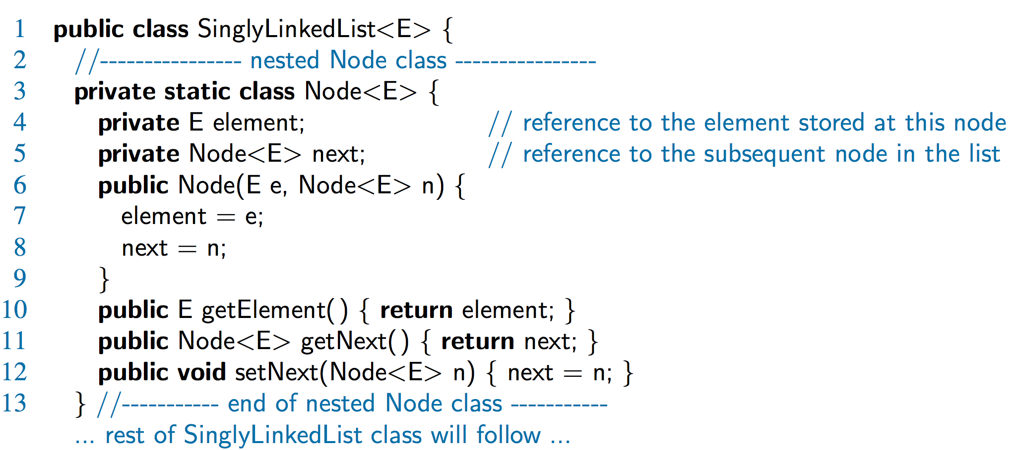
A Nested Node Class

Slide 4
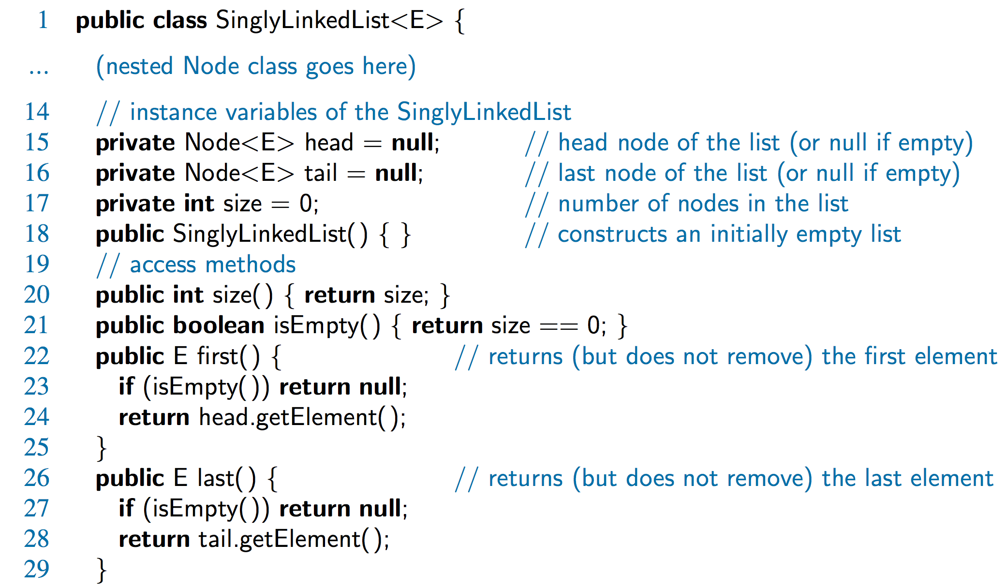
Accessor Methods

Slide 5
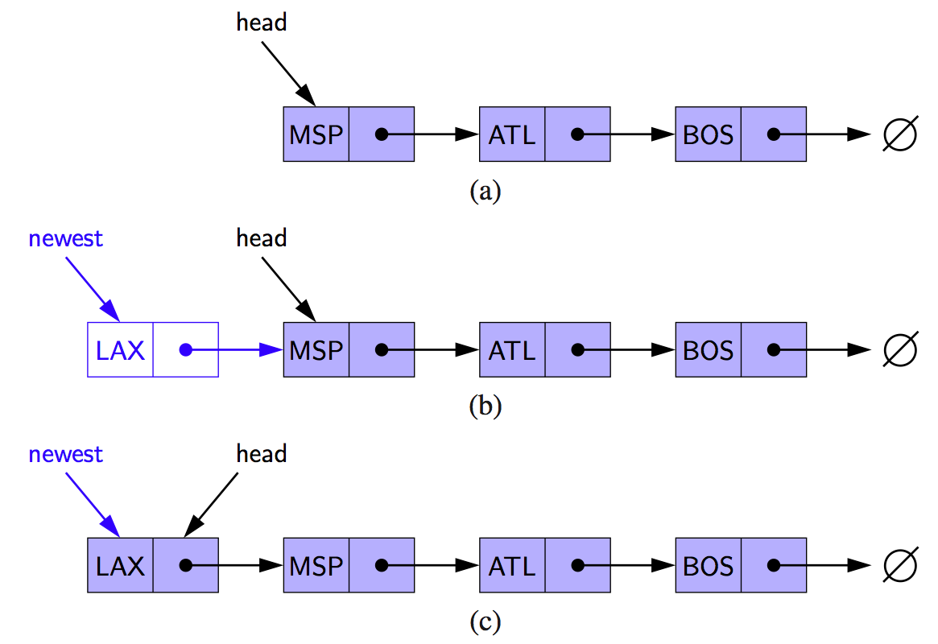
Inserting at the Head
Allocate new node
Insert new element
Have new node point to old head
Update head to point to new node

Slide 6
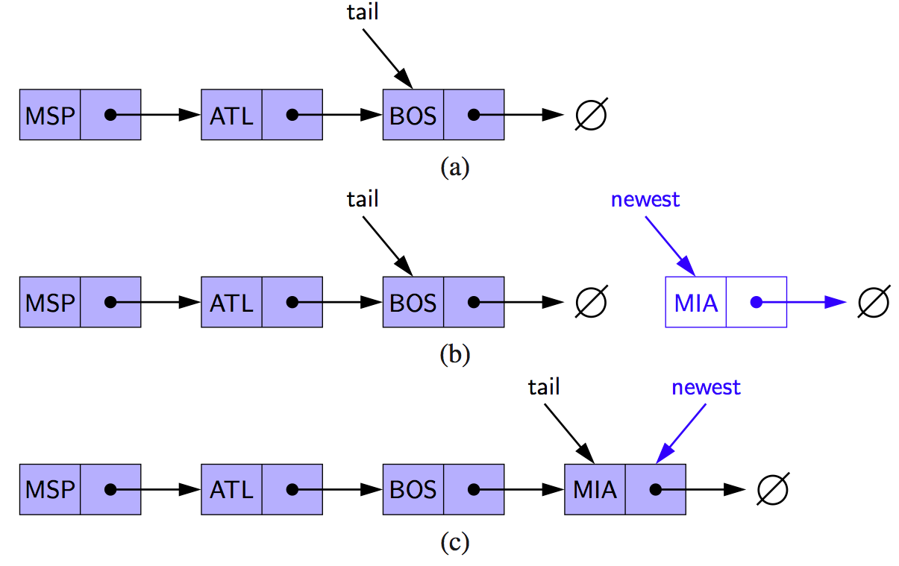
Inserting at the Tail
Allocate a new node
Insert new element
Have new node point to null
Have old last node point to new node
Update tail to point to new node

Slide 7
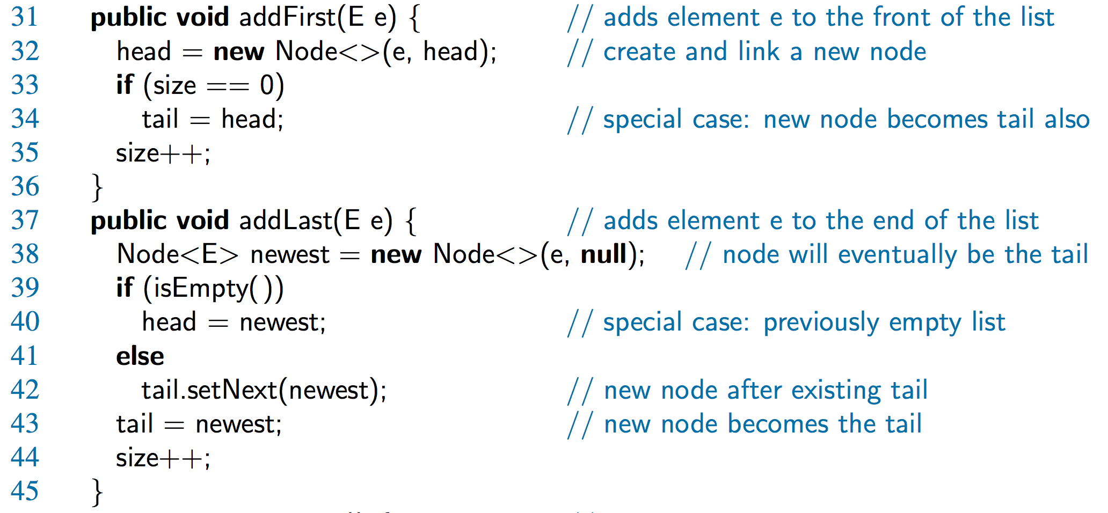
Java Methods

Slide 8
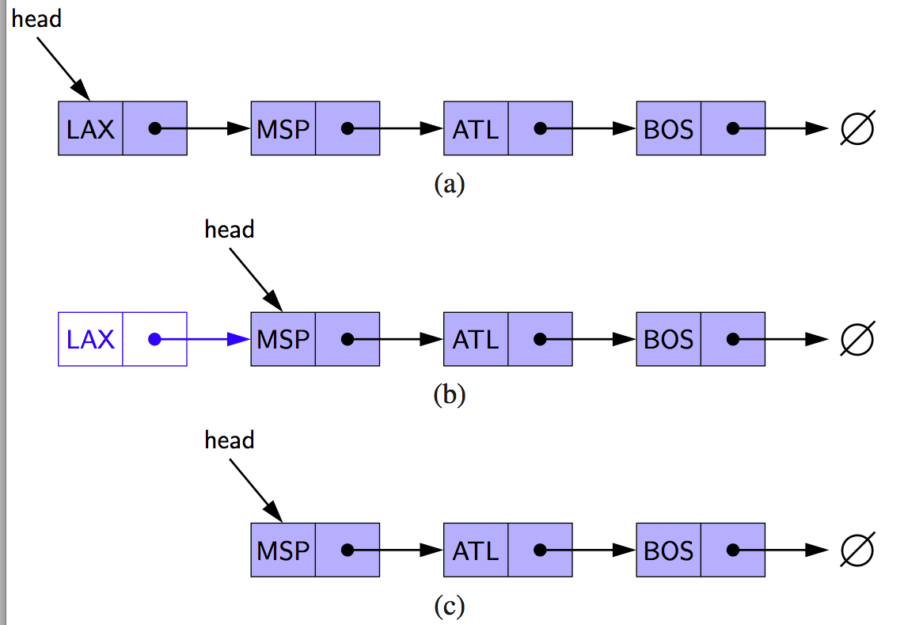
Removing at the Head
Update head to point to next node in the list
Allow garbage collector to reclaim the former first node

Slide 9
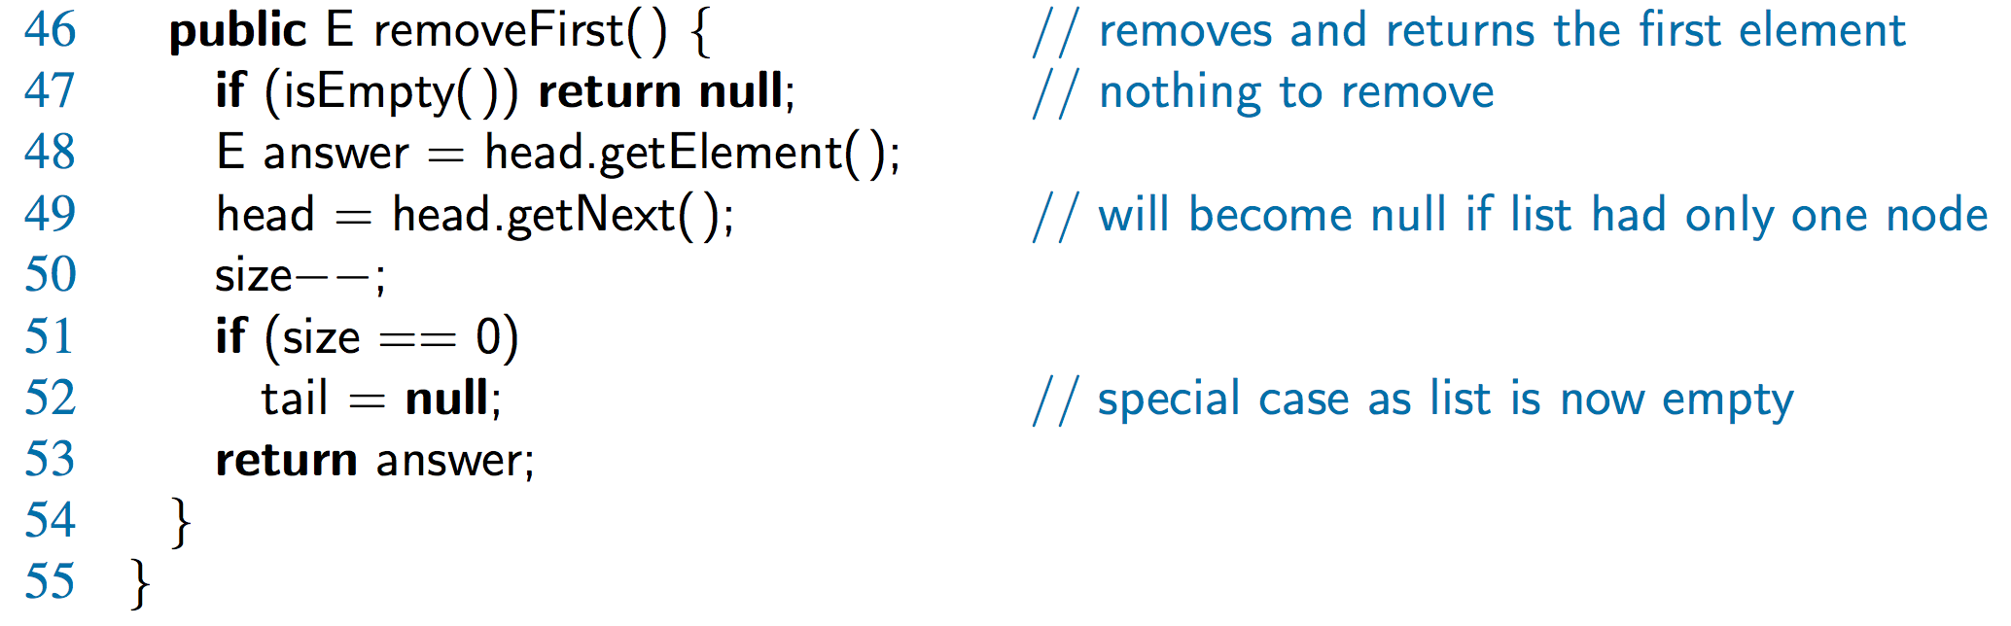
Java Method

Slide 10
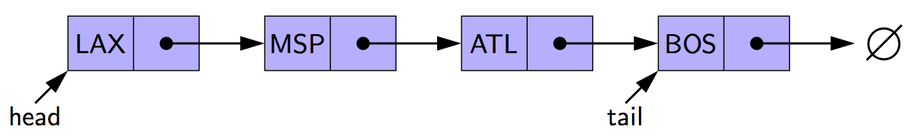
Removing at the Tail
Removing at the tail of a singly linked list is not efficient!
There is no constant-time way to update the tail to point to the previous node

Slide 11
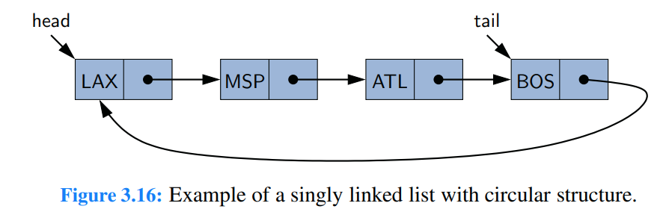
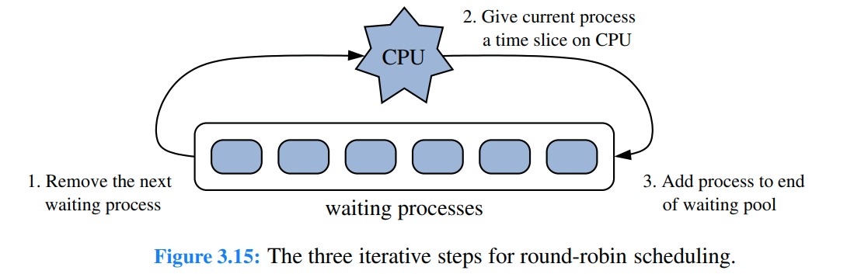
Circularly Linked Lists

Slide 12
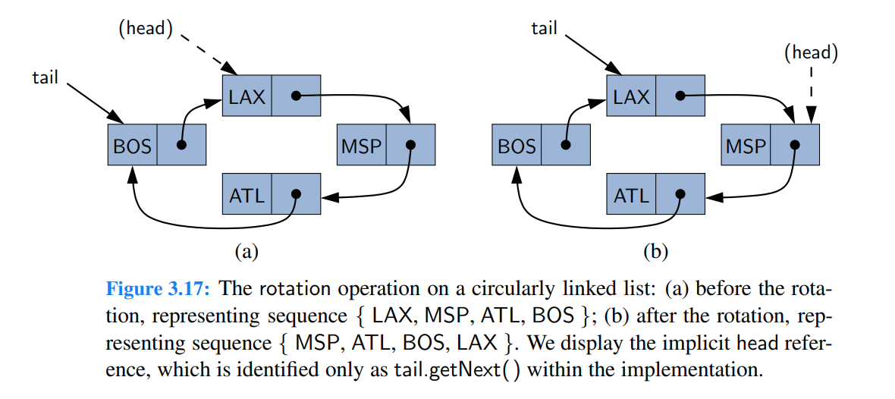
Additional Optimization

