Slide 1
Recursion
Presentation for use with the textbook Data Structures and Algorithms in Java, 6th edition, by M. T. Goodrich, R. Tamassia, and M. H. Goldwasser, Wiley, 2014

Slide 2
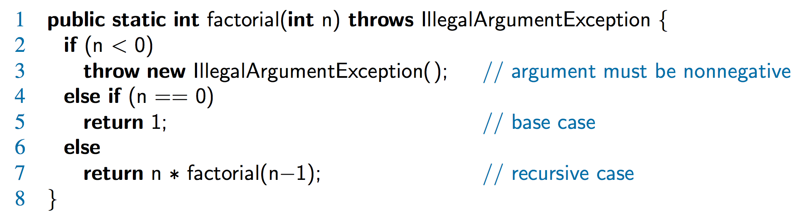
The Recursion Pattern
Recursion: when a method calls itself
Classic example – the factorial function:
n! = 1· 2· 3· ··· · (n-1)· n
Recursive definition:
As a Java method:

Slide 3
Content of a Recursive Method
Base case(s)
  Values of the input variables for which we perform no recursive calls are called base cases (there should be at least one base case).
  Every possible chain of recursive calls must eventually reach a base case.
Recursive calls
  Calls to the current method.
  Each recursive call should be defined so that it makes progress towards a base case.

Slide 4
Visualizing Recursion
Recursion trace
  A box for each recursive call
  An arrow from each caller to callee
  An arrow from each callee to caller showing return value
Example
return
4
*
call
6
=
24
final answer
recursiveFactorial
(
4
)
return
3
*
call
2
=
6
recursiveFactorial
(
3
)
return
2
*
call
1
=
2
recursiveFactorial
(
2
)
return
1
*
call
1
=
1
recursiveFactorial
(
1
)
return
call
1
recursiveFactorial
(
0
)

Slide 5
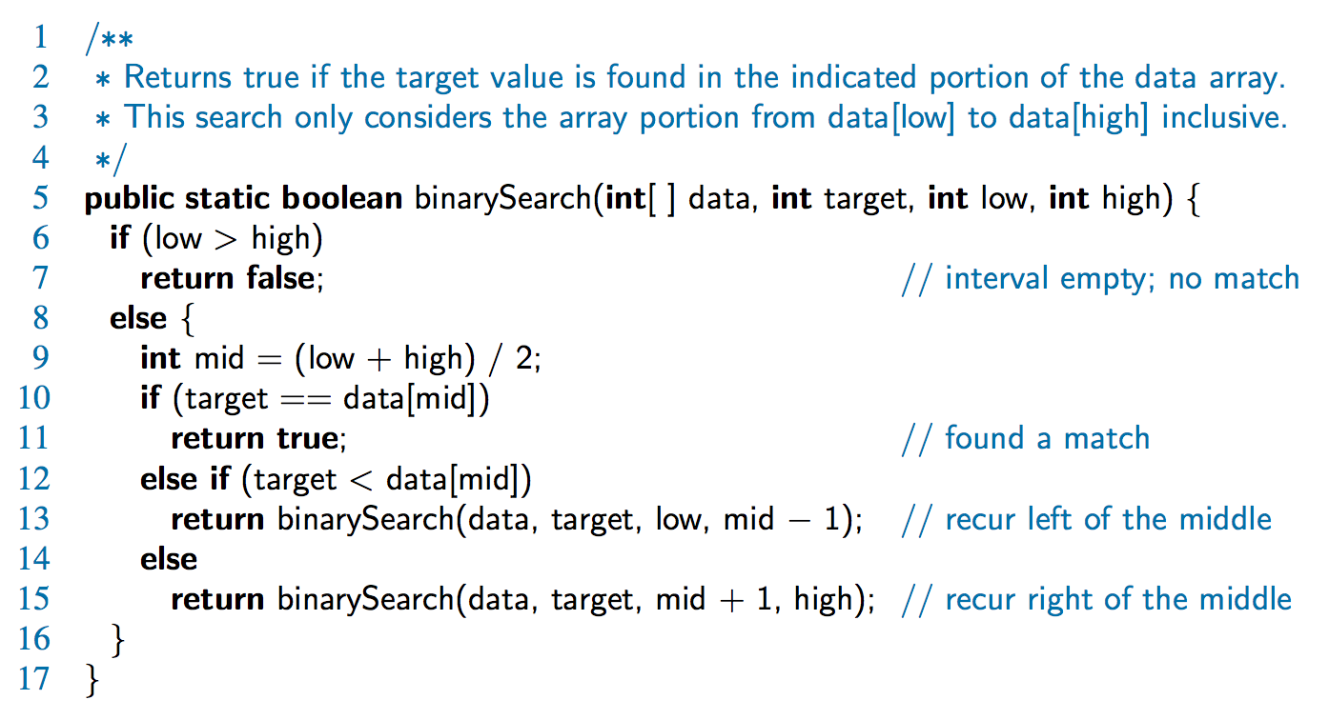
Binary Search
Search for an integer in an ordered list

Slide 6
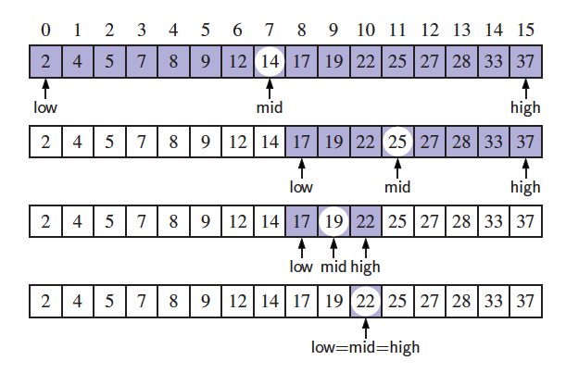
Visualizing Binary Search
We consider three cases:
  If the target equals data[mid], then we have found the target.
  If target < data[mid], then we recur on the first half of the sequence.
  If target > data[mid], then we recur on the second half of the sequence.

Slide 7
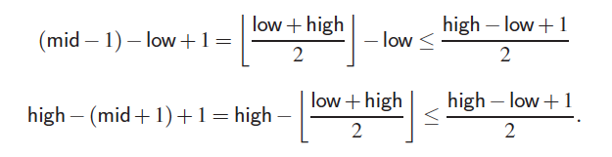
Analyzing Binary Search
Runs in O(log n) time.
  The remaining portion of the list is of size high – low + 1
  After one comparison, this becomes one of the following:
  Thus, each recursive call divides the search region in half; hence, there can be at most log n levels

Slide 8
Linear Recursion
Test for base cases
  Begin by testing for a set of base cases (there should be at least one).
  Every possible chain of recursive calls must eventually reach a base case, and the handling of each base case should not use recursion.
Recur once
  Perform a single recursive call
  This step may have a test that decides which of several possible recursive calls to make, but it should ultimately make just one of these calls
  Define each possible recursive call so that it makes progress towards a base case.

Slide 9
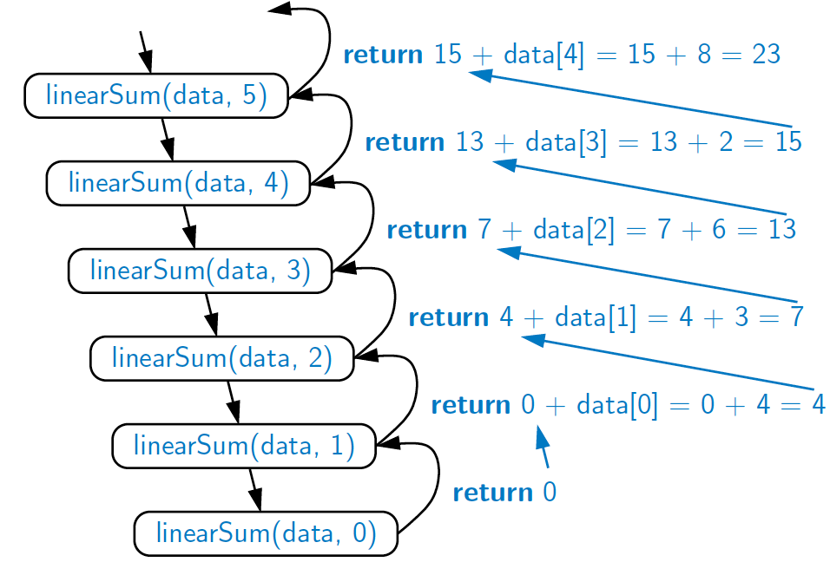
Example of Linear Recursion
Recursion trace of linearSum(data, 5) called on array data = [4, 3, 6, 2, 8]
Algorithm linearSum(A, n):
Input:
Array, A, of integers
Integer n such that
0 ≤ n ≤ |A|
Output:
Sum of the first n
integers in A
if n = 0 then
return 0
else
return
linearSum(A, n - 1) + A[n - 1]

Slide 10
Reversing an Array
Algorithm reverseArray(A, i, j):
Input: An array A and nonnegative integer indices i and j
Output: The reversal of the elements in A starting at index i and ending at
if i < j then
Swap A[i] and A[ j]
reverseArray(A, i + 1, j − 1)
return

Slide 11
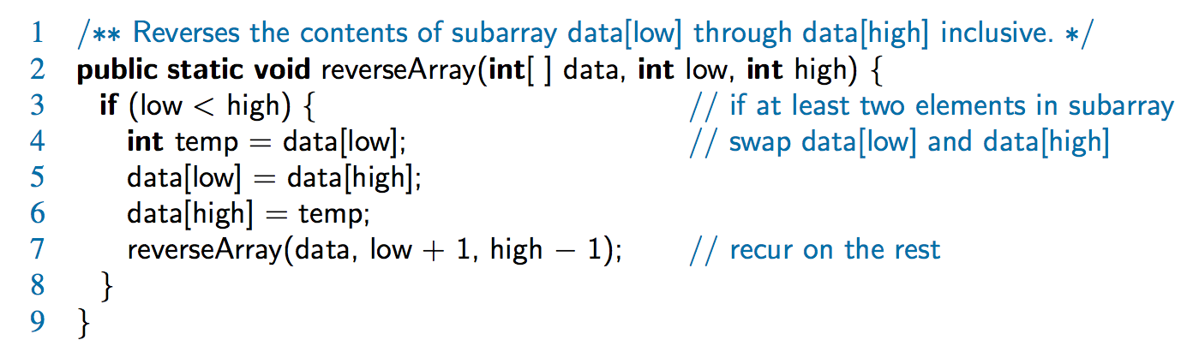
Defining Arguments for Recursion
In creating recursive methods, it is important to define the methods in ways that facilitate recursion.
This sometimes requires we define additional parameters that are passed to the method.
For example, we defined the array reversal method as reverseArray(A, i, j), not reverseArray(A)

Slide 12
Tail Recursion
Tail recursion occurs when a linearly recursive method makes its recursive call as its last step.
The array reversal method is an example.
Such methods can be easily converted to non-recursive methods (which saves on some resources).
Example:
  Algorithm IterativeReverseArray(A, i, j ):
  Input: An array A and nonnegative integer indices i and j
  Output: The reversal of the elements in A starting at index i and ending at j
  while i < j do
    Swap A[i ] and A[ j ]
    i = i + 1
    j = j - 1
  return

Slide 13
Binary Recursion
Binary recursion occurs whenever there are two recursive calls for each non-base case.

Slide 14
Another Binary Recursive Method
Problem: add all the numbers in an integer array A:
  Algorithm BinarySum(A, i, n):
  Input: An array A and integers i and n
  Output: The sum of the n integers in A starting at index i
  if n = 1 then
  return A[i]
  return BinarySum(A, i, n/ 2) + BinarySum(A, i + n/ 2, n/ 2)
Example trace:
0
,
8
0
,
4
4
,
4
0
,
2
2
,
2
4
,
2
6
,
2
0
,
1
1
,
1
2
,
1
3
,
1
4
,
1
5
,
1
6
,
1
7
,
1

Slide 15
Computing Fibonacci Numbers
Fibonacci numbers are defined recursively:
    F₀ = 0
    F₁ = 1
    F_{i} = F_{i-1} ⁺ F_{i-2} for i > 1.
Recursive algorithm (first attempt):
      Algorithm BinaryFib(k):
      Input: Nonnegative integer k
      Output: The kth Fibonacci number F_{k}
      if k = 1 then
      return k
      else
      return BinaryFib(k − 1) + BinaryFib(k − 2)

Slide 16
Analysis
Let n_{k} be the number of recursive calls by BinaryFib(k)
  n₀ = 1
  n₁ = 1
  n₂ = n₁ + n₀ + 1 = 1 + 1 + 1 = 3
  n₃ = n₂ + n₁ + 1 = 3 + 1 + 1 = 5
  n₄ = n₃ + n₂ + 1 = 5 + 3 + 1 = 9
  n₅ = n₄ + n₃ + 1 = 9 + 5 + 1 = 15
  n₆ = n₅ + n₄ + 1 = 15 + 9 + 1 = 25
  n₇ = n₆ + n₅ + 1 = 25 + 15 + 1 = 41
  n₈ = n₇ + n₆ + 1 = 41 + 25 + 1 = 67.
Note that n_{k} at least doubles every other time
That is, n_{k} > 2^{k/2}. It is exponential!

Slide 17
A Better Fibonacci Algorithm
Use linear recursion instead
    Algorithm LinearFibonacci(k):
    Input: A nonnegative integer k
    Output: Pair of Fibonacci numbers (F_{k} , F_{k−1})
    if k = 1 then
    return (k, 0)
    else
    (i, j) = LinearFibonacci(k − 1)
    return (i +j, i)
LinearFibonacci makes k−1 recursive calls

Slide 18
Tower of Hanoi
Tower of Hanoi is a mathematical puzzle where we have three rods and n disks. The objective of the puzzle is to move the entire stack to another rod, obeying the following simple rules:
  Only one disk can be moved at a time.
  Each move consists of taking the upper disk from one of the stacks and placing it on top of another stack i.e. a disk can only be moved if it is the uppermost disk on a stack.
  No disk may be placed on top of a smaller disk.

Slide 19
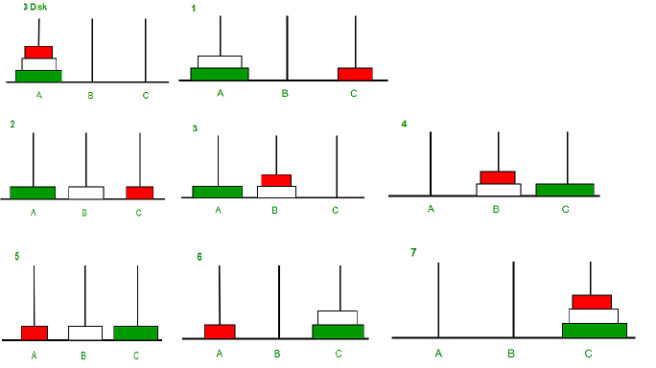
Tower of Hanoi

