Slide 1
Stacks
Presentation for use with the textbook Data Structures and Algorithms in Java, 6th edition, by M. T. Goodrich, R. Tamassia, and M. H. Goldwasser, Wiley, 2014

Slide 2
Abstract Data Types (ADTs)
An abstract data type (ADT) is an abstraction of a data structure
An ADT specifies:
  Data stored
  Operations on the data
  Error conditions associated with operations
Example: ADT modeling a simple stock trading system
  The data stored are buy/sell orders
  The operations supported are
    order buy(stock, items, price)
    order sell(stock, items, price)
    void cancel(order)
  Error conditions:
    Buy/sell a nonexistent stock
    Cancel a nonexistent order

Slide 3

The Stack ADT
Examples of stacks in "real life":
    The stack of trays in a cafeteria;
    A stack of plates in a cupboard;
    A driveway that is only one car wide.
The Stack ADT stores arbitrary objects
Insertions and deletions follow the last-in first-out scheme
Examples of stacks in "real life":
  The stack of trays in a cafeteria;
  A stack of plates in a cupboard;
  A driveway that is only one car wide.
Main stack operations:
  push(object): inserts an element
  object pop(): removes and returns the last inserted element
Auxiliary stack operations:
  object top(): returns the last inserted element without removing it
  integer size(): returns the number of elements stored
  boolean isEmpty(): indicates whether no elements are stored

Slide 4
Stack Interface in Java
Java interface corresponding to our Stack ADT
Assumes null is returned from top() and pop() when stack is empty
Different from the built-in Java class java.util.Stack
public interface Stack<E> {
int size();
boolean isEmpty();
E top();
void push(E element);
E pop();
}

Slide 5
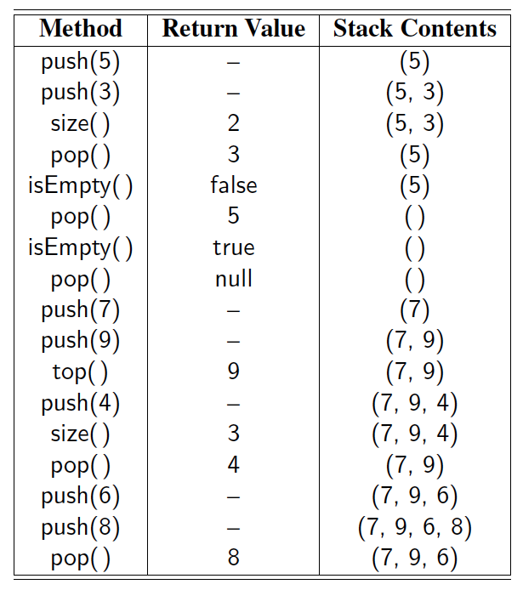
Example

Slide 6
Exceptions vs. Returning Null
Attempting the execution of an operation of an ADT may sometimes cause an error condition
Java supports a general abstraction for errors, called exception
An exception is said to be “thrown” by an operation that cannot be properly executed
In our Stack ADT, we do not use exceptions
Instead, we allow operations pop and top to be performed even if the stack is empty
For an empty stack, pop and top simply return null

Slide 7
Applications of Stacks
Direct applications
  Page-visited history in a Web browser
  Undo sequence in a text editor
  Chain of method calls in the Java Virtual Machine
Indirect applications
  Auxiliary data structure for algorithms
  Component of other data structures

Slide 8
Method Stack in the JVM
The Java Virtual Machine (JVM) keeps track of the chain of active methods with a stack
When a method is called, the JVM pushes on the stack a frame containing
  Local variables and return value
  Program counter, keeping track of the statement being executed
When a method ends, its frame is popped from the stack and control is passed to the method on top of the stack
Allows for recursion
main() {
int i = 5;
foo(i);
}
foo(int j) {
int k;
k = j+1;
bar(k);
}
bar(int m) {
…
}
bar
PC = 1
m = 6
foo
PC = 3
j = 5
k = 6
main
PC = 2
i = 5

Slide 9
Array-based Stack
A simple way of implementing the Stack ADT uses an array
We add elements from left to right
A variable keeps track of the index of the top element
Algorithm size()
return t + 1
Algorithm pop()
if isEmpty() then
return null
else
t ← t − 1
return S[t + 1]
…
S
0
1
2
t

Slide 10
Array-based Stack (cont.)
The array storing the stack elements may become full
A push operation will then throw a FullStackException
  Limitation of the array-based implementation
  Not intrinsic to the Stack ADT
Algorithm push(o)
if t = S.length − 1 then
throw IllegalStateException
else
t ← t + 1
S[t] ← o
…
S
0
1
2
t

Slide 11
Performance and Limitations
Performance
  Let n be the number of elements in the stack
  The space used is O(n)
  Each operation runs in time O(1)
Limitations
  The maximum size of the stack must be defined a priori and cannot be changed
  Trying to push a new element into a full stack causes an implementation-specific exception

Slide 12
Array-based Stack in Java
public class ArrayStack<E>
implements Stack<E> {
// holds the stack elements
private E[ ] S;
// index to top element
private int top = -1;
// constructor
public ArrayStack(int capacity) {
S = (E[ ]) new Object[capacity]);
}
public E pop() {
if isEmpty()
return null;
E temp = S[top];
// facilitate garbage collection:
S[top] = null;
top = top – 1;
return temp;
}
… (other methods of Stack interface)

Slide 13
Example Use in Java
public class Tester {
// … other methods
public intReverse(Integer a[]) {
Stack<Integer> s; s = new ArrayStack<Integer>();
… (code to reverse array a) …
}
public floatReverse(Float f[]) {
Stack<Float> s; s = new ArrayStack<Float>();
… (code to reverse array f) …
}

Slide 14
Parentheses Matching
Each “(”, “{”, or “[” must be paired with a matching “)”, “}”, or “[”
  correct: ( )(( )){([( )])}
  correct: ((( )(( )){([( )])}
  incorrect: )(( )){([( )])}
  incorrect: ({[ ])}
  incorrect: (

Slide 15
Parenthesis Matching (Java)
public static boolean isMatched(String expression) {
final String opening = "({["; // opening delimiters
final String closing = ")}]"; // respective closing delimiters
Stack<Character> buffer = new LinkedStack<>( );
for (char c : expression.toCharArray( )) {
if (opening.indexOf(c) != −1) // this is a left delimiter
buffer.push(c);
else if (closing.indexOf(c) != −1) { // this is a right delimiter
if (buffer.isEmpty( )) // nothing to match with
return false;
if (closing.indexOf(c) != opening.indexOf(buffer.pop( )))
return false; // mismatched delimiter
}
}
return buffer.isEmpty( ); // were all opening delimiters matched?
}

Slide 16
HTML Tag Matching
For fully-correct HTML, each <name> should pair with a matching </name>
<body>
<center>
<h1> The Little Boat </h1>
</center>
<p> The storm tossed the little
boat like a cheap sneaker in an
old washing machine. The three
drunken fishermen were used to
such treatment, of course, but
not the tree salesman, who even as
a stowaway now felt that he
had overpaid for the voyage. </p>
<ol>
<li> Will the salesman die? </li>
<li> What color is the boat? </li>
<li> And what about Naomi? </li>
</ol>
</body>
The Little Boat
The storm tossed the little boat
like a cheap sneaker in an old
washing machine. The three
drunken fishermen were used to
such treatment, of course, but not
the tree salesman, who even as
a stowaway now felt that he had
overpaid for the voyage.
1. Will the salesman die?
2. What color is the boat?
3. And what about Naomi?

Slide 17
HTML Tag Matching (Java)
public static boolean isHTMLMatched(String html) {
Stack<String> buffer = new LinkedStack<>( );
int j = html.indexOf('<'); // find first ’<’ character (if any)
while (j != −1) {
int k = html.indexOf('>', j+1); // find next ’>’ character
if (k == −1)
return false; // invalid tag
String tag = html.substring(j+1, k); // strip away < >
if (!tag.startsWith("/")) // this is an opening tag
buffer.push(tag);
else { // this is a closing tag
if (buffer.isEmpty( ))
return false; // no tag to match
if (!tag.substring(1).equals(buffer.pop( )))
return false; // mismatched tag
}
j = html.indexOf('<', k+1); // find next ’<’ character (if any)
}
return buffer.isEmpty( ); // were all opening tags matched?
}
Notes:
We make a left-to-right pass through the raw string, using index j to track our progress. The indexOf method of the String class, which optionally accepts a
starting index as a second parameter, locates the '<' and '>' characters that define the tags. Method substring, also of the String class, returns the substring starting
at a given index and optionally ending right before another given index. Opening tags are pushed onto the stack, and matched against closing tags as they are popped
from the stack

Slide 18
Evaluating Arithmetic
Expressions
Slide by Matt Stallmann included with permission.
14 – 3 * 2 + 7 = (14 – (3 * 2) ) + 7
Operator precedence
* has precedence over +/–
Associativity
operators of the same precedence group
evaluated from left to right
Example: (x – y) + z rather than x – (y + z)
Idea: push each operator on the stack, but first pop and perform higher and equal precedence operations.

Slide 19
Algorithm for
Evaluating Expressions
Slide by Matt Stallmann included with permission.
Two stacks:
opStk holds operators
valStk holds values
Use $ as special “end of input” token with lowest precedence
Algorithm doOp()
  x ← valStk.pop();
  y ← valStk.pop();
  op ← opStk.pop();
  valStk.push( y op x )
Algorithm repeatOps( refOp ):
while ( valStk.size() > 1 ∧
prec(refOp) ≤ prec(opStk.top())
doOp()
Algorithm EvalExp()
  Input: a stream of tokens representing an arithmetic expression (with numbers)
  Output: the value of the expression
while there’s another token z
if isNumber(z) then
valStk.push(z)
else
repeatOps(z);
opStk.push(z)
repeatOps($);
return valStk.top()

Slide 20
Algorithm on an
Example Expression
Slide by Matt Stallmann included with permission.
Operator ≤ has lower precedence than +/–
14 ≤ 4 – 3 * 2 + 7
4
–
14
≤
3
*
$
$
4
–
7
$
14
≤
F
+
-2
+
5
+
14
≤
14
≤
2
2
3
*
3
*
6
4
–
4
–
4
–
-2
+
14
≤
14
≤
14
≤
14
≤

