Slide 1
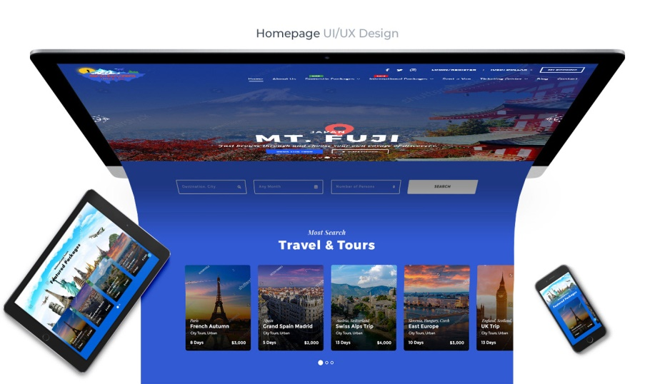
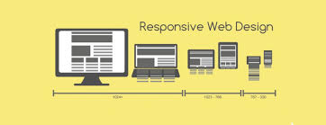

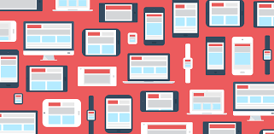
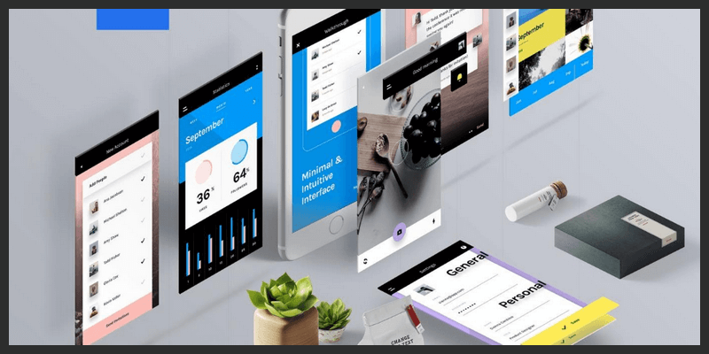
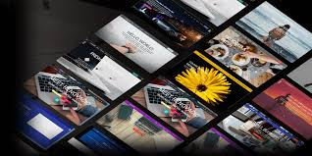
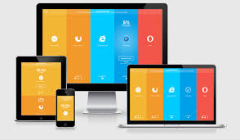



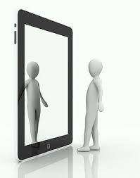

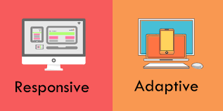
BOOTSTRAP
Hichem Tounsi
HICHEM Tounsi

Slide 2
WHat is bootstrap
Bootstrap is a free front-end framework for faster and easier web development
Bootstrap includes HTML and CSS based design templates for typography, forms, buttons..
Bootstrap also gives you the ability to easily create responsive designs.
Responsive Design allow your page works for computer, tablets and mobile phones.

Slide 3
ADVANTAGES OF BOOTSTRAP
1
Easy to use
2
Responsive features
3
Big List Of Components
4
Browser compatibility

Slide 4
GRID CLASSES
lg
xs
md
For phones
sm
For larger
desktops
For tablets
For desktops

Slide 5
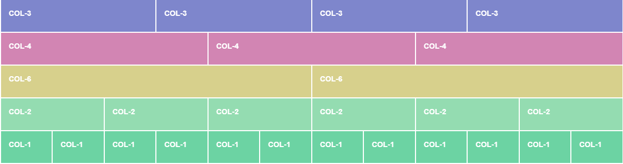
BOOTSTRAP GRID

Slide 6
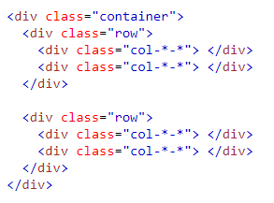
Basic Structure of a Bootstrap Grid

Slide 7
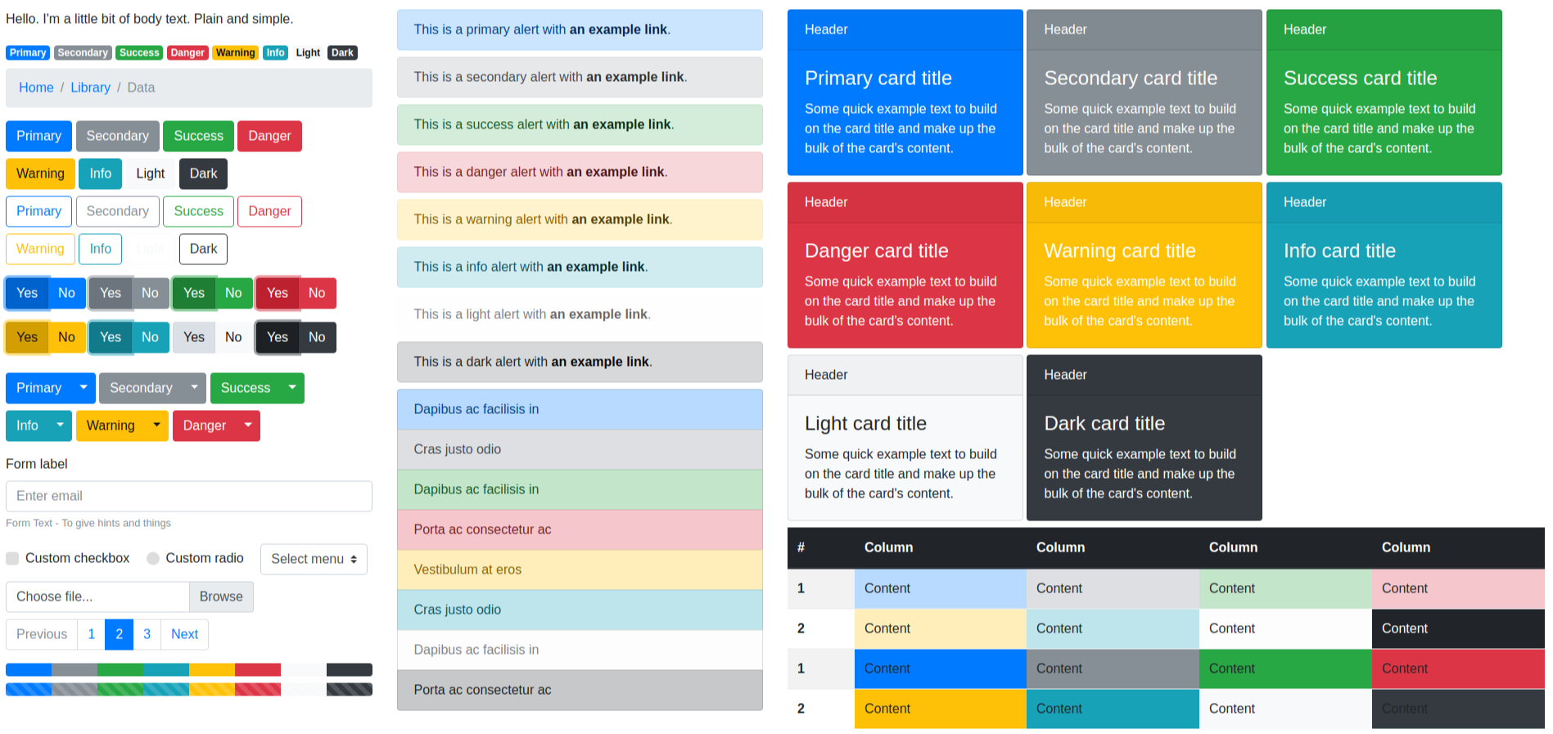
COMPONENTS

Slide 8


Merci pour votre attention
Notes:
Je vous remercie d'avoir pris le temps d'écouter notre présentation.

