Slide 1


Introduced to Business World in 2003
Organization Monitor NPS - Leading indicator of Customer Loyalty
Scale of 0 – 10
Detractor – spread negative sentiments
“How likely is it that you would recommend this company or product/service to a friend or colleague?
What leads to NPS Score?

Slide 2

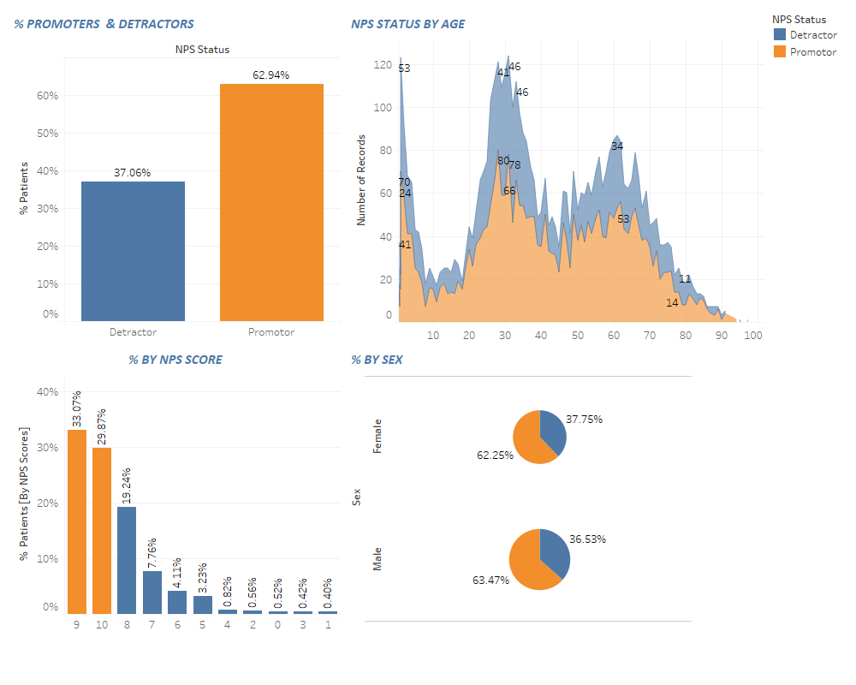

Slide 3
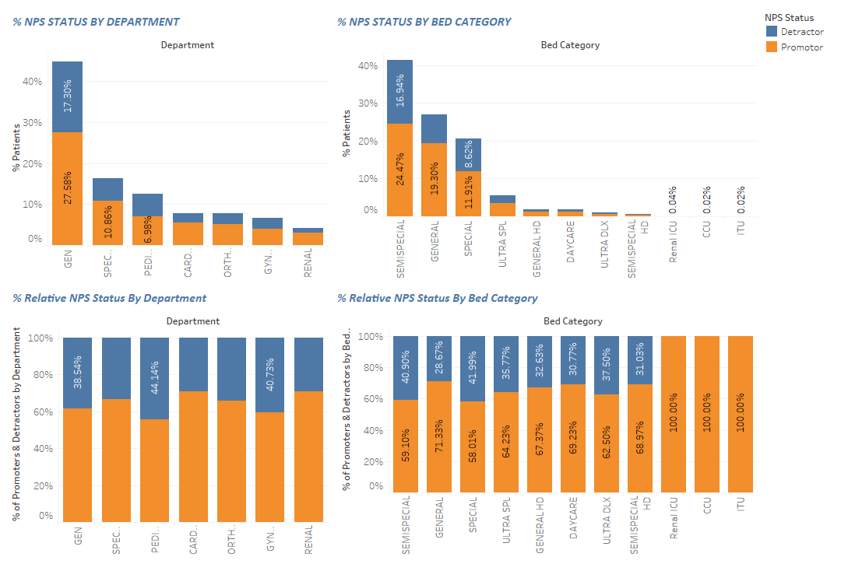

Slide 4
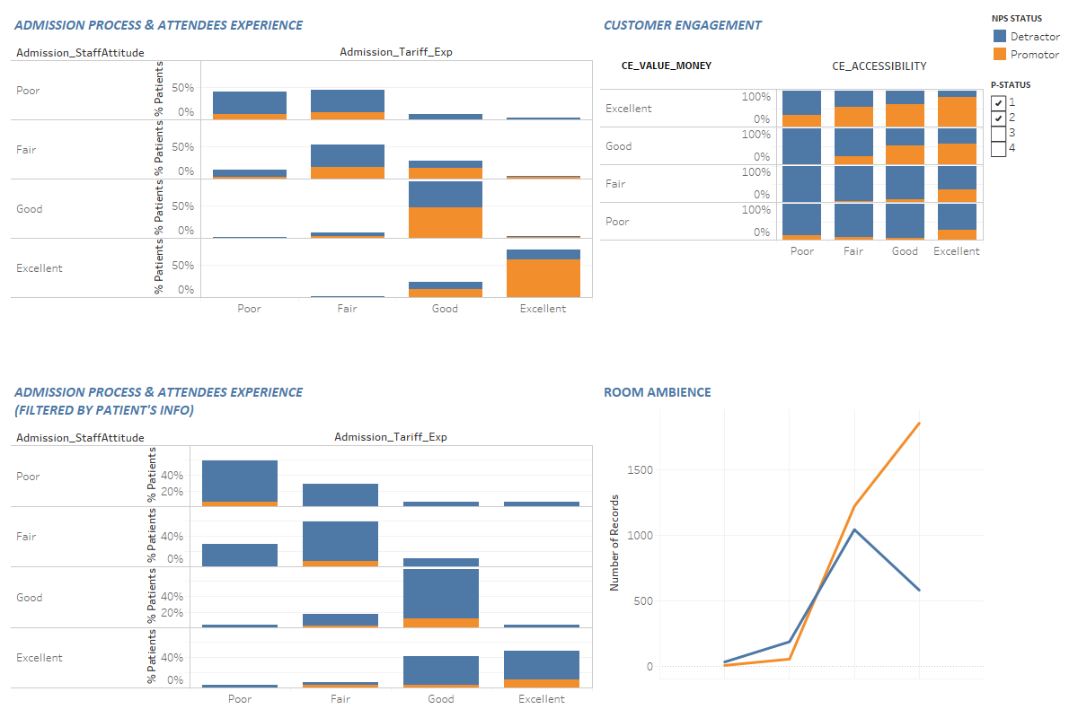

Slide 5
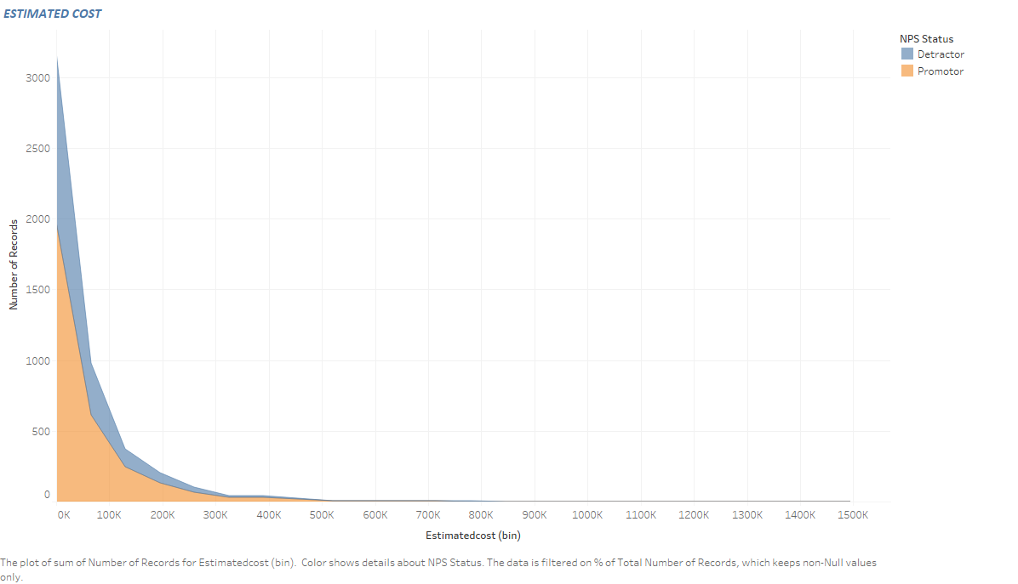

Slide 6

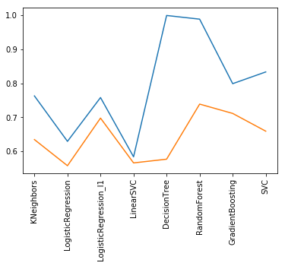
PREDICTING NPS
52 ATTRIBUTES ON “CUSTOMER ENGAGEMENT, ATTENDEES EXPERIENCE, IN ROOM EXPERIENCE ETC.”
4989 OBSERVATIONS (TRAIN), 364 OBSERVATIONS (TEST)
CE_NPS & NPS
NO MISSING DATA
CATEGORIES MISSING ON TEST DATA (MARITAL STATUS: WIDOWED, DIVORCED, BED CATEGORY: ITU, CCU, RENAL ICU)
MACHINE LEARNING ALGORITHMS APPLIED

Slide 7
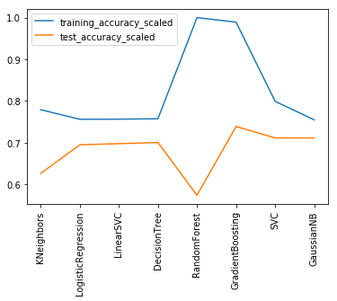
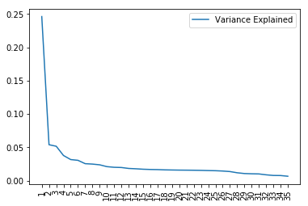
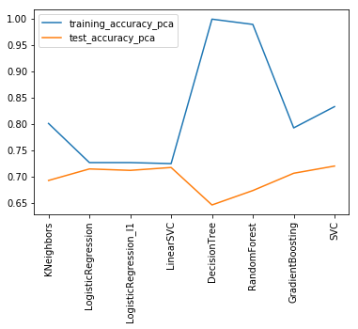
PREDICTING NPS
`

Slide 8
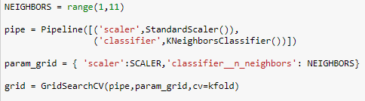
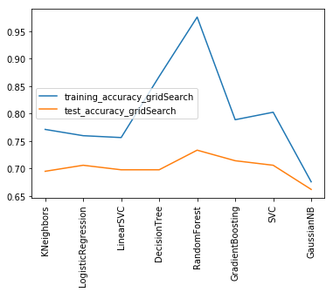
PREDICTING NPS
GRADIENT BOOSTING CLASSIFIER (TRAINING ACCURACY 0.7889, TESTING ACCURACY 0.7142)
HYPERAMETERS (learning rate: 0.1, max_depth: 3, min_samples_split: 4, n_estimators: 70, scaler: None)
SVC (TRAINING ACCURACY 0.8025, TESTING ACCURACY 0.70604)
HYPERPARAMETERS (C:1, gamma:0.01, kernel:rbf, scaler: StandardScaler)

Slide 9
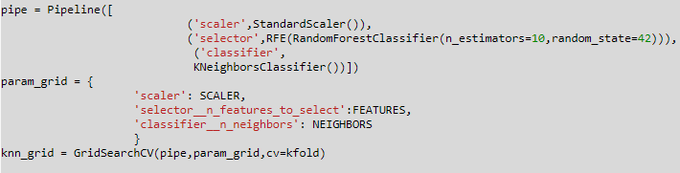
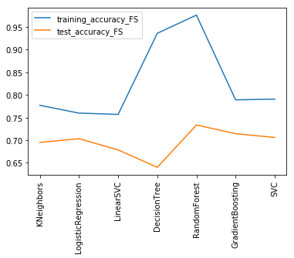
PREDICTING NPS
GRADIENT BOOSTING CLASSIFIER
SVC

Slide 10
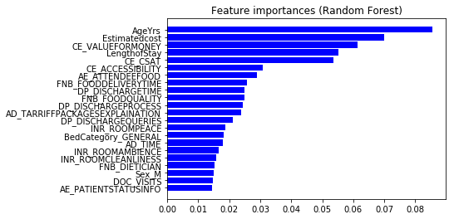
MANAGERIAL IMPLICATION

Slide 11
RECOMMENDATIONS
DATA QUALITY NEEDS TO BE IMPROVED
PARENTS BRINGING THEIR KIDS TO HOSPITALS SHOULD BE HANDLED CAREFULLY – (GRAPHS PERTAINING TO AGE & PEDIATRIC DEPARTMENT)
ESTIMATED COST – PATIENTS WITH INCREASING ESTIMATED COSTS SHOULD BE HANDLED MORE CAREFULLY
ADMISSION STAFF ATTITUDE – EVEN IF PERFORMING EXCELLENT ON OTHER AREAS OF ADMISSION PROCESS!
PATIENTS STATUS INFORMATION – EVEN IF PERFORMING GREAT ON AREAS OF ATTENDEE CARE!
IMPROVEMENT AREAS – GYNAE, PEDIATRIC, GENERAL

