Slide 1
Preterm Prelabor Rupture of Membranes
Hamdy Bakry Alqenawy, MD
Clinical Lecturer in Obstetrics & Gynecology Ain Shams University Faculty of Medicine

Slide 2
Outline
Introduction
Definition
Incidence
Risk factors
Clinical evaluation
Management
Complications
SEPSIS

Slide 3
Definitions
ROM: spontaneous rupture of the fetal membranes (amnion and chorion) after the onset of labor in a term pregnancy (≥ 37 wk)
Latency period: the time from PROM (or P-PROM) to onset of labor.
 | GA | Labor status
ROM | term (≥ 37 wk) | after onset of labor
Prelabor ROM = PROM | term (≥ 37 wk) | before onset of labor
Preterm PROM = PPROM | preterm (≥ 24 – < 37 wk) | before onset of labor
Previable ROM | < 24 wk

Slide 4
Definitions
Inevitable miscarriage |  |  |  |  |  |  |  |  |  |  | Previable ROM |  |  |  |  |  |  |  |  |  |  |  |  |  |  |  | Preterm PROM |  |  |  |  |  |  |  |  | Term PROM
1 | 2 | 3 | 4 | 5 | 6 | 7 | 8 | 9 | 10 | 11 | 12 | 13 | 14 | 15 | 16 | 17 | 18 | 19 | 20 | 21 | 22 | 23 | 24 | 25 | 26 | 27 | 28 | 29 | 30 | 31 | 32 | 33 | 34 | 35 | 36 | 37 | 38 | 39 | 40 | 41 | 42
Early miscarriage |  |  |  |  |  |  |  |  |  |  | Late miscarriage |  |  |  |  |  |  |  |  |  |  |  | Extremely PT |  |  |  | Very PT |  |  |  | Moderate PT |  | Late PT |  |  | Early term |  | Full term |  | Late term | Post term

Slide 5
Is it common? Is it important? Incidence & Significance
Term PROM (37 wk or more, before onset of labor)
8% of term pregnancies
Preterm PROM (before 37 wk, before onset of labor)
30% of preterm births →
PPROM < 26 weeks
50% → labor within 1 week
PPROM between 28–34 weeks
50% → labor within 24 hours
80–90% → labor within 1 week

Slide 6
Risk factors
Previous PPROM (3x)
Genital tract infection (particularly bacterial vaginosis)
Antepartum bleeding in more than one trimester (3–7 x)
Cigarette smoking (2–4 x)
Cervical incompetence
Increased intra-amniotic pressure (multifetal pregnancy, polyhydramnios)
Iatrogenic (amniocentesis, cerclage, ECV)
Idiopathic

Slide 7
Clinical evaluation
For a provisional diagnosis, we should collect data to:
Obtain relevant history and identify the risk factors
Confirm the diagnosis
Rule out complications

Slide 8
Complications
Chorioamnionitis = intra-amniotic infection/inflammation
Preterm labor
Placental abruption: Possibly due to the progressive decrease in intrauterine surface area and sudden decrease in intramniotic pressure especially in cases of polyhydramnios.
Of oligohydramnios: pulmonary hypoplasia, contractures
VTE: due to prolonged bed rest (?)
Fetal/neonatal distress, due to:
Cord compression, prolapse, cord vessels spasm, or infection.
Fetal compromise secondary to maternal fever and chorioamnionitis.

Slide 9
Clinical evaluation
History
Gush of watery vaginal fluid followed by recurrent dampness
History of risk factors
Symptoms of complications: fever, contractions, pain
Examination (check for signs of complications)
General: pulse and temperature (chorioamnionitis)
Abdominal: FL < GA
FL > GA (abruption)
tenderness (chorioamnionitis)
contractions (PTL)
FHR (fetal tachycardia .. earliest sign of chorioamnionitis)
Vaginal: ?
DDx
Leucorrhea (excessive normal vaginal discharge) of pregnancy
Cervicovaginal infection
Urinary incontinence

Slide 10
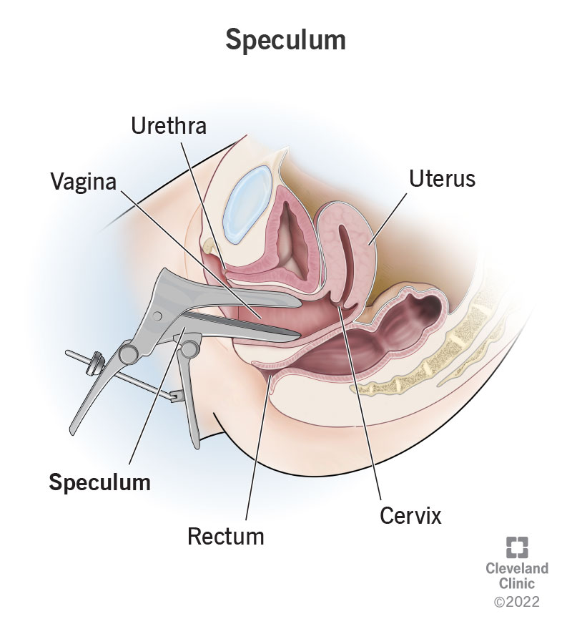
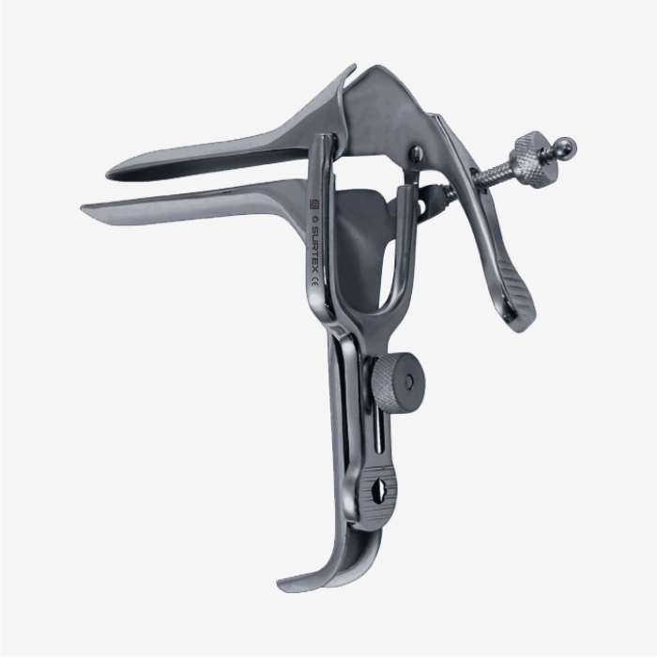
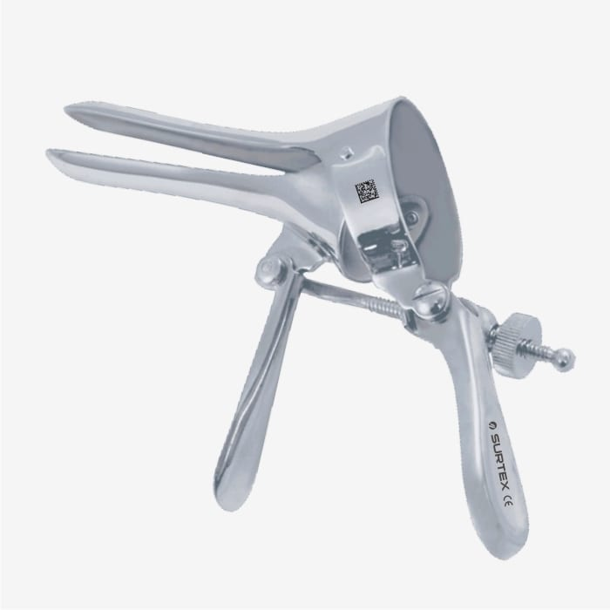
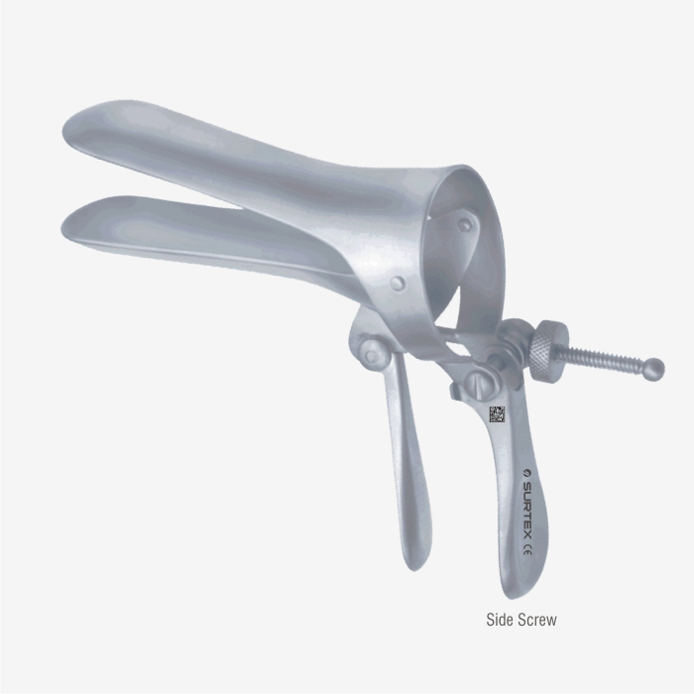
Next? “Confirm” the diagnosis
SSE: sterile speculum examination
To confirm membrane rupture
pooling of amniotic ﬂuid in the posterior fornix
passage of amniotic ﬂuid from the cervical canal (with Valsalva)
POCT … ?
To rule out cervical changes
To rule out cord prolapse

Slide 11
Investigations
Point-of-care testing (POCT)
Nitrazine test
Ferning
PAMG-1 (AmniSure)
IGFBP-1/AFP (AmnioQuick/ …Duo+)
fFN
US
Assessment of AF
Assessment of fetal growth
Labs: CBC for leukocytosis, CRP ?
… and follow-up

Slide 12

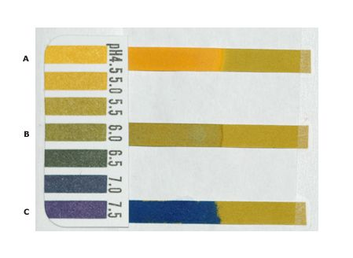
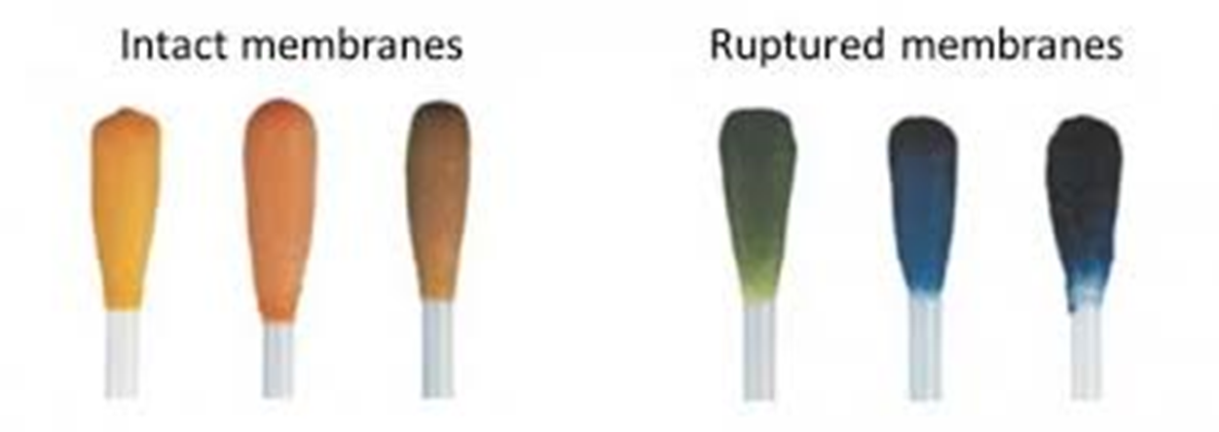
Nitrazine test
Ferning
Normally vaginal pH is 4.5–5.0, while pH of AF is nearly 7.0
Nitrazine turns deep blue at a pH >6.
Microscopic examination of the vaginal fluid for characteristic ferning of dried AF

Slide 13

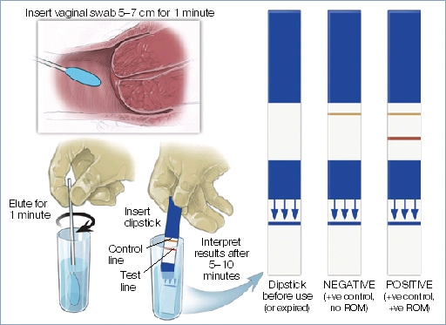
AmniSure .. PAMG-1
Placental alpha microglobulin-1
AmnioQuick Duo+ .. IGFBP-1/AFP
Insulin-like growth factor binding protein-1
Alpha-fetoprotein

Slide 14
Amnio-dye test
Pad test
The gold-standard
Injecting indigo carmine transabdominally under US guidance
Dye detected vaginally
Never done ☺; risk of infection
If diagnostic uncertainty remains following presentation, clinical assessment and point-of-care testing, .. Repeated dry pads argue against the diagnosis.

Slide 15
AVOID
Digital vaginal examination (unless delivery is imminent)
increases the risk of infection
decreases the latency period

Slide 16
Management outline for (P)PROM
Termination of pregnancy |  |  |  |  |  |  |  |  |  |  |  | TOP or Expectant |  |  |  | Expectant |  |  |  |  |  | Expectant or Deliver |  |  | Deliver
Previable ROM |  |  |  |  |  |  |  |  |  |  |  |  |  |  |  | P-PROM |  |  |  |  |  |  |  |  | PROM
12 | 13 | 14 | 15 | 16 | 17 | 18 | 19 | 20 | 21 | 22 | 23 | 24 | 25 | 26 | 27 | 28 | 29 | 30 | 31 | 32 | 33 | 34 | 35 | 36 | 37 | 38 | 39 | 40 | 41 | 42
Late miscarriage |  |  |  |  |  |  |  |  |  |  |  | Extremely PT |  |  |  | Very PT |  |  |  | Moderate PT |  | Late PT |  |  | Early term |  | Full term |  | Late term | Post term
The goals are to screen for underlying chorioamnionitis or placental abruption, and deliver if complications are identified.
Otherwise, prolonging the latency period is desired, depending on gestational age.

Slide 17
Management algorithm
Initial management
• Admit to L&D • Confirm the diagnosis • Exclude other diagnoses • Confirm GA • Monitor uterine activity
Any YES
All NO
Immediate delivery
Continue expectant management
• ACS (consider if <35 wk) • ABx • MgSO4 (consider <34 wk if est. PTL) • Fetal surveillance
< 24 wk
24 – 33⁺⁶ wk
Offer TOP ? or expectant management
Check for contraindications to expectant management
• GA ≥ 34 wk • Intraamniotic infection • Non-reassuring fetal testing • Established PTL • Excessive bleeding

Slide 18
PPROM: Management algorithm
Initial management
• Admit to L&D • Confirm the diagnosis • Exclude other DDx • Confirm GA • Monitor uterine activity
Any YES
All NO
Recommend delivery
Continue expectant management
• ABx • ACS • MgSO4 (<30/<34 wk if est. PTL) • Fetal surveillance
< 24 wk
24 – 33⁺⁶ wk
Offer TOP ? or expectant management
Check for contraindications to expectant management
• GA ≥ 37 wk • Intraamniotic infection • Non-reassuring fetal testing • Established PTL • Excessive bleeding
≥34 wk
Consider delivery (individualized)
• ACS if <35 wk

Slide 19
Management
Admission
Clinical evaluation (to rule out complications that preclude conservation)
Latency antibiotics:
ACS (dexamethasone, betamethasone)
Neuroprotection (MgSO₄ <30/<34 weeks)
10-day regimen (RCOG) | 7-day regimen (ACOG)
Erythromycin 250 mg PO/6h for 10 days | Azithromycin 1 g PO at the time of admission PLUS Ampicillin 2g IV/6h for 48 hours, followed by Amoxicillin 500 mg PO/8h for an additional 5 days
Notes:
ORACLE I
Clavulanate and NEC
ORACLE II ?

Slide 20
Management
Tocolysis?
Generally contraindicated in PPROM except for extreme prematurity to allow ACS administration.
Contraindicated if chorioamnionits is suspected.

Slide 21
Chorioamnionitis (CA) / Intra-amniotic infection
Usually due to ascending polymicrobial infection:
Ureaplasma, Mycoplasma, Bacteroides, Gardnerella vaginalis, group B streptococci, E. coli
Listeria is one of the organisms that cause CA via bacteremia
Risk factors similar to PPROM
Beware of:
Sepsis (maternal/neonatal)
Atonic PPH

Slide 22
Diagnosis of CA
Gold standard: amniocentesis and culture ❌
Clinical diagnosis:✅
Maternal fever: ≥38 °C
Plus 2 or more of:
Maternal tachycardia (> 100 bpm)
Fetal tachycardia (> 160 bpm)
Uterine tenderness
Foul odor of the amniotic fluid
Maternal leukocytosis (> 15,000 /mm³)

Slide 23
Management of CA
Control general condition
Expedite Delivery (regardless of GA)
ABx
Ampicillin (2 g IV /6h) + Gentamicin (1.5 mg/kg IV/ 8h).
+ Clindamycin (900 mg IV) to reduce anaerobic infections in patients undergoing CS.
Antipyretics to reduce intrapartum fever (and reduce fetal tachycardia)
Induction/augmentation vs CS
Guard against sepsis
Guard against PPH
Anti-D
Neonatal care and ABx

Slide 24
In a nut-shell
A history of a gush of fluid or a trickle causing a woman to be constantly wet may suggest the diagnosis
Physical examination should include abdominal and sterile speculum examination. PROM is a clinical diagnosis.
Digital vaginal examinations should be avoided (because they promote ascending intra-amniotic infection)
Diminished amniotic fluid volume (by ultrasound) will further suggest the diagnosis

Slide 25
SEPSIS

Slide 26
Classic definitions:
SIRS
Sepsis
Severe Sepsis
Septic shock
SIRS: at least 2 of 4 findings:
T° >38°C or <36°C
HR >90 bpm
RR >20 bpm or hyperventilation with Pa_{co2} <32 mmHg
WBC >12,000 /mm³ or <4,000 /mm³
Sepsis: SIRS due to infection (presumed or confirmed)
Severe Sepsis: sepsis associated with acute organ dysfunction
Septic shock: hypotension despite fluid resuscitation

Slide 27
Classic definitions: Organ dysfunction
SBP <90 mmHg or MAP <65 mmHg or lactate >2.0 mmol/L (18 mg/dL) (after initial fluid challenge)
INR >1.5 or aPTT >60 s
Bilirubin >2 mg/dL
Urine output <0.5 mL/kg/h for 2 h
Creatinine >2.3 mg/dL
Platelets <100,000 /mm³
Sa_{o2} <90% (RA)

Slide 28
New sepsis definition
Life-threatening organ dysfunction caused by a dysregulated host response to infection [suspected or confirmed].
Organ dysfunction is defined as an acute change in Sequential [Sepsis-related] Organ Failure Assessment (SOFA) score ≥ 2 points consequent to infection, reflecting an overall mortality rate of approximately 10%.
SOFA score grades (on a scale of 0 to 4) the function of 6 organ systems using objective measurements:
1. Respiration 2. Coagulation 3. Liver
4. CVS 5. CNS 6. Renal
The baseline SOFA score is assumed to be 0 in patients not known to have preexisting organ dysfunction.

Slide 29
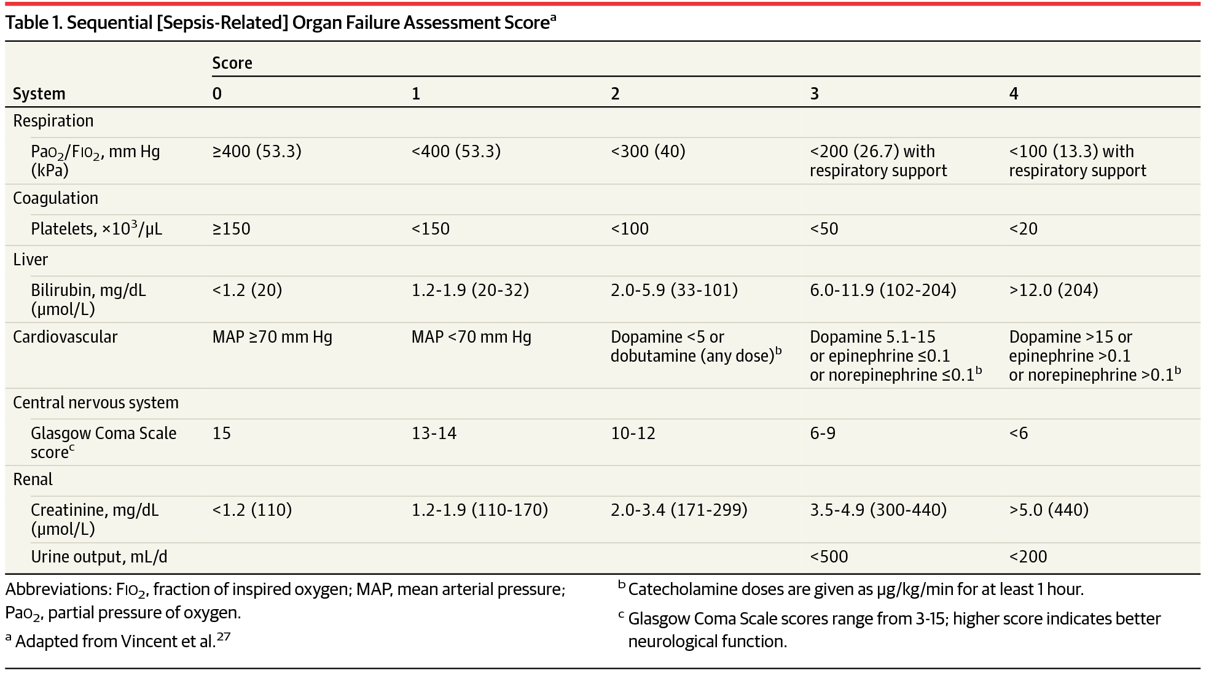

Slide 30
Sepsis care bundle
Measure lactate
and other labs to evaluate for organ dysfunction
Cultures
Measure urine output
Keep Sa_{o2} ≥ 95%
IV Antibiotics
Fluid resus
30 mL/kg crystalloid for hypotension or lactate ≥4mmol/L (36 mg/dL)
Vasopressors
if MAP <65 mmHg despite IV fluids

Slide 31
Thank You

