Slide 1
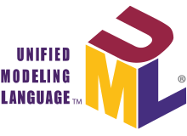
Unified Modeling Language
a graphical language for visualizing, specifying, constructing, and documenting
the artifacts of a software-intensive system

Slide 2
Introduction
UML is a graphical language for visualizing, specifying, constructing, and documenting the artifacts of a software-intensive system as well as for business modeling and other non-software systems.
UML is a standardized general-purpose modeling language in the field of object-oriented software engineering.
In 1997, UML was adopted as a standard by the Object Management Group (OMG), and has been managed by this organization ever since.
Using the UML helps project teams communicate, explore potential designs, and validate the architectural design of the software.
Notes:
https://www.visual-paradigm.com/guide/uml-unified-modeling-language/what-is-uml/

Slide 3
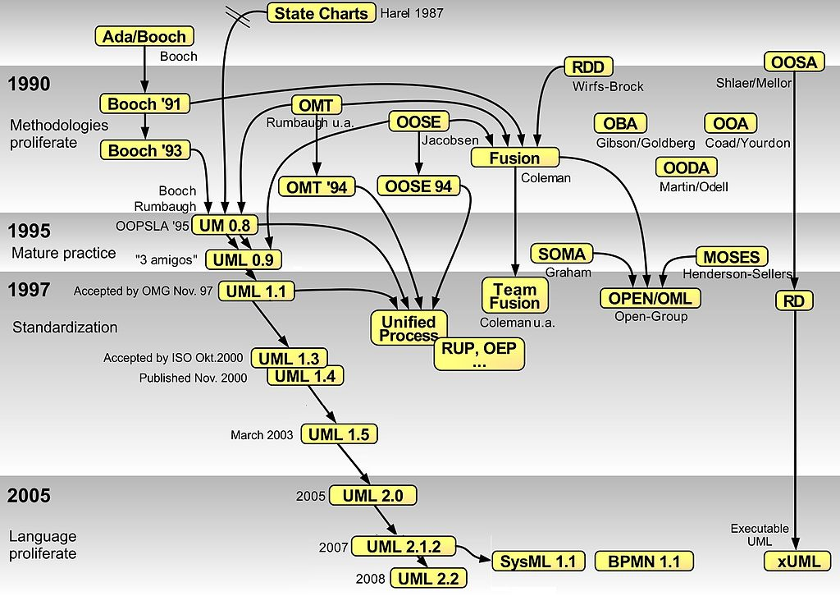
Long Story of UML
Notes:
The Object Management Group (OMG) is a computer industry standards consortium.
UML is a notation that resulted from the unification of OMT from
Object Modeling Technique OMT [James Rumbaugh 1991] - was best for analysis and data-intensive information systems.
Booch [Grady Booch 1994] - was excellent for design and implementation. Grady Booch had worked extensively with the Ada language, and had been a major player in the development of Object Oriented techniques for the language. Although the Booch method was strong, the notation was less well received (lots of cloud shapes dominated his models - not very tidy)
OOSE (Object-Oriented Software Engineering [Ivar Jacobson 1992]) - featured a model known as Use Cases. Use Cases are a powerful technique for understanding the behaviour of an entire system (an area where OO has traditionally been weak).
In 1994, Jim Rumbaugh, the creator of OMT, stunned the software world when he left General Electric and joined Grady Booch at Rational Corp. The aim of the partnership was to merge their ideas into a single, unified method (the working title for the method was indeed the "Unified Method").
By 1995, the creator of OOSE, Ivar Jacobson, had also joined Rational, and his ideas (particularly the concept of "Use Cases") were fed into the new Unified Method - now called the Unified Modelling Language1. The team of Rumbaugh, Booch and Jacobson are affectionately known as the "Three Amigos"
UML has also been influenced by other object-oriented notations:
Mellor and Shlaer [1998]
Coad and Yourdon [1995]
Wirfs-Brock [1990]
Martin and Odell [1992]
UML also includes new concepts that were not present in other major methods at the time, such as extension mechanisms and a constraint language.
Ivar Jacobson was born in Ystad, Sweden on September 2, 1939. He received his Master of Electrical Engineering degree
In 1967 at Ericsson, Jacobson proposed the use of software components in the new generation of software controlled telephone switches Ericsson was developing. In doing this he invented sequence diagrams, and developed collaboration diagrams. He also used state transition diagrams to describe the message flows between components.^{[citation needed]}
Jacobson saw a need for blueprints for software development. He was one of the original developers of the Specification and Design Language (SDL)^{[4]}. In 1976, SDL became a standard in the telecoms industry^{[5]}.
At Objectory he also invented use cases as a way to specify functional software requirements.The ITU-T has defined SDL in Recommendations Z.100 to Z.106. SDL originally focused on telecommunication systems;

Slide 4
Need for Modelling
Achieve a common understanding of the system
Better communication with non programmers about requirements, functionalities and processes of the system.
Better quality
Well-defined architecture could support more reliability ,scalability and extendibility and all needs of users are meet.
Reduce complexity
Clear and simplified representative of system helps to build good imagination and well-defined applications. Improve maintainability.
Reduce time-to-market
Better team members collaboration. More predictable schedules.
Reduce cost
Endless architectural problems will be solved at design phase and high cost of modification at later phases will be eliminated.
Reduce failure risk
Identifying failure scenario at early development phase and eliminating them by making relevant changes.
Testing the architecture of the system before coding begins.
Notes:
Risk is defined as a combination of two factors: probability of malfunctioning (failure) and the consequence of malfunctioning (severity).
Risk assessment should therefore be performed during the early stages of software development in order to avoid the high costs of 1 modifying software at the later stages
Risks that are assessed closer to the release of software are mostly infeasible to prevent, since making changes to software architecture, design or code at that stage is very expensive.
Furthermore, the use of UML will help:
The communication of the desired structure and behaviour of a system between analysts, architects, developers, stakeholders and users.
The visualisation and control of system architecture.
Promote a deeper understanding of the system, exposing opportunities for simplification and re-use.
Manage risk.

Slide 5
Why UML?
It is standard notation and conventional.
expressive visual modeling language so users can develop and exchange meaningful models.
Be independent of particular programming languages and development processes.
Provide a formal basis for understanding the modeling language.
Support higher-level development concepts such as collaborations, frameworks, patterns and components.
Integrate best practices(Design patterns).
UML is flexible ,it Provides extensibility and specialization mechanisms to extend the core concepts.(stereotypes)
Notes:
UML is flexible
Stereotypes and profiles can let you tailor UML to your needs. In other words, you can have modeling elements and relations that are specialized for your domain or for the technologies you’re using.
Conventional -> Tool support
UML tools from FOSS to multi-thousand $ price abound in the market, including plug-ins to most popular IDEs. Besides drawing diagrams, some of these tools can generate code, apply design patterns, mine requirements, reverse engineer code, and perform impact analysis, refactorings, and complexity analysis.

Slide 6
UML tools
Rational software Architecture (IBM)
PlantUML
StartUML
Umbrello
Visual paradigm
Umlet
Enterprise Architecture
…
Commercial
Support all platforms
Open source, free
Support all platforms
Commercial
Support all platforms
Open source, free
Support all platforms
Commercial
Support all platforms
Open source, free
Windows
Commercial
Windows

Slide 7
Uml alternatives
Comes from manufacturing and target
all engineering project
IDEF(Integrated DEFinition method)
Fund from US Airforce on 1980 until now.
No tool supports it
general-purpose modeling language
SysML(System Modelling Language)
It is a extension to UML
It supports systems engineering activities.
Some UML diagrams removed, some diagrams added
The biggest alternative to UML is to not do modelling at all.
So UML hasn’t any formal alternatives.
Notes:
In many situations, people don’t think they need UML diagrams to communicate their designs. They get by with informal, box-and-line diagrams, which are easy to create in PowerPoint, in Visio, or on a whiteboard.
However, even the best architecture, created based on years of experience and carefully selected design patterns, may be useless if not properly communicated to the people who need to use it.

Slide 8


UML and Agility
Common Myths Surrounding Agile Architecture
1. Agilists don’t “do architecture”
2. Agilists start coding right away
3. Agilists don’t follow enterprise architecture strategies
4. Agilists don’t model
5. Agilists don’t document
“We do not use UML because we are agile.”
Notes:
https://www.geeksforgeeks.org/software-engineering-comparison-between-agile-model-and-other-models/

Slide 9
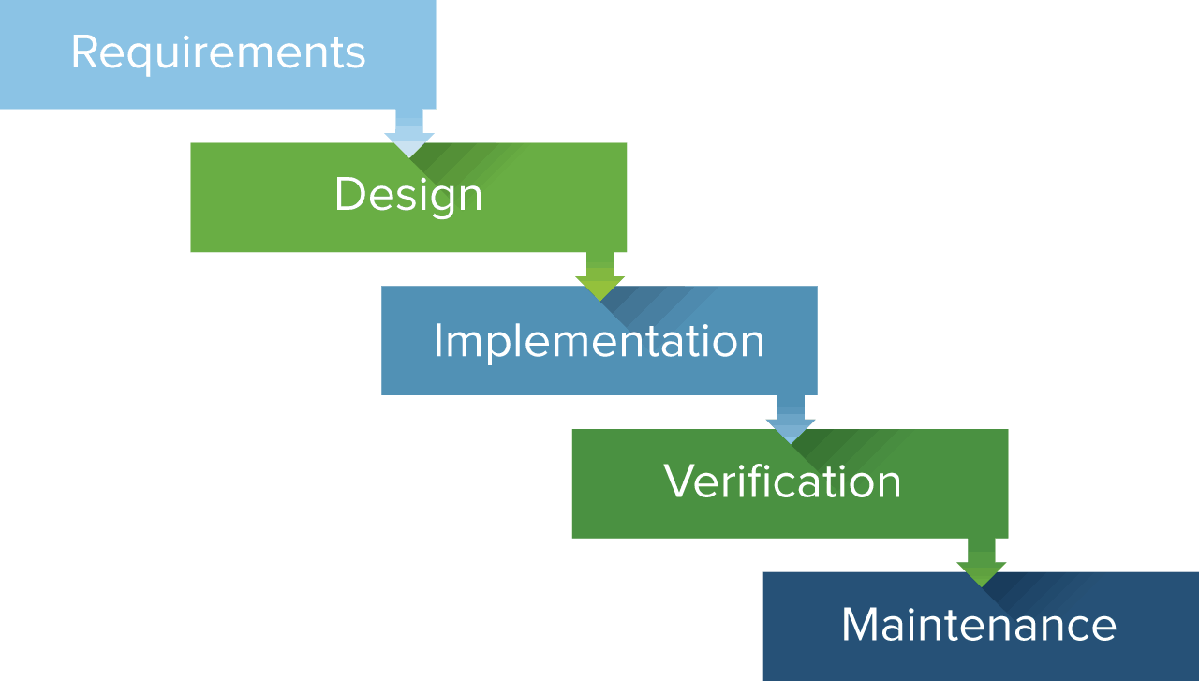
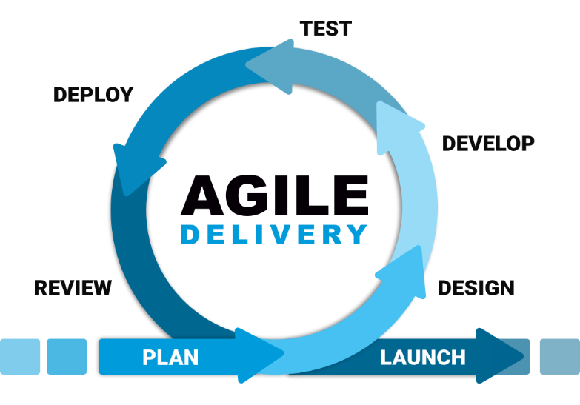
Architecture Development
Emergent Design Minimal, Continues Design
JEDI Just Enough Design Initially
JIT Just In Time
Adaptation Anticipation
BDUF
Big Design UpFront
Waterfall, RUP, Spiral are BDUP
gathering, recording, analyzing requirements
moves the concentration from problem domain
to solution domain- output : software Architecture
the development, and integration
of software – output : software
Testing and debugging the
defects
modification of a software product
after delivery to correct faults
Notes:
Emergent design : Design, rather than occurring all up front, occurs continuously during development. The cumulative effect of these small changes can radically
improve the design. You learn from building the system how to improve the design
Waterfall, RUP, Spiral are BDUP.
Requirement phase:
Conceptually, requirements analysis includes three types of activities:^{[citation needed]}
Eliciting requirements: (e.g. the project charter or definition), business process documentation, and stakeholder interviews. This is sometimes also called requirements gathering or requirements discovery.
Recording requirements: Requirements may be documented in various forms, usually including a summary list and may include natural-language documents, use cases, user stories, process specifications and a variety of models including data models.
Analyzing requirements: determining whether the stated requirements are clear, complete, unduplicated, concise, valid, consistent and unambiguous, and resolving any apparent conflicts. Analyzing can also include sizing requirements.
Software design is the first step in SDLC (Software Design Life Cycle), which moves the concentration from problem domain to solution domain. It tries to specify how to fulfill the requirements mentioned in SRS(Software Requirement Specification)
https://www.ukessays.com/essays/management/rapid-application-development-vs-agile-methodologies.php#:~:text=In%20conclusion%2C%20although%20RAD%20and,which%20are%20then%20delivered%20in

Slide 10
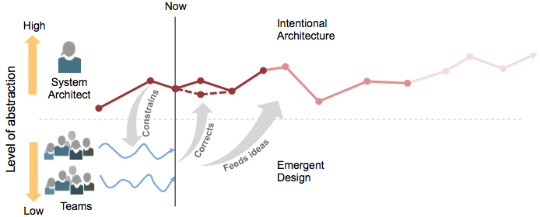
Agile architecture
Enables incremental value delivery by balancing between emergent design & intentional architecture:
Emergent Design – the design “emerges” continuously during development through the use of Refactoring, TDD, Continuous Integration, Incremental Design, etc.
Intentional architecture – A set of purposeful, planned architectural initiatives, which enhance solution design, performance & usability

Slide 11
Why agile is opposed to BDUP?
Software development is not comparable to civil Eng. Its more malleable.
Stakeholders like heavy models because they are looking for accurate estimation of project, but they are unable to tell us what they actually want. Inaccurate information.
Stakeholders mistakenly think you could fully specify system before construction, even if you succeed, you've wasted a lot of time, because:
Requirement change
People's understanding of the requirements change
Early requirement brainstorm
Ignore requirement because project run out of resource
Limit programmers to learn a wider range of skills
BDUP increases the chance of poor decisions.
BDUP Reduces your willingness to embrace evolving requirement
BDUP removes all of the joy out of development for coders
Inducing a low-value sense to programmers, If you treat programmers like "coding monkeys“
Are overly specialized, When you have modeling specialists on the project they'll do a lot of modeling, and likely write a lot of documentation, because that's what they're good at. The end result is that you'll get far more documentation than you actually need
Notes:
"Big modeling up front" (BMUF) is a popular approach because people:
Mistakenly compare software development to civil engineering. A common analogy is to compare software models to architectural diagrams for a bridge or building. Unfortunately the analogy isn't an accurate one: software is more malleable than concrete making it easier and much less expensive to change your mind part way through the effort; The material (app servers, operating systems, …) used to build software isn't as well understood as the material to build bridges (steel, concrete, …) making it much more difficult to accurately plan up front; Incremental delivery often doesn't make much sense when you're building a bridge, so what if the foundation has been set but the rest of the bridge isn't in place, although incremental delivery of software is clearly possible and as I argue above the norm. Much better analogies are comparing software developers with chefs or comparing software development with putting on a play (as described in the wonderful book Artful Making).
Get motivated to do so by the business. Your business stakeholders often demand "accurate" estimates and schedules to be developed early in the lifecycle so that they can determine whether they want to fund the project. This motivates IT people to model in detail up front to support the creation of those detailed project plans, plans which often prove to be wildly inaccurate in practice. This inaccuracy is the result of our stakeholders being unable to tell us what they actually want, this is human nature, so as a result the quality of our estimates are only as good as the quality of the information the they're based upon. We need to educate the business on the inherent challenges associated with fixed price projects and provide them with better strategies for funding agile projects.
Think comprehensive requirements documentation means something. There is a common misconception among project stakeholders that you can fully specify a system before constructing it. Yes, you can in fact do so, but as you see in Examining the "Big Requirements Up Front (BRUF)" Approach this leads to incredible amounts of wastage even if you end up "successfully" delivering software. In other instances, development teams often misunderstand, or outright ignore, parts or all of the requirements specification anyway.
Don't know any better. Many organizations have spent the last thirty years putting a well-defined, non-agile, and very serial process in place that encourages BMUF. The U.S. Federal Government is a classic example of such an organization, often requiring extensive requirements documents to be created before allowing any other form of development to occur. Yet, as this site shows, you do in fact have other options.
Are overly specialized. When you staff your project with specialists, they'll perform their specialist tasks very well whether it's appropriate or not. When you have modeling specialists on the project they'll do a lot of modeling, and likely write a lot of documentation, because that's what they're good at. The end result is that you'll get far more documentation than you actually need -- you pay for it, you get it. What you really want are generalizing specialists who have the skills and abilities to do just enough modeling, coding, and so on.
Believe programmers don't have the skills to model themselves. This is a self-fulfilling prophecy. If you hire overly specialized people, then set up an environment where one group of specialists hands off work products (e.g models) to other groups of specialists, then you pretty much guarantee that they won't learn a wider range of skills.
They got sidetracked by traditional data professionals. Unfortunately many within the data community believe that you require a serial approach to design, particularly when it comes to databases. This belief is the result of either not understanding evolutionary development or some misguided need to identify the "one truth above all else". Evolutionary database design techniques such as agile data modeling, database refactoring, and database regression testing work incredibly well in practice.
Impact
There are several significant problems with a BMUF approach:
It reduces your willingness to embrace evolving requirements. The more that you invest in detailed models early in a project, the more decisions that you will make based on those details, and the harder it will be to update your work if change does occur. This quickly demotivates you to embrace change. But, the reality is that change happens. Yes, it is clearly possible to create comprehensive requirements documents before allowing construction to begin, and you can clearly build a system that fulfills those requirements, but is it what you really want? As I discuss in Agile Requirements Modeling project stakeholders' understanding of the system and their environment changes, their priorities change, the environment in which they do business changes, all motivating changes to requirements. A BMUF approach may ensure that you get the system that you ask for but it virtually guarantees that you won't get what you actually need. The interesting thing is that the 2008 Project Success Survey found that when given the choice business stakeholders overwhelmingly prefer solutions which meet their actual needs, not solutions built to spec.
It increases the chance of poor decisions. This isn't intuitive at first, but the reality is that at the beginning of a project is when you are most ignorant about the situation that you face. Yes, gathering more information can help a bit, but what usually happens is that you start going down an inappropriate path and simply gather more information which backs up your poor choice. We know that people aren't very good at defining up front what they want, but that they are reasonably good at providing feedback and homing in on a solution via an evolutionary approach. The implication is that although creating detailed models early in a project provides a "scientific facade", all it really does is motivate you to make and then commit to decisions based on what we know to be poor quality information. As lean software development tells us, we are much better advised to defer committing to decisions until the point where we actually need to make them as that puts us in a position where we'll have the best possible information upon which to base that decision.
It increases the chance your vision will be ignored. By doing too much modeling up front, then handing it off to the coders, you pretty much remove all of the joy out of development for them. Is it any wonder that developers often choose to ignore the models they're provided, or to "improve upon" the ideas contained in them?
It decreases morale. If you treat programmers like "coding monkeys" who can't be trusted to make important technical decisions, you're effectively telling them that they are low-skilled and unimportant. The end result is that your good developers will leave your organization, and that a significant percentage of your remaining developers will in fact be the low-skilled people that you're apparently striving to attract. Doesn't sound like a great strategy to me.
http://agilemodeling.com/essays/bmuf.htm

Slide 12
UML and Agility
BDUF(Big Design UpFront) : design should be completed and perfected before implementation(like waterfall)
UML is suited for BDUF and is ill-suited for incremental approaches.
But still UML is useful for Agile teams :
UML is just standardized way to visually represent complex concepts. it provides a common understanding to facilitate the exchange of ideas.
Each iteration in agile process model include design phase, UML helps to modeling in those phases. Of course, it should be noted that teams modelling only what they need currently.
Efficient communication particularly with other teams and stockholders.
Standard notation for sprints backlog or user stories in order to everyone could quickly understand.
Sprint planning goes faster since UML allows the diagrams to be interpreted without requiring the author to be there explaining
With all this, agile approaches have a limited usage of UML.
Because of nature of agile approaches
Notes:
همچنان نیاز هست تا ایده هایتان با بقیه اعضای تیم به اشتراک بگزارید تا چکش کاری شود و نیاز به زبان برای انتقال ایده ها و مفاهیم دارید.
تمام مدل هایی که درست میشوند وسیله ای برای رسیدن هدفی خاص میباشند و اصلا هدف مستند سازی ندارند.
در روش های چابک هم وقتی در هر دور به فاز طراحی میرسند از uml برای طراحی استفاده میکنند ولی خوب نه به تفضیل و جزییات زیاد. فقط اهداف همان دور را مدل میکنند.
The following set of UML artefacts are highly recommended to use in Agile methodology:
Class diagrams and Deployment diagrams
UML Sequence diagrams can be useful for the development team. However, they could be considered as optional artefacts.(ref: UML and Agile Methods: Looking for an Agreement)

Slide 13
UML and OOP(Object Oriented Paradigm)
The three founders (Ivar, Grady and James) all came from OOP background and describe UML in the perspective of OOP.
However, UML is not restricted to modelling software(its applicability for modelling business situations).
Moreover, UML is not restricted to model something based on an object oriented. For example some UML diagrams (use case, state diagram, activity diagram) allow to represent software systems avoiding an obvious dependence on OOP features.
But there is no doubt that UML is genetically has a tight relation to OOP. For example Class diagram only belongs to OOP.
So The purpose of UML is OOP, but you can use it for anything you want
Notes:
https://stackoverflow.com/questions/26212374/are-uml-diagrams-only-for-object-oriented-approach
https://stackoverflow.com/questions/3467724/alternatives-to-object-oriented-programming

Slide 14
Why OOP?
Abstraction
Reality modeling. Reduce complexity
Encapsulation
Data hiding,
security
Polymorphism
Single interface,
Many implementation
Inheritance
Re-usability & extendibility.
Top-down approach
Modularity
decomposing a complex problem into a set of modules. re-usability ,scalability
Design patterns
best practices
Notes:
top down approach which can help in managing the classes
modeling is the only way to visualize your design and check it against requirements before your crew starts to code.

Slide 15
Software Design concepts & Consideration
Notes:
https://www.tutorialspoint.com/software_engineering/software_design_basics.htm#:~:text=Software%20design%20is%20a%20process,in%20software%20coding%20and%20implementation.&text=Software%20design%20is%20the%20first,problem%20domain%20to%20solution%20domain.
https://en.wikipedia.org/wiki/Software_design

Slide 16
Stakeholder different viewpoints
Many different role participating in software development process
So
UML support multiple different diagram for each view point with different level of details
System Analyst
requirements elicitation and outlining the system's functionality and delimiting the system
Use Case
Developer
Needs to know Design of system and convert it to low level code.
Class Diagram, Sequence Diagram
Business Analyst
analyzes an organization or business domain (real or hypothetical) and documents its business, processes or systems, assessing the business model or its integration with technology.
Activity Diagram, Data Flow Diagram, State Machine Diagram
Designer
defines the responsibilities, operations, attributes, and relationships of one or several classes, and determines how they will be adjusted to the implementation environment
Class Diagram, Component Diagram, Package Diagram

Slide 17
THree Perspectives to Apply UML
Information Modeling Includes :
Domain Model / Conceptual Model / Solution Independent Model(SIM) / Conceptual Information Model
A domain model will provide visual representation of the conceptual classes within the domain, the basic relationships between the domain classes, and any key attributes of the classes. However, since the domain model is used by all parties involved including the customer any details related to actual design or implementation are left out.
2. Design Model /Specification Model / Platform Independent Model(PIM) / Information Design Model
The design model is going to spell out how everything works together, how things should be connected, and how they actually interact with each other. This may include more classes than the domain model since they are specific to the technical design of the application. The actual responsibilities of the classes should also be determined and laid out in this step. This diagram describe software abstractions or components with specifications and interfaces, but no commitment to a particular implementation (e.g., not C# or Java).
3. Implementation Model / Platform Specific Model(PSM)
the diagrams describe software implementations in a particular technology (such as Java).
different levels of precision
Notes:
Every model may be expressed at different levels of precision
https://stackoverflow.com/questions/21265491/what-is-the-difference-between-a-domain-class-diagram-and-a-design-class-diagram#:~:text=A%20domain%20model%20is%20called,model%20is%20called%20logical%20model.&text=(platform%2Dspecific)%20implementation%20models,from%20an%20information%20design%20model.
https://agile-ideation.com/information-assurance/2012/11/14/domain-model-vs-design-model.html
http://stg-tud.github.io/eise/WS11-EiSE-07-Domain_Modeling.pdf

Slide 18
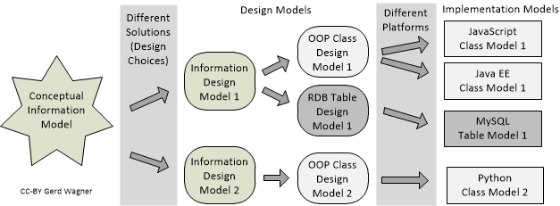
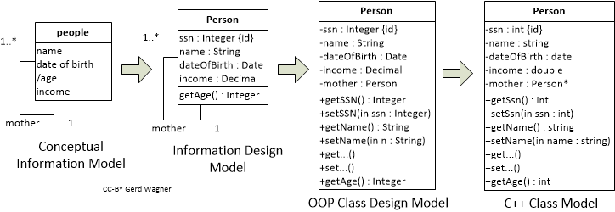
Conceptual to implementation
Analysis Phase
Design Phase
Develop Phase
Notes:
https://stackoverflow.com/questions/21265491/what-is-the-difference-between-a-domain-class-diagram-and-a-design-class-diagram

Slide 19
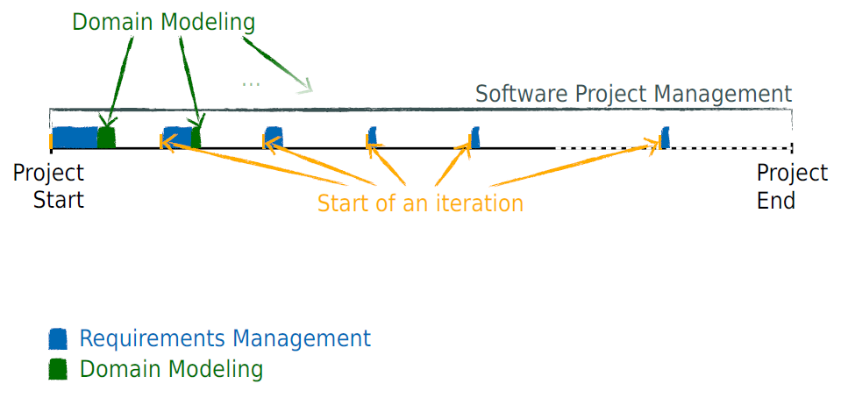
Modeling Workload
Notes:
http://stg-tud.github.io/eise/WS11-EiSE-07-Domain_Modeling.pdf
no operations are defined in domain models only domain objects and conceptual classes, associations between them and attributes of conceptual classes.
Domain model-Conceptual model has different meanings in different context.
But in Object Oriented Analysis context they are same
A domain model in problem solving and software engineering is a conceptual model of all the topics related to a specific problem. It describes the various entities, their attributes, roles, and relationships, plus the constraints that govern the problem domain
https://stackoverflow.com/questions/21265491/what-is-the-difference-between-a-domain-class-diagram-and-a-design-class-diagram#:~:text=A%20domain%20model%20is%20called,model%20is%20called%20logical%20model.&text=(platform%2Dspecific)%20implementation%20models,from%20an%20information%20design%20model.
https://agile-ideation.com/information-assurance/2012/11/14/domain-model-vs-design-model.html
http://stg-tud.github.io/eise/WS11-EiSE-07-Domain_Modeling.pdf

Slide 20
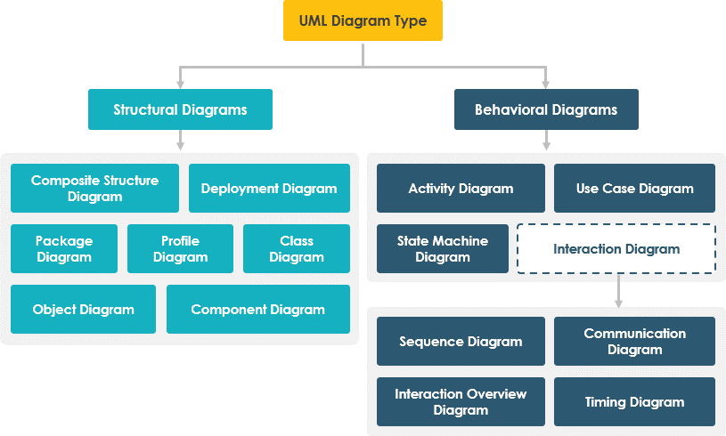
UML Diagrams
Notes:
Structure diagrams show the static structure of the system and its parts on different abstraction and implementation levels and how they are related to each other. The elements in a structure diagram represent the meaningful concepts of a system, and may include abstract, real world and implementation concepts,
Behavior diagrams show the dynamic behavior of the objects in a system, which can be described as a series of changes to the system over time.

Slide 21
Diagrams drawing order
There is no fixed order
It is all based on what you think is most useful to you/your team.
Remember that you do not model your software in UML for its own sake.
You are seeking a special goal for modeling
So you should decide which diagrams in which order could help you better
Use Case utilized as the basis for discussions from which the requirements are then determined.
State Machines are already popular on the requirements level as well.
Class Diagram when lower level of details is needed.
Sequence Diagram when you have complex sequences in your architecture
Communication Diagram you developing a distributed system, or something where components have to communicate a lot with each other
It takes some experience to decide this.
Only for suggest, State Machine, Class, Activity and Sequence diagrams are most popular.
And first Use Case then Sequence and then Class Diagram is a recommended order.
Its better to have a few diagrams that you keep updated
rather than
having lots of diagrams that are least updated
Notes:
https://softwareengineering.stackexchange.com/questions/152301/what-is-the-order-of-diagram-drawing-in-a-design

Slide 22
Use case diagram
Use Case diagram is a behavioral diagram so its purpose is show dynamic behavior of system.
But its specific purpose is identifying, clarifying, and organizing requirement of system including internal and external influences.
Use Case diagram is a list of actions or event steps typically defining the interactions between a role of an actor and a system to achieve a goal.
Well-structured Use Case also describes precondition, postcondition and exception.
Use Case Diagram is useful for presentation system/subsystem to managers and project stakeholder
Because, Use Cases are easy to understand and provide an excellent way for communicating with customers and users as they are written in natural language.
Notes:
What's the Difference Between a Package Diagram and a Component Diagram? Package diagram elements are always public, while component diagram elements are private.
A component diagram, describes the organization and wiring of the physical components in a system. A component is a logical unit block of the system, a slightly higher abstraction than classes. Component diagrams are essentially class diagrams that focus on a system's components that often used to model the static implementation view of a system.

Slide 23
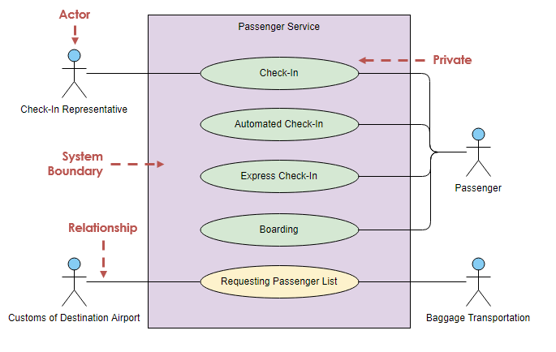
Use case Notation
Actor : human or other external system which involve with system
Use Case : describes how actors uses a system to accomplish a particular goal. Functional requirements of a system.
Association : Relationships between and among the actors and the use cases.
System boundary(optional) : indicates the scope of your system.
Packages (optional) : organize model elements (such as use cases) into groups.

Slide 24
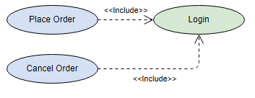

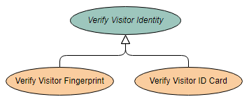
Associations variety
<<Include>> or <<uses>>
Include is useful to extract use cases that are duplicated in multiple UC.
Base UC can not stand alone and is not complete without included UC.
When base UC is executed, the included UC is executed every time.
Included UC execution is mandatory
<<Extend>>
Extend is used when a UC conditionally add some steps to another UC.
Base UC can stand on its own without the extended UC
When base UC is executed, the extended UC is executed sometimes.
Extended UC execution is optional
The base must be meaningful on its own
Extended Extending
Inheritance
Inheritance between use cases is not as common as either the use of extend or include dependencies, but it is still possible.

Slide 25
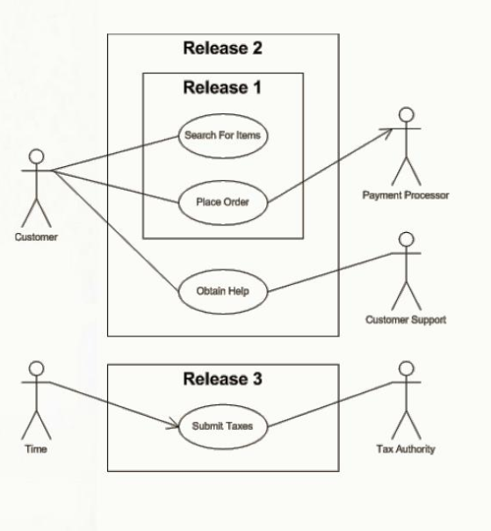
boundary boxes to indicate releases.

Slide 26
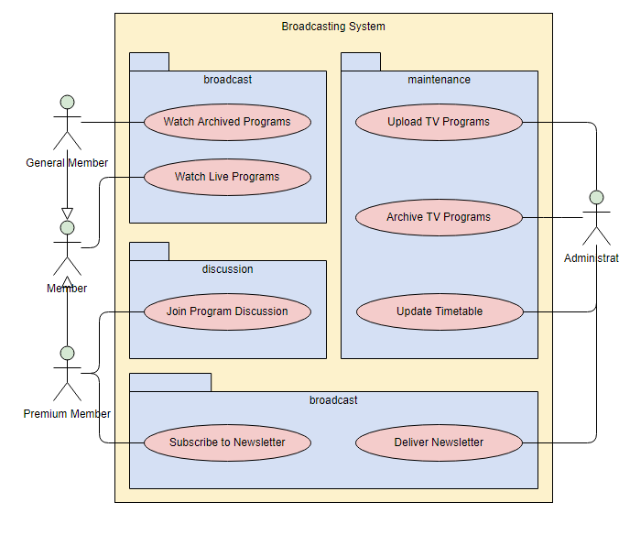
Applying packages to simplify use case diagrams
packages make a logical categorization of use cases into related subsystems.

Slide 27

Use case Example
registrar
applicant
Name: Enroll in University
Identifier: UC 19
Description:
Enroll someone in the university.
Preconditions:
The Registrar is logged into the system.
The Applicant has already undergone initial checks to verify that they are eligible to enroll.
Postconditions:
The Applicant will be enrolled in the university as a student if they are eligible.
Basic Course of Action:
The applicant hands a filled out copy of form UI13 University Application Form to the registrar.
The registrar inputs the name, address, and phone number of the applicant. [Extension Point: UC34 Perform Security Check.]
The system determines that the applicant does not already exist within the system [Alternate Course F: Students Appears to Exist Within The System].
The system determines that the applicant is on the eligible applicants list. [Alternate Course G: Person is Not Eligible to Enroll]
The system adds the applicant to its records. The applicant is now considered to be a student.
The registrar helps the student to enroll in seminars via the use case UC17 Enroll in Seminar.
The use case ends.
student
Enroll in University
<<Include>>
Enroll in seminar
<<Extend>>
Perform security check
Enroll Family Member in University
International
student
Understanding that associations don't represent flows of information is important.
they just indicate an actor is somehow involved with a use case.
Information is flowing back and forth between the actor and the use case.
for example, students would need to indicate which seminars they want to enroll in and the system would need to indicate to the students whether they have been enrolled. However, use case diagrams don't model this sort of information.
Information flow can be modeled using UML activity diagrams.
The association between Student and Enroll in University indicates this use case is initially invoked by a student and not by a registrar.
Notes:
Ah no. This is an association, in the norm, association between actor and use has no direction. Please see image extracted from the norm.
The usage is: if the actor is on the left, it means that's a "primary actor", the actor who activates the use case. If the actor is on the right, it means that the actor is a secondary one: he participates to use case but does not activate it.
The point is if you get a lot of actors, keeping them on the left or the right is not easy. So "I" (but this is my way, not the norm) use directed association, if this is from the actor to the use case, it means that's the actor is a primary one, if this is from the use case to the actor it means this is a secondary one.

Slide 28
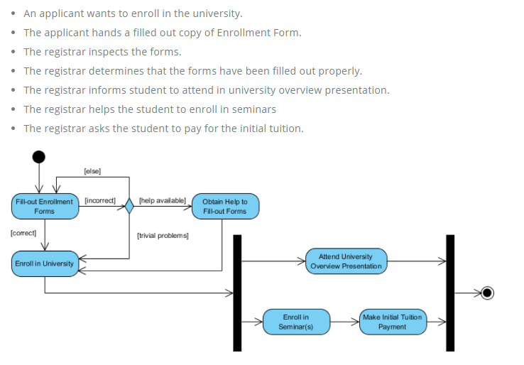
Activity Diagram Example - Student Enrollment
An activity diagram portrays the control flow from a start point to a finish point showing the various decision paths that exist while the activity is being executed

Slide 29
Entity-Control-Boundary pattern
An architectural pattern used in Use Case driven object oriented software design that structures the classes composing a software according to their responsibilities in the use-case realization.
Boundary
encapsulates interaction with external actors(e.g. a user or external service)
Windows, screens and menus are examples of boundaries that interface with users.
Entity
Actor
Boundary
Control
Entity
Control
Objects that mediate between boundaries and entities.
implementing the logic required to manage the various elements and their interactions.
You can use ECB to ensure that your use cases are sufficiently robust to represent the usage requirements for the system you're building
Its other name is robustness diagram
Every use case is represented as a control class
Every different relation between a use-case and an actor is represented as a boundary class
Entity
represents long-lived information
Notes:
http://agilemodeling.com/artifacts/robustnessDiagram.htm#:~:text=A%20robustness%20diagram%20is%20basically,Boundary%20elements.

Slide 30
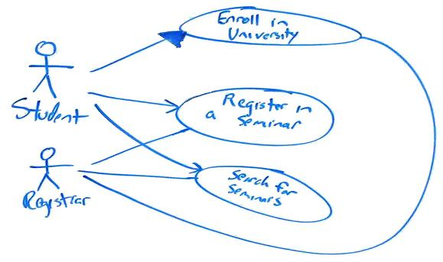
Remaining Agile
First, focus on keeping it as simple as possible so Use simple, flexible tools to model with.
Whiteboard is good option.
Agile modeling tells us that Content is More Important Than Representation so it isn't a big issue that the diagram is hand drawn.
The goal is to record just enough information about the use case so that we understand what it is all about. If we need more details we can always add them later.

Slide 31
Sequence diagram
UML sequence diagrams model the flow of logic within your system in a visual manner, enabling you both to document and validate your logic
commonly used for both analysis and design purposes.
Sequence diagrams are the most popular UML artifact for dynamic modeling
Sequence diagrams, along with class diagrams and physical data models are in my opinion the most important design-level models for modern business application development.
Notes:
https://www.agilemodeling.com/artifacts/sequenceDiagram.htm
Phase 2: Analysis
In the analysis phase, end user business requirements are analyzed and project goals converted into the defined system functions that the organization intends to develop. The three primary activities involved in the analysis phase are as follows:
Gathering business requirement
Creating process diagrams
Performing a detailed analysis
Business requirement gathering is the most crucial part at this level of SDLC. Business requirements are a brief set of business functionalities that the system needs to meet in order to be successful. Technical details such as the types of technology used in the implementation of the system need not be defined in this phase. A sample business requirement might look like “The system must track all the employees by their respective department, region, and the designation”. This requirement is showing no such detail as to how the system is going to implement this requirement, but rather what the system must do with respect to the business.
https://blog.testlodge.com/software-development-life-cycle/#:~:text=In%20the%20analysis%20phase%2C%20end,Gathering%20business%20requirement&text=Performing%20a%20detailed%20analysis

Slide 32
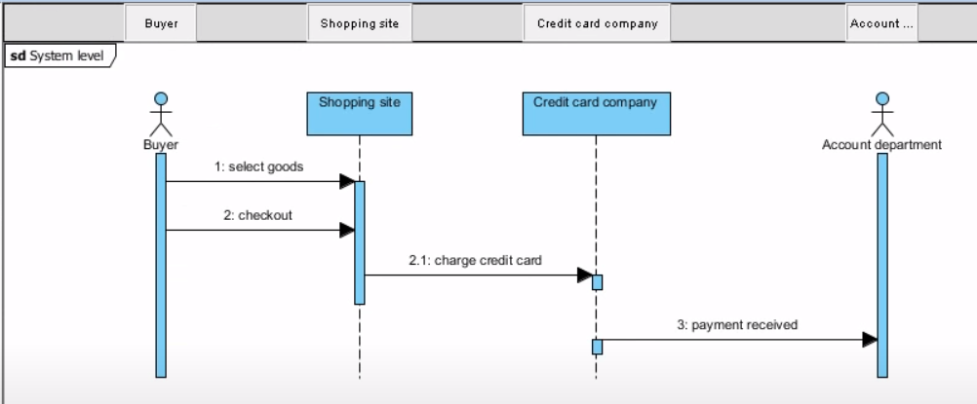
3 different Seq approach
System Level or Usage scenario
Show interaction and ordering of the messages between users and systems, one entire pass through a use cases.
this diagram is tightly coupled with Use Case diagram.
Notes:
https://www.geeksforgeeks.org/difference-between-sequence-diagram-and-activity-diagram/

Slide 33
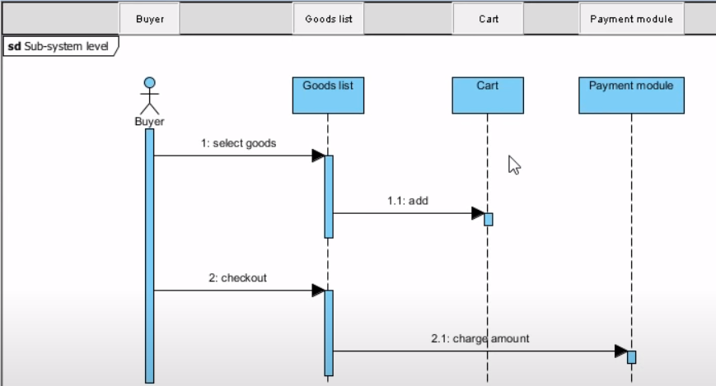
3 different Seq approach
2. Sub-System Level or Service-level
Show interaction and ordering of the messages between services, components and other sub-systems as well as business transactions.
It expose more detail rather than System level Sequence diagram

Slide 34
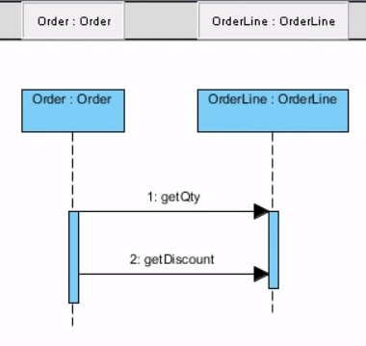
3 different Seq approach
Object Level
Sequence diagrams also can be used to explore the logic of a complex operations and objects interaction.
this diagram is tightly coupled with class diagram and shows classes interactions.

Slide 35


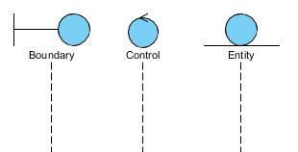

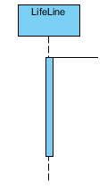
Seq Diagram Notation
Actor
Represent roles played by human users, external hardware, or other systems.
external to the system
Lifeline
Represents an individual participant in the Interaction.
Could be object, component, service and etc.
Lifeline end
Represents the life of Lifelife is ended and its object destroyed.
Activation
Represents the period during which an element is performing an operation
It shows focus of control
A lifeline always portrays an object internal to the system whereas actors are used to depict objects external to the system.

Slide 36
Seq Diagram Notation
Freshman: Student
: Student
An example of the Student class used in a lifeline whose instance name is freshman
An example of the Student class used in a lifeline whose instance name is unknown
Notes:
https://developer.ibm.com/articles/the-sequence-diagram/

Slide 37



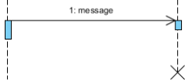
Seq Diagram Notation
Call Message
Represents an invocation of operation of target lifeline.
Return Message
Represents the pass of information back to the caller of a corresponded former message.
Create Message
Represents the instantiation of (target) lifeline.
Destroy Message
Represents the request of destroying the lifecycle of target lifeline.

Slide 38
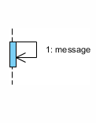
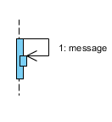
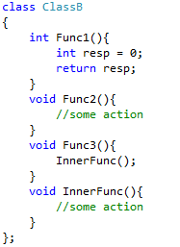
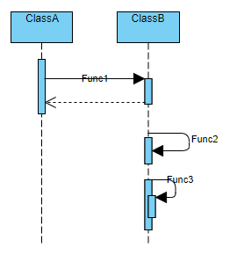
Seq Diagram Notation
Self Message
Represents a message when you are calling functions in the same class which don't call other functions
Recursive Message
Represents a message when you are calling functions in the same class which call other inner functions
Notes:
You should use a self message when you are calling functions in the class which either don't call other functions, don't send any messages (or they do but you don't want to show this in the sequence).
If you also want to model how the inner functions of the class interact with other lifelines, you have to use recursive calls to show this, otherwise the reader can't know that the messages are sent/received from the inner function.

Slide 39
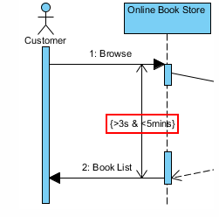

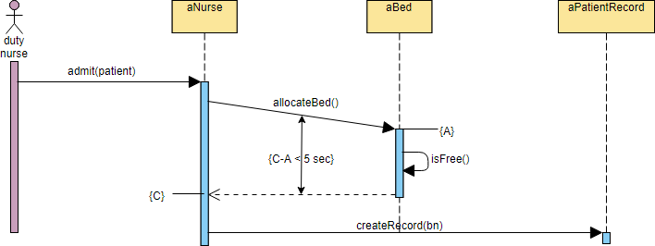
Seq Diagram Notation
Duration Message
It describes a communication particularly between the lifelines of an interaction, which portrays the time passage of the message while modeling a system.
Duration Constraint
It usually used to shows timing constraints on messages. They can apply to the timing of one message or intervals between messages.
It's especially useful when you want to model a real-time system.

Slide 40
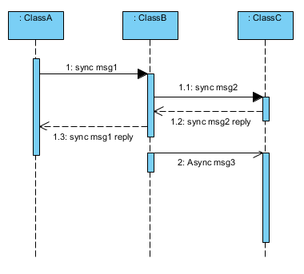
Seq Diagram Notation
Synchronous Call Message
Represents a message which the source lifeline is blocked from other operations until it receives a response from the target lifeline.
Asynchronous Call Message
Represents a message which the source lifeline is not blocked from receiving or sending other messages. Useful for threads communications.
Synchronous message activation box
cover each other.

Slide 41
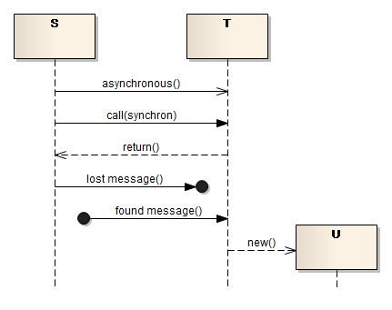
Seq Diagram Notation
Found Message
Represents a message sent from an unknown sender, or from a sender which not shown on current diagram
Lost Message
Represents a message sent to an unknown receiver, or to a receiver which not shown on current diagram

Slide 42
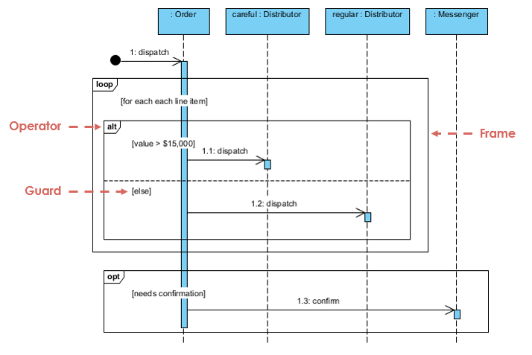
Seq Diagram Notation
Combined fragments(Sequence fragments)
Alt: if then else
Opt: if
Par: Parallel: each fragment is run in parallel.
Loop:
Region: Critical region, the fragment can have only one thread executing it at once.
Neg: Negative, the fragment shows an invalid interaction.
Ref: Reference, refers to an interaction defined on another diagram. The frame is drawn to cover the lifelines involved in the interaction. You can define parameters and a return value.
Break
Sd: Sequence diagram, used to surround an entire sequence diagram.

Slide 43
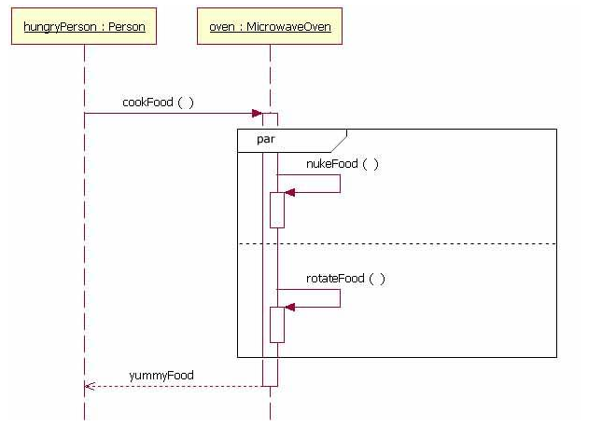
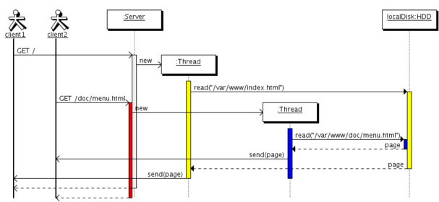
Seq Diagram concurrency
More practical solution is to indicate each thread with a separate lifeline
A microwave is an example of an object that does two tasks in parallel
Notes:
https://stackoverflow.com/questions/1643733/how-to-illustrate-multiple-threads-in-sequence-diagram

Slide 44
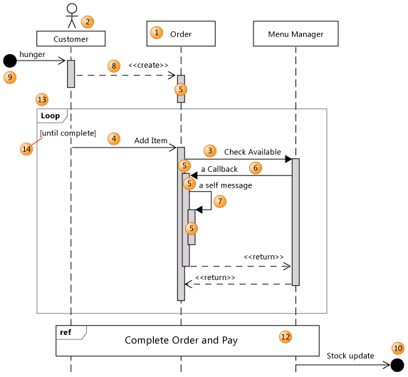
Seq diagram example
Notes:
https://docs.microsoft.com/sr-latn-rs/visualstudio/modeling/uml-sequence-diagrams-reference?view=vs-2015

Slide 45
Class diagram
Class diagram represents the static view of an application.
Class diagram describes the structure of a system by showing the system's classes, their attributes, operations (or methods), and the relationships among objects.
Class diagram is not only used for visualizing, describing, and documenting different aspects of a system but also for constructing executable code of the software application.
Class diagrams are the only diagrams which can be directly mapped with object-oriented languages and thus widely used at the time of construction.
It is the most popular UML diagram in the coder community.
It is Base for component and deployment diagrams.

Slide 46
Class notation
Class is a group of objects all with similar roles in the system, which consists of:
Structural features (attributes)
Behavioral features (operations)
Class name
Student
- name : String
Attributes
- grade : int
A class may be involved in one or more relationships with other classes. A relationship can be one of the following types
Inheritance (or Generalization)
Dependency
Association
Aggregation
Composition
Realization
Visibility
+ int getGrade()
Operations
~ int getName()
# void register(params)
Non Whole-part relation
0..*
Whole-part relation
Relationship
Multiplicity
Multiplicity : How many objects of each class take part in the relationships and multiplicity can be expressed as
1
Exactly one - 1 Zero or one - 0..1
Many - 0..* or * One or more - 1..*
Exact Number - e.g. 3..4 or 6
complex relationship -. 0..1, 3..4, 6.*
Courses
- students : Student

Slide 47
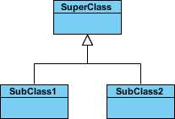
Relationships in Class Diagrams
Inheritance (or Generalization)
A generalization is a taxonomic relationship between a more general classifier and a more specific classifier.
Each instance of the specific classifier is also an indirect instance of the general classifier.
Thus, the specific classifier inherits the features of the more general classifier.
Represents an "is-a" relationship.
An abstract class name is shown in italics.
SubClass1 and SubClass2 are specializations of SuperClass.

Slide 48

Relationships in Class Diagrams
1.Dependency
Non Whole-Part structure
Typically implies that an object accepts another object as a method parameter or return type.
Another class object is not stored in any fields
Person uses Book
Person depends on Book

Slide 49
Relationships in Class Diagrams
2.Association
Non Whole-Part structure
a relationship between two classes where one class use another.
almost always implies that one object has the other object as a field/property/attribute.
object contains a pointer or reference to another class object.
Student Knows/ has a / uses Address object (as a member variable)
Student
Address
- name : String
- street : String
- address : Address
- city : String
- zip : String

Slide 50
Relationships in Class Diagrams
3.Aggregation
Whole-Part structure
It implies a relationship where the child can exist independently of the parent.
Example: Class (parent) and Student (child). Delete the Class and the Students still exist. child life time has no relation to parent.
like employee and department.
list variables almost indicates aggregations
Class has a Student object
Class
Student
Address
- students : List<Student>
- name : String
- street : String
- address : Address
- city : String
- zip : String
Association – Non whole-part structure
Aggregation - whole-part structure

Slide 51
Relationships in Class Diagrams
4.Composition
Whole-Part structure
It implies a relationship where the child cannot exist independent of the parent.
Example: House (parent) and Room (child). Rooms don't exist separate to a House. like car and engine. child has no meaning without parent.
If a composite object is deleted, all of its part instances that are objects are deleted with it.
Book
Student
- name : String
- chapters : list<Chapter>
- name : String
Association
- address : Address
Address
Class
- street : String
Composition
whole-part structure
- students : List<Student>
- city : String
- book : Book
- zip : String
Association
Non whole-part structure
Chapter
Aggregation
whole-part structure
- Number : String

Slide 52
Aggregation vs composition
The most important criteria for the distinction
Compositions have non-shareable (exclusive) parts,
while Aggregations may share their parts.
Compositions : a) each “whole” can be considered as a grouping of “parts” b) each “part” can belong to only one “whole” at a time c) the “parts” should be deleted when the “whole” is deleted
Aggregation : a) a Group can be considered a “grouping” of parts b) a part can be part of multiple Groups at the same time c) a part should not be deleted when a Group is deleted.
Note that the parts can be moved from one composition to another,
but they cannot be part of two composition at the same time.

Slide 53
Aggregation vs composition
Problem’s concept is important
Car
This is a whole-part structure
Exhaust
Composition or Aggregation?
Yes ,in car-part store
Aggregation
Could the exhaust be alive standalone?
It depends on the application
No ,in racing game
Composition
Last word of advice.
Don't waste too much time on this issue. It isn't worth it.
The distinction is hardly useful in practice.
Even if you have a completely clear "composition", you may still want to implement it as an aggregation due to technical reasons.
Notes:
Take the car example mentioned in another answer - yes, it is true that a car exhaust can stand "on its own" so may not be in composition
with a car - but it depends on the application.
If you build an application that actually has to deal with stand alone car exhausts (a car shop management application?),
aggregation would be your choice. But if this is a simple racing game and the car exhaust only serves as part of a car - well, composition would be quite fine.

Slide 54
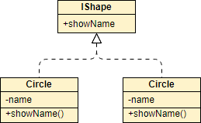
Relationships in Class Diagrams
5.Realization
A realization is a relationship between two classes where one class (an interface) specifies a operation that another class guarantees to implementing that operation.

Slide 55
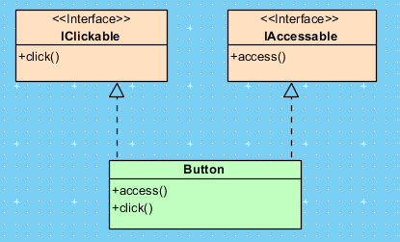
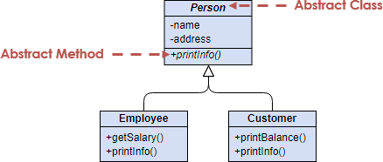
Abstract class vs Interface
Interface
Abstract
Interfaces can have no state or implementation
A class that implements an interface must provide an implementation of all the methods of that interface
Interfaces support multiple-inheritance
Abstract classes may contain state (data members) and/or implementation (methods)
Abstract classes can be inherited without implementing the abstract methods
Abstract class doesn’t support multiple-inheritance
Notes:
https://stackoverflow.com/questions/761194/interface-vs-abstract-class-general-oo

Slide 56
Code Smells Between Classes
Comments
Are the comments necessary? Do they explain "why" and not "what"? Can you refactor the code so the comments aren't required?
Long Method
a shorter method is easier to read, easier to understand, and easier to troubleshoot. Refactor long methods into smaller methods if you can.
Long Parameter List
Limit the number of parameters you need in a given method, or use an object to combine the parameters.
Duplicated code
Duplicated code is the bane of software development. Stamp out duplication whenever
possible.
Conditional Complexity
Watch out large conditional blocks that tend to grow larger or change significantly over time. Consider alternative object-oriented approaches such as decorator, strategy, or state.
Notes:
Comments

Slide 57
Code Smells Between Classes
Combinatorial Explosion
You have lots of code that does almost the same thing.. but with tiny variations in data or behavior. This can be difficult to refactor-- perhaps using generics or an interpreter?
Large Class
Large classes, like long methods, are difficult to read, understand, and troubleshoot. Does the class contain too many responsibilities? Can the large class be restructured or broken into
smaller classes?
Type Embedded in Name
Avoid placing types in method names; it's not only redundant, but it forces you to change the name if the type changes.
Uncommunicative Name
Does the name of the method describe what that method does in short and clear manner? If not, rename it or rewrite it.
Inconsistent Names
Pick a set of standard terminology and stick to it throughout your methods. For example, if you have Open(), you should probably have Close().

Slide 58
Code Smells Between Classes
Dead Code
Ruthlessly delete code that isn't being used. That's why we have source control systems!
Temporary Field
Watch out for objects that contain a lot of optional or unnecessary fields. If you're passing an object as a parameter to a method, make sure that you're using all of it and not cherry-picking
single fields.
Primitive Obsession
Don't use a gaggle of primitive data type variables as a poor man's substitute for a class. If your data type is sufficiently complex, write a class to represent it.
Data Class
Avoid classes that passively store data. Classes should contain data and methods to operate on that data, too.
Data Clumps
If you always see the same data hanging around together, maybe it belongs together. Consider rolling the related data up into a larger class.
Refused Bequest
If you inherit from a class, but never use any of the inherited functionality, should you really be using inheritance?
Notes:
https://en.wikipedia.org/wiki/Data_clump

Slide 59
Code Smells Between Classes
Inappropriate Intimacy
Watch out for classes that spend too much time together. Good classes should know as little as possible about each other.
Indecent Exposure
Beware of classes that unnecessarily expose their internals. Aggressively refactor classes to minimize their public surface. You should have a compelling reason for every item you make public. If you don't, hide it.
Feature Envy
Methods that make extensive use of another class may belong in another class. Consider moving this method to the class it is so envious of.
Lazy Class
If you have a class that isn't doing enough to pay for itself, can it be collapsed or combined into another class? Perhaps a class was designed to be fully functional but after some of the refactoring it has become ridiculously small.
Message Chains
A message chain occurs when a client requests another object, that object requests yet another one, and so on. These chains mean that the client is dependent on navigation along the class structure.
To delete a message chain, use Hide Delegate.
Notes:
https://refactoring.guru/smells/inappropriate-intimacy
https://refactoring.guru/smells/feature-envy
https://refactoring.guru/smells/lazy-class

Slide 60
Code Smells Between Classes
Middle Man
If a class is delegating all its work, why does it exist?
Divergent Change
You find yourself having to change many unrelated methods when you make changes to a
class.
Shotgun Surgery
Making any modifications requires that you make many small changes to many different classes.
Switch Statements
Relatively rare use of switch and case operators is one of the hallmarks of object-oriented code. Often code for a single switch can be scattered in different places in the program. When a new condition is added, you have to find all the switch code and modify it.
As a rule of thumb, when you see switch you should think of polymorphism.
Notes:
Divergent Change resembles Shotgun Surgery but is actually the opposite smell. Divergent Change is when many changes are made to a single class. Shotgun Surgery refers to when a single change is made to multiple classes simultaneously.

Slide 61
Refactoring Techniques
Design Patterns

