Slide 1
Mobile Device Usage and User Behavior Analysis
Data Visualization Project
Student: Hamedallah Anwer Hamedallah Issa
Student ID: 320220603007

Slide 2
Dataset Description
This dataset provides a comprehensive analysis of mobile device usage patterns and user behavior classification.
Key Features:
User ID.
Device Model.
Operating System.
App Usage Time.
Screen On Time.
Battery Drain.
Number of Apps Installed.
Data Usage.
Age.
Gender.
User Behavior Class.

Slide 3
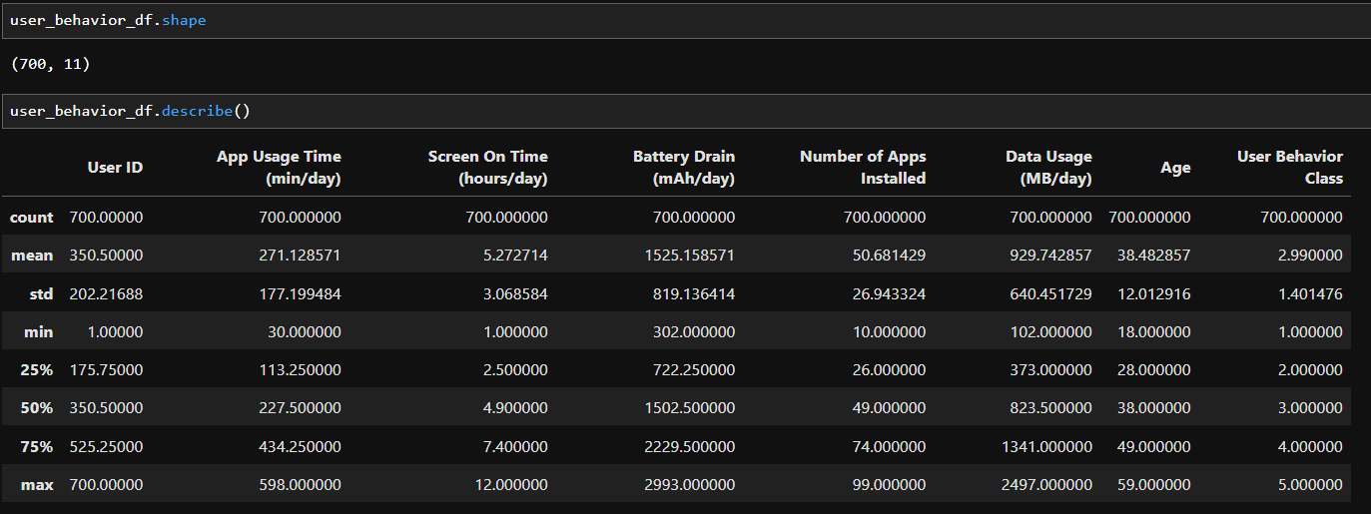
Dataset Description

Slide 4
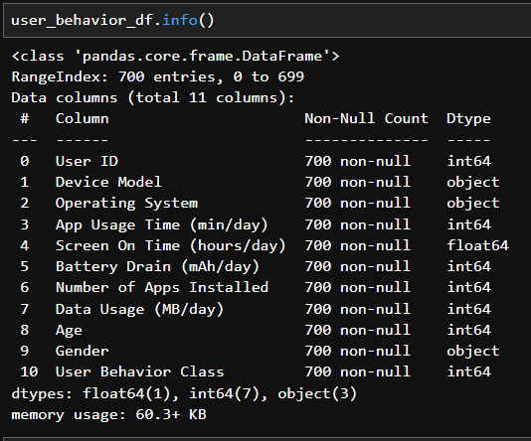
Dataset Description

Slide 5
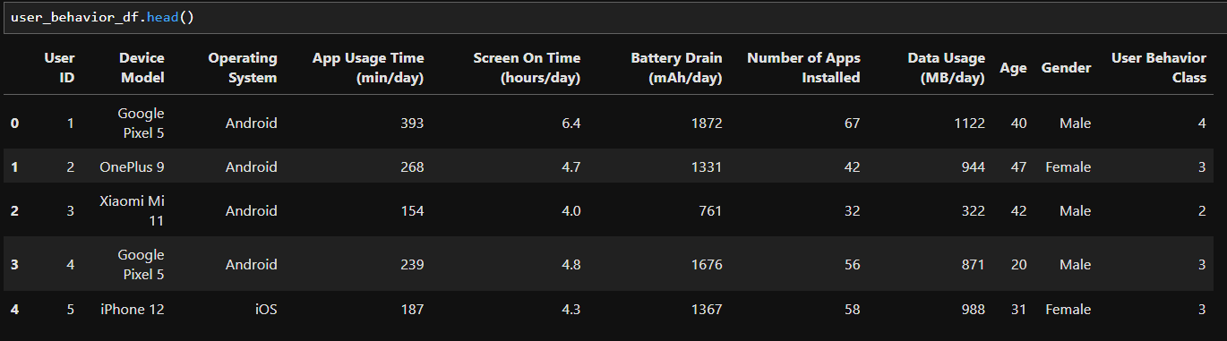
Dataset Sample Snapshot

Slide 6
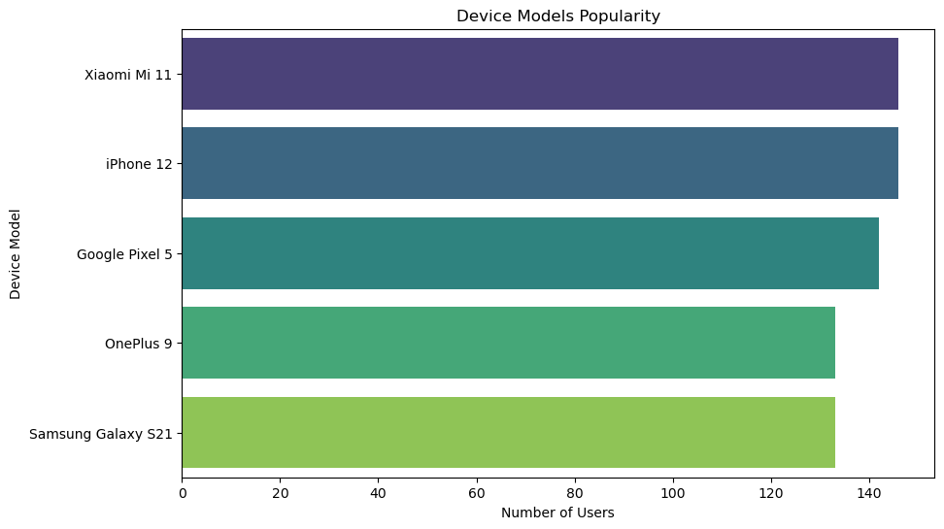
Dataset Visualizations

Slide 7
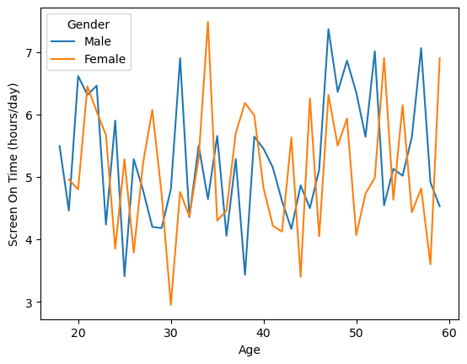
Dataset Visualizations

Slide 8
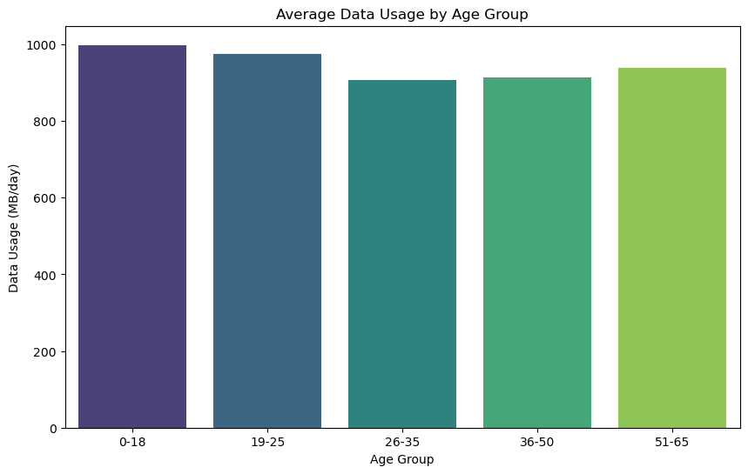
Dataset Visualizations

Slide 9
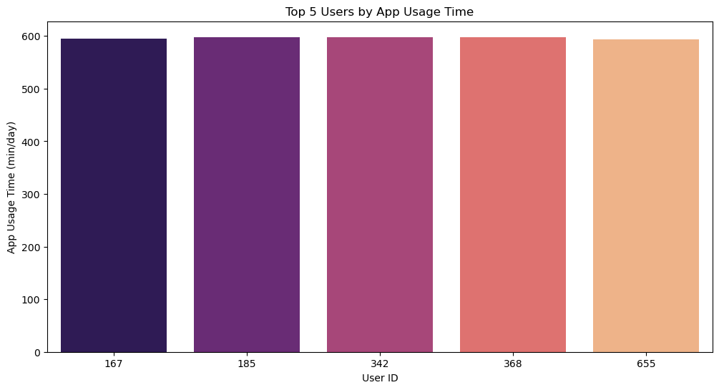
Dataset Visualizations

Slide 10
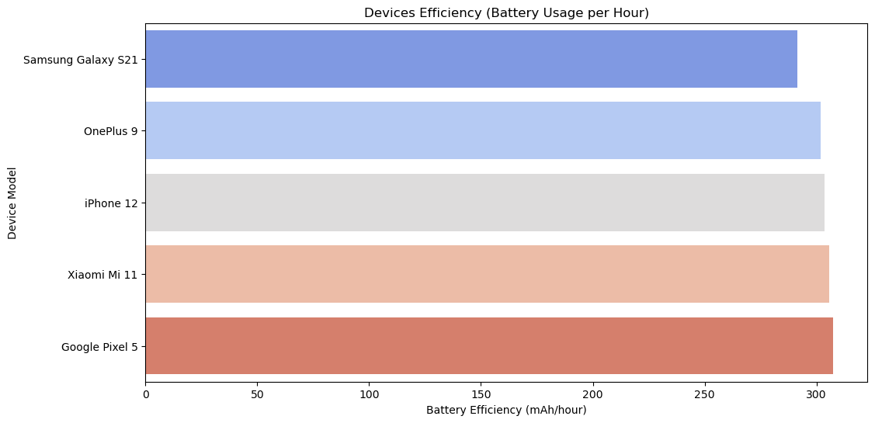
Dataset Visualizations

Slide 11
References/source of the dataset
https://www.kaggle.com/datasets/valakhorasani/mobile-device-usage-and-user-behavior-dataset?resource=download

Slide 12
Questions ?

