Slide 1
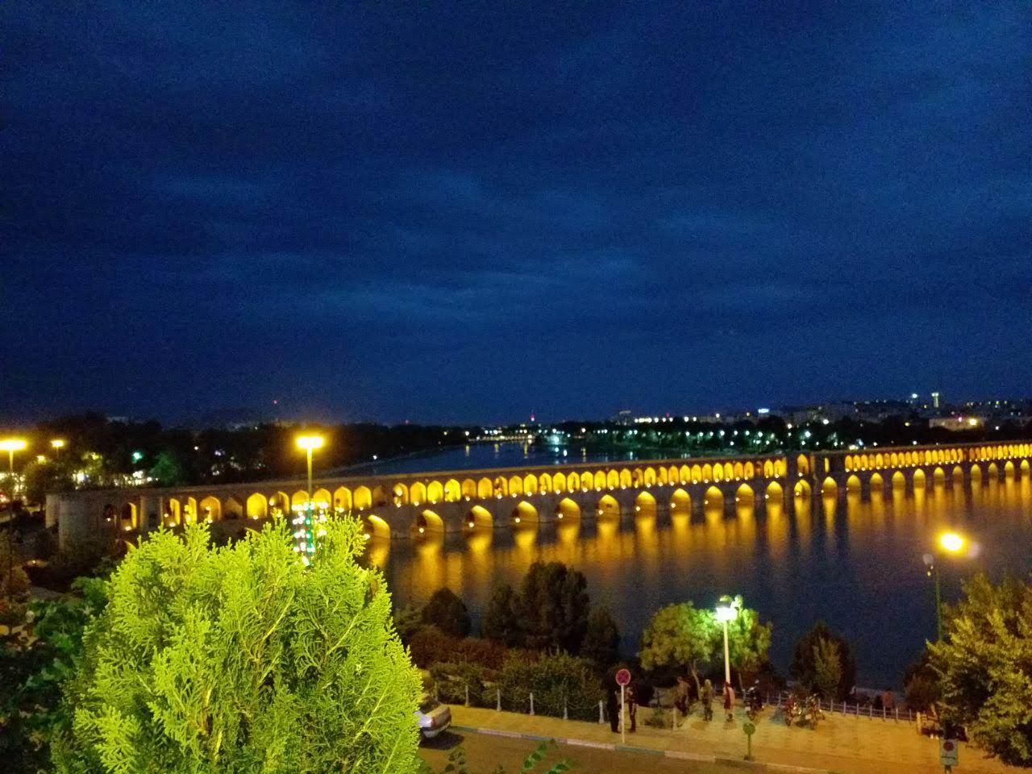
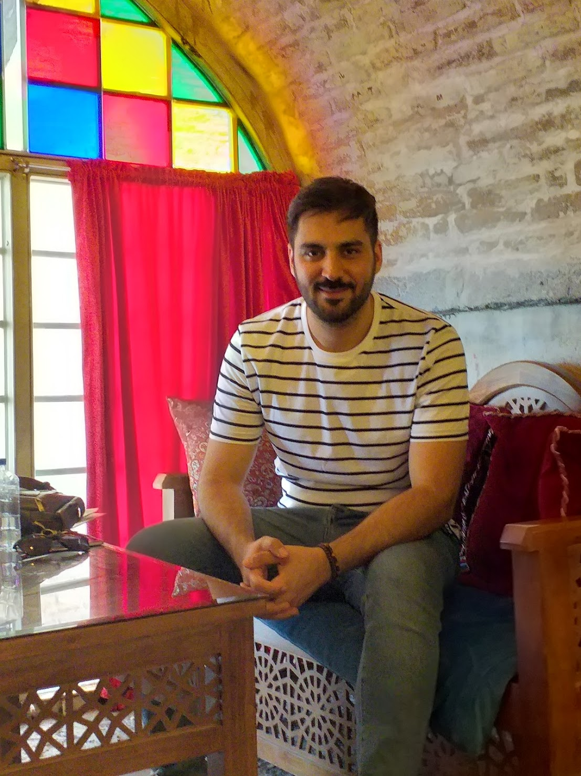
Home CV Tutorials About & Contact
Rasoul Norouzi
Welcome to my world!
This is a place that you can follow the questions of my mind!

