Slide 1

Inter-prediction for Multiview video coding
组员：杨毅远 谭世琦

Slide 2

Group Introduction
组员 | 专业 | 具体分工
谭世琦 | 自动化系 | 1.基于权重矩阵的优化问题的代码实现，以及可视化代码的实现（PSNR热力图等）； 2.报告结果以及实验过程部分撰写； 3.PPT制作。
杨毅远 | 自动化系 | 1.基于数值型权重的优化问题的代码实现，以及可视化代码的实现（PSNR直方图等）； 2.报告总结以及实验过程部分撰写； 3.PPT制作。
 |  | 共同完成 前期调研以及两模型融合的代码实现。

Slide 3

Contens
Chap.1
Project brief
Chap.2
Our models
Chap.3
Models fusion
Chap.4
Results and analysis
Chap.5
Summary & Future

Slide 4
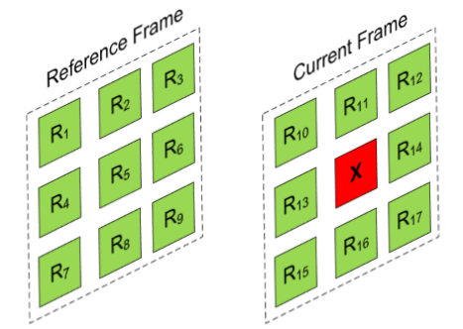
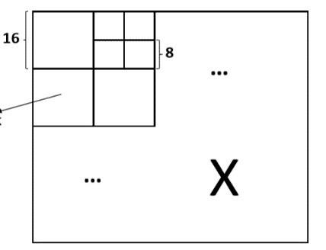

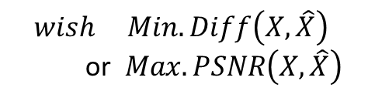
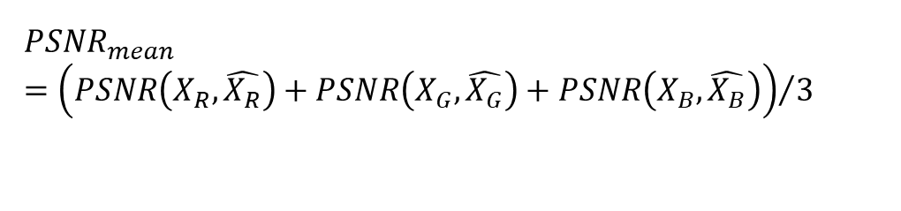
Project brief
Problem:
$$\hat{X}=f\left(R_{1},R_{2},R_{3}…R_{17}\right)$$
$$wish Min.Diff\left(X,\hat{X}\right)$$
$\text{or} Max.PSNR\left(X,\hat{X}\right)$
$$PSNR_{mean}={\left(PSNR\left(X_{R},\hat{X_{R}}\right)+PSNR\left(X_{G},\hat{X_{G}}\right)+PSNR\left(X_{B},\hat{X_{B}}\right)\right)}/3$$
blk_size=4,8,16,32,64

Slide 5
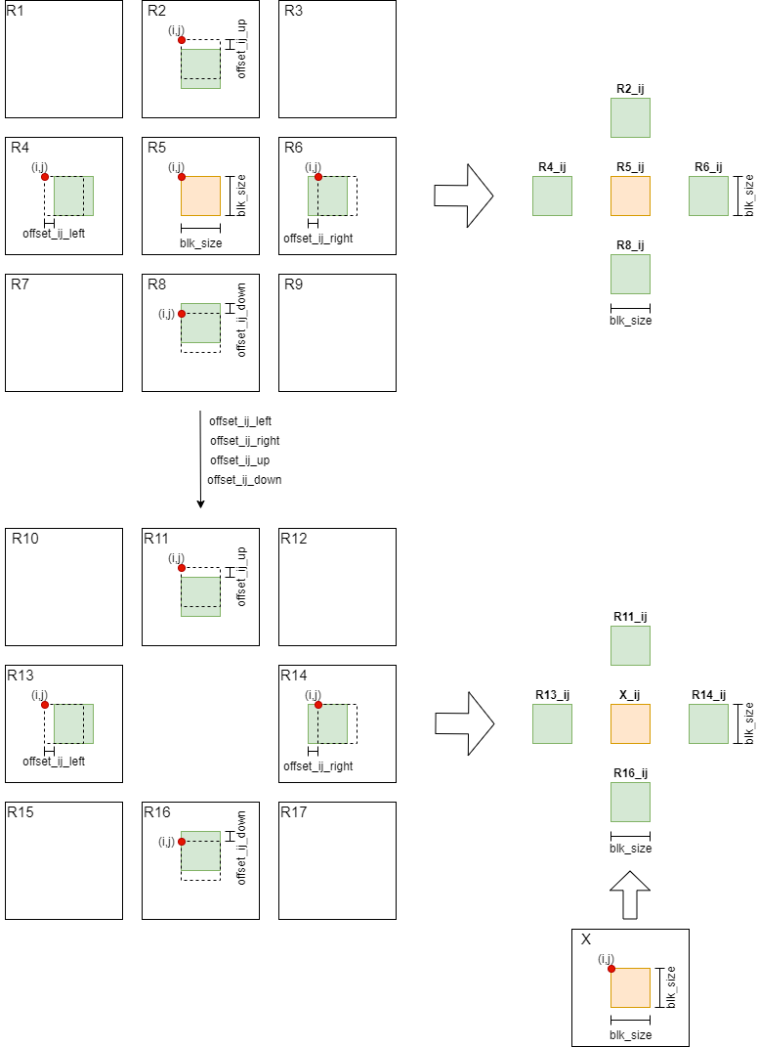
Our models

Slide 6
Our models
The previous frame

Slide 7
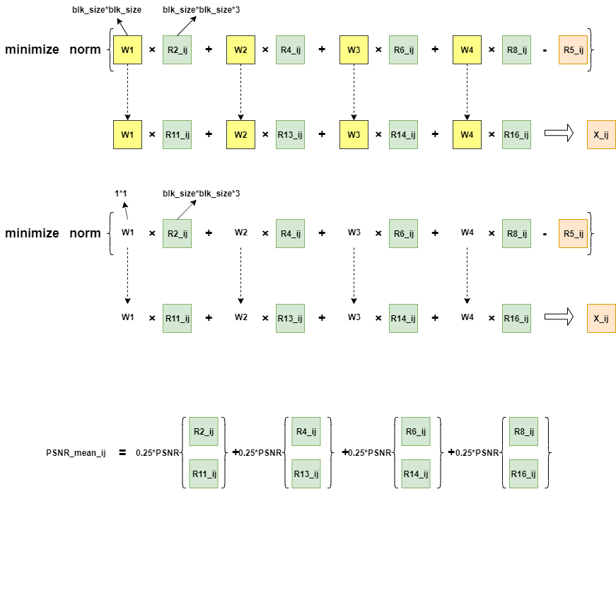
Our models
Model 1 : the weighting parameter W is a matrix (size(W)=blk_size*blk_size*4)
Advantage: per-pixel, Preserving texture details
Disadvantage: overfitting, the number of parameters(blk_size*blk_size*4)
is larger than the number of samples(blk_size*blk_size*3)

Slide 8


Our models
Algorithm flow and complexity
$$for i in range\left(block_{num row}\right):$$
$$for j in range\left(block_{num col}\right):$$
$$var W=\left[w_{1}, w_{2}, w_{3}, w_{4}\right]=blk_{size}∗blk_{size}∗4$$
$minimize norm(R5\left(i,j\right), ω_{1}∗R2\left(i,j\right)+ω_{2}∗R4\left(i,j\right)+ω_{3}∗R6\left(i,j\right)+ω_{4}∗R8\left(i,j\right))$
$$\hat{X}\left(i,j\right)=ω_{1best}∗R11\left(i,j\right)+ω_{2best}∗R13\left(i,j\right)+ω_{3best}∗R14\left(i,j\right)+ω_{4best}∗R16\left(i,j\right)$$
$PSNR(X,$ $\hat{X})$
Complexity=$block_{num row}$*$block_{num col}$* complexity_of_cvx_problem

Slide 9
Our models
Model 2 : the weighting parameter W is a number ( size(W)=1*1*4 )
Advantage: Prevent overfitting
Disadvantage: loss the texture details

Slide 10
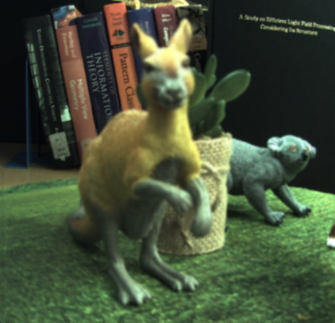
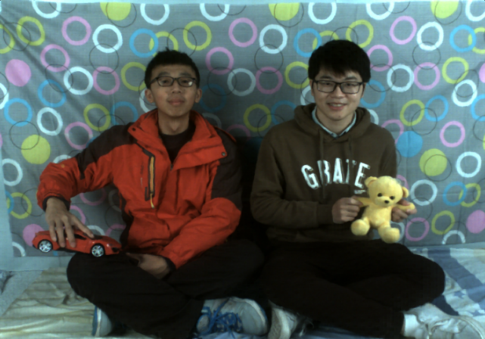

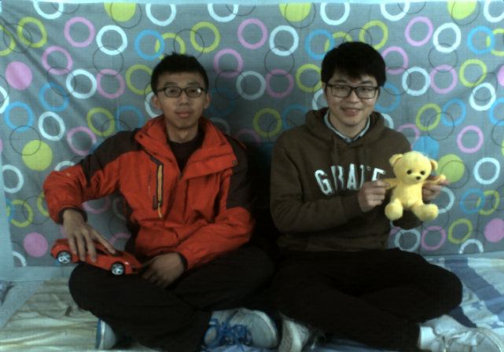
Model fusion
static
dynamic
previous frame
next frame
We need different model for different block.

Slide 11

Model fusion
For each block_ij, calculate:
PSNR_mean_ij: Represents the difference between the previous frame and the next frame.
PSNR_mean_threshold=25
PSNR_mean_ij > PSNR_mean_threshold: Model 1, size(W)=blk_size*blk_size*4
PSNR_mean_ij < PSNR_mean_threshold: Model 2, size(W)=1*1*4

Slide 12
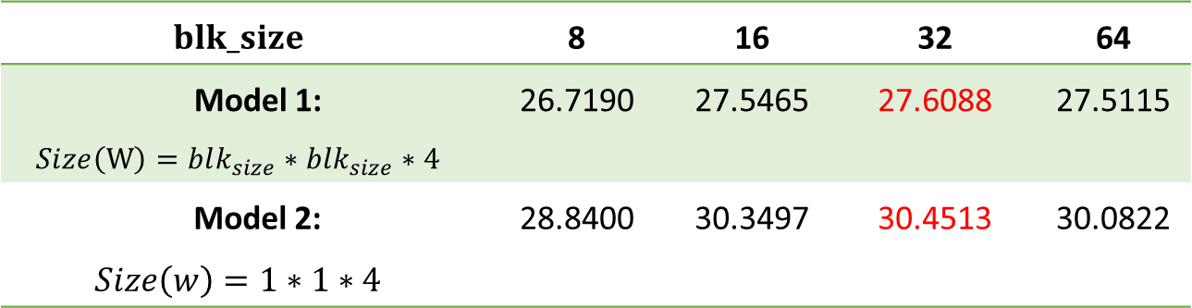

Results and analysis
For Trees
$$blk_size$$ | 8 | 16 | 32 | 64
Model 1: $$Size\left(W\right)=blk_{size}∗blk_{size}∗4$$ | 26.7190 | 27.5465 | 27.6088 | 27.5115
Model 2: $$Size\left(w\right)=1∗1∗4$$ | 28.8400 | 30.3497 | 30.4513 | 30.0822
Best block size:$32∗32$

Slide 13
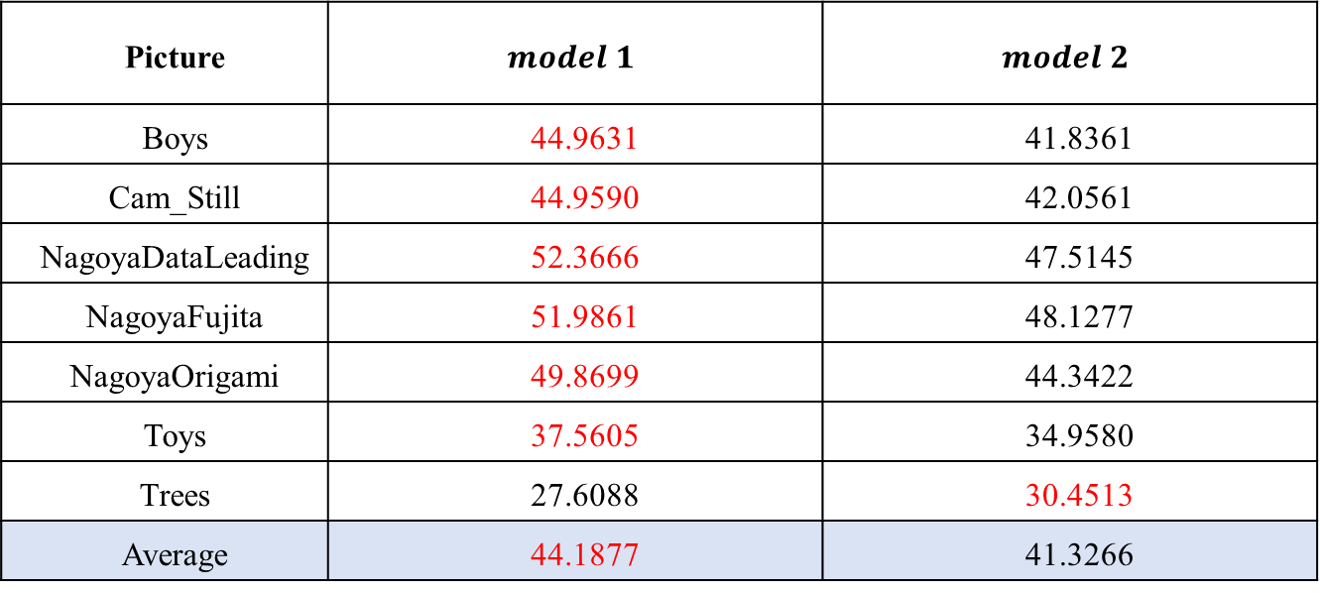
Results and analysis
Different model
Picture | $$model 1$$ | $$model 2$$
Boys | 44.9631 | 41.8361
Cam_Still | 44.9590 | 42.0561
NagoyaDataLeading | 52.3666 | 47.5145
NagoyaFujita | 51.9861 | 48.1277
NagoyaOrigami | 49.8699 | 44.3422
Toys | 37.5605 | 34.9580
Trees | 27.6088 | 30.4513
Average | 44.1877 | 41.3266

Slide 14
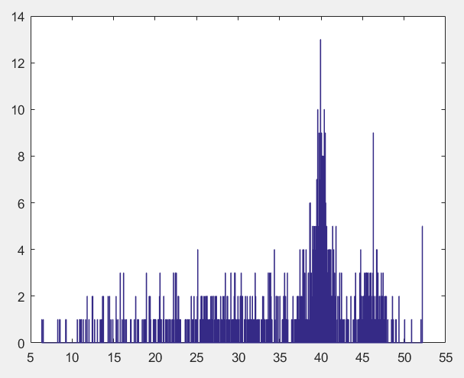
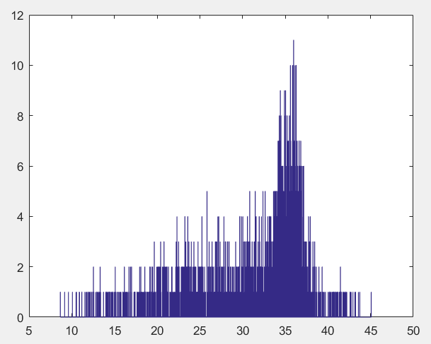
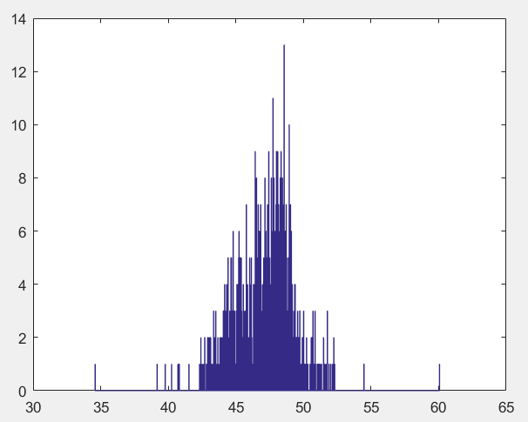
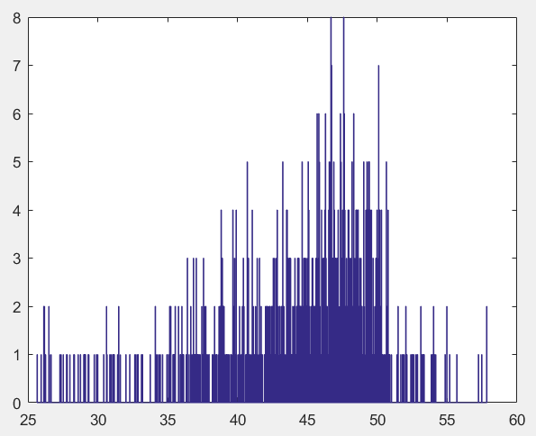
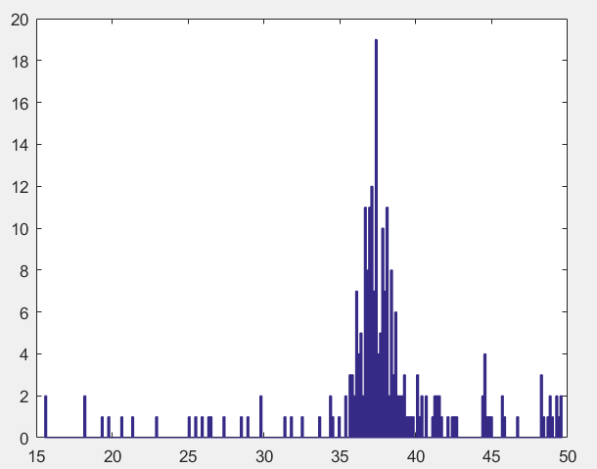
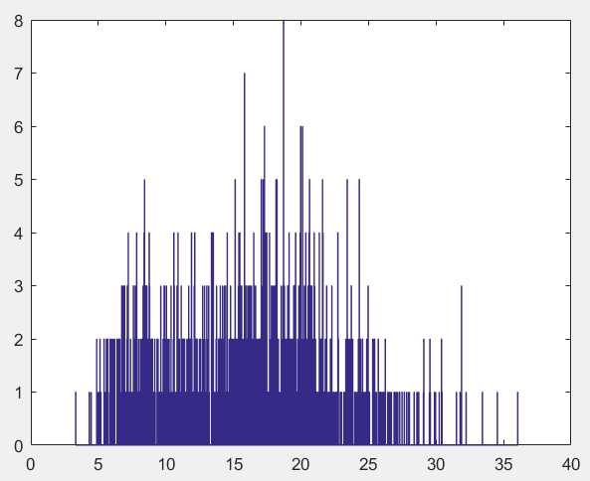
Results and analysis
Difference between the previous frame and the next frame
Boys
Cam_Still*
NagoyaDataLeading
NagoyaFujita
Toys
Trees

Slide 15
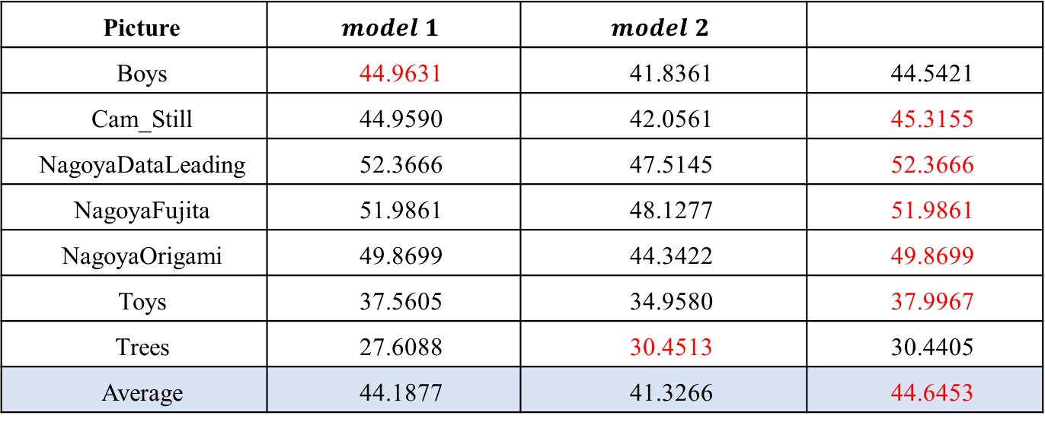
Results and analysis
Different model
Picture | $$model 1$$ | $$model 2$$
Boys | 44.9631 | 41.8361 | 44.5421
Cam_Still | 44.9590 | 42.0561 | 45.3155
NagoyaDataLeading | 52.3666 | 47.5145 | 52.3666
NagoyaFujita | 51.9861 | 48.1277 | 51.9861
NagoyaOrigami | 49.8699 | 44.3422 | 49.8699
Toys | 37.5605 | 34.9580 | 37.9967
Trees | 27.6088 | 30.4513 | 30.4405
Average | 44.1877 | 41.3266 | 44.6453

Slide 16
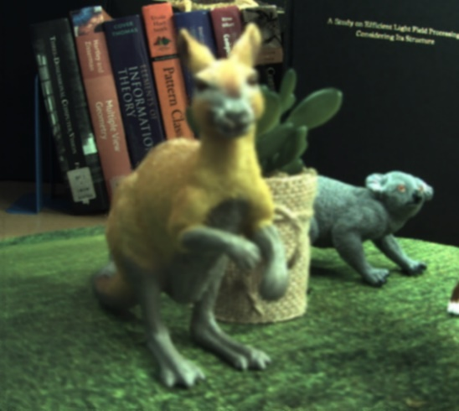
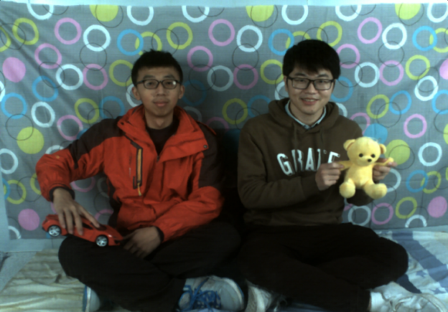
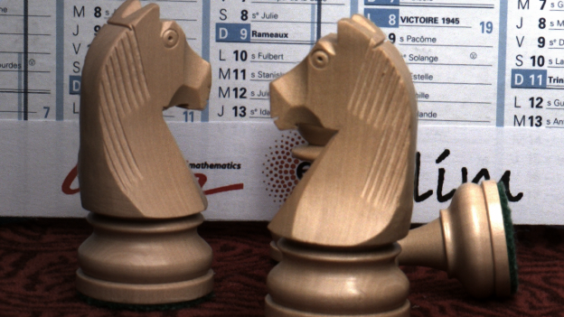



Results and analysis
Original
image
Prediction
image

Slide 17
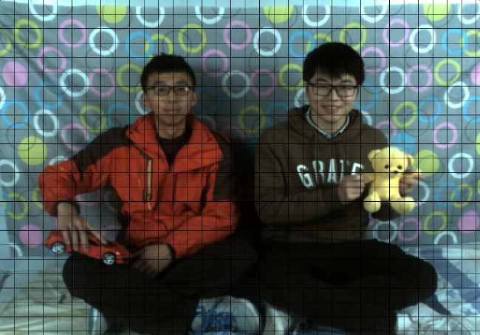
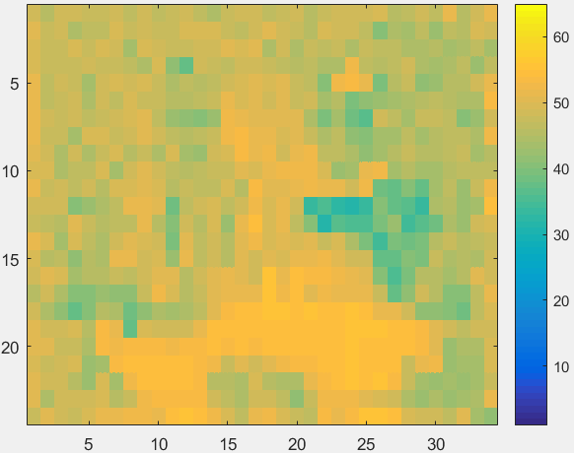
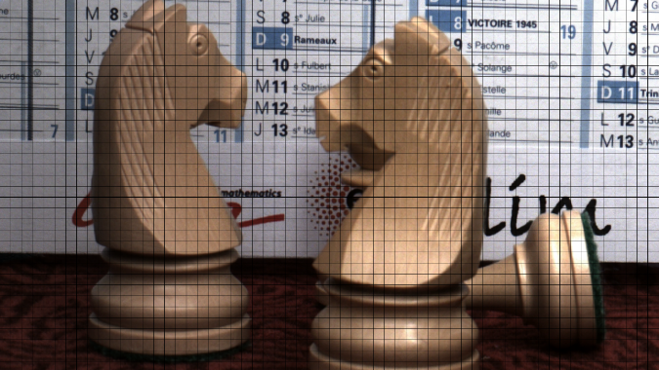
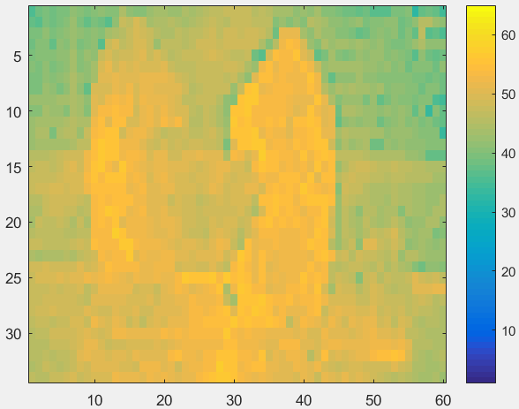
Results and analysis
Blocking results and PSNR heatmap

Slide 18
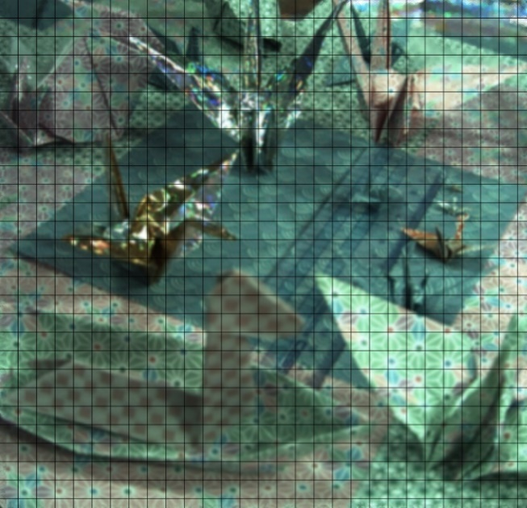
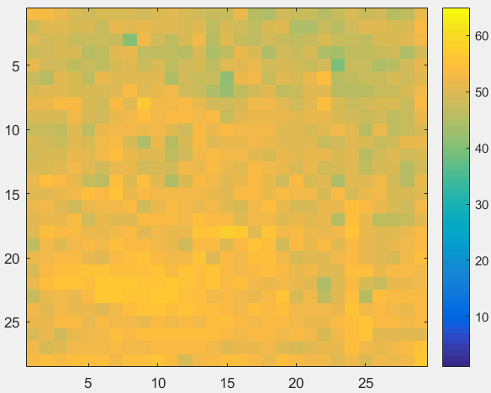
Results and analysis
Blocking results and PSNR heatmap

Slide 19
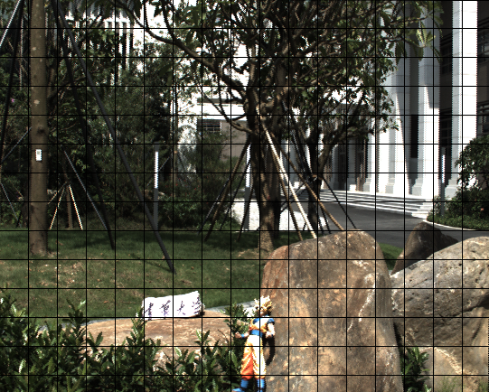
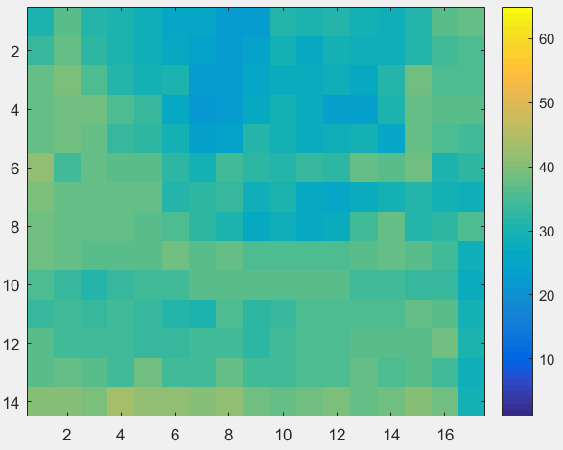
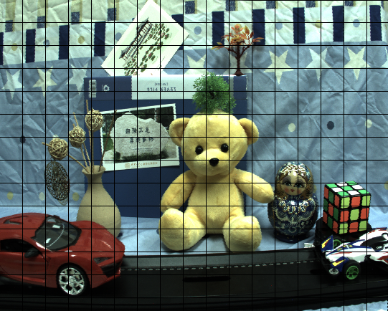
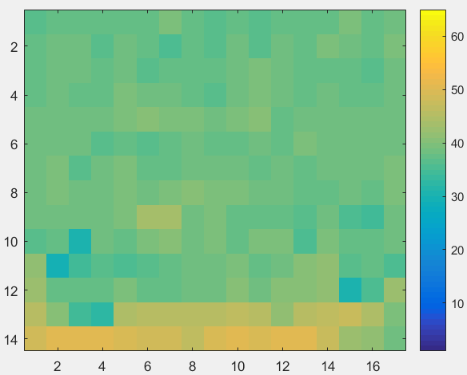
Results and analysis
Blocking results and PSNR heatmap

Slide 20
Summary & Future
The optimization variable is the weight matrix(value), not the pixels of the image to be predicted
Determine the weight format by calculating the PSNR of the same area of the different frames
The threshold of PSNR is selected scientifically through the PSNR’s histogram , not aimlessly attempt
By using the results of block's thermodynamic diagram, the reason why PSNR can't be improved is further analyzed

Slide 21
Thanks
Q & A

