Slide 1
Building an AI Model to Predict Immunogenicity of Monoclonal Antibodies – Proof of Concept Investigation
Aug, 2025
DARS Computational Biology & Pharmacology Team

Slide 2
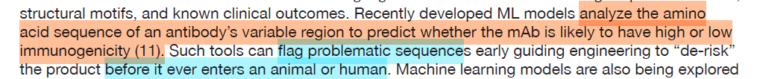
Motivation
In April 2025, FDA announced a roadmap to phase out animal testing for monoclonal antibodies (mAbs) and other drugs
In Silico Tools and Computational Modeling proposed as one of the New Approach Methodologies (NAMs)
An AI model published by Wang et al. 2024 was featured

Slide 3




Applying Large Language Models to mAbs
Large data collection
Learning the “Grammar” by Predicting Next Word
Model Pretraining
Process Amino Acids into “Words”
Pre-processing
Model Inference
Tokenization
Post-Processing
Immunogenic or Not
Wang et al. 2024. AbImmPred: An Immunogenicity prediction method for therapeutic antibodies using AntiBERTy-based sequence features.

Slide 4
Issues We Found in Wang et al. Model
Authors claim the percentage of patients developing Anti-Drug Antibody (ADA) in clinical studies for each mAb was extracted from FDA website
However, out of the 199 MABs used in the paper, most are unapproved
unclear where the authors obtained the information without accessing FDA internal databases
The percentage of patients developing ADA is highly dependent on the assay being used
Authors used a cut-off of 2% to define immunogenic vs non-immunogenic
No concrete rationale given about this cut-off

Slide 5
Our Solution to Issue 1
Our own data collection strategy relies on detailed immunogenicity data from clinical study reports of individual submissions
DARRTS and DocuBridge were searched
Data extraction currently focus on treatment-induced/enhanced ADA cases, but can be expanded (e.g., neutralizing antibodies, etc.)
Out of the 199 mAbs used by Wang 2024
87 were FDA approved (label provides immunogenicity information)
For the rest unapproved drugs:
83 had immunogenicity information in FDA internal databases
17 had IND submission without immunogenicity information
12 had no IND submissions to FDA

Slide 6
Our Solution to Issue 2
We hypothesized that there is a group of mAbs that are non-immunogenic
No matter what kind of assay is used, the percentage of subjects developing ADAs is close to 0 (or below a certain threshold)
For the other immunogenic mAbs, the ADA percentage varies according to the assay being used
But generally above a certain threshold
Question: do these two groups of mAbs look “different”, in terms of their amino acid sequences (variable region)?
What ADA percentage threshold defines non-immunogenic vs immunogenic?

Slide 7
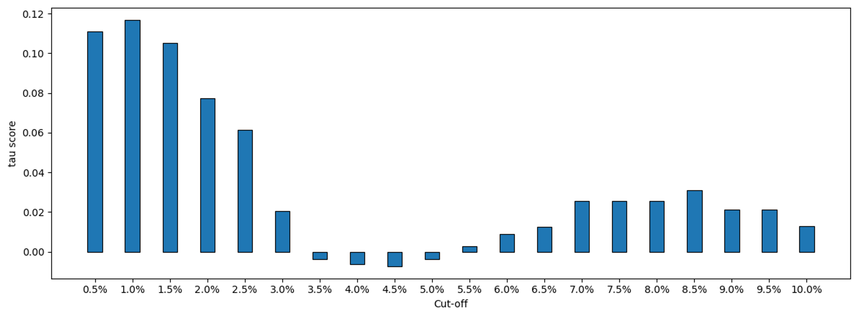
Immunogenic vs Non-immunogenic mAbs
When using 1% as a cut-off, mAbs above the threshold and those below the threshold form two distinct clusters based on their variable region sequences
Degree of Sequence Dissimilarity
(Immunogenic vs Non-immunogenic mAbs)
Cut-off Threshold to Define Immunogenic vs Non-immunogenic mAbs

Slide 8
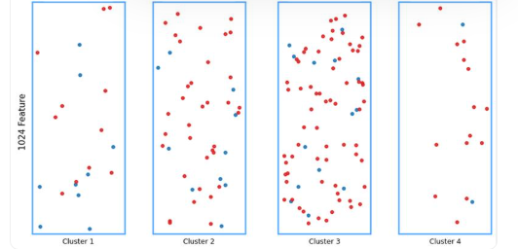
Sequence Similarity And Immunogenicity
Half/Half
(55% red)
Red dominated
(78% red)
Red Dominated
(83% red)
Red Dominated
(88% red)
mAbs were grouped into 4 clusters based on sequence similarity only
Unsupervised learning (no immunogenicity information given)
Most (117 out of 128) immunogenic mAbs have some sequence features distinct from non-immunogenic ones
They were put into immunogenic dominated clusters 2-4
Some (11 out of 128) immunogenic mAbs have their sequences similar to non-immunogenic ones
They were put into “half/half” cluster 1
Red dots: immunogenic mAbs (ADA% > 1%)
Blue dots: non-immunogenic mAbs (ADA% <= 1%)

Slide 9
Model Training & Validation
A cut-off threshold of 1% applied to the ~163 mAbs
35 non-immunogenic, 128 immunogenic
5-fold cross-validation: each time using 130 mAbs for training, and 33 for validation
Performance across 5 runs are averaged

Slide 10
Model Performance
Metric | Interpretation | Value
Precision (Positive Predictive Value) | If model predicts a mAb to be immunogenic, what is the probability that this mAb is indeed immunogenic? | 0.81+/- 0.04
Recall (Sensitivity) | Of all mAbs that are immunogenic, how many (in fraction) will be predicted as immunogenic | 0.80 +/- 0.05
F1 | A balanced single metric combining precision and recall | 0.80 +/- 0.03
Accuracy | Of all mAbs out there (either immunogenic or non-immunogenic), how many (in fraction) will be predicted correctly | 0.700 +/- 0.06

Slide 11
Summary
We improved upon the AI model to predict immunogenicity of mAbs based on their amino acid sequences
Original model (Wang et al. 2024) mentioned by the FDA Roadmap
Knowledge gathering from FDA internal databases initiated
Can expand to cover other endpoints
For non-immunogenic mAbs, the ADA percentage is likely to be below certain threshold, no matter what assay was used
Current data suggest this threshold is around 1%
Immunogenic and non-immunogenic mAbs may have different sequence features
Our model has relatively high accuracy in identifying immunogenic mAbs based on their sequences

Slide 12
Next step
Clean up the data
Some heavy/light chain of mAbs may need to be updated
Right now collected ADA% are mixed: some are treatment-induced/enhanced, some include background rate.
Strengthen the model
Expand the model/data
More unapproved mAbs in the internal databases
Neutralizing antibodies, or ADAs that affect PK/PD
Other models and endpoints?

Slide 13
BACKUP

Slide 14
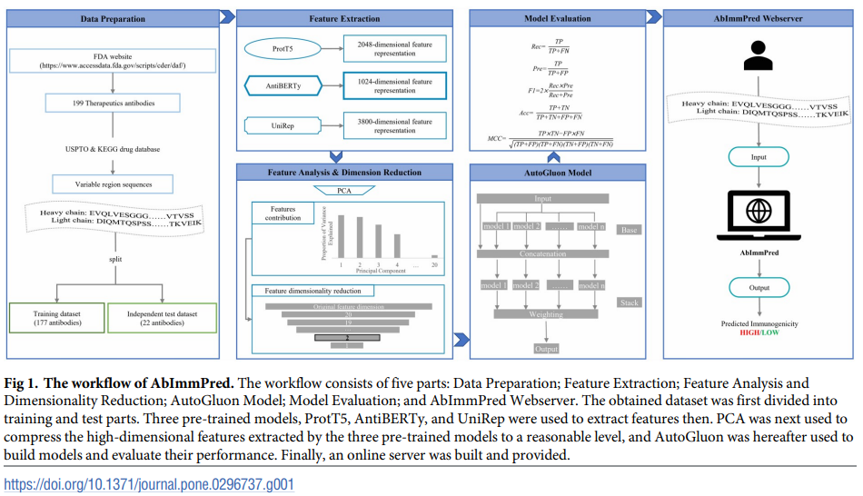
Most Recent Study: Antibody Sequence-Based Large Language Models to Predict Clinical Immunogenicity
199 monoclonal antibody (MAB) as training and validation/testing
End point: percentage of patients developing anti-drug antibodies (ADAs) in clinical trials
Wang et al. 2024. AbImmPred: An Immunogenicity prediction method for therapeutic antibodies using AntiBERTy-based sequence features.

Slide 15
Note
Immunogenicity: binding ADA, for now, we are counting all ADA positive case for each therapeutic antibody, including ADA in monotherapy and combination therapy, and counting all different doses as separate events.
Label: antibody drug name, application ID, study ID
Condition A: Number of subjects that had AT LEAST one USABLE sample for anti-drug antibody measurement
Condition B: Number of subjects that meet condition A, with AT LEAST one sample tested AFTER drug dosing
Condition C: Number of subjects that meet conditions A&B, with AT LEAST one POST-DOSING sample that is POSITIVE
Condition D: Number of subjects that meet conditions A,B,C, with NO Positive samples PRE-DOSING
Percentage of positive subjects (in theory D/B). This was compared to the percentage of positive as reported by the sponsor (if exists)

