Slide 1
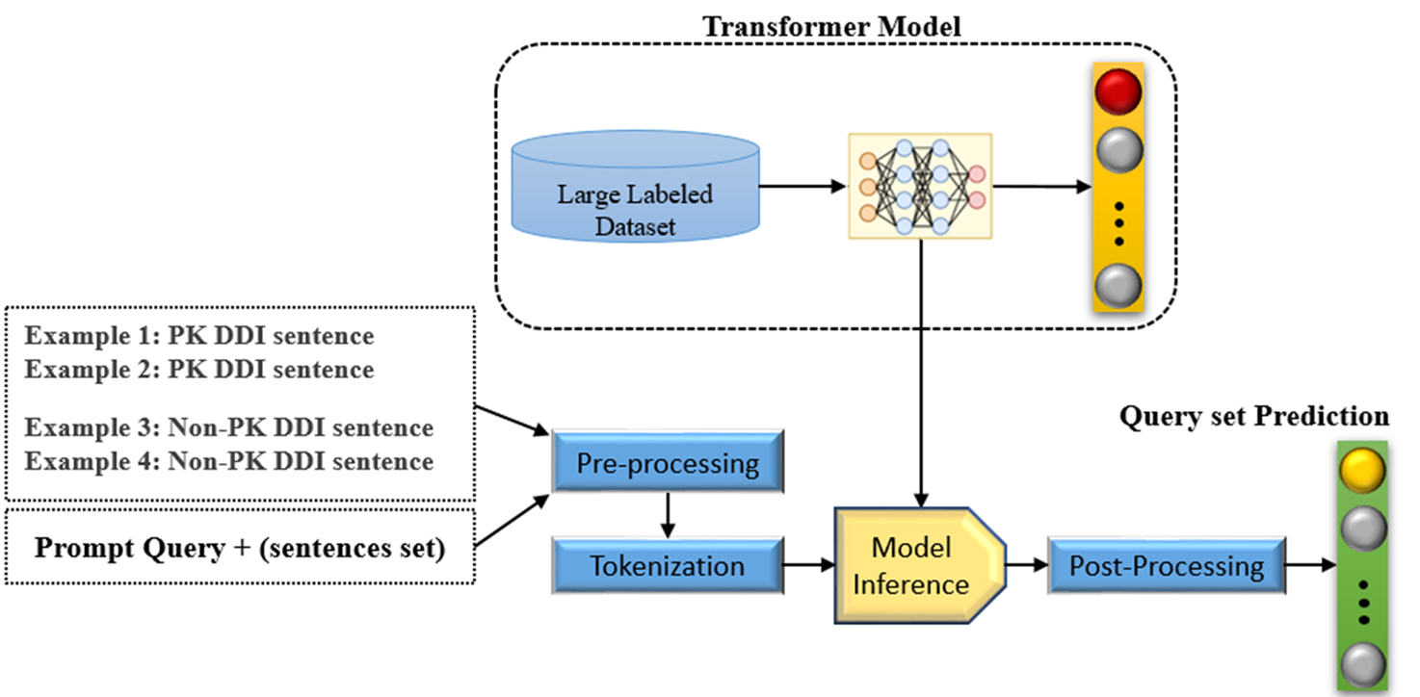
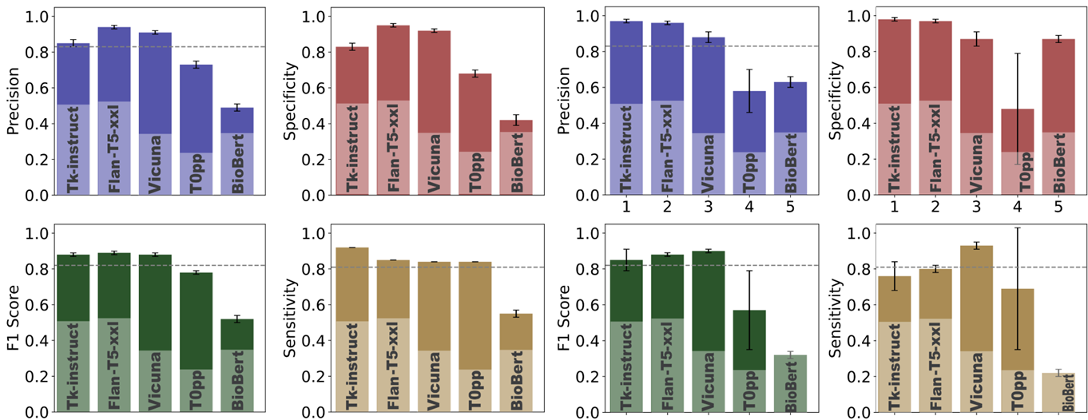
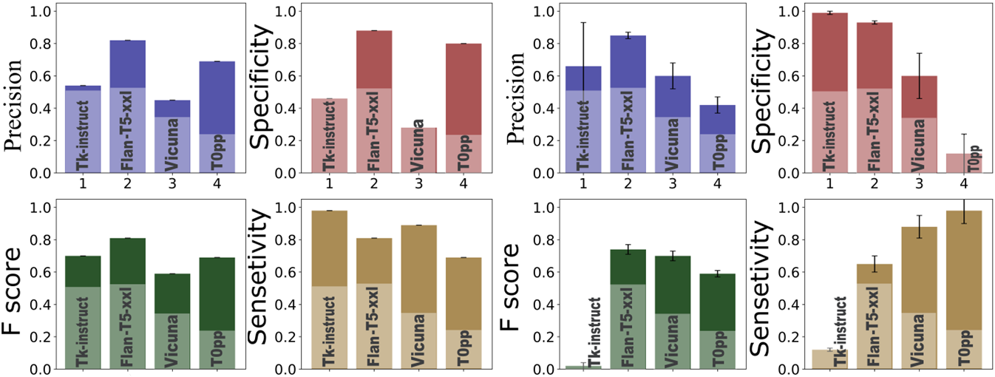
Harnessing Large Language Models’ Zero-Shot and Few-Shot Learning Capabilities for Regulatory Research
Hamed Meshkin, Joel Zirkle, John Mann, Anik Chaturbedi, Shilpa Chakravartula, Bradlee Thrasher, Ghazal Arabidarrehdor, and Zhihua Li Division of Applied Regulatory Science (DARS), Office of Clinical Pharmacology (OCP), Office of Translational Sciences (OTS), Center for Drug Evaluation and Research (CDER), U.S. Food and Drug Administration (FDA)
Silver Spring, MD, USA
Abstract
Large Language Models (LLMs) are sophisticated AI-driven models trained on vast sources of natural language data. They are adept at generating responses that closely mimic human conversational patterns. One of the most notable examples is OpenAI's ChatGPT, which has been extensively used across diverse sectors. Despite their flexibility, a significant challenge arises as most users must transmit their data to the servers of companies operating these extensive models. Utilizing ChatGPT-like models online may inadvertently expose sensitive information to the risk of data breaches. Therefore, implementing ChatGPT-like LLMs that are open source and smaller in scale within a secure local network becomes a crucial step for organizations where ensuring data privacy and protection has the highest priority, such as regulatory agencies. As a feasibility evaluation, we implemented a series of open-source LLMs within a regulatory agency’s local network and assessed their performance on specific tasks involving identifying pharmacokinetic drug-drug interactions. Our research shows that some models work well in the context of few- or zero-shot learning, reaching a level of performance that is similar to neural network models that needed thousands of training samples. One of the models was selected to address a real-world issue of finding intrinsic factors that affect drugs' clinical exposure without any training or fine-tuning. In a dataset of over two million sentences, the model showed a 78.5% accuracy rate. Our work pointed to the possibility of implementing open-source ChatGPT-like LLMs within a secure local network and using these models to perform various natural language processing tasks when large numbers of training examples are not available.
A)
Large Language models and Schematic procedure for large language models
Result and Discussion
PK-DDI Sentence Classification
In both zero-shot and few-shot settings, open-source LLMs—particularly Flan-T5, Tk-Instruct, and Vicuna—achieved performance comparable to or better than our previously fine-tuned BioBERT model, which required over 21,000 labeled sentences for training. (Table E)
These LLMs accurately distinguished pharmacokinetic drug–drug interaction (PK-DDI) sentences with high precision and sensitivity using only 4 training examples or none at all. This demonstrates the efficiency and flexibility of in-context learning for regulatory text classification. (Figure B)
Intrinsic Factor Detection
Flan-T5 also delivered the highest performance in detecting patient intrinsic factors (e.g., liver impairment, age, genetics) that affect drug exposure. (Figure C)
Without any training, Flan-T5 correctly identified relevant sentences with over 80% overall accuracy in a balanced, manually annotated dataset.
Real-World Application
Using zero-shot learning, Flan-T5 was deployed to scan 708,024 sentences from FDA drug labels for 28 CiPA drugs.
It identified 553 unique positive sentences, with a manually confirmed precision of 78.5%, demonstrating real-world utility in extracting pharmacologically significant information without task-specific training.
Discussion
🔍 Open-source LLMs can streamline regulatory NLP tasks by eliminating the need for large annotated datasets.
🧠 Flan-T5 achieved 78.5% precision scanning FDA labels for intrinsic factors
📉 Reduced training data need by 95% - 100% vs. fine-tuned BioBERT
🔒 All processing done locally — zero data exposure risk
🚀 Careful prompt design (Table D) is key to achieving high performance, especially for biomedical terminology.
Model | Flan-T5-XXL | Tk-Instruct | T0pp | Vicuna v1.5 | ChatGPT3 | BioBERT
Parameter size | 11B | 11B | 11B | 13.7B | 175B | 0.34B
B)
Introduction
Large Language Models (LLMs) like ChatGPT have revolutionized natural language processing by generating human-like responses from vast pretraining on text data.
However, cloud-based LLMs raise data privacy and security concerns, especially for regulatory agencies dealing with sensitive healthcare information.
To address this, we explored the deployment of open-source LLMs within a secure local network, allowing use of advanced NLP without risking data leakage.
A key advantage of LLMs is their ability to perform few-shot and zero-shot learning, enabling effective task execution with minimal or no training data.
We evaluated LLMs including Flan-T5, Tk-Instruct, T0pp, Vicuna, and BioBERT on two regulatory-relevant tasks (Figure A)
Relationship Extraction (RE): Identifying pharmacokinetic drug–drug interaction (PK-DDI) sentences
Intrinsic Factor Classification: Detecting intrinsic factors (e.g., liver disease, age, etc.) that affect drug exposure
These results were compared to our prior state of the art (fine-tuned BioBERT) model, which required >21,000 labeled sentences.
Surprisingly, some open-source LLMs matched or outperformed state of the art model using no training data, highlighting their potential to streamline regulatory document analysis with no compromise on data security.
Performance of the sentence classification between PK and Non-PK DDI phrases
Zero-shot learning
Few-shot learning
Drug-drug interactions (DDI) of cannabidiol (CBD) with citalopram and morphine in a clinical study cohort
Conclusion
We demonstrated the feasibility of deploying open-source LLMs (e.g., Flan-T5, Vicuna) within a secure local environment for regulatory research.
Models using zero-shot and few-shot learning achieved performance comparable to or better than state-of-the-art models trained on large datasets.
These LLMs performed well on diverse tasks, including:
PK-DDI sentence classification
Detection of intrinsic patient factors affecting drug exposure
Prompt design played a critical role—well-crafted prompts significantly improved performance, especially in biomedical contexts.
By keeping all data processing local, this approach ensures data privacy and regulatory compliance while leveraging state-of-the-art AI capabilities.
The successful large-scale use of Flan-T5 on 700K+ sentences from FDA labels demonstrates the practical utility of LLMs in real-world regulatory workflows.
As LLMs continue to evolve, their integration into regulatory science offers a path to greater efficiency without compromising scientific rigor or data security.
C)
Performance of sentences relate to patient’s intrinsic factors altering drugs’ clinical exposure
Zero-shot learning
Few-shot learning
Material and Methods
Dataset Preparation We utilized two key datasets derived from FDA-approved drug labels:
PK-DDI Classification Task: Based on the TAC (Text Analysis Conference) 2019 Drug–Drug Interaction (DDI) track, categorized as either Positive (PK-DDI) or Negative (non-PK-DDI) sentences. 10,634 labeled sentences were for evaluation in this study.
Intrinsic Factor Detection Task: We collected 708,024 sentences from FDA drug labels (DailyMeds) and manually annotated them as either Positive (containing intrinsic factors affecting exposure) or Negative. A manually annotated subset of 500 sentences (198 positive, 302 negative) was used to evaluate model performance, with the rest set aside as a case study for real-world application.
Models Evaluated We tested the following open-source LLMs: All models were deployed locally using Hugging Face Transformers and evaluated (Figure A)
Few-Shot Learning: For each task, we randomly selected 4 sentences (2 positive, 2 negative) as few-shot exemplars.
Zero-Shot Learning: Models were prompted with task-specific instructions but no labeled examples.
Real-world application
Detection of intrinsic factor of 708,024 sentences were processed directly without ground-truth labels (zero-shot learning).
D)
Two example of prompt query for zero-shot learning:
PK-DDI | ”The co-administration of AFINITOR with long-acting octreotide increased octreotide Cmin by approximately 50%.” Is it true that this sentence relates to how the pharmacokinetics of one drug, namely absorption, distribution, metabolism, or excretion, change when co-administered with another drug, indicating a pharmacokinetic drug-drug interaction? Options: - Yes - No
Intrinsic Factor | Is it true that the given sentence relates exclusively to the drug’s pharmacokinetics as altered by patients’ intrinsic factors, such as Gender, Age, Weight, Genetics, Organ’s function, Additional diseases, and so forth? Given sentence: “Levetiracetam Cmax and AUC were 20% higher in women (N=11) compared to men (N=12).” Options: - Yes – No
Disclaimer
The findings and conclusions in this presentation reflect the views of the authors and should not be construed to represent FDA’s views or policies.
This project was supported in part by an appointment to the Research Fellowship Program at US Food and Drug Administration (FDA), administered by the Oak Ridge Institute for Science and Education
References
[1] Chung, Hyung Won, et al. "Scaling instruction-finetuned language models." arXiv preprint arXiv:2210.11416 (2022).
[2] Wang, Yizhong, et al. "Super-naturalinstructions: Generalization via declarative instructions on 1600+ nlp tasks." arXiv preprint arXiv:2204.07705 (2022).
[3] Sanh, Victor, et al. "Multitask prompted training enables zero-shot task generalization." arXiv preprint arXiv:2110.08207 (2021).
[4] Zheng, Lianmin, et al. "Judging LLM-as-a-judge with MT-Bench and Chatbot Arena." arXiv preprint arXiv:2306.05685 (2023).
[5] Lee, Jinhyuk, et al. "BioBERT: A pre-trained biomedical language representation model for biomedical text mining." Bioinformatics 36.4 (2020): 1234-1240.
[6] Zirkle J et al. Deeplearning enabled natural language processing to identify directional pharmacokinetic drug–drug interactions. BMC Bioinformatics: 2023;24:413
[7] https://huggingface.co/
Flan-T5-xxl | Tk-Instruct | T0pp | Vicuna | BioBERT | SetFit
E)
Earlier state of the art model —a fine-tuned BioBert model (BioBERT_directionalDDI) Performance of the sentence classification step (Left) and the named entity recognition (Right) to identifying object and precipitant drugs in PK DDI sentences from traditional AI model (BioBert model fine-tuned on 21,593 training examples) .
Recall | 80.6%
Precision | 82.7%
F score | 81.6%
 | Object | Precipitant
Recall | 93.7 % | 94.6 %
Precision | 100 % | 100 %
F score | 96.8 % | 97.2 %

