Slide 1

Exploratory Data Analysis
G2M Insight for Cab investment firm
20-03-2023

Slide 2

Agenda
Executive Summary
Problem Statement
Approach
EDA
EDA Summary
Recommendations

Slide 3
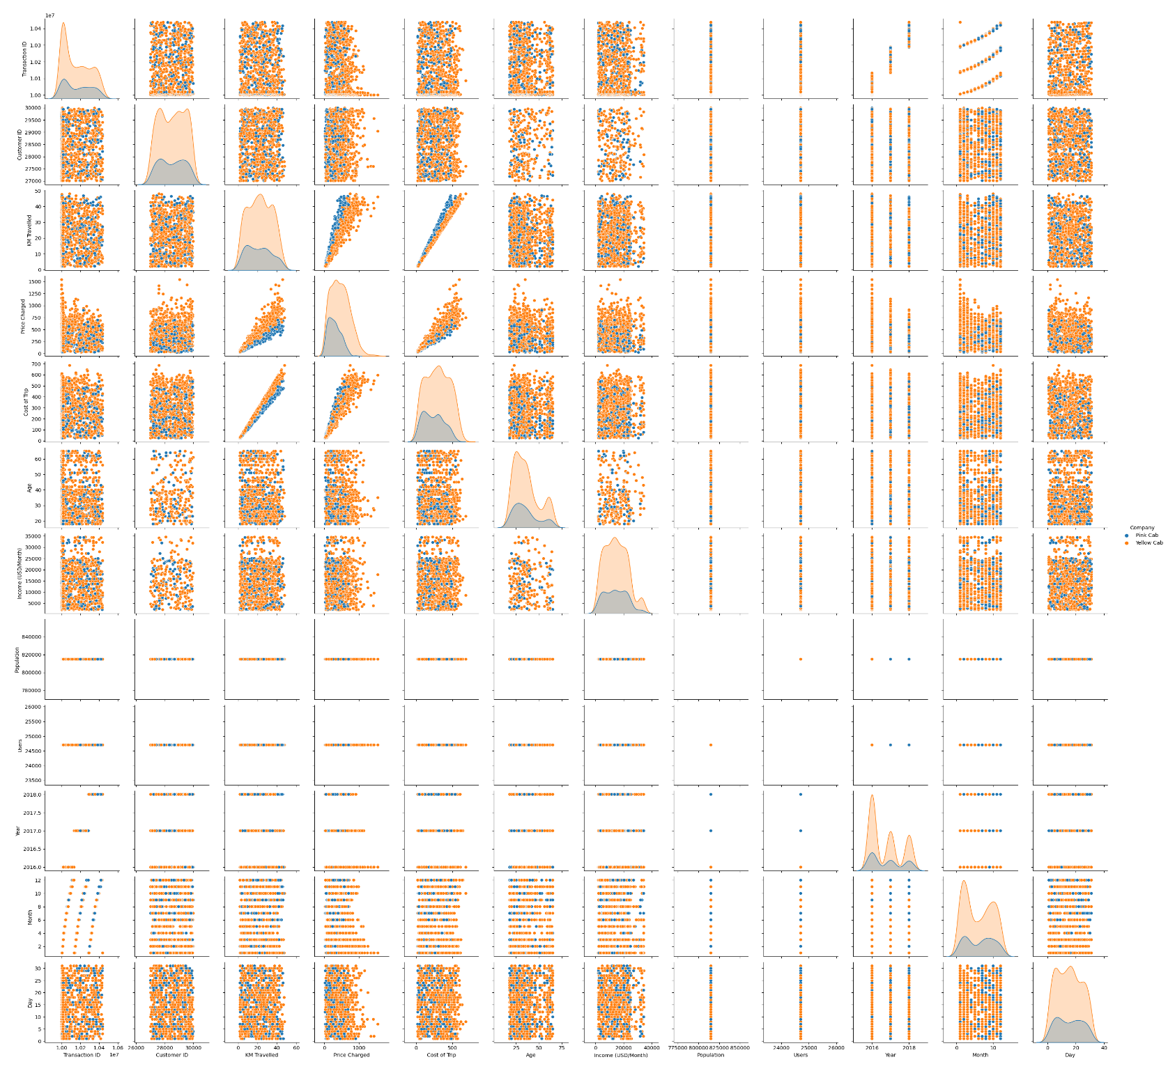
Graph showing the relationship between the variables

Slide 4
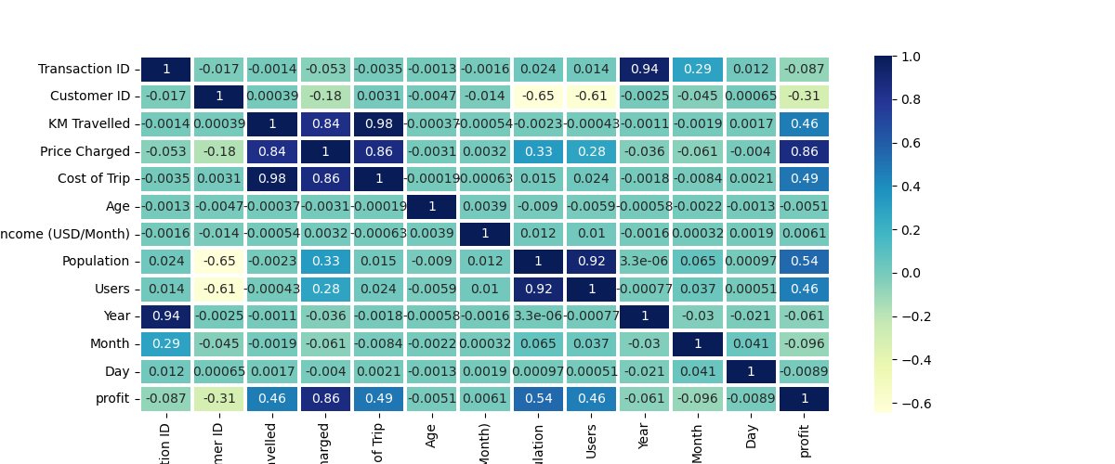
Heat map showing the correlation between the variables From the heatmap, there is a strong positive correlation between 1. Kilometer Traveled and Cost of the Trip 2. Kilometer Traveled and The Price Charged 3. Cost of the Trip and The Priced Charged

Slide 5
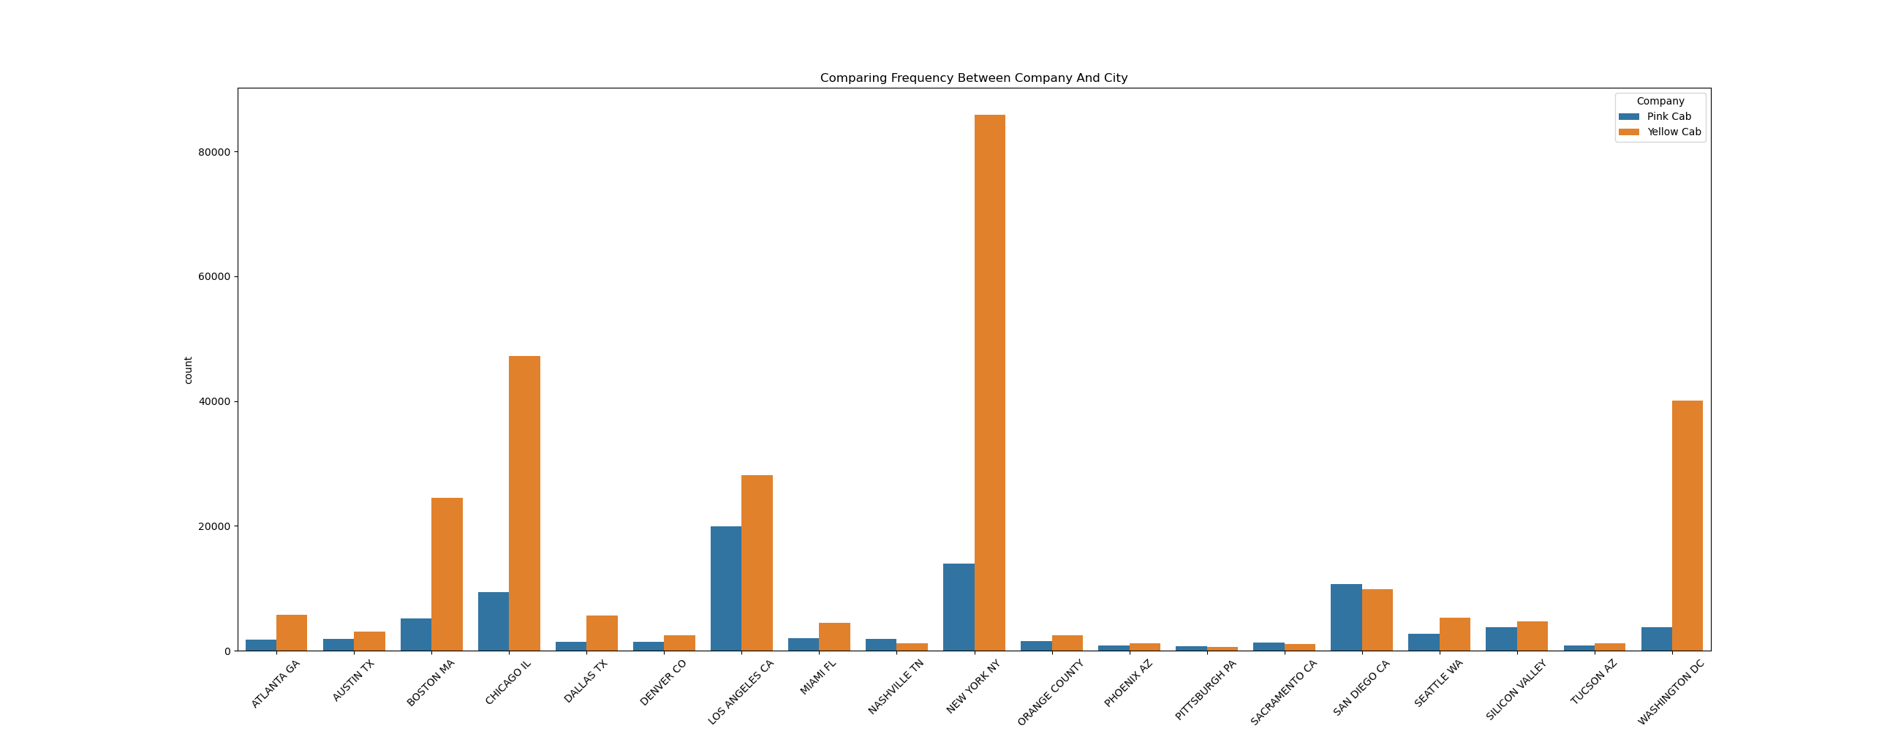
Number of each company cab in different cities. From the graph, the yellow cab has the highest number in almost all the cities.

Slide 6
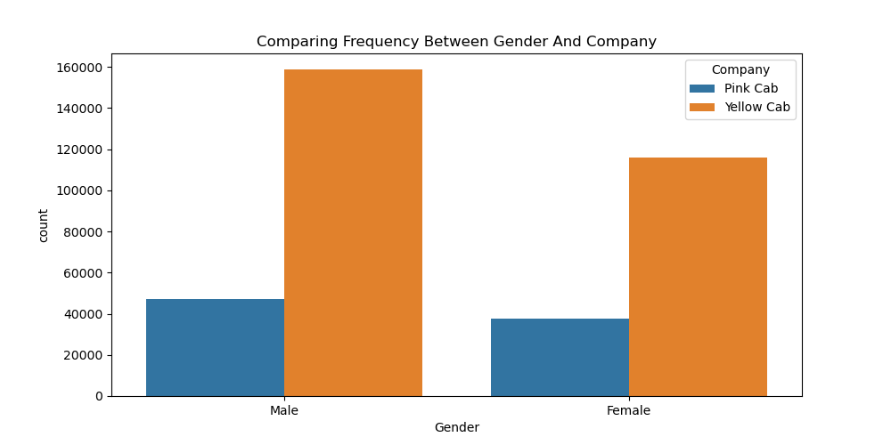
Which Company has more Users with respect to gender. Both gender rides more on the yellow cab than the pink cab.

Slide 7
Thank You

Slide 8
Thank You

Slide 9
Agenda
Executive Summary
Problem Statement
Approach
EDA
EDA Summary
Recommendations

Slide 10
Agenda
Executive Summary
Problem Statement
Approach
EDA
EDA Summary
Recommendations

Slide 11
Agenda
Executive Summary
Problem Statement
Approach
EDA
EDA Summary
Recommendations

Slide 12
Agenda
Executive Summary
Problem Statement
Approach
EDA
EDA Summary
Recommendations

Slide 13
Agenda
Executive Summary
Problem Statement
Approach
EDA
EDA Summary
Recommendations

Slide 14
Agenda
Executive Summary
Problem Statement
Approach
EDA
EDA Summary
Recommendations

Slide 15
Agenda
Executive Summary
Problem Statement
Approach
EDA
EDA Summary
Recommendations

Slide 16
Agenda
Executive Summary
Problem Statement
Approach
EDA
EDA Summary
Recommendations

Slide 17
Agenda
Executive Summary
Problem Statement
Approach
EDA
EDA Summary
Recommendations

Slide 18
Agenda
Executive Summary
Problem Statement
Approach
EDA
EDA Summary
Recommendations

Slide 19
Agenda
Executive Summary
Problem Statement
Approach
EDA
EDA Summary
Recommendations

Slide 20
Agenda
Executive Summary
Problem Statement
Approach
EDA
EDA Summary
Recommendations

