Slide 1
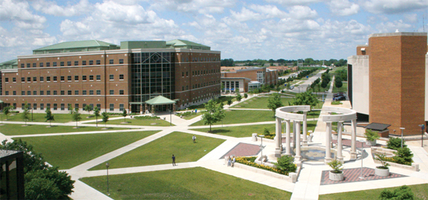
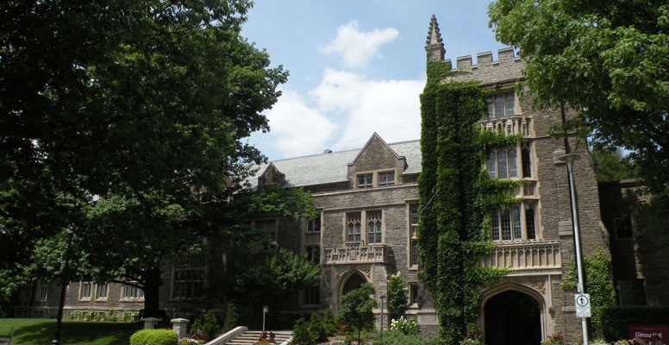
A little about myself…
Hamed Qahri-Saremi
Assistant Professor of Management Information Systems (MIS), College of Business & Management, University of Illinois (Springfield Campus).
Ph.D. in Business Administration with concentration on Information Systems from DeGroote School of Business, McMaster University, Canada.

Slide 2
A little about myself…
Research Interests & Examples
Information Systems Use (Patterns of Use, Antecedents, and Consequences)
  Turel, O. & Qahri-Saremi, H. (equal contributions) “Ambivalence and its Responses in Information System Use: An Integrative Framework and Empirical Examination”, Invited to Revise & Resubmit for 2nd Round of Review at Management Science.
  Turel, O. & Qahri-Saremi, H. (equal contributions) “Dual-System Etiology and Consequences of Compulsive Use of Information Systems: An Examination of Social Networking Site Users”. Under Review at Information Systems Research.
  Qahri-Saremi, H. & Turel, O. (equal contributions) “School Engagement on IT use and School Performance”. Under Review at Computers & Education.
  Montazemi, A.R., & Qahri-Saremi, H. 2015. (equal contributions) "Factors Affecting Adoption of Online Banking: A Meta-Analytic Structural Equation Modeling Study," Information & Management (52:2), pp. 210-226.
  Montazemi, A.R., Pittaway, J.J., Qahri Saremi, H., and Wei, Y. 2012. (equal contributions) "Factors of Stickiness in Transfers of Know-How between MNC Units," The Journal of Strategic Information Systems (21), pp. 31-57.
Electronic Word of Mouth and Online Social Networks
  Qahri-Saremi, H., Pittaway J. J., & Montazemi, A. R. (equal contributions) “The effectiveness of electronic word-of-mouth on the formation of consumers’ perception of products/services adoption process: a mixed-method literature synthesis”. To be submitted to MIS Quarterly.
  Qahri Saremi, H. & Montazemi, A. R. (equal contributions) “Factors affecting the impacts of electronic word-of-mouth on consumers’ perceptions of using products/services: the role of consumers’ prior knowledge and innovativeness”. To be submitted to MIS Quarterly.
  Qahri-Saremi, H., Ebrahimi, S., Pittaway J. J., & Montazemi, A. R. (equal contributions) (2015) “Factors Affecting Firms’ Crises on Online Social Media and the Effectiveness of the Remedial Actions: A Mixed-Methods Research Program”, Presented at the Conference on Digital Experimentation (CODE) @ MIT, October 16-17.

Slide 3
Ambivalence and Its Responses in Information System Use:
An Integrative Framework And Empirical Examination
Hamed Qahri-Saremi, Ph.D.
Management Information Systems (MIS) Department,
College of Business & Management, University of Illinois at Springfield
Citation:
Turel, O. & Qahri-Saremi, H. (equal contributions) “Ambivalence and its Responses in Information System Use: An Integrative Framework and Empirical Examination”, Invited to Revise and Resubmit for 2nd Round of Review at Management Science.

Slide 4
Conceptualization of Users’ Orientations toward Information Systems (IS) as a Unidimensional Bipolar Continuum
e.g., Perceived Threat
e.g., Perceived Usefulness
Users’ Negative Orientation
Users’ Positive Orientation
Discontinued Use of IS
Continued Use of IS
(e.g., Cenfetelli and Schwarz 2011; Maier et al. 2015; Bhattacherjee and Hikmet, 2007; Liang and Xue, 2009)
(e.g., Davis 1993; Davis et al. 1992; Venkatesh et al. 2008; Venkatesh et al. 2003)

Slide 5
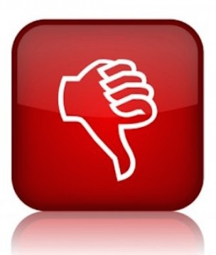

“Ambivalence”
Individuals may simultaneously experience different levels of both negative and positive orientations toward objects and behaviors, such as using an IS.
  “Ambivalence” occurs when opposing cognitions, emotions, or cognitions and emotions clash.
    Having “mixed feelings”.
    “Love & Hate relationship”.
    “Feeling torn” between conflicting ideas/emotions toward an object and/or a behavior.
(e.g., Ashforth et al. 2014; Conner et al. 2002; Horney 1946; Hirschman 1970; Pratt and Doucet 2000)

Slide 6
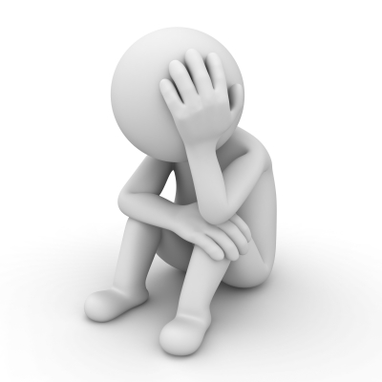
Responses to Ambivalence
The experience of ambivalence, even very small levels of it, feels wrong, unpleasant, and can result in disorientation.
Users engage in conscious or subconscious attempts to reduce or resolve the discomfort of ambivalence, which are called “responses to ambivalence”.
  Responses to ambivalence can involve modification and/or formation of cognitions, affects, and/or behavioral choices.
(e.g., Ashforth et al. 2014; Harrist 2006; Plambeck and Weber 2009; Pratt and Doucet 2000; Pratt and Pradies 2012)

Slide 7
Ambivalence:
A Bi-dimensional View Of Users’ Orientations
Users’ Negative Orientation
Users’ Positive Orientation
Users’ Positive Orientation
Users’ Negative Orientation

Slide 8
Objectives and the Scope of the Study
This study draws on “ambivalence” theories to conceptualize and empirically validate:
Triggers of Ambivalence
A bi-dimensional (positive and negative) framework of users’ orientations toward using an IS, based on the ambivalence concept
  Typical combinations of positive and negative orientations (states of ambivalence) toward using an IS that users may experience.
Plausible users’ responses to the typical combinations of positive and negative orientations (states of ambivalence).
  Users’ plausible responses to the different states of ambivalence.
States of Ambivalence
(Typical combinations of positive and negative orientations)
Resulted Behavior
(e.g., Patterns of IS Use)

Slide 9

Context of the Study
In this study, we investigate users’ ambivalence toward using an online social networking site (SNS), Facebook in particular, as an example of IS use at the individual level.
(e.g., Davis 2012; Turel 2015)

Slide 10
Hypothesis 1:
Users experience one of five unique states of ambivalence, based on the combinations of their different degrees of negative and positive orientations toward using the SNS.
Adapted from Ashforth et al. (2014)
State of ambivalence:
Low Negative – High Positive (L-H)
State of ambivalence:
High Negative – High Positive (H-H)
High
State of ambivalence:
Medium Negative – Medium Positive (M-M)
Positive Orientation Toward Continuing to Use the SNS (Facebook)
State of ambivalence:
Low Negative – Low Positive (L-L)
State of ambivalence:
High Negative – Low Positive (H-L)
Low
Low
High
Negative Orientation Toward Continuing to Use the SNS (Facebook)

Slide 11
Hypotheses 2 & (3):
Users in L-H state (H-L state) of ambivalence have significantly higher intention to continue (discontinue) using the SNS than users experiencing other states of ambivalence.
State of ambivalence:
Low Negative – High Positive (L-H)
Proposed response (H2):
Significantly higher intention to continue using the SNS.
(Positive Domination)
State of ambivalence:
High Negative – High Positive (H-H)
High
State of ambivalence:
Medium Negative – Medium Positive (M-M)
Positive Orientation Toward Continuing to Use the SNS (Facebook)
State of ambivalence:
Low Negative – Low Positive (L-L)
State of ambivalence:
High Negative – Low Positive (H-L)
Proposed response (H3):
Significantly higher intention to discontinue using the SNS.
(Negative Domination)
Low
(e.g., Ashforth et al. 2014;
Pratt and Pradies 2012)
Low
High
Negative Orientation Toward Continuing to Use the SNS (Facebook)

Slide 12
Hypothesis 4:
Users in L-L state of ambivalence have significantly lower ambivalence salience than users experiencing other states of ambivalence.
State of ambivalence:
Low Negative – High Positive (L-H)
State of ambivalence:
High Negative – High Positive (H-H)
High
State of ambivalence:
Medium Negative – Medium Positive (M-M)
Positive Orientation Toward Continuing to Use the SNS (Facebook)
State of ambivalence:
Low Negative – Low Positive (L-L)
Proposed response (H4):
Significantly lower ambivalence salience.
(Avoidance)
State of ambivalence:
High Negative – Low Positive (H-L)
Low
(e.g., Ashforth et al. 2014;
Pratt and Pradies 2012)
Low
High
Negative Orientation Toward Continuing to Use the SNS (Facebook)

Slide 13
Hypothesis 5:
Users in M-M state of ambivalence have made significantly more attempts to reduce using the SNS than users experiencing other states of ambivalence.
State of ambivalence:
Low Negative – High Positive (L-H)
State of ambivalence:
High Negative – High Positive (H-H)
High
State of ambivalence:
Medium Negative – Medium Positive (M-M)
Proposed response (H5):
Significantly more attempts to reduce using the SNS.
(Gray Compromises)
Positive Orientation Toward Continuing to Use the SNS (Facebook)
State of ambivalence:
Low Negative – Low Positive (L-L)
State of ambivalence:
High Negative – Low Positive (H-L)
Low
(e.g., Ashforth et al. 2014;
Pratt and Pradies 2012)
Low
High
Negative Orientation Toward Continuing to Use the SNS (Facebook)

Slide 14
Hypothesis 6:
Users in M-M state of ambivalence have made significantly more attempts to stop using the SNS than users experiencing other states of ambivalence.
State of ambivalence:
Low Negative – High Positive (L-H)
State of ambivalence:
High Negative – High Positive (H-H)
High
State of ambivalence:
Medium Negative – Medium Positive (M-M)
Proposed response (H6):
Significantly more attempts to stop using the SNS.
(Black and White Compromises)
Positive Orientation Toward Continuing to Use the SNS (Facebook)
State of ambivalence:
Low Negative – Low Positive (L-L)
State of ambivalence:
High Negative – Low Positive (H-L)
Low
(e.g., Ashforth et al. 2014;
Pratt and Pradies 2012)
Low
High
Negative Orientation Toward Continuing to Use the SNS (Facebook)

Slide 15
Hypotheses 7 & 8:
The holistic adaptations of the SNS is significantly more likely & ambivalence salience is significantly higher among the users in H-H state of ambivalence than users experiencing other states of ambivalence.
State of ambivalence:
Low Negative – High Positive (L-H)
State of ambivalence:
High Negative – High Positive (H-H)
Proposed responses:
(H7) Holistic adaptations of the SNS is significantly more likely.
High
State of ambivalence:
Medium Negative – Medium Positive (M-M)
(H8) Significantly higher ambivalence salience.
(Holism)
Positive Orientation Toward Continuing to Use the SNS (Facebook)
State of ambivalence:
Low Negative – Low Positive (L-L)
State of ambivalence:
High Negative – Low Positive (H-L)
Low
(e.g., Ashforth et al. 2014;
Pratt and Pradies 2012)
Low
High
Negative Orientation Toward Continuing to Use the SNS (Facebook)

Slide 16
Methodology
Sample
  An online survey was used for data collection from 442 Facebook users who were undergraduate and graduate students at a large North American university – a response rate of 81%.
Measures
  Adapted from well-established and reliable research instruments in all but one case, in which a measure was self-developed.
    Holistic adaptation was operationalized based the sum of percentages of daily time participants spend on Facebook to:
      Perform school related tasks for which Facebook use is not mandatory.
      Perform work related tasks for which Facebook use is not mandatory.
    Positive and negative orientations were measured in terms of positive and negative attitudes toward continue using Facebook.
Preliminary Analyses
    Reliability
    Validity
    Normality Assumption
    Absence of Multicollinearity
    Absence of Common Method Variance Bias

Slide 17
Results for Testing Hypothesis 1
Latent Profile Analysis (LPA)
  To identify the optimal number of distinct classes of participants that demonstrate the best fit to the data
    Based on participants’ level of positive and negative orientations (i.e., attitudes) toward continuing to use Facebook.
  LPA was conducted using the “mclust” package version 5.0.2 in R version 3.2.2 (Fraley et al., 2012).
    Optimum number of classes is determined based on Bayesian Information Criterion (BIC) (Schwarz 1978).
  LPA results showed that the data best fit a five-cluster solution, as expected.
(e.g., Schwarz 1978; Melas et al., 2014)

Slide 18
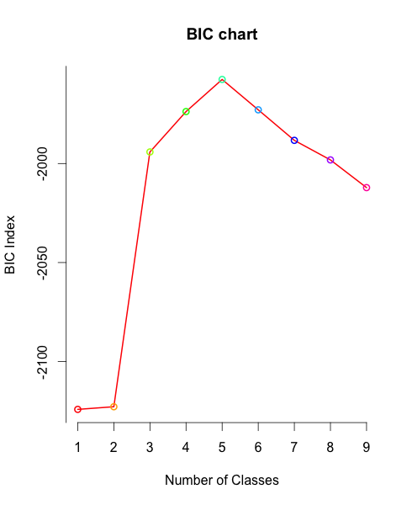
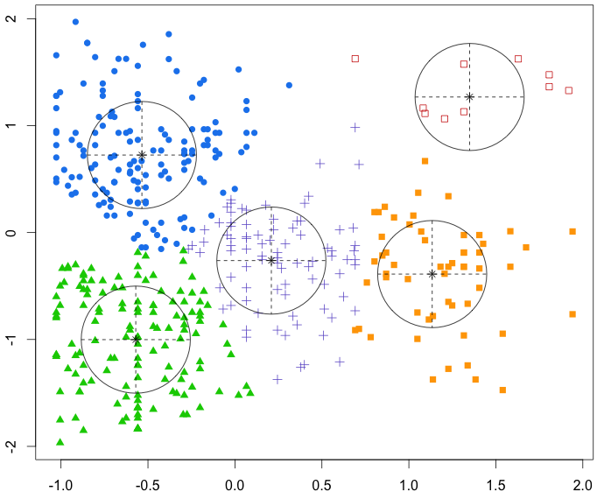
LPA (mclust package in R) Results for Testing Hypothesis 1
H-H
L-H
Positive Attitudes Toward Continuing to Use Facebook
M-M
H-L
L-L
Negative Attitudes Toward Continuing to Use Facebook

Slide 19
LPA (mclust) Results for Testing Hypothesis 1:
Summary of the Five-Class Solution
Class # | 1 | 2 | 3 | 4 | 5
Class Name* | L-H (Positive Domination) | H-L (Negative Domination) | L-L (Avoidance) | M-M (Compromise) | H-H (Holism)
Negative Orientation toward Continuing to Use Facebook (Class Centers – Standardized Scores) | -0.535 | 1.134 | -0.570 | 0.209 | 1.349
Positive Orientation toward Continuing to Use Facebook (Class Centers – Standardized Scores) | 0.725 | -0.388 | -1.001 | -0.262 | 1.268
Class Size | 149 | 56 | 141 | 86 | 10
Proportion of participants in Each Class | 33.7% | 12.7% | 31.9% | 19.5% | 2.3%
BIC for Five-Class Solution | -1957.539
* The notation we use for cluster description is: the level of negative orientation (L, M, or H) - the level of positive orientation (L, M, or H); where L=Low, M=Medium, and H=High.

Slide 20
ANOVA Results for Testing Hypotheses 2 to 8
Based on a series of between-class ANOVA tests:
Hypotheses |  | Results (p < 0.05)
H2 | Users in L-H state of ambivalence have significantly higher intention to continue using the SNS than users experiencing other states of ambivalence. | Supported *
H3 | Users in H-L state of ambivalence have significantly higher intention to discontinue using the SNS than users experiencing other states of ambivalence. | Supported *
H4 | Users in L-L state of ambivalence have significantly lower level of ambivalence salience than users experiencing other states of ambivalence. | Supported *
H5 | Users in M-M state of ambivalence have made significantly more attempts to reduce using the SNS than users experiencing other states of ambivalence. | Supported *
H6 | Users in M-M state of ambivalence have made significantly more attempts to stop using the SNS than users experiencing other states of ambivalence. | Supported **
H7 | The holistic adaptations of the SNS is significantly more likely among the users in H-H state of ambivalence than users experiencing other states of ambivalence. | Not Supported
H8 | Users in H-H state of ambivalence have significantly higher level of ambivalence salience than users experiencing other states of ambivalence. | Not Supported
* Except for H-H state of ambivalence (N = 10). ** Except for H-H and H-L states of ambivalence.

Slide 21
Means and Standard Errors of our Six Dependent Factors in the Five States of Ambivalence

Slide 22
Post-hoc Analysis:
ANOVA Results for Testing Hypotheses 2 to 8
(After Jittered Replication of H-H class to 100 cases)
Hypotheses |  | Results (p < 0.05)
H2 | Users in L-H state of ambivalence have significantly higher intention to continue using the SNS than users experiencing other states of ambivalence. | Supported *
H3 | Users in H-L state of ambivalence have significantly higher intention to discontinue using the SNS than users experiencing other states of ambivalence. | Supported *^
H4 | Users in L-L state of ambivalence have significantly lower level of ambivalence salience than users experiencing other states of ambivalence. | Supported *
H5 | Users in M-M state of ambivalence have made significantly more attempts to reduce using the SNS than users experiencing other states of ambivalence. | Supported *
H6 | Users in M-M state of ambivalence have made significantly more attempts to stop using the SNS than users experiencing other states of ambivalence. | Supported *^^
H7 | The holistic adaptations of the SNS is significantly more likely among the users in H-H state of ambivalence than users experiencing other states of ambivalence. | Supported *
H8 | Users in H-H state of ambivalence have significantly higher level of ambivalence salience than users experiencing other states of ambivalence. | Supported *
* Based on H-H class of 100 (after jittered replication). ^ Except for H-H state of ambivalence. ^^ Except for H-L and H-H states of ambivalence.

Slide 23
Post-hoc Analysis:
Means and Standard Errors of our Six Dependent Factors in the Five States of Ambivalence

Slide 24
Discussions
Some of the Main Theoretical Contributions:
  Extends the oft-taken unidimensional bipolar view of IS users’ decision making to a bi-dimensional view, which is more elaborate and realistic.
  Helps explain IS use behaviors from a more holistic standpoint, taking into account different types of situations and responses to them.
    By showing that different states of ambivalence lead to different responses, this study provides an explanation for the different patterns of IS use.
  Points to less-often explored patterns of IS use.
    This study paves the way for further research on IS users’ mindsets, ambivalence in IS use contexts and responses to different types of ambivalence among IS users.

Slide 25
Discussions
One of the Main Practical Implications:
  Our findings point to the need to adopt the more realistic, bi-dimensional view to system implementation by simultaneously focusing on both positive and negative orientations toward system use.
Limitations:
  This study examined a snapshot of ambivalence states without considering their potential changes over time.
    Requires a longitudinal empirical study (an avenue for future research).
  The hypotheses were empirically validated in a single context, namely the use of a SNS.
    Extension to other contexts, such as organizational contexts, is an avenue for future research.

Slide 26
References
Ashforth, B.E., Rogers, K.M., Pratt, M.G., and Pradies, C. 2014. "Ambivalence in Organizations: A Multilevel Approach," Organization Science (25:5), pp. 1453-1478.
Cenfetelli, R.T., and Schwarz, A. 2011. "Identifying and Testing the Inhibitors of Technology Usage Intentions," Information Systems Research (22:4), Dec, pp. 808-823.
Conner, M., Sparks, P., Povey, R., James, R., Shepherd, R., and Armitage, C.J. 2002. "Moderator Effects of Attitudinal Ambivalence on Attitude–Behaviour Relationships," European Journal of Social Psychology (32:5), pp. 705-718.
Davis, F.D. 1993. "User Acceptance of Information Technology: System Characteristics, User Perceptions and Behavioral Impacts," International Journal of Man-Machine Studies (38:3), pp. 475-487.
Davis, F.D., Bagozzi, R.P., and Warshaw, P.R. 1992. "Extrinsic and Intrinsic Motivation to Use Computers in Workplace," Journal of Applied and Social Psychology (22:14), pp. 1111-1132.
Davis, J.L. 2012. "Social Media and Experiential Ambivalence," Future Internet (4:4), pp. 955-970.
Fraley C, Raftery AE, Murphy TB, Scrucca L (2012). Mclust version 4 for R: Normal mixture modeling for model-based clustering, classification, and density estimation.
Hirschman, A.O. 1970. Exit, Voice, and Loyalty: Responses to Decline in Firms, Organizations, and States. USA: Harvard University Press.
Horney, K. 1946. Our Inner Conflicts: A Constructive Theory of Neurosis. Oxfordshire, UK: Routledge.
Maier, C., Laumer, S., Eckhardt, A., and Weitzel, T. 2015. "Giving Too Much Social Support: Social Overload on Social Networking Sites," European Journal of Information Systems (Forthcoming:-), pp. 1-18.
Pratt, M.G., and Doucet, L. 2000. "Ambivalent Feelings in Organizational Relationships," in Emotion in Organizations, S. Fineman (ed.). London, UK: Sage, pp. 204–226.
Schwarz, G. 1978. "Estimating the Dimension of a Model," The annals of statistics (6:2), pp. 461-464.
Stein MK, Newell S, Wagner EL, Galliers RD (2015). Coping with information technology: Mixed emotions, vacillation, and nonconforming use patterns. MIS Quarterly. 39(2): 367-392.
Venkatesh, V., Brown, S.A., Maruping, L.M., and Bala, H. 2008. "Predicting Different Conceptualizations of System Use: The Competing Roles of Behavioral Intention, Facilitating Conditions, and Behavioral Expectation," MIS Quarterly (32:3), pp. 483-502.
Venkatesh, V., Morris, M.G., Davis, G.B., and Davis, F.D. 2003. "User Acceptance of Information Technology: Toward a Unified View," MIS Quarterly (27:3), Sep., pp. 425-478.

Slide 27
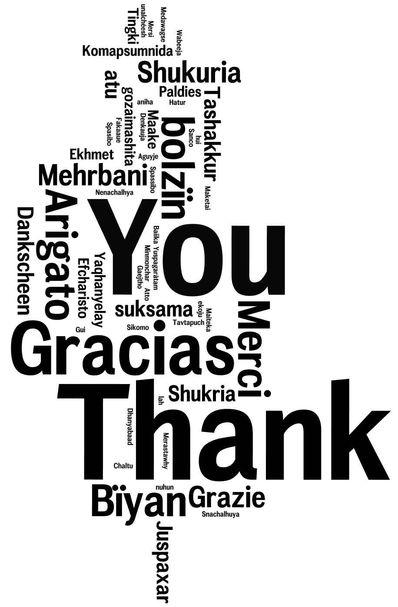
Q&A
תודה
سپاس
شکرا‍‍‍‍
谢谢
Image by WoodleyWonderWorks

Slide 28
Constructs & Measurement Instruments (1/2)
Positive Attitude Toward Continuing to Use Facebook (Positive Orientation) | Please indicate the likelihood that continuing to use Facebook would result in each of these seven different outcomes (1 = extremely unlikely to 7 = extremely likely). Also, please indicate how good or bad each of the seven possible outcomes presented would be for you (1 = Not good at all to 7 = extremely good). Free up my time Allow me to improve my relationship with family and friends Help me improve my academic achievement Reduce my stress Improve my mood Reduce my negative feelings Reduce my need to come up with excuses explaining my behavior
Negative Attitude Toward Continuing to Use Facebook (Negative Orientation) | Please indicate the likelihood that continuing to use Facebook would result in each of these seven different outcomes (1 = extremely unlikely to 7 = extremely likely). Also, please indicate how good or bad each of the seven possible outcomes presented would be for you (1 = Not bad at all to 7 = extremely bad). Negatively affect my social life Ruin my relationship with friends Hurt my academic achievement Increase my stress Negatively affect my mood Increase my negative feelings Increase my need to come up with excuses explaining my behavior
Intention to Continue Using Facebook | Please reflect on your experience with Facebook. Then indicate the extent of your future intentions to use it, as per the statements below (1 = not at all to 7 = to a very large extent). I intend to use Facebook in the next 3 months. I predict I would use Facebook in the next 3 months. I plan to use Facebook in the next 3 months.
Intention to Discontinue Using Facebook | Please reflect on your experience with Facebook. Then indicate the extent of your future intentions to stop using it, as per the statements below (1 = not at all to 7 = to a very large extent). I intend to stop using Facebook in the next 3 months. I predict I would stop using Facebook in the next 3 months. I plan to stop using Facebook in the next 3 months.

Slide 29
Constructs & Measurement Instruments (2/2)
Ambivalence Salience | Reflecting on your experience with Facebook, how often did you face internal struggles between intentions to continue using it and intentions to discontinue using it… (1 = never 7 = extremely often) ...in the last week ...in the last month ...in the last 3 months
Number of Use Reduction Attempts | Please reflect on your experience with Facebook (1=never to 7=more than 10 times) How many times have you tried to reduce the time you spend on Facebook? How many times have you tried to reduce your use of Facebook?
Number of Use Stop Attempts | Please reflect on your experience with Facebook (1=never to 7=more than 10 times) How many times have you tried to stop using Facebook? How many times have you tried to stop using Facebook in the last three months?
Holistic Adaptation | Please consider a typical day, and allocate the percentage of time you spend on using Facebook for each one of these purposes: To perform school related tasks (e.g., ask for help with assignments or collaborate on school projects) To perform work related tasks (e.g., communicate with customers or advertise the business)

Slide 30
Descriptive Statistics, Reliabilities,
Square Root of AVEs (on diagonal), and Correlations
 | Mean (SD) | Skewness (Kurtosis) | Comp Rel. (Cronbach alpha) | 1 | 2 | 3 | 4 | 5 | 6 | 7 | 8 | 9 | 10 | 11 | 12
(1) Behavioural intention to discontinue | 1.79 (1.3) | 1.73 (2.42) | 0.98 (0.96) | 0.97
(2) Behavioural intention to continue | 5.80 (1.3) | -1.10 (0.94) | 0.98 (0.97) | -0.57** | 0.97
(3) Negative Attitude | 6.72 (4.5) | 0.946 (0.66) | 0.94 (0.92) | 0.35** | -0.30** | 0.82
(4) Positive Attitude | 18.68 (7.7) | 0.102 (-0.725) | 0.90 (0.87) | -0.03 | 0.12* | -0.01 | 0.76
(5) Ambivalence Salience | 1.74 (1.0) | 1.44 (1.46) | 0.96 (0.93) | 0.32** | -0.21** | 0.21** | 0.19** | 0.94
(6) Number of Use Reduction Attempts | 2.34 (1.7) | 1.19 (0.49) | 0.96 (0.92) | 0.22** | -0.08* | 0.06 | 0.09* | 0.36** | 0.96
(7) Number of Use Stop Attempts | 1.60 (0.98) | 2.32 (4.01) | 0.83 (0.75) | 0.23** | -0.17** | 0.11* | 0.10* | 0.34** | 0.53** | 0.84
(8) Holistic Adaptation | 13.78 (18) | 1.96 (4.24) | NA | 0.11* | -0.17** | 0.09 | 0.02 | 0.05 | 0.03 | 0.05 | 0.77
(9) Age | 24 (5.0) | NA | NA | 0.03 | -0.07 | 0.06 | -0.14** | -0.11* | -0.10* | -0.09 | -0.05 | NA
(10) Gender | 0.53 (0.5) | NA | NA | -0.03 | 0.09 | 0.01 | -0.07 | -0.04 | -0.12* | -0.10* | 0.06 | -0.04 | NA
(11) Years of Facebook Experience | 3.7 (1.6) | NA | NA | 0.17** | -0.03 | 0.13** | 0.10* | 0.06 | 0.09 | 0.06 | 0.06 | -0.06 | 0.02 | NA
(12) Number of Contacts on Facebook | 320 (284) | NA | NA | -0.06 | 0.11* | 0.00 | 0.07 | 0.07 | 0.20** | 0.08 | 0.12* | -0.30** | 0.01 | 0.08 | NA
(13) Other Social Networking Sites Used | 1.2 (1.2) | NA | NA | -0.10* | 0.15** | -0.02 | 0.09 | 0.05 | 0.07 | 0.01 | 0.05 | -0.05 | -0.02 | 0.03 | 0.23**

Slide 31
ANOVA Results for Hypothesis 2
(I) Class | (J) Class | Mean Difference (I-J) | Std. Error | Sig. | 95% Confidence Interval |  | Result
 |  |  |  |  | Lower Bound | Upper Bound
L-H | H-H | 0.648 | 0.308 | 0.036* | 0.043 | 1.253 | Supported
L-H | L-L | 0.262 | 0.111 | 0.018* | 0.045 | 0.480 | Supported
L-H | M-M | 0.354 | 0.128 | 0.006*** | 0.103 | 0.605 | Supported
L-H | H-L | 0.918 | 0.148 | 0.000*** | 0.628 | 1.209 | Supported
* Sig. at 0.05; *** Sig. at 0.001.

Slide 32
ANOVA Results for Hypothesis 3
(I) Class | (J) Class | Mean Difference (I-J) | Std. Error | Sig. | 95% Confidence Interval |  | Result
 |  |  |  |  | Lower Bound | Upper Bound
H-L | L-H | 0.877 | 0.148 | 0.000*** | 0.586 | 1.169 | Supported
H-L | H-H | -0.266 | 0.325 | 0.414 | -0.904 | 0.372 | Not Supported
H-L | L-L | 0.752 | 0.149 | 0.000*** | 0.459 | 1.046 | Supported
H-L | M-M | 0.537 | 0.162 | 0.001** | 0.218 | 0.856 | Supported
** Sig. at 0.01; *** Sig. at 0.001.

Slide 33
ANOVA Results for Hypothesis 4
(I) Class | (J) Class | Mean Difference (I-J) | Std. Error | Sig. | 95% Confidence Interval |  | Result
 |  |  |  |  | Lower Bound | Upper Bound
L-L | L-H | -0.279 | 0.114 | 0.015* | -0.504 | -0.054 | Supported
L-L | H-H | -0.766 | 0.319 | 0.017* | -1.393 | -0.140 | Supported
L-L | M-M | -0.263 | 0.133 | 0.049* | -0.525 | -0.001 | Supported
L-L | H-L | -0.486 | 0.154 | 0.002** | -0.788 | -0.183 | Supported
* Sig. at 0.05; ** Sig. at 0.01.

Slide 34
ANOVA Results for Hypothesis 5
(I) Class | (J) Class | Mean Difference (I-J) | Std. Error | Sig. | 95% Confidence Interval |  | Result
 |  |  |  |  | Lower Bound | Upper Bound
M-M | L-H | 0.325 | 0.126 | 0.010* | 0.077 | 0.573 | Supported
M-M | H-H | 0.457 | 0.311 | 0.143 | -0.155 | 1.068 | Not Supported
M-M | L-L | 0.409 | 0.127 | 0.001** | 0.159 | 0.660 | Supported
M-M | H-L | 0.368 | 0.160 | 0.022* | 0.053 | 0.682 | Supported
* Sig. at 0.05; ** Sig. at 0.01.

Slide 35
ANOVA Results for Hypothesis 6
(I) Class | (J) Class | Mean Difference (I-J) | Std. Error | Sig. | 95% Confidence Interval |  | Result
 |  |  |  |  | Lower Bound | Upper Bound
M-M | L-H | 0.290 | 0.134 | 0.031* | 0.027 | 0.554 | Supported
M-M | H-H | 0.152 | 0.331 | 0.647 | -0.499 | 0.802 | Not Supported
M-M | L-L | 0.471 | 0.136 | 0.001** | 0.205 | 0.737 | Supported
M-M | H-L | 0.255 | 0.170 | 0.134 | -0.079 | 0.590 | Not Supported
* Sig. at 0.05; ** Sig. at 0.01.

Slide 36
ANOVA Results for Hypothesis 7
(I) Class | (J) Class | Mean Difference (I-J) | Std. Error | Sig. | 95% Confidence Interval |  | Result
 |  |  |  |  | Lower Bound | Upper Bound
H-H | L-H | 0.610 | 0.325 | 0.061† | -0.029 | 1.250 | Marginally Supported
H-H | L-L | 0.500 | 0.326 | 0.126 | -0.141 | 1.140 | Not Supported
H-H | M-M | 0.311 | 0.333 | 0.351 | -0.343 | 0.965 | Not Supported
H-H | H-L | 0.441 | 0.342 | 0.198 | -0.231 | 1.113 | Not Supported
† Sig. at 0.1.

Slide 37
ANOVA Results for Hypothesis 8
(I) Class | (J) Class | Mean Difference (I-J) | Std. Error | Sig. | 95% Confidence Interval |  | Result
 |  |  |  |  | Lower Bound | Upper Bound
H-H | L-H | 0.487 | 0.318 | 0.126 | -0.138 | 1.113 | Not Supported
H-H | L-L | 0.766 | 0.319 | 0.017* | 0.140 | 1.393 | Supported
H-H | M-M | 0.503 | 0.325 | 0.123 | -0.136 | 1.143 | Not Supported
H-H | H-L | 0.281 | 0.334 | 0.402 | -0.376 | 0.938 | Not Supported
** Sig. at 0.01; *** Sig. at 0.001.

Slide 38
ANOVA Tests for Hypotheses 2-8 with extended H-H (Holism) Class (n=100)
(I) Class | (J) Class | Mean Difference (I-J) | Std. Error | Sig. | 95% Confidence Interval |  | Result
 |  |  |  |  | Lower Bound | Upper Bound
Results for Testing Hypothesis 2 (n=100):
L-H | H-H | 0.676 | 0.123 | 0.000*** | 0.434 | 0.919 | Supported
Results for Testing Hypothesis 3 (n=100):
H-L | H-H | -0.230 | 0.155 | 0.108 | -0.534 | 0.074 | Not Supported
Results for Testing Hypothesis 4 (n=100):
L-L | H-H | -0.745 | 0.127 | 0.000*** | -0.994 | -0.496 | Supported
Results for Testing Hypothesis 5 (n=100):
M-M | H-H | 0.507 | 0.146 | 0.001** | 0.221 | 0.793 | Supported
Results for Testing Hypothesis 6 (n=100):
M-M | H-H | 0.150 | 0.146 | 0.303 | -0.136 | 0.437 | Not Supported
Results for Testing Hypothesis 7 (n=100):
H-H | L-H | 0.618 | 0.127 | 0.000*** | 0.369 | 0.867 | Supported
H-H | L-L | 0.508 | 0.128 | 0.000*** | 0.257 | 0.760 | Supported
H-H | M-M | 0.320 | 0.144 | 0.027* | 0.037 | 0.603 | Supported
H-H | H-L | 0.450 | 0.163 | 0.006** | 0.128 | 0.771 | Supported
Results for Testing Hypothesis 8 (n=100):
H-H | L-H | 0.473 | 0.125 | 0.000*** | 0.226 | 0.719 | Supported
H-H | L-L | 0.745 | 0.127 | 0.000*** | 0.496 | 0.994 | Supported
H-H | M-M | 0.488 | 0.143 | 0.001** | 0.208 | 0.769 | Supported
H-H | H-L | 0.271 | 0.162 | 0.095† | -0.047 | 0.589 | Marginally Supported
Note: † Sig. at 0.1; * Sig. at 0.05; ** Sig. at 0.01; *** Sig. at 0.001.

Slide 39
Responses to Ambivalence towards Using an IS in the Prior IS Research
Responses to the Ambivalence Towards Using an IS | Examples of Constructs used in the Prior IS Research | Research Method | Individual Level | Collective Level | Multi-level
Holistic Adaptation | Adaptation of IT and processes (Goh et al. 2011) Adaptive system use (Sun 2012) Innovative use (Li et al. 2013) | Quantitative | 6 | - | -
 |  | Qualitative | 4 | 1 | -
 |  | Theoretical | - | 1 | -
Use Continuance | Adoption (e.g., Niculescu et al. 2012) Assimilation of Enterprise Systems (e.g., Liang et al. 2007) Intention to Continue Using (e.g., Ortiz de Guinea and Markus 2009) System Acceptance (e.g., van Offenbeek et al. 2013) Technology Use (e.g., Kim 2009) | Quantitative | 53 | 19 | 1
 |  | Qualitative | 5 | 5 | -
 |  | Mixed-Methods | 1 | 1 | -
 |  | Theoretical | 4 | 1 | 2
 |  | Simulation | - | 1 | 1
Use Discontinuance | Intention to Discontinue Using (e.g., Sun 2013) Discontinuance Intentions (Turel 2015) Discontinued Use (Maier et al. 2015) Switching Behavior (Ranganathan et al. 2006) | Quantitative | 7 | 1 | -
 |  | Qualitative | 3 | - | -
 |  | Mixed-Methods | 1 | 1 | 1
 |  | Theoretical | - | 1 | -
Use Reduction | Diversity of Electronic Patient Record Use (Oborn et al. 2011) | Qualitative | 1 | - | -
Vacillation | Vacillating between focusing on positive and negative orientations toward using the IS (Stein, et al., 2015) | Qualitative | 1 | - | -
Ambivalence Salience | - | - | - | - | -

Slide 40
Lack of Significance in an ANOVA Test in Support of H6
A Non-Significant ANOVA Result for H6.
Between M-M and H-H for vacillation strategy (H6):
  The direction of differences in means is consistent with our hypothesis.
  Our findings show that vacillation strategy is not significantly more plausible in M-M cluster as compared to H-H cluster.
  This finding is consistent with Stein et al., (2015) suggestion that it is difficult to differ the vacillation strategy between H-H and M-M classes.
  Future studies can shed a better light on this issue.

Slide 41
Lack of Significance in an ANOVA Test in Support of H6
A Non-Significant ANOVA Result for H6.
Between M-M and H-L for vacillation strategy (H6):
  The direction of differences in means is consistent with our hypothesis.
  Considering that H-L represents participants with stronger intention to discontinue using SNS, perhaps the number of attempts to stop using can not adequately distinguish the vacillation strategy between these two clusters.
  This study is the first study that is quantitatively measuring the vacillation strategy. Future studies should use other operationalizations to shed a better light on this.

Slide 42
Lack of Significance in an ANOVA Test in Support of H3
A Non-Significant ANOVA Result for H3.
Between H-H and H-L for intention to discontinue using (H3):
  We could not find a theoretical explanation for this result.
  However, it can be a consequence of inflated outlier effect in a small class:
    Considering the small size of H-H, it is more prone to inflated effects of outliers. This problem is not resolved, if not extended, by jittered replication.
  Future studies can shed a better light on this, as to whether this is the effect of outliers in a small class or it has a theoretical explanation.

Slide 43
Lack of Significance in an ANOVA Test in Support of H3:
Distribution of “Intention to Discontinue Using SNS” Factor in H-H Class
Our examination of the distribution of “intention to discontinue using” factor in H-H class shows that while the mean is 2.9, the standard deviation is 2.3, which indicates a large range of values.
  In particular, while 8 out of 10 participants (80% of values) scored 4 or below out of 7, two participants (20% of values) scored 6 and 7 out of 7 for intention to discontinue using.
  We believe that these two data points (out of 10) have inflated the mean.
Values | Frequency | Percent |  | Valid Percent | Cumulative Percent
1 | 3 | 30 |  | 30 | 30
1 | 1 | 10 |  | 10 | 40
2 | 2 | 20 |  | 20 | 60
4 | 2 | 20 |  | 20 | 80
6 | 1 | 10 |  | 10 | 90
7 | 1 | 10 |  | 10 | 100
Total | 10 | 100 |  | 100
Mean: Standard Deviation: |  |  | 2.9 2.3

