Slide 1

Introduction to Meta Analysis
Hamed Qahri-Saremi
DePaul University
Chicago, IL
Sudeep Sharma
University of Illinois at Springfield
Springfield, IL

Slide 2
Overview of the Workshop
Topics covered will include
  Review of the basic methods
    Problem definition
    Document Retrieval
    Coding
    Effect sizes and computation
    Analysis of effect sizes
    Publication Bias
  Cutting edge issues
  Interpretation of results
  Evaluating the quality of a meta-analysis

Slide 3
What is a Meta-Analysis?
Meta-analysis is a statistical technique for synthesizing the results of a set of independent, quantitative, empirical studies on a topic, in order to determine an overall estimate of a treatment effect.
“… now widely accepted as a method of summarizing the results of empirical studies within the behavioral, social and health sciences.” Lipsey and Wilson (2001)

Slide 4

A little bit of History…
The Great Debate (Lipsey and Wilson, 2001)
  In 1952, Hans J. Eysenck concluded that there were no favourable effects of psychotherapy, starting a raging debate…
    20 years of evaluation research and hundreds of studies failed to resolve the debate
  In 1977, Smith and Glass statistically aggregated the findings of 375 psychotherapy outcome studies to show Eysenck is wrong and psychotherapy is indeed effective.
    In their research, they used a method developed by Glass (1976), called “not for want of a less pretentious name - the meta-analysis of research” (p. 3).

Slide 5
A little bit of History…
Ideas behind meta-analysis predate Glass’s work
  Karl Pearson (1904)
    averaged correlations for studies of the effectiveness of inoculation for typhoid fever
  W. G. Cochran (1953)
    Discusses a method of averaging means across independent studies
    Laid-out much of the statistical foundation that modern meta-analysis is built upon (e.g., Inverse variance weighting and homogeneity testing)

Slide 6

Meta-Analysis vs. Narrative Reviews
Let us review this sample of studies and answer the following two questions:
  What tentative conclusions can you reach about the relationship between job satisfaction and organizational commitment?
  What variables do you believe moderate this relationship?
Source: Hunter & Schmidt (2004)

Slide 7

Meta-Analysis vs. Narrative Reviews
Source: Hunter & Schmidt (2004)

Slide 8
Meta-Analysis vs. Narrative Reviews
The preceding review was conducted using standard review practices that characterize many narrative reviews in social sciences, including information systems.

Slide 9
Meta-Analysis vs. Narrative Reviews
There is one problem, though:
  The data were constructed by a Monte Carlo simulation:
    The mean population correlation was assumed to be 0.33.
    The sample sizes were randomly chosen from a distribution centering about 40.
    The study characteristics were assigned randomly.
  In other words,
    The variation among correlations is entirely the result of sampling error.
    The moderator effects that appear to make sense are purely the results of chance.
The crucial lesson: “conflicting results in the literature” may be entirely artefactual.
  Meta-Analysis can help us detect them and differentiate between artefactual and systematic sources of variations in results.

Slide 10
Meta-Analysis vs. Single Studies
Single studies may not be sufficient to determine the utility of an intervention or a hypothesis’ validity.
  E.g., ‘The Great Debate’ on Psychotherapy’s effectiveness (1952-1978) (Lipsey and Wilson, 2001).
  Single studies are limited in their statistical power, unless the sample size is very large, which is not common.
    Low statistical power can increase the error rates well beyond the 5%.
Meta-Analysis can be used as original publications, highlighting directions for future research on a topic.

Slide 11
When Can You Do Meta-analysis?
Meta-analysis is applicable to collections of research that
  Are empirical, rather than theoretical.
  Produce quantitative results, rather than qualitative findings.
  Examine the same constructs and relationships.
  Provide findings that can be configured in a comparable statistical form as effect sizes.
  Are “comparable” given the question at hand.
Source: Lindsey & Wilson (2001)

Slide 12
Eight Steps to Conduct a Meta-Analysis
Problem Definition
Establishing Inclusion/Exclusion Criteria
Literature Search and Studies Retrieval
Coding Data and Calculating Effect Sizes
Doing the Basic Meta-Analysis
  Decide on Fixed-Effects vs. Random-Effects Meta-Analysis
  Conduct the Basic Meta-Analysis
Moderation Analysis
Estimating the Publication Bias
Writing it up!

Slide 13
Problem Definition
Forms of Problems Suitable to a Meta-analysis:
(determine the choice of effect size)
  Association between Variables
    What is the correlation between system use and job satisfaction?
    Measurement Research
      Validation Generalization.
  Central Tendency Description
    What is the mean level of satisfaction among users of a system?
  Pre-Post Contrasts
    How did employees’ satisfaction levels change before and after adopting a system?
  Group Contrasts
    Are employees who are using a system more satisfied than non-users?
Source: Lindsey & Wilson (2001)

Slide 14
Establishing Inclusion/Exclusion Criteria: Which Studies to Include?
Components of a detailed criteria:
  Distinguishing Features
    E.g., post-adoption studies.
  Research respondents
    E.g., Studies of online banking users.
  Key variables
  Research methods
    E.g., Survey-based research.
  Cultural and linguistic range
  Time frame
  Publication types
Refine the criteria as you interact with the literature.
Source: Lindsey & Wilson (2001)

Slide 15
Establishing Inclusion/Exclusion Criteria: Which Studies to Include?
Include or exclude low quality studies?
  The findings of all studies are potentially in error
    Methodological quality is a continuum, not a dichotomy.
  Being too restrictive may restrict ability to generalize.
  Being too inclusive may weaken the confidence that can be placed in the findings.
  Methodological quality is often in the “eye-of-the-beholder”.
  You must strike a balance that is appropriate to your research question.
Source: Lindsey & Wilson (2001)

Slide 16
Literature Search and Studies Retrieval
Search Far & Wide
(not just published studies)
You should have EVERY relevant article
  Census, not a sample.
  Look for conference presentations and proceedings
Search in electronic reference databases.
Search bibliography of previous reviews and pertinent primary studies.
Hand search journals that frequently publish on the topic.
  AND the important journals in the field.
Try to find “special issues” on the topic.
Post to Listservs and relevant forums for unpublished work.
Contact authors who have published on your topic.

Slide 17

Literature Search and Studies Retrieval
Source: Moher D, Liberati A, Tetzlaff J, Altman DG, The PRISMA Group (2009). Preferred Reporting Items for Systematic Reviews and Meta Analyses: The PRISMA Statement. PLoS Med 6(7): e1000097. doi:10.1371/journal.pmed1000097
www.prisma-statement.org.

Slide 18
Coding Data
What to code – An important decision…
Decide which characteristics you want to code in each study.
  Choice of Effect Sizes to Code.
    Depends on Problem Definition.
  Choice of potential Moderators to Code.
    Code everything that might explain variation in findings
      Methodological Issues
        E.g., Variations in Measures and Operationalization; Survey vs. Panel data.
      Study Characteristics
        E.g., Contextual Differences; Rigor.
      Theoretical Differences Across Studies
        E.g., Firm Size; Pre-adoption vs. Post-adoption Studies.

Slide 19
Effect Size (ES):
The Key to Meta-Analysis
An effect size (ES) is a measure of the magnitude and direction of a relationship between two variables or a contrast between groups.
  It is the “dependent variable” in meta-analysis.
  The ES encodes the selected research findings on a numeric scale.
An ES should be:
  Comparable across studies (generally requires standardization across studies).
  Independent of sample size.
Different meta-analyses use different effect size indices depending on their objectives.
  Each ES type may also have multiple methods of computation.

Slide 20
Effect Size (ES):
The Correlation Coefficient
Represents the strength of association between two inherently continuous variables.
Generally reported directly as “r” (the Pearson product moment coefficient)
Source: Lindsey & Wilson (2001)

Slide 21
Effect Size (ES):
The Standardized Mean Difference
Represents a standardized group contrast on an inherently continuous measure.
Uses the pooled standard deviation (some situations use control group standard deviation).
  Cohen’s d
  Hedge’s g
Source: Lindsey & Wilson (2001)

Slide 22

Effect Size (ES):
The Odds-Ratio
Represents a group contrast on an inherently dichotomized measure.
The odds-ratio is based on a 2 x 2 contingency table:
  The odds of success in the treatment group relative to the odds of success in the control group.
e.g.,
System Users
e.g.,
Job Satisfaction
ES
Source: Lindsey & Wilson (2001)

Slide 23
Effect Size (ES):
The Risk Ratio
Represents a group contrast on an inherently dichotomized measure.
The risk ratio is also based on data from a 2 by 2 contingency table:
  The ratio of the probability of success (or failure) for each group.
e.g.,
System Users
e.g.,
Job Promotion

Slide 24
Effect Size (ES):
Additional Data to Code Along With the ES
Sample Size
Construct Measurement Scale
Reliability of Constructs
  E.g., Cronbach’s Alpha.

Slide 25
Effect Size (ES):
Issues in Coding Effect Sizes
Not every article will have a nice correlation table with sample size (N), alphas, etc.
So, you may need to look for “r” substitutes:
  Beta values if there is only one independent variable (IV) in the regression equation.
  Beta if this is the first step in hierarchical regression.
  A path coefficient in SEM (if no other IVs affecting that dependent variable).
  (See: Appendix B in Montazemi & Qahri-Saremi (2015))

Slide 26
Effect Size (ES):
Independent Set of Effect Sizes
Must be dealing with an independent set of effect sizes before proceeding with the analysis.
  One ES per a study OR
  One ES per each subsample within a study
Remember:
  One paper can report multiple independent studies (e.g., study1, study 2)
    Therefore, one paper can provide multiple ES, one for each independent sample.
  Multiple studies might be based on the same sample
    In this case, only one ES from that sample should be drawn.
Source: Montazemi & Qahri-Saremi (2015)

Slide 27
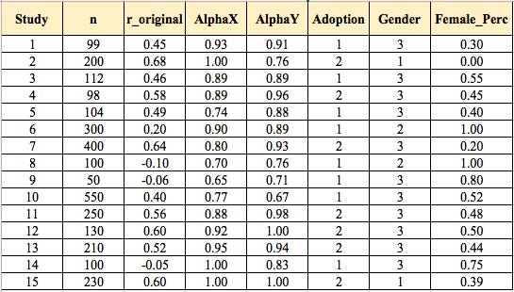
Effect Size (ES)
So far, you should have a list of studies with their:
  Effect sizes
  Sample sizes
  Reliabilities of Measures
  Potential moderators

Slide 28
The Basic Meta-Analysis
Fixed-Effects vs. Random-Effects Meta-Analysis
Fixed-Effects Meta-Analysis:
  All studies are drawn from ONE homogenous population and any variation among their effect sizes is the result of sampling errors.
    There is a fixed effect that varies in different samples (studies) as a result of sampling error.
  The variance for the pooled ES is made up only sampling errors (within study variance).
    E.g., Hedges & Olkin (1985) fixed-effects method.
Source: Montazemi & Qahri-Saremi (2015)

Slide 29
The Basic Meta-Analysis
Fixed-Effects vs. Random-Effects Meta-Analysis
Random-Effects Meta-Analysis:
  The assumption is that the average effect size in the population varies randomly from study to study:
    Studies in a meta-analysis come from populations that have different average effect sizes, so population effect sizes can be thought of as being sampled from a ‘super population’.
    In this case, the effect sizes should be heterogeneous because they come from populations with varying average effect sizes.
  The variance for the pooled ES includes both sampling error (within study variance) and between-study variance.
    E.g., Hunter & Schmidt (2004); Hedges & Olkin (1985) random-effects method.
Source: Montazemi & Qahri-Saremi (2015)

Slide 30
The Basic Meta-Analysis
Fixed-Effects vs. Random-Effects Meta-Analysis
Which Approach Should be Selected for the Meta-Analysis?
  Fixed-effect models are appropriate for inferences that extend only to the studies included in the meta-analysis (conditional inferences).
    Only if the effect sizes are homogenous.
  Random-effects models allow inferences that generalize beyond the studies included in the meta-analysis (unconditional inferences).
    When the effect sizes are not homogenous.
    Data suggest that a random-effects approach should be the norm in social sciences data.
    Note that the consequences of applying fixed-effects methods to random-effects data can be quite dramatic:
      Significance tests of the estimate of the population effect size (pooled effect size) have Type I error rates inflated from the normal 5% to 11% – 80%.
Source: Field & Gillette (2010)

Slide 31
The Basic Meta-Analysis:
Correct the effect sizes for unreliability
Standardize the effect sizes using Fisher’s Z Transformation
Weight the effect sizes
Calculate the overall weighted mean effect size (pooled effect size)
Calculate the homogeneity index (Q statistic) for the pooled effect size.
  Provide the ground for random-effects analysis and moderation analysis.
Calculate the confidence interval for the pooled effect size.

Slide 32

The Basic Meta-Analysis:
Correction for the sources of errors in effect sizes:
  Such as measurement errors (measures reliability):
  So if:
    r_{xy} = .45
    r_{xx} = .93
    r_{yy} = .91
    Then r_{c} = 0.45 / sqrt(0.93 x 0.91) = 0.49
  No reliability reported = 1.
For other possible corrections, see:
  Hunter, J.E., and Schmidt, F.L. 2004. Methods of Meta-Analysis: Correcting Error and Bias in Research Findings, (Second ed.), Sage Publications, Inc.
Corrected Correlation between variables x and y.
Observed Correlation between variables x and y.
Reliabilities for
variables x and y.

Slide 33

The Basic Meta-Analysis:
Correction for the sources of errors in effect sizes:

Slide 34
The Basic Meta-Analysis:
Transform Corrected Correlations to Fisher’s Z (standardization)
  The unstandardized corrected r has a problematic standard error formulation, so we transform it:
= 0.5 x ln (( 1 + .49)/(1 - .49))
= 0.53.
  Depending on the tools that you use, you may need to do this transformation manually (e.g., in SPSS macro provided by Wilson (2001)).
    Some tools does the transformation for you, such as metafor package in R.

Slide 35
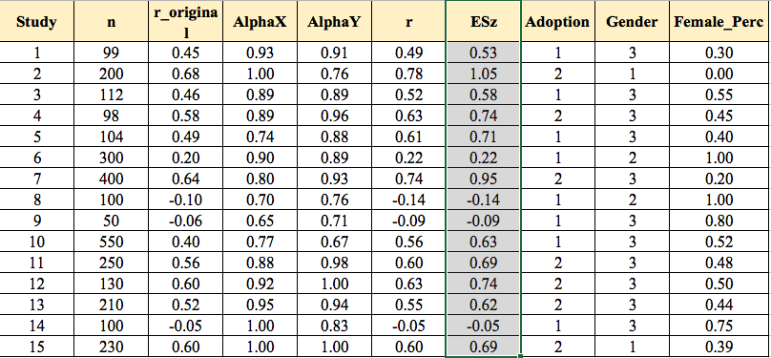
The Basic Meta-Analysis:
Transform Corrected Correlations to Fisher’s Z (standardization)

Slide 36
The Basic Meta-Analysis:
Weight the effect sizes
  The standard error (SE) is a direct index of ES precision.
    The smaller the SE, the more precise the ES.
    We would like to reduce the effect of effect sizes that are less precise (have larger SE) on our results.
    Hedges showed that the optimal weight for effect sizes is:
  The weight (w) for the transformed r (Zr) is simply:
    n = sample size for the pertinent effect size.
  w = n-3

Slide 37
The Basic Meta-Analysis:
Calculate the overall weighted mean effect size (pooled effect size)
Remember: w = n-3.
= 1780.03 / 2888
= 0.62.
  Since we have considered sampling error (SE) as the only component of variance for weighting the effect sizes, this is the “fixed-effect” pooled effect size.
z
z

Slide 38
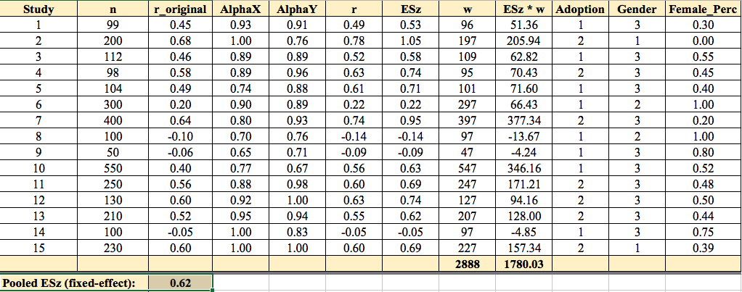
The Basic Meta-Analysis:
Weight the effect sizes
Calculate the overall weighted mean effect size (pooled effect size)

Slide 39
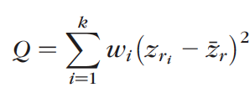


The Basic Meta-Analysis:
Calculate the homogeneity index (Q statistic) for the pooled effect size.
  Q has a chi-square distribution, with number of effect sizes (k) – 1 degrees of freedom (df).
  To assess existence of heterogeneity, Q should be compared with the critical value in chi-square distribution with df = k-1 for alpha level (0.05).
    Compare with 6.571 for K = 15-1 = 14 and alpha=0.05.
  Other homogeneity indices:
Source: Huedo-Medina et al., (2006)

Slide 40
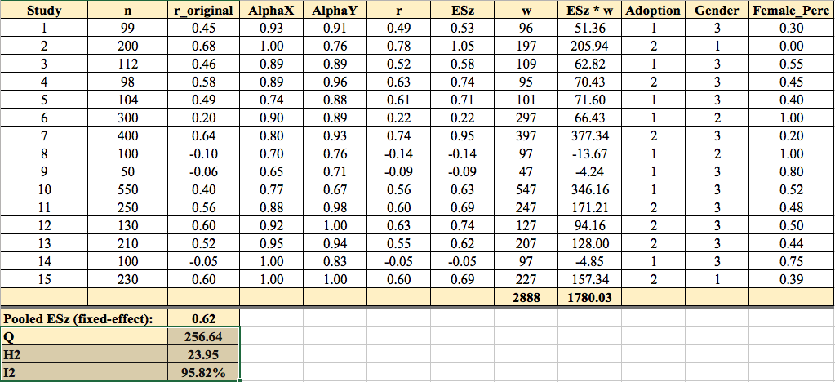
The Basic Meta-Analysis:
Calculate the homogeneity index (Q statistic) for the pooled effect size.
Notes:
What does happen to credibility interval when the effect sizes are homogenous?

Slide 41
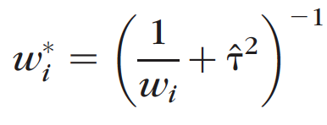
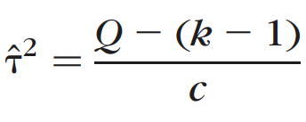
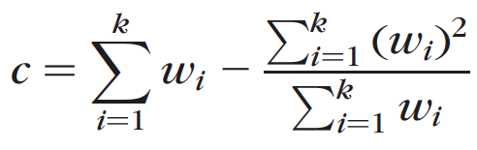
The Basic Meta-Analysis:
Weight the effect sizes for random-effects calculation.
  To Calculate the random-effects pooled effect size, we should add an additional element to the weight for the effect sizes that reflect “between-study variance” (T²):

Slide 42
The Basic Meta-Analysis:
Calculate the overall weighted mean effect size (random-effects pooled effect size) using new weights
Remember to use w*.
= 79.65 / 149.03
= 0.53.
*
z
z
*

Slide 43
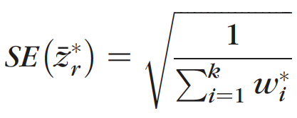
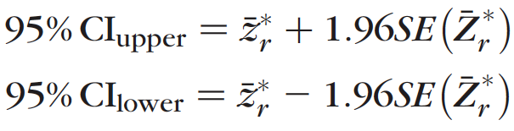
The Basic Meta-Analysis:
Calculate the confidence interval for the pooled effect size.
  For alpha = 0.05 (two-tailed Z (Z_{0.025}) = 1.96):

Slide 44
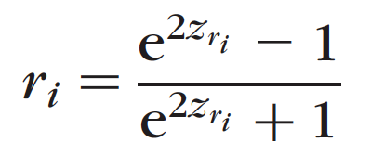
The Basic Meta-Analysis:
The pooled effect size is based on z-transformed values. You can transform it back to correlation, using:
  Depending on the tools that you use, you may need to do this transformation manually (e.g., in SPSS macro provided by Wilson (2001)).
    Some tools does the transformation for you, such as metafor package in R.

Slide 45
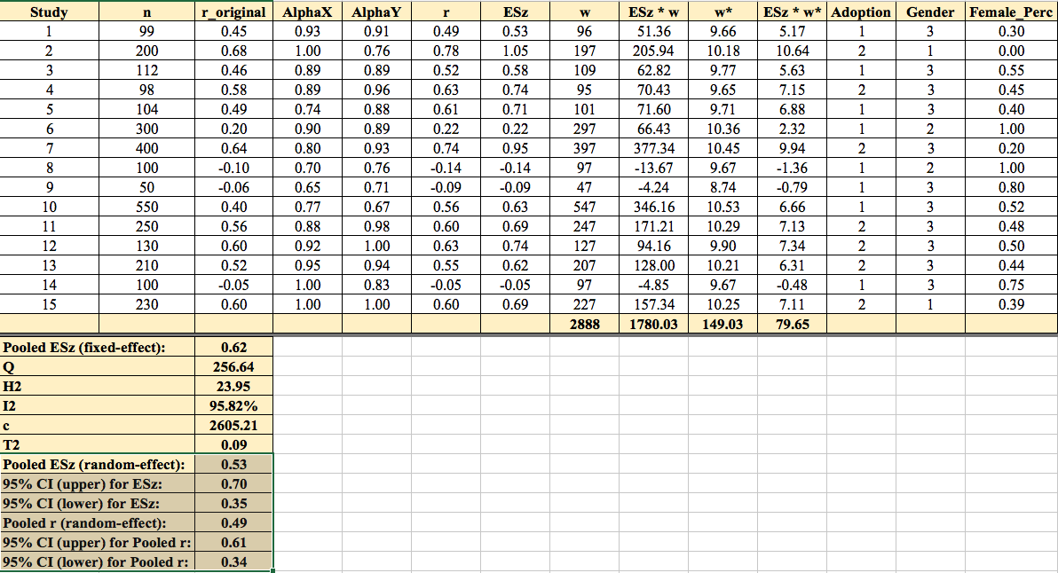
The Basic Meta-Analysis:
Weight the effect sizes
Calculate the overall weighted mean effect size (pooled effect size)
  Transform the z-transformed value back to correlation.
Calculate the confidence interval for the pooled effect size

Slide 46
Moderator Analysis
The model for moderator effects is a mixed model:
  It assumes a general linear model in which each z-transformed effect size can be predicted from the transformed moderator effect represented by b1:
Z_{r} = b₀ + b₁ M + e_{i}

Slide 47
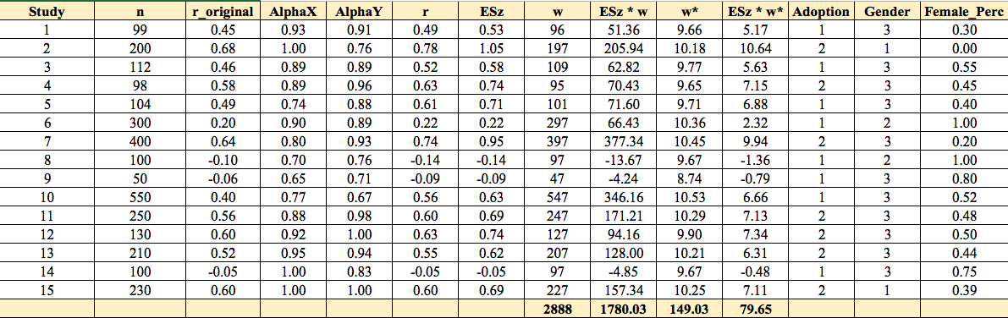
Moderator Analysis
Categorical Moderators
  E.g., Adoption; Gender
  Analyzed based on dichotomous variables
Continuous
  Female Percentage (Female_Perc)

Slide 48
Tools for Meta-Analysis
Wilson/Lipsey SPSS Macro.
  Free
  Uses Syntax function in SPSS
Mix Excel Macro.
Metafor package in R.

Slide 49
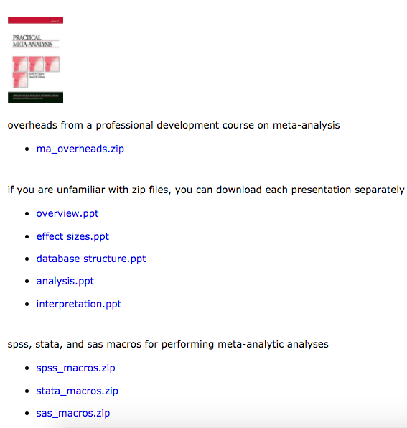
Tools for Meta-Analysis:
Wilson/Lipsey SPSS Macro
http://mason.gmu.edu/~dwilsonb/ma.html

Slide 51
The Basic Meta-Analysis:
Weight the effect sizes
  To Calculate the random-effects pooled effect size, we should add an additional element to the weight for the effect sizes that reflect “between-study variance” (T²):

Slide 52
iii) weight results
The standard error (SE) is a direct index of ES precision.
The smaller the SE, the more precise the ES.
Hedges’ showed that the optimal weight for meta-analysis is:

Slide 53
Weight results (two steps)
The weight (w) for the transformed r (Z_{r}) is simply:
  n-3
However, because r was corrected for unreliability, then w also needs to be adjusted to w’ or:
w’ = w(r_{xx})(r_{yy})
  = (99 – 3) (.93)(.91) = 81.24

Slide 54
Calculate the Weighted Mean Effect Size
Recall:
= 317.27 / 464.24
= .68

Slide 55
The Basic Meta-Analysis
Two most widely used methods of Meta-Analysis are:
  Hunter and Schmidt (Hunter and Schmidt, 2004)
    Is a random-effects method.
  Hedges and colleagues (Hedges,1992; Hedges & Olkin, 1985; Hedges & Vevea, 1998)
    Provide both fixed- and random-effects methods.
While both of these methods are widely used in the literature, several studies comparing them have shown a slightly less bias in estimation of pooled effect sizes in Hunter & Schmidt method than Hedges and colleagues method.
  See Field (2005); Field & Gillette (2010)

Slide 56
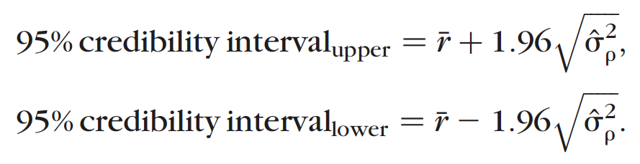

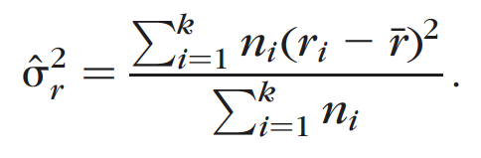
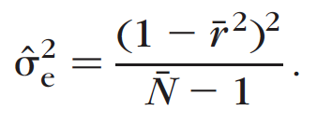
The Basic Meta-Analysis:
Hunter & Schmidt Method
Calculate the credibility interval for the pooled effect size.
  Credibility interval indicates the generalizability of a pooled effect size.
  It is different than confidence interval, which shows the precision of estimation.
Two-tailed Z-score for alpha = 0.05
Between-Study Variance
Within-Study Variance (sampling error)
Total Variance
Notes:
What does happen to credibility interval when the effect sizes are homogenous?

Slide 57
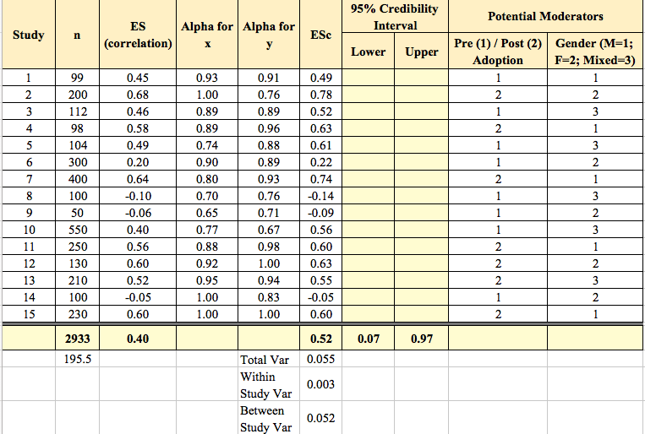
The Basic Meta-Analysis:
Hunter & Schmidt Method
Calculate the credibility interval for the pooled effect size.
Notes:
What does happen to credibility interval when the effect sizes are homogenous?

Slide 58
The Basic Meta-Analysis:
Hunter & Schmidt Method
Calculate the homogeneity index (Q statistic) for the pooled effect size.
  Q has a chi-square distribution, with number of effect sizes (k) – 1 degrees of freedom (df).
  To assess existence of heterogeneity, Q should be compared with the critical value in chi-square distribution with df = k-1 for alpha level (0.05).
    Compare with 6.571 for K = 15-1 = 14 and alpha=0.05.
  Other homogeneity indices:
n_{i}
n_{i}
_{i}
_{i}
n_{i}
Source: Huedo-Medina et al., (2006)
Notes:
What does happen to credibility interval when the effect sizes are homogenous?

Slide 59
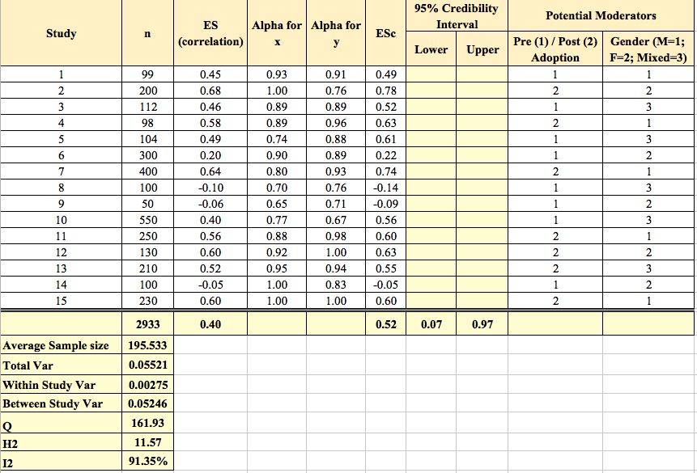
The Basic Meta-Analysis:
Hunter & Schmidt Method
Calculate the homogeneity index (Q statistic) for the pooled effect size.
Notes:
What does happen to credibility interval when the effect sizes are homogenous?

Slide 60
The Basic Meta-Analysis:
Hunter & Schmidt Method
Correct the effect sizes for unreliability
Weigh the effect sizes
Calculate the overall weighted mean effect size (pooled effect size)
Calculate the credibility interval for the pooled effect size.
Calculate the homogeneity index (Q statistic) for the pooled effect size.
  Provide the ground for moderation analysis.

Slide 65
Strengths of Meta-analysis
Imposes a discipline on the process of summing up research findings
Represents findings in a more differentiated and sophisticated manner than conventional reviews
Capable of finding relationships across studies that are obscured in other approaches
Protects against over-interpreting differences across studies
Can handle a large numbers of studies (this would overwhelm traditional approaches to review)

Slide 66
Weaknesses of Meta-analysis
Requires a good deal of effort
Mechanical aspects don’t lend themselves to capturing more qualitative distinctions between studies
“Apples and oranges” criticism
Most meta-analyses include “blemished” studies to one degree or another (e.g., a randomized design with attrition)
Selection bias posses a continual threat
  Negative and null finding studies that you were unable to find
  Outcomes for which there were negative or null findings that were not reported
Analysis of between study differences is fundamentally correlational

Slide 68
Conceptualization of Users’ Orientations toward Information Systems (IS) as a Unidimensional Bipolar Continuum
e.g., Perceived Threat
e.g., Perceived Usefulness
Users’ Negative Orientation
Users’ Positive Orientation
Discontinued Use of IS
Continued Use of IS
(e.g., Cenfetelli and Schwarz 2011; Maier et al. 2015; Bhattacherjee and Hikmet, 2007; Liang and Xue, 2009)
(e.g., Davis 1993; Davis et al. 1992; Venkatesh et al. 2008; Venkatesh et al. 2003)

Slide 69


“Ambivalence”
Individuals may simultaneously experience different levels of both negative and positive orientations toward objects and behaviors, such as using an IS.
  “Ambivalence” occurs when opposing cognitions, emotions, or cognitions and emotions clash.
    Having “mixed feelings”.
    “Love & Hate relationship”.
    “Feeling torn” between conflicting ideas/emotions toward an object and/or a behavior.
(e.g., Ashforth et al. 2014; Conner et al. 2002; Horney 1946; Hirschman 1970; Pratt and Doucet 2000)

