Slide 1

Introduction to Meta Analysis
Hamed Qahri-Saremi
DePaul University
Chicago, IL
Sudeep Sharma
University of Illinois at Springfield
Springfield, IL

Slide 2
Overview of the Workshop

Slide 3
What is a Meta-Analysis?
Meta-analysis is a statistical technique for synthesizing the results of a set of independent, quantitative, empirical studies on a topic, in order to determine an overall estimate of a treatment effect.
“… now widely accepted as a method of summarizing the results of empirical studies within the behavioral, social and health sciences.” Lipsey and Wilson (2001)

Slide 4

A little bit of History…
The Great Debate (Lipsey and Wilson, 2001)
  In 1952, Hans J. Eysenck concluded that there were no favourable effects of psychotherapy, starting a raging debate…
    25 years of evaluation research and hundreds of studies failed to resolve the debate
  In 1977, Smith and Glass statistically aggregated the findings of 375 psychotherapy outcome studies to show Eysenck is wrong and psychotherapy is indeed effective.
    In their research, they used a method developed by Glass (1976), called “not for want of a less pretentious name - the meta-analysis of research” (p. 3).
Glass, G.V. 1976. "Primary, Secondary, and Meta-Analysis of Research," Educational Researcher (5:10), pp. 3-8.

Slide 5

Meta-Analysis vs. Narrative Reviews
Let us review this sample of studies and answer the following two questions:
  What tentative conclusions can you reach about the relationship between job satisfaction and organizational commitment?
      Significant negative relation: 0/30.
      Significant positive relation: 19/30.
      Non-significant relation: 11/30.
  What variables do you believe can moderate this relationship?
Source: Hunter & Schmidt (2004)

Slide 6

Meta-Analysis vs. Narrative Reviews
Source: Hunter & Schmidt (2004)

Slide 7
Meta-Analysis vs. Narrative Reviews
The preceding review was conducted using standard review practices that characterize many narrative reviews in social sciences, including information systems.

Slide 8
Meta-Analysis vs. Narrative Reviews
There is one problem, though:
  The data were constructed by a Monte Carlo simulation:
    The mean population correlation was assumed to be 0.33.
    The sample sizes were randomly chosen from a distribution centering about 40.
      The variance across correlations and their significance levels were determined using population correlation and the sample size.
    The study characteristics were assigned randomly.
  In other words,
    The variation among correlations is entirely the result of sampling error.
      The significance levels are the result of “random” sample sizes.
    The moderator effects that appear to make sense are purely the results of chance.

Slide 9
Meta-Analysis vs. Narrative Reviews
The crucial lesson:
conflicting results in the literature may be entirely random.
  Meta-Analysis can help us differentiate between artefactual (random) and systematic sources of variations in results.
  Meta-analysis focuses on the direction and magnitude of the effects across studies (effect sizes), not their statistical significances.
    Significance testing is not well suited for comparison in a review, because it is highly dependent on sample sizes.
Sources:
Hunter & Schmidt (2004);
Lindsey & Wilson (2001)

Slide 10
Meta-Analysis vs. Single Studies
Single studies may not be sufficient to determine the utility of an intervention or a hypothesis’ validity.
  E.g., ‘The Great Debate’ on Psychotherapy’s effectiveness (1952-1977) (Lipsey and Wilson, 2001).
  Single studies are limited in their statistical power, unless the sample size is very large, which is not common.
    Low statistical power can increase the error rates well beyond the 5%.

Slide 11
When Can You Do Meta-analysis?
Meta-analysis is applicable to collections of research studies that
  Are empirical, rather than theoretical.
  Produce quantitative results, rather than qualitative findings.
  Examine the same constructs and relationships.
  Provide findings that can be configured in a comparable statistical form as effect sizes.
Source: Lindsey & Wilson (2001)

Slide 12
Seven Steps to Conduct a Meta-Analysis
Problem Definition
Establishing Inclusion/Exclusion Criteria
Literature Search and Studies Retrieval
Coding Data and Effect Sizes for Studies
Doing the Basic Meta-Analysis
  Decide on Fixed-Effects vs. Random-Effects Meta-Analysis
  Conduct the Basic Meta-Analysis
Moderation Analysis
  Testing Potential Systematic Sources of Variance Across Effect Sizes
Generating the Plots (as needed)
  Estimating the Publication Bias

Slide 13
Problem Definition
Forms of Problems Suitable to a Meta-analysis (it determines the choice of effect size):
  Association between Variables
    What is the correlation between the extent of system use and job satisfaction?
  Central Tendency Description
    What is the mean level of satisfaction among users of a system?
  Group Contrasts
    Are employees who are using a system more satisfied than non-users?
  Pre-Post Contrasts
    How did employees’ satisfaction levels change before and after adopting a system?
Source: Lindsey & Wilson (2001)

Slide 14
Establishing Inclusion/Exclusion Criteria: Which Studies to Include?
Components of detailed inclusion/exclusion criteria:
  Key variables
    E.g., Job Satisfaction and Organizational Commitment.
  Distinguishing Features
    E.g., Post-adoption studies.
    Research Samples
      E.g., Studies of online banking users.
  Research methods
    E.g., Survey-based research.
  Time frame
    E.g., After 2000.
Refine the criteria as you interact with the literature.
Source: Lindsey & Wilson (2001)

Slide 15
Literature Search and Studies Retrieval
Search Far & Wide
(not just published studies)
General Rule in Meta-Analysis: you should have EVERY relevant article
  Census, not a sample.
  Look for conference presentations and proceedings
Search in electronic reference databases.
  E.g., EBSCOhost; ScienceDirect; Web of Science;
Search bibliography of previous reviews and pertinent primary studies.
Hand search journals that frequently publish on the topic.
  AND the important journals in the field.
Try to find “special issues” on the topic.
Post to Listservs and relevant forums for unpublished work.
Contact authors who have published on your topic.

Slide 16
Coding Data
What to code is an important decision…
  Effect Sizes and their related information.
    Depends on Problem Definition.
    Sample Size for the effect size.
    Reliability of Constructs used for the effect size.
      E.g., Cronbach’s Alpha.
  Potential Moderators.
    Code everything that might explain variation in findings
      Methodological Differences
        E.g., Variations in Measures and Operationalization; Survey vs. Panel data.
      Study Characteristics
        E.g., Contextual Differences; Quality; Characteristics of the Sample.
      Theoretical Differences Across Studies
        E.g., Firm Size; Pre-adoption vs. Post-adoption Studies.

Slide 17
Effect Size (ES):
The Key to Meta-Analysis
An effect size (ES) is a measure of the magnitude and direction of a relationship between two variables or a contrast between groups.
  It is the “dependent variable” in meta-analysis.
  The ES encodes the selected research findings on a numeric scale.
An ES should be:
  Comparable across studies (generally requires standardization across studies).
  Independent of sample size.
Different meta-analyses use different effect size indices depending on their objectives.
  Each ES type may also have different methods of computation.

Slide 18
Effect Size (ES):
The Correlation Coefficient
Represents the magnitude and direction of association between two variables.
Generally reported directly as “r” (the Pearson correlation coefficient)
Source: Lindsey & Wilson (2001)

Slide 19
Effect Size (ES):
The Standardized Mean Difference
Represents a standardized group contrast on an inherently continuous measure.
Uses the pooled standard deviation (some situations use control group standard deviation).
  Cohen’s d.
  Hedges’s g.
Source: Lindsey & Wilson (2001)

Slide 20

Effect Size (ES):
The Odds-Ratio
Represents a group contrast on an inherently dichotomized measure.
The odds-ratio is based on a 2 x 2 contingency table:
  The odds of success in the treatment group relative to the odds of success in the control group.
e.g.,
System Users
e.g.,
Job Satisfaction
ES
Source: Lindsey & Wilson (2001)

Slide 21
Effect Size (ES):
The Risk Ratio
Represents a group contrast on an inherently dichotomized measure.
The risk ratio is also based on data from a 2 by 2 contingency table:
  The ratio of the probability of success (or failure) for each group.
e.g.,
System Users
e.g.,
Job Promotion
Source: Lindsey & Wilson (2001)

Slide 22
Effect Size (ES):
Independent Set of Effect Sizes
Must be dealing with an independent set of effect sizes before proceeding with the analysis.
  One ES per a study OR
  One ES per each subsample within a study
Remember:
  One paper can report multiple independent studies (e.g., study1, study2)
    Therefore, one paper can provide multiple ES, one for each independent sample.
  Multiple studies might be based on the same sample
    In this case, only one ES from that sample should be drawn.
Source: Montazemi & Qahri-Saremi (2015)

Slide 23
Effect Size (ES):
Issues in Coding Effect Sizes
Not every article will have a nice correlation table with sample size (N), alphas, etc.
  So, you may need to look for “r” substitutes:
    Beta values if there is only one independent variable (IV) in the regression equation.
    Beta if this is the first step in hierarchical regression.
    A path coefficient in SEM (if no other IVs affecting that dependent variable).
  (See: Appendix B in Montazemi & Qahri-Saremi (2015)).

Slide 24
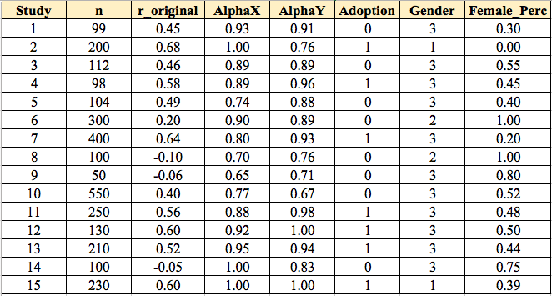
Effect Size (ES)
So far, you should have a list of studies with their:
  Effect sizes
  Sample sizes
  Reliabilities of Measures
  Potential moderators

Slide 25
The Basic Meta-Analysis:
Fixed-Effects vs. Random-Effects Method of Meta-Analysis
Fixed-Effects Meta-Analysis:
  All studies are drawn from ONE homogenous population and any variation among their effect sizes is the result of sampling errors.
    The variance for the pooled ES is made up only sampling errors (within study variance).
      E.g., Hedges & Olkin (1985) fixed-effects method.
Source: Montazemi & Qahri-Saremi (2015)

Slide 26
The Basic Meta-Analysis:
Fixed-Effects vs. Random-Effects Method of Meta-Analysis
Random-Effects Meta-Analysis:
  Studies in a meta-analysis come from heterogeneous populations that have different average effect sizes, so population effect sizes can be thought of as being sampled from a ‘super population’:
    The variance for the pooled ES includes both sampling error (within study variance) and between-study variance.
      E.g., Hunter & Schmidt (2004); Hedges & Olkin (1985) random-effects method.
Source: Montazemi & Qahri-Saremi (2015)

Slide 27
The Basic Meta-Analysis:
Fixed-Effects vs. Random-Effects Method of Meta-Analysis
Which Approach Should be Selected for the Meta-Analysis?
  Fixed-effect models are appropriate for inferences that extend only to the studies included in the meta-analysis (conditional inferences).
    Limited generalization.
  Random-effects models allow inferences that generalize beyond the studies included in the meta-analysis (unconditional inferences).
    When the effect sizes are not homogenous.
    Random-effects approach should be the norm in social sciences data.
    The consequences of applying fixed-effects methods to random-effects data can be quite dramatic:
      Significance tests of the estimate of the population effect size (pooled effect size) have Type I error rates inflated from the nominal 5% to 11% – 80%.
Source: Field & Gillette (2010)

Slide 28
The Basic Meta-Analysis:
The objective is to calculate the pooled-effect size for the relation under study, its confidence intervals, and test the homogeneity of effect sizes in the meta-analysis:
  Correct the effect sizes for unreliability
  Standardize the effect sizes using Fisher’s Z Transformation
  Weight the z-transformed effect sizes
  Calculate the overall weighted mean effect size (pooled effect size)
  Calculate the homogeneity index (Q statistic) for the pooled effect size.
    Provide the ground for random-effects analysis and moderation analysis.
  Calculate the confidence interval for the pooled effect size.

Slide 29
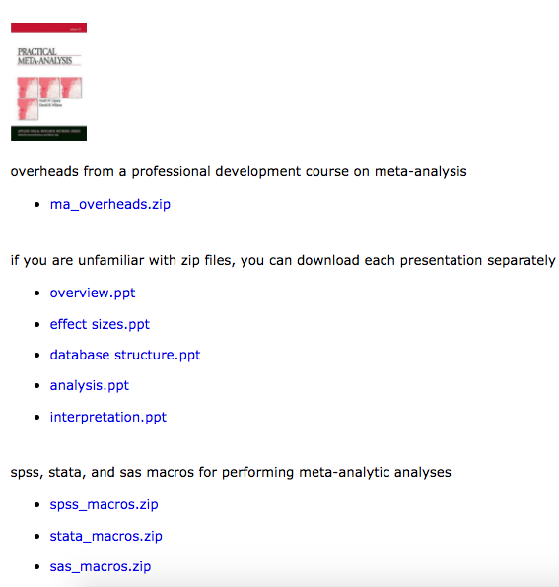
Tools for Meta-Analysis:
Wilson/Lipsey SPSS Macros
http://mason.gmu.edu/~dwilsonb/ma.html

Slide 30
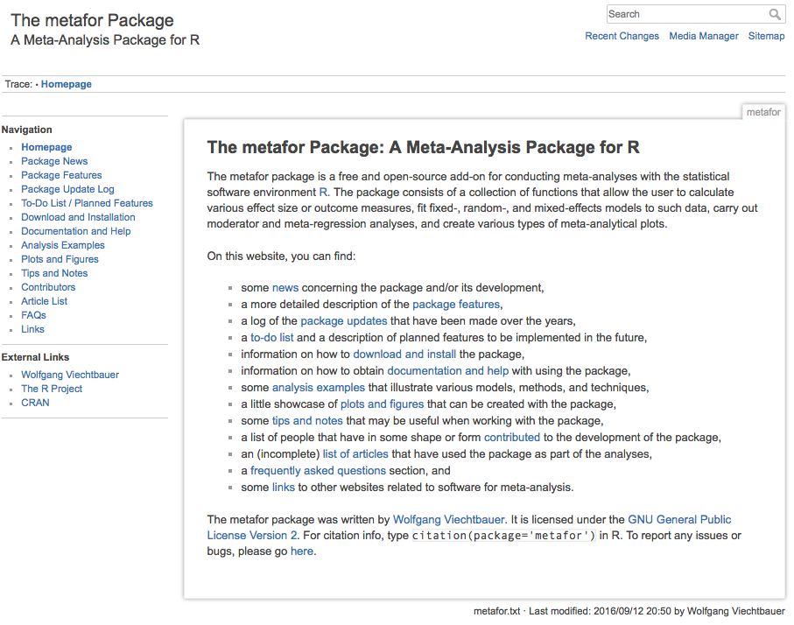
Tools for Meta-Analysis:
Metafor Package in R
http://www.metafor-project.org/doku.php

Slide 31

The Basic Meta-Analysis:
Correction for the sources of errors in effect sizes:
  Such as measurement errors (measures unreliability):
  So if:
    r_{xy} = .45
    r_{xx} = .93
    r_{yy} = .91
    Then r_{c} = 0.45 / sqrt(0.93 x 0.91) = 0.49
  No reliability reported = 1.
For other possible corrections, see:
  Hunter, J.E., and Schmidt, F.L. 2004. Methods of Meta-Analysis: Correcting Error and Bias in Research Findings, (Second ed.), Sage Publications, Inc.
Corrected Correlation between variables x and y.
Observed Correlation between variables x and y.
Reliabilities for
variables x and y.

Slide 32

The Basic Meta-Analysis:
Correction for the sources of errors in effect sizes:

Slide 33
The Basic Meta-Analysis:
Transform Corrected Correlations to Fisher’s Z (standardization)
  We normalize the corrected correlations using:
= 0.5 x ln (( 1 + .49)/(1 - .49))
= 0.53.
  Depending on the tools that you use, you may need to do this transformation manually (e.g., in SPSS macros provided by Wilson (2001)).
    Some tools can do the transformation for you, such as metafor package in R or Mix 2.0 software.

Slide 34
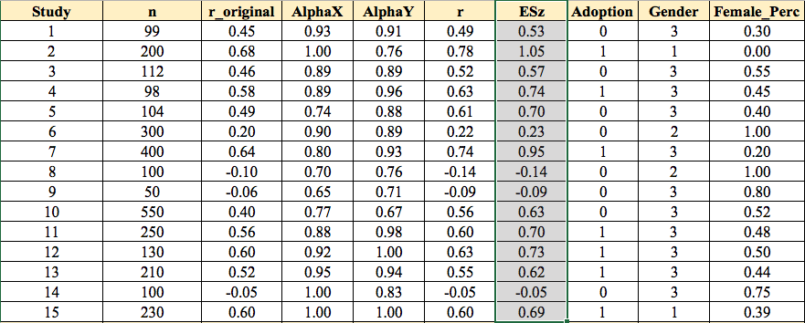
The Basic Meta-Analysis:
Transform Corrected Correlations to Fisher’s Z (standardization)

Slide 35
The Basic Meta-Analysis:
Weight the effect sizes
  The standard error (SE) is a direct index of ES precision.
    The smaller the SE, the more precise the ES.
      We would like to reduce the effect of effect sizes that are less precise (have larger SE) on our results.
    Hedges showed that the optimal weight for effect sizes is:
  The weight (w) for the transformed r (Zr) is simply:
    n = sample size for the pertinent effect size.
  w = n-3
    Depending on the tools that you use, you may need to do this calculation manually (e.g., in SPSS macros provided by Wilson (2001)).

Slide 36
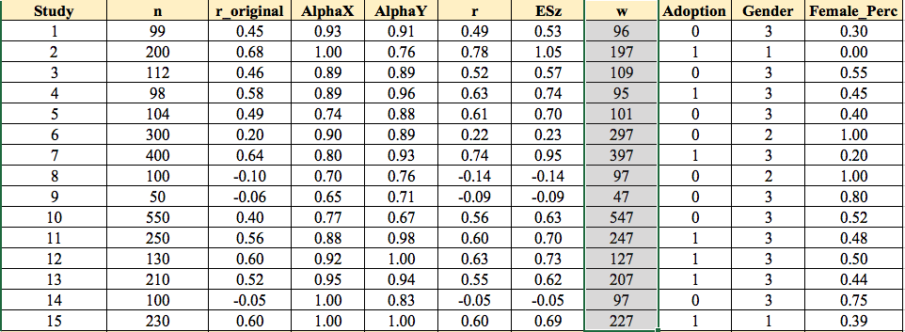
The Basic Meta-Analysis:
Weight the z-transformed effect sizes:

Slide 37
The Basic Meta-Analysis:
Calculate the overall weighted mean effect size (fixed-effects pooled effect size)
Remember: w = n-3.
= 1780.03 / 2888
= 0.62
  Since we have considered sampling error (SE) as the only component of variance for weighting the effect sizes, this is the “fixed-effect” pooled effect size.
z
z

Slide 38
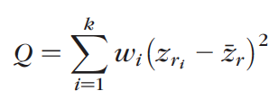


The Basic Meta-Analysis:
Calculate the homogeneity index (Q statistic) for the effect sizes.
  Q has a chi-square distribution, with number of effect sizes (k) – 1 degrees of freedom (df).
    Q for our example is approximately 257.
  To assess existence of heterogeneity, Q should be compared with the critical value in chi-square distribution with df = k-1 for alpha level (0.05).
    Compare with 6.571 for K = 15-1 = 14 and alpha=0.05.
  Other homogeneity indices:
Source: Huedo-Medina et al., (2006)

Slide 39
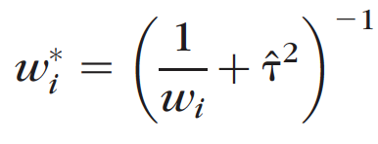
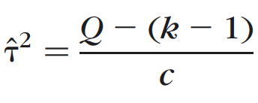
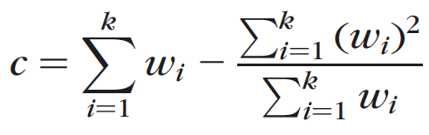
The Basic Meta-Analysis:
Weight the effect sizes for random-effects calculation.
  To Calculate the random-effects pooled effect size, we should add an additional element to the weight for the effect sizes that reflect “between-study variance” (T²):

Slide 40
The Basic Meta-Analysis:
Calculate the overall weighted mean effect size (random-effects pooled effect size) using new weights
Remember to use w*.
= 79.65 / 149.03
= 0.53
*
z
z
*

Slide 41
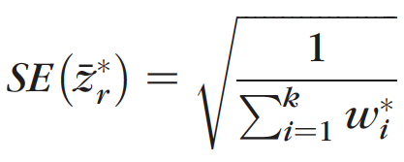
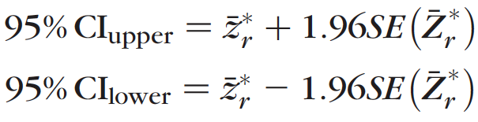
The Basic Meta-Analysis:
Calculate the confidence interval for the random-effects pooled effect size:
  For alpha = 0.05 (two-tailed Z (Z_{0.025}) = 1.96):

Slide 42
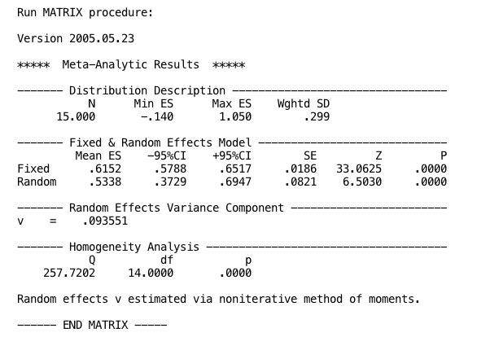
The Basic Meta-Analysis:
Wilson/Linsey SPSS Macros
Compared with 6.571, chi-square critical value for K = 15-1 = 14.

Slide 43
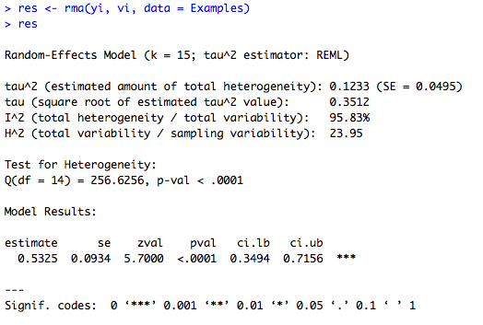
The Basic Meta-Analysis:
Metafor Package in R

Slide 44
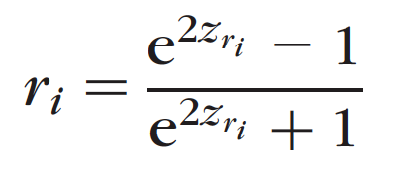
The Basic Meta-Analysis:
The pooled effect size and its confidence interval are based on z-transformed values. You can transform them back to correlation, using:
  Depending on the tools that you use, you may need to do this transformation manually (e.g., in SPSS macro provided by Wilson (2001)).
    Some tools does the transformation for you, such as metafor package in R.

Slide 45
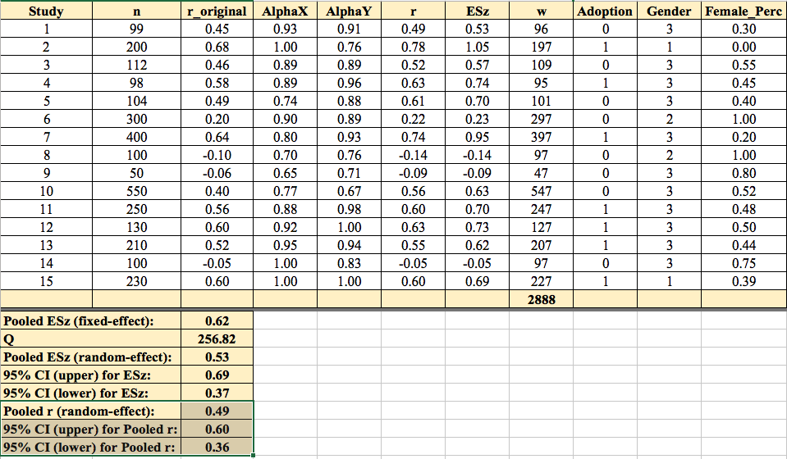
The Basic Meta-Analysis:

Slide 46

The Basic Meta-Analysis:
Metafor Package in R

Slide 47
Your Turn:
Use Wilson/Linsey SPSS Macros
Download the
  SPSS data file (Example_Datafile.sav),
  Wilson’s SPSS Macros,
  SPSS syntax
from:
http://facsrv.cdm.depaul.edu/~hqahrisa/#workshops
Unzip the macros zip file
  (remember the location where the unzipped folder is on your computer).
Run the macros in SPSS Syntax as instructed.

Slide 48
Your Turn:
Use Metafor Package in R
Download
  the .csv file (Example.csv)
  Metafor_Script.R
from:
http://facsrv.cdm.depaul.edu/~hqahrisa/#workshops
You need metafor package installed in R, using RStudio.
  Download RStudio: https://www.rstudio.com/
  Install “metafor” package using RStudio interface.
Open and run the R script as instructed.

Slide 49
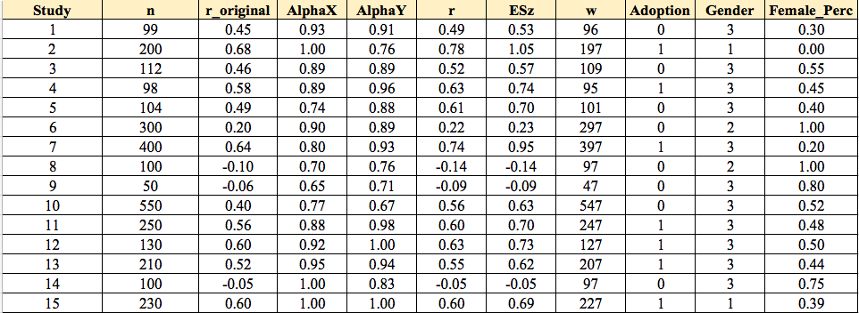
Moderator Analysis
Categorical Moderators
  E.g., Adoption; Gender
Continuous
  Female Percentage (Female_Perc)

Slide 50
Moderator Analysis:
Wilson/Linsey SPSS Macros
For Categorical Variables using Meta Factor function (MetaF)
  Analog to a one-way ANOVA
  Useful for testing the differences across mean effect sizes for a categorical variable.
  Example of the output for “Adoption” as a categorical moderator.

Slide 51
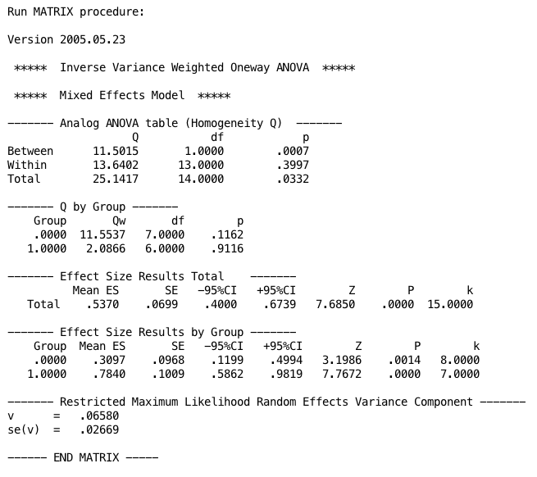
Moderator Analysis:
Wilson/Linsey SPSS Macros

Slide 52
Moderator Analysis:
Wilson/Linsey SPSS Macros
For Continuous Variables using Meta Regression (MetaReg)
  Analog to a regression analysis
    Estimate beta values using restricted maximum likelihood estimator (REML).
      You can change the estimation method if you want.
  Example of the output for “Female_Perc” as a continuous moderator.

Slide 53
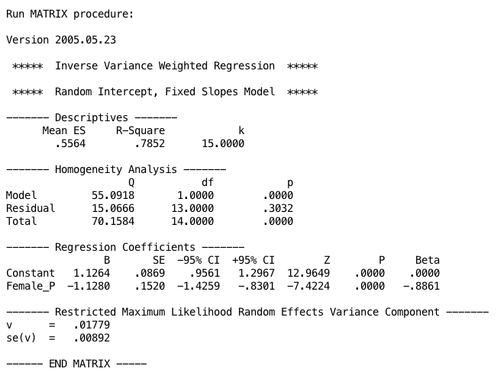
Moderator Analysis:
Wilson/Linsey SPSS Macros

Slide 54
Your Turn:
Use Wilson/Linsey SPSS Macros
Run the macro in SPSS Syntax as instructed:
  Run MetaF for “adoption” as a categorical moderator.
  Run MetaReg for “Female_Perc” as a continuous moderator.

Slide 55
Moderator Analysis:
Metafor Package in R
For both Continuous and Categorical Variables uses Meta Regression: rma() function.
  Analog to the regression analysis
    Estimate beta values using restricted maximum likelihood estimator (REML).
      You can change the estimation method if you want.
  Categorical variables are tested in form of dichotomous variables.
  Examples of the output for
    Adoption as a categorical moderator.
    “Female_Perc” as a continuous moderator.
    Both moderators together in a model.

Slide 56
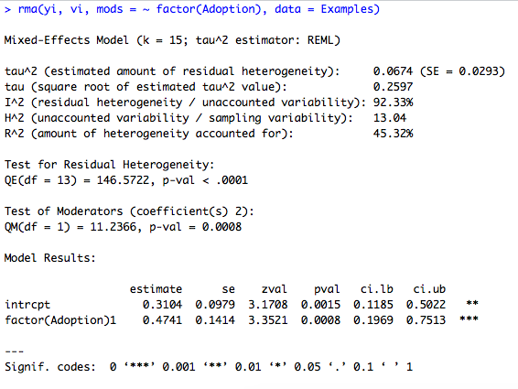
Moderator Analysis:
Metafor Package in R

Slide 57
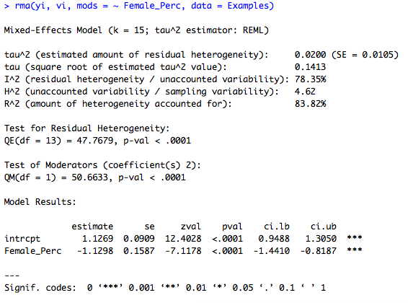
Moderator Analysis:
Metafor Package in R

Slide 58
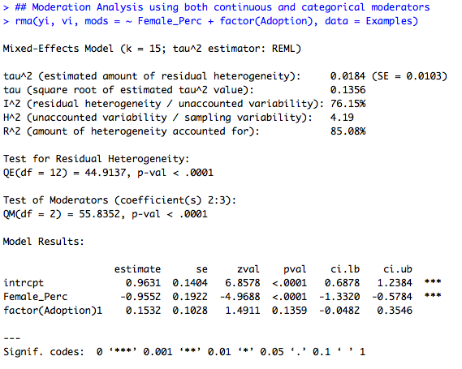
Moderator Analysis:
Metafor Package in R

Slide 59
Your Turn:
Metafor Package in R
Run the metafor package in RStudio as instructed:
  Run rma () function for testing:
    Adoption as a categorical moderator.
    Female_Perc as a continuous moderator.
    Both moderators together in a model.

Slide 60
Other Tool for Meta-Analysis:
Mix 2.0 add-in in MS Excel
https://www.meta-analysis-made-easy.com/
MIX 2.0 is a sophisticated statistical add-in for performing meta-analysis in Excel. The name MIX comes from Meta-analysis In eXcel and 2.0 identifies a major upgrade of the source code a few years back.
  It has been around for more than 10 years and has been used in hundreds of analyses and publications.
  It helps perform various types of fixed and random effects meta-analyses, assess subgroups, make basic indirect comparisons, integrate covariates via meta-regression, and do this all while you have access to a number of plots (which are all Excel objects so easily adjustable).
    The Lite version is specifically meant for educational purposes and provides all the advanced features of the Pro version with built-in datasets.
    The paid Pro version enables the import and export features so you can create and edit your own datasets and save your analysis results.
      $175 one time fees for academic for two activations.
      $85 one time fees for students for two activations.

Slide 61
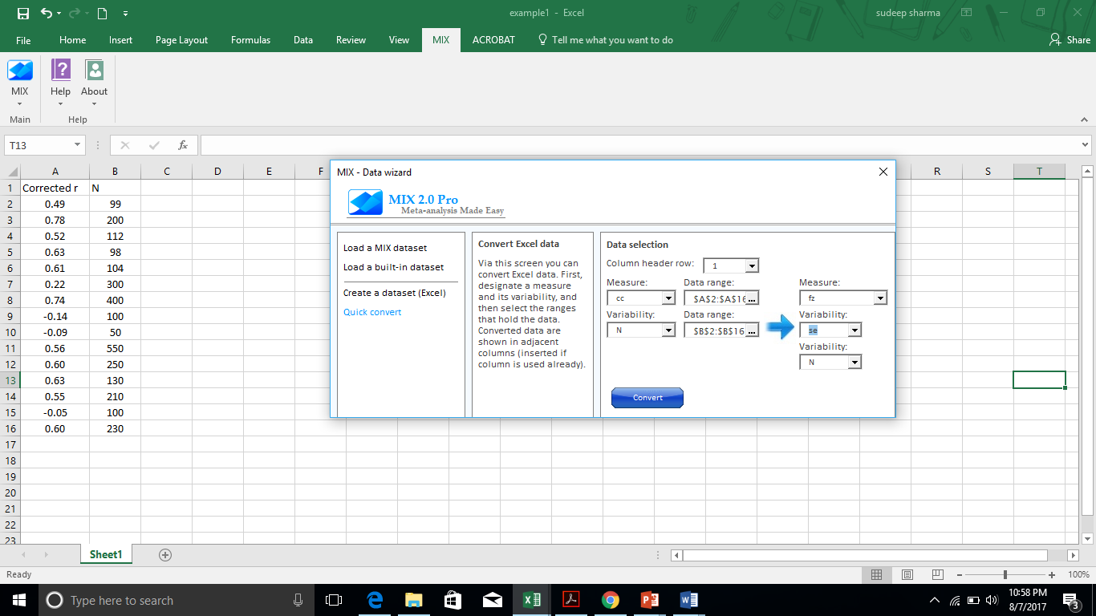
Transform Corrected Correlations to Fisher’s Z (standardization)

Slide 62
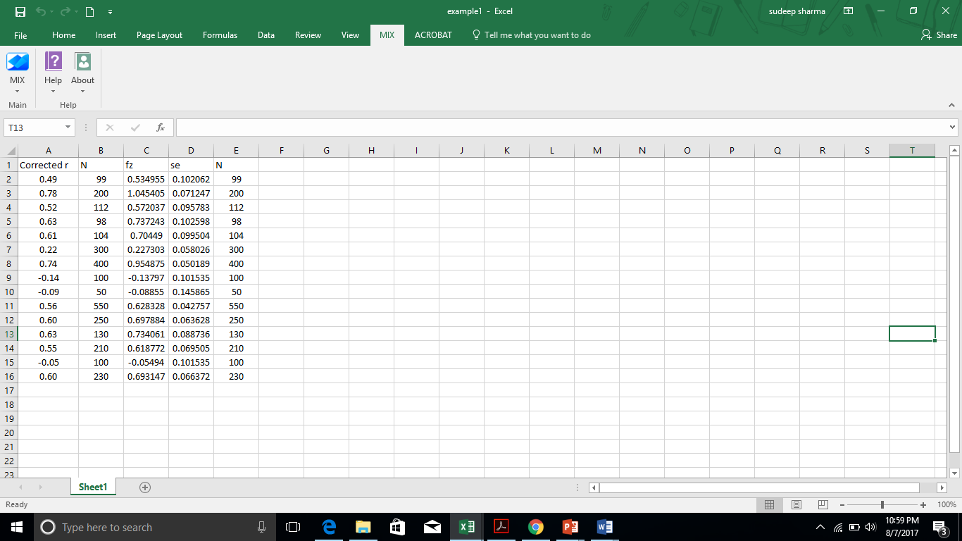
Data with Fisher’s Z and Standard Error

Slide 63
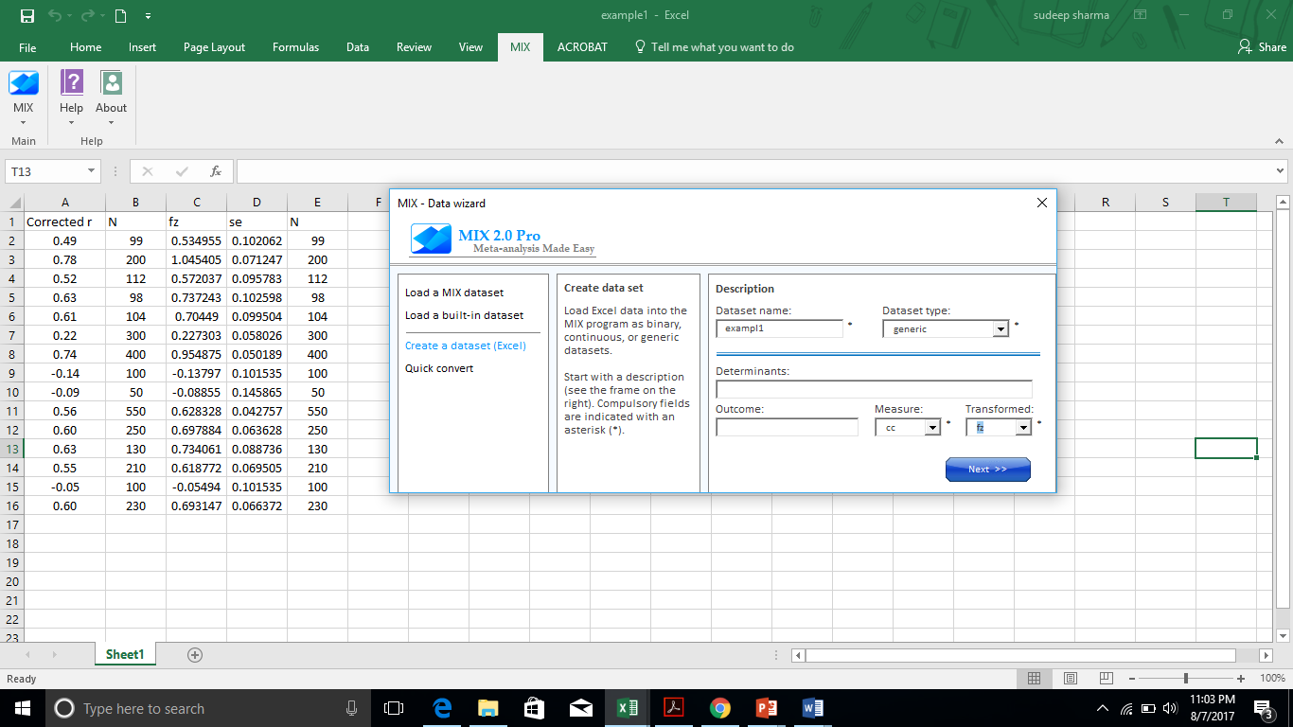
Weighted effect size

Slide 64
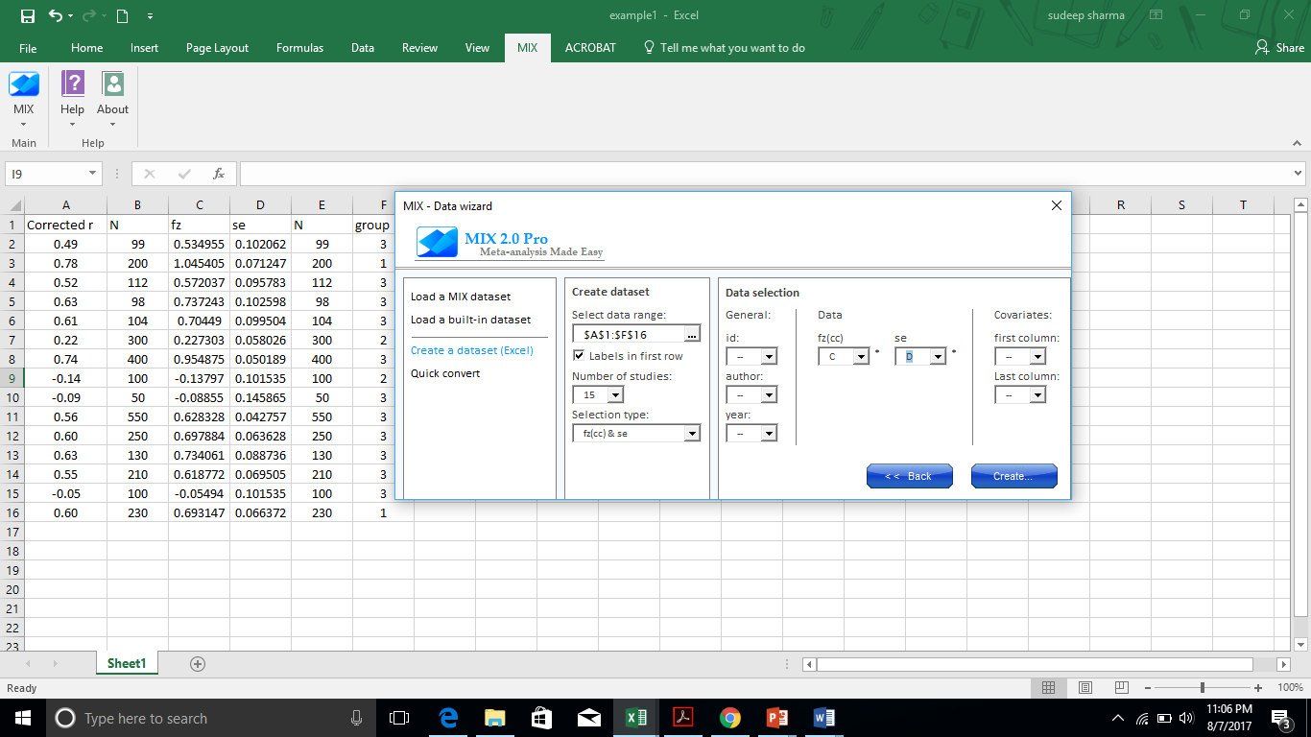

Slide 65
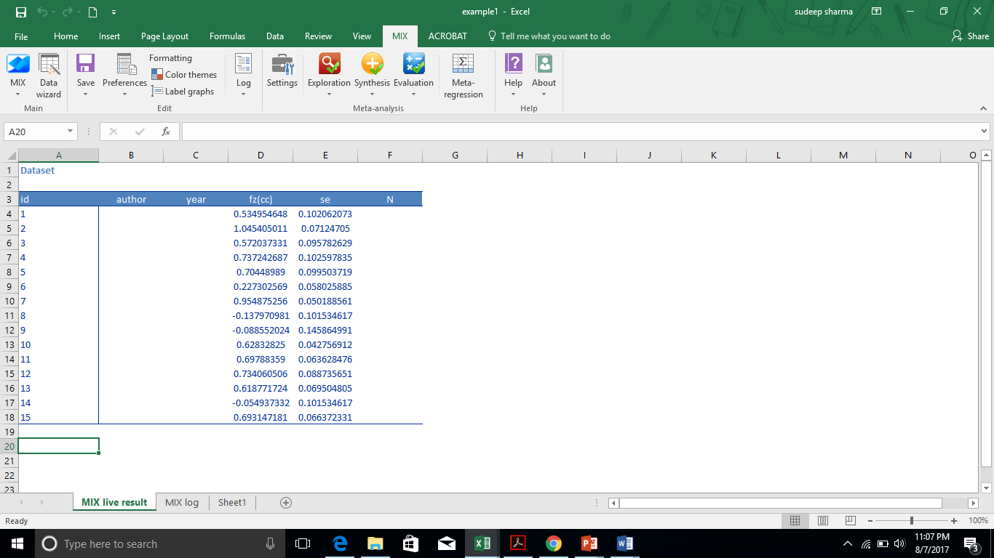
Data for meta-analysis

Slide 66
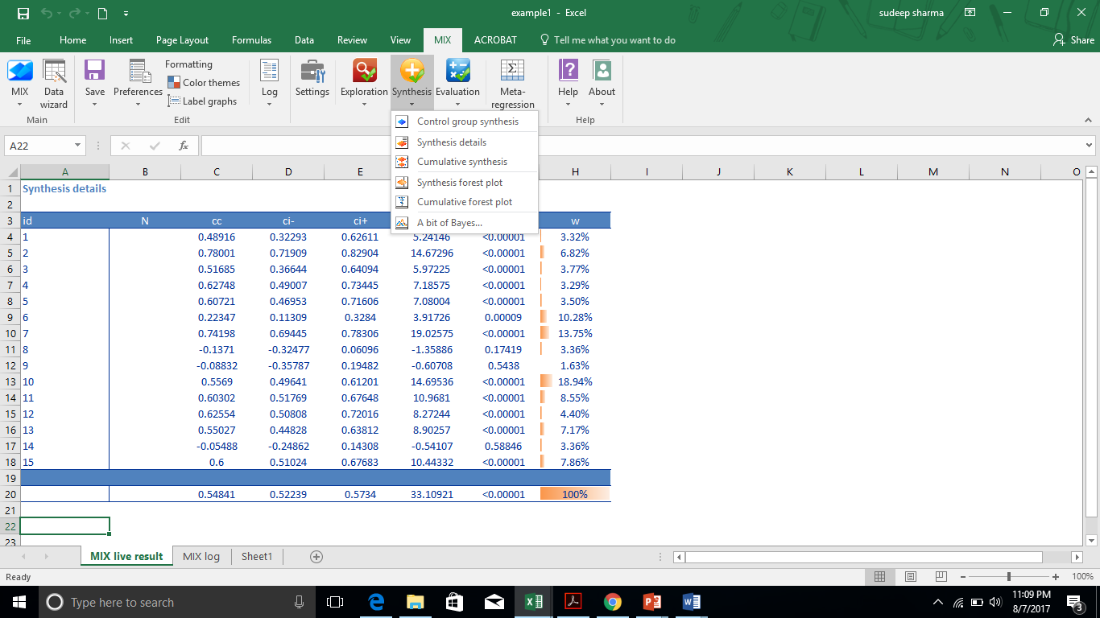
Overall weighted mean effect size

Slide 67

Heterogeneity Statistics

Slide 68
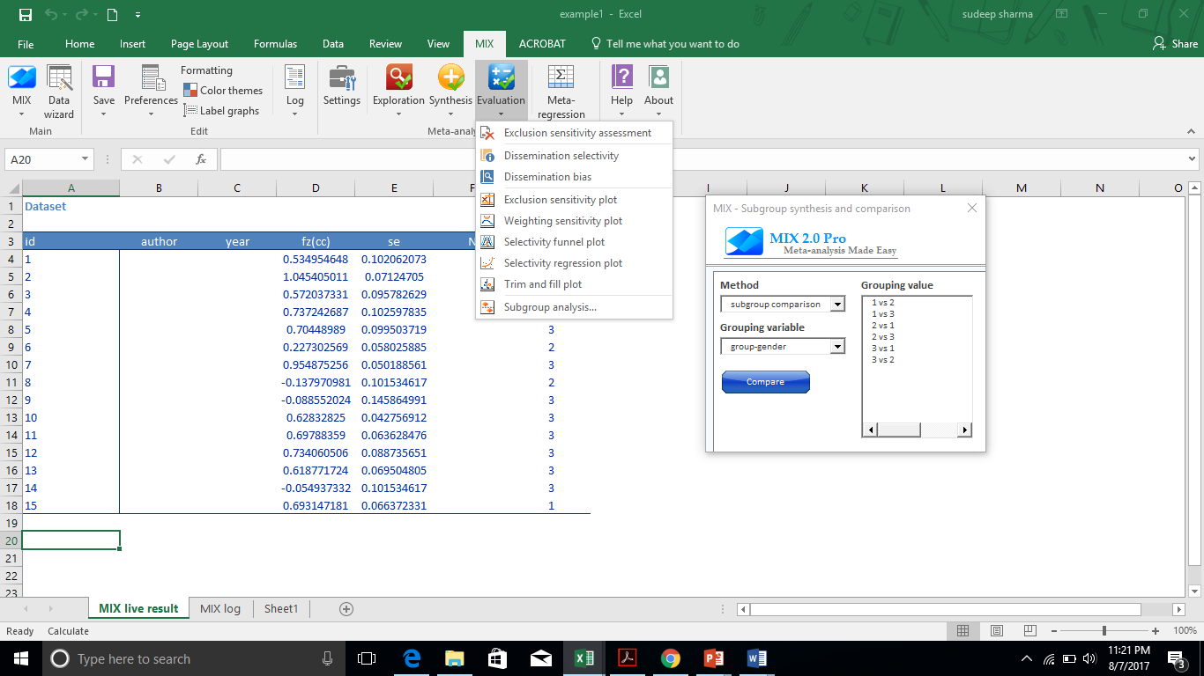
Moderating analysis Categorical variable

Slide 69
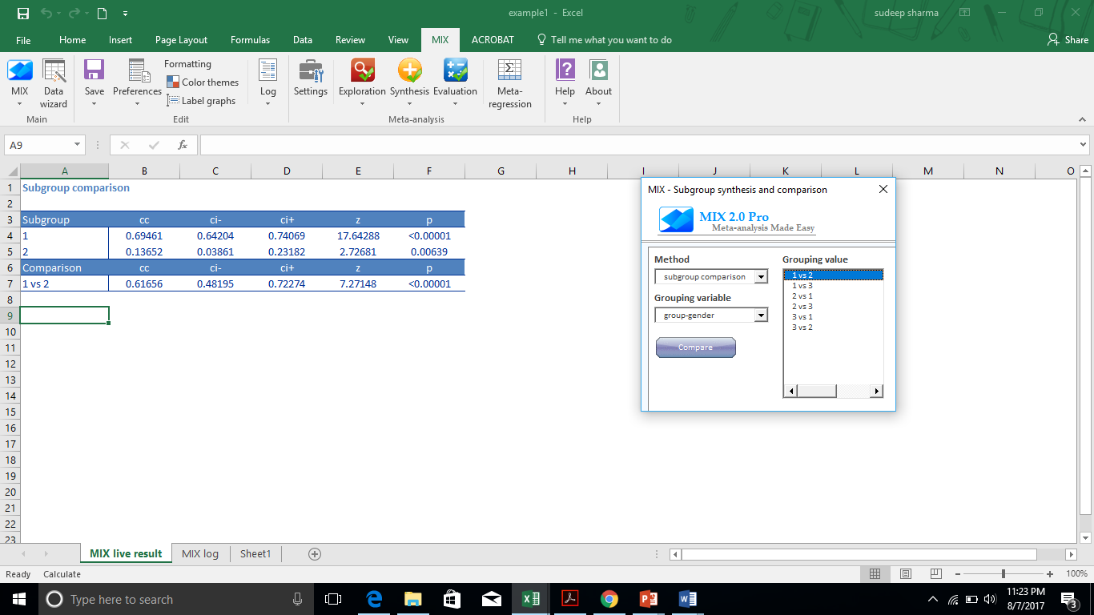
Findings for group 1 vs. group 2

Slide 70
Plots for Meta-Analysis:
Stem and Leaf from Example
Dependent Variable
Stem | Leaf
.7 | 48
.6 | 00133
.5 | 256
.4 | 9
.3
.2 | 2
.1
.0
-.0 | 59
-.1 | 4
-.2
-.3
-.4
-.5

Slide 71
Plots for Meta-Analysis:
Stem and Leaf (Other examples)
Concession Behavior(k=16) |  | Socio Psychological outcomes(k=4)
Stem | Leaf | Stem | Leaf
0.5 |  | 0.5
0.4 | 779 | 0.4
0.3 | 34 | 0.3
0.2 | 12456 | 0.2
0.1 | 6 | 0.1
0 | 6 | 0
0 |  | 0
0.1 |  | -0.1
-0.2 | 6 | -0.2 | 77
-0.3 |  | -0.3 | 17
-0.4 | 0 | 0.4
-0.5 |  | 0.5
Extraversion |  | Neuroticism |  | Agreeableness |  | Openness |  | Conscientiousness
Stem | Leaf | Stem | Leaf | Stem | Leaf | Stem | Leaf | Stem | Leaf
.5 |  | .5 |  | .5 |  | .5 |  | .5
.4 | 2 | .4 |  | .4 |  | .4 |  | .4 | 1
.3 | 0 | .3 | 3 | .3 |  | .3 |  | .3 | 1
.2 | 088 | .2 |  | .2 | 558 | .2 |  | .2
.1 |  | .1 |  | .1 | 3 | .1 | 2 | .1 | 12
.0 | 5 | .0 | 7 | .0 |  | .0 | 56 | .0
-.0 | 1 | -.0 | 2 | -.0 | 2 | -.0 | 5 | -.0
-.1 |  | -.1 | 5559 | -.1 |  | -.1 |  | -.1
-.2 |  | -.2 |  | -.2 |  | -.2 |  | -.2
-.3 |  | -.3 | 5 | -.3 |  | -.3 |  | -.3
-.4 |  | -.4 |  | -.4 |  | -.4 |  | -.4
-.5 |  | -.5 |  | -.5 |  | -.5 |  | -.5

Slide 72
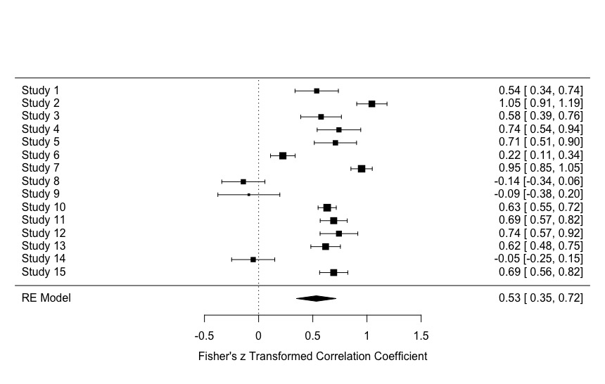
Plots for Meta-Analysis:
Forest Plot
For showing the variability of effect sizes across studies.
  Can be used for both raw correlations as well as z-transformed effect sizes.

Slide 73
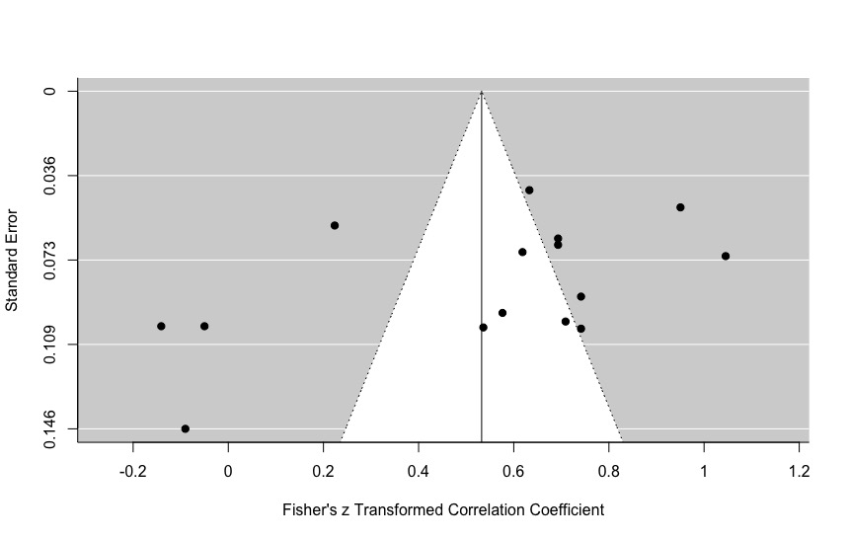
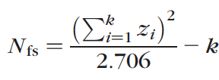
Plots for Meta-Analysis:
Funnel Plot
For assessing publication bias (a.k.a., file drawer problem)
  Significant findings are more likely to be published than non-significant findings.
  Alternative measure is fail-safe N measure. (Rosenthal, 1979)
    Number of unpublished studies not included in the meta-analysis to make the population effect size non-significant

Slide 74
Cutting Edge Issues in Meta-Analysis
Meta-Analytic Structural Equation Modeling (MASEM)
  Using Meta-Analytic Data for testing Structural Models using Covariance-based Structural Equation Modeling (SEM).
    It can provide the best of both worlds: Meta-Analysis & SEM.
    Can be used for testing hypotheses and theoretical models.
    More complex than bivariate (basic) meta-analysis.
  Should be implemented using metaSEM package in R:
    https://courses.nus.edu.sg/course/psycwlm/internet/metasem/
  References:
    Cheung (2015) book on two-stage MASEM.
    Montazemi & Qahri-Saremi (2015)’s I&M paper.

Slide 75
References
Cheung, M.W.-L. 2015. Meta-Analysis: A Structural Equation Modeling Approach. United Kingdom: John Wiley & Sons.
Field, A.P. 2005. "Is the Meta-Analysis of Correlation Coefficients Accurate When Population Correlations Vary?," Psychological Methods (10:4), pp. 444-467.
Field, A.P., and Gillett, R. 2010. "How to Do a Meta‐Analysis," British Journal of Mathematical and Statistical Psychology (63:3), pp. 665-694.
Glass, G.V. 1976. "Primary, Secondary, and Meta-Analysis of Research," Educational Researcher (5:10), pp. 3-8.
Hedges, L.V., and Olkin, I. 1985. Statistical Methods for Meta-Analysis. San Diego, CA: Academic Press.
Huedo-Medina, T.B., Sánchez-Meca, J., Marín-Martínez, F., and Botella, J. 2006. "Assessing Heterogeneity in Meta-Analysis: Q Statistic or I² Index?," Psychological Methods (11:2), p. 193.
Hunter, J.E., and Schmidt, F.L. 2004. Methods of Meta-Analysis: Correcting Error and Bias in Research Findings, (Second ed.). Sage Publications, Inc.
Lipsey, M., and Wilson, D.B. 2001. Practical Meta-Analysis. Thousand Oaks, CA: Sage Publications: http://mason.gmu.edu/~dwilsonb/ma.html.
Moher D., Liberati A., Tetzlaff J., Altman D.G., The PRISMA Group. 2009. “Preferred Reporting Items for Systematic Reviews and Meta Analyses: The PRISMA Statement”. PLoS Med 6(7): e1000097. doi:10.1371/journal.pmed1000097.
Montazemi, A.R., and Qahri-Saremi, H. 2015. "Factors Affecting Adoption of Online Banking: A Meta-Analytic Structural Equation Modeling Study," Information & Management (52:2), pp. 210-226.
Rosenthal, R. 1979. "The “File Drawer Problem” and Tolerance for Null Results," Psychological Bulletin (86:3), pp. 638-641.
Sharma, S., Bottom, W.P., and Elfenbein, H.A. 2013. "On the Role of Personality, Cognitive Ability, and Emotional Intelligence in Predicting Negotiation Outcomes: A Meta-Analysis," Organizational Psychology Review (3:4), pp. 293-336.
Viechtbauer, W. 2010. "Conducting Meta-Analyses in R with the Metafor Package," Journal of Statistical Software (36:3), pp. 1-48.

Slide 76

Image by WoodleyWonderWorks

Slide 77

Literature Search and Studies Retrieval
Preferred Reporting Items for Systematic Reviews and Meta-Analyses (PRISMA):
* Not Needed for
Meta-Analysis
Source: Moher D, Liberati A, Tetzlaff J, Altman DG, The PRISMA Group (2009). Preferred Reporting Items for Systematic Reviews and Meta Analyses: The PRISMA Statement. PLoS Med 6(7): e1000097. doi:10.1371/journal.pmed1000097
www.prisma-statement.org.

