Slide 1
EVAL 6970: Meta-Analysis
Introduction to Meta-Analysis
Dr. Chris L. S. Coryn
Kristin A. Hobson
Fall 2013

Slide 2
Agenda
Course overview
An overview of and brief introduction to meta-analysis
Selection of working groups
In-class activity
Next meeting

Slide 3


Required Textbooks
Bornenstein, M., Hedges, L. V., Higgins, J. P. T., & Rothstein, H. R. (2009). Introduction to meta-analysis. West Sussex, UK: Wiley.
Cooper, H., Hedges, L. V., & Valentine, J. C. (Eds.). (2009). The handbook of research synthesis and meta-analysis (2nd ed.). New York, NY: Russell Sage Foundation.

Slide 4
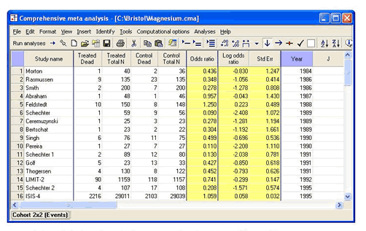
Software Requirements
Comprehensive Meta-Analysis 2.0
  $95 for a one year lease at the student rate
  $195 for a complete, unlimited license at the student rate

Slide 5
Homework
Homework #1: Formulating a problem statement and reviewing the literature
Homework #2: Coding and storing studies for analysis
Homework #3: Computing effect sizes and standard errors from studies
Homework #4: Quantifying heterogeneity and publication bias

Slide 6
Final Project
Final Project Part 1 (take home): You will execute and write-up a small meta-analysis
Final Project Part 2 (in class): You will give a 15 minute presentation of the meta-analysis completed in Part 1

Slide 7
Weighting of Components
Attendance & participation (10%)
Homework #1 (10%)
Homework #2 (10%)
Homework #3 (10%)
Homework #4 (10%)
Final Project (50%)
  100% – 95% = A
  94% – 90% = BA
  89% – 85% = B
  84% – 80% = CB
  79% – 75% = C
  < 75% = F

Slide 8
Instructional Format
Approximately 1 to 1 ½ hour lecture
Approximately 1 to 1 ½ hour in-class work with data sets and problems, or other types of activities

Slide 9
Course Website and eLearning
Course Website
  http://www.wmich.edu/evalphd/courses/eval-6970-meta-analysis/
    Readings
    Homework
    Lectures
    Data sets
    Effect size calculators and meta-analysis spreadsheets
eLearning
  Submit homework assignments and projects

Slide 10
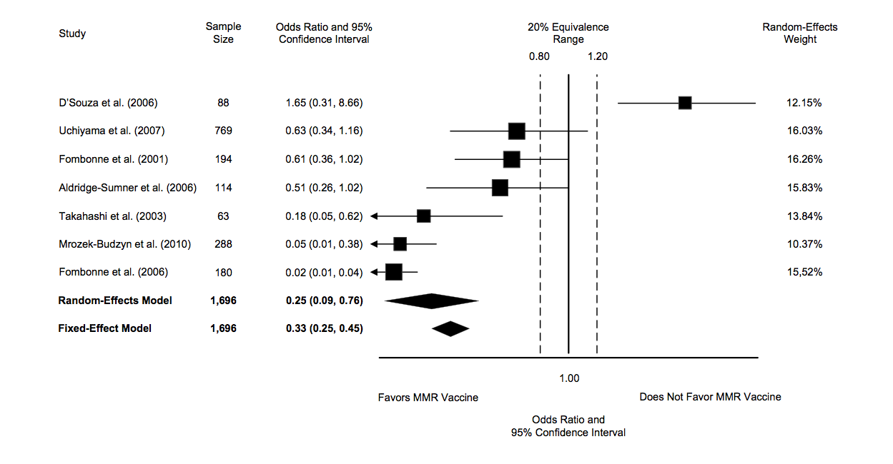
Introduction to Meta-Analysis
Forest plot from a meta-analysis of the relationship between MMR and autism (study completed last time this course was offered)

Slide 11
The Great Debate
1952: Hans Eysenck concluded that there were no favorable effects of psychotherapy, starting a raging debate
  20 years of research and hundreds of studies failed to resolve the debate
1978: To prove Eysenk wrong, Gene Glass (and colleague Smith) statistically aggregated the findings of 375 psychotherapy outcome studies
  Concluded that psychotherapy did indeed work
  Glass called his method “meta-analysis”

Slide 12
Historical Origins
Ideas behind meta-analysis predate Glass’ work by several decades
  Karl Pearson (1904)
    Averaged correlations for studies of the effectiveness of inoculation for typhoid fever
  R. A. Fisher (1944)
    “When a number of quite independent tests of significance have been made, it sometimes happens that although few or none can be claimed individually as significant, yet the aggregate gives an impression that the probabilities are on the whole lower than would often have been obtained by chance”
    Source of the idea of cumulating probability values

Slide 13
Emergence of Meta-Analysis
W. G. Cochran (1953)
  Discusses a method of averaging means across independent studies
  Laid-out much of the statistical foundation that modern meta-analysis is built upon (e.g., inverse variance weighting and homogeneity testing)

Slide 14
Logic of Meta-Analysis
Traditional methods of review focus on statistical significance testing
Significance testing is not well suited to this task
  Highly dependent on sample size
  Null finding does not carry the same “weight” as a significant finding
    Significant effect is a strong conclusion
    Nonsignificant effect is a weak conclusion

Slide 15
Logic of Meta-Analysis
Meta-analysis focuses on the direction and magnitude of effects across studies, not statistical significance
  Isn’t this what we are interested in anyway?
  Direction and magnitude are represented by the effect size

Slide 16
When Can You Do Meta-Analysis?
Meta-analysis is applicable to collections of research that
  Are empirical, rather than theoretical
  Produce quantitative results, rather than qualitative findings
  Examine the same constructs and relationships
  Have findings that can be configured in a comparable statistical form (e.g., as effect sizes, correlation coefficients, odds-ratios, proportions)
  Are “comparable” given the question at hand

Slide 17
Suitable for Meta-Analysis
Central tendency research
  Prevalence rates
Pre-post contrasts
  Growth rates
Group contrasts
  Experimentally created groups
    Comparison of outcomes between treatment and control/comparison groups
  Naturally occurring groups
    Comparison of spatial abilities between boys and girls
    Rates of morbidity among high and low risk groups

Slide 18
Suitable for Meta-Analysis
Association between variables
  Measurement research
    Validity generalization
  Individual differences research
    Correlation between personality constructs

Slide 19
Effect Sizes: The Key
The effect size makes meta-analysis possible
  It is the “dependent variable”
  It standardizes findings across studies such that they can be directly compared

Slide 20
Effect Sizes: The Key
Any standardized index can be an “effect size” (e.g., standardized mean difference, correlation coefficient, odds-ratio) as long as it meets the following
  Is comparable across studies (generally requires standardization)
  Represents the magnitude and direction of the relationship of interest
  Is independent of sample size
Different meta-analyses may use different effect size indices

Slide 21
The Replication Continuum
Pure Replications
Conceptual Replications
You must be able to argue that the collection of studies you are meta-analyzing examine the same relationship
  This may be at a broad level of abstraction, such as the relationship between criminal justice interventions and recidivism or between school-based prevention programs and problem behavior
  Alternatively it may be at a narrow level of abstraction and represent pure replications
The closer to pure replications your collection of studies, the easier it is to argue comparability

Slide 22
Which Studies to Include?
It is critical to have explicit inclusion and exclusion criteria
  The broader the research domain, the more detailed they tend to become
  Refine criteria as you interact with the literature
  Components of a detailed criteria
    Distinguishing features
    Research respondents
    Key variables
    Research methods
    Cultural and linguistic range
    Time frame
    Publication types

Slide 23
Method Quality Dilemma
Include or exclude low quality studies?
  The findings of all studies are potentially in error (methodological quality is a continuum, not a dichotomy)
  Being too restrictive may restrict ability to generalize
  Being too inclusive may weaken the confidence that can be placed in the findings
  Methodological quality is often in the “eye-of-the-beholder”
  You must strike a balance that is appropriate to your research question

Slide 24
Searching Far and Wide
The “we only included published studies because they have been peer-reviewed” argument
Statistically significant findings are more likely to be published than statistically nonsignificant findings
Critical to try to identify and retrieve all studies that meet your eligibility criteria

Slide 25
Searching Far and Wide
Potential sources for identification of documents
  Computerized bibliographic databases
  “Google” and “Google Scholar” internet search engines
  Authors working in the research domain (e-mail a relevant Listserv?)
  Conference programs
  Dissertations
  Review articles
  Hand searching relevant journals
  Government reports, bibliographies, clearinghouses

Slide 26
Bibliographic Databases
Rapidly changing area
Get to know your local librarian!
Searching one or two databases is generally inadequate
Throw a wide net
  Filter down with a manual reading of study abstracts

Slide 27
Strengths of Meta-Analysis
Imposes a discipline on the process of `summing-up’ research findings
Represents findings in a more differentiated and sophisticated manner than conventional reviews
Capable of finding relationships across studies that are obscured by other approaches
Protects against over-interpreting differences across studies
Can handle large numbers of studies (this would overwhelm traditional approaches to research review)

Slide 28
Weaknesses of Meta-Analysis
Requires a good deal of effort
Mechanical aspects don’t lend themselves to capturing more qualitative distinctions between studies
“Apples and oranges” criticism
Most meta-analyses include “blemished” studies to one degree or another (e.g., a randomized design with attrition)
Selection bias posses a continual threat
  Negative and null finding studies that you were unable to find
  Outcomes for which there were negative or null findings that were not reported

Slide 29
Selection of Working Groups
Throughout the semester you may work individually or in small groups
This includes all in-class activities as well as homework and the final project (with instructor approval)
Groups should be no larger than 3 people so that everyone learns all of the statistical and non-statistical techniques

Slide 30
Today’s In-Class Activity
Individually, or in your working groups, review the instructions for Homework #1 and begin discussing a research area or problem that you or your group might consider investigating for a meta-analysis
  If you are in a group, determine who will be responsible for what specific tasks to complete Homework #1
Conduct a brief search to determine if one or more meta-analyses have already been conducted and, if so, how recently
Write down the draft statement of problem or focal area and discuss with the class

