Slide 1
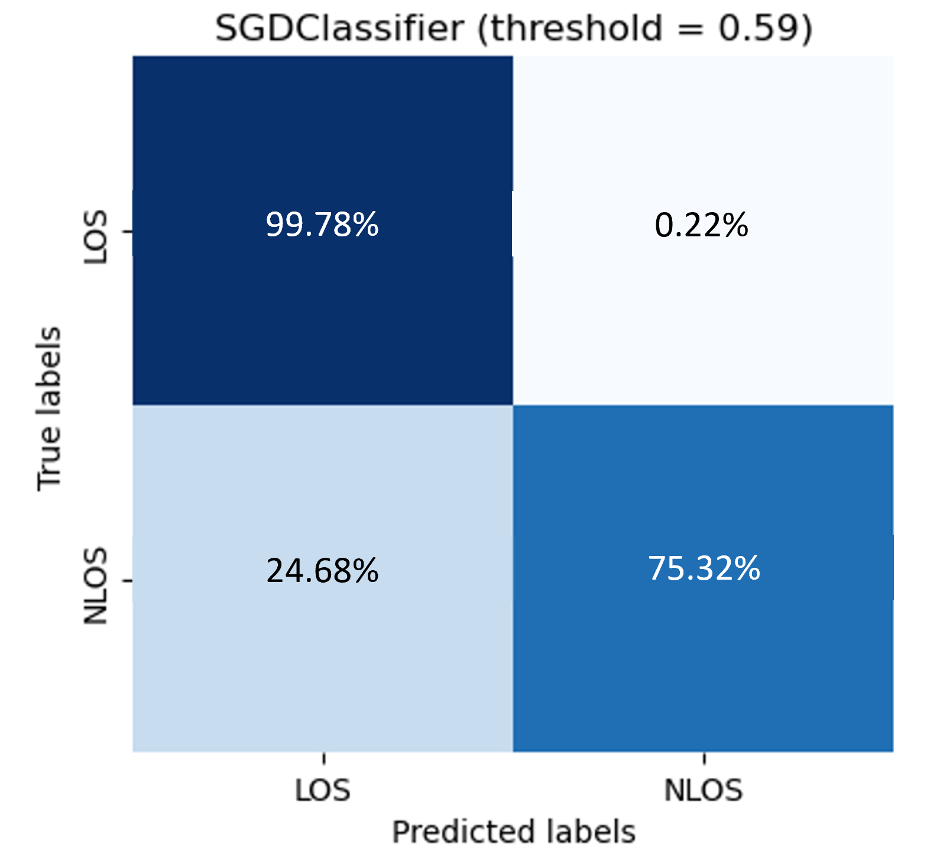
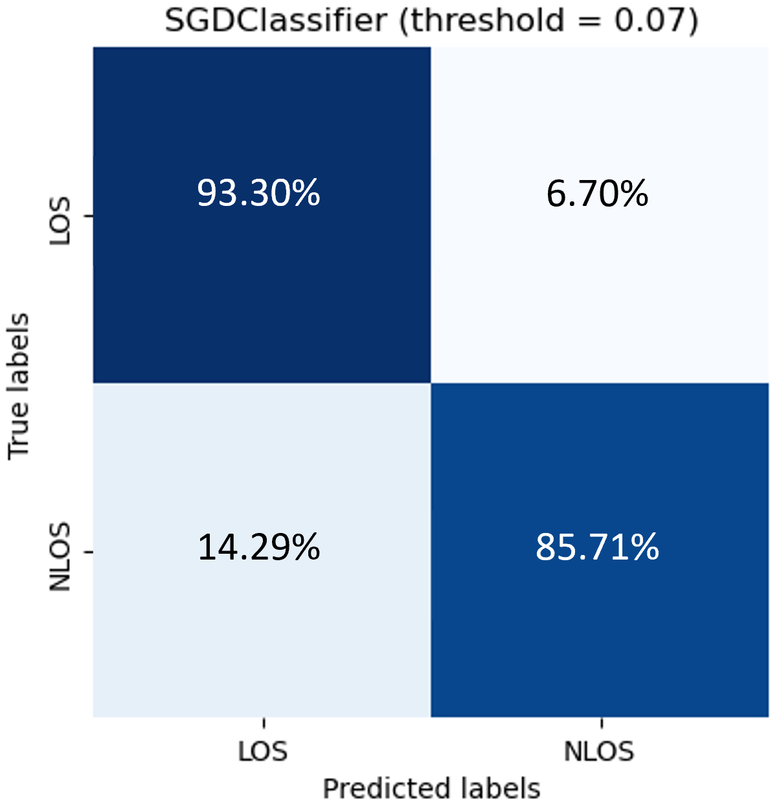

Slide 2



Random base classifier A
A prediction
Random base classifier B
B prediction
Random base classifier C
C prediction
Dataset
Collection of probabilistic prediction
Random base classifier N
N prediction
Output
Input
Final prediction
Meta CNN Classifier
[1 1 0]
array([[0.95652112, 0.04347888],
[0.95238562, 0.04761438],
[0.95235112, 0.04764888],
Heterogeneous Parallel Ensemble Learning
Meta-classifier can be any ML algorithm

