Slide 1
Fault Type Prediction in Power Systems
CAPSTONE PROJECT
Presented By:
1. MA HAMEED –Swamy Vivekananda Institute of Technology – CSE-IOT

Slide 2
OUTLINE
Problem Statement
Proposed System/Solution
System Development Approach (Technology Used)
Algorithm & Deployment
Result (Output Image)
Conclusion
Future Scope
References

Slide 3
Problem Statement
Power systems are prone to faults such as line breakages, transformer failures, and overheating, which can lead to blackouts, equipment damage, and economic losses.Manual detection and classification of such faults are time-consuming and inefficient.A robust and automated approach is needed to predict the type of fault based on electrical and environmental parameters.

Slide 4
Proposed Solution
Data Collection: Gather historical data on power system faults, including voltage, current, power load, and temperature. Include contextual data such as weather conditions, wind speed, maintenance status, and component health to enhance fault classification accuracy.
Data Preprocessing: Clean and preprocess the collected data to handle missing values, outliers, and inconsistencies. Perform feature engineering to derive meaningful input features from raw sensor data that influence fault occurrence.
Machine Learning Algorithm: Implement a classification algorithm to predict fault types such as Line Breakage, Transformer Failure, or Overheating based on historical patterns. Consider multiple influencing parameters like voltage, temperature, and component health to improve model robustness.
Deployment: Design a system interface to input new sensor readings and obtain predicted fault type in real time. Ensure the solution is scalable and can be integrated into existing grid monitoring systems for proactive fault management.
Evaluation: Evaluate the model using performance metrics such as Accuracy, Precision, Recall, and F1-Score. Fine-tune the model based on validation feedback and update it regularly with fresh fault data for continuous improvement.

Slide 5
System Approach
Platform: IBM Cloud Lite – Watson Studio
Service Used: IBM AutoAI (Watson Machine Learning)
Dataset: CSV file with labeled fault data (voltage, current, power load, temperature, etc.)
Libraries/Tools:
IBM Watson Studio
AutoAI pipeline (No-code ML)
Hardware: Cloud-based execution (no local setup required)

Slide 6
Algorithm & Deployment
Algorithm Selection: AutoAI automatically selected the best classification model (e.g., Random Forest, XGBoost, etc.)
Input Features:
Voltage (V), Current (A), Power Load (MW)
Temperature (°C), Wind Speed, Weather Conditions
Component Health, Maintenance Status
Target Column: Fault Type
Training Process:
AutoAI performed data cleaning, model selection, and hyperparameter tuning
Deployment:
Best model deployed as an online REST API service using Watson Machine Learning

Slide 7
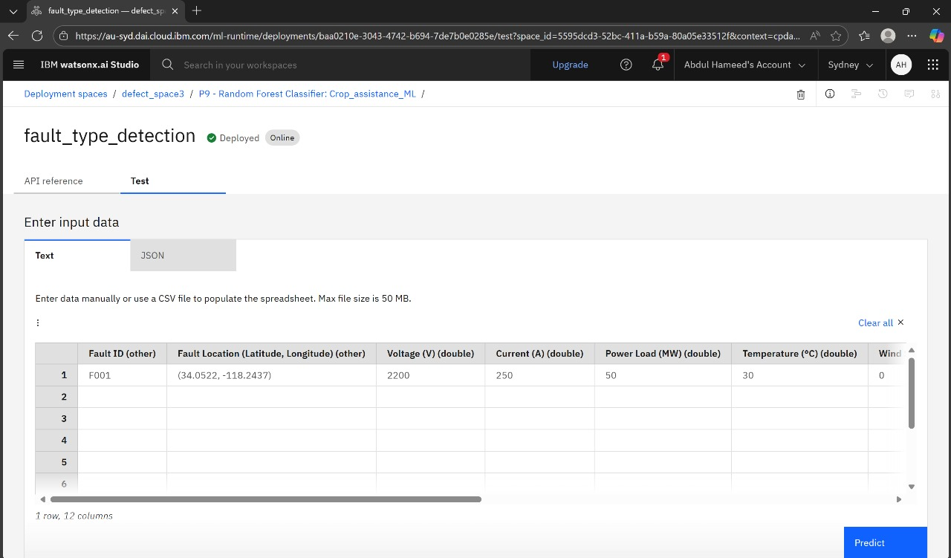
Result
TEST DATA :

Slide 8
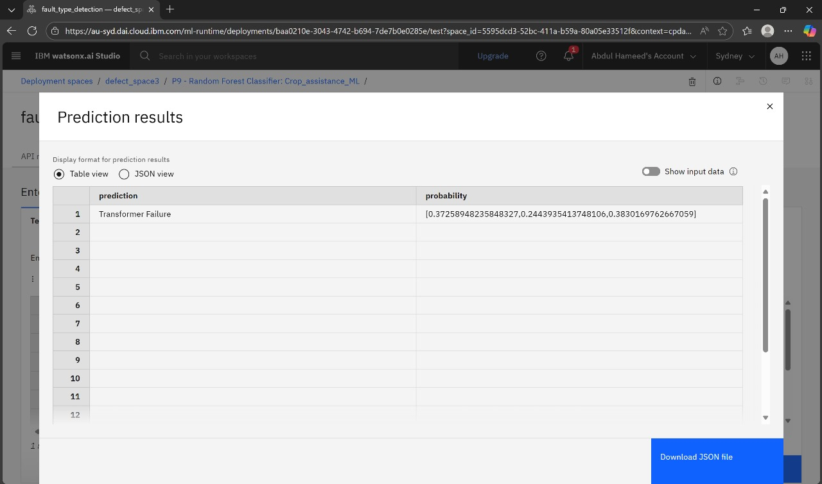
Result
PREDICTION OUTPUT :

Slide 9
Conclusion
The developed machine learning-based system successfully predicts the type of fault in power systems using key electrical and environmental parameters. By automating fault classification, the system enhances the speed and accuracy of fault detection, allowing for faster response and improved grid stability. The use of historical data, combined with predictive modeling, provides actionable insights that support preventive maintenance and reduce system downtime. The solution also demonstrates the effectiveness of data-driven approaches in modernizing traditional infrastructure and contributing to smarter, more reliable power systems. Overall, the project validates the potential of machine learning to optimize fault management and improve operational efficiency in power distribution networks.

Slide 10
Future scope
The proposed fault prediction system can be enhanced and expanded in several ways:
Real-time Integration: Connect the model with live data streams from IoT sensors for continuous fault monitoring and instant predictions.
Multi-Fault Classification: Extend the model to handle multiple simultaneous or cascading faults within a power system.
Scalability to Smart Grids: Adapt the solution for large-scale smart grid infrastructures with complex networks and varying topologies.
Geographic Expansion: Train the model on region-specific data to adapt to diverse environmental and electrical conditions.
Visualization Dashboard: Develop an interactive dashboard for utility operators to visualize fault predictions, locations, and risk levels.
Self-Learning System: Incorporate continuous learning from new fault cases to enhance the model's adaptability and accuracy over time.

Slide 11
References
IBM Cloud Documentation – https://cloud.ibm.com/docs
AutoAI: https://www.ibm.com/cloud/watson-studio/autoai
Power System Fault Analysis – IEEE papers
Kaggle Dataset : https://www.kaggle.com/datasets/ziya07/power-system-faults-dataset

Slide 12
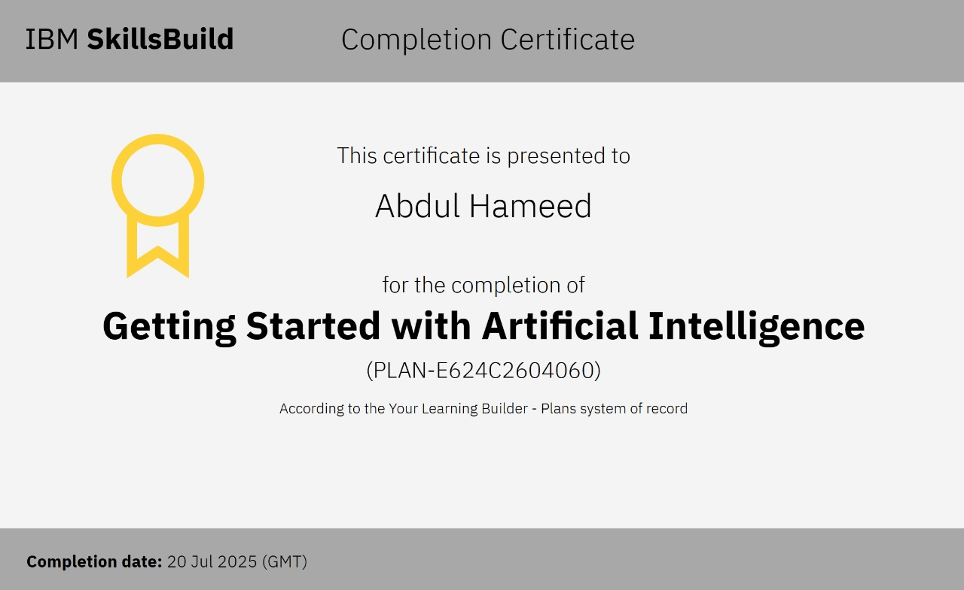
IBM Certifications

Slide 13
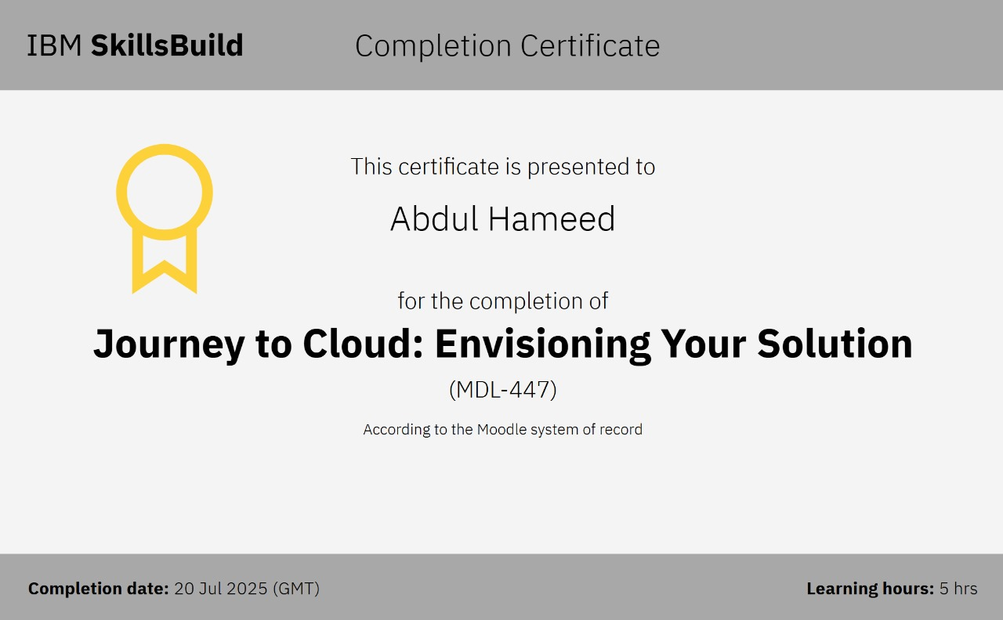
IBM Certifications

Slide 14
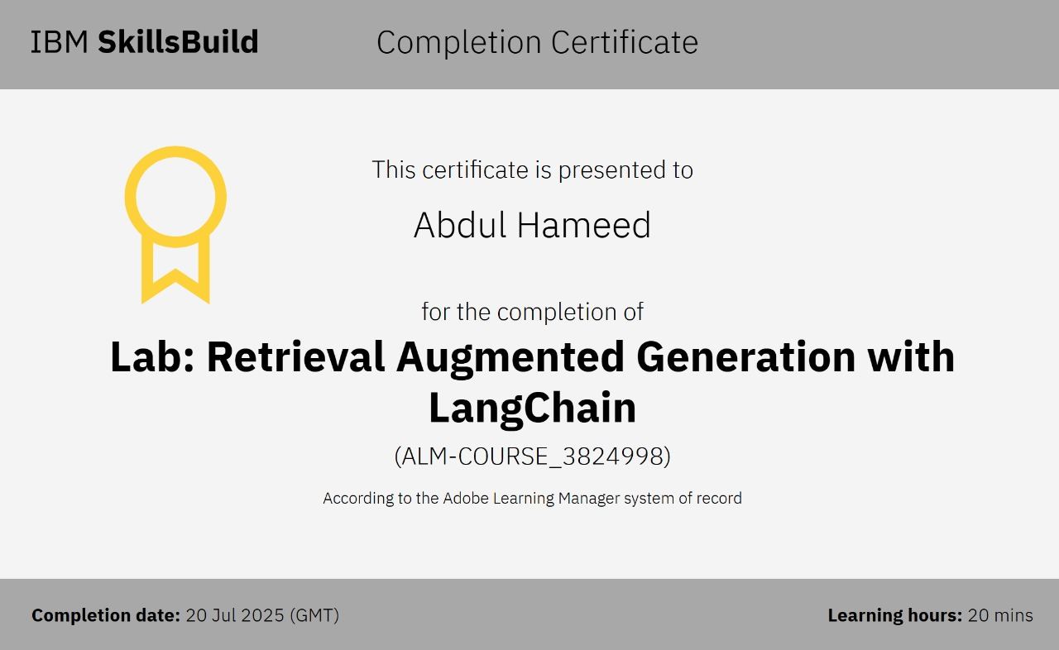
IBM Certifications

Slide 15
THANK YOU

