Slide 1
Serverless Data Pipeline for Real-Time Ingestion & Processing
AWS-Based Automated System for Multisource Data

Slide 2
Project Overview
Real-time ingestion pipeline
Three data sources: Yahoo Finance, CoinMarketCap, Open Exchange Rates
Serverless architecture using AWS

Slide 3
Data Sources
Source | Data Type | Tech Used
Yahoo Finance | S&P 500 OHLCV | yfinance
CoinMarketCap | Top 10 Cryptos | BeautifulSoup
Open Exchange Rates | Live Forex Rates | Request

Slide 4
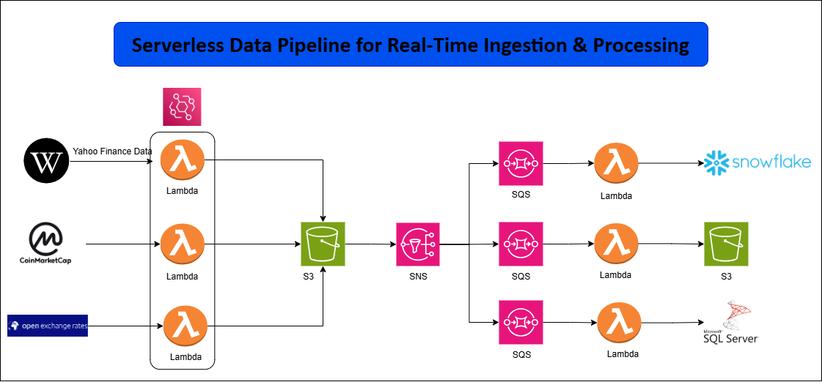
Architecture Overview

Slide 5
Task 1 – Data Acquisition
Triggered via EventBridge every minute
Lambda fetches data from their respective source
Stores data in S3 bucket with folder structure:
raw/{source}/YYYY/MM/DD/HHMM.EXT

Slide 6
Lambda Function Details – Ingestion
Lambda Name | Source | Output Path Format
lambda_yahoofinance | Yahoo Finance | raw/yahoofinance/YYYY/MM/DD/HHMM.EXT
lambda_coinmarketcap | CoinMarketCap | raw/coinmarketcap/YYYY/MM/DD/HHMM.EXT
lambda_exchangerates | Open Exchange Rates | raw/openexchangerates/YYYY/MM/DD/HHMM.EXT

Slide 7
Task 2 – S3 to Processing
S3 triggers SNS on new object creation
SNS filters event using folder metadata
Routes to the appropriate SQS queue

Slide 8
SQS Queues
Queue Name | Data Source
yahoo-finance-queue | Yahoo Finance
coinmarketcap-queue | CoinMarketCap
openexchangerates-queue | Open Exchange Rates

Slide 9
Lambda Function Details – Processing
Lambda Name | Action | Destination
process_yahoofinance | Parse OHLCV → Load to Snowflake | Snowflake
process_coinmarketcap | Transform & Store | S3
process_exchangerates | Parse & Insert | SQL Server

Slide 10
Lambda Layers & Packages
pyodbc – SQL Server connection
snowflake-connector-python – Snowflake integration
pandas – Data transformation

Slide 11
Output Destinations
Destination | Source | Path/Integration
Snowflake DW | Yahoo Finance | Direct insert
S3 Processed | CoinMarketCap | /processed/coinmarketcap/YYYY/MM
SQL Server | Open Exchange Rates | pyodbc insert

Slide 12
Benefits of This Architecture
Serverless and cost-effective
Scalable and real-time ready
Fully decoupled and modular
Handles cloud and local destinations

Slide 13
Thank You
Any Questions?
GitHub: github.com/hameed980
Email: abdulhameedak247@gmail.com
Linkedin: linkedin.com/in/abdul-hameed-088921296/

