Slide 1
Streaming and Massively Parallel Algorithms for Edge Coloring
Soheil Behnezhad, Mahsa Derakhshan, MohammadTaghi Hajiaghayi, Marina Knittel, Hamed Saleh

Slide 2
Edge Coloring Preliminaries
Goal: Given graph G=(V,E), color edges in E such that any two incident edges have different colors
Try to minimize the number of colors
Lower bound: Δ (trivial)
Upper bound: Δ+1 [Vizing, 1964]
(Δ+1)-coloring algorithms are highly sequential

Slide 3
Massively Parallel Communication

Slide 4
Massively Parallel Communication (MPC) Model
Process:
Distribute the data across machines and perform local computation
Machines send messages to each other
Repeat
Complexities
Round complexity: minimize required communication
Local space complexity: minimize individual machine space (should be O(n) words)
Total space complexity: minimize overall space (should be O(m) words)

Slide 5
Our MPC Results
Main result: There exists an MPC algorithm that using O(n) space per machine and O(m) total space, returns a (1+o(1))∆ (precisely ∆ + Õ(∆^{3/4})) edge coloring within O(1) rounds.
Prior to our work, known algorithms required a strongly super linear space of n∆^{Ω(1)} to return such coloring [Harvey et al. SPAA 2018].

Slide 6
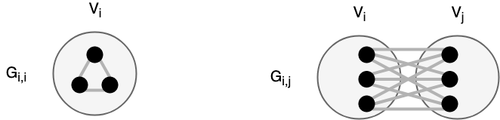
Our MPC Results
We randomly partition vertices into k groups V₁, V₂, …, V_{k}
Consider the induced subgraphs within each groups, and bipartite induced subgraphs between each pair of groups.
G_{i,j} = { e = (u, v) | u ∈ V_{i} and v ∈ V_{j} } for i ≤ j

Slide 7


Our MPC Results
We randomly partition vertices into k groups V₁, V₂, …, V_{k}
Consider the induced subgraphs within each groups, and bipartite induced subgraphs between each pair of groups.
G_{i,j} = { e = (u, v) | u ∈ V_{i} and v ∈ V_{j} } for i ≤ j
In each subgraph, the maximum degree is at most
In each subgraph, the number of edges is at most

Slide 8
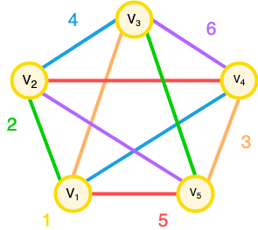
Our MPC Results
We put each G_{i,j} in a single machine and find the optimal edge coloring in each of them, using Vizing’s algorithm with Δ(G_{i,j}) + 1 colors.
We use different set of colors, aka palettes, for the neighboring subgraphs.
We give a valid coloring using k+1 disjoint palettes.

Slide 9

Our MPC Results
The total number of colors used by Algorithm 1 is at most
The required space per machine is also at most
Setting k = log n + √∆, we get a (1+o(1))∆ edge coloring with O(n) space.

Slide 10
Random Streaming

Slide 11
Random Streaming Background
Input edges and output coloring are streamed
O(n) words of space available
One pass allowed
Input arrives in random order (later we study adversarial)
The output is as large as the input, so we have to report the output in a streaming fashion as well.
Challenge: The algorithm cannot remember all the reported colors, yet has to ensure there are no conflicts.
Little to no results in this area.

Slide 12
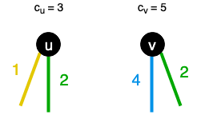
Random Streaming Results
The algorithm is relatively straight-forward.
Maintain a counter c_{v} for each vertex v, initially set to 1.
Upon arrival of each edge e = (u, v), color it with max(c_{v}, c_{u}).

Slide 13
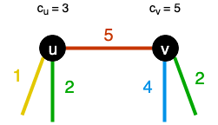
Random Streaming Results
The algorithm is relatively straight-forward.
Maintain a counter c_{v} for each vertex v, initially set to 1.
Upon arrival of each edge e = (u, v), color it with max(c_{v}, c_{u}).
Set the counter of both vertices u and v to max(c_{v}, c_{u}) + 1.

Slide 14
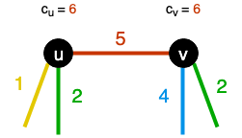
Random Streaming Results
The algorithm is relatively straight-forward.
Maintain a counter c_{v} for each vertex v, initially set to 1.
Upon arrival of each edge e = (u, v), color it with max(c_{v}, c_{u}).
Set the counter of both vertices u and v to max(c_{v}, c_{u}) + 1.

Slide 15
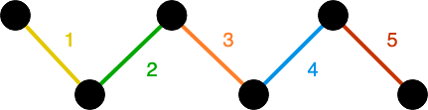
Random Streaming Results
Theorem 9: Algorithm 2 uses at most (2e + ε)Δ = 5.44Δ colors with high probability when the edges arrive random order.
Let 𝚿 be the length of the longest monotone path in the line graph.

Slide 16
Random Streaming Results
Theorem 9: Algorithm 2 uses at most (2e + ε)Δ = 5.44Δ colors with high probability when the edges arrive random order.
Let 𝚿 be the length of the longest monotone path in the line graph.
Lemma 8: Algorithm 2 uses 𝚿 colors.
We can construct a monotone path of length max_{e} c_{e} in reverse order, starting from the edge with the maximum color.

Slide 17
Random Streaming Results
Theorem 9: Algorithm 2 uses at most (2e + ε)Δ = 5.44Δ colors with high probability when the edges arrive random order.
Let 𝚿 be the length of the longest monotone path in the line graph.
Lemma 8: Algorithm 2 uses 𝚿 colors.
We can construct a monotone path of length max_{e} c_{e} in reverse order, starting from the edge with the maximum color.
Each edge with color x has some neighbor in line graph with color x - 1.

Slide 18

Random Streaming Results
Theorem 9: Algorithm 2 uses at most (2e + ε)Δ = 5.44Δ colors with high probability when the edges arrive random order.
Let 𝚿 be the length of the longest monotone path in the line graph.
The probability of existence of at least one monotone path with length at least 𝛂Δ in the line graph is limited as following,

Slide 19

Random Streaming Results
Theorem 9: Algorithm 2 uses at most (2e + ε)Δ = 5.44Δ colors with high probability when the edges arrive random order.
Let 𝚿 be the length of the longest monotone path in the line graph.
For 𝛂 = (2e + ε), we will not have a monotone path of length 𝛂Δ with high probability.
We also assume Δ = ω(log n). Otherwise, we can store all of the edges into Õ(n) memory.

Slide 20
Adversarial Streaming

Slide 21
Adversarial Streaming Background
Input edges and output coloring are streamed
O(n) words of space available
One pass allowed
Input arrives in adversarial order
We assume the adversary is oblivious, i.e., the order of edges is predetermined, so that the adversary cannot use the random bits of the algorithm.

Slide 22
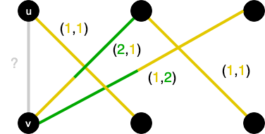
Adversarial Streaming Results
We solve the problem for bipartite graphs with O(Δ²) colors.
Maintain a counter c_{v} for each vertex v, initially set to 1.
Upon arrival each edge e = (u, v) such that u is in the top part and v is in the bottom part, color it with an ordered pair (c_{u}, c_{v}).

Slide 23
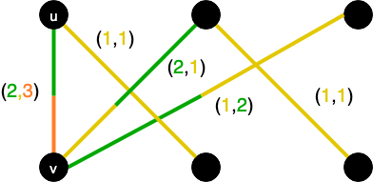
Adversarial Streaming Results
We solve the problem for bipartite graphs with O(Δ²) colors.
Maintain a counter c_{v} for each vertex v, initially set to 1.
Upon arrival each edge e = (u, v) such that u is in the top part and v is in the bottom part, color it with an ordered pair (c_{u}, c_{v}).
Increase both c_{u} and c_{v} by one.

Slide 24
Adversarial Streaming Results
We solve the problem for bipartite graphs with O(Δ²) colors.
The resulting coloring is a valid coloring.

Slide 25
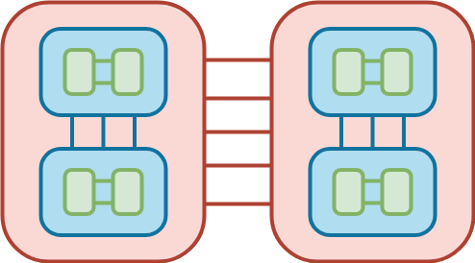
Adversarial Streaming Results
We solve the problem for bipartite graphs with O(Δ²) colors.
We can decompose the edges into O(log n) random bipartite graphs, and color each of them with a different palette, with a total of O(Δ²) colors.

Slide 26
Conclusion
Massively Parallel Communication: (1+o(1))Δ-coloring
Tunable algorithm
O(n) words per machine, O(1) rounds
First strong coloring results in this model
Extends to Congested Clique Model
Random Streaming: 5.44Δ-coloring using O(n) space
In practice, achieves <3.9Δ on small cliques
Adversarial Streaming: O(Δ²)-coloring using O(n) space
Main open problem: Can we also get an O(∆) edge coloring using O(n) space in the adversarial arrival model?

Slide 27
Thanks!
Contacts
Soheil Behnezhad: soheil@cs.umd.edu
Mahsa Derakhshan: mahsa@cs.umd.edu
MohammadTaghi Hajiaghayi: hajiagha@cs.umd.edu
Marina Knittel: mknittel@cs.umd.edu
Hamed Saleh: hamed@cs.umd.edu

Slide 28
Related work in MPC
MPC has been applied to: vertex cover, independent set, vertex coloring, etc.
Assadi et al for vertex coloring:
Closed the MPC problem on vertex coloring for Δ+1 colors
Used only O(n) words of machine space, O(nlog²n) rounds
Unfortunately can’t be extended to edge coloring because line graph is large
Harvey et al for edge coloring:
Randomly partition edges into machines and color the partitions
Trade off between number of colors and machine space
For a small coloring, superlinear local space is required
Our work builds off Harvey et al

Slide 29
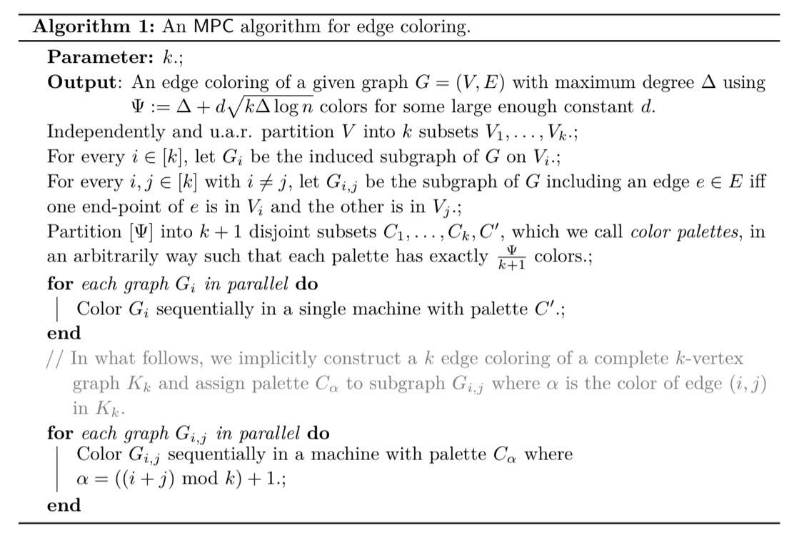
Our MPC Results

Slide 30
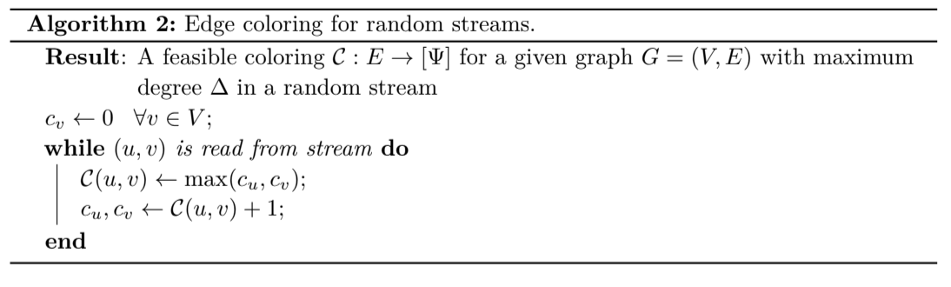
Random Streaming Results
Theorem 9: Algorithm 2 uses at most (2e + ε)Δ = 5.44Δ colors with high probability when the edges arrive random order.

Slide 31
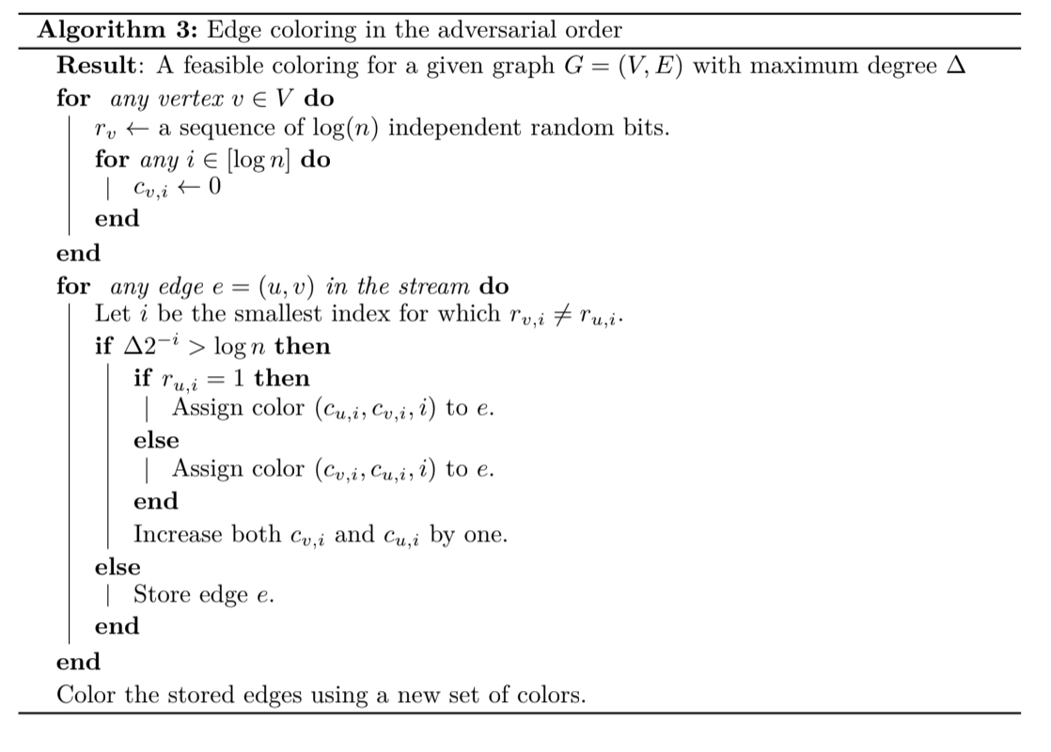
Adversarial Streaming Results

