Slide 1

AWS Amplify
develop and deploy cloud-powered mobile and web apps
ThinQ Platform TP / DXT Center

Slide 2
목차
모 듈 | 상 세 내 용
Amplify 이해 | Descriptions Features Firebase vs Amplify Amplify CLI Console Folder structure Amplify files
Amplify 환경세팅 | Installation Configuration
Amplify.js | Examples Modularization
Case Study | Team Environment Building a ‘Notes’ app [React]

Slide 3
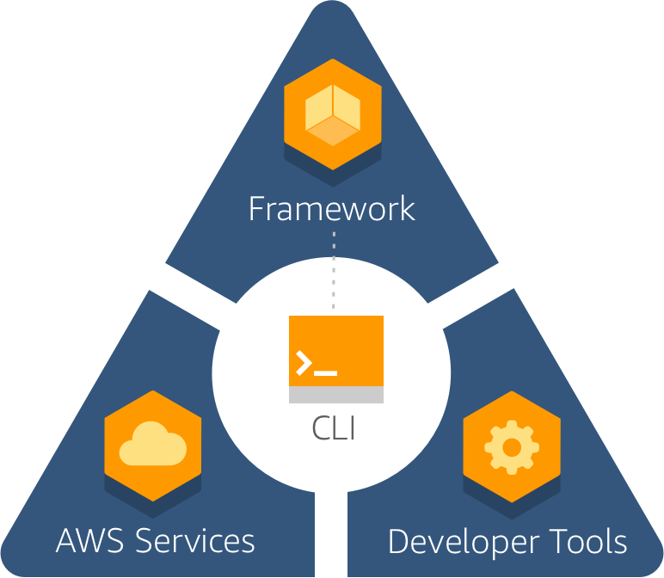




Amplify 이해
Descriptions
모바일 및 앱 애플리케이션을 구축하는 가장 빠른 방법을 제공하며
안전하고 확장 가능한 모바일 및 웹 애플리케이션을 구축하기 위한 개발 플랫폼.
쉬운 사용자 인증
안전한 데이터 및 사용자 메타 데이터 저장
기계학습 통합
응용 프로그램 지표를 분석
버전관리, 코드테스트, 프로덕션 배포 등 개발 워크플로우를 포괄하여 쉽게 확장 가능
https://docs.amplify.aws/lib/q/platform/js
https://docs.amplify.aws/cli
https://docs.aws.amazon.com/amplify/latest/userguide/welcome.html

Slide 4
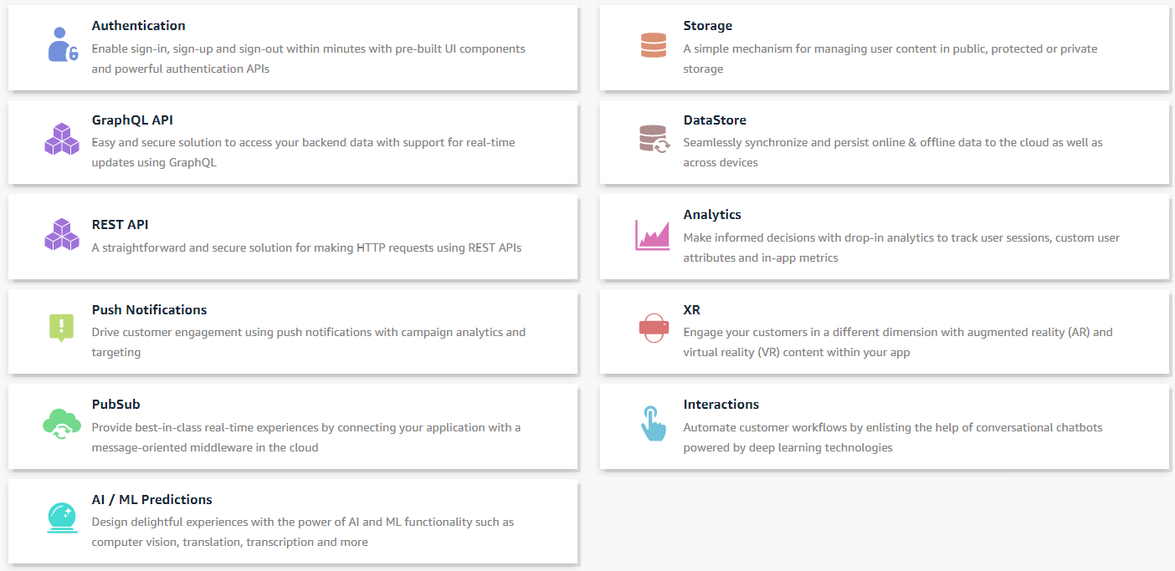
Amplify 이해
Features [Libraries]
https://docs.amplify.aws/lib/auth/getting-started/q/platform/js
https://docs.amplify.aws/lib/storage/getting-started/q/platform/js
https://docs.amplify.aws/lib/graphqlapi/getting-started/q/platform/js
https://docs.amplify.aws/lib/datastore/getting-started/q/platform/js
https://docs.amplify.aws/lib/restapi/getting-started/q/platform/js
https://docs.amplify.aws/lib/analytics/getting-started/q/platform/js
https://docs.amplify.aws/lib/push-notifications/getting-started/q/platform/js
https://docs.amplify.aws/lib/xr/getting-started/q/platform/js
https://docs.amplify.aws/lib/pubsub/getting-started/q/platform/js
https://docs.amplify.aws/lib/interactions/getting-started/q/platform/js
https://docs.amplify.aws/lib/predictions/getting-started/q/platform/js

Slide 5
Amplify 이해
Firebase vs Amplify
What is Firebase?
Firebase is an excellent backend as a service that powers bleeding-edge applications on Google Cloud. The platform allows developers to focus more on creating innovative app solutions.
What is AWS Amplify?
AWS Amplify is an Amazon-backed platform for developing web and mobile apps. It consists of an open-source JavaScript library that helps expedite development tasks. It presents the user with an easy-to-use interface and CLI tools for building application backends.
What are the benefits of Firebase?
– Reduces the time used in developing apps. – No need for backend coding. – Developers can focus on creating top-notch functions for their apps. – Robust SDKs and APIs that simplify the development process. – Easy to use analytics features. – Powerful APIs that allows for the development of cross-platform apps.
What are the benefits of AWS Amplify?
– Easy to use platform that expedites the development of web and mobile application using a cloud-based backend service. – Scale apps without having to bother about upgrading server infrastructure. – Cost-efficient service because Amplify uses a flexible payment plan that allows users to pay for only the service they use. – Makes the procedure of app testing and feature rollout seamless.
https://blog.back4app.com/2020/04/13/firebase-vs-aws-amplify/

Slide 6
Amplify 이해
Firebase vs Amplify
Similarities
AWS Amplify and Firebase are both development platforms designed for building secure and scalable mobile and web applications. They attempt to make it easy to authenticate users, store data and user metadata securely, authorise access to data selectively, and integrate machine learning.
Firebase Pros and Cons
Pros
Firebase is easy to use and doesn’t have a high learning curve. For example, to add authentication or login features takes only a few hours.
This convenience makes it easier to avoid convoluted code.
Firebase generally has more features than AWS Amplify.
Firebase may be, in my opinion, the better choice for small and medium-sized projects and companies.
Cons
Firebase may not be a good choice for building “big data” projects that require millions of database transactions per second (such as e-commerce),
since the costs may well become prohibitive.
AWS Amplify Pros and Cons
Pros
Amplify offers many cloud features that can be utilised to improve existing applications.
Amplify can use GraphQl to simplify data processing, a feature not supported by Firebase.
Prices are more manageable and can be adjusted according to usage.
Cons
AWS in general has a learning curve that is actually higher than for AWS Amplify itself, and there are some features that are quite difficult to implement.
https://www.mitrais.com/news-updates/aws-amplify-vs-google-firebase-which-is-better/

Slide 7
Amplify 이해
Amplify CLI
Install
Configure Amplify CLI
https://docs.amplify.aws/cli
https://docs.amplify.aws/cli/start/install
npm install -g @aws-amplify/cli
amplify configure
amplify configure will ask you to sign into the AWS Console.
Specify the AWS Region
? region: # Your preferred region
Specify the username of the new IAM user:
? user name: # User name for Amplify IAM user
Complete the user creation using the AWS console
Create a user with AdministratorAccess to your account to provision AWS resources for you like AppSync, Cognito etc.
Once the user is created, Amplify CLI will ask you to provide the accessKeyId and the secretAccessKey to connect Amplify CLI with your newly created IAM user.
Enter the access key of the newly created user:
? accessKeyId: # YOUR_ACCESS_KEY_ID
? secretAccessKey: # YOUR_SECRET_ACCESS_KEY
This would update/create the AWS Profile in your local machine
? Profile Name: # (default)
Successfully set up the new user.

Slide 8
Amplify 이해
Amplify CLI
Initialize new project
Common CLI commands
https://docs.amplify.aws/cli
Clone sample Amplify project
run the command from the root directory of your frontend app.
To clone a sample amplify project, execute the following command inside an empty directory
amplify init
amplify init --app <github url>
amplify init
During the init process, the root stack is created with three resources:
IAM role for unauthenticated users, IAM role for authenticated users, S3 bucket, the deployment bucket, to support this provider’s workflow
The information of the project metadata file : amplify/backend/amplify-meta.json, The root stack’s template can be found in amplify/backend/awscloudformation.
amplify add
Once init is complete, run the command amplify <category> add to add resources of a category to the cloud. This will place a CloudFormation template for the resources of this category in the category’s subdirectory amplify/backend/<category> and insert its reference into the above-mentioned root stack as the nested child stack. When working in teams, it is good practice to run an amplify pull before modifying the backend categories.
amplify push
Once you have made your category updates, run the command amplify push to update the cloud resources. The CLI will first upload the latest versions of the category nested stack templates to the S3 deployment bucket, and then call the AWS CloudFormation API to create / update resources in the cloud. Based upon the resources added/updated, the aws-exports.js file (for JS projects) and the awsconfiguration.json file (for native projects) gets created/updated.
amplify pull
The amplify pull command fetching upstream backend environment definition changes from the cloud and updating the local environment to match that definition.
amplify console
The amplify console command launches the browser directing you to your cloud project in the AWS Amplify Console.
amplify configure project
The command should be used to modify the project configuration present in the .config/ directory and re-configuring AWS credentials

Slide 9
Amplify 이해
Amplify CLI
List of commands
Category commands
https://docs.amplify.aws/cli
amplify <category> <subcommand>
amplify push
amplify pull
amplify env <subcommand>
amplify configure
amplify console
amplify delete
amplify help
amplify init
amplify publish
amplify run
amplify status
amplify <category> add
amplify <category> update
amplify <category> remove
amplify <category> push

Slide 10
Amplify 이해
Amplify Console
The AWS Amplify Console provides a Git-based workflow for hosting fullstack serverless web apps with continuous deployment. A fullstack serverless app consists of a backend built with cloud resources such as GraphQL or REST APIs, file and data storage, and a frontend built with single page application frameworks such as React, Angular, Vue, or Gatsby.
AWS Amplify Console supports common Single Page App (SPA) frameworks (e.g. React, Angular, Vue.js, Ionic, Ember), as well as static-site generators like Gatsby, Eleventy, Hugo, VuePress, and Jekyll.
Features
Manage production and staging environments for your frontend and backend by connecting new branches. See feature branch deployments.
Connect your custom domain. If you manage your domain in Amazon Route 53, the Amplify Console automatically connects the root (yourdomain.com), www subdomains (www.yourdomain.com), and branch (https://dev.yourdomain.com) subdomains. See custom domains.
Preview changes during code reviews by setting up Pull-Request Previews.
Improve your app quality with end to end tests. See End-to-End Testing.
Password protect your web app so you can work on new features without making them publicly accessible. See restricting access.
Set up rewrites and redirects to maintain SEO rankings and route traffic based on your client app requirements. See redirects.
Also:
Instant cache invalidations ensure your app is updated on every code commit instantly.
Atomic deployments eliminate maintenance windows by ensuring that the web app is only updated when the entire deployment has finished. This eliminates scenarios where files fail to upload properly.
Get screen shots of your app rendered on different mobile devices to pinpoint layout issues.
https://docs.aws.amazon.com/amplify/latest/userguide/welcome.html

Slide 11
Amplify 이해
Amplify Console
Getting Started with Existing Code
Step 1: Connect Repository
Step 2: Confirm Build Settings for the Front End
Step 3: Confirm Build Settings for the Backend
Step 4: Add Environment Variables (Optional)
Step 5: Save and Deploy
Getting Started with Fullstack Continuous Deployments
Step 1: Deploy a fullstack sample
Step 2: Explore the Fullstack App
Step 3: Add a GraphQL backend
https://docs.aws.amazon.com/amplify/latest/userguide/welcome.html
https://docs.aws.amazon.com/amplify/latest/userguide/getting-started.html
https://docs.aws.amazon.com/amplify/latest/userguide/deploy-backend.html

Slide 12
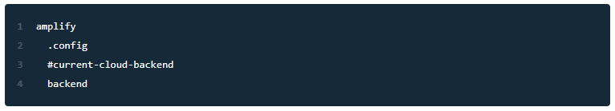
Amplify 이해
Folder structure
https://docs.amplify.aws/cli/usage/files
The CLI places the following folder structure at the root directory of the project when init is completed successfully:
amplify/.config
Contains files that store cloud configuration and user settings/preferences
amplify/#current-cloud-backend
Contains backend resources specifications in the cloud from the last synchronization, by the amplify push or amplify env pull command. Each plugin stores contents in its own subfolder inside this folder.
amplify/backend
It contains the latest local development of the backend resources specifications to be pushed to the cloud. Each plugin stores contents in its own subfolder inside this folder.

Slide 13
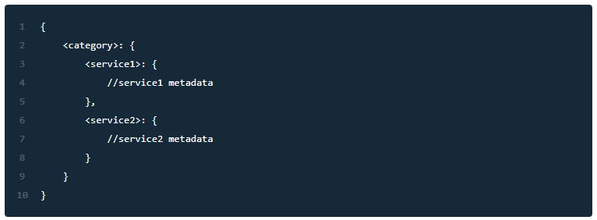
Amplify 이해
Amplify files
https://docs.amplify.aws/cli/usage/files
amplify-meta.json file
amplify-meta.json in the backend directory serves as the whiteboard for the CLI core and the plugins to log information for themselves, and to communicate with each other.
The CLI core provides read and write access to the file for the plugins.
Because one category might create multiple services within one project the category metadata generally follows a two-level structure like the following:
aws-exports.js file
This file is generated only for JavaScript projects. It contains the consolidated outputs from all the categories and is placed under the src directory that the user (the developer) specified during the init process. It is updated after each successful execution of the amplify push command, that has created or updated the cloud resources.
Cognito security best practices for web app
Security / Best Practice for poolData (UserPoolId, ClientId) in a browser JS app
Are the Cognito User pool id and Client Id sensitive?

Slide 14
Amplify 환경 세팅
Installation
AWS Amplify is available as aws-amplify package on npm.
Web
React
Angular
Vue
React Native
$ npm install aws-amplify --save
or you could install the module you want to use individually
$ npm install @aws-amplify/auth --save
$ npm install aws-amplify --save
$ npm install aws-amplify-react --save
$ npm install aws-amplify --save
$ npm install aws-amplify-angular --save
$ npm install aws-amplify --save
$ npm install aws-amplify-vue --save
$ npm install aws-amplify --save
If you are developing a React Native app, you can install an additional package aws-amplify-react-native containing Higher Order Components
$ npm install aws-amplify-react-native --save

Slide 15
Amplify 환경 세팅
Configuration
Somewhere in your app, preferably at the root level, configure Amplify with your resources.
Using AWS Resources
Without AWS
import Amplify from 'aws-amplify';
import aws_exports from './aws-exports';
Amplify.configure(aws_exports);
// or if you don't want to install all the categories
import Amplify from '@aws-amplify/core';
import Auth from '@aws-amplify/auth';
import aws_exports from './aws-exports';
// in this way you are only importing Auth and configuring it.
Amplify.configure(aws_exports);
Amplify.configure({
API: {
graphql_endpoint: 'https://www.example.com/my-graphql-endpoint',
},
});

Slide 16
Amplify.js
Examples
Collect user session metrics
Add Authentication to your App
https://github.com/aws-amplify/amplify-js/tree/a047ce73abe98c3bf82e888c3afb4d2f911805f3#examples
By default, AWS Amplify can collect user session tracking data with a few lines of code:
import Analytics from '@aws-amplify/analytics';
Analytics.record('myCustomEvent');
See our Analytics Developer Guide for detailed information.
Add user sign up and sign in using two of the many methods available to the Auth class:
import Auth from '@aws-amplify/auth';
Auth.signUp({
username: 'AmandaB',
password: 'MyCoolPassword1!',
attributes: {
email: 'someemail@example.com',
},
});
Auth.signIn(username, password)
.then(success => console.log('successful sign in'))
.catch(err => console.log(err));
See our Authentication Developer Guide for detailed information.

Slide 17
Amplify.js
Examples
Sign Http requests
Upload and Download public or private content
https://github.com/aws-amplify/amplify-js/tree/a047ce73abe98c3bf82e888c3afb4d2f911805f3#examples
AWS Amplify automatically signs your REST requests with AWS Signature Version 4 when using the API module:
import API from '@aws-amplify/api';
let apiName = 'MyApiName';
let path = '/path';
let options = {
headers: {...} // OPTIONAL
}
API.get(apiName, path, options).then(response => {
// Add your code here
});
See our API Developer Guide for detailed information.
AWS Amplify provides an easy-to-use API to store and get content from public or private storage folders:
Storage.put(key, fileObj, { level: 'private' })
.then(result => console.log(result))
.catch(err => console.log(err));
// Store data with specifying its MIME type
Storage.put(key, fileObj, { level: 'private', contentType: 'text/plain', })
.then(result => console.log(result))
.catch(err => console.log(err));
See our Storage Developer Guide for detailed information.

Slide 18
Amplify.js
Modularization
https://github.com/aws-amplify/amplify-js/wiki/Amplify-modularization
As more and more modules are introduced to AWS Amplify, it became a necessity to modularize the library into smaller pieces so that users could avoid importing unnecessary parts into their app. The goal of this design is to make AWS Amplify modularized and also keep it backward compatible to avoid breaking changes.
Modular import prevents unnecessary code dependencies are included with the app, and thus decreases the bundle size and enables adding new functionality without the risk of introducing errors related to the unused code.
@aws-amplify/auth
@aws-amplify/analytics
@aws-amplify/api
@aws-amplify/storage
@aws-amplify/pubsub
@aws-amplify/core
Usage
First install the modular import you would like to use:
npm install @aws-amplify/auth;
Then import the library module you would like to use:
import Auth from '@aws-amplify/auth';
Instead of importing the whole library:
import Amplify from 'aws-amplify';

Slide 19
Amplify.js
Modularization
Dependencies
We have a class named Amplify in the @aws-amplify/core which will be the registry table for all the other modules. Modules will register themselves into Amplify class when they are loaded and they can reference other modules through this class.
@aws-amplify/api/API.ts
@aws-amplify/core/src/Amplify.js
// API has a dependency on PubSub.
import PubSub from '@aws-amplify/pubsub';
PubSub.subscribe();
// by using that amplify object
import Amplify from '@aws-amplify/core';
if (Amplify.PubSub && typeof Amplify.PubSub.subscribe === 'function') {
Amplify.PubSub.subscribe();
} else {
// PubSub module is not installed in your app!
}
export default class Amplify {
private static _modules = [];
private static _config = {};
// register the module into Amplify
static register(module) {
this._modules.add(module);
module.configure(this._config);
Amplify[module.getModuleName()] = module;
}
static configure(config) {
Object.assign(this._config, config);
this._modules.map(module => {
module.configure(this._config);
});
}
}
@aws-amplify/pubsub/src/index.ts
import PubSubClass from './PubSub';
import Amplify from '@aws-amplify/core';
const instance = new PubSubClass();
Amplify.register(instance);
export default instance;

Slide 20
Amplify.js
Modularization
Apply modularized Amplify to other packages
The way to make them work with the modularized version of Amplify is to
Define @aws-amplify/core as one of the dependencies
Export module references from @aws-amplify/core/Amplify
import Amplify from '@aws-amplify/core';
const Auth = Amplify.Auth;
When the @aws-amplify/auth is not imported, Auth would be null or undefined
Check if the module is imported before using any method from the module:
// in aws-amplify-react/src/Auth/SignIn.jsx
signIn() {
const { username, password } = this.inputs;
if (!Auth || typeof Auth.signIn !== 'function') {
throw new Error('No Auth module found, please ensure @aws-amplify/auth is imported');
}
Auth.signIn(username, password)
// ...
})
.catch(err => {
// ...
});
}

Slide 21
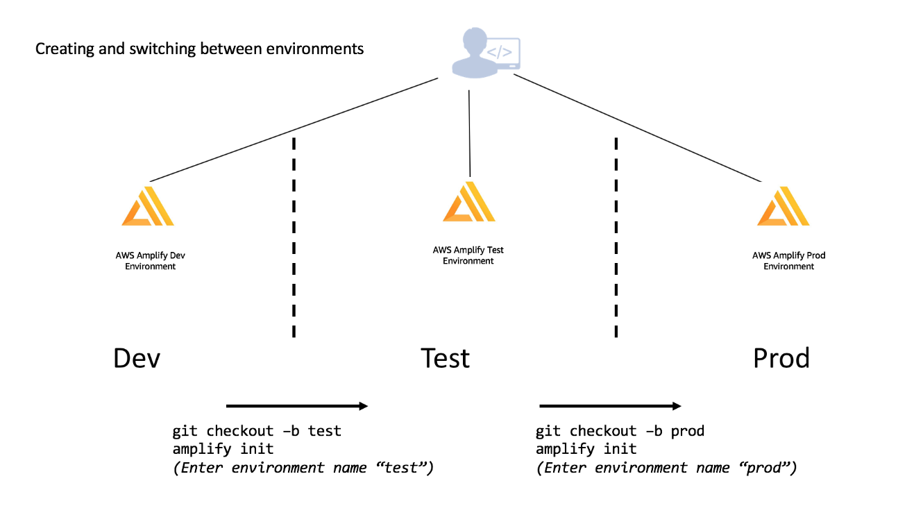
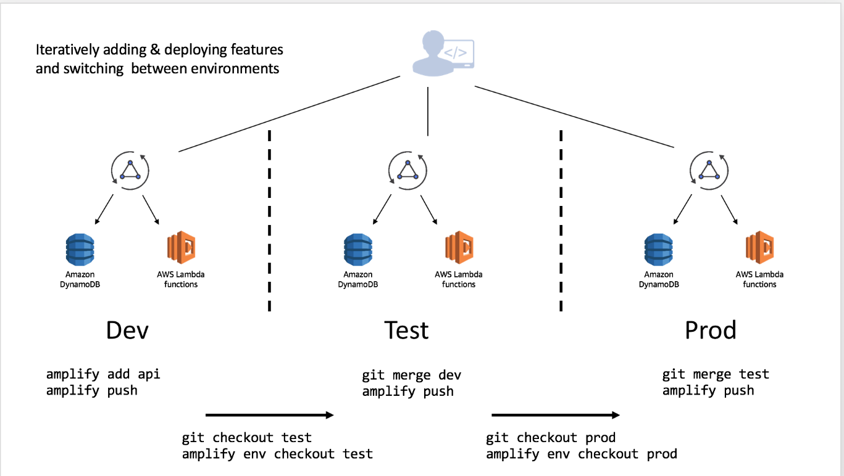
Case Study
Team Environment
> Overview
https://docs.amplify.aws/cli/teams/overview
[Multiple environments]
[Add features to each environment]

Slide 22
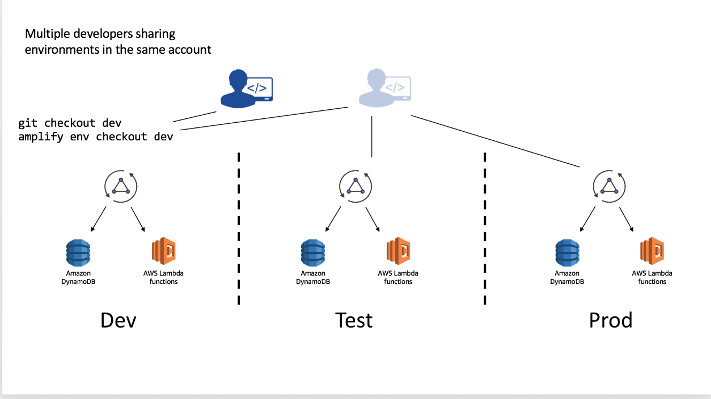
Case Study
Team Environment
> Overview
https://docs.amplify.aws/cli/teams/overview
[Sharing Environment to other account]
You can alternatively, have developers setup their own isolated replica of these environments in different AWS account.
Clone the existing project
Run amplify env add and set up a new environment (e.g. “mydev”) with
that developer’s account and AWS profile
Deploy with amplify push
This workflow can be used to share complete Amplify projects with people outside of your organization as well by committing the project into a Git repository. If you are doing this remove (or add to the .gitignore) the team-provider-info.json which is located in the amplify directory. You can learn more about this file here.
[Command]
amplify env add : Adds a new environment to your Amplify Project
amplify env list [–details] [–json] : Displays a list of all the environments in
your Amplify project
amplify env remove : Removes an environment from the Amplify project
amplify env get –name : Displays the details of the environment specified
in the command
amplify env pull : Pulls your environment from the cloud without impacting
any local backend edits. Add the --restore flag to overwrite your local backend
edits (operates like the amplify pull command).
amplify env import : Imports an already existing Amplify project environment
stack to your local backend. Here’s a sample usage of the same
[Multiple developers sharing in same account]

Slide 23
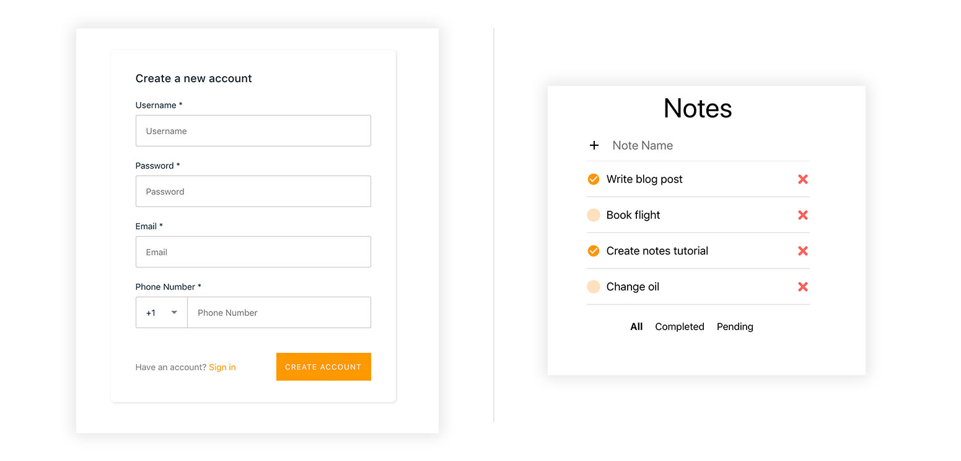
Case Study
Building a ‘Notes’ app [React]
> Overview
https://github.com/dabit3/react-notes
In this tutorial, you will create a React 'Notes’ app that connects to a serverless backend via the Amplify Framework. The app will provide user authentication with Amazon Cognito, in-app analytics with Amazon Pinpoint, and it will be connected to a serverless GraphQL backend with AWS AppSync.
Here is the sequence of the tutorial:
Part 1: Creating the React App Part 2: Adding Cloud Features Part 3: Enabling GraphQL Backend
[Tip 1] 소스 오류로 아래 명령 실행 필요
> amplify remove analytics
[Tip 2] Local test
> npm start

