Slide 1
Battle of the Neighborhoods
HELPING ENTREPRENEURS CHOOSE BUSINESS STARTUPS BASED
ON MOST POPULAR VENUES VIA FOURSQUARE

Slide 2
It is very important to own a business in these times as COVID-19 has a huge impact on the economy resulting in major job losses.
The purpose of this project is to use Foursquare to help identify stakeholders/entrepreneurs the best type of business they can invest in/start.
In this project, we will identify the top 10 venues in every neighborhood of Staten Island so that our clients get an idea of what type of business is most popular to invest in.

Slide 3
I have gathered New York City data from previous weeks as it has all the neighborhood information along with the latitude and longitude values of all the neighborhoods in the city.
number of businesses and their types and location in every neighborhood will be obtained using Foursquare API.

Slide 4
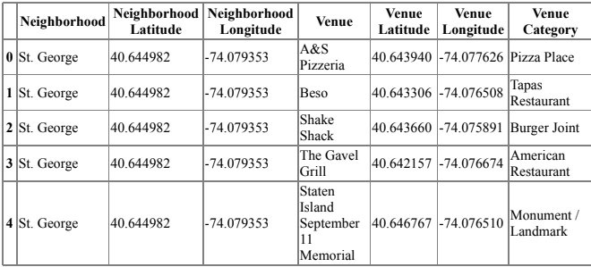
Data after categorization

Slide 5
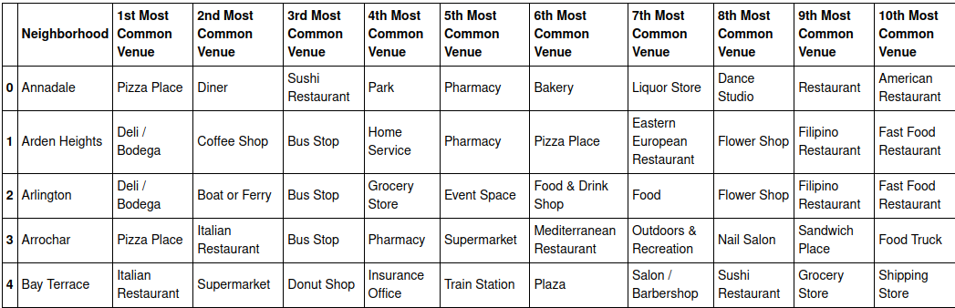
Final Outcome

Slide 6
Conclusion
Purpose of this project was for stakeholders/entrepreneurs to identify the top venues in every neighborhoods which can help them in choosing the best options for their business interests.
Final decision on optimal business idea will be made by stakeholders based on specific characteristics of neighborhoods and locations in every recommended zone, taking into consideration additional factors like attractiveness of each location (proximity to park or water), levels of noise / proximity to major roads, real estate availability, prices, social and economic dynamics of every neighborhood etc.

