Slide 1
Pixel Density

Slide 2
Consider a 24″ HD monitor (20″ wide), that has a known, native resolution of 1920 pixels (horizontal). Let us assume an artist created a new image at this monitor resolution of 1920 pixels, possibly intended for the web without regard to printing. Rewriting the formula above can tell us the pixel density (PPI) of the image on the monitor display:

Slide 3


To print a larger banner at 48″ horizontally.
we can use the same formula again to give the PPI of the printed poster:
printer device is capable of printing at 300 ppi, the resolution of the original image is well below w
a 1920 × 1080 pixel image does not have enough pixels to be printed in a large format.

Slide 4

Calculation of PPI (Pixels per inch (ppi)
PPI can be calculated from knowing the diagonal size of the screen in inches and the resolution in pixels (width and height). This can be done in two steps:
Calculate diagonal resolution in pixels using the Pythagorean theorem, then the actual PPI:
Where w_{p} is width resolution in pixels, h_{p} is height resolution in pixels
d_{i} diagonal size in inches

Slide 5

For a 21.5 inches (546.1 mm) screen with a 1920×1080 resolution you get
102.46 PPI

Slide 6
For 32 inch screen with a 3840×2160 resolution you get
102.46 PPI

Slide 7

For 32 inch screen with a 3840×2160 resolution you ge
138 PPI
ref: https://www.sven.de/dpi/

Slide 8
Calculate Megapixels
For screen with a 1920×1080 resolution you get
Size = 1920 x 1080 = 2,073,600 pixels
Pixel count = 2.07MP pixels
Resolution = 2.07MP pixels

Slide 9
Calculate Megapixels
For screen with a 1920×1080 resolution you get, Pixel Resolution:
  Size = 1920 x 1080 = 2,073,600 pixels
  Pixel count = 2.07MP pixels
  Resolution = 2.07MP pixels
  ref: http://web.forret.com/tools/megapixel.asp

Slide 10
Calculate Megapixels
For screen with a 1920×1080 resolution you get, Aspect Ratio:
  Width / Height: 1.78
  "landscape" (horizontal) orientation
  Type of aspect ratio = "HD 16:9"

Slide 11
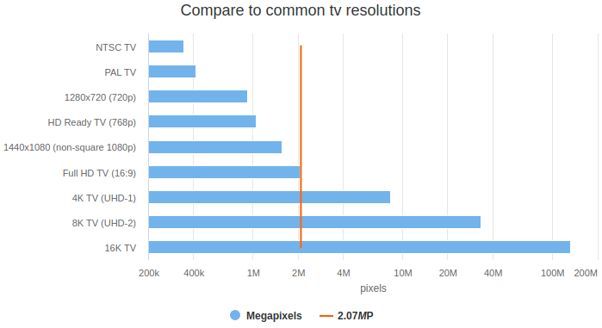
Calculate Megapixels

