Slide 1
Case Study: Regression
Mid Term Project
Nadine Kampmann, Silja Loik,
Hamid Khurshid, Raffaele Vergnani
Notes:
build a model that will predict the price of a house based on features provided in the dataset.
explore the characteristics of the houses using some business intelligence tools.
understand which factors are responsible for higher property value - $650K and above.

Slide 2
Data
Overview

Slide 3
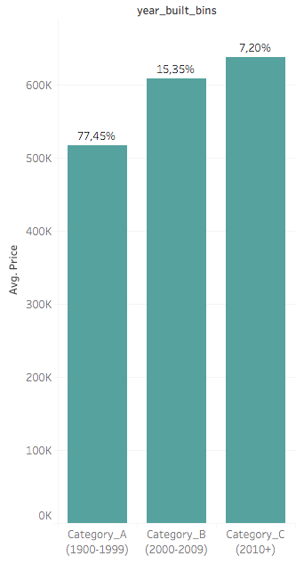
Split by year build
Date Range May 2014 - May 2015
Dataset of 21.597 observations
Average price of houses sold: $ 530k
Prices ranging from $ 78k to $ 6.890 k
77% of the houses sold were built between 1900 and 2000, with most houses having 3-4 bedrooms

Slide 4
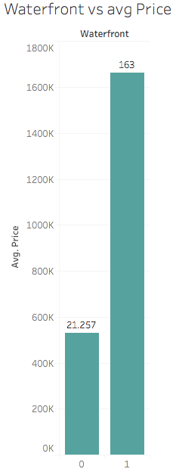
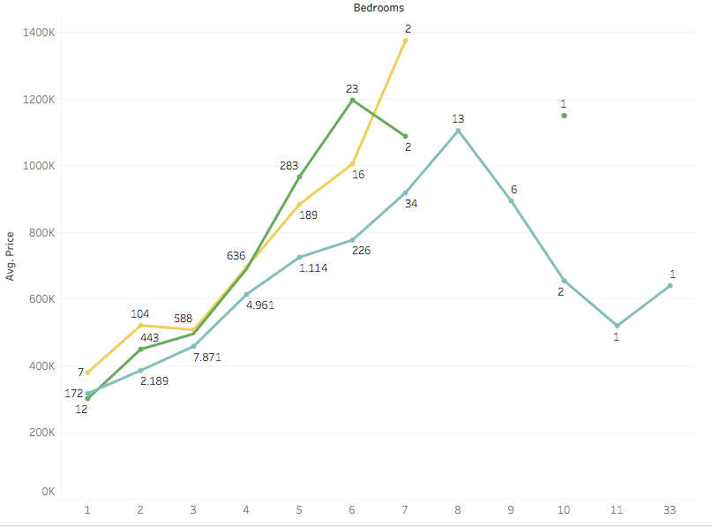
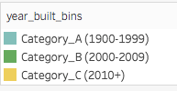
Factors likely to impact avg. Selling Price

Slide 5
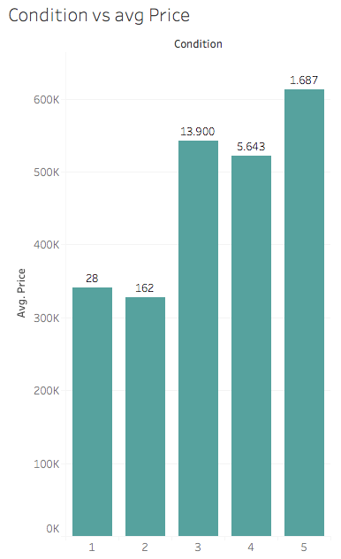
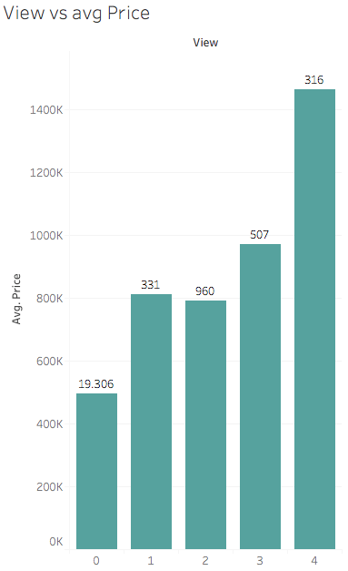
Factors likely to impact avg. Selling Price
Factors like View and Condition impact the average selling price, but not showing linear growth.

Slide 6
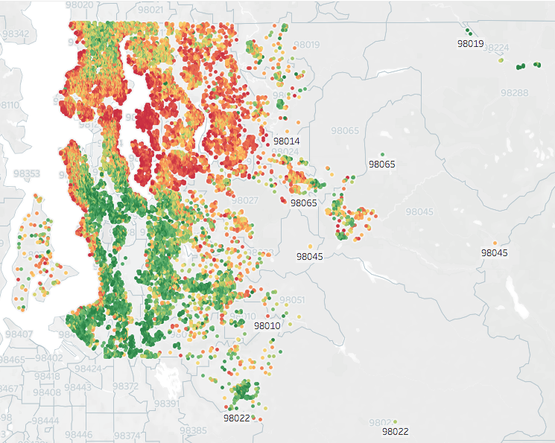

Impact of Area - North/ South discrepancy
House selling prices show a clear north-south divide
$
$$

Slide 7
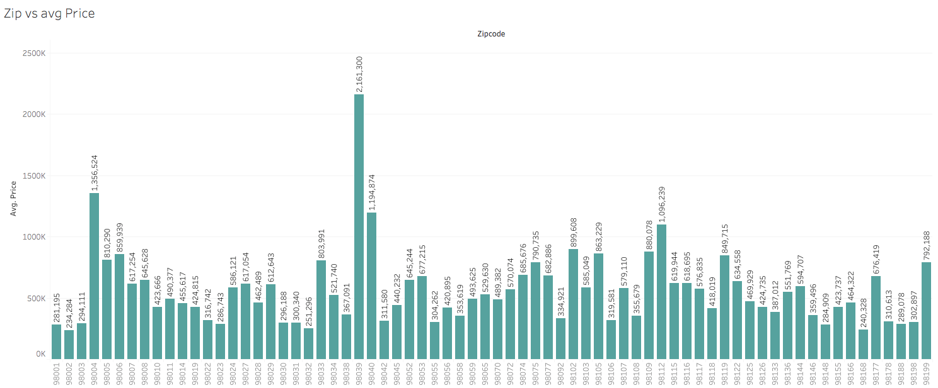
Impact of Area - Zip code
Certain zip code areas with double to quadruple the average sales price

Slide 8
Factors responsible for property value
> 650k USD

Slide 9

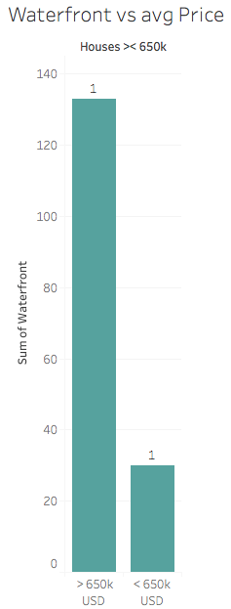
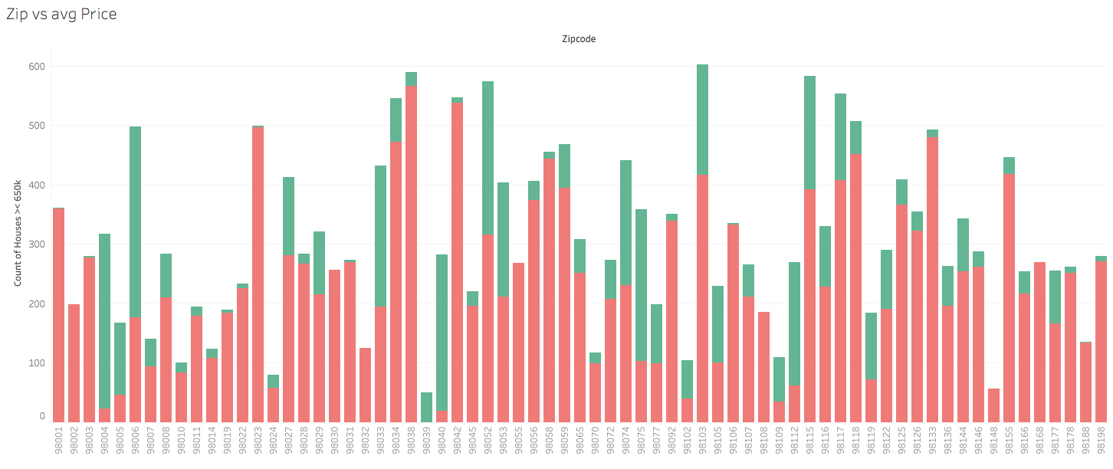
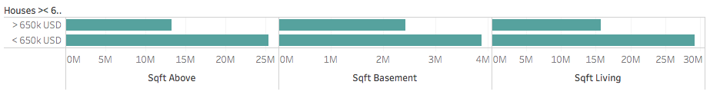
Location, Waterfront & Sqft impacting property value > 650k USD

Slide 10
Workflow & Model Evaluation

Slide 11
Workflow
Testing model before making many changes to original data to get an understanding
Applied power transformations
Trying to reduce the amount of features
Adjusted transformation approach
Applied Variance Inflation Factor
Adjusted train/test split to see impact on model accuracy, removed outliers with IQR
Applied RandomForestRegressor
1. basic data cleaning
2. Ordinal Encoding of cat. data
3. normalized cat. & num. data using Normalizer
1. Checked for multicollinearity between our independent features
2. dropped 2 columns, which are highly correlated
1. Replaced Normalizer for Standard
Scaler
1. selected only 3 variables to apply the log transformation on
1. tried different thresholds (50, 30, 10)
1. StandardScaler
1. IQR multiplyer: 3
2. Reduced the test size to 20% and increased train set to 80%
Approx. 50% accuracy for both models
Approx. 60%+ accuracy for both models
increased model accuracy by 5% points in each case
reduced model accuracy by 1% points in each case
accuracy score dropped to 60% - final result to avoid overfitting
did not have a positive impact on the accuracy
this had positive impact on the accuracy score
we got 88% accuracy

Slide 12
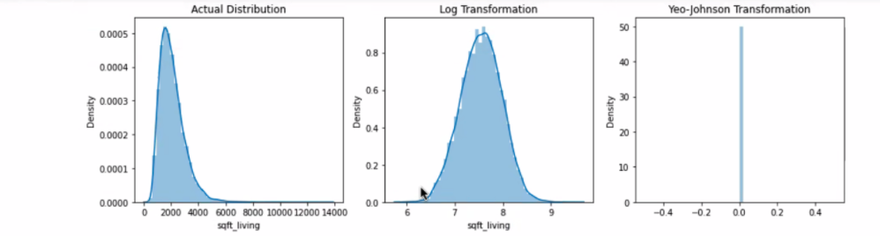
Main Challenges
Accuracy of linear regression
Figuring out how and where to best use power transformations
How to best deal with outliers
Using Variance Inflation Factor to pick out best features
Dropping columns based on Multicollinearity did not improve our linear regression r-score

Slide 13
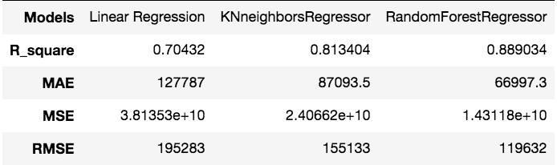
Model Evaluation
Linear Regression - part of the problem
assumes the data is normally distributed
K Neighbors - works well on regression problems, based on the features of known observations that are close to it.
assumes the neighbor points are similar to each other
Random Forest - commonly used model for regression and classification tasks.
does not make assumption that the data is normally distributed
Average Price
Actual Test Data | Linear Regression Model | KNeighbors Regressor Model | Random Forest Regressor Model
529.871 USD | 528.879 USD | 527.034 USD | 530.321 USD
Notes:
Non-parametric means that KNN does not make assumptions about the distribution of the data it is modeling.
With a linear regression, for example, the model assumes the data is normally distributed. If the data follows a much different distribution, say, bimodal, a linear regression no longer works. So not having to worry about distribution is a big advantage, it means KNN can be applied to lots of data sets.
When we call KNN ‘lazy’, we mean that it takes little or no training time.

Slide 14
Conclusion & Learnings

Slide 15
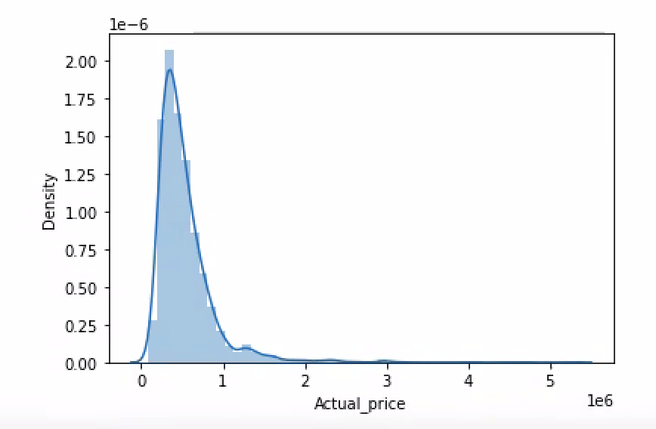
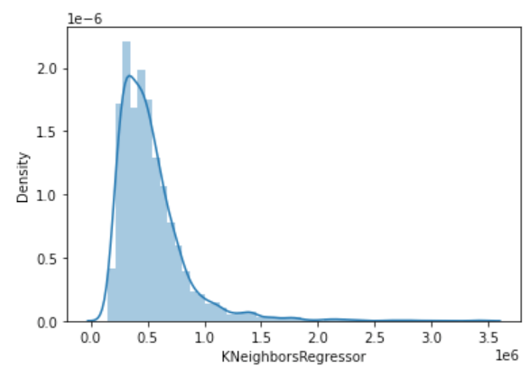
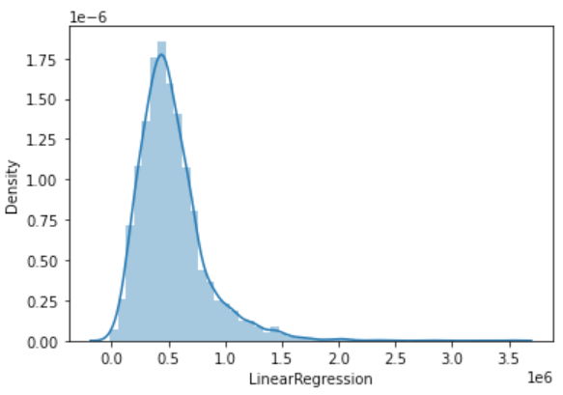
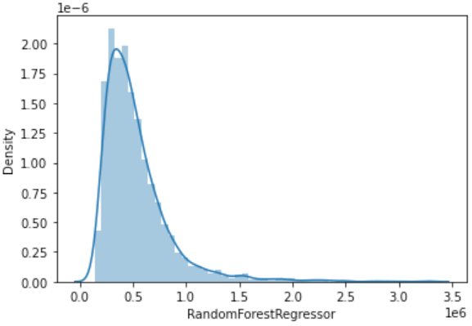
Model Recommendation
On the basis of the predicted values’ distributions compared the actual price, the given values in test data have impacted the distributions of the predicted values
Mode of:
y_test: 525 000
Linear Regr.: 62 993
K Neighbors: 219 700
Random Forest: 140 456
y_train: 350 000

Slide 16
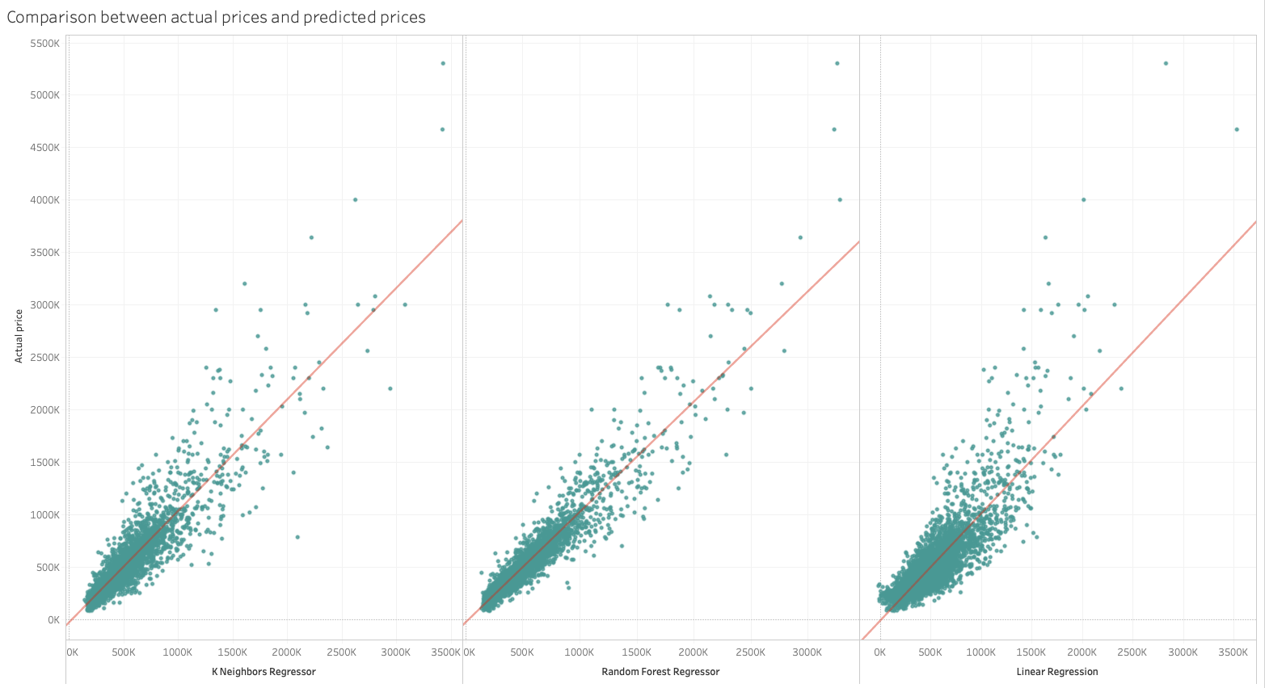
Conclusions
Houses with a price > 800.000 USD account for 2.943 observations . Based on the number of such observations Linear regression R_ score is only at 0.70
On the given data through linear regression we cannot train our model better to get the prices of house > 650.000 USD
Based on this data, using the Random Forest Regressor we can predict the sales prices of houses with an r-Score of 0.88

Slide 17
Learnings
Data Cleaning depends on the model we choose.
Prediction depends on what data we have trained the model - the imbalance in house prices towards lower priced houses does not allow our model to make good predictions on higher priced houses
Analyse the actual predictions to learn and improve the model

Slide 18
BACKUP

Slide 19
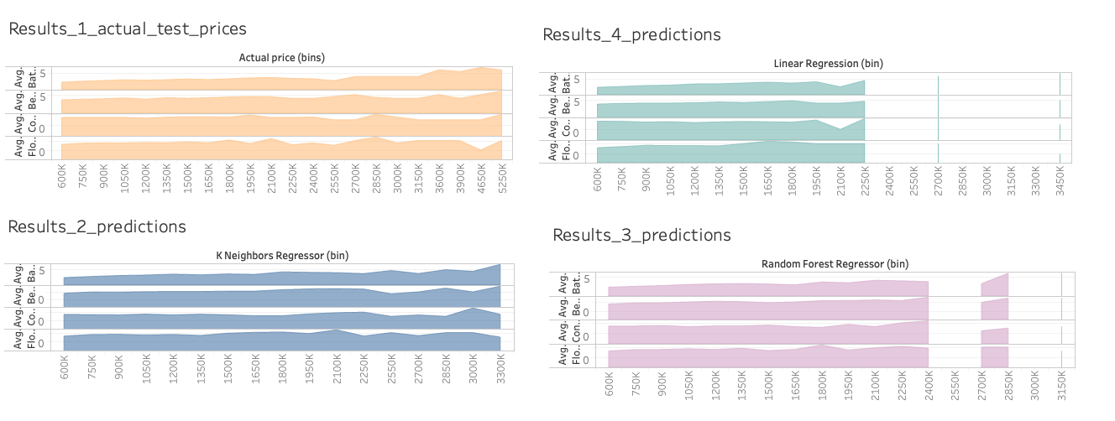

Slide 20
 | General Step | Details | TAKEAWAY
1 | Testing our model before making a lot of changes to the original data and transforming it to get an understanding of it | 1. we had just done basic necessary data cleaning 2. 2nd round we applied Ordinal Encoding to encode categorical data 3. normalized both categorical and numerical data using Normalizer | we got approximately 50% accuracy for both applied models
2 |  | 1. instead of Normalizer we used StandardScaler | we got approximately more than 60% accuracy for both applied models
3 | Applied power transformations | 1. StandardScaler | it reduced our model accuracy: by 5% percentage points in each case
4 | Trying to reduce the amount of features | 1. Checked for multicollinearity between our independent features 2. dropped 2 columns, which are highly correlated | it reduced our model accuracy: by 1% percentage points in each case
5 | Adjusted the train/test split to see the impact on the model accuracy removed outliers by using IQR | 1. IQR multiplyer: 3 2. Reduced the test size to 20% and increased train set to 80% | this had positive impact on the accuracy score
6 | Applied Variance Inflation Factor | 1. tried different thresholds (50, 30, 10) | did not have a positive impact on the accuracy
7 | Adjusted transformation approach | selected only 3 variables to apply the log transformation on | the accuracy score improved to 70% - the final result to avoid overfitting
8 | Applied RandomForestRegressor |  | we got 88% accuracy

