Slide 1
GAS Sensor Using Ardiuno
Microprocessor And Embedded System
Section :[E]
Group :7
Semester: Fall[20-21]

Slide 2
Group info:
Md. Abdus Sobhan (18-37855-2)
Mokabbera Billah(18-37480-1)
Md Nayeem Reza Shopnil (18-36267-1)
Shahriyar Shazib (18-36610-1)
Avishek Shaha (18-36064-1)
Hamid Ahmed Antor (18-36061-1)

Slide 3
Background
Statistic Accident
Importance
Cost
Implementation
Present Situation of our country

Slide 4
Components
Simulino
MQ2 gas Sensor
LCD Display(Lm016L)
LED light
Registers
Connecting Wire etc.

Slide 5
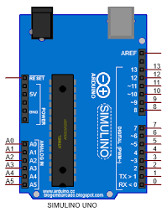
Simulino
Simulino is a microcontroller like Arduino Uno.This Micro controller Board Equipped with sets of digital input and output (I/O) pins that may be interfaced to various expansions Board six Analogue (I/O)pins and is programmable with the Arduino IDE . It can be Powered By USB cable or External 9 v Battery though it accepts 7-20 V

Slide 6
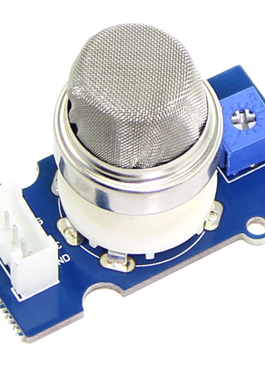
MQ2 gas Sensor
MQ2 gas sensor are Commonly used gas sensors. It is a metal Oxide Semi conductor (MOS) type Semi conductor Also known as chemiresistors as detection is based on upon change of resistance of the sensing material when the gas comes in contact with the material. It detect gas like LPG ,Alcohol ,Propene ,Hydrogen ,CO and Methane and the Module version Sensor Comes with a digital pin Which makes the sensor to operate even Without micro controller.

Slide 7

Lcd Display LM016L
It is 16*2 LCD module it has 16 pin 7-14 data pin and the operating voltage of the module 4.7~5.3 current consumption 1 mA. It can display Alphabet and number each character built by5*8 pixel box it can work both 4 and 8 bit mode at also can print custom built character it has 2 row and each roe consist 16 character

Slide 8
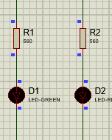
Led light Registers & connecting Wire
In the project we use 2 register 2 led red and Green
and connecting wires to register are used to keep the led safe that over voltage could not burn out the led and the Led are usually use to indicate the gas lick or not and connecting wire to connect whole the circuit

Slide 9
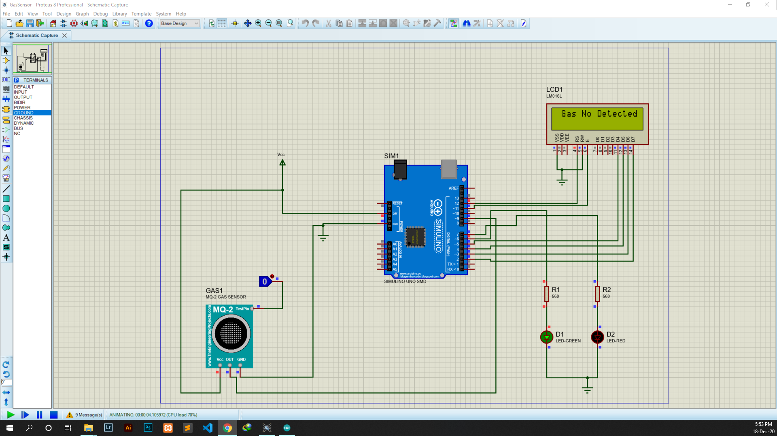
Simulation

Slide 10
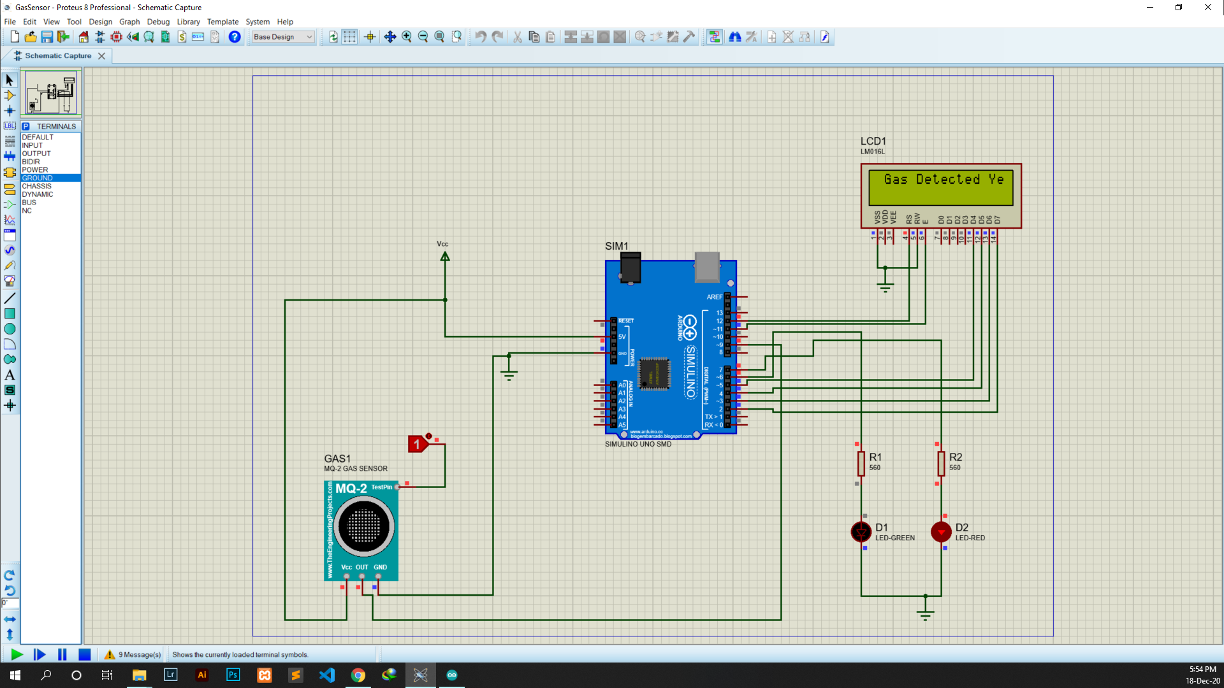
Simulation

Slide 11
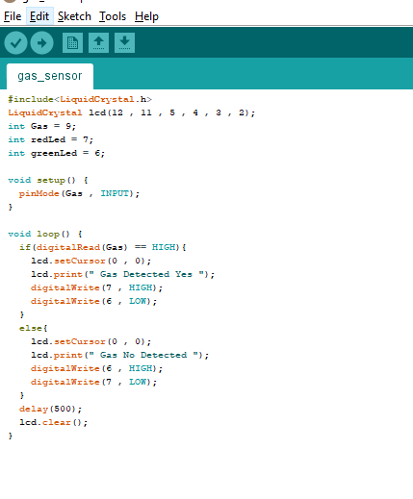
cODE

Slide 12
Conclusion
In Bangladesh Towns Morales in every House we use gas And in Our country often the accident occurs due to gas cylinder bluest or gas lick so our system will able to detect whether the gas is licking or not

Slide 13
Thank You

