Slide 1
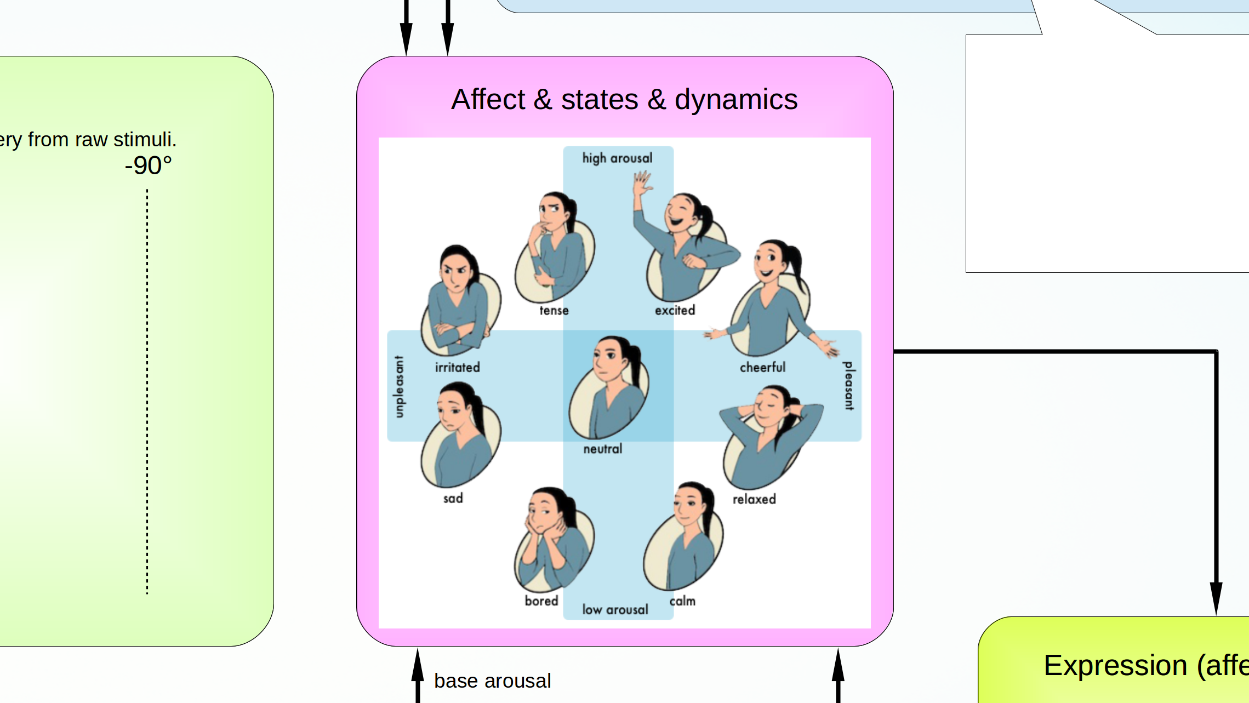
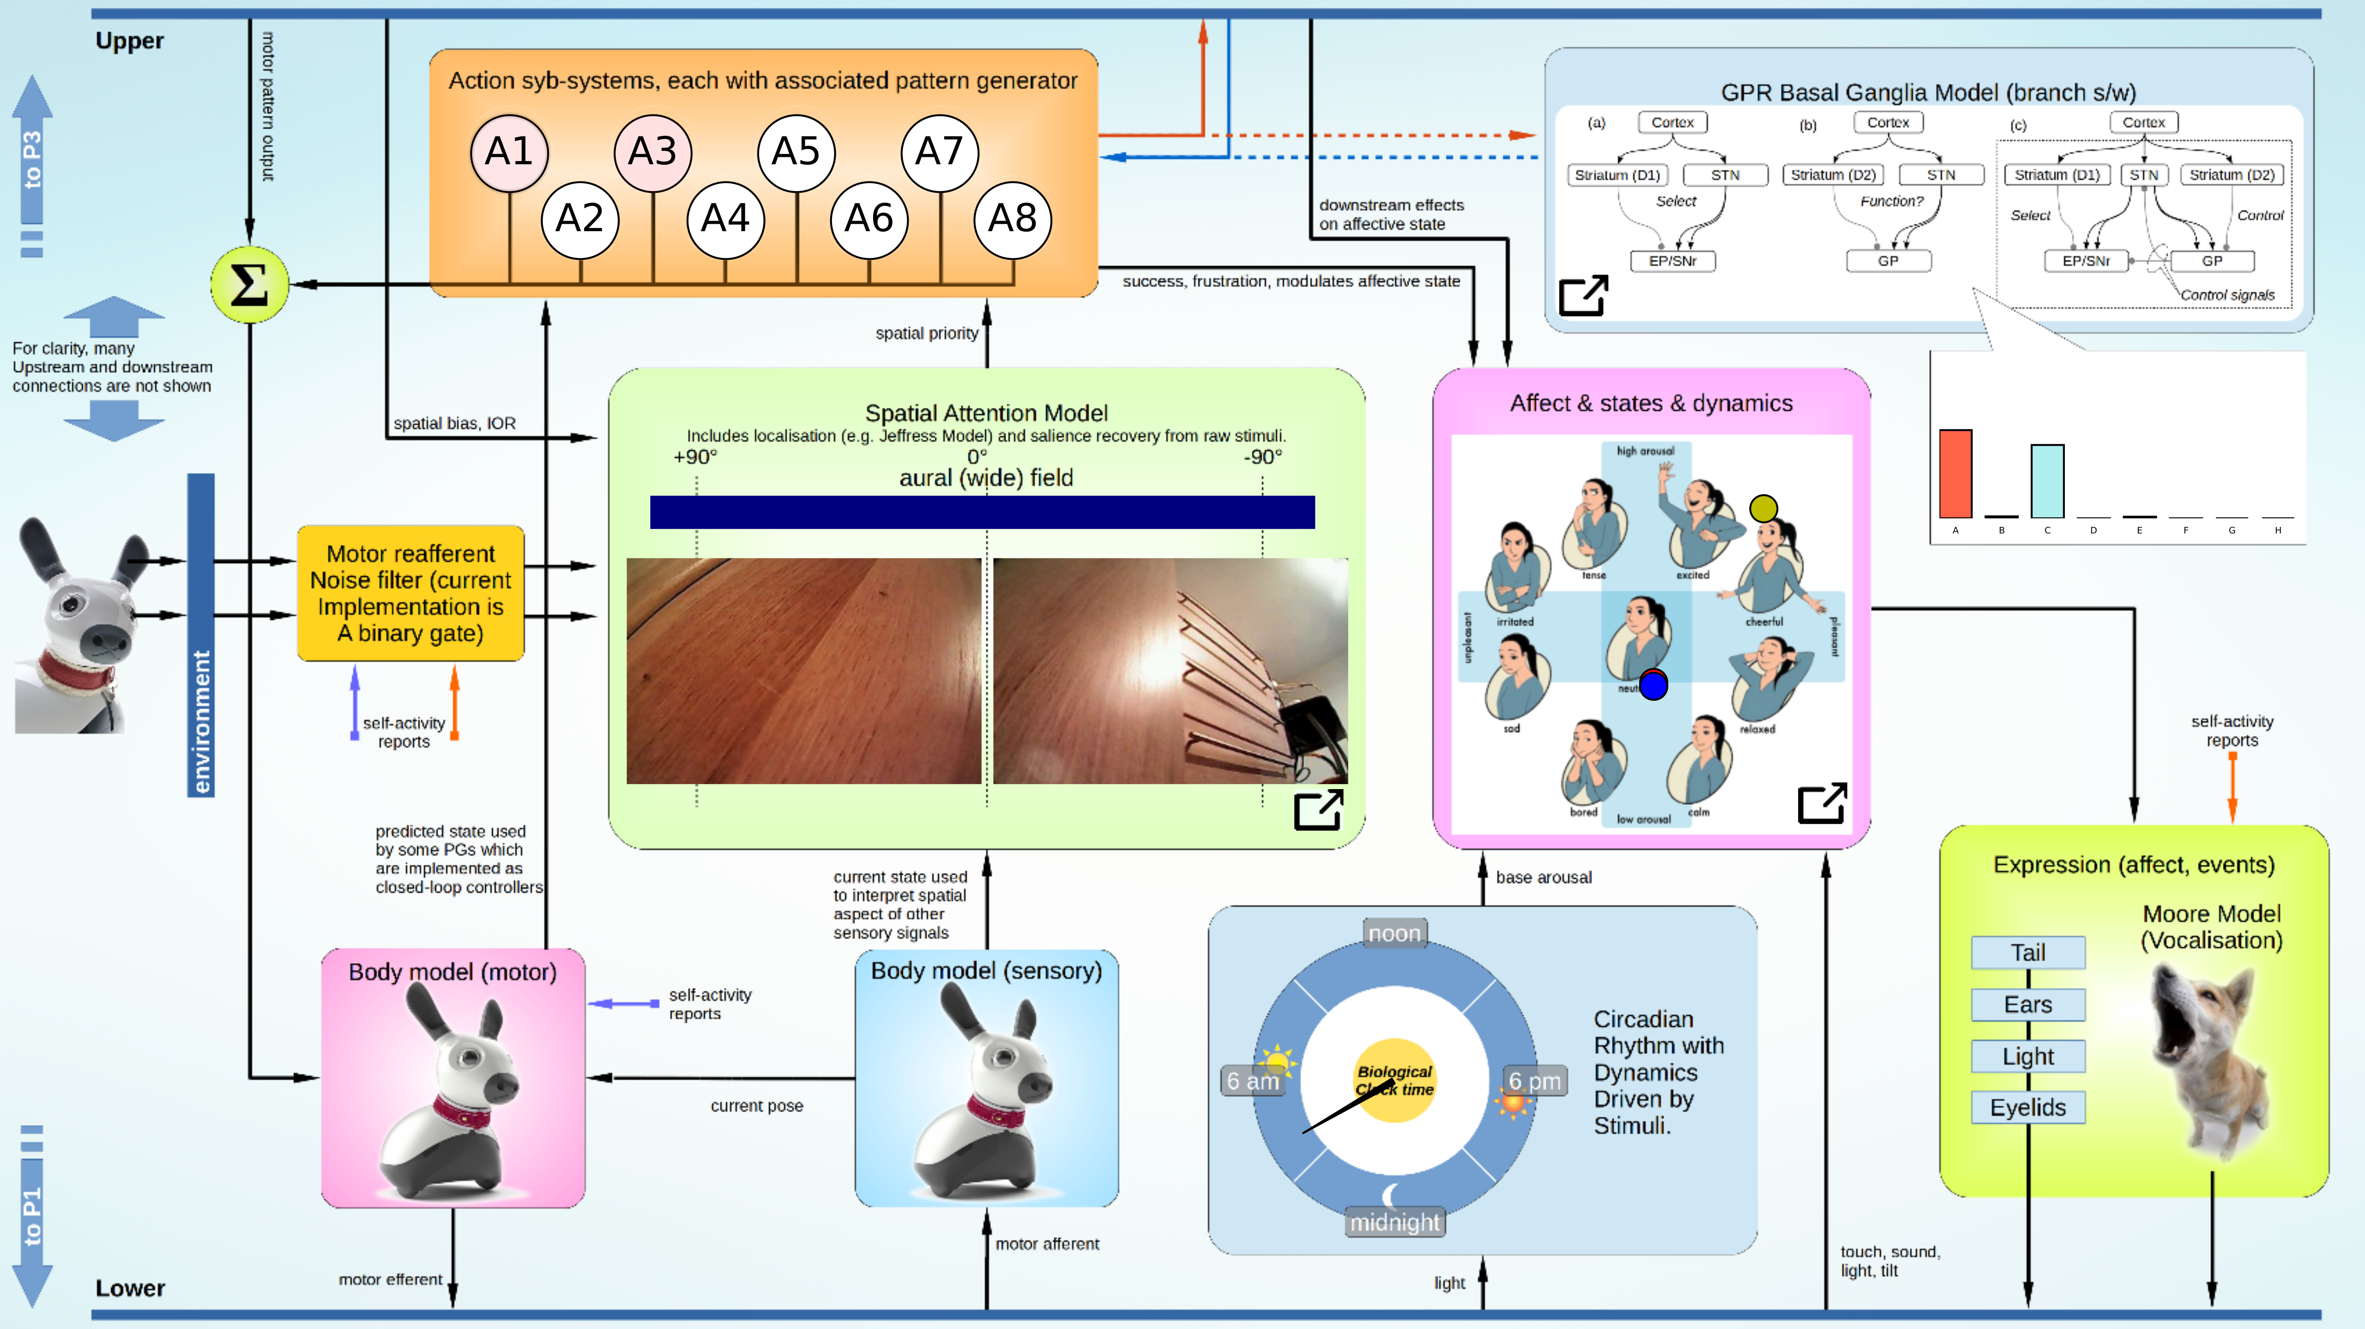
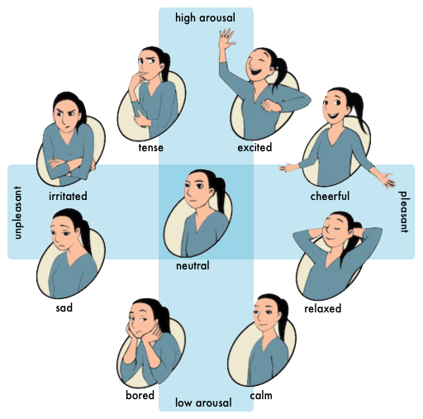
success, frustration, modulates affective state
downstream effects
on affective state
Affect & states & dynamics
touch, sound,
light, tilt

