Slide 1
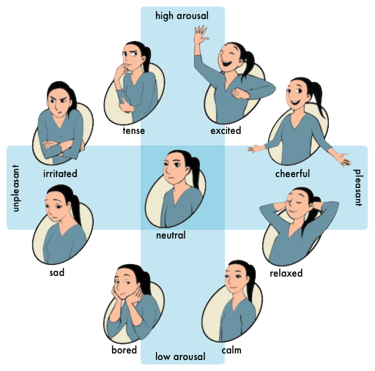
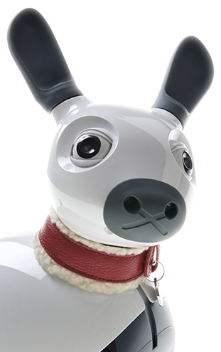
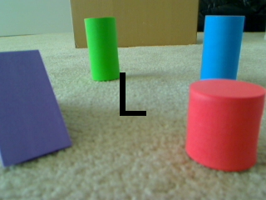
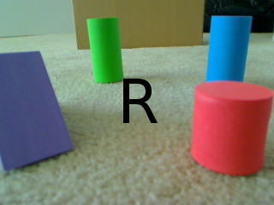
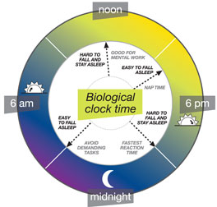
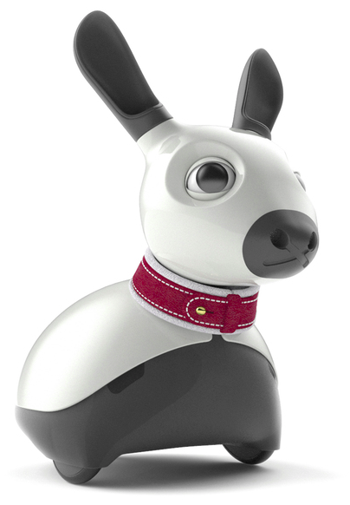

Upper
Action syb-systems, each with associated pattern generator
GPR Basal Ganglia Model (branch s/w)
to P3
A1
A3
A5
A7
motor pattern output
(a)
Cortex
(b)
Cortex
(c)
Cortex
For clarity, many upstream
and downstream connections
are not shown
Striatum (D1)
Select
STN
Striatum (D2)
Function?
STN
Striatum (D1)
STN
Striatum (D2)
A2
A4
A6
A8
Select
Control
EP/SNr
GP
EP/SNr
GP
downstream effects on affective state
Σ
Control signals
spatial bias, IOR
spatial priority
Affect & states & dynamics
Spatial Attention Model
Includes localisation (e.g. Jeffress Model) and salience recovery from raw stimuli.
+90° 0° -90°
success, frustration, modulates affective state
Motor reafferent
Noise filter (current
Implementation is
A binary gate)
aural (wide) field
E
M
S
environment
self-activity
reports
self-activity
reports
current state used
to interpret spatial
aspect of other
sensory signals
base arousal
Expression (affect, events)
predicted state used
by some PGs which
are implemented as
closed-loop controllers
Moore Model
(Vocalisation)
Body model (sensory)
Body model (motor)
Circadian
Rhythm with
Dynamics
Driven by
Stimuli.
self-activity
reports
Tail
current pose
Ears
Light
motor efferent
Eyelids
Playback
Streaming
light
touch, sound, light, tilt
motor afferent
Lower
to P1
Ascending signal transforms (inc. pattern detectors)
VOX
encoder
Ascending signal transforms
(inc. pattern detectors)

