Slide 1
Cognito-based User Authentication flow
Front-end
GraphQL
REST
User credentials
Token + User ID + User Role + Query
JWT token
Elevate Auth Server
Elevate specific JWT token
JWT Token
pre-auth Lambda trigger (Node.js)
exports.handler = async (event) => { if (event.triggerSource === 'TokenGeneration_HostedAuth' || event.triggerSource === 'TokenGeneration_UserPoolClient') { // Define default role and allowed roles const hasuraClaims = { 'x-hasura-default-role': 'user', 'x-hasura-allowed-roles': ['user', 'admin'], 'x-hasura-user-id': event.request.userAttributes.sub }; event.response = { claimsOverrideDetails: { claimsToAddOrOverride: { 'https://hasura.io/jwt/claims': JSON.stringify(hasuraClaims) } } }; } return event; };
Hasura
REST server (Payment, CMS)
AWS Cognito
Payment Database
Cognito User Pool
Users, Groups, Roles

Slide 2
RBAC in Cognito
Manage roles and permissions by:
Cognito Groups → assign users to predefined groups, e.g. admin, customer
Custom Attributes → Up to 50 can be added
Lambda Custom Attributes → assign per-user roles or metadata
Post-Confirmation Lambda Triggers → auto-assign group on sign-up
X-hasura-default-role : Least privilege role
X-hasura-allowed-roles: A list of roles that are allowed to be set for x-hasura-default-role in HTTP header by Hasura client
To override the default role, Elevate frontend must set a value for x-hasura-default-role in HTTP header

Slide 3
Leverage Cognito groups for customer roles and custom attributes such as frontier_customer_id
For each Elevate role such as operations, compliance etc., create a user group
For each role a user can have within an organization (like Maker, Checker, etc.), create separate Cognito groups
users can be assigned different roles by placing them in the appropriate groups within Cognito
Customer details will be linked to users, stored in custom attributes within Cognito and retrieved whenever the user logs in.
Hasura attributes such as x-hasura-default-role can be initialised in the pre-auth Lambda function
On the backend side, when a user logs in, you can check both their assigned Cognito group (for their role) and their organization from the custom attributes to make authorization decisions. This setup keeps user management in Cognito, while Postgres holds the organization data, which you can link by querying when needed. This keeps everything in Cognito for user and role management.

Slide 4
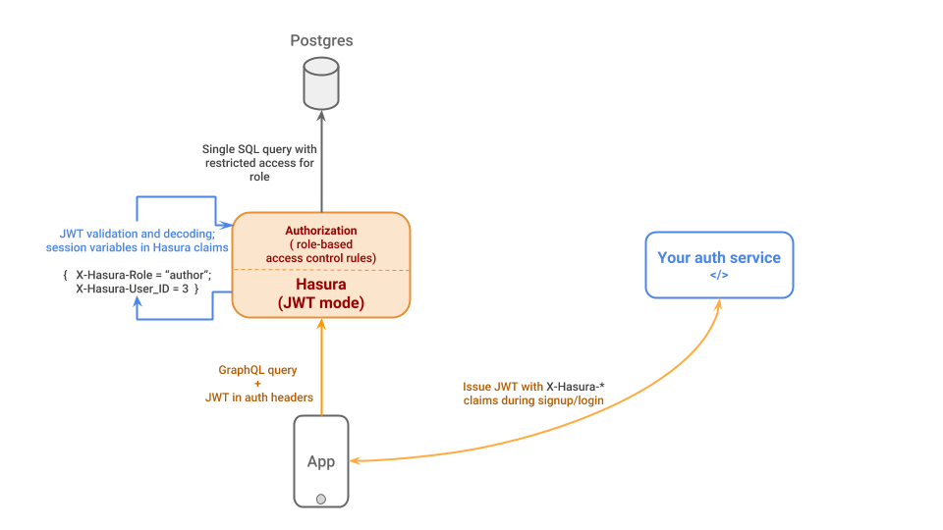

Slide 5
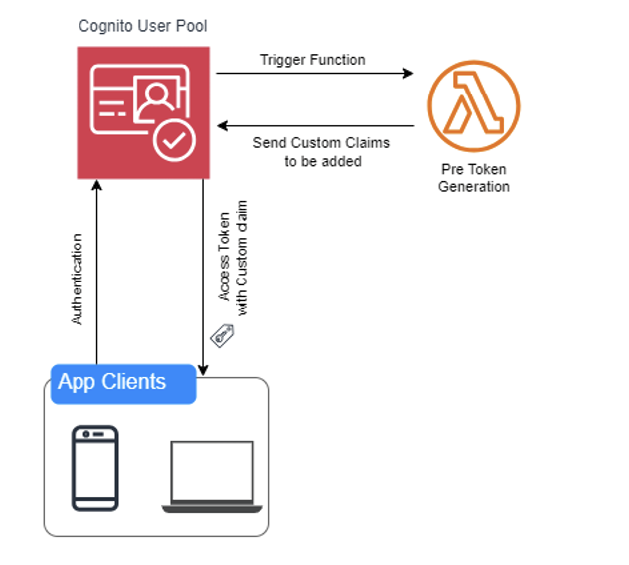

Slide 6
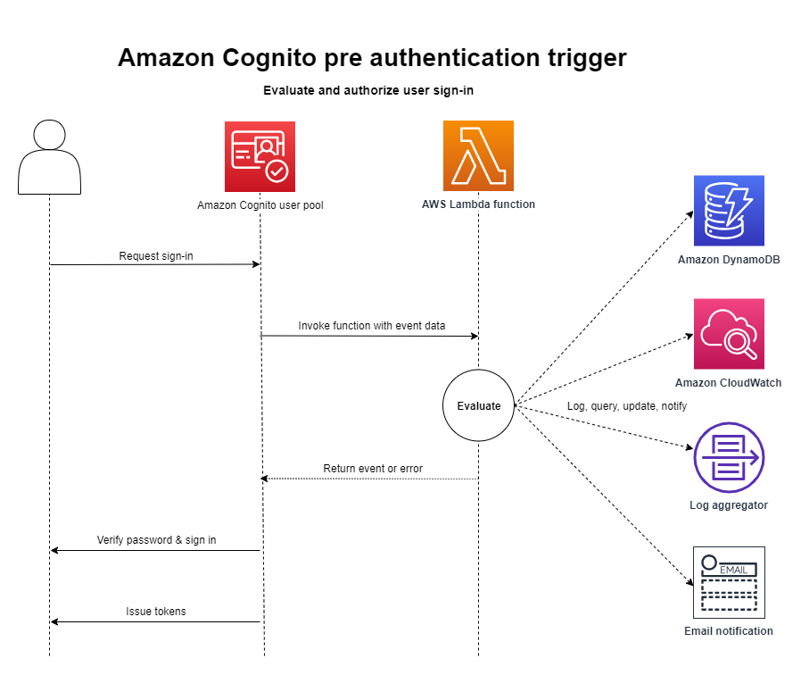
Cognito pre-authentication

Slide 7
Cognito Managed login
Cognito provides UI for login, logout, forgotten password, change password

Slide 8
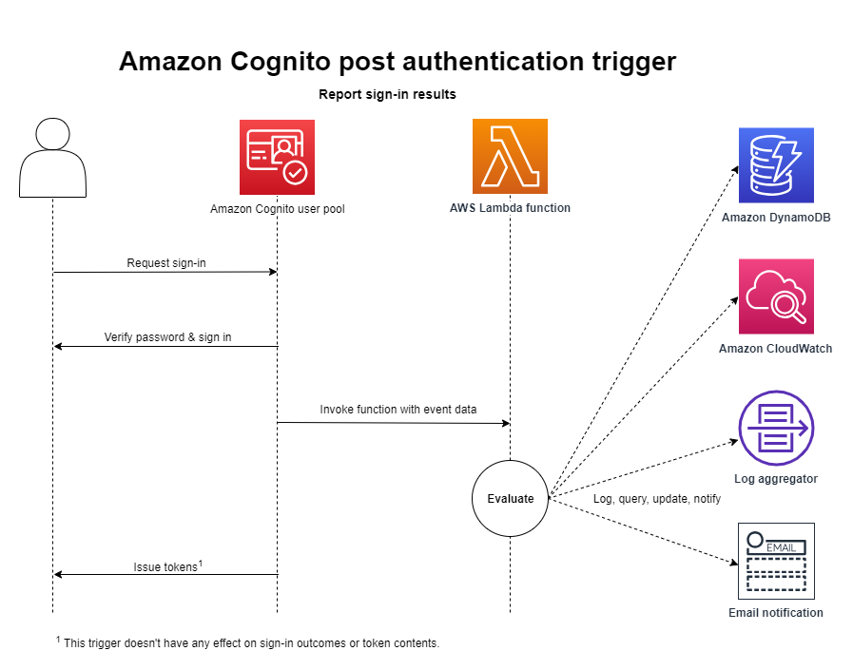
Cognito post-authentication
A post authentication Lambda that doesn't return the request body to Amazon Cognito can still cause authentication to fail to complete.

Slide 10
If your Lambda function doesn't return the request and response parameters to Amazon Cognito, or returns an error, the authentication event doesn't succeed.
You can return an error in your function to prevent a user's sign-up, authentication, token generation, or any other stage of their authentication flow that invokes Lambda trigger.
Managed login returns errors that Lambda triggers generate as error text above the sign-in prompt. The Amazon Cognito user pools API returns trigger errors in the format [trigger] failed with error [error text from response]. As a best practice, only generate errors in your Lambda functions that you want your users to see. Use output methods like print() to log any sensitive or debugging information to CloudWatch Logs. For an example, see Pre sign-up example: Deny sign-up if user name has fewer than five characters.

Slide 11
User pool workflow
User Pool Flow | Operation | Description
Custom Authentication Flow | Define Auth Challenge | Determines the next challenge in a custom auth flow
 | Create Auth Challenge | Creates a challenge in a custom auth flow
 | Verify Auth Challenge Response | Determines if a response is correct in a custom auth flow
Authentication Events | Pre authentication Lambda trigger | Custom validation to accept or deny the sign-in request
 | Post authentication Lambda trigger | Logs events for custom analytics
 | Pre token generation Lambda trigger | Augments or suppresses token claims
Sign-Up | Pre sign-up Lambda trigger | Performs custom validation that accepts or denies the sign-up request
 | Post confirmation Lambda trigger | Adds custom welcome messages or event logging for custom analytics
 | Migrate user Lambda trigger | Migrates a user from an existing user directory to user pools
Messages | Custom message Lambda trigger | Performs advanced customization and localization of messages
Token Creation | Pre token generation Lambda trigger | Adds or removes attributes in ID and access tokens
Email and SMS third-party providers | Custom sender Lambda triggers | Uses a third-party provider to send SMS and email messages

