Slide 1
Spotify Audio Features
Hamid Niki
Springboard
Capstone Project 1

Slide 2
Objective: Predict popularity of a music track based on its audio features
Being able to predict a track/album’s popularity has applications in the music business
Helps label companies base their decisions of whether or not they want to sponsor an artist
This is a purely data oriented decision. The sponsors do not need to even know the artist or like their music. In the past the company had to intimately know the artists and their work to sponsor them

Slide 3
Dataset Description
116,372 music tracks from spotify (one row per track) and 17 variables
Outcome variable: Popularity (between 0 and 100, calculated based on the number of times a trak was played)
Numeric predictors: Acousticness, danceability, duration_ms, energy, instrumentalness, liveness, loudness, speechiness, tempo and valence
(more info: https://developer.spotify.com/documentation/web-api/reference/tracks/get-audio-features/)
Categorical predictors: mode (major or minor), key, time signature

Slide 4
Data Cleaning and Wrangling:
Tidiness:
Each track attribute is measured in a separate variable
Each observation (i.e. track) is in a separate row
There are no duplicates in the data
Missing Ratio: There were no missing values in the data
Outliers: There were some outliers in the duration_ms variables (tracks with 80-90 minutes length). Tracks were looked up in spotify the duration values were confirmed.
Artist name: John, Tracks: Whatever, 5,040,048 ms (~84 mins) and Ever, 5,610,020 ms (~93.5 mins)
Artist name: Gentle Whispering, Track: Fluffy Sleepy Whispers, 2,097,245 (~35 mins)

Slide 5
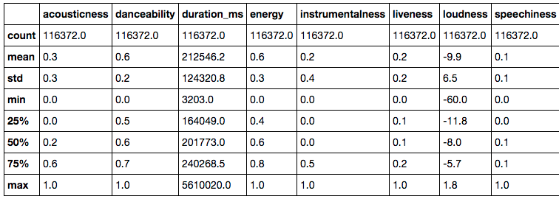
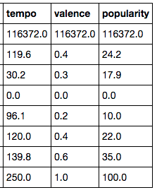
Descriptive Statistics
Numerical variables:

Slide 6
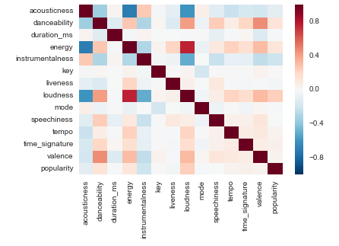
Correlation Plot(matrix):
Loudness, energy and danceability are positively correlated with popularity
Instrumentalness and acousticness are negatively correlated with popularity

Slide 7

Scatter Matrix:
Tracks with very long length (duration_ms) are less popular
Live tracks (liveness) are less popular
Tracks with extreme tempo levels (< 50 BPM or > 250 BMP) are not popular

Slide 8
Formal Tests of Correlation - Popularity vs Numerical Variables
All distributions under the null hypothesis were generated using bootstrap method:
 | Hypothesis to Test | Observed correlation | P_value | Conclusion
Loudness vs popularity | H0: No Correlation Ha: Positive correlation | 0.235 | 0.0 | Rejecting the null
Danceability vs popularity | H0: No Correlation Ha: Positive correlation | 0.134 | 0.0 | Rejecting the null
Instrumentalness vs popularity | H0: No Correlation Ha: Negative correlation | -0.21 | 0.0 | Rejecting the null
Track duration vs popularity | H0: No Correlation Ha: Negative correlation | -0.009 | 0.001 | Rejecting the null
Liveness vs popularity | H0: No Correlation Ha: Negative correlation | -0.028 | 0.001 | Rejecting the null

Slide 9
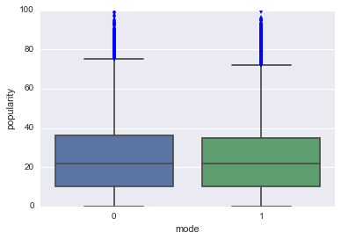
Categorical Variables: Mode, Time Signature, Key
These variables, though presented as integers in the dataset, should be used as categorical variables in the analysis because they do not have an ordinal nature
Popularity vs Mode (major or minor):
No visible difference in popularity between modes

Slide 10
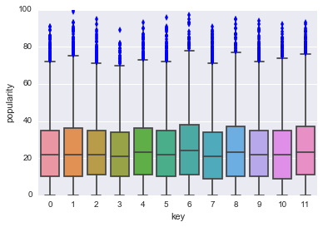
Popularity vs Key( C, Db, D, Eb, E, etc)
There are 12 possible keys
There is no visible difference in
popularity between keys

Slide 11
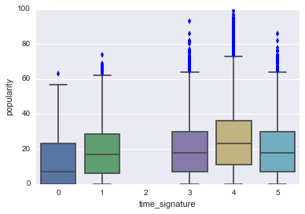
Popularity vs Time Signature:
4-beat time signatures seem to be
more popular
4-beat rhythm is more common
than other time signatures (86%
of the tracks in the dataset)
4-beat is the most familiar beat to human ear
2-sample bootstrap hypothesis test between 4-beat and ‘other’
Observed difference in means popularity: 4.56, p_value close to 0.0 -> Reject the null

