Slide 1
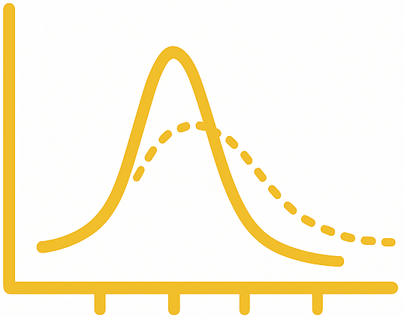
SPeak Fit – Raman Processing Module
From the Bol Group at the University of Michigan – Ann Arbor

