Slide 1
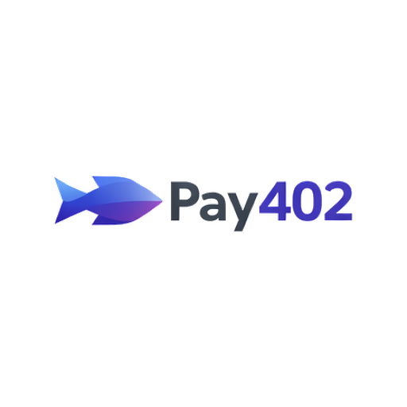
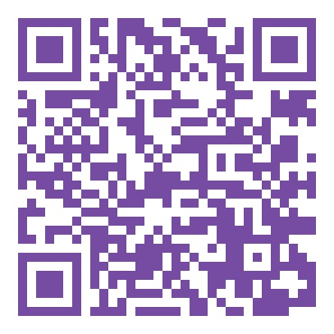
First x402 Facilitator on SUI
🔗 LIVE DEMO
merchant-production-0255.up.railway.app
ETH Global HackMoney 2026

Slide 2
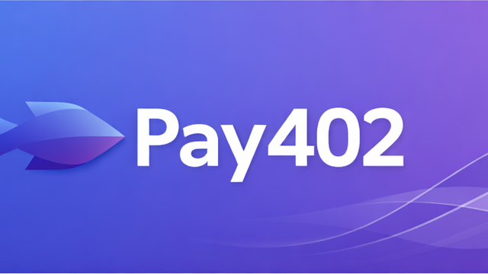
x402: Micropayments Are Here
Market Traction
(December 2025)
$600M
  annualized volume
63M+
  monthly transactions
$7.5M
  monthly USDC
1,100+
  projects using x402
Chain | Facilitator | Status
Base | Coinbase x402 SDK | ✅ Live, mainnet
Solana | PayAI | ✅ Live, mainnet
SUI | ❌ None | ← We're first
x402 is proven, production-scale technology.

Slide 3
Micropayments with Zero Friction
SUI Unlocks Novel Features
Feature | Enabling Technology
Onboarding Non-Crypto Users | zkLogin + Enoki --> OAuth Wallet
No Browser Wallet | Gas Sponsorship (native)
Low Latency | Sub-Second Finality
Audit & Conflict Resolution | Cheap On-Chain Events
Flexible Extensions | Programmable Transaction Blocks
Massive Scaling | Object Model (Owned Objects)
Difficult or impossible on EVM/Solana

Slide 4
Live Demo - See It Work
🔗 https://merchant-production-0255.up.railway.app
1
1. Visit Merchant
5
5. PTB Verification
Click 'Get Premium Data ($0.10)' → HTTP 402
Widget verifies transaction before signing
2
2. Payment Widget Opens
6
6. Confirm & Pay
Stripe-like checkout shows details
1-click sign, gas sponsored by facilitator
3
3. Sign in with Google
7
7. Content Delivered
zkLogin derives SUI address - No wallet!
Payment confirmed, receipt on blockchain
4
4. [First Time] Fund USDC
Get test USDC for demo

Slide 5
How We Built It - Technology Stack
⛓️ On-Chain Components
☁️ Off-Chain Components
• Smart Contract (SUI Move)
• Generic Coin<T> settlement
• Atomic PTB execution
• On-chain receipt events
• Circle USDC (native)
• Gas sponsorship
Facilitator API
(Node.js + TypeScript)
  • PTB construction
  • Balance checking
  • Settlement modes
Payment Widget
(React + Vite)
  • zkLogin integration
  • PTB verification
  • Payment UI
Merchant
(Node.js + Express)
  • Invoice generation
  • HTTP 402 pattern
  • Content delivery

Slide 6
Implementation Status & Roadmap
Hackathon Achievements
✅ OAuth Login
✅ Gas Sponsorship
✅ PTB Validation
✅ zkLogin Signing
✅ Optimistic Settlement
✅ Pessimistic Settlement
✅ USDC Persistence
✅ Merchant Onboarding
✅ On-Chain Receipts
Roadmap
🔄 Mainnet Deployment
🔄 Browser Extension
🔄 Production Monitoring
🔄 Multi-Region Nodes
🔄 Embeddable Widget
🔄 Merchant SDK (NPM)
🔄 CCTP Integration for multi-chain
settlement
🔄 Merchant Dashboard

Slide 7
First x402 on SUI - Best x402, Period
🔗 merchant-production-0255.up.railway.app
💻 github.com/hamiha70/Pay402
Solo Hacker Submission

Slide 8
Trust Model & PTB Verification
Buyer DOES NOT trust facilitator for:
  • Spending funds without signature
  • Altering payment amount
  • Redirecting to wrong merchant
Buyer TRUSTS:
  • Own signature (zkLogin)
  • PTB verification in widget
  • SUI blockchain execution
PTB Verification Checks:
  • Only allowed commands
  • Amount matches invoice
  • Recipient is merchant
  • No unauthorized transfers

Slide 9
Why SUI? - Detailed Comparison
Feature | SUI | Solana | EVM (Base)
zkLogin | Native | ❌ | ⚠️ Complex
PTBs | Native | ⚠️ Versioned tx | ❌ Single-call
Object Model | Owned objects | Account-based | Account-based
Finality | 600-700ms | ~400ms | ~12 min (L1)
Gas Sponsor | Built-in | Supported | ⚠️ EIP-4337
Receipt Cost | ~$0.0003 | ~$0.00025 | ~$0.50-$5
Key Insight: Not 'only possible on SUI' - but dramatically simpler and better

Slide 10
zkLogin Deep Dive
Traditional Crypto Payment
Install wallet extension (2 min)
Save seed phrase (3 min)
Buy crypto on exchange (1-3 days)
Transfer to wallet (10 min)
Connect to site (1 min)
Sign transaction (30 sec)
Total: Days of setup
Pay402 with zkLogin
Click payment link (1 sec)
Sign in with Google (3 sec)
First time: get address (instant)
Confirm payment (1 sec)
Total: ~5 seconds
How zkLogin Works
1. User authenticates with Google (OAuth 2.0)
2. zkLogin derives: Address = Hash(Provider + User_ID + Salt)
3. User signs with ephemeral key + ZK proof
4. SUI validators verify proof and execute

Slide 11
Gas Sponsorship Mechanics
How It Works on SUI
PTB has two 'actors':
  ptb.setSender(buyerAddress) // Who initiates (owns USDC)
  ptb.setGasOwner(facilitatorAddress) // Who pays gas (owns SUI)
Why This Is Safe
✓ Buyer signature = USDC spend
✓ Facilitator signature = SUI gas
✓ Neither can spend other's funds
✓ Object model enforces ownership
Economic Attack Mitigation
Gas budget capped per tx (~$0.01 max)
Facilitator rate-limits by address
PTB verifier prevents complex calls
Cost per tx: ~$0.0002 gas
Facilitator fee: $0.001
Net profit: ~$0.0008

