Slide 1

Custom Dialog Editor
Hamilton VENUS Software Training

Slide 2
Customized dialog
Custom Dialog Editor
Hamilton VENUS Software Training
Custom Dialog Overview
  Editor Window
  Properties
  Events
  Variables
Advanced
  How do custom dialogs really work?
  Animations
Limitations and Known Problems

Slide 3
Customized dialog
What is it?
The Customized dialog step is a GUI creator that allows one to individualize dialogs and add intelligence to them.

Slide 4
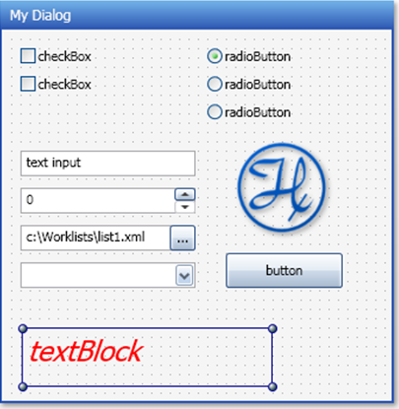
Customized dialog
Custom dialog: Mixed user input formats are possible
Buttons
Check box
Image
Text block
Radio Button
Text input
Numeric input
Path input
Drop down list

Slide 5
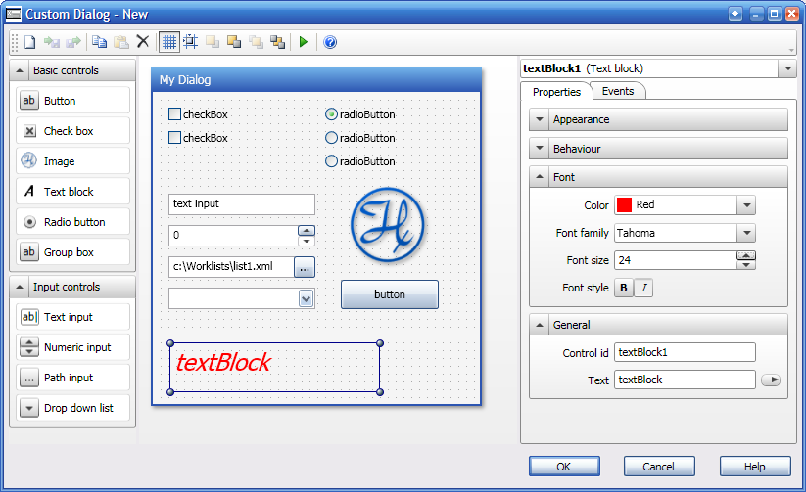
Customized dialog
Custom Dialog: Editor Window

Slide 6
Customized dialog
Custom Dialog: Editor Window
1. Add elements

Slide 7
Customized dialog
Custom Dialog: Editor Window
2. Define Properties

Slide 8
Customized dialog
Properties overview
Appearance
Background color
Drop shadow
Opacity
Visibility
Behaviour
Enabled/disabled
Tooltip text

Slide 9
Customized dialog
Properties overview
Font
Color
Font family (type)
Font size
Font style (bold/italic)
General
Control ID (id for events)
Text
Type depending settings (checked, header,
path, items etc.)

Slide 10
Customized dialog
Custom Dialog: Editor Window
3. Add intelligence

Slide 11
Customized dialog
Using EVENTS
Events are used to control the behaviour of elements depending on other elements.

Slide 12
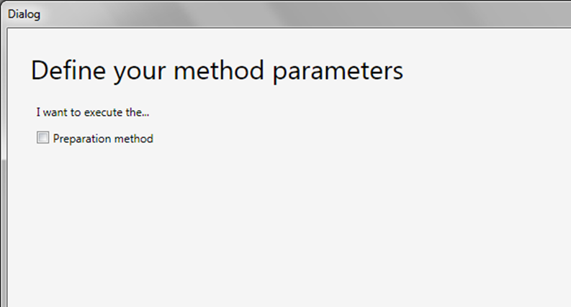
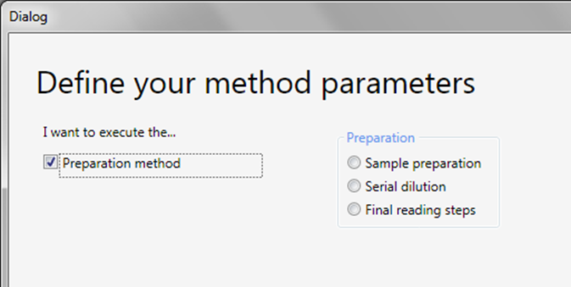
Customized dialog
Using EVENTS
Example
Preparation method details are only visible if the check box “Preparation method“ is active.

Slide 13
Customized dialog
Event Overview
Checked
  Used to control the visibility of other elements
Unchecked
  Activates actions when the element is unchecked.
Click
  Activates actions when the element is clicked.
Mouse enter
  Activates actions when mouse enters the area.
Mouse leave
  Activates actions when mouse leaves the area.

Slide 14
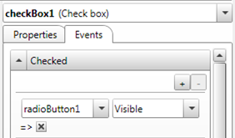
Customized dialog
How to Define Event Dependencies?
1. Select the CONTROLLING element
2. Choose ‘Events‘
3. Add the element to be controlled

Slide 15
Customized dialog
How to define Event dependencies?
4. Select the action that shall be applied
5. Define the action state

Slide 16
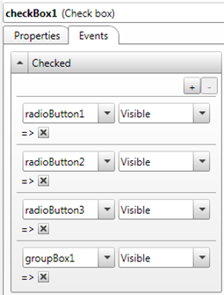
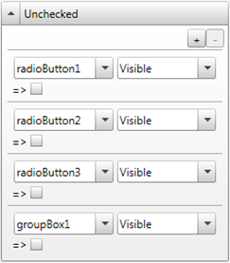
Customized dialog
How to Define Event Dependencies?
6. Repeat that for other elements…
7. …and other events

Slide 17
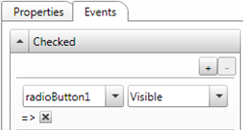

Customized dialog
Please note:
The flag is connected to the selected action
radioButton1
=
visible
radioButton1
=
invisible

Slide 18
Customized dialog
Linking variable values to/from custom dialog
Customized Dialog step
Variable TO method
- Which radiobutton was selected
- Which button was used to close
- Which element from dropdownlist
- Which pathname, etc.

Slide 19
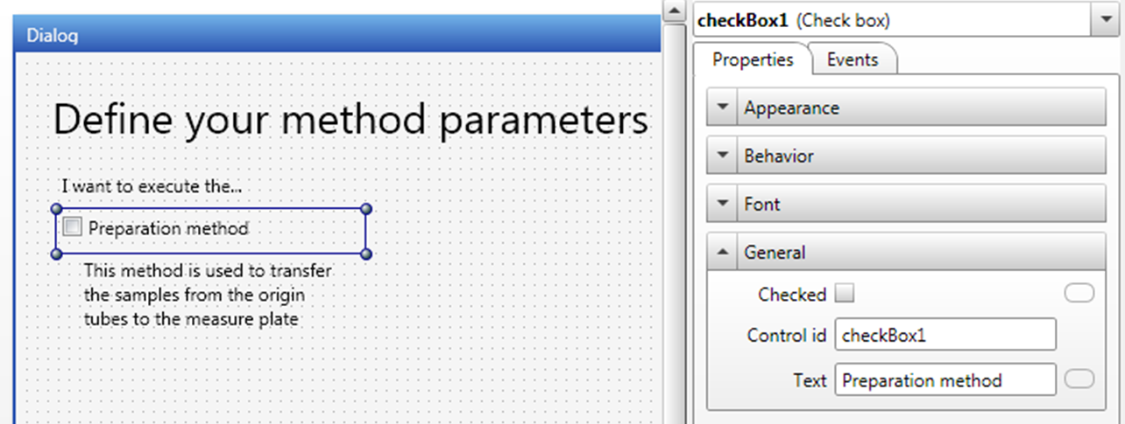
Customized dialog
Linking variable values to/from custom dialog
1. Select the element to link
2. Activate the General tab

Slide 20
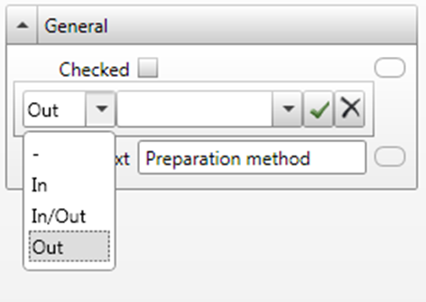
Customized dialog
Linking variable values to/from custom dialog
1. Select the link button (of the Checked action)
2. Define the variable direction

Slide 21
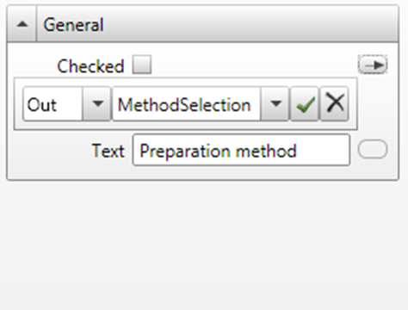
Customized dialog
Linking variable values to/from custom dialog
1. Type in a new or select an existing variable.
2. Close the definition dialog

Slide 22
Customized dialog
Linking variable values to/from custom dialog
Variable FROM method
Custom. Dialog step
Variables FROM the method can be used for displaying default values, populate drop down list values, etc.

Slide 23
Customized dialog
Advanced
How do custom dialogs really work?
.NET 3.5, a software framework installed with VENUS, introduced the Windows Presentation Foundation (WPF)
Part of WPF is XAML (eXtensible Application Markup Language), which is an XML “script” that separates views (like a GUI) from their underlying API (like C++). XAML code can be interpretive, meaning that you can load XAML pages on-the-fly at runtime (like we can with HSL code).
What does this mean?
This means that you can use 3rd party tools to make GUIs beyond the capability of the custom dialog editor, and then load them into a custom dialog!
For example, we can build custom animations!

Slide 24
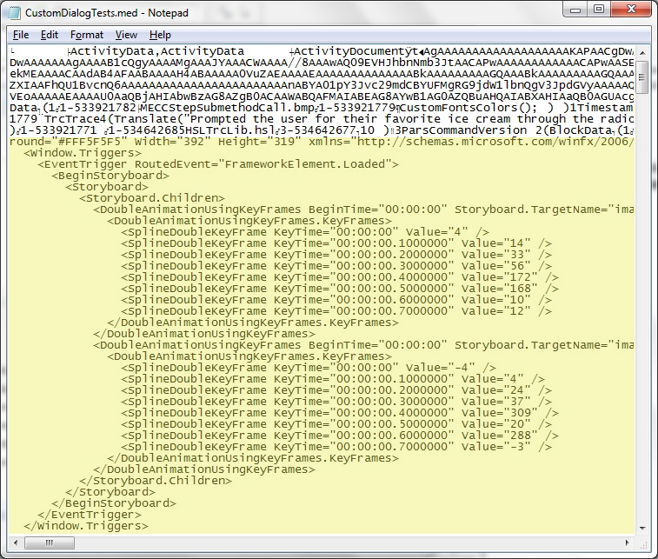
Customized dialog
Advanced
How do custom dialogs really work?
A custom dialog in VenusTwo is actually generating XAML code that is embedded into your .med file.

Slide 25
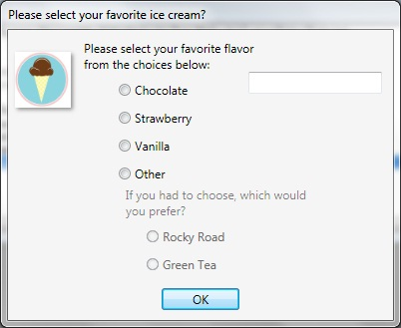
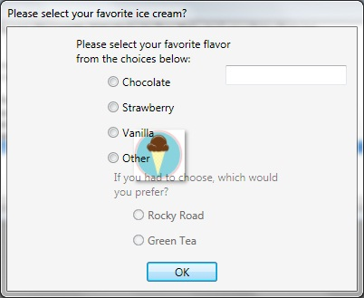
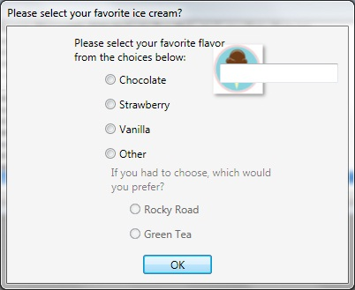
Customized dialog
Advanced
Creating an animation
  Design your custom dialog using the custom dialog editor in Venus Two.
  Use the export feature to export to a .xaml file.
  Using a 3rd party XAML editor, create a storyboard for your animation. Import the modified .xaml file back into your custom dialog and save!
Frame 1 Frame 2 Frame 3

Slide 26
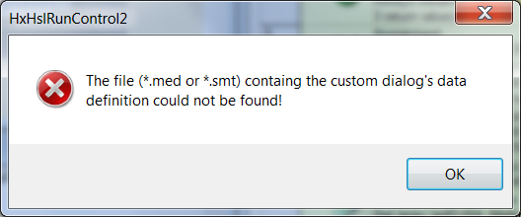
Customized dialog
Limitations and Known Problems
It is not possible to use the Customized Dialog directly in the Advanced section of a Workflow (in scheduling environment).
Create a sub method library and include that library in the Advanced section of the workflow.
Or, make a copy of the workflow file (*.wfl) and change the extension of the copy to *.med. This workaround will need to be repeated if the custom dialog is changed.

Slide 27
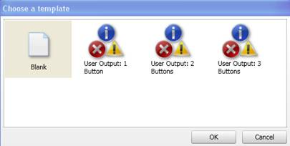
Customized dialog
Limitations and Known Problems
It is not clear how or if a dialog template can be added to the default selection:
There is no Timeout function equivalent to the function in a standard User Output command.
Custom dialogs cannot perform on the fly calculations outside of hard coded events. Even if you tried to bind a property as IN/OUT and modified that property in a parallel process, the property value does not change within the custom dialog.

Slide 28
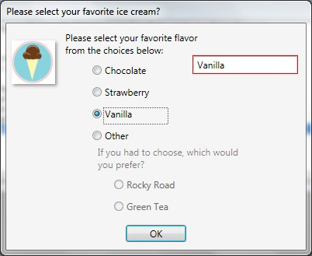
Customized dialog
Limitations and Known Problems
A XAML expression error occurs at runtime. The control with the error is highlighted in red.
Check that the expression is properly formed, and that the value being passed into the control is valid (i.e. an integer if it is expecting only digits)

Slide 29
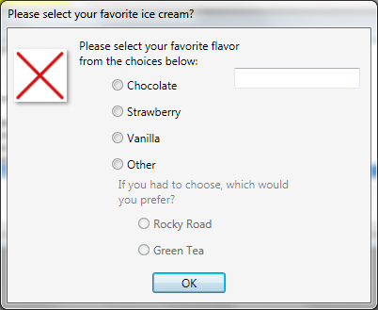
Customized dialog
Limitations and Known Problems
If an image was not found at runtime, then the image is replaced with an image of a red X on a white background:

Slide 30
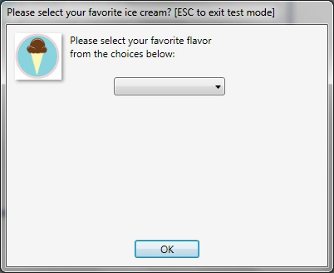
Customized dialog
Limitations and Known Problems
A drop down control doesn’t show a default selection when using an array. Even if the Selected index property contained a valid index (like 1):
This issue is intermittent and there are 2 workarounds:
Bind a variable to the Selected index property as IN/OUT and set the variable to the index you’d like selected by default. Enter manual entries into the item list and manually enter a Selected index value. These will be overridden during runtime and the variable index value will be displayed.
Delete the variable for the Select index, then save and close the Custom Dialog and the method. Reopen the method and define a new variable for the index.

Slide 31
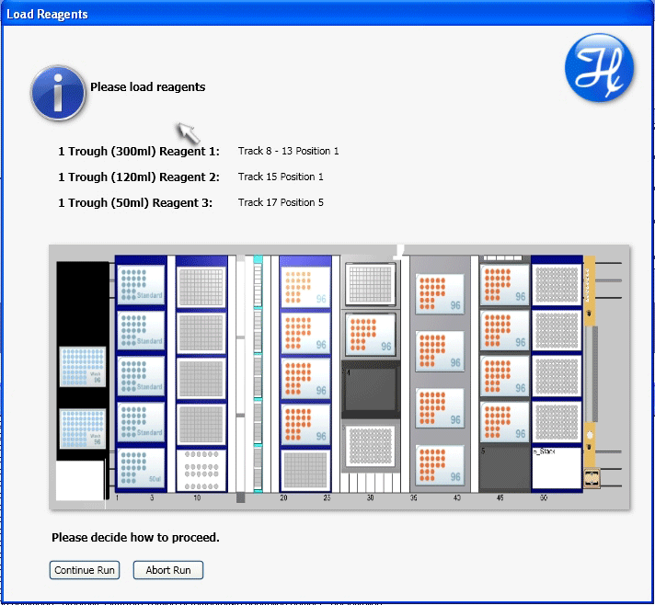
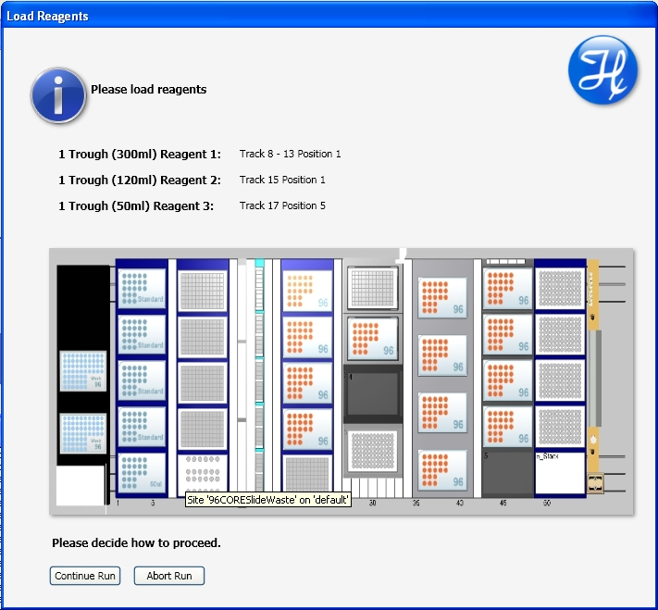
Examples
Experience Exchange Yvonne, Applications Engineer(Germany):
Custom Dialog for loading procedure
Use buttons and events to highlight labware

