Slide 1
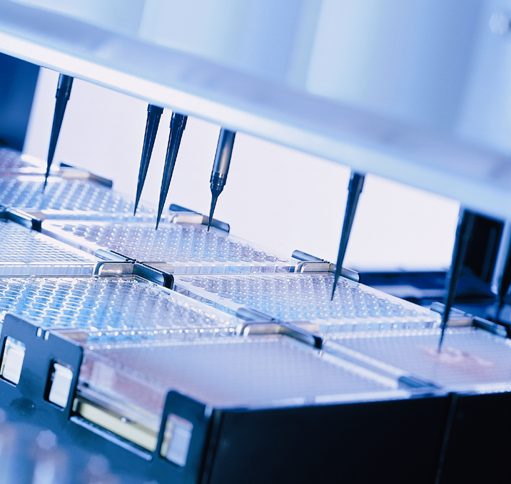
HAMILTON MICROLAB® STAR
Barcoding Technology In Vector Software

Slide 2
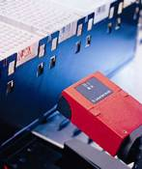
Reading Barcodes With The ML_STAR
The Autoloader is the primary device that the STAR uses to scan barcodes.
The autoloader can scan most standard barcode formats (these are listed in the User Manual) but cannot scan 2D barcodes.
There are some other standalone barcode scanners that can be integrated on the STAR.

Slide 3
Reading Barcodes With The ML_STAR
Barcodes can be scanned in 3 ways using the autoloader
  When the autoloader pulls in a carrier it can scan the barcodes of the labwares on the carrier.
  The iSwap can be used to pick up a labware and pass it in front of the autoloader.
  Similarly the CORE grippers can be used to pick up labware and scan the barcode.

Slide 4
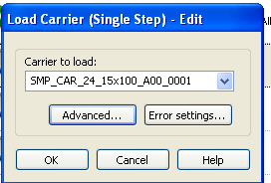
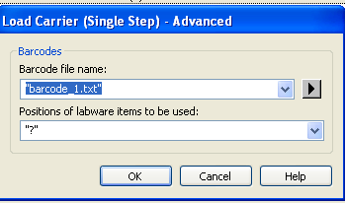
Reading Barcodes With The Autoloader
After selecting which carrier to load click on the “Advanced” Button.
The file name allows you to dictate what files the scanned barcodes will be written to.
The ‘Positions of labware items to be used’ drop down allows you to dictate how the barcodes will be scanned.
You can enter a wildcard character here or provide a string that tells exactly what positions of the carrier to read.

Slide 5
Barcode Read Wildcards
The Wildcards that can be used are as follows:
Wildcard | What it tells the instrument to do
“?” | This will have the instrument read all the positions where it detects that a labware is present. If you will have partially filled carriers this is what you would want to use as it would not give you a barcode read error if there is no tube in one or more of the carrier positions.
“*” | This will have the instrument try to read all of the carrier positions regardless of whether or not there is actually a tube/plate in that carrier position. If there is no labware in one or more positions you will get a barcode read error.
“” | The empty quotes tells the instrument not to read any barcodes for that carrier.

Slide 6
Getting Barcodes When Using The Autoloader
There are 3 ways in which you can get the barcodes into your program when using the autoloader commands.
  Open the resulting Barcode log with vector and find the information you are looking for.
  Use the Labware State Library (HSLLabwareStateLib.hsl).
  Use the Step Return Library (HSLMlStarStepReturnLib).

Slide 7
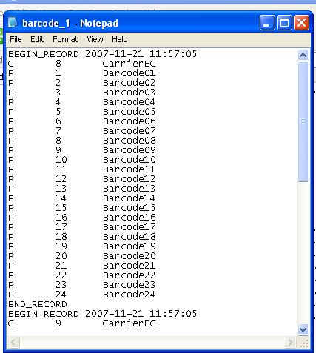
Getting The Barcodes From The Barcode Log File
All barcodes are stored in a file when read in with the autoloader. You set this file in the advanced dialog.
You can use Vector to open the file and parse thru the list and find your barcodes.
This can be messy since the file format is not very straightforward.

Slide 8
Getting The Barcodes With The Labware State Library
The Labware State Library links to the MS-SQL database that Vector runs off of and gives you information about the labware in question.
You must have ‘Sample Tracking’ enabled in the system configuration for this library to work.
This library can be used to perform a variety of tasks on labware such as setting/getting the barcode of the labware or finding out certain properties of the labware.
When a labware barcode is read using either the autoloader or gripping devices it is stored in the database. This library allows you to get it out of the database.

Slide 9
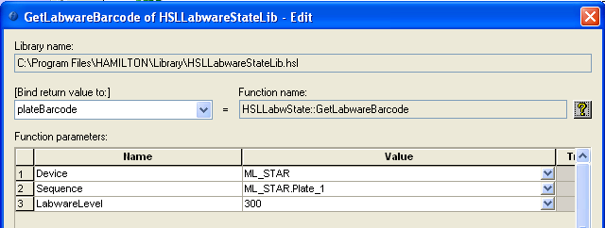
Getting The Barcodes With The Labware State Library
To get the labware barcode using this library use the ‘GetLabwareBarcode’ function. You will need to provide the following information.
  The Device (ML_STAR)
  The sequence in which you are interested in.
  The labware level (300 for racks, 400 for wells/tubes)
  Bind the return value to a variable that will contain the BC

Slide 10
Getting The Barcodes With The Labware State Library
If you are trying to use this command to get barcodes of a sequence you will have to do it multiple times. For instance if you are trying to get sample tube barcodes you will have to:
  Loop an appropriate # of times or over the sequence.
  Each time thru the loop you will have to adjust the current sequence position to be equal to the loop counter.
  Then use the command to get the labware barcode at that sequence position.
  Write the barcode to a file or an array for future use.

Slide 11
Getting The Barcodes With The Step Return Library
We have already talked about the Step Return Library when we discussed Error Handling. This library gives you back information about a physical step that the STAR has performed.
It can also provide you with barcodes with a similar methodology as the Labware State Library. Deep down this is done in a different fashion. It is not getting the barcodes from the database but from the STAR itself.
You do not have to have ‘Sample Tracking’ enabled to use this library.

Slide 12
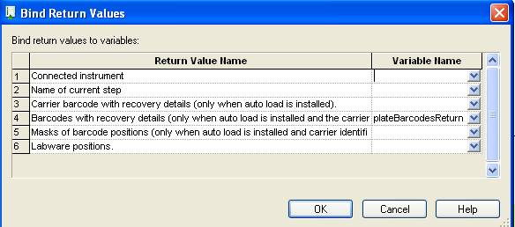
Getting The Barcodes With The Step Return Library
To get the barcode with this library you first need to bind the step return (4th return) of the load command.
Use the “GetBarcode” function:
  Tell it what position of the carrier (step return) you are interested in.
  What the bound return variable is.
  Bind the return value to a variable that will contain the BC

Slide 13
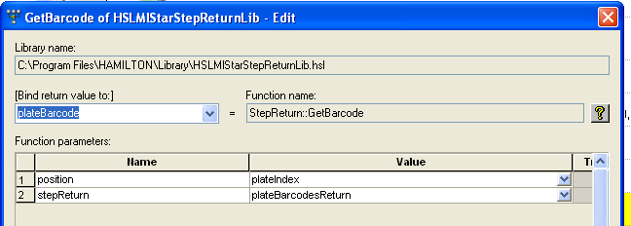
Getting The Barcodes With The Step Return Library
To get all of the barcodes of the labware on a carrier you will have to use the command multiple times. For instance if you would like to get the barcodes of all the plates on a carrier:
  Loop 5 times.
  Use the command and use the loop counter variable as the ‘position’ value.
  Write the barcode to a file or an array for future use.

Slide 14
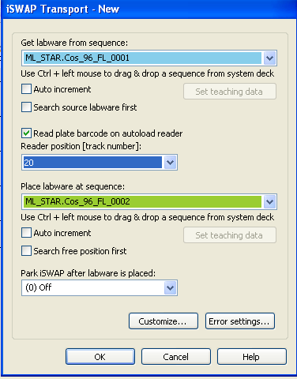
Reading Barcodes With The iSwap Or CORE Grips
Using this feature you can only scan one plate at a time.
In the iSwap or Core Grip transport commands just enable the barcode reading by clicking the appropriate box.
Then in the drop down box tell the system what track number you would like the grippers to put the labware down in front of the scanner.
You can optimize the placement and read height in the “Customize” dialogs.

Slide 15
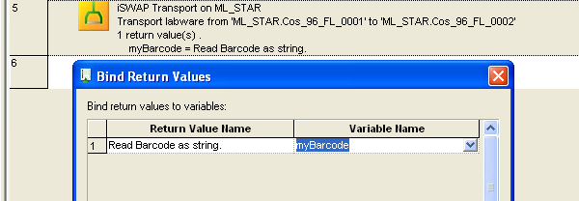
Getting The Barcode When Using The iSwap Or CORE Grips
Once you have scanned the barcode using a gripping device the barcode is printed directly to the run trace file (logfile).
If you would like to get the barcode for programming purposes you can get it by ‘binding’ the return value of the transport step to a variable.

