Slide 1


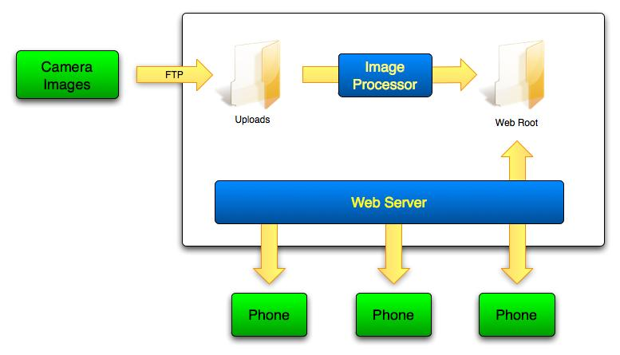
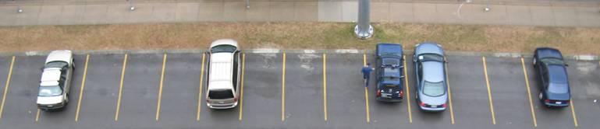

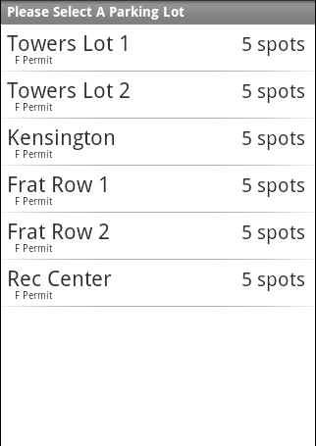
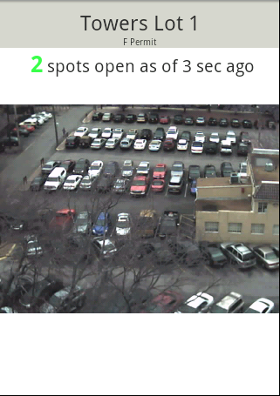
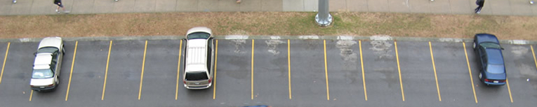
A configurable, self-learning image processing system for detecting empty spaces in parking lots
Adam Albright, Rob McColl, Hamilton Turner
Vanderbilt University, EECE
Project Sponsor: Jeff Black
Advisors: Ryan Bickham, Irdem….
Background
Solution
Hardware/Software Detail
- Whats up
Camera
VGA (640x480) Resolution
Built-in 802.11b/g
Uploads photos at fixed rate over File Transfer Protocol (FTP)
  Web Server
    PHP and MySQL powered
    Utilizes XML feeds for compatibility between components
  Image Processor
    Built on the OpenCV library
    Utilizes: Canny transform (Edge Detection)
    Hough transform (Line Counting)
Problem
Results
  Finding a parking spot is frustrating and time-consuming
    10+ minute search to find a spot
  Lots are frequently completely full
    Must drive around hoping to see someone leave
  Some lots are intentionally over-sold or sold to capacity
  Students experience increased stress & road-rage
$200
Lines in region 0: 0
Lines in region 1: 15
Lines in region 2: 0
Lines in region 3: 0
Lines in region 4: 1
Lines in region 5: 17
Lines in region 6: 3
Lines in region 7: 3
Lines in region 8: 2
Lines in region 9: 19
Lines in region 10: 12
Lines in region 11: 0
Lines in region 12: 2
Lines in region 13: 7
Lines in region 14: 3
Empty spaces: 10
Operational Requirements
Show number of available spots within a specific lot
Available from a mobile interface
  Display recent parking lot image on mobile phone
Accurate to within +/- 2 spots
Image refresh rate of at least twice per minute
Lines in region 0: 1
Lines in region 1: 11
Lines in region 2: 1
Lines in region 3: 2
Lines in region 4: 0
Lines in region 5: 18
Lines in region 6: 4
Lines in region 7: 3
Lines in region 8: 3
Lines in region 9: 10
Lines in region 10: 5
Lines in region 11: 0
Lines in region 12: 3
Lines in region 13: 6
Lines in region 14: 2
Empty spaces: 12

