Slide 1
Naive Bayes Classifier
By: Trevor Hamilton & Jonathan Stonebraker

Slide 2
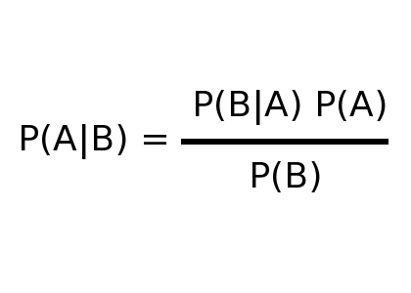
Introduction
Naive Bayes classifiers are a family of classifiers that are based on the use of Bayes theorem, while making the assumption that variables are independent of each other.
Bayes Theorem

Slide 3
Pros and Cons of using Naive Bayes
Pros
Easy to Implement.
Great for discrete data
Cons
Variables can not be dependant
Continuous values do not work

Slide 4
Program Steps
Import data from excel spreadsheet
Selections of training set 4 methods.
Random selection
Stride
First
User picked records

Slide 5
Program Steps
3. Generation of Probability of Occurrence
Uses linked list data structures to evaluate each node, keeping track of each seen classification
Array used to store frequency of each classification which

Slide 6
Program Steps
4. Computation of Probability

Slide 7
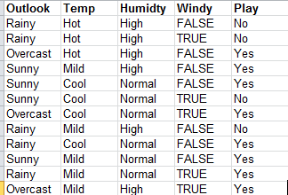
Example
Starting Data

Slide 8
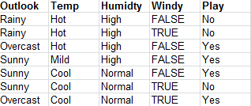
Example
2. Training set selected

Slide 9

Example
3. Generation of probability
A probability will be generated for each variables likelihood of determining the outcome.

Slide 10
Example
4. Computation of Probability
Probability
( Rainy | NO) + ( Hot | NO ) + (Humidity High | No) + ( Windy FALSE | No)
Probability of No

