Slide 1
High Dimensional KDE: Results from MidKDE1.m
J. S. Marron
Dept. of Statistics and Operations Research
University of North Carolina

Slide 2
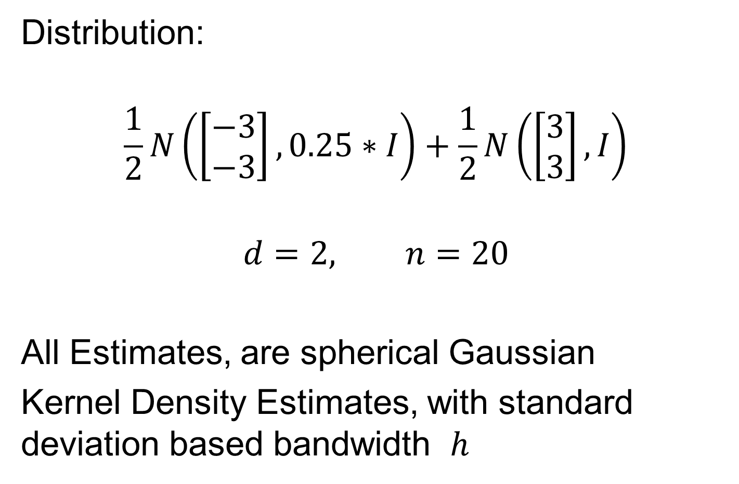
2-d Toy Example
Note ½ the s.d.
Distribution:
$$\frac{1}{2}N\left(\left[\begin{matrix}−3 \\ −3\end{matrix}\right],0.25∗I\right)+\frac{1}{2}N\left(\left[\begin{matrix}3 \\ 3\end{matrix}\right], I\right)$$
$$d=2, n=20$$
All Estimates, are spherical Gaussian
Kernel Density Estimates, with standard deviation based bandwidth $h$

Slide 3
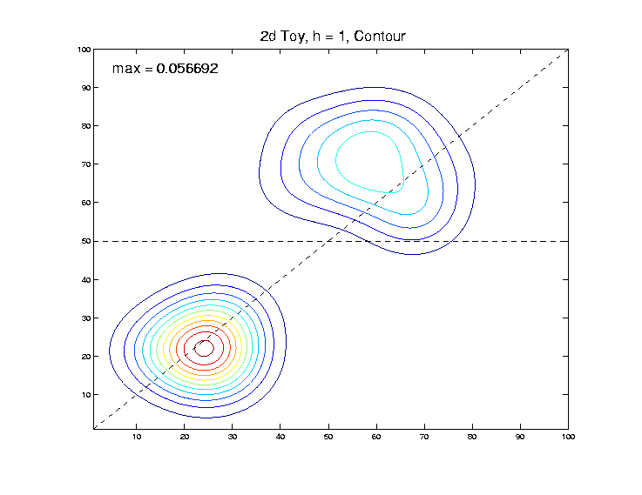

2-d Toy Example
“Good” Bandwidth, $h=1$, Contour Plot:
Will look on
These slices

Slide 4
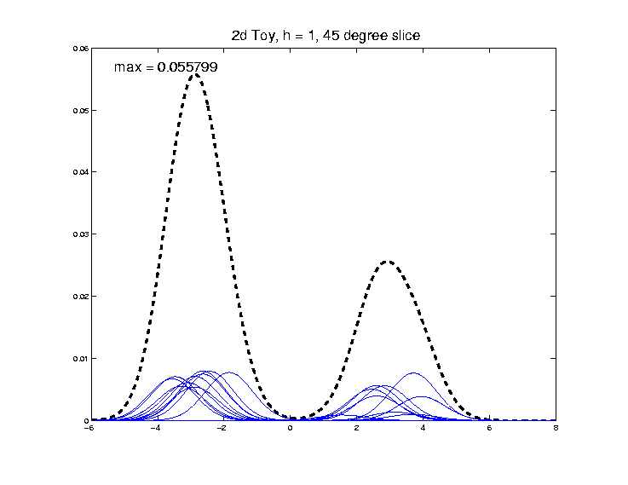

2-d Toy Example
“Good” Bandwidth, $h=1$, ${45}^{°}$ Line Slice:
Looks Reasonable

Slide 5
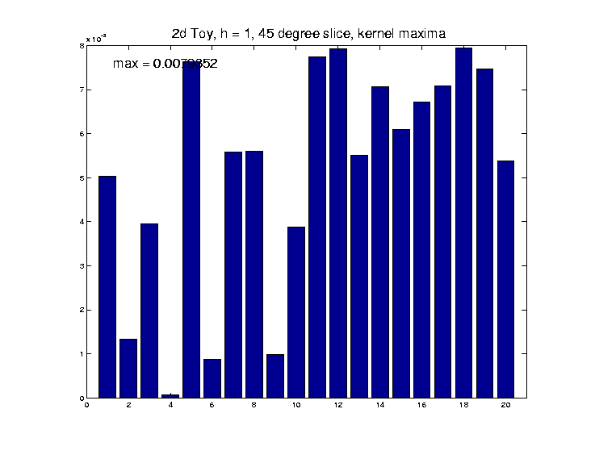

2-d Toy Example
“Good” $h=1$, ${45}^{°}$ Line Kernel Heights:
More variation
than expected?

Slide 6
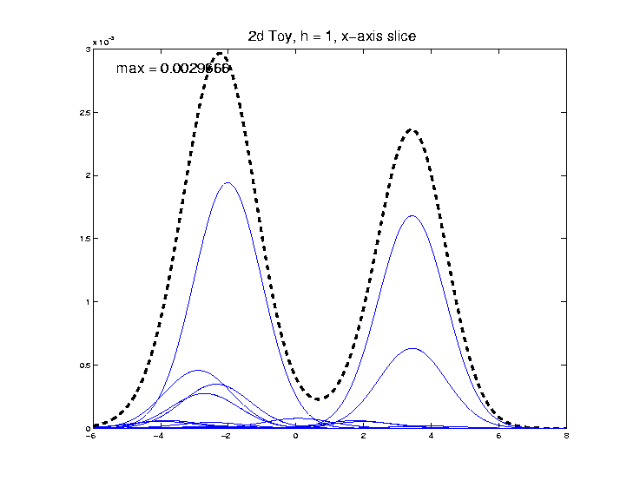

2-d Toy Example
“Good” Bandwidth, $h=1$, x-Axis Slice:
Few Dominant
Kernels

Slide 7
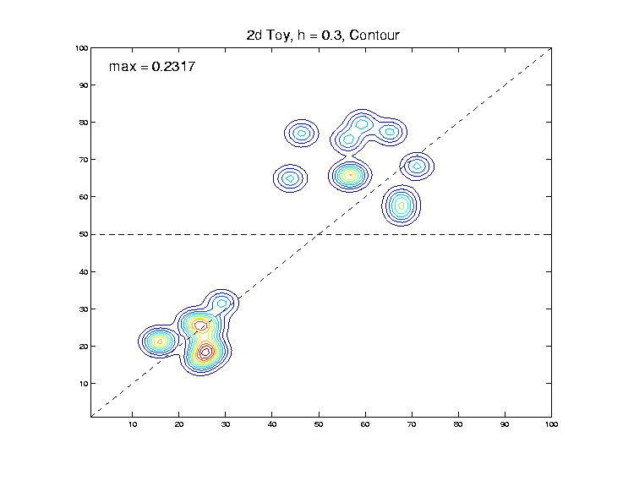

2-d Toy Example
“Small” Bandwidth, $h=0.3$, Contour Plot:
Can almost see
all 10 points
Recall ½ the
distance between

Slide 8
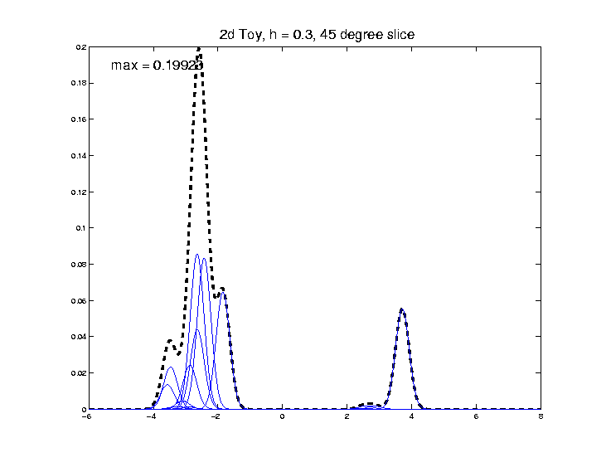

2-d Toy Example
“Small” Bandwidth, $h=0.3$, ${45}^{°}$ Line Slice:
Peak substantially lower
Most of these
too far away
Recall ½ the
distance between

Slide 9
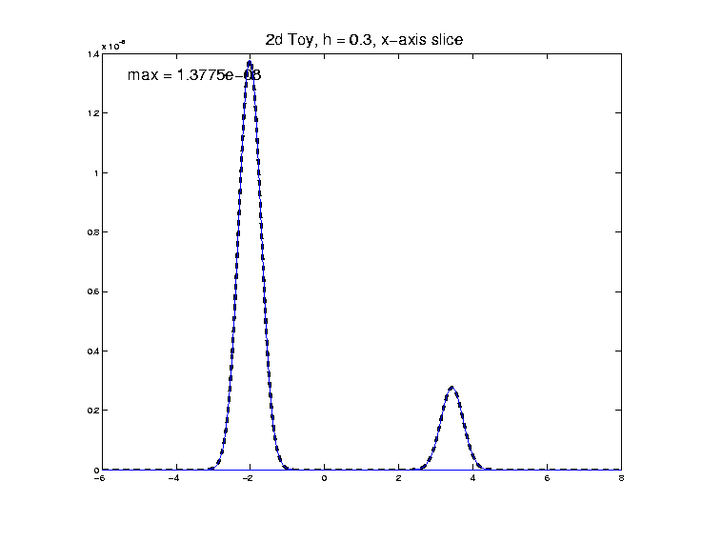

2-d Toy Example
“Small” Bandwidth, $h=0.3$, x-Axis Slice:
KDE driven by single
kernels, since far away
Note much smaller

Slide 10
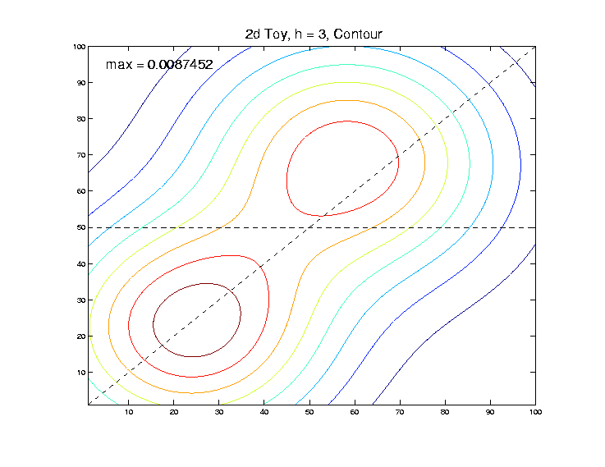

2-d Toy Example
“Large” Bandwidth, $h=$3, Contour Plot:

Slide 11
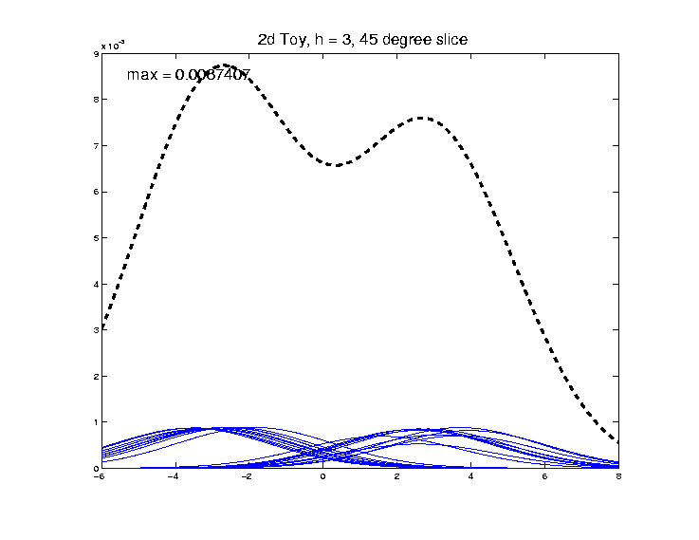

2-d Toy Example
“Large” Bandwidth, $h=3$, ${45}^{°}$ Line Slice:
2 modes almost
smoothed out

Slide 12
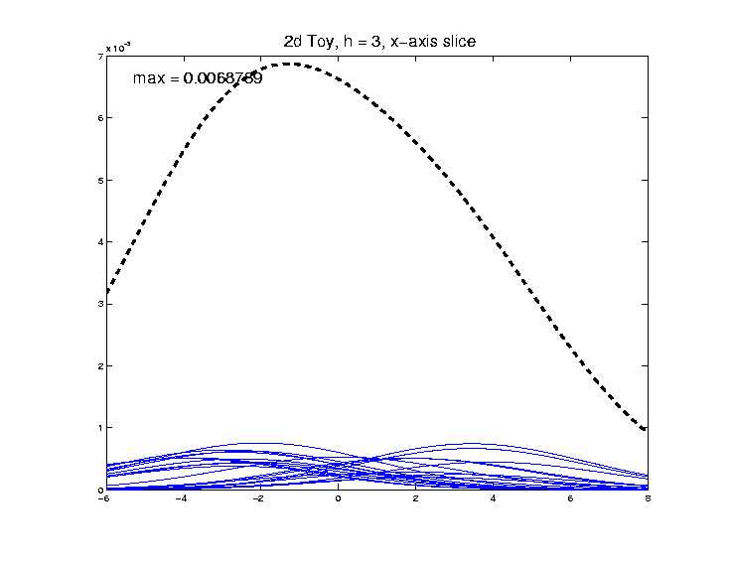

2-d Toy Example
“Large” Bandwidth, $h=3$, x-Axis Slice:
2 modes
completely
disappear

Slide 13
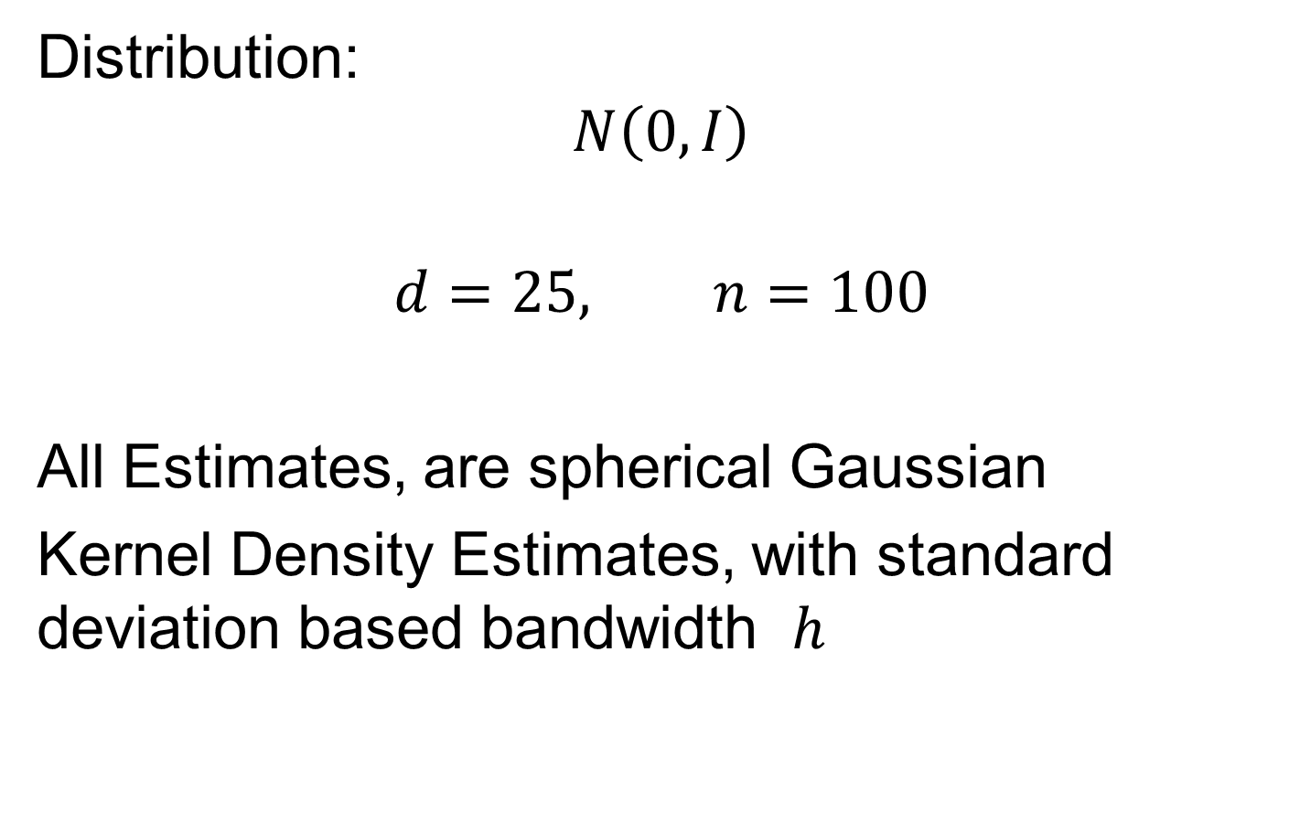
25-d Gaussian Example
Distribution:
$$N\left(0, I\right)$$
$$d=25, n=100$$
All Estimates, are spherical Gaussian
Kernel Density Estimates, with standard deviation based bandwidth $h$

Slide 14
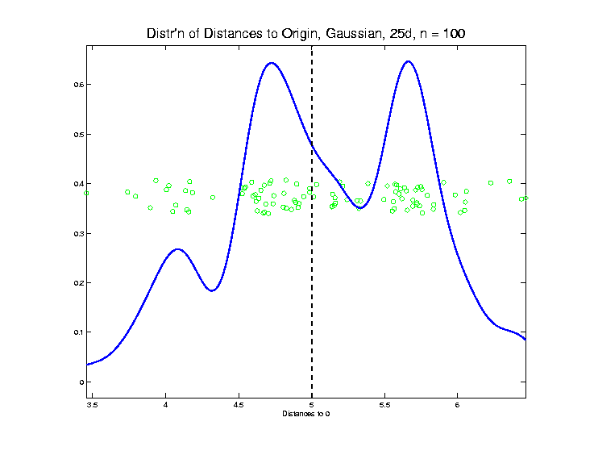

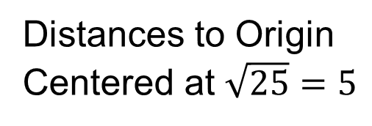
25-d Toy Example
Gaussian, $d=25$, $n=100$, Explore HDLSS
Distances to Origin
Centered at $\sqrt{25}=5$

Slide 15
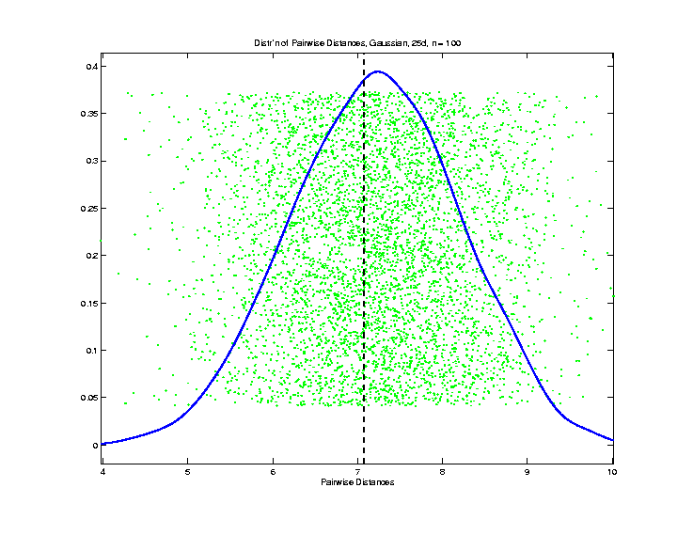
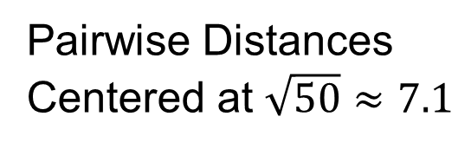
25-d Toy Example
Gaussian, $d=25$, $n=100$, Explore HDLSS
Pairwise Distances
Centered at $\sqrt{50}≈7.1$

Slide 16
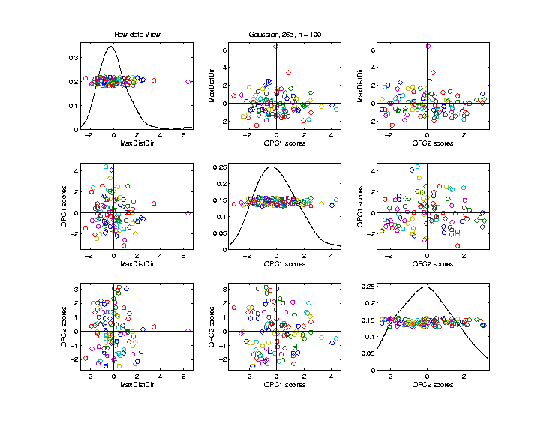

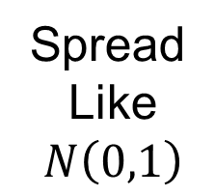
25-d Toy Example
Gaussian, $d=25$, $n=100$, 2-d Proj’ns View
0 to Max
Direction
Spread
Like
$$N\left(0,1\right)$$

Slide 17
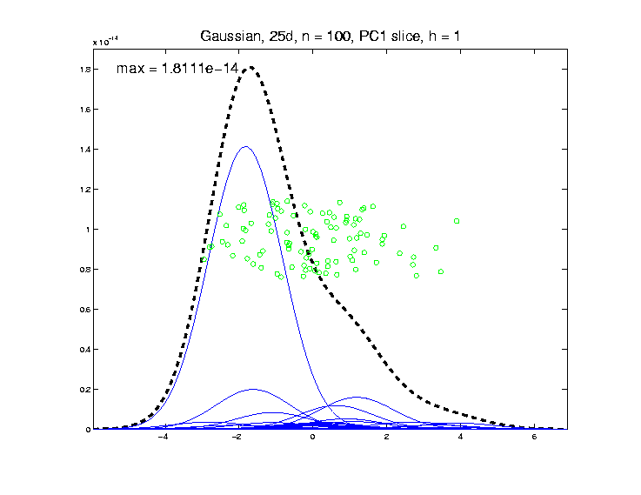

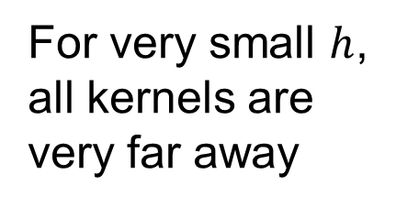
25-d Toy Example
Gaussian $\left(25,100\right)$, PC1 Slice KDE, $h=1$
Strongly dominated
by only one kernel
Note small
overall
For very small $h$,
all kernels are
very far away

Slide 18
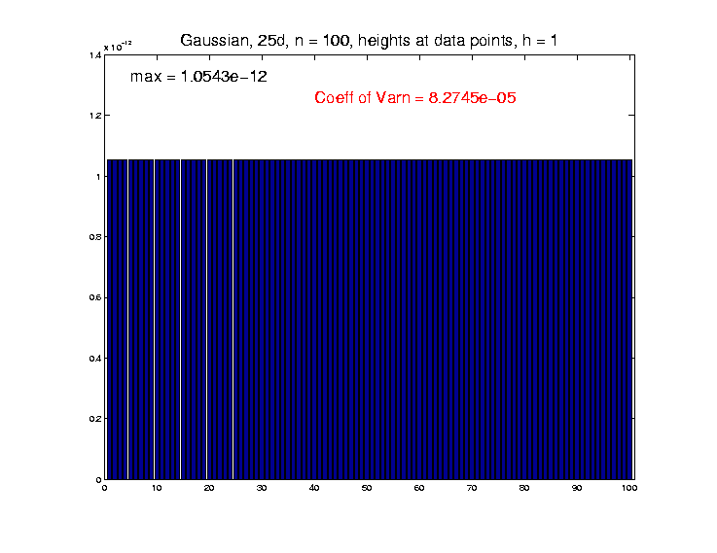


25-d Toy Example
Gaussian $\left(25,100\right)$, KDE h’ts at data, $h=1$
Surprisingly
similar to
each other?
Much taller than along slice
Shows each
kernel is
essentially
isolated
$h$ way too
small?

Slide 19
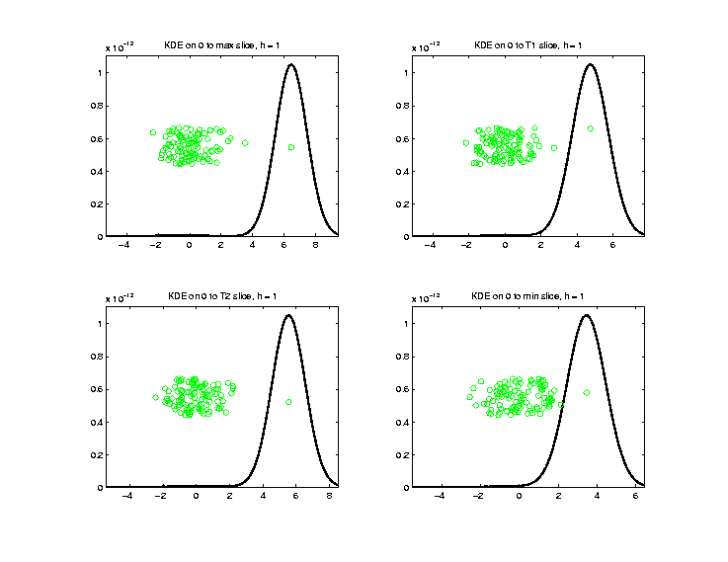

25-d Toy Example
Gaussian $\left(25,100\right)$, 0 to Data Slices, $h=1$
Each has peak
at singleton
Very low
at bulk,
since too
far away
Data point with
distance to 0
at 1st Tertile
Main lesson: all are singletons for $h$ too small

Slide 20
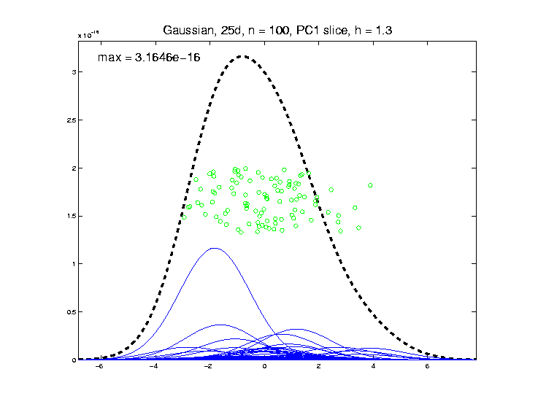

25-d Toy Example
Gaussian $\left(25,100\right)$, PC1 Slice KDE, $h=1.3$
Still a big one,
but others
more involved

Slide 21
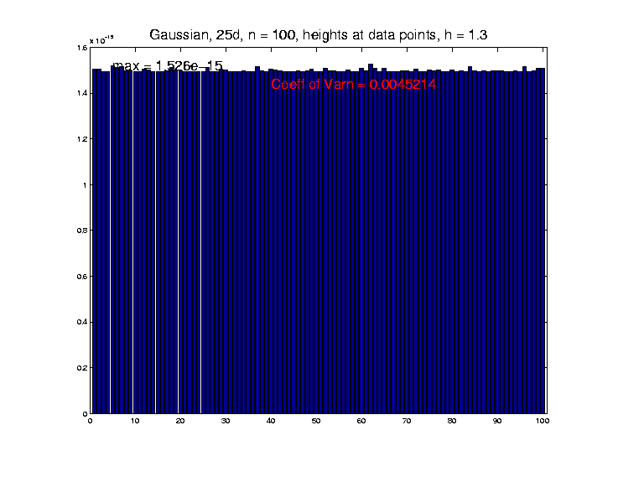

25-d Toy Example
Gaussian $\left(25,100\right)$, KDE h’ts at data, $h=1.3$
Slightly
More
Variation

Slide 22
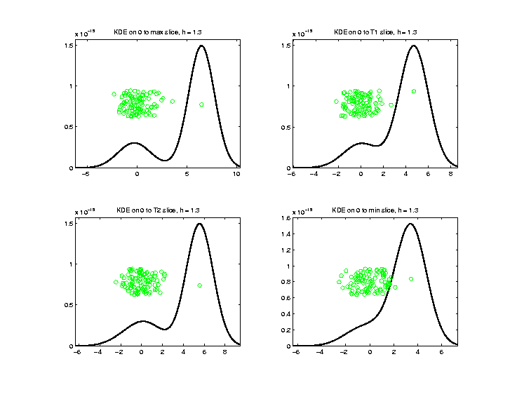


25-d Toy Example
Gaussian $\left(25,100\right)$, 0 to Data Slices, $h=1.3$
Bulk is now
a player but
still very small
Min too close to
separate bump
Main lesson: $h$ still too small

Slide 23
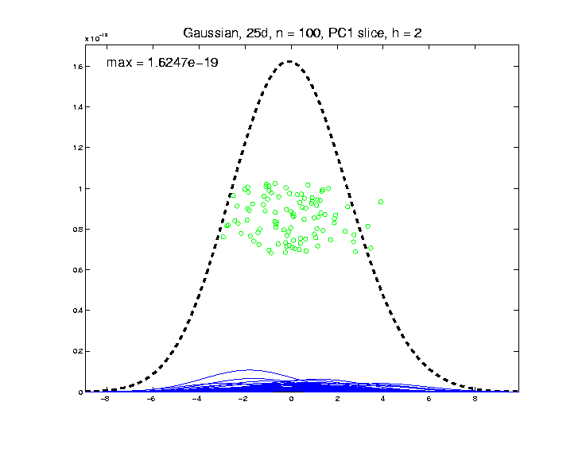

25-d Toy Example
Gaussian $\left(25,100\right)$, PC1 Slice KDE, $h=2$
All 100 now
contributing
more or less
the same

Slide 24
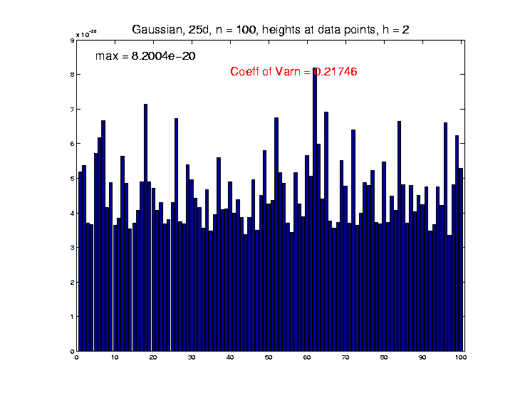


25-d Toy Example
Gaussian $\left(25,100\right)$, KDE h’ts at data, $h=2$
Measured by
Coefficient of
Variation = $\frac{s}{\overline{X}}$
Much More
Variation

Slide 25
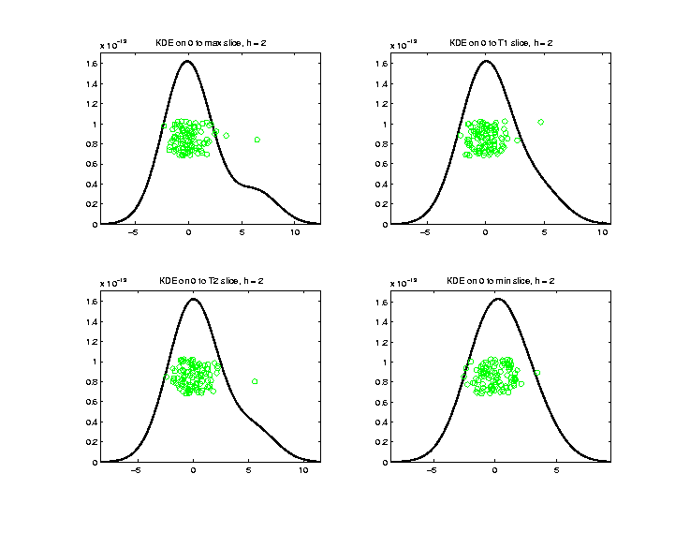

25-d Toy Example
Gaussian $\left(25,100\right)$, 0 to Data Slices, $h=2$
Now taller
at bulk
of data

Slide 26




25-d Toy Example
Gaussian $\left(25,100\right)$, PC1 Slice KDE, $h=2.6$
And far lower: ${10}^{−19}→{10}^{−22}$
Looks
similar
Respect
$d=25$!!!
But got wider

Slide 27


25-d Toy Example
Gaussian $\left(25,100\right)$, KDE h’ts at data, $h=2.6$
Note heights at data are smaller,
Suggesting good bandwidth?

Slide 28



25-d Toy Example
Gaussian $\left(25,100\right)$, 0 to Data Slices, $h=2.6$
Reasonable Choice of $h$ for $N(0,1)$?

Slide 29



25-d Toy Example
Gaussian $\left(25,100\right)$, PC1 Slice KDE, $h=4$
And lower: ${10}^{−22}→{10}^{−26}$
Looks
similar
But wider still

Slide 30


25-d Toy Example
Gaussian $\left(25,100\right)$, KDE h’ts at data, $h=4$
Note less variation

Slide 31



25-d Toy Example
Gaussian $\left(25,100\right)$, 0 to Data Slices, $h=4$
Seems $h$ too large, distribution too spread

Slide 32


25-d Toy Example
Gaussian $\left(25,100\right)$, PC1 Slice KDE, $h=8$
Patterns
Continue

Slide 33


25-d Toy Example
Gaussian $\left(25,100\right)$, KDE h’ts at data, $h=8$
Patterns
Continue

Slide 34


25-d Toy Example
Gaussian $\left(25,100\right)$, 0 to Data Slices, $h=8$
Patterns
Continue

Slide 35



25-d Toy Example
Gaussian $\left(25,100\right)$, PC1 Slice KDE, $h=$16
Far Beyond the
Range of the
Data, So KDE
Is Just a Spread
Gaussian Density
Centered at $≈\overline{X}$
Patterns
Continue

Slide 36


25-d Toy Example
Gaussian $\left(25,100\right)$, KDE h’ts at data, $h=16$
Patterns
Continue

Slide 37

25-d Toy Example
Possible Bandwidth Selection Approach:
Choose $h$ to Maximize:
Coefficient of Variation
of KDE Heights at Data Points

Slide 38


25-d Toy Example
Gaussian $\left(25,100\right)$, CofV as a function of $h$
Appears to Fit Very Well

Slide 39


25-d Bimodal #1 Example
Moves mean by $\sqrt{25∗2∗2}=10$
Distribution:
$$\frac{1}{2}N\left(0, I\right)+\frac{1}{2}N\left(\left[\begin{matrix}2 \\ ⋮ \\ 2\end{matrix}\right], I\right)$$
$$d=25, n=100$$
All Estimates, are spherical Gaussian
Kernel Density Estimates, with standard deviation based bandwidth $h$
Note Same Spread in Each Peak

Slide 40


25-d Toy Example
Bimodal #1, $d=25$, $n=100$, Explore HDLSS

Slide 41

25-d Toy Example
Bimodal #1, $d=25$, $n=100$, Explore HDLSS

Slide 42


25-d Toy Example
Bimodal #1, $d=25$, $n=100$, 2-d Proj’ns View
0 to Max
Direction

Slide 43



25-d Toy Example
Bimodal #1 $\left(25,100\right)$, CofV as a function of $h$
Max Very Slightly Larger
Than Previous $h=2.55$

Slide 44


25-d Toy Example
Bimodal #1 $\left(25,100\right)$, PC1 Slice KDE, $h=2.6$
Seems
Reasonable?
Want More
Dip Between?

Slide 45


25-d Toy Example
Bimodal #1 $\left(25,100\right)$, KDE h’ts, data, $h=2.6$
Seems
Reasonable?

Slide 46


25-d Toy Example
Bimodal #1 $\left(25,100\right)$, 0 to Data Slices, $h=2.6$
Seems
Reasonable?
Outliers Not
Dominant

Slide 47


25-d Toy Example
Bimodal #1 $\left(25,100\right)$, PC1 Slice KDE, $h=4$
Looks Too
Spread?

Slide 48


25-d Toy Example
Bimodal #1 $\left(25,100\right)$, KDE h’ts, data, $h=4$
Looks Less
Variable?

Slide 49


25-d Toy Example
Bimodal #1 $\left(25,100\right)$, 0 to Data Slices, $h=4$
Looks Too
Spread?

Slide 50


25-d Toy Example
Bimodal #1 $\left(25,100\right)$, PC1 Slice KDE, $h=2$
Apparent Good
Separation
Of Bumps?

Slide 51


25-d Toy Example
Bimodal #1 $\left(25,100\right)$, KDE h’ts, data, $h=2$

Slide 52


25-d Toy Example
Bimodal #1 $\left(25,100\right)$, 0 to Data Slices, $h=2$
Some Influence
Of Outlier

Slide 53


25-d Toy Example
Bimodal #1 $\left(25,100\right)$, PC1 Slice KDE, $h=1.3$
Apparent Great
Separation
Of Bumps?

Slide 54


25-d Toy Example
Bimodal #1 $\left(25,100\right)$, KDE h’ts, data, $h=1.3$
Variation
Way Too
Small!

Slide 55


25-d Toy Example
Bimodal #1 $\left(25,100\right)$, 0 to Data Slices, $h=1.3$
Outliers
Way Too
Dominant!

Slide 56
25-d Toy Example
Bimodal #1

Slide 57

25-d Bimodal #2 Example
Note ½ the s.d.
Distribution:
$$\frac{1}{3}N\left(\left[\begin{matrix}−4 \\ ⋮ \\ −4\end{matrix}\right], 4∗I\right)+\frac{1}{3}N\left(0, I\right)+\frac{1}{3}N\left(\left[\begin{matrix}2 \\ ⋮ \\ 2\end{matrix}\right], 0.25∗I\right)$$
$$d=25, n=100$$
All Estimates, are spherical Gaussian
Kernel Density Estimates, with standard deviation based bandwidth $h$
Note twice the s.d.

Slide 58


25-d Toy Example
Bimodal #2, $d=25$, $n=100$, Explore HDLSS

Slide 59

25-d Toy Example
Bimodal #2, $d=25$, $n=100$, Explore HDLSS

Slide 60


25-d Toy Example
Bimodal #2, $d=25$, $n=100$, 2-d Proj’ns View
0 to Max
Direction

Slide 61



25-d Toy Example
Bimodal #2 $\left(25,100\right)$, CofV as a function of $h$
Max Very Slightly Smaller
Than Gaussian $h=2.55$

Slide 62

25-d Toy Example
Bimodal #1 $\left(25,100\right)$, PC1 Slice KDE, $h=2.6$

Slide 63

25-d Toy Example
Bimodal #1 $\left(25,100\right)$, PC1 Slice KDE, $h=2.6$

Slide 64


25-d Toy Example
Bimodal #2 $\left(25,100\right)$, 0 to Data Slices, $h=2.6$

Slide 65


25-d Toy Example
Bimodal #2 $\left(25,100\right)$, KDE h’ts, data, $h=1.3$

Slide 66

25-d Toy Example
Bimodal #2 $\left(25,100\right)$, KDE h’ts, data, $h=1.3$

Slide 67


25-d Toy Example
Bimodal #2 $\left(25,100\right)$, 0 to Data Slices, $h=1.3$

Slide 68


25-d Toy Example
Bimodal #2 $\left(25,100\right)$, KDE h’ts, data, $h=4$

Slide 69

25-d Toy Example
Bimodal #2 $\left(25,100\right)$, KDE h’ts, data, $h=4$

Slide 70


25-d Toy Example
Bimodal #2 $\left(25,100\right)$, 0 to Data Slices, $h=4$

Slide 71


25-d Toy Example
Bimodal #2 $\left(25,100\right)$, KDE h’ts, data, $h=5.2$

Slide 72


25-d Toy Example
Bimodal #2 $\left(25,100\right)$, KDE h’ts, data, $h=5.1$

Slide 73


25-d Toy Example
Bimodal #2 $\left(25,100\right)$, 0 to Data Slices, $h=5.2$

Slide 74
25-d Toy Example
Conclusions from Bimodal #2:

Slide 75
25-d Toy Example
a

