Slide 1
High Dimensional KDE: Results from MidKDE1.m
J. S. Marron
Dept. of Statistics and Operations Research
University of North Carolina

Slide 2
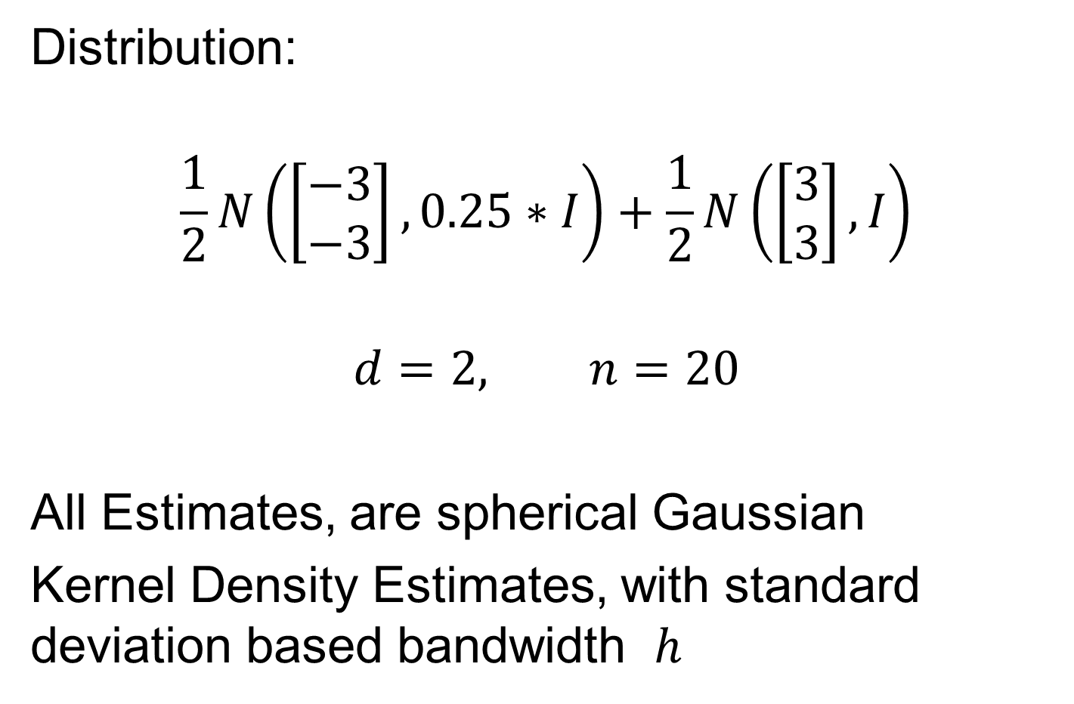
2-d Toy Example
Note ½ the s.d.
Distribution:
$$\frac{1}{2}N\left(\left[\begin{matrix}−3 \\ −3\end{matrix}\right],0.25∗I\right)+\frac{1}{2}N\left(\left[\begin{matrix}3 \\ 3\end{matrix}\right], I\right)$$
$$d=2, n=20$$
All Estimates, are spherical Gaussian
Kernel Density Estimates, with standard deviation based bandwidth $h$

Slide 3
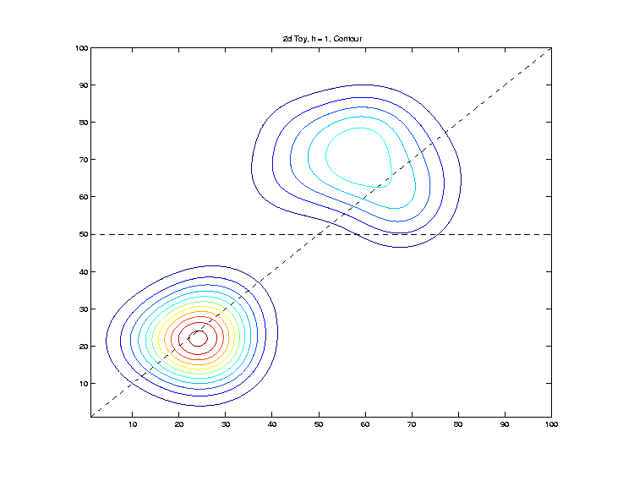

2-d Toy Example
“Good” Bandwidth, $h=1$, Contour Plot:
Will look on
These slices

Slide 4
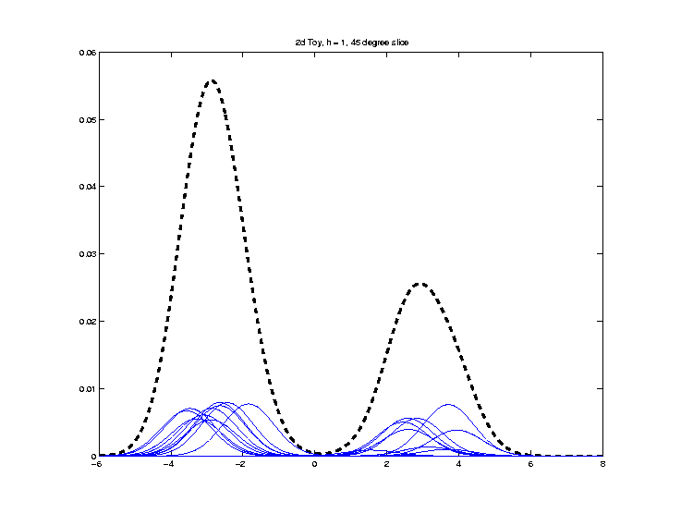

2-d Toy Example
“Good” Bandwidth, $h=1$, ${45}^{°}$ Line Slice:
Looks Reasonable

Slide 5
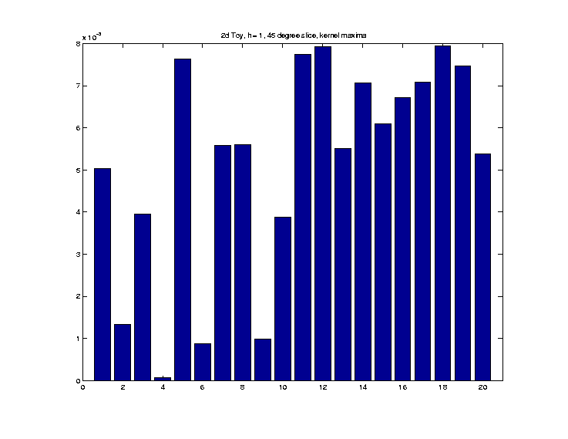

2-d Toy Example
“Good” $h=1$, ${45}^{°}$ Line Kernel Heights:
More variation
than expected?

Slide 6
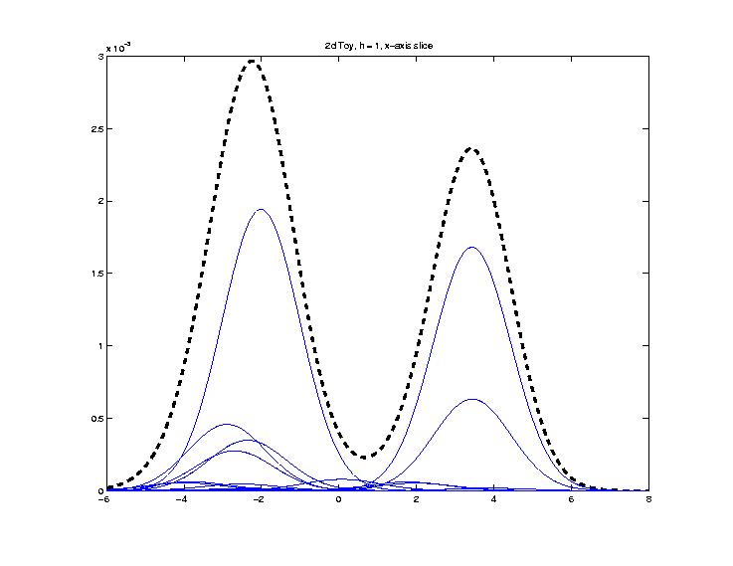

2-d Toy Example
“Good” Bandwidth, $h=1$, x-Axis Slice:
Few Dominant
Kernels

Slide 7
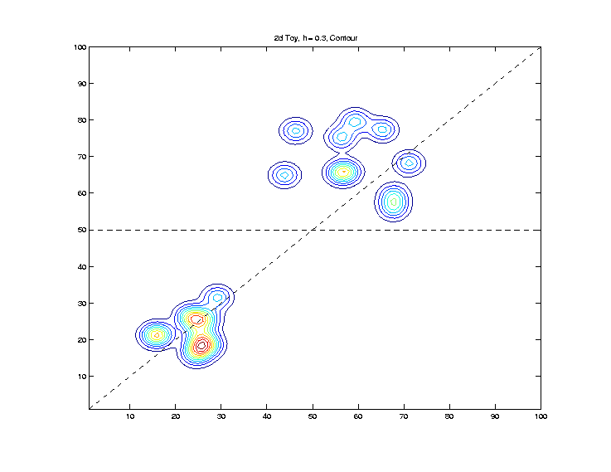

2-d Toy Example
“Small” Bandwidth, $h=0.3$, Contour Plot:
Can almost see
all 10 points
Recall ½ the
distance between

Slide 8
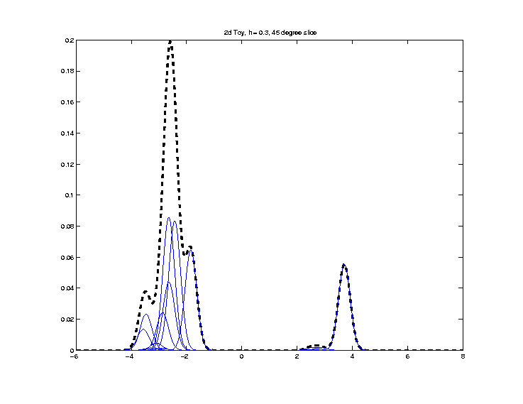

2-d Toy Example
“Small” Bandwidth, $h=0.3$, ${45}^{°}$ Line Slice:
Most of these
too far away
Recall ½ the
distance between

Slide 9
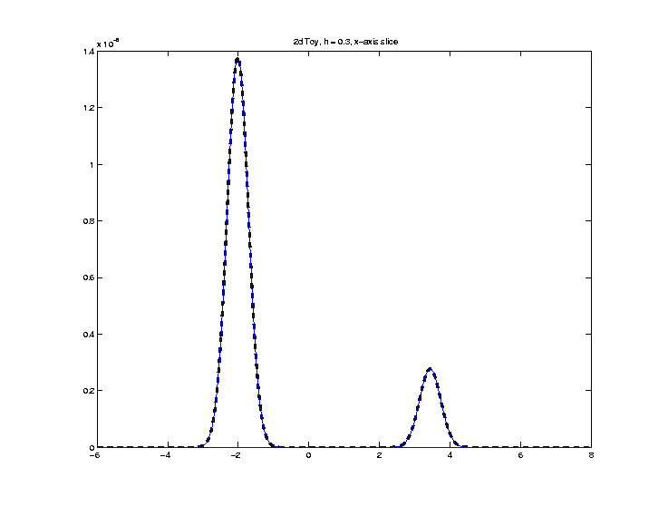

2-d Toy Example
“Small” Bandwidth, $h=0.3$, x-Axis Slice:
Note very small
KDE driven by single
kernels, since far away

Slide 10
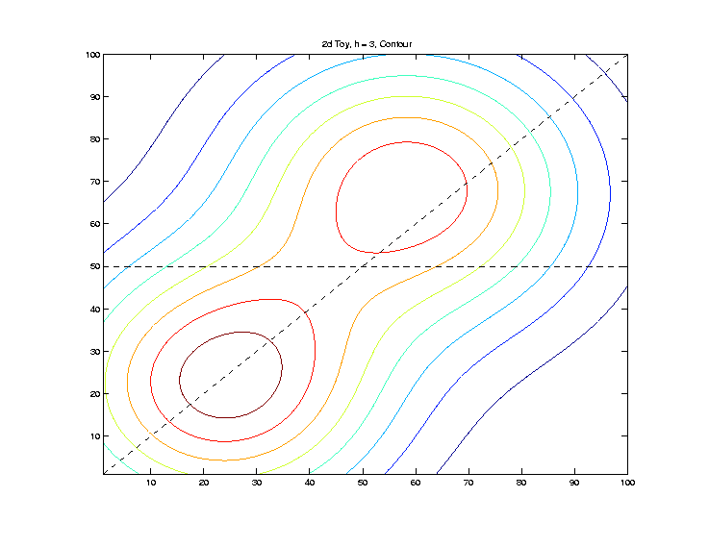

2-d Toy Example
“Large” Bandwidth, $h=$3, Contour Plot:

Slide 11
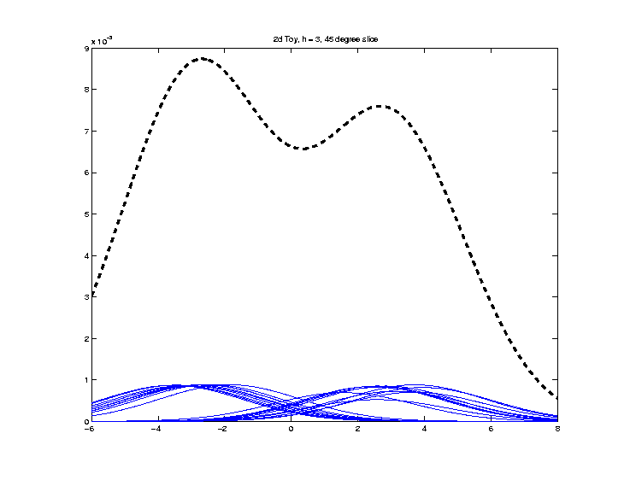

2-d Toy Example
“Large” Bandwidth, $h=3$, ${45}^{°}$ Line Slice:
2 modes almost
smoothed out

Slide 12
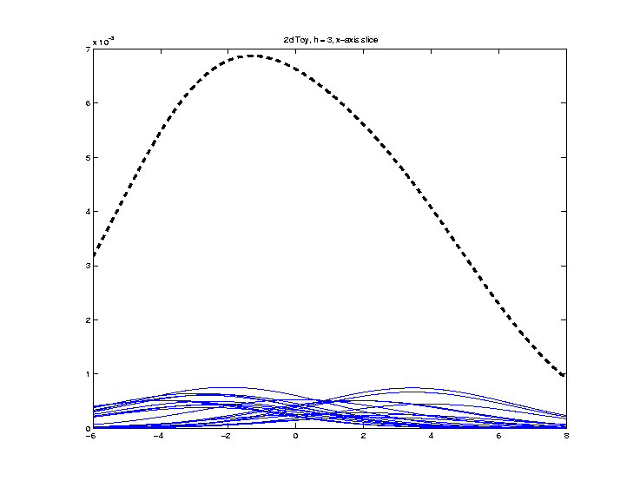

2-d Toy Example
“Large” Bandwidth, $h=3$, x-Axis Slice:
2 modes
completely
disappear

Slide 13
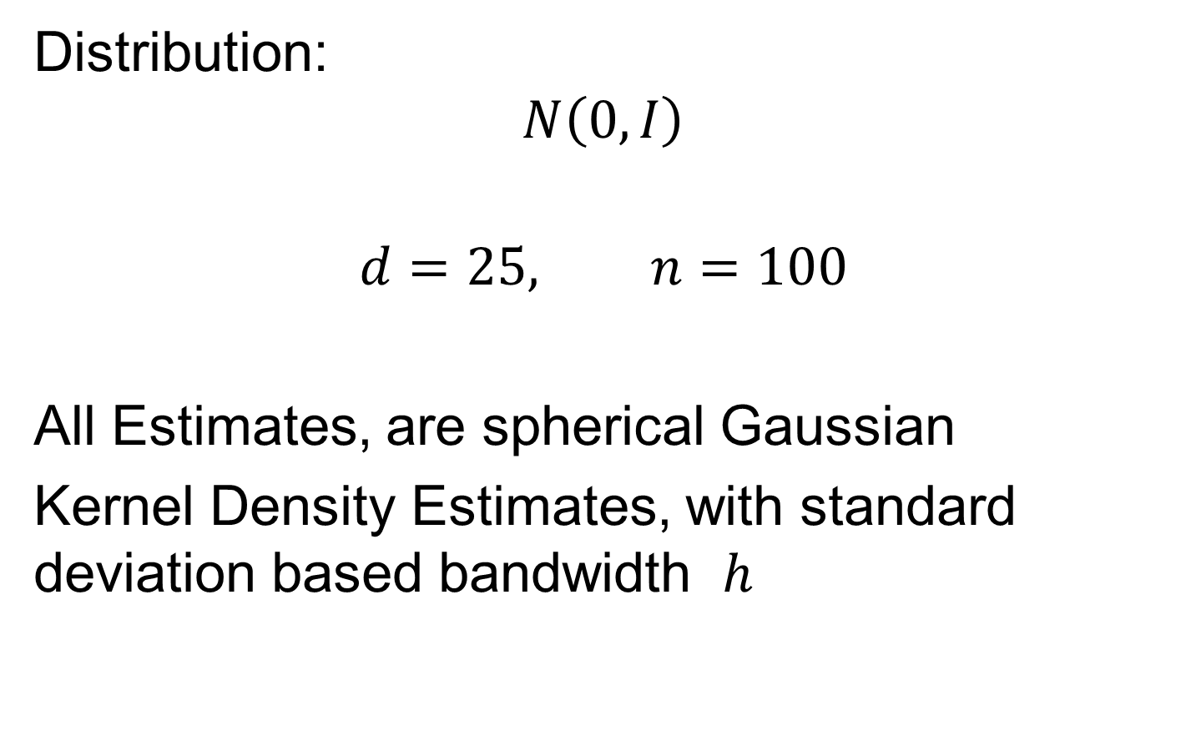
25-d Gaussian Example
Distribution:
$$N\left(0, I\right)$$
$$d=25, n=100$$
All Estimates, are spherical Gaussian
Kernel Density Estimates, with standard deviation based bandwidth $h$

Slide 14
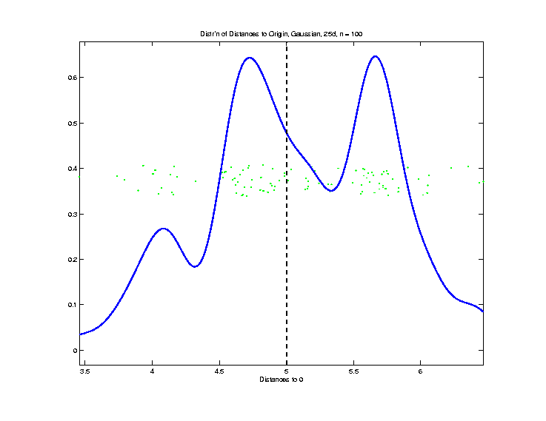

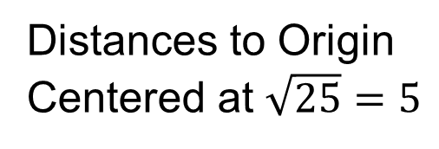
25-d Toy Example
Gaussian, $d=25$, $n=100$, Explore HDLSS
Distances to Origin
Centered at $\sqrt{25}=5$

Slide 15
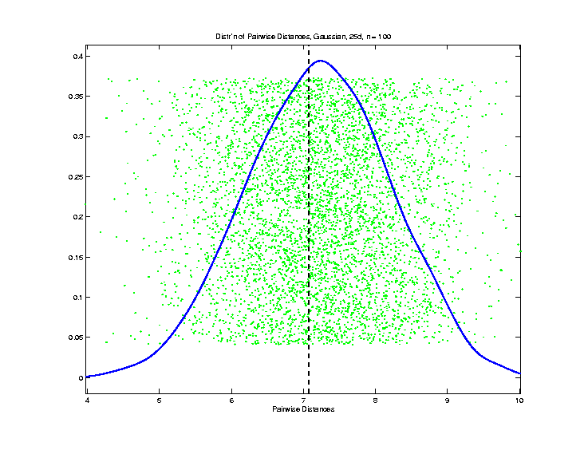
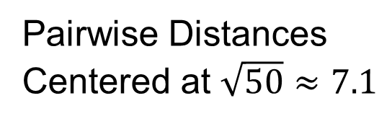
25-d Toy Example
Gaussian, $d=25$, $n=100$, Explore HDLSS
Pairwise Distances
Centered at $\sqrt{50}≈7.1$

Slide 16
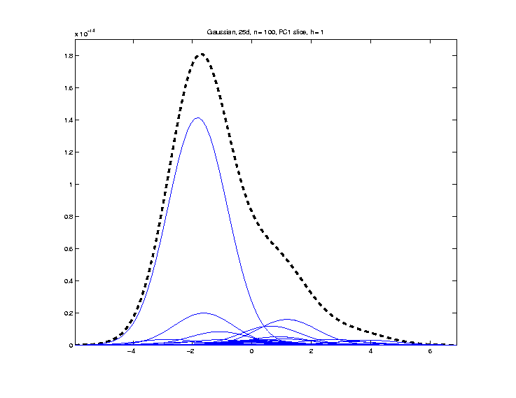

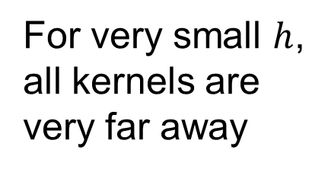
25-d Toy Example
Gaussian $\left(25,100\right)$, PC1 Slice KDE, $h=1$
Strongly dominated
by only one kernel
Note all are
very small
For very small $h$,
all kernels are
very far away

Slide 17
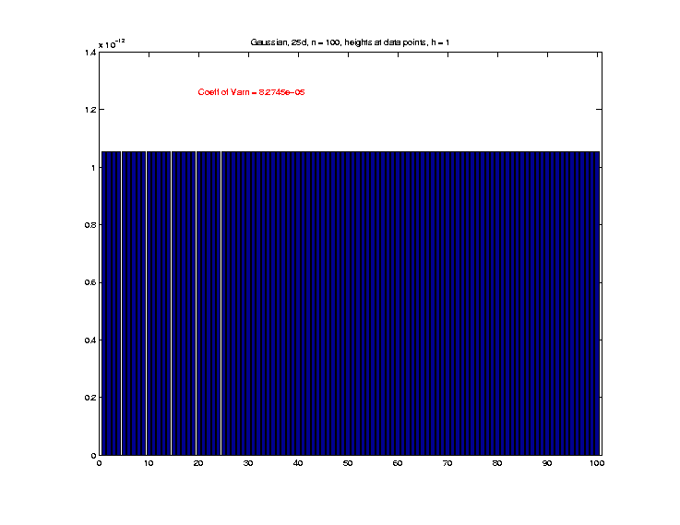

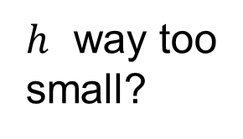
25-d Toy Example
Gaussian $\left(25,100\right)$, KDE h’ts at data, $h=1$
Surprisingly
similar?
Shows each
kernel is
essentially
isolated
$h$ way too
small?

Slide 18
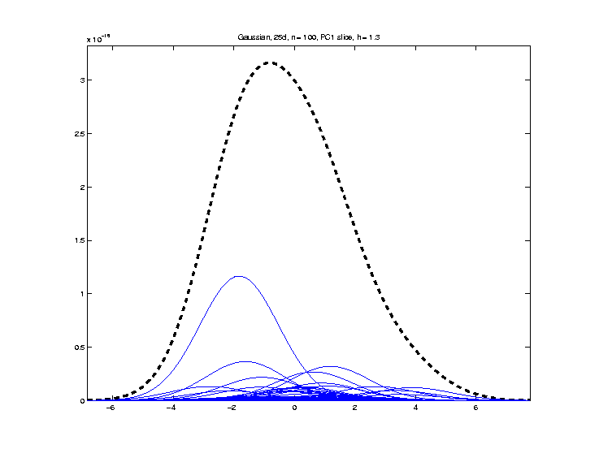

25-d Toy Example
Gaussian $\left(25,100\right)$, PC1 Slice KDE, $h=1.3$

Slide 19
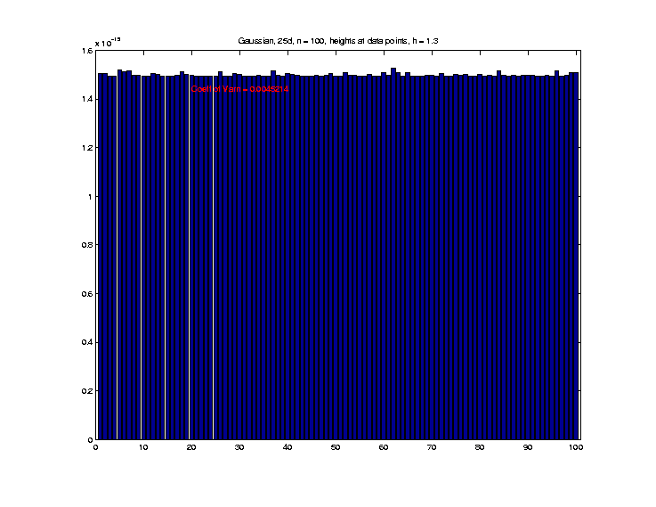

25-d Toy Example
Gaussian $\left(25,100\right)$, KDE h’ts at data, $h=1.3$

Slide 20
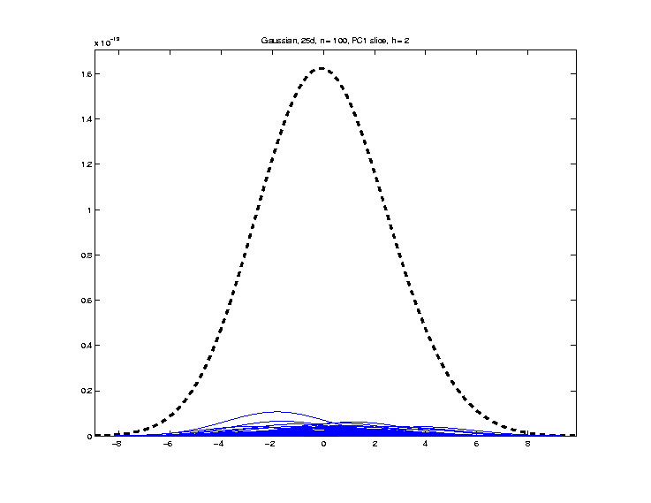

25-d Toy Example
Gaussian $\left(25,100\right)$, PC1 Slice KDE, $h=2$

Slide 21
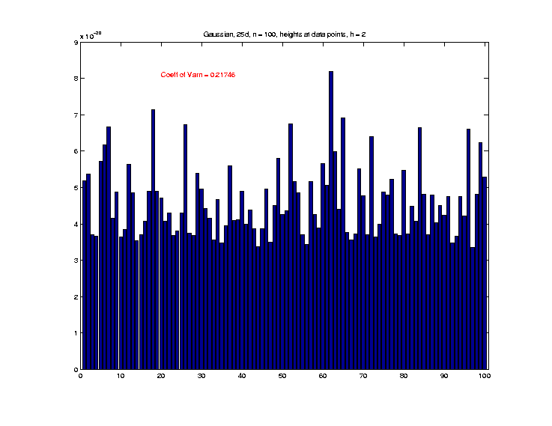

25-d Toy Example
Gaussian $\left(25,100\right)$, KDE h’ts at data, $h=2$

Slide 22
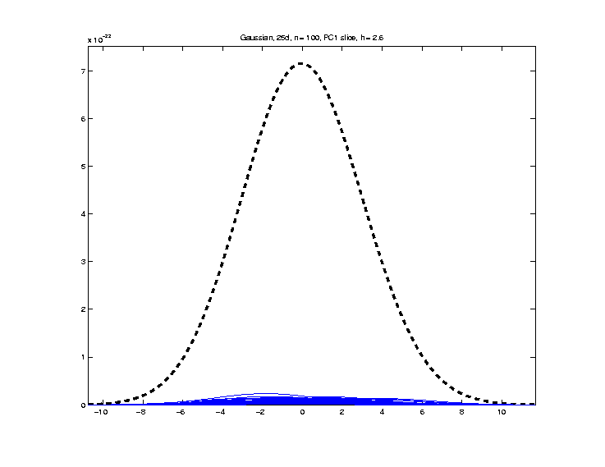

25-d Toy Example
Gaussian $\left(25,100\right)$, PC1 Slice KDE, $h=2.6$

Slide 23
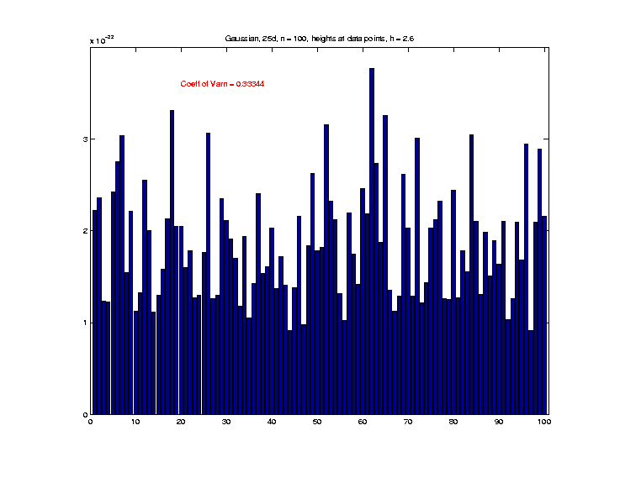

25-d Toy Example
Gaussian $\left(25,100\right)$, KDE h’ts at data, $h=2.6$

Slide 24
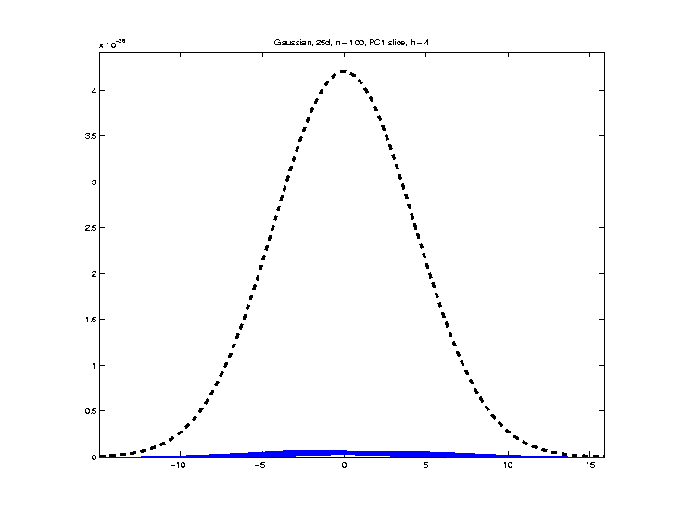

25-d Toy Example
Gaussian $\left(25,100\right)$, PC1 Slice KDE, $h=4$

Slide 25
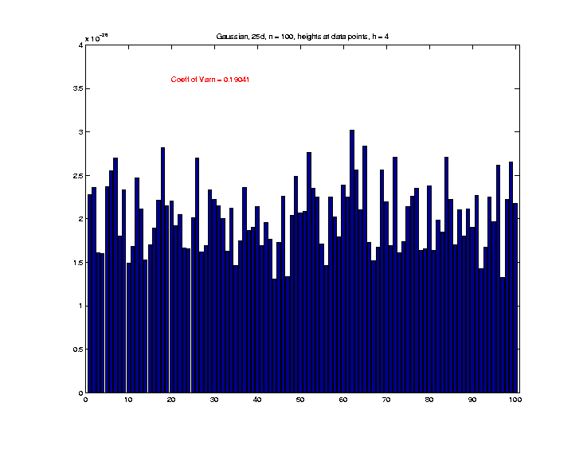

25-d Toy Example
Gaussian $\left(25,100\right)$, KDE h’ts at data, $h=4$

Slide 26
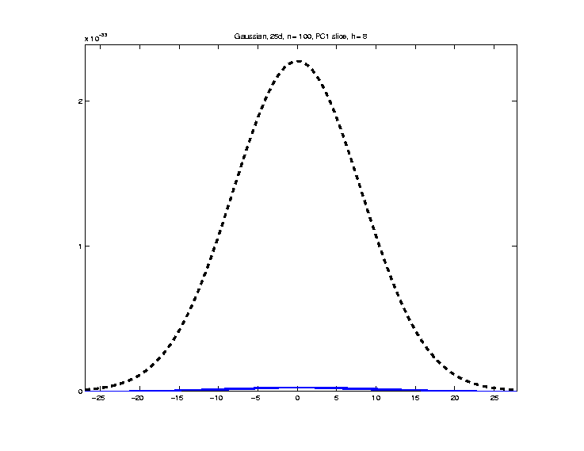

25-d Toy Example
Gaussian $\left(25,100\right)$, PC1 Slice KDE, $h=8$

Slide 27


25-d Toy Example
Gaussian $\left(25,100\right)$, KDE h’ts at data, $h=8$

Slide 28


25-d Toy Example
Gaussian $\left(25,100\right)$, PC1 Slice KDE, $h=$16

Slide 29


25-d Toy Example
Gaussian $\left(25,100\right)$, KDE h’ts at data, $h=16$

Slide 30
25-d Toy Example
a

Slide 31


25-d Bimodal #1 Example
Moves mean by $\sqrt{25∗2∗2}=10$
Distribution:
$$\frac{1}{2}N\left(0, I\right)+\frac{1}{2}N\left(\left[\begin{matrix}2 \\ ⋮ \\ 2\end{matrix}\right], I\right)$$
$$d=25, n=100$$
All Estimates, are spherical Gaussian
Kernel Density Estimates, with standard deviation based bandwidth $h$

Slide 32

25-d Bimodal #2 Example
Note ½ the s.d.
Distribution:
$$\frac{1}{3}N\left(\left[\begin{matrix}−4 \\ ⋮ \\ −4\end{matrix}\right], 4∗I\right)+\frac{1}{3}N\left(0, I\right)+\frac{1}{3}N\left(\left[\begin{matrix}2 \\ ⋮ \\ 2\end{matrix}\right], 0.25∗I\right)$$
$$d=25, n=100$$
All Estimates, are spherical Gaussian
Kernel Density Estimates, with standard deviation based bandwidth $h$

Slide 33
25-d Toy Example
a

