Slide 1

Column Generation Algorithm:
Optimizing Large-Scale LP & IP Problems
A term Presentation for Crew Scheduling Problem
Presented by: Md. Inzamamul Lohani
Institute of Information Technology (IIT),
University of Dhaka
Supervisor: Shah Mostafa Khaled, Ph.D.
Institute of Information Technology (IIT),
University of Dhaka

Slide 2

Technologies Used
Languages or Tools to be used:
- Simplex Method
- Dual Problem
Programming Language: JAVA Libraries: IBM CPLEX Optimization Studio Tools: Git, VS Code
Platform: macOS
LOC: 750+
Finished: About 70%

Slide 3
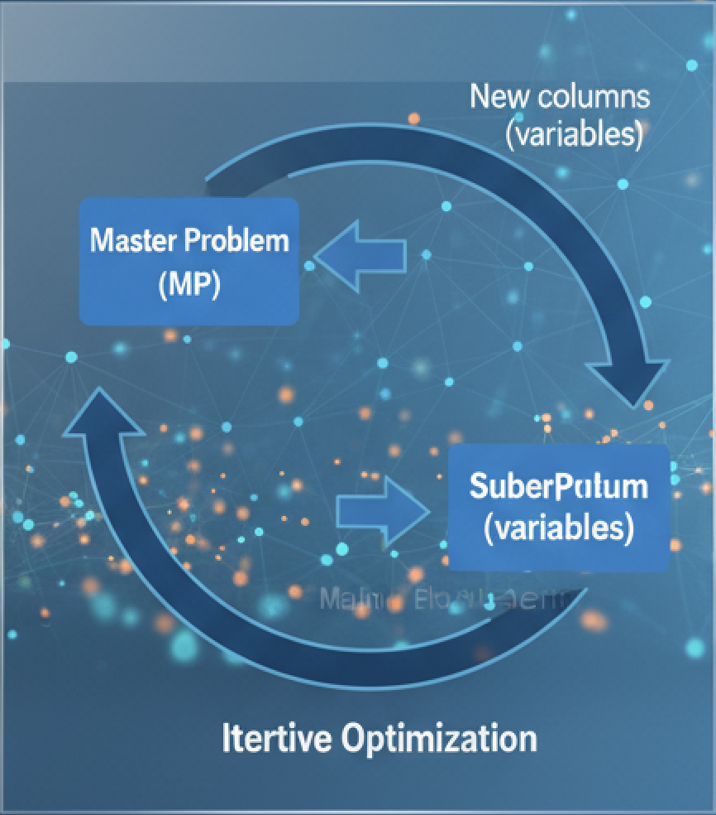
Project Overview: Column Generation Algorithm
For Large-Scale LP & IP Problems
CGA Decomposition:
- Decomposition technique for large-scale LPs
- It generates variables only when needed
- Instead of solving the full problem:
- Master Problem: Start with a small subset of variables
- Sub Problem: Iteratively add promising variables
Subproblem
(Variables)

Slide 4
Project Overview: Column Generation Algorithm
For Large-Scale LP & IP Problems
- In optimal solutions:
- Most variables are zero (solution sparsity)
- Only a few variables affect optimality
- Column Generation:
- Identifies these useful variables
- Avoids generating useless ones

Slide 5
Column Generation Algorithm Steps
1. Initialize RMP with feasible columns
2. Solve RMP
3. Obtain Dual Prices
4. Solve Pricing Problem(subproblem)
5. Add negative Reduced Cost columns
6. Repeat until no improving column exists

Slide 6
Crew Scheduling Problem (Overview)
Objective:
- Assign crews to cover all flights at minimum cost
• Each crew follows labor and operational rules
• Each possible crew schedule is called a pairing

Slide 7
Why Crew Scheduling Is Hard
Constraints:
Every flight must cover
Start from base
Duty hour limits
Flight time limits
Turn around
- A single pairing = one variable
- Number of feasible pairings is enormous

Slide 8

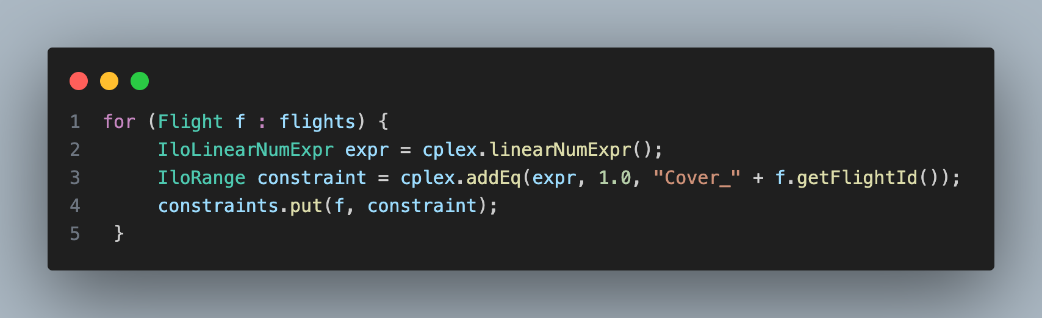

Standard Linear Programming Form
Subject to:
• i : very large variable set
• Explicit enumeration is impossible
Adding constraints

Slide 9
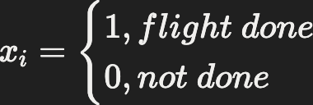

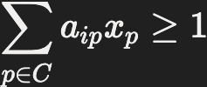
Mathematical Model (Master Problem)
- Decision variable
- Objective
- Constraints

Slide 10
Step:1 Restricted Master Problem (RMP)
• Start with a small subset
• Solve:
Subject to original constraints
• This is called the Restricted Master Problem

Slide 11
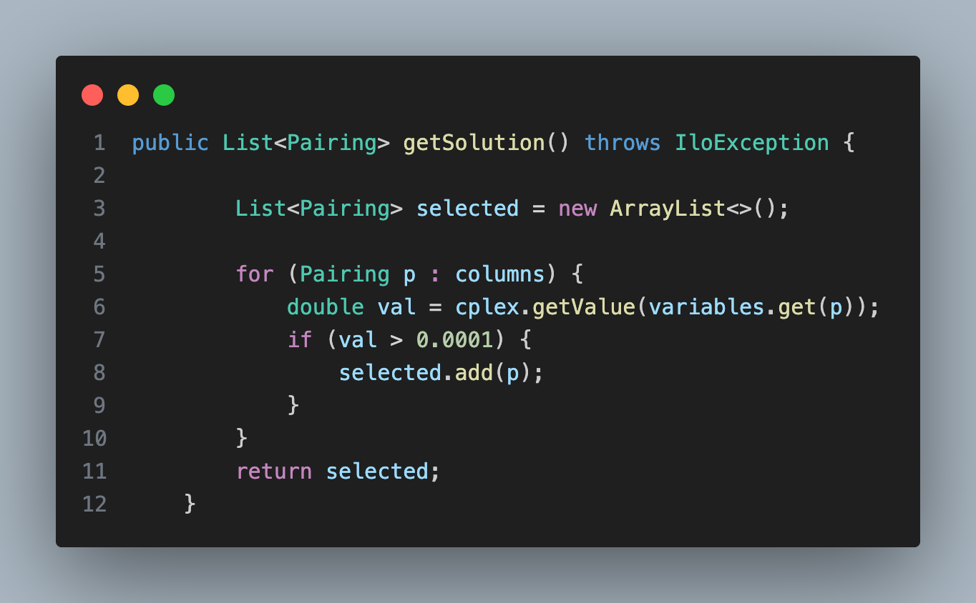
Restricted Master Problem in Crew Scheduling
• Start with:
• Simple pairings
• Single-flight or short pairings
• Solve LP
• Obtain dual prices for flights

Slide 12
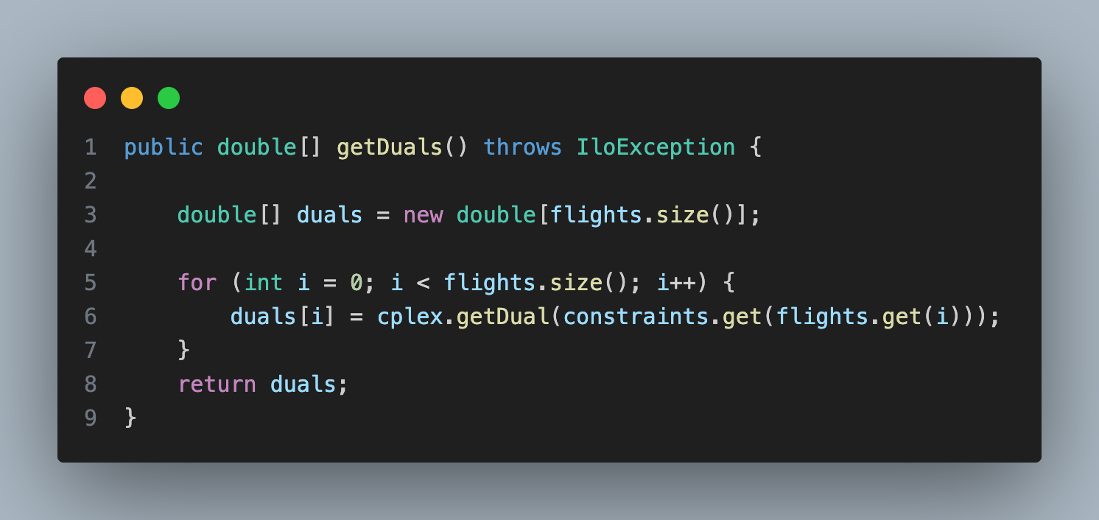
Dual Variables (Shadow Prices)
Solving RMP gives:
• Primal variables
• Dual variables π
Dual variables represent:
• Marginal value of satisfying each constraint

Slide 13
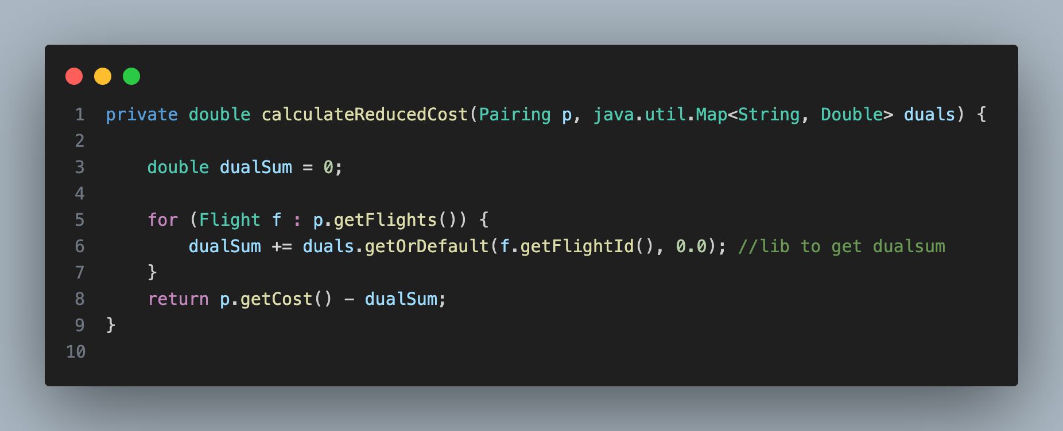

Reduced Cost
For any variable i:
If reduced cost < 0:
• Variable can improve solution
If all reduced costs ≥ 0:
• Current solution is optimal (LP)

Slide 14
Step:2 Pricing Problem(Sub Problem)
• Goal: find variables with negative reduced cost
• This is called the Pricing Problem
• It is problem-specific
• For scheduling problems:
• Often a shortest path problem

Slide 15
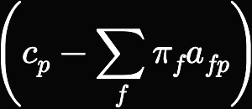
Pricing Problem in Crew Scheduling
• Generate new crew pairings
• Objective:
min
• This becomes:
• Shortest path problem with constraints

Slide 16
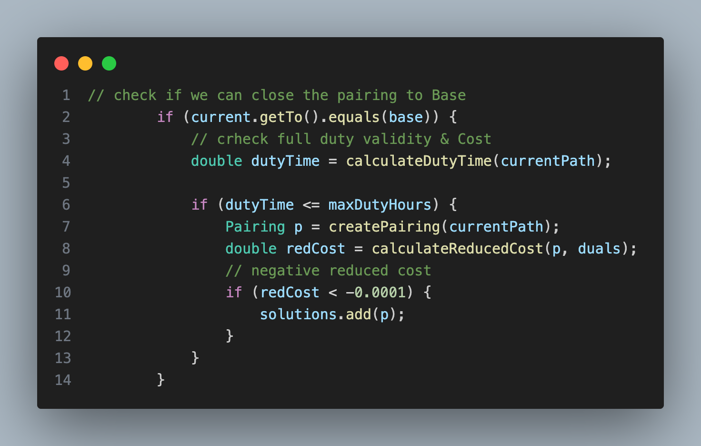
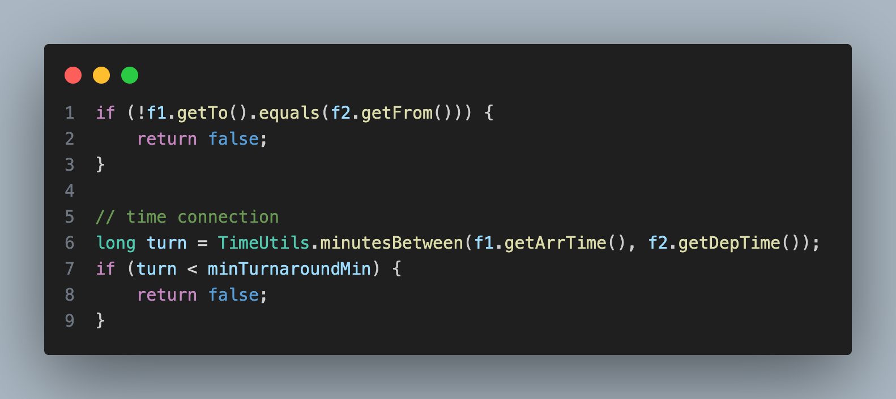
Handle the Constraints in Pricing Problem
Base, duty time, negative reduced cost
F1.To() == F2.From(), turnaround time

Slide 17
Column Generation Loop (Crew Scheduling)
1. Solve RMP
2. Get flight dual prices
3. Solve shortest path problem
4. Generate new pairing
5. Add to RMP
6. Repeat

Slide 18
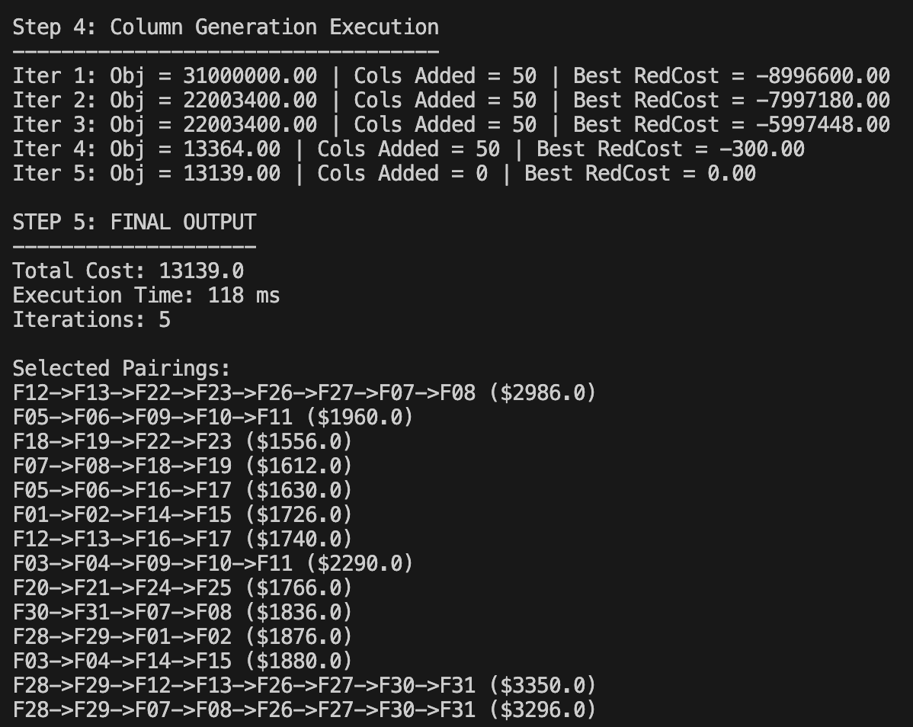
Termination
• When no pairing has negative reduced cost
• RMP solution is LP-optimal
Final Output

Slide 19
Thank you

