Slide 1
Column Generation Algorithm:
Optimizing Large-Scale LP & IP Problems (CSP & VRP)
Presented by: Md. Inzamamul Lohani
Institute of Information Technology (IIT),
University of Dhaka
Supervisor: Shah Mostafa Khaled, Ph.D.
Institute of Information Technology (IIT),
University of Dhaka

Slide 2
Technologies Used
Programming Language: JAVA
Libraries: IBM CPLEX Optimization Studio
Tools: Git, VS Code
Platform: macOS
LOC: 1250+

Slide 3
Column Generation Algorithm
CGA Decomposition:
- Decomposition technique for large-scale LPs
- It generates variables only when needed
- Instead of solving the full problem:
- Master Problem: Start with a small subset of variables
- Sub Problem: Iteratively check efficiently

Slide 4
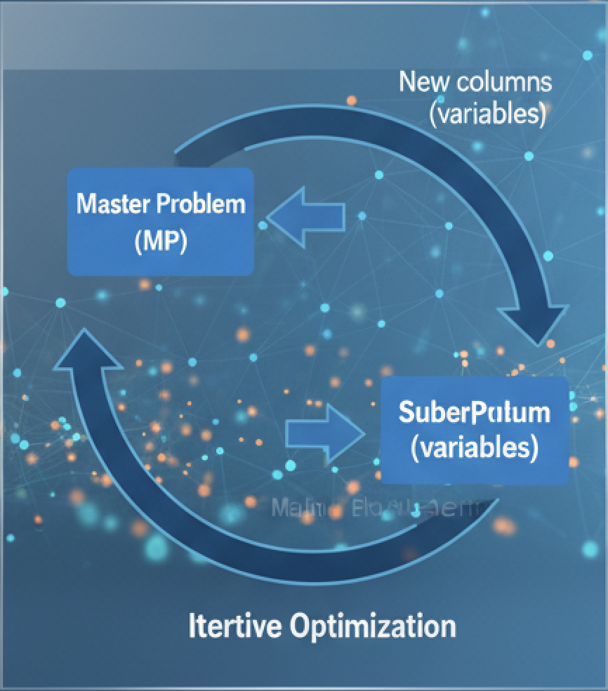
Column Generation Algorithm Steps
1. Initialize RMP with feasible variable
2. Solve RMP
3. Obtain Dual Prices
4. Solve Pricing Problem (subproblem)
5. Add negative Reduced Cost variables
6. Repeat until no improving variable exists
Subproblem
(Variables)
Iterative

Slide 5
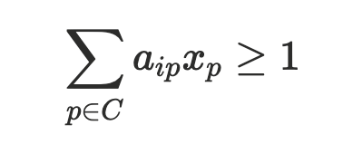
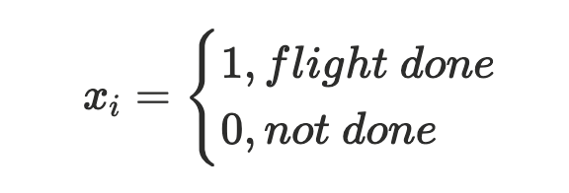
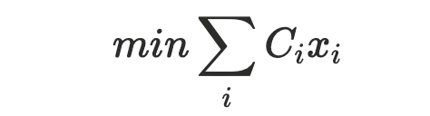
Mathematical Model (Master Problem)
- Constraints
- Decision variable
- Objective

Slide 6
Project Structure
cplex/
├── CSP/ # Crew Scheduling Problem module
│ ├── data/ # Input CSV files
│ └── src/ # Java source code
│
├── VRP/ # Vehicle Routing Problem module
│ ├── data/ # Input CSV files
│ └── src/ # Java source code
│
├── bin/ # Compiled class output
└── run.sh # Compile and run entry script

Slide 7
Project Feature
1. The project demonstrates a practical implementation of column generation
2. It reads input data from files and solves optimization models through CPLEX
3. The modular structure makes it easy to test CSP and VRP separately
4. This project shows how decomposition can solve large-scale real-world optimization problems efficiently

Slide 8
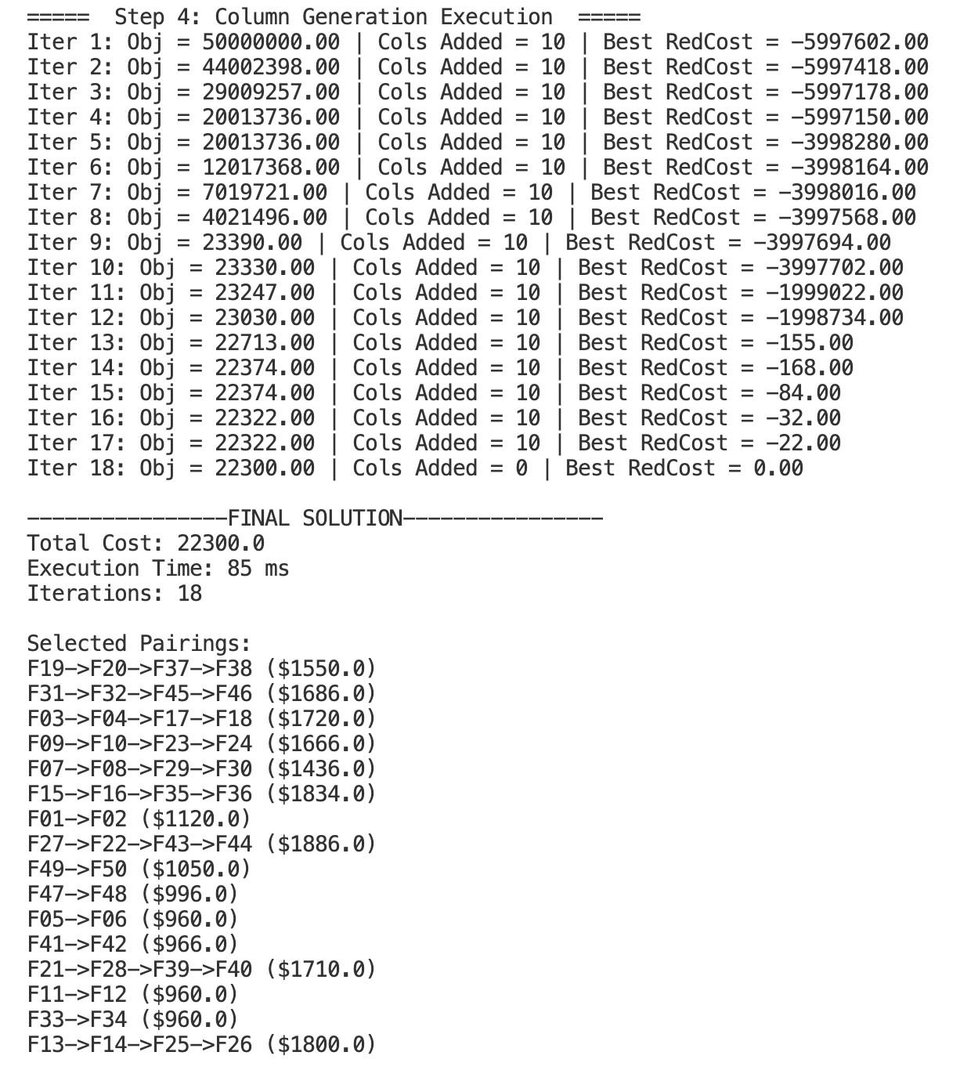
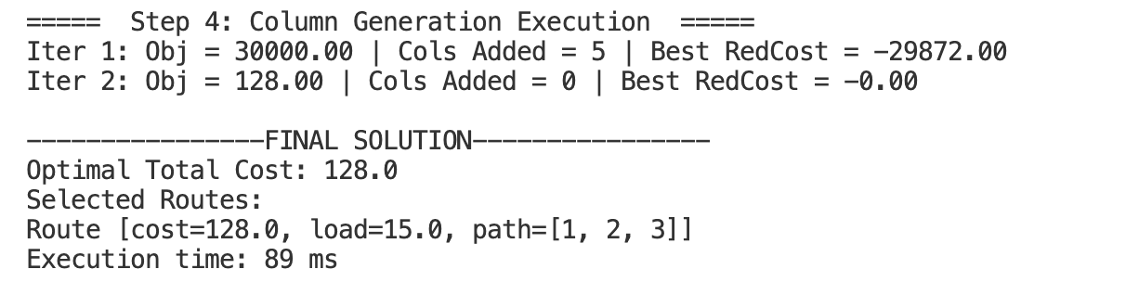
Output

Slide 9
Thank You

