Slide 1
Chapter 12: Indexing and Hashing
Rev. Sep 17, 2008

Slide 2
Chapter 12: Indexing and Hashing
Basic Concepts
Ordered Indices
B⁺-Tree Index Files
B-Tree Index Files
Static Hashing
Dynamic Hashing
Comparison of Ordered Indexing and Hashing
Index Definition in SQL
Multiple-Key Access

Slide 3
Basic Concepts
Indexing mechanisms used to speed up access to desired data.
  E.g., author catalog in library
Search Key - attribute to set of attributes used to look up records in a file.
An index file consists of records (called index entries) of the form
Index files are typically much smaller than the original file
Two basic kinds of indices:
  Ordered indices: search keys are stored in sorted order
  Hash indices: search keys are distributed uniformly across “buckets” using a “hash function”.
search-key
pointer

Slide 4
Index Evaluation Metrics
Access types supported efficiently. E.g.,
  records with a specified value in the attribute
  or records with an attribute value falling in a specified range of values (e.g. 10000 < salary < 40000)
Access time
Insertion time
Deletion time
Space overhead

Slide 5
Ordered Indices
In an ordered index, index entries are stored sorted on the search key value. E.g., author catalog in library.
Primary index: in a sequentially ordered file, the index whose search key specifies the sequential order of the file.
  Also called clustering index
  The search key of a primary index is usually but not necessarily the primary key.
Secondary index: an index whose search key specifies an order different from the sequential order of the file. Also called
non-clustering index.
Index-sequential file: ordered sequential file with a primary index.

Slide 6
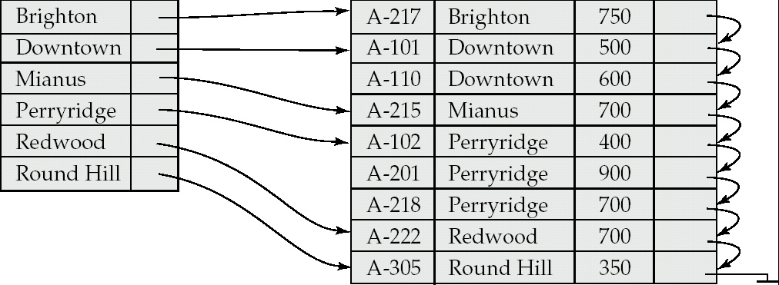
Dense Index Files
Dense index — Index record appears for every search-key value in the file.

Slide 7
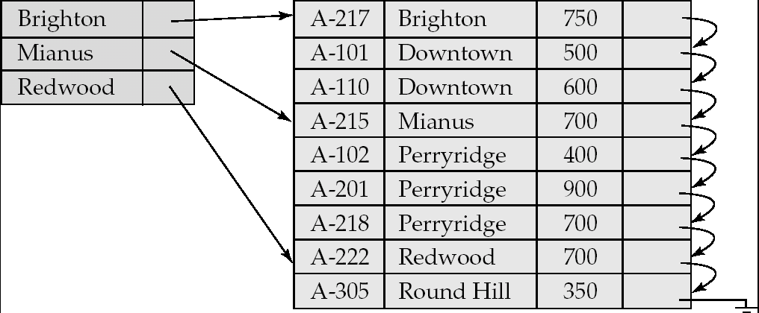
Sparse Index Files
Sparse Index: contains index records for only some search-key values.
  Applicable when records are sequentially ordered on search-key
To locate a record with search-key value K we:
  Find index record with largest search-key value < K
  Search file sequentially starting at the record to which the index record points

Slide 8
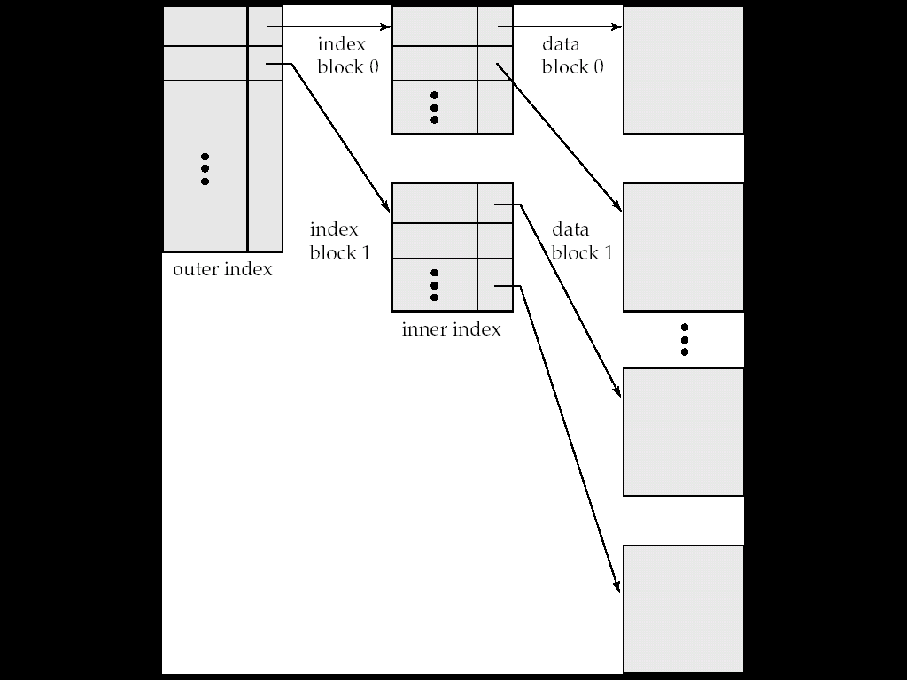
Sparse Index Files (Cont.)
Compared to dense indices:
  Less space and less maintenance overhead for insertions and deletions.
  Generally slower than dense index for locating records.
Good tradeoff: sparse index with an index entry for every block in file, corresponding to least search-key value in the block.

Slide 9
Multilevel Index
If primary index does not fit in memory, access becomes expensive.
Solution: treat primary index kept on disk as a sequential file and construct a sparse index on it.
  outer index – a sparse index of primary index
  inner index – the primary index file
If even outer index is too large to fit in main memory, yet another level of index can be created, and so on.
Indices at all levels must be updated on insertion or deletion from the file.

Slide 10
Multilevel Index (Cont.)

Slide 11
Index Update: Record Deletion
If deleted record was the only record in the file with its particular search-key value, the search-key is deleted from the index also.
Single-level index deletion:
  Dense indices – deletion of search-key: similar to file record deletion.
  Sparse indices –
    if deleted key value exists in the index, the value is replaced by the next search-key value in the file (in search-key order).
    If the next search-key value already has an index entry, the entry is deleted instead of being replaced.

Slide 12
Index Update: Record Insertion
Single-level index insertion:
  Perform a lookup using the key value from inserted record
  Dense indices – if the search-key value does not appear in the index, insert it.
  Sparse indices – if index stores an entry for each block of the file, no change needs to be made to the index unless a new block is created.
    If a new block is created, the first search-key value appearing in the new block is inserted into the index.
Multilevel insertion (as well as deletion) algorithms are simple extensions of the single-level algorithms

Slide 13
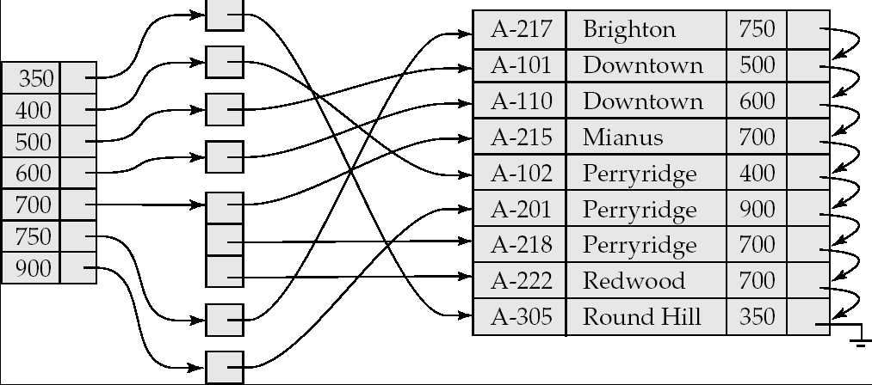
Secondary Indices Example
Secondary index on balance field of account
Index record points to a bucket that contains pointers to all the actual records with that particular search-key value.
Secondary indices have to be dense

Slide 14
Primary and Secondary Indices
Indices offer substantial benefits when searching for records.
BUT: Updating indices imposes overhead on database modification --when a file is modified, every index on the file must be updated,
Sequential scan using primary index is efficient, but a sequential scan using a secondary index is expensive
  Each record access may fetch a new block from disk
  Block fetch requires about 5 to 10 micro seconds, versus about 100 nanoseconds for memory access

Slide 15
B⁺-Tree Index Files
B⁺-tree indices are an alternative to indexed-sequential files.
Disadvantage of indexed-sequential files
  performance degrades as file grows, since many overflow blocks get created.
  Periodic reorganization of entire file is required.
Advantage of B⁺-tree index files:
  automatically reorganizes itself with small, local, changes, in the face of insertions and deletions.
  Reorganization of entire file is not required to maintain performance.
(Minor) disadvantage of B⁺-trees:
  extra insertion and deletion overhead, space overhead.
Advantages of B⁺-trees outweigh disadvantages
  B⁺-trees are used extensively

Slide 16
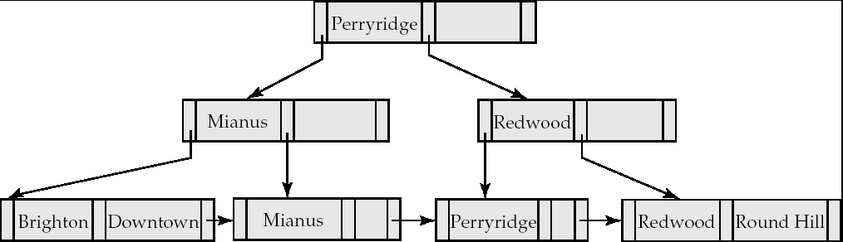
B⁺-Tree Index Files (Cont.)
A B⁺-tree is a rooted tree satisfying the following properties:
All paths from root to leaf are of the same length
Each node that is not a root or a leaf has between ⎡n/2⎤ and n children.
A leaf node has between ⎡(n–1)/2⎤ and n–1 values
Special cases:
  If the root is not a leaf, it has at least 2 children.
  If the root is a leaf (that is, there are no other nodes in the tree), it can have between 0 and (n–1) values.

Slide 17
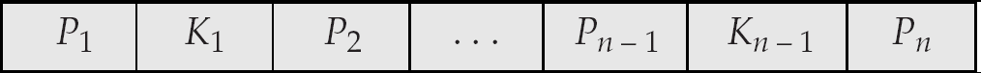
B⁺-Tree Node Structure
Typical node
  K_{i} are the search-key values
  P_{i} are pointers to children (for non-leaf nodes) or pointers to records or buckets of records (for leaf nodes).
The search-keys in a node are ordered
K₁ < K₂ < K₃ < . . . < K_{n–1}

Slide 18
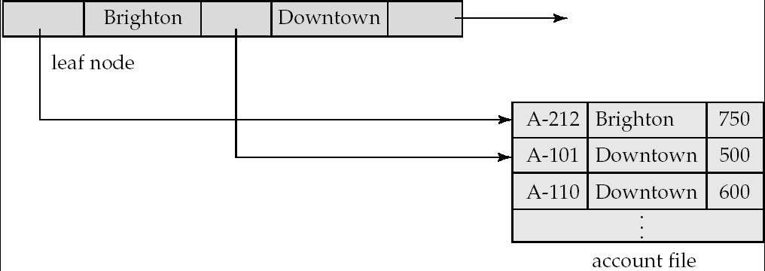
Leaf Nodes in B⁺-Trees
Properties of a leaf node:
For i = 1, 2, . . ., n–1, pointer P_{i} either points to a file record with search-key value K_{i}, or to a bucket of pointers to file records, each record having search-key value K_{i}. Only need bucket structure if search-key does not form a primary key.
If L_{i}, L_{j} are leaf nodes and i < j, L_{i}’s search-key values are less than L_{j}’s search-key values
P_{n} points to next leaf node in search-key order

Slide 19
Non-Leaf Nodes in B⁺-Trees
Non leaf nodes form a multi-level sparse index on the leaf nodes. For a non-leaf node with m pointers:
  All the search-keys in the subtree to which P₁ points are less than K₁
  For 2 ≤ i ≤ n – 1, all the search-keys in the subtree to which P_{i} points have values greater than or equal to K_{i–1} and less than K_{i}
  All the search-keys in the subtree to which P_{n} points have values greater than or equal to K_{n–1}

Slide 20
Example of a B⁺-tree
B⁺-tree for account file (n = 3)

Slide 21
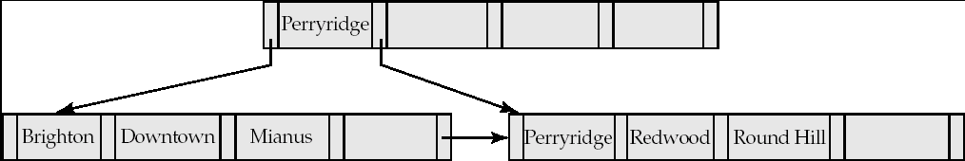
Example of B⁺-tree
B⁺-tree for account file (n = 5)
Leaf nodes must have between 2 and 4 values
(⎡(n–1)/2⎤ and n –1, with n = 5).
Non-leaf nodes other than root must have between 3 and 5 children (⎡(n/2⎤ and n with n =5).
Root must have at least 2 children.

Slide 22
Observations about B⁺-trees
Since the inter-node connections are done by pointers, “logically” close blocks need not be “physically” close.
The non-leaf levels of the B⁺-tree form a hierarchy of sparse indices.
The B⁺-tree contains a relatively small number of levels
    Level below root has at least 2* ⎡n/2⎤ values
    Next level has at least 2* ⎡n/2⎤ * ⎡n/2⎤ values
    .. etc.
  If there are K search-key values in the file, the tree height is no more than ⎡ log_{⎡n/2⎤}(K)⎤
  thus searches can be conducted efficiently.
Insertions and deletions to the main file can be handled efficiently, as the index can be restructured in logarithmic time (as we shall see).

Slide 23
Queries on B⁺-Trees
Find all records with a search-key value of k.
  N=root
  Repeat
    Examine N for the smallest search-key value > k.
    If such a value exists, assume it is K_{i}. Then set N = P_{i}
    Otherwise k ≥ K_{n–1}. Set N = P_{n}
    Until N is a leaf node
  If for some i, key K_{i} = k follow pointer P_{i} to the desired record or bucket.
  Else no record with search-key value k exists.

Slide 24
Queries on B⁺⁻Trees (Cont.)
If there are K search-key values in the file, the height of the tree is no more than ⎡log_{⎡n/2⎤}(K)⎤.
A node is generally the same size as a disk block, typically 4 kilobytes
  and n is typically around 100 (40 bytes per index entry).
With 1 million search key values and n = 100
  at most log₅₀(1,000,000) = 4 nodes are accessed in a lookup.
Contrast this with a balanced binary tree with 1 million search key values — around 20 nodes are accessed in a lookup
  above difference is significant since every node access may need a disk I/O, costing around 20 milliseconds

Slide 25
Updates on B⁺-Trees: Insertion
Find the leaf node in which the search-key value would appear
If the search-key value is already present in the leaf node
  Add record to the file
If the search-key value is not present, then
  add the record to the main file (and create a bucket if necessary)
  If there is room in the leaf node, insert (key-value, pointer) pair in the leaf node
  Otherwise, split the node (along with the new (key-value, pointer) entry) as discussed in the next slide.

Slide 26
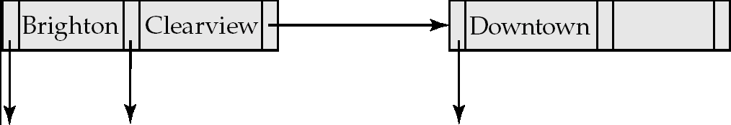
Updates on B⁺-Trees: Insertion (Cont.)
Splitting a leaf node:
  take the n (search-key value, pointer) pairs (including the one being inserted) in sorted order. Place the first ⎡n/2⎤ in the original node, and the rest in a new node.
  let the new node be p, and let k be the least key value in p. Insert (k,p) in the parent of the node being split.
  If the parent is full, split it and propagate the split further up.
Splitting of nodes proceeds upwards till a node that is not full is found.
  In the worst case the root node may be split increasing the height of the tree by 1.
Result of splitting node containing Brighton and Downtown on inserting Clearview
Next step: insert entry with (Downtown,pointer-to-new-node) into parent

Slide 27

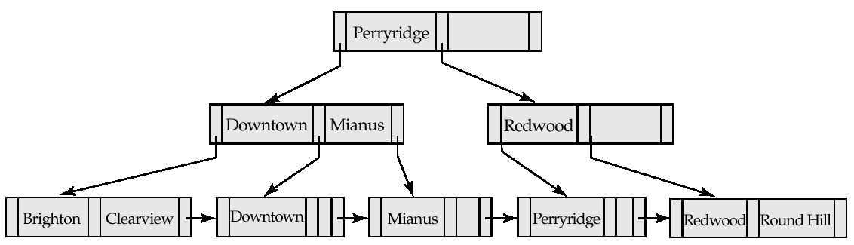
Updates on B⁺-Trees: Insertion (Cont.)
B⁺-Tree before and after insertion of “Clearview”

Slide 28
Insertion in B⁺-Trees (Cont.)
Splitting a non-leaf node: when inserting (k,p) into an already full internal node N
  Copy N to an in-memory area M with space for n+1 pointers and n keys
  Insert (k,p) into M
  Copy P₁,K₁, …, K _{⎡n/2⎤-1},P _{⎡n/2⎤} from M back into node N
  Copy P_{⎡n/2⎤+1},K _{⎡n/2⎤+1},…,K_{n},P_{n+1} from M into newly allocated node N’
  Insert (K _{⎡n/2⎤},N’) into parent N
Read pseudocode in book!
Mianus
Downtown Mianus Perryridge
Downtown
Redwood

Slide 29
Updates on B⁺-Trees: Deletion
Find the record to be deleted, and remove it from the main file and from the bucket (if present)
Remove (search-key value, pointer) from the leaf node if there is no bucket or if the bucket has become empty
If the node has too few entries due to the removal, and the entries in the node and a sibling fit into a single node, then merge siblings:
  Insert all the search-key values in the two nodes into a single node (the one on the left), and delete the other node.
  Delete the pair (K_{i–1}, P_{i}), where P_{i} is the pointer to the deleted node, from its parent, recursively using the above procedure.

Slide 30
Updates on B⁺-Trees: Deletion
Otherwise, if the node has too few entries due to the removal, but the entries in the node and a sibling do not fit into a single node, then redistribute pointers:
  Redistribute the pointers between the node and a sibling such that both have more than the minimum number of entries.
  Update the corresponding search-key value in the parent of the node.
The node deletions may cascade upwards till a node which has ⎡n/2⎤ or more pointers is found.
If the root node has only one pointer after deletion, it is deleted and the sole child becomes the root.

Slide 31

Examples of B⁺-Tree Deletion
Before and after deleting “Downtown”
Deleting “Downtown” causes merging of under-full leaves
  leaf node can become empty only for n=3!

Slide 32
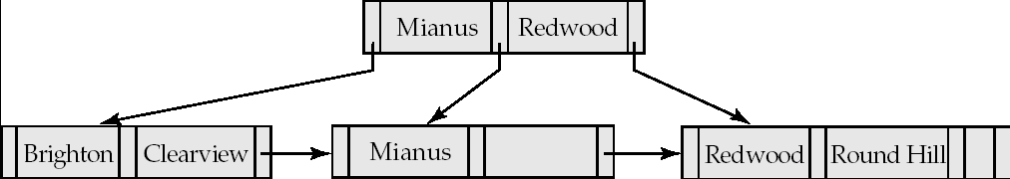
Examples of B⁺-Tree Deletion (Cont.)
Before and After deletion of “Perryridge” from result of previous example

Slide 33
Examples of B⁺-Tree Deletion (Cont.)
Leaf with “Perryridge” becomes underfull (actually empty, in this special case) and merged with its sibling.
As a result “Perryridge” node’s parent became underfull, and was merged with its sibling
  Value separating two nodes (at parent) moves into merged node
  Entry deleted from parent
Root node then has only one child, and is deleted

Slide 34
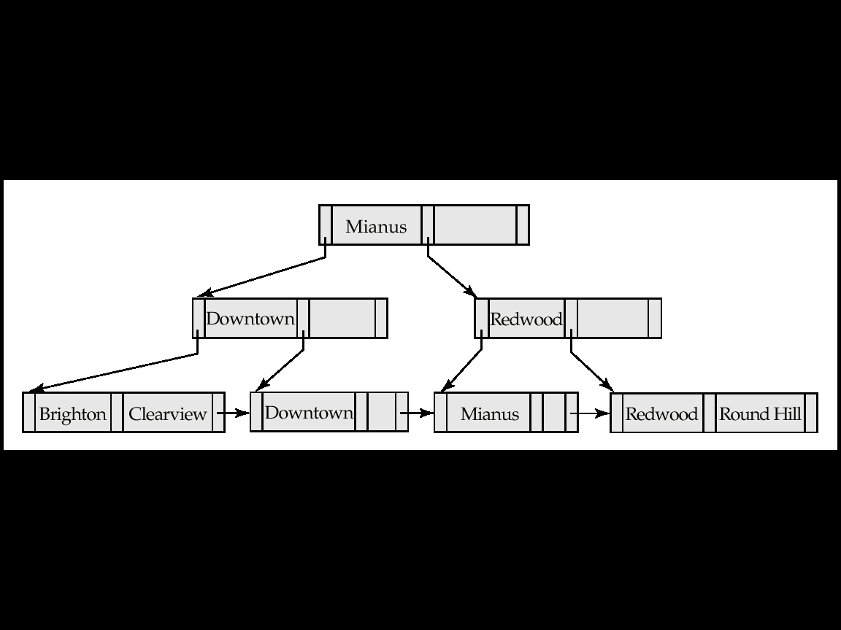
Example of B⁺-tree Deletion (Cont.)
Before and after deletion of “Perryridge” from earlier example
Parent of leaf containing Perryridge became underfull, and borrowed a pointer from its left sibling
Search-key value in the parent’s parent changes as a result

Slide 35
B⁺-Tree File Organization
Index file degradation problem is solved by using B⁺-Tree indices.
Data file degradation problem is solved by using B⁺-Tree File Organization.
The leaf nodes in a B⁺-tree file organization store records, instead of pointers.
Leaf nodes are still required to be half full
  Since records are larger than pointers, the maximum number of records that can be stored in a leaf node is less than the number of pointers in a nonleaf node.
Insertion and deletion are handled in the same way as insertion and deletion of entries in a B⁺-tree index.

Slide 36
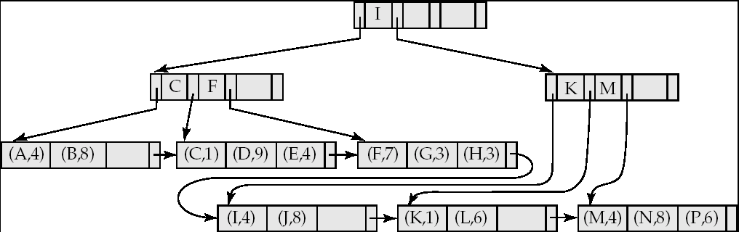

B⁺-Tree File Organization (Cont.)
Example of B⁺-tree File Organization
Good space utilization important since records use more space than pointers.
To improve space utilization, involve more sibling nodes in redistribution during splits and merges
  Involving 2 siblings in redistribution (to avoid split / merge where possible) results in each node having at least entries

Slide 37
Indexing Strings
Variable length strings as keys
  Variable fanout
  Use space utilization as criterion for splitting, not number of pointers
Prefix compression
  Key values at internal nodes can be prefixes of full key
    Keep enough characters to distinguish entries in the subtrees separated by the key value
      E.g. “Silas” and “Silberschatz” can be separated by “Silb”
  Keys in leaf node can be compressed by sharing common prefixes

Slide 38
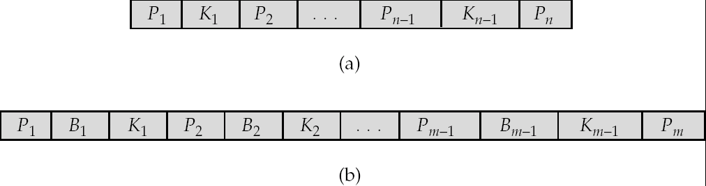
B-Tree Index Files
Similar to B+-tree, but B-tree allows search-key values to appear only once; eliminates redundant storage of search keys.
Search keys in nonleaf nodes appear nowhere else in the B-tree; an additional pointer field for each search key in a nonleaf node must be included.
Generalized B-tree leaf node
Nonleaf node – pointers Bi are the bucket or file record pointers.

Slide 39
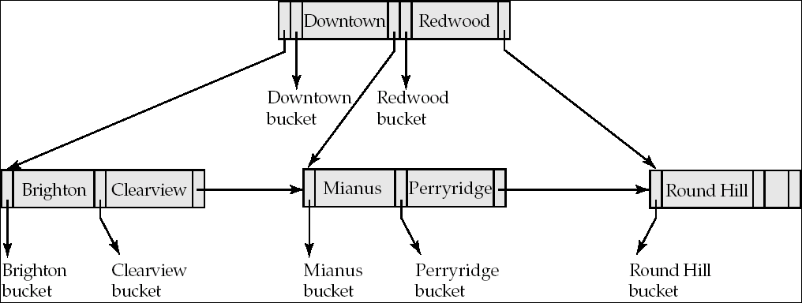
B-Tree Index File Example
B-tree (above) and B+-tree (below) on same data

Slide 40
B-Tree Index Files (Cont.)
Advantages of B-Tree indices:
  May use less tree nodes than a corresponding B⁺-Tree.
  Sometimes possible to find search-key value before reaching leaf node.
Disadvantages of B-Tree indices:
  Only small fraction of all search-key values are found early
  Non-leaf nodes are larger, so fan-out is reduced. Thus, B-Trees typically have greater depth than corresponding B⁺-Tree
  Insertion and deletion more complicated than in B⁺-Trees
  Implementation is harder than B⁺-Trees.
Typically, advantages of B-Trees do not out weigh disadvantages.

Slide 41
Multiple-Key Access
Use multiple indices for certain types of queries.
Example:
  select account_number
  from account
  where branch_name = “Perryridge” and balance = 1000
Possible strategies for processing query using indices on single attributes:
  1. Use index on branch_name to find accounts with branch name Perryridge; test balance = 1000
  2. Use index on balance to find accounts with balances of $1000; test branch_name = “Perryridge”.
  3. Use branch_name index to find pointers to all records pertaining to the Perryridge branch. Similarly use index on balance. Take intersection of both sets of pointers obtained.

Slide 42
Indices on Multiple Keys
Composite search keys are search keys containing more than one attribute
  E.g. (branch_name, balance)
Lexicographic ordering: (a₁, a₂) < (b₁, b₂) if either
  a₁ < b₁, or
  a₁=b₁ and a₂ < b₂

Slide 43
Indices on Multiple Attributes
Suppose we have an index on combined search-key
(branch_name, balance).
For
where branch_name = “Perryridge” and balance = 1000
the index on (branch_name, balance) can be used to fetch only records that satisfy both conditions.
  Using separate indices in less efficient — we may fetch many records (or pointers) that satisfy only one of the conditions.
Can also efficiently handle
where branch_name = “Perryridge” and balance < 1000
But cannot efficiently handle
where branch_name < “Perryridge” and balance = 1000
  May fetch many records that satisfy the first but not the second condition

Slide 44
Non-Unique Search Keys
Alternatives:
  Buckets on separate block (bad idea)
  List of tuple pointers with each key
    Low space overhead, no extra cost for queries
    Extra code to handle read/update of long lists
    Deletion of a tuple can be expensive if there are many duplicates on search key (why?)
  Make search key unique by adding a record-identifier
    Extra storage overhead for keys
    Simpler code for insertion/deletion
    Widely used

Slide 45
Other Issues in Indexing
Covering indices
  Add extra attributes to index so (some) queries can avoid fetching the actual records
    Particularly useful for secondary indices
      Why?
  Can store extra attributes only at leaf
Record relocation and secondary indices
  If a record moves, all secondary indices that store record pointers have to be updated
  Node splits in B⁺-tree file organizations become very expensive
  Solution: use primary-index search key instead of record pointer in secondary index
    Extra traversal of primary index to locate record
      Higher cost for queries, but node splits are cheap
    Add record-id if primary-index search key is non-unique

Slide 46
Hashing

Slide 47
Static Hashing
A bucket is a unit of storage containing one or more records (a bucket is typically a disk block).
In a hash file organization we obtain the bucket of a record directly from its search-key value using a hash function.
Hash function h is a function from the set of all search-key values K to the set of all bucket addresses B.
Hash function is used to locate records for access, insertion as well as deletion.
Records with different search-key values may be mapped to the same bucket; thus entire bucket has to be searched sequentially to locate a record.

Slide 48
Example of Hash File Organization
Hash file organization of account file, using branch_name as key
(See figure in next slide.)
There are 10 buckets,
The binary representation of the ith character is assumed to be the integer i.
The hash function returns the sum of the binary representations of the characters modulo 10
  E.g. h(Perryridge) = 5 h(Round Hill) = 3 h(Brighton) = 3

Slide 49
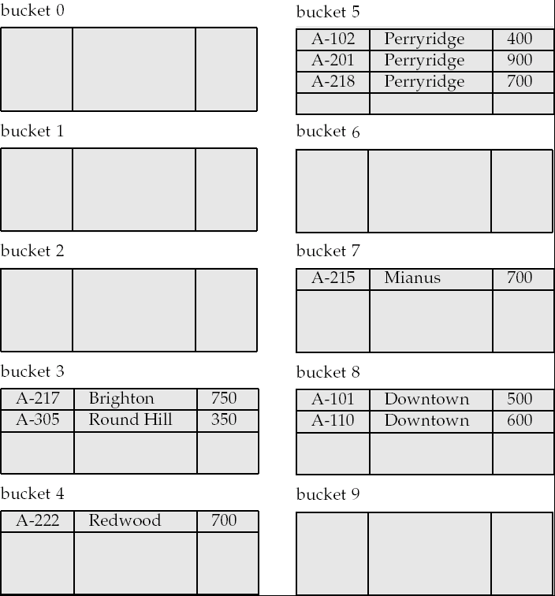
Example of Hash File Organization
Hash file organization of account file, using branch_name as key
(see previous slide for details).

Slide 50
Hash Functions
Worst hash function maps all search-key values to the same bucket; this makes access time proportional to the number of search-key values in the file.
An ideal hash function is uniform, i.e., each bucket is assigned the same number of search-key values from the set of all possible values.
Ideal hash function is random, so each bucket will have the same number of records assigned to it irrespective of the actual distribution of search-key values in the file.
Typical hash functions perform computation on the internal binary representation of the search-key.
  For example, for a string search-key, the binary representations of all the characters in the string could be added and the sum modulo the number of buckets could be returned. .

Slide 51
Handling of Bucket Overflows
Bucket overflow can occur because of
  Insufficient buckets
  Skew in distribution of records. This can occur due to two reasons:
    multiple records have same search-key value
    chosen hash function produces non-uniform distribution of key values
Although the probability of bucket overflow can be reduced, it cannot be eliminated; it is handled by using overflow buckets.

Slide 52
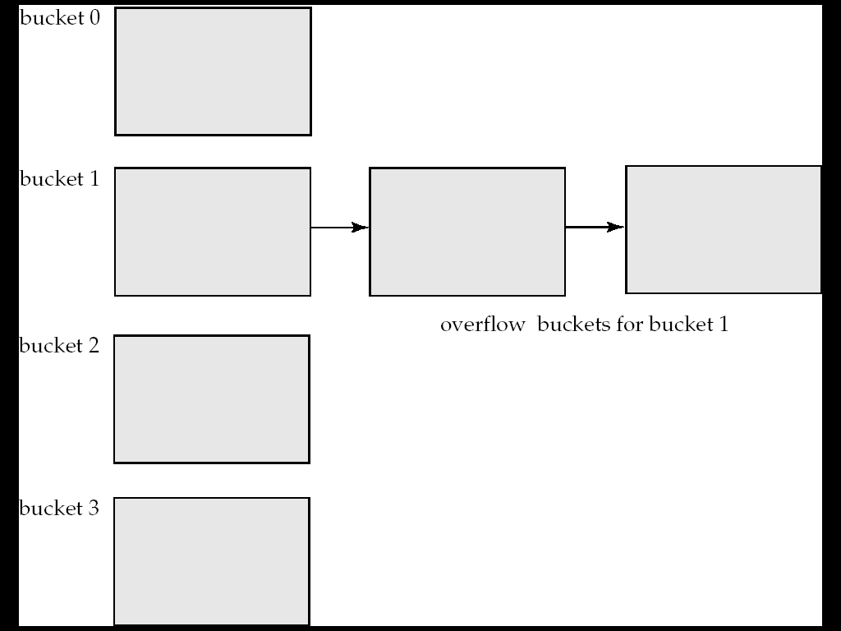
Handling of Bucket Overflows (Cont.)
Overflow chaining – the overflow buckets of a given bucket are chained together in a linked list.
Above scheme is called closed hashing.
  An alternative, called open hashing, which does not use overflow buckets, is not suitable for database applications.

Slide 53
Hash Indices
Hashing can be used not only for file organization, but also for index-structure creation.
A hash index organizes the search keys, with their associated record pointers, into a hash file structure.
Strictly speaking, hash indices are always secondary indices
  if the file itself is organized using hashing, a separate primary hash index on it using the same search-key is unnecessary.
  However, we use the term hash index to refer to both secondary index structures and hash organized files.

Slide 54
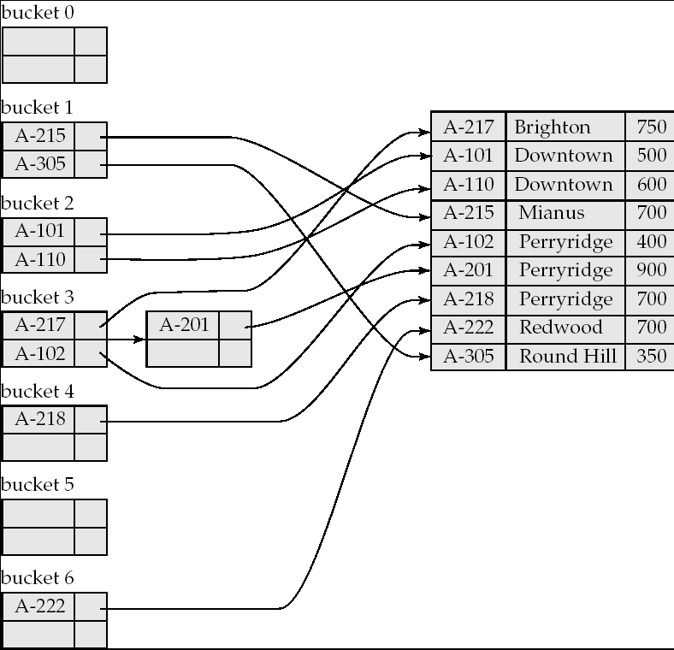
Example of Hash Index

Slide 55
Deficiencies of Static Hashing
In static hashing, function h maps search-key values to a fixed set of B of bucket addresses. Databases grow or shrink with time.
  If initial number of buckets is too small, and file grows, performance will degrade due to too much overflows.
  If space is allocated for anticipated growth, a significant amount of space will be wasted initially (and buckets will be underfull).
  If database shrinks, again space will be wasted.
One solution: periodic re-organization of the file with a new hash function
  Expensive, disrupts normal operations
Better solution: allow the number of buckets to be modified dynamically.

Slide 56
Dynamic Hashing
Good for database that grows and shrinks in size
Allows the hash function to be modified dynamically
Extendable hashing – one form of dynamic hashing
  Hash function generates values over a large range — typically b-bit integers, with b = 32.
  At any time use only a prefix of the hash function to index into a table of bucket addresses.
  Let the length of the prefix be i bits, 0 ≤ i ≤ 32.
    Bucket address table size = 2^{i.} Initially i = 0
    Value of i grows and shrinks as the size of the database grows and shrinks.
  Multiple entries in the bucket address table may point to a bucket (why?)
  Thus, actual number of buckets is < 2^{i}
    The number of buckets also changes dynamically due to coalescing and splitting of buckets.

Slide 57
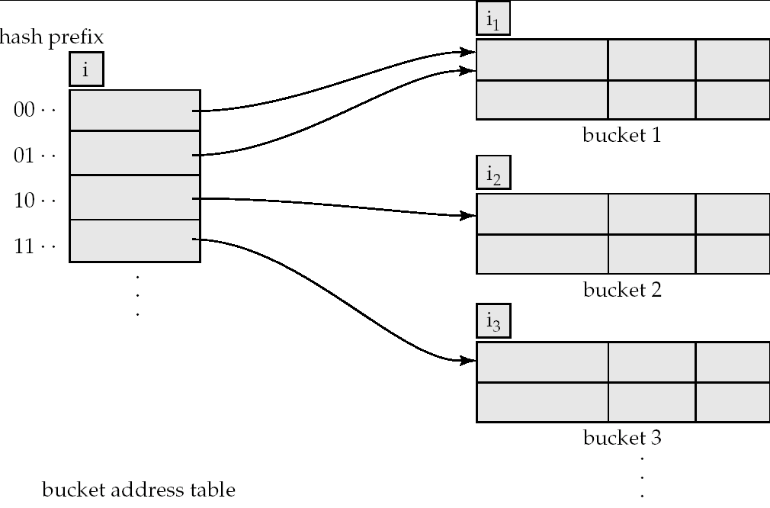
General Extendable Hash Structure
In this structure, i₂ = i₃ = i, whereas i₁ = i – 1 (see next slide for details)

Slide 58
Use of Extendable Hash Structure
Each bucket j stores a value i_{j}
  All the entries that point to the same bucket have the same values on the first i_{j} bits.
To locate the bucket containing search-key K_{j}:
  1. Compute h(K_{j}) = X
  2. Use the first i high order bits of X as a displacement into bucket address table, and follow the pointer to appropriate bucket
To insert a record with search-key value K_{j}
  follow same procedure as look-up and locate the bucket, say j.
  If there is room in the bucket j insert record in the bucket.
  Else the bucket must be split and insertion re-attempted (next slide.)
    Overflow buckets used instead in some cases (will see shortly)

Slide 59
Insertion in Extendable Hash Structure (Cont)
To split a bucket j when inserting record with search-key value K_{j}:
If i > i_{j} (more than one pointer to bucket j)
  allocate a new bucket z, and set i_{j} = i_{z} = (i_{j} + 1)
  Update the second half of the bucket address table entries originally pointing to j, to point to z
  remove each record in bucket j and reinsert (in j or z)
  recompute new bucket for K_{j} and insert record in the bucket (further splitting is required if the bucket is still full)
If i = i_{j} (only one pointer to bucket j)
  If i reaches some limit b, or too many splits have happened in this insertion, create an overflow bucket
  Else
    increment i and double the size of the bucket address table.
    replace each entry in the table by two entries that point to the same bucket.
    recompute new bucket address table entry for K_{j}
    Now i > i_{j} so use the first case above.

Slide 60
Deletion in Extendable Hash Structure
To delete a key value,
  locate it in its bucket and remove it.
  The bucket itself can be removed if it becomes empty (with appropriate updates to the bucket address table).
  Coalescing of buckets can be done (can coalesce only with a “buddy” bucket having same value of i_{j} and same i_{j} –1 prefix, if it is present)
  Decreasing bucket address table size is also possible
    Note: decreasing bucket address table size is an expensive operation and should be done only if number of buckets becomes much smaller than the size of the table

Slide 61
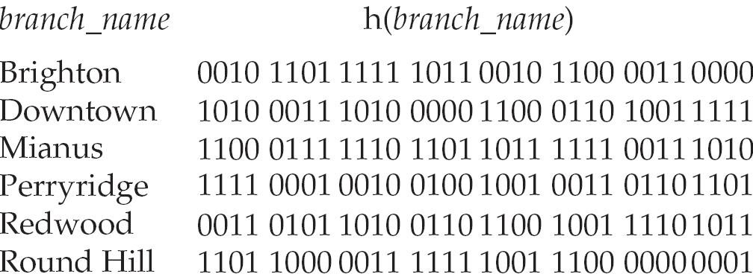
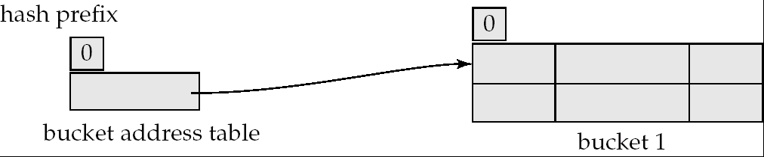
Use of Extendable Hash Structure: Example
Initial Hash structure, bucket size = 2

Slide 62
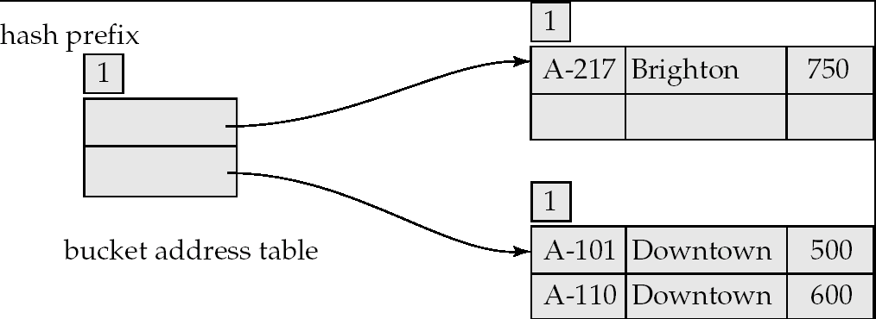
Example (Cont.)
Hash structure after insertion of one Brighton and two Downtown records

Slide 63
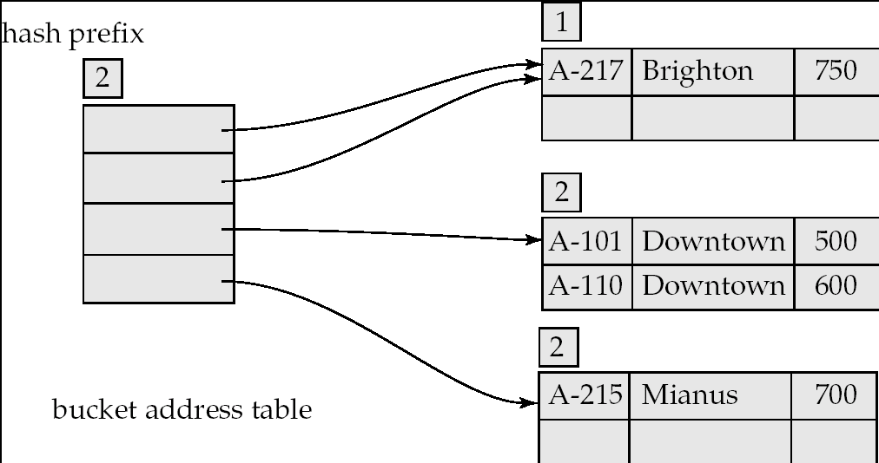
Example (Cont.)
Hash structure after insertion of Mianus record

Slide 64
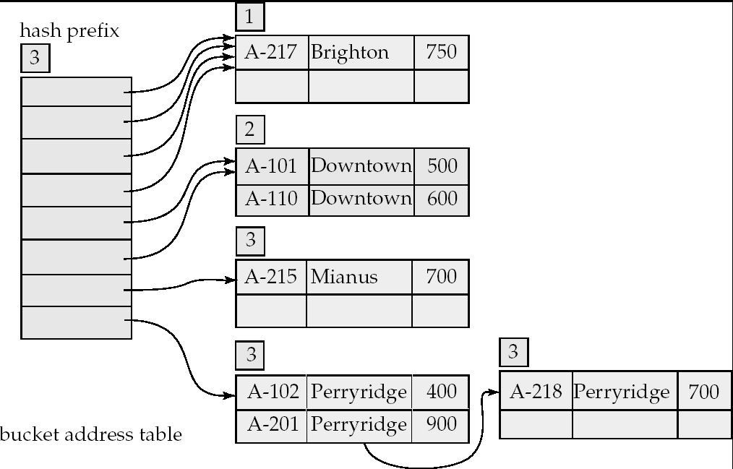
Example (Cont.)
Hash structure after insertion of three Perryridge records

Slide 65
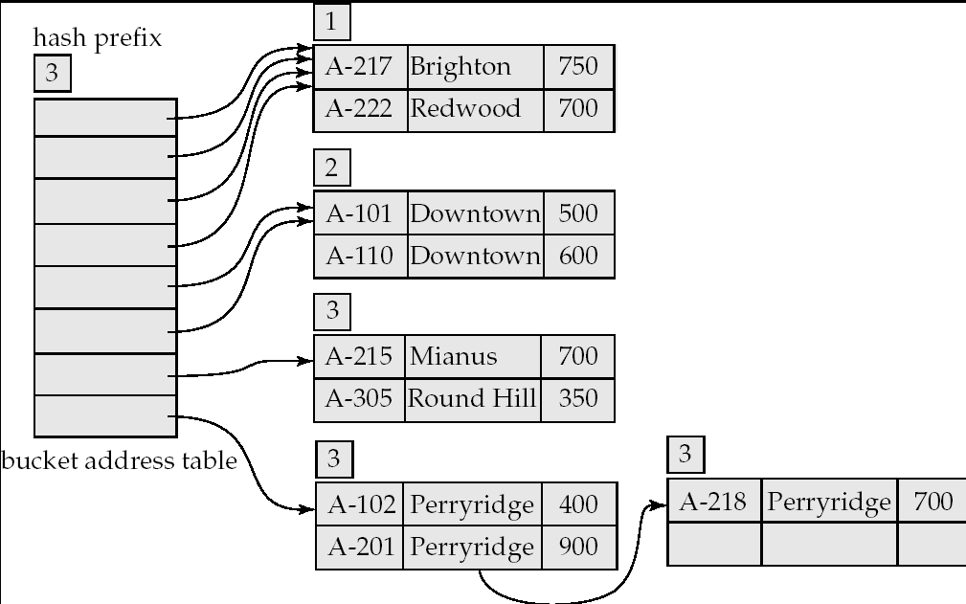
Example (Cont.)
Hash structure after insertion of Redwood and Round Hill records

Slide 66
Extendable Hashing vs. Other Schemes
Benefits of extendable hashing:
  Hash performance does not degrade with growth of file
  Minimal space overhead
Disadvantages of extendable hashing
  Extra level of indirection to find desired record
  Bucket address table may itself become very big (larger than memory)
    Cannot allocate very large contiguous areas on disk either
    Solution: B⁺-tree file organization to store bucket address table
  Changing size of bucket address table is an expensive operation
Linear hashing is an alternative mechanism
  Allows incremental growth of its directory (equivalent to bucket address table)
  At the cost of more bucket overflows

Slide 67
Comparison of Ordered Indexing and Hashing
Cost of periodic re-organization
Relative frequency of insertions and deletions
Is it desirable to optimize average access time at the expense of worst-case access time?
Expected type of queries:
  Hashing is generally better at retrieving records having a specified value of the key.
  If range queries are common, ordered indices are to be preferred
In practice:
  PostgreSQL supports hash indices, but discourages use due to poor performance
  Oracle supports static hash organization, but not hash indices
  SQLServer supports only B⁺-trees

Slide 68
Bitmap Indices
Bitmap indices are a special type of index designed for efficient querying on multiple keys
Records in a relation are assumed to be numbered sequentially from, say, 0
  Given a number n it must be easy to retrieve record n
    Particularly easy if records are of fixed size
Applicable on attributes that take on a relatively small number of distinct values
  E.g. gender, country, state, …
  E.g. income-level (income broken up into a small number of levels such as 0-9999, 10000-19999, 20000-50000, 50000- infinity)
A bitmap is simply an array of bits

Slide 69
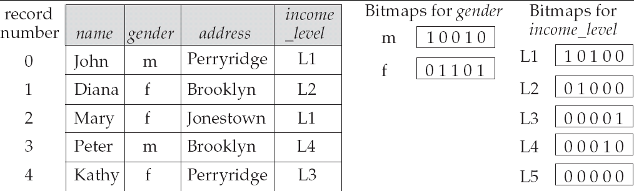
Bitmap Indices (Cont.)
In its simplest form a bitmap index on an attribute has a bitmap for each value of the attribute
  Bitmap has as many bits as records
  In a bitmap for value v, the bit for a record is 1 if the record has the value v for the attribute, and is 0 otherwise

Slide 70
Bitmap Indices (Cont.)
Bitmap indices are useful for queries on multiple attributes
  not particularly useful for single attribute queries
Queries are answered using bitmap operations
  Intersection (and)
  Union (or)
  Complementation (not)
Each operation takes two bitmaps of the same size and applies the operation on corresponding bits to get the result bitmap
  E.g. 100110 AND 110011 = 100010
  100110 OR 110011 = 110111
  NOT 100110 = 011001
  Males with income level L1: 10010 AND 10100 = 10000
    Can then retrieve required tuples.
    Counting number of matching tuples is even faster

Slide 71
Bitmap Indices (Cont.)
Bitmap indices generally very small compared with relation size
  E.g. if record is 100 bytes, space for a single bitmap is 1/800 of space used by relation.
    If number of distinct attribute values is 8, bitmap is only 1% of relation size
Deletion needs to be handled properly
  Existence bitmap to note if there is a valid record at a record location
  Needed for complementation
    not(A=v): (NOT bitmap-A-v) AND ExistenceBitmap
Should keep bitmaps for all values, even null value
  To correctly handle SQL null semantics for NOT(A=v):
    intersect above result with (NOT bitmap-A-Null)

Slide 72
Efficient Implementation of Bitmap Operations
Bitmaps are packed into words; a single word and (a basic CPU instruction) computes and of 32 or 64 bits at once
  E.g. 1-million-bit maps can be and-ed with just 31,250 instruction
Counting number of 1s can be done fast by a trick:
  Use each byte to index into a precomputed array of 256 elements each storing the count of 1s in the binary representation
    Can use pairs of bytes to speed up further at a higher memory cost
  Add up the retrieved counts
Bitmaps can be used instead of Tuple-ID lists at leaf levels of
B⁺-trees, for values that have a large number of matching records
  Worthwhile if > 1/64 of the records have that value, assuming a tuple-id is 64 bits
  Above technique merges benefits of bitmap and B⁺-tree indices

Slide 73
Index Definition in SQL
Create an index
  create index <index-name> on <relation-name>
  (<attribute-list>)
  E.g.: create index b-index on branch(branch_name)
Use create unique index to indirectly specify and enforce the condition that the search key is a candidate key is a candidate key.
  Not really required if SQL unique integrity constraint is supported
To drop an index
  drop index <index-name>
Most database systems allow specification of type of index, and clustering.

Slide 74
End of Chapter

Slide 75
Partitioned Hashing
Hash values are split into segments that depend on each attribute of the search-key.
(A₁, A₂, . . . , A_{n}) for n attribute search-key
Example: n = 2, for customer, search-key being
(customer-street, customer-city)
search-key value hash value
(Main, Harrison) 101 111
(Main, Brooklyn) 101 001
(Park, Palo Alto) 010 010
(Spring, Brooklyn) 001 001
(Alma, Palo Alto) 110 010
To answer equality query on single attribute, need to look up multiple buckets. Similar in effect to grid files.

Slide 76
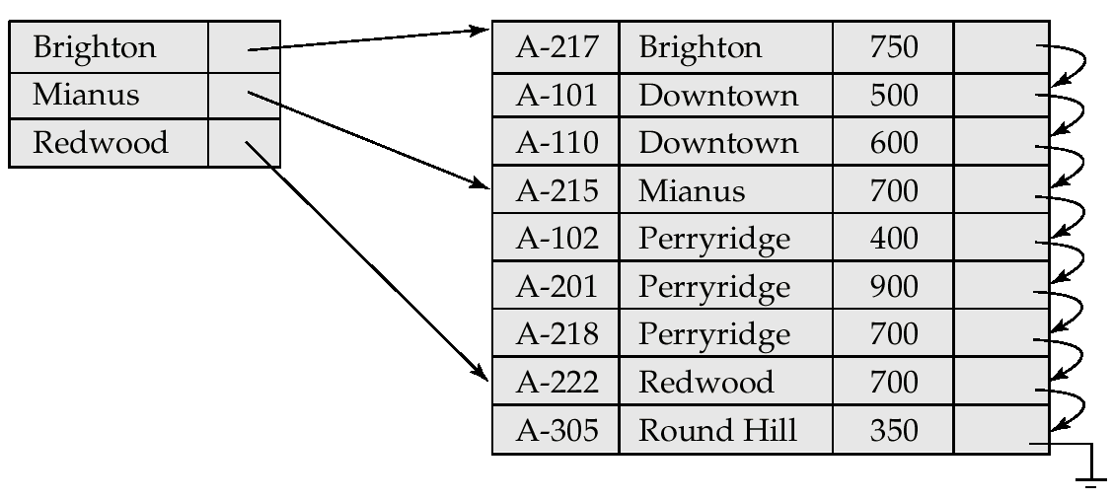
Sequential File For account Records

Slide 77
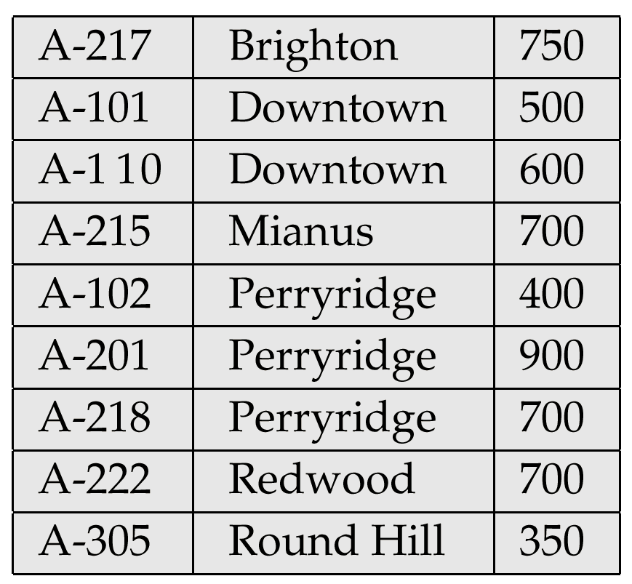
Sample account File

Slide 78
Figure 12.2

Slide 79
Figure 12.14

Slide 80
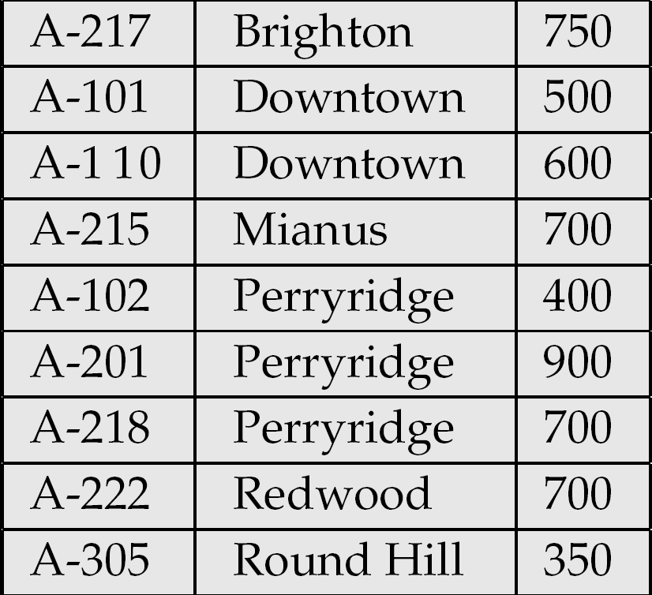
Figure 12.25

Slide 81
Grid Files
Structure used to speed the processing of general multiple search-key queries involving one or more comparison operators.
The grid file has a single grid array and one linear scale for each search-key attribute. The grid array has number of dimensions equal to number of search-key attributes.
Multiple cells of grid array can point to same bucket
To find the bucket for a search-key value, locate the row and column of its cell using the linear scales and follow pointer

Slide 82
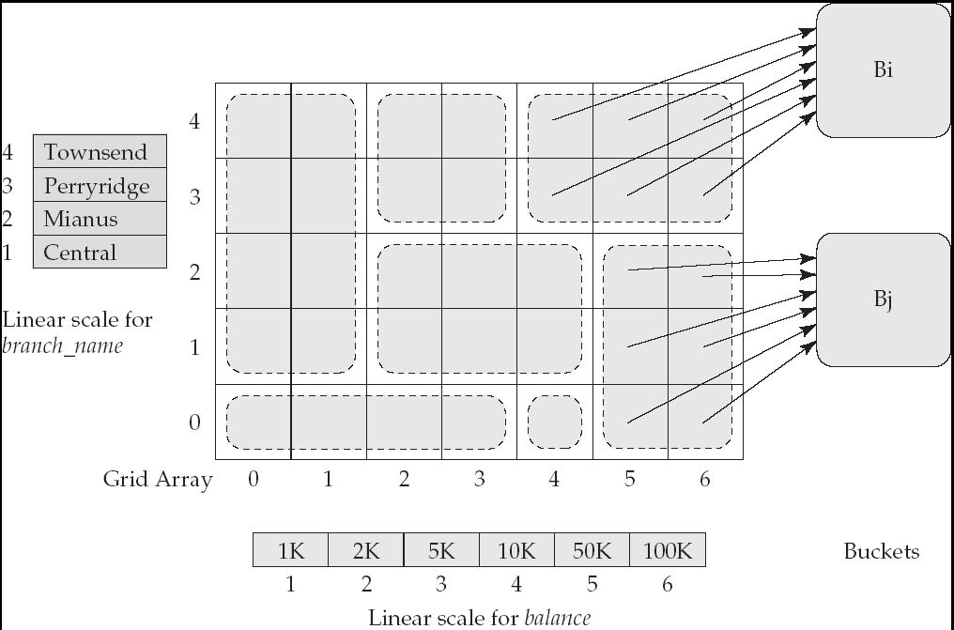
Example Grid File for account

Slide 83
Queries on a Grid File
A grid file on two attributes A and B can handle queries of all following forms with reasonable efficiency
  (a₁ ≤ A ≤ a₂)
  (b₁ ≤ B ≤ b₂)
  (a₁ ≤ A ≤ a₂ ∧ b₁ ≤ B ≤ b₂),.
E.g., to answer (a₁ ≤ A ≤ a₂ ∧ b₁ ≤ B ≤ b₂), use linear scales to find corresponding candidate grid array cells, and look up all the buckets pointed to from those cells.

Slide 84
Grid Files (Cont.)
During insertion, if a bucket becomes full, new bucket can be created if more than one cell points to it.
  Idea similar to extendable hashing, but on multiple dimensions
  If only one cell points to it, either an overflow bucket must be created or the grid size must be increased
Linear scales must be chosen to uniformly distribute records across cells.
  Otherwise there will be too many overflow buckets.
Periodic re-organization to increase grid size will help.
  But reorganization can be very expensive.
Space overhead of grid array can be high.
R-trees (Chapter 23) are an alternative

